Slide 1
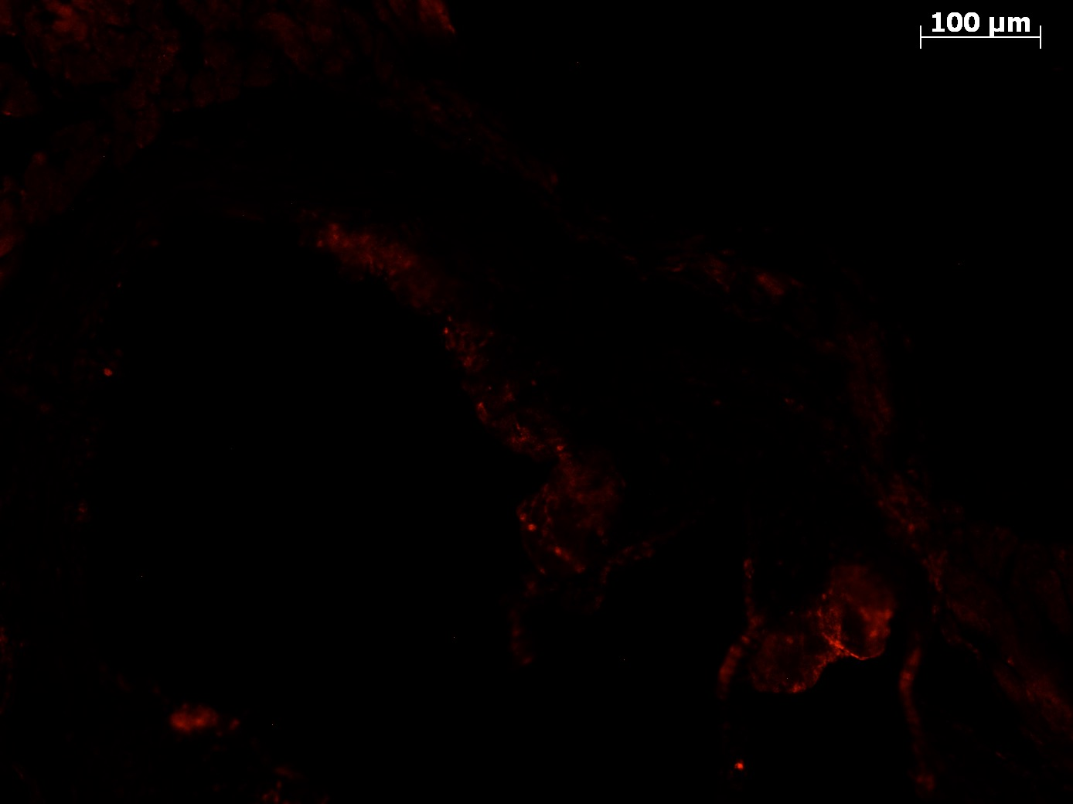
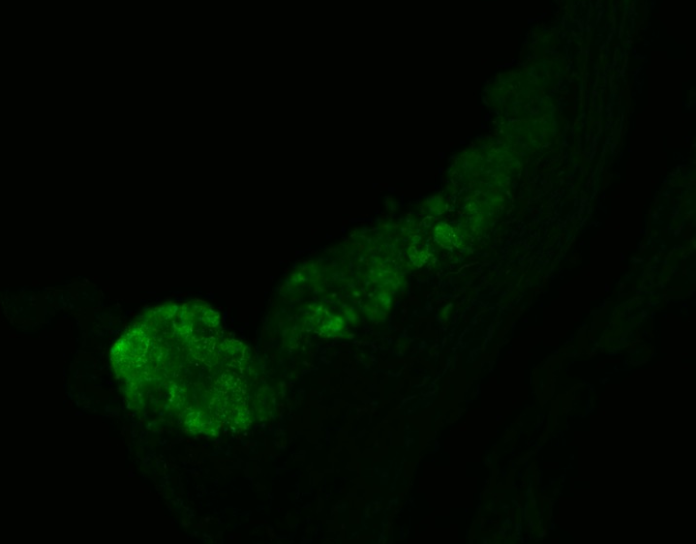
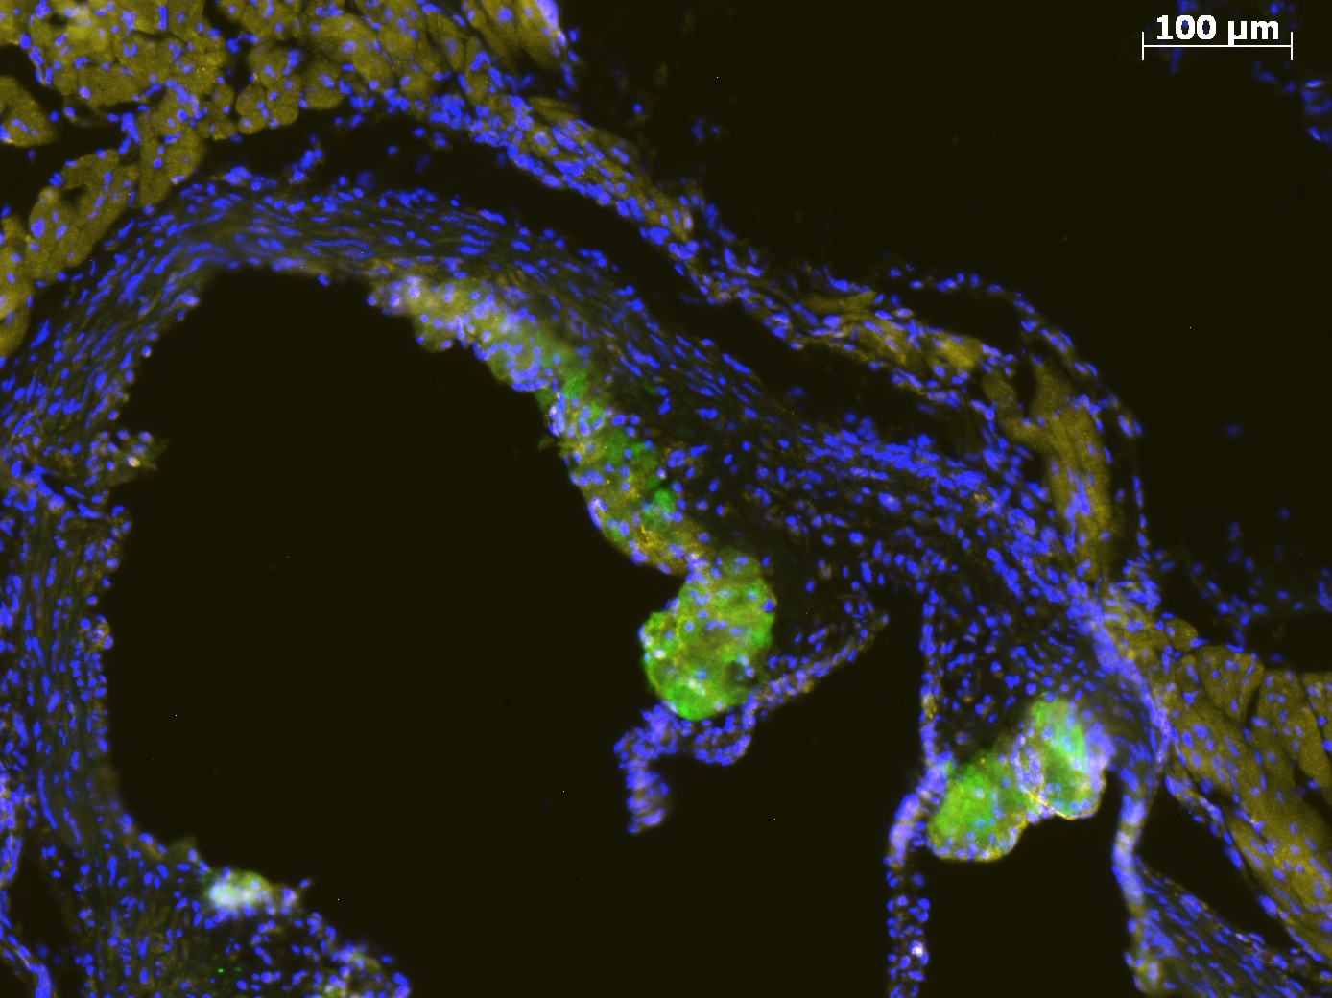
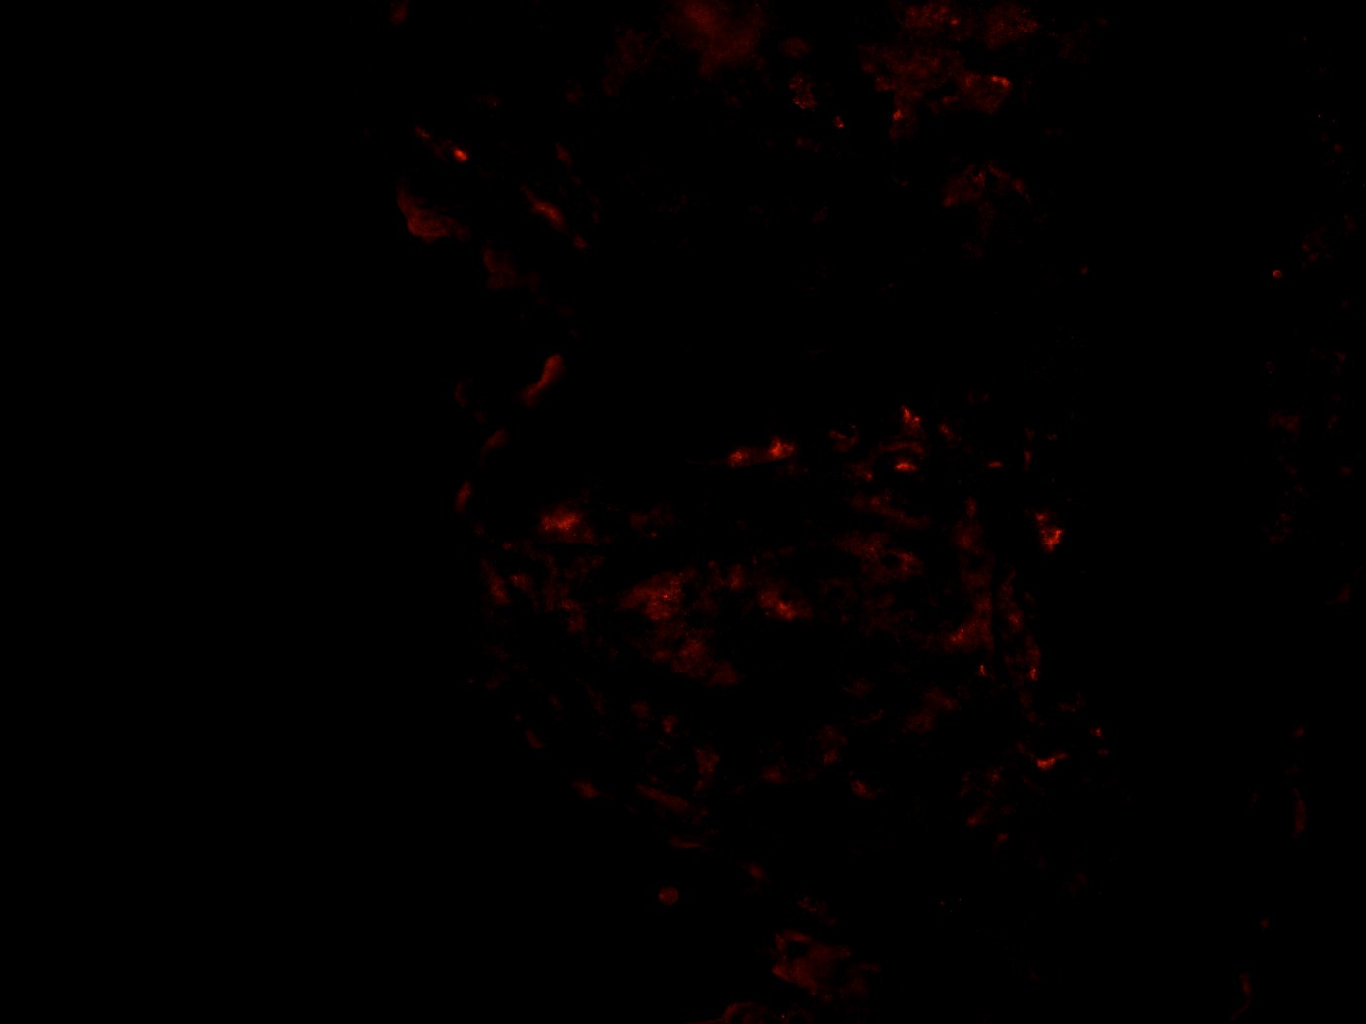
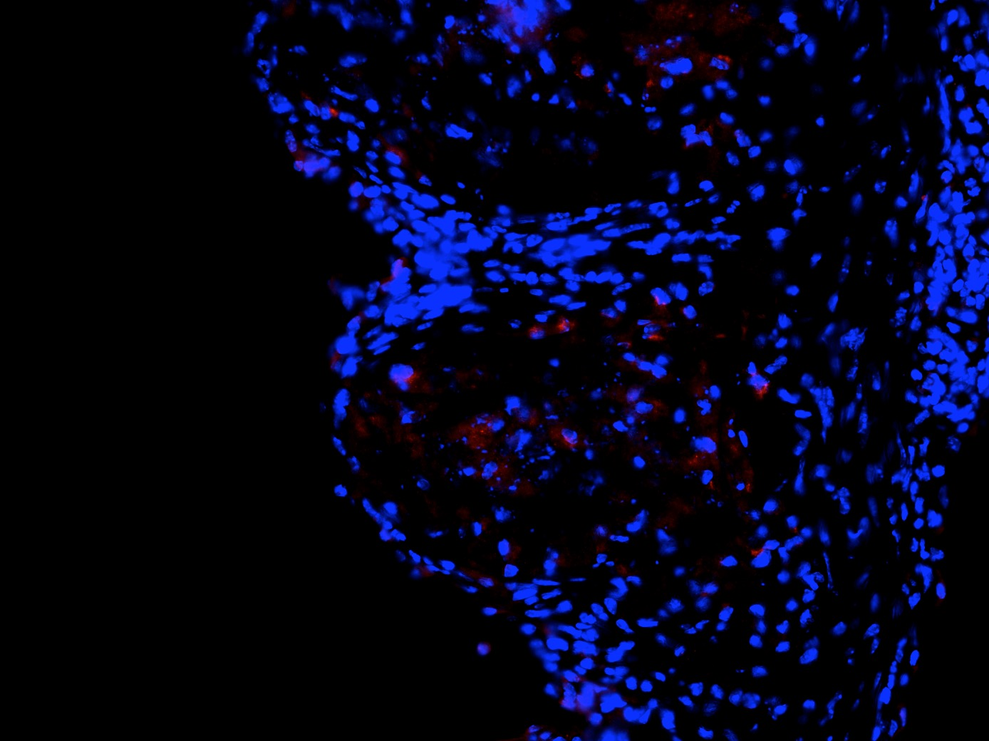

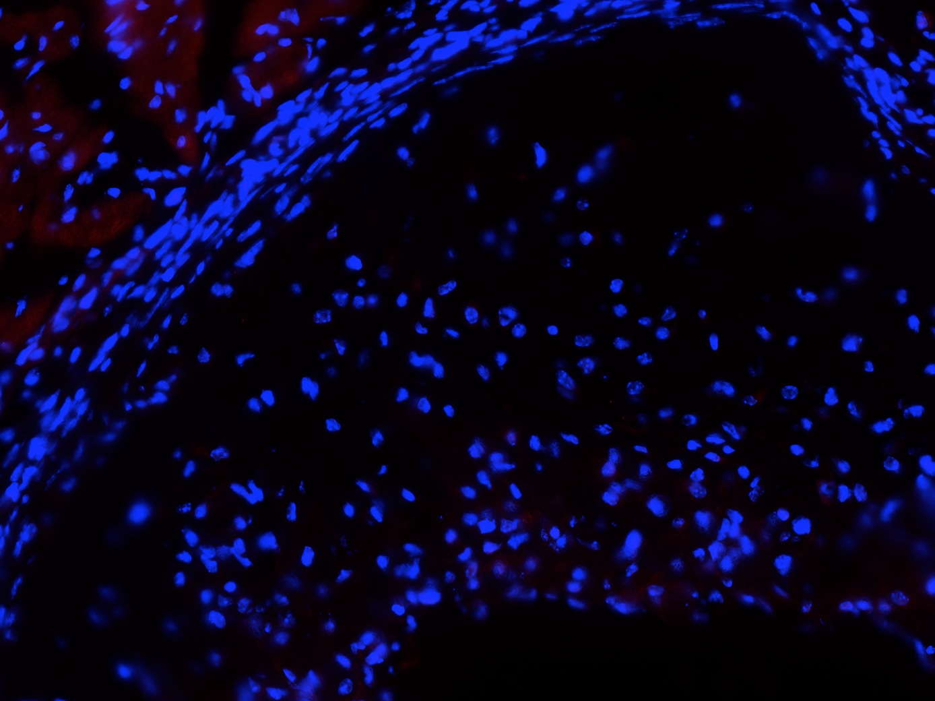
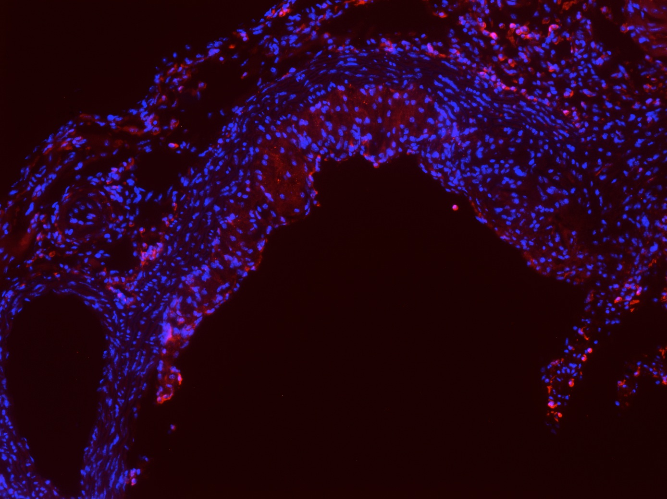
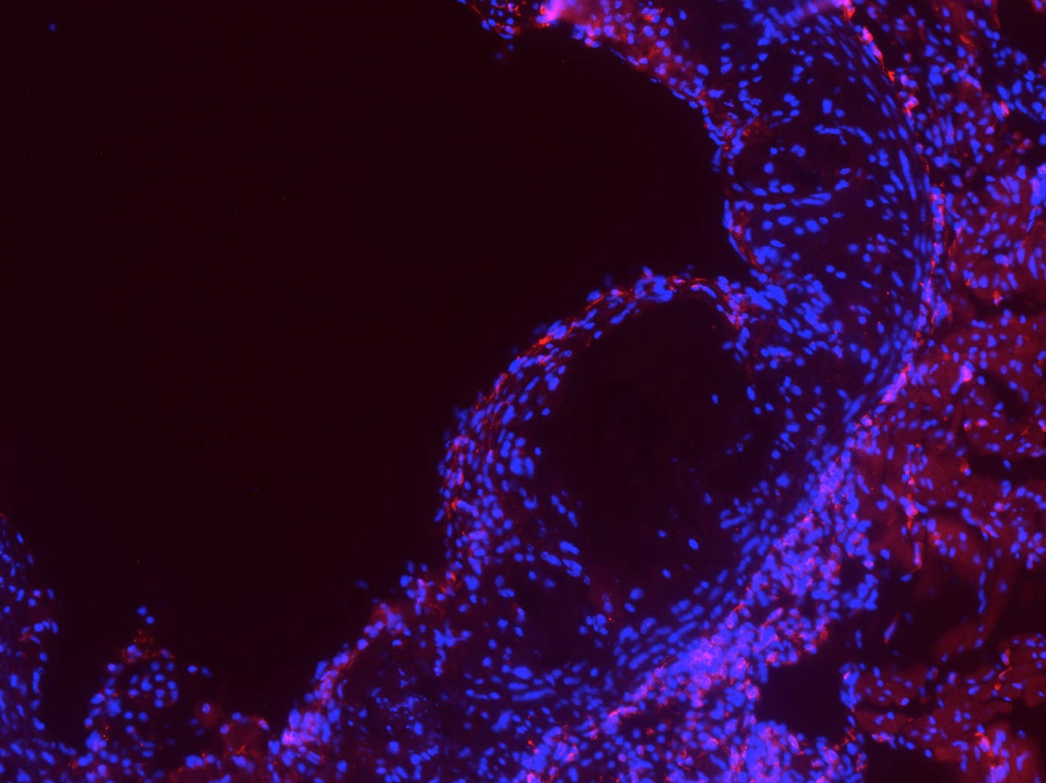
Supplementary figure 1
CARD9
MOMA-2
Merge
B
CARD9
CARD9/DAPI
A
Apoe^{-/-}
Apoe^{-/-}Card9^{+/+}
C
D
Apoe^{-/-}Card9^{-/-}
CD3 DAPI
E
F
Apoe^{-/-} Card9^{+/+}
Apoe^{-/-} Card9^{-/-}
Apoe^{-/-} Card9^{+/+}
Apoe^{-/-} Card9^{-/-}
Atherosclerotic plaque characterization. A, Card9 (Red) and MOMA-2 (Green) immunofluorescent stainings in atherosclerotic plaques of 12-week old Apoe^{-/-} mice; bar scale 50 μm. B, Card9 (Red) immunofluorescent staining and DAPI (nucleus, Blue) in atherosclerotic plaques of Apoe^{-/-}Card9^{+/+} and Apoe^{-/-}Card9^{-/-} mice after 6 weeks of high fat diet; bar scale 100 μm. C and D, body weight and plasma cholesterol levels after 6 weeks of fat diet (n=10/group). E, representative photomicrographs and quantitative analysis of collagen content within atherosclerotic lesions of Apoe^{-/-} Card9^{+/+} and Apoe^{-/-} Card9^{-/-} mice (Sirius red staining). F, representative photomicrographs and quantitative analysis of CD3+ T cell infiltration (Red fluorescent staining). *, P<0.05; Bar scale 50 μm.

Slide 2
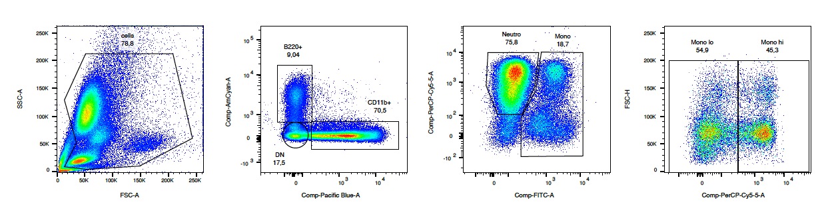
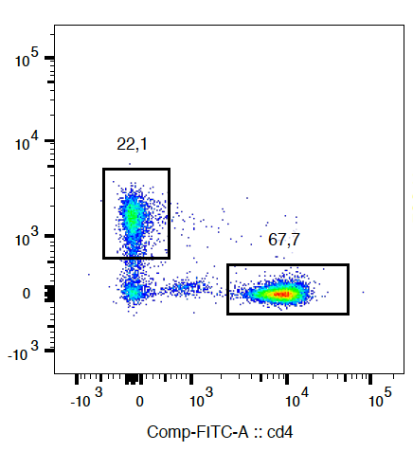
Supplementary figure 2
SSC
B220
Gr1
FSH
CD8
FSC
CD11b
CD115
Gr1
CD4
Characterization by flow cytometry of immune cell subsets in the blood of Apoe^{-/-}Card9^{+/+} and Apoe^{-/-}Card9^{-/-} mice. Classical monocytes were defined as CD11b+CD115+Gr1high cells; Non-classical monocytes were defined as CD11b+CD115+Gr1Low cells; neutrophils were defined as CD11b+ CD115-Gr1+ cells. CD4+ T Lymphocytes were selected as B220-CD11b-CD4+ cells, CD8+ T Lymphocytes were selected as B220-CD11b-CD8+ cells. B cells were defined as CD11b-B220+ cells. Neutrophil proportion was slightly increased in the blood of Apoe^{-/-}Card9^{-/-} mice as well as the proportion of classical monocytes. No difference in CD4+ T, CD8+ T and B cell subsets between groups. *, P<0.05

Slide 3
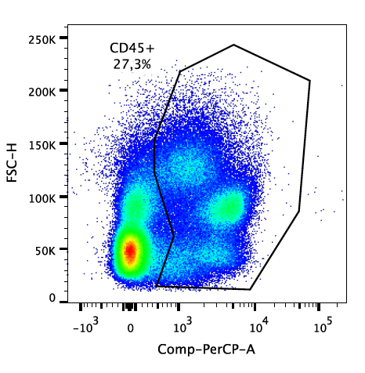
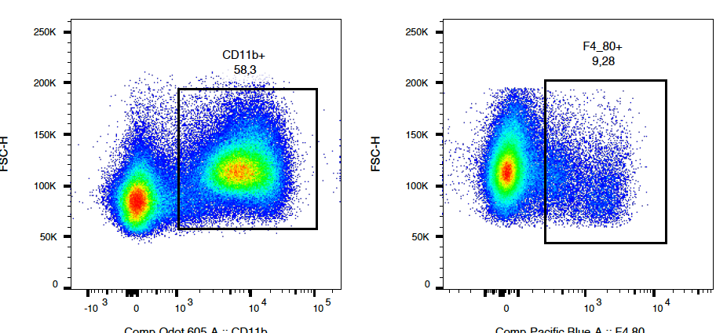
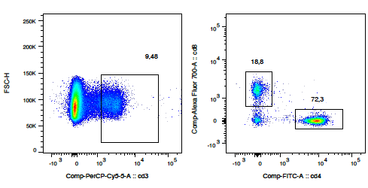
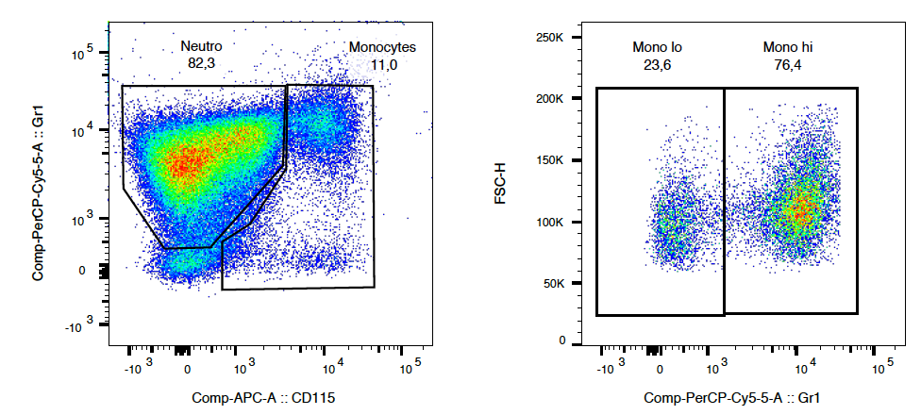
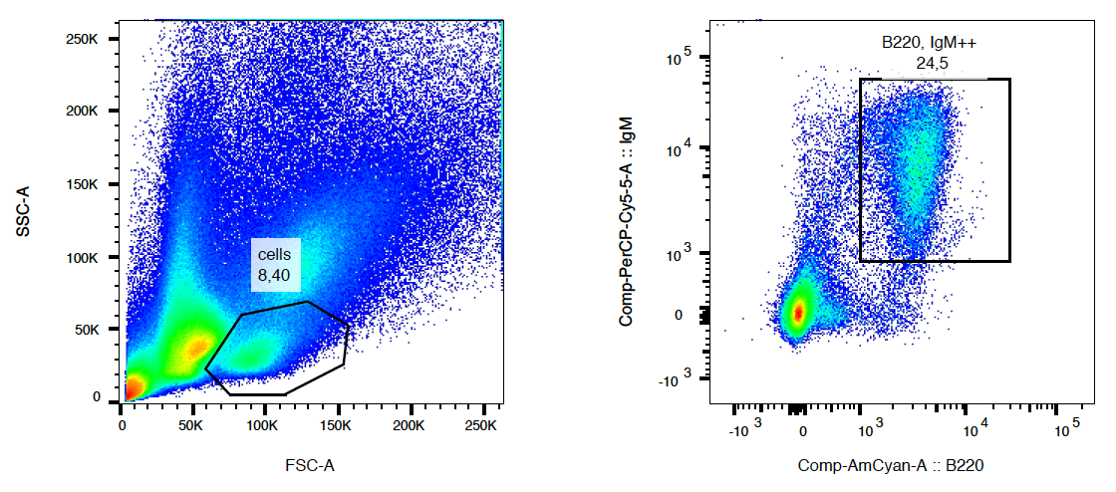
Supplementary figure 3
A
B
FSC-H
FSC-H
FSC-H
FSC-H
FSC-H
CD8
CD45
CD11b
F4/80
CD45
CD3
CD4
Gr1
FSC-H
IgM
CD115
Gr1
B220
C
Characterization by flow cytometry of immune cell subsets in the spleen of Apoe^{-/-}Card9^{+/+} and Apoe^{-/-}Card9^{-/-} mice. A, Myeloid cells were defined as CD45+CD11b+ cells. Classical monocytes were defined as CD45+CD11b+CD115+Gr1high cells; Non-classical monocytes were defined as CD45+CD11b+CD115+Gr1Low cells; neutrophils were defined as CD45+CD11b+CD115-Gr1+ cells. Macrophages were defined CD45+CD11b+F4/80+ cells. B, T Lymphocytes were selected as CD45+CD3+ cells. CD4+ T cells were selected as CD45+CD3+CD4+ cells. CD8+ T cells were selected as CD45+CD3+CD8+ cells. B cells were defined as B220+IgM+ cells. C, quantification of spleen leukocyte subsets in the 2 groups. **, P<0.01

Slide 4
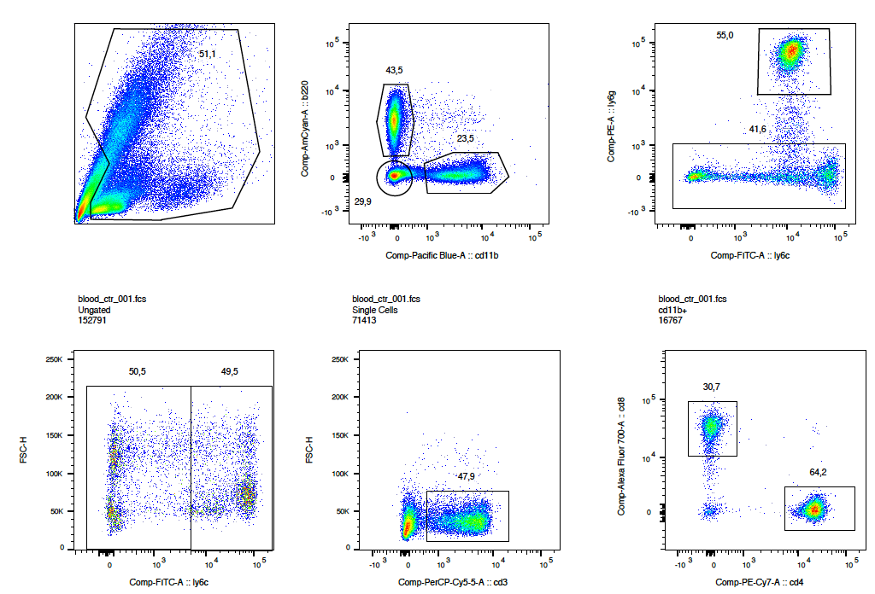
Supplementary figure 4
Blood
A
B
SSC-A
B220
Ly6G
FSC-H
FSC-A
CD11b
Ly6C
Ly6C
FSC-H
FSC-H
CD8
CD3
CD4
Characterization by flow cytometry of immune cell subsets in the blood of chimeric Ldlr^{-/-}Card9^{+/+} and Ldlr^{-/-}Card9^{-/-} mice A, classical monocytes were defined as CD11b+Ly6G-Ly6high cells; Non-classical monocytes were defined as CD11b+ Ly6G-Ly6CLow cells; neutrophils were defined as CD11b+ Ly6G+Ly6C- cells. CD4+ T Lymphocytes were selected as B220-CD11b-CD3+CD4+ cells, CD8+ T Lymphocytes were selected as B220-CD11b-CD3+CD8+ cells. B cells were defined as CD11b-B220+ cells. B, quantification of blood leukocyte subsets in the 2 groups. *, P<0.05

Slide 5
Supplementary figure 5
A
B
Characterization of atherosclerotic plaques from chimeric Ldlr^{-/-}Card9^{+/+} and Ldlr^{-/-}Card9^{-/-} mice after 8 weeks of fat diet. A, Quantitative analysis of collagen content (Sirius red). B, Quantitative analysis of CD3+ T cell infiltration (Anti-CD3 immunostaining). ***, P<0.001;

Slide 6
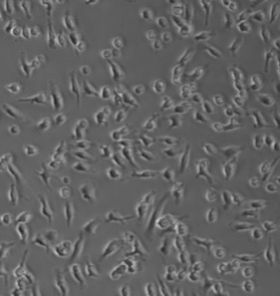
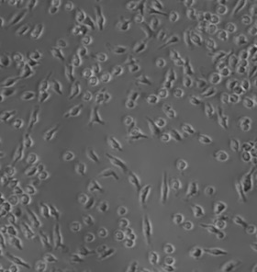
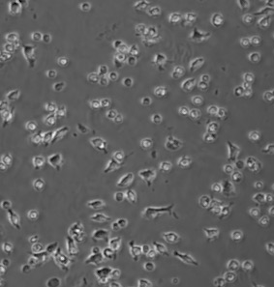
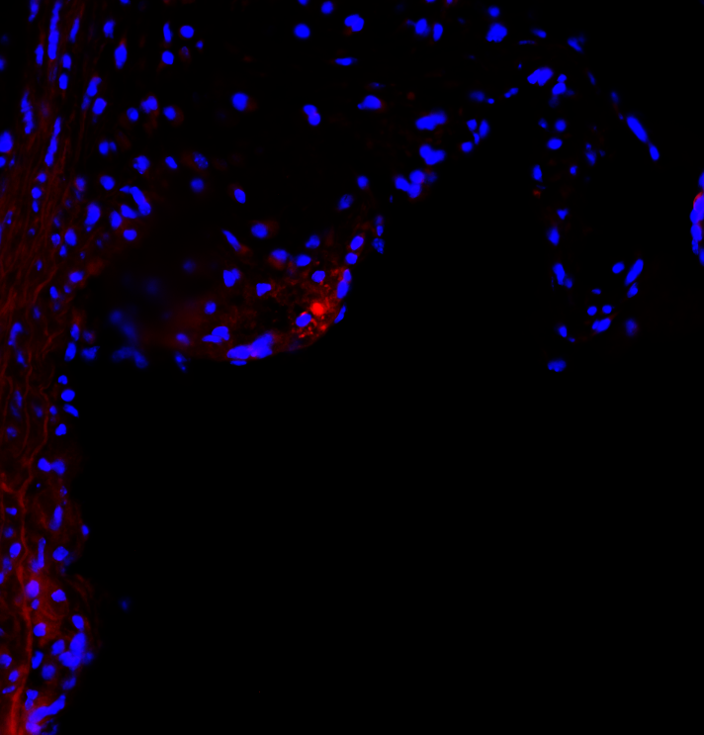
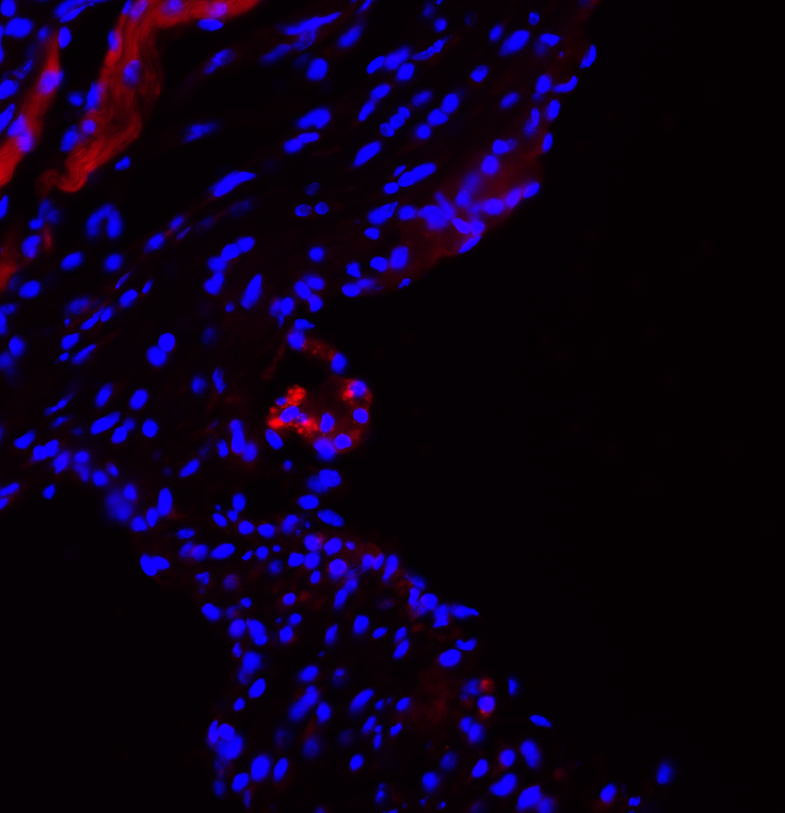
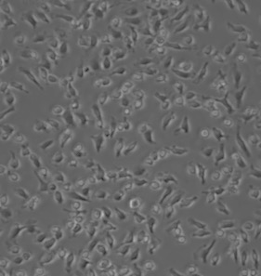
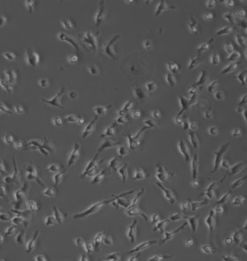
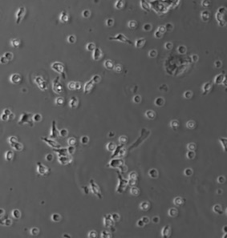
Supplementary figure 6
Bodipy
RelB
CD36
A
B
Apoe^{-/-}Card9^{+/+}
Apoe^{-/-}Card9^{-/-}
C
Baseline
OxLDL 20 μg/ml
OxLDL 200 μg/ml
D
Tunel DAPI
Apoe^{-/-}Card9^{+/+}
Lumen
Lumen
Apoe^{-/-}Card9^{-/-}
Apoe^{-/-} Rag2^{-/-} Card9^{+/+}
Apoe^{-/-} Rag2^{-/-} Card9^{-/-}
Card9 deficiency increased cell death susceptibility. A, Cd36 mRNA quantification by qPCR in the thoraco-abdominal aorta of Apoe^{-/-}Card9^{+/+} and Apoe^{-/-}Card9^{-/-}mice after 6 weeks of fat diet. **, P<0.01. B, BM-derived macrophages from Apoe^{-/-}Card9^{+/+} and Apoe^{-/-}Card9^{-/-}mice were stimulated in vitro by oxLDL during 12 hours and stained to quantify and localize lipid (bodipy, green), CD36 (Blue) and RelB (Red). ***, P<0.001. C, representative pictures of Bone marrow-derived macrophages isolated from Apoe^{-/-}Card9 ^{+/+} or Apoe^{-/-}Card9 ^{+/+} mice challenged in vitro with oxLDL during 24 hours. D, representative photomicrographs and quantitative analysis of TUNEL staining in atherosclerotic lesions of Apoe^{-/-} Rag2^{-/-}Card9^{+/+} and Apoe^{-/-} Rag2^{-/-} Card9^{-/-} mice. Scale bar 20 μm. *, P<0.05

Slide 7
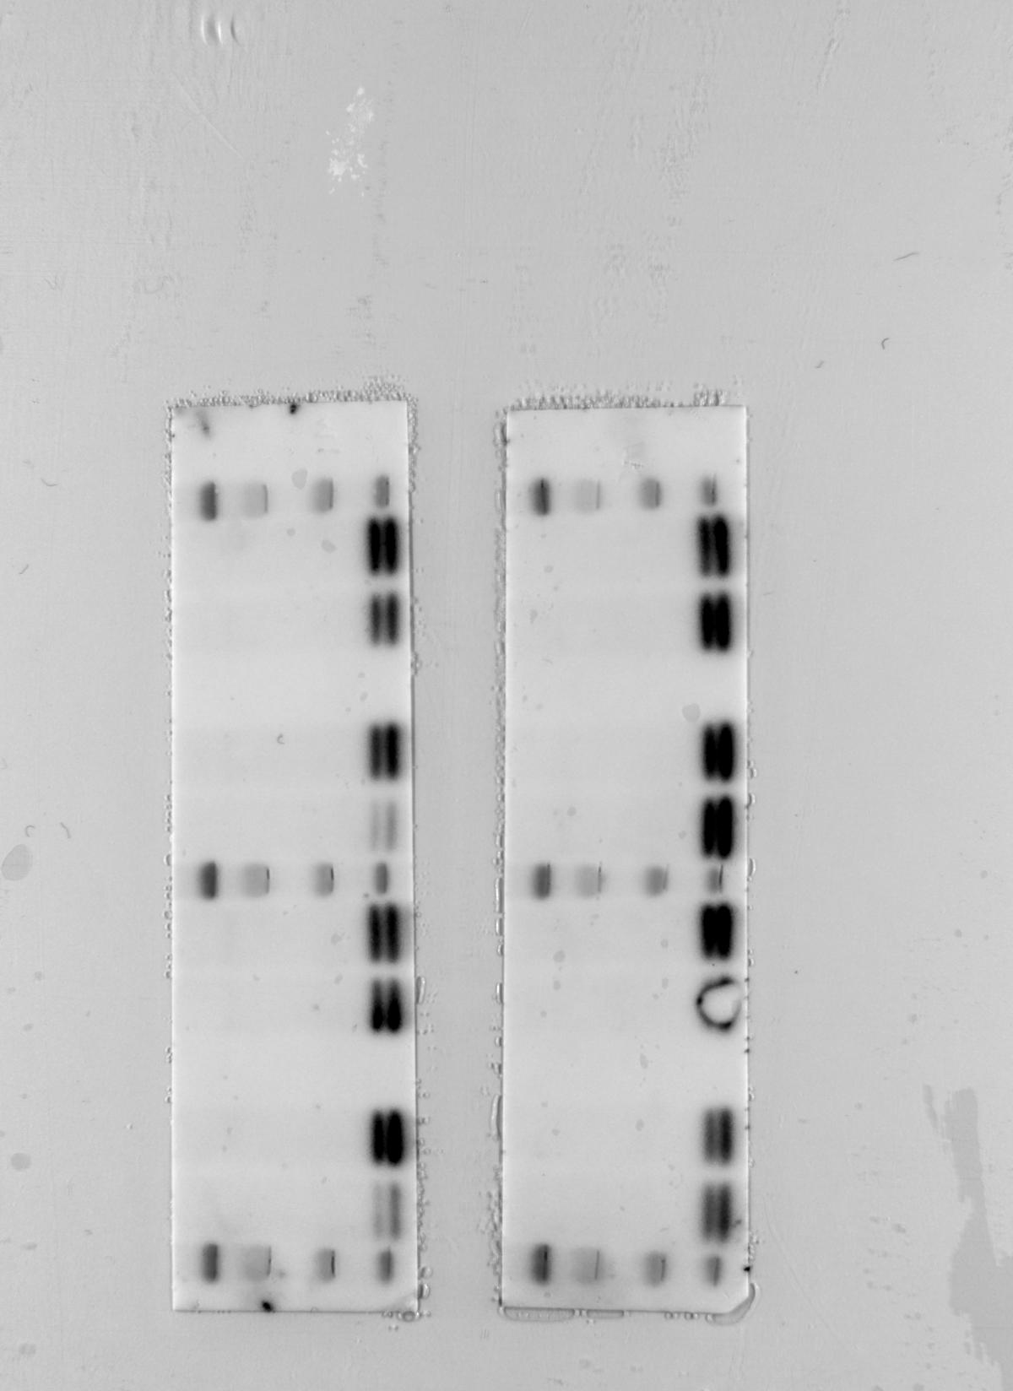
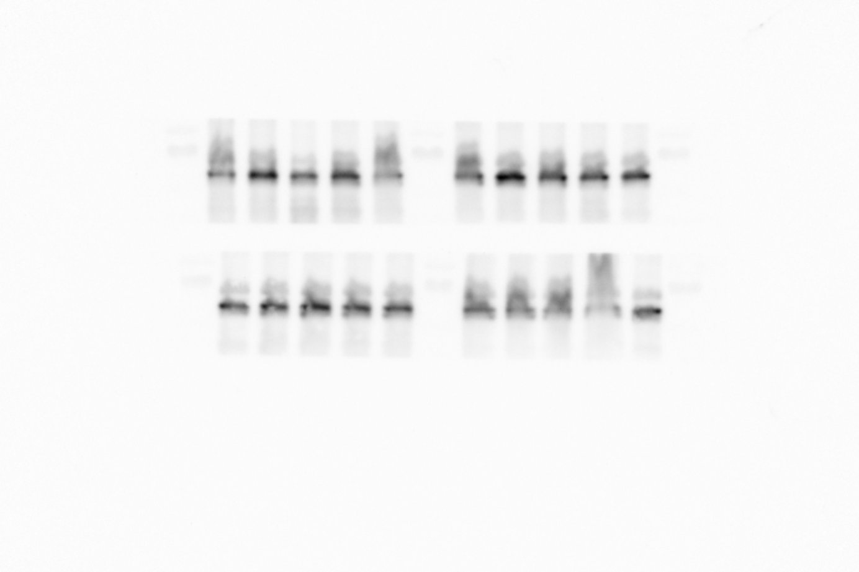
Supplementary figure 7
MW
(kDa)
Apoe^{-/-}
Card9^{+/+}
MW
(kDa)
Apoe^{-/-}
Card9^{-/-}
Apoe^{-/-}
Card9^{+/+}
Apoe^{-/-}
Card9^{-/-}
MW
(kDa)
Apoe^{-/-}
Card9^{+/+}
Apoe^{-/-}
Card9^{-/-}
CHOP
60
P-Beclin-1
55
P-LKB1
27
40
β-actin
60
Beclin-1
55
LKB1
Dowstream autophagy pathways in macrophages. Bone marrow-derived macrophages isolated from Apoe^{-/-}Card9 ^{+/+} or Apoe^{-/-}Card9 ^{+/+} mice were challenged in vitro during 8 hours with Ox-LDL (50 μg/mL). CHOP as well as phosphorylation of Beclin and LKB1 were quantified by Western Blot (N=4/group/condition).

Slide 8
Supplementary figure 8
A
B
C
D
Pharmacological modulation of autophagy in vivo. 8-week old Apoe^{-/-}Card9^{+/+} and Apoe^{-/-}Card9^{-/-} mice were treated IP with Rapamycin (4 mg/kg/day) and were put under a high fat diet during 6 weeks. A, plasma cholesterol level (n=7/group) and (B) body weight at sacrifice (n=7/group). 8-week old Apoe^{-/-}Card9^{+/+} and Apoe^{-/-}Card9^{-/-} mice were treated with Metformin (300mg/kg/day, drinking water) and put under a high fat diet during 6 weeks (n=7-8/group). Plasma cholesterol level (C) and body weight (D) at sacrifice.

Slide 9
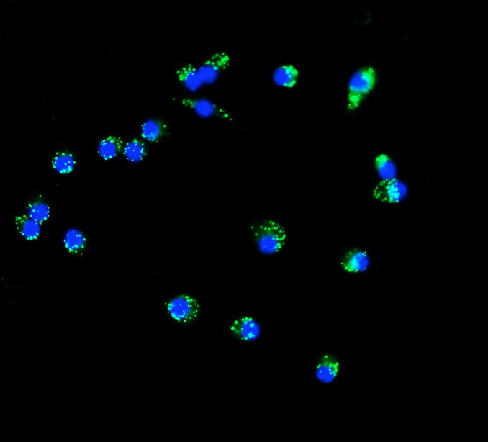
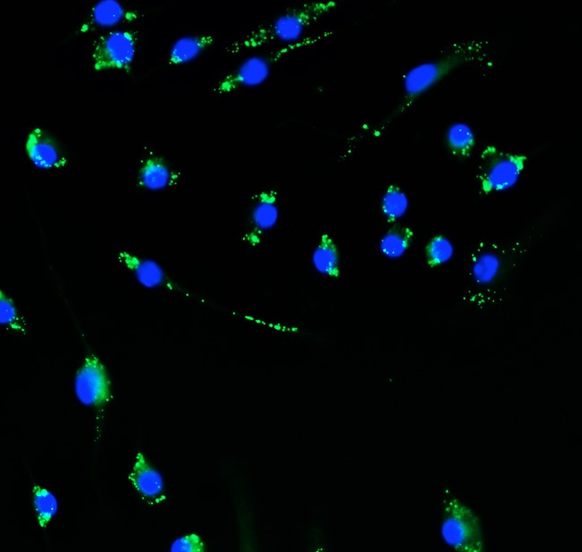
Supplementary figure 9
A
B
BODIPY DAPI
Cd36^{-/-} Card9^{+/+}
Cd36^{-/-} Card9^{-/-}
C
Lipid uptake in the absence of CD36. A, quantification of intracellular ester cholesterol on BM-derived macrophages from cd36^{-/-}Card9^{+/+} and Cd36^{-/-}Card9^{-/-} mice after exposure to ox-LDL (n=5/group/timepoints). B, Representative photomicrographs and quantitative analysis of Bodipy+ foam cells (green) after incubation of BM-derived macrophages from CD36^{-/-}Card9^{+/+} and Cd36^{-/-}Card9^{-/-} mice with oxLDL during 24 hours (n=6/group/timepoints). **, P<0.01. C, Card9 mRNA expression in peritoneal macrophages of chimeric Ldlr^{-/-}Cd36^{-/-}Card9^{+/+} and Ldlr^{-/-}Cd36^{-/-}Card9^{-/-} mice (n=8/group, **, ¨P<0.001, ***, P<0.001).

Slide 10
Supplementary figure 10
CARD9
CD68
Merge
CARD9
Alpha-SMA
Merge
CARD9 protein expression in human atherosclerotic plaques using immunofluorescent staining. CARD9 (Red) is not expressed in normal aorta. CD68 (Green) is a marker of macrophages and Alpha-SMA is a marker of smooth muscle cells. Magnitude X20.

