Slide 1
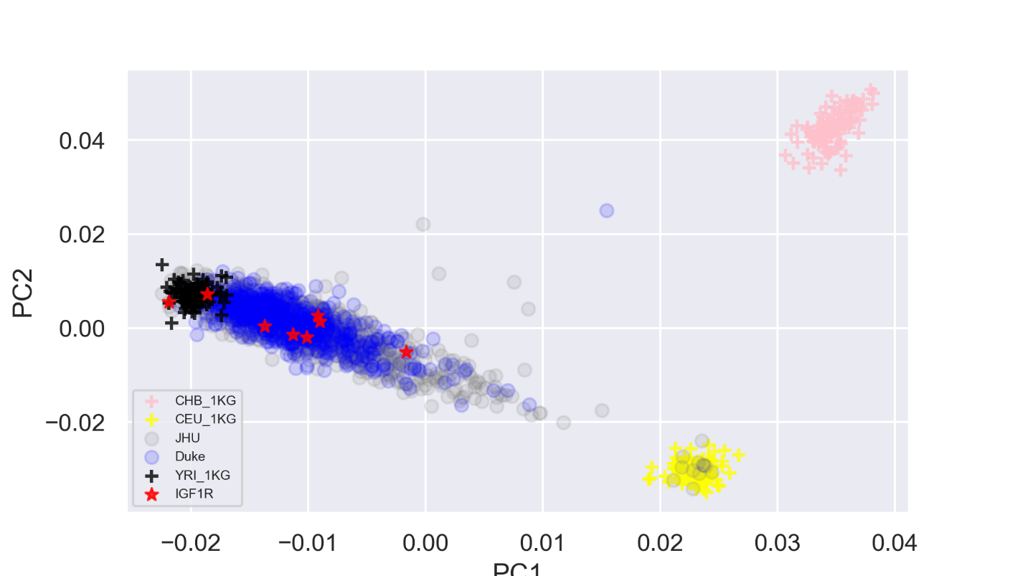
sFigure 1b: Eigen plot for the top two principal components derived from 209 ancestry informative markers for prostate cancer patients and subjects from 1000 Genome. The red star indicate subjects with IGF1R carriers.
PC2
PC1

