Slide 1
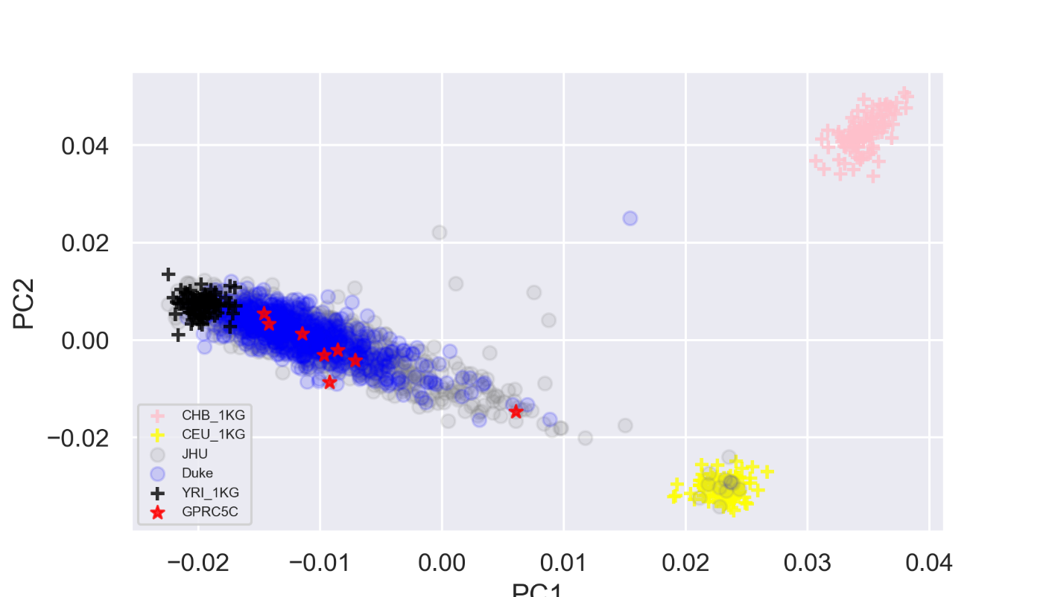
sFigure 1a: Eigen plot for the top two principal components derived from 209 ancestry informative markers for prostate cancer patients and subjects from 1000 Genome. The red star indicate subjects with GPRC5C carriers.
PC2
PC1

