Slide 1
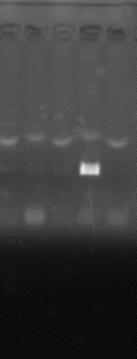
Supplemental Figure 1
Gelatin #9: COI
46
48
50
52
54
Tm ºC
(bps)
1000
700
→
500
400
300
200

