Slide 1


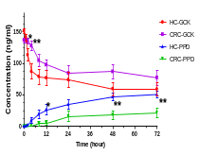
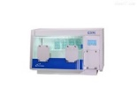

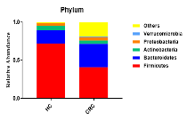
Graphic abstract
LC-MS/MS
Ginsenoside CK
DNA
Ion S5TMXL
Gut microbiota
PCR
QIIME2
CRC
patients
Healthy
subjects
16S rRNA gene sequencing

