Slide 1
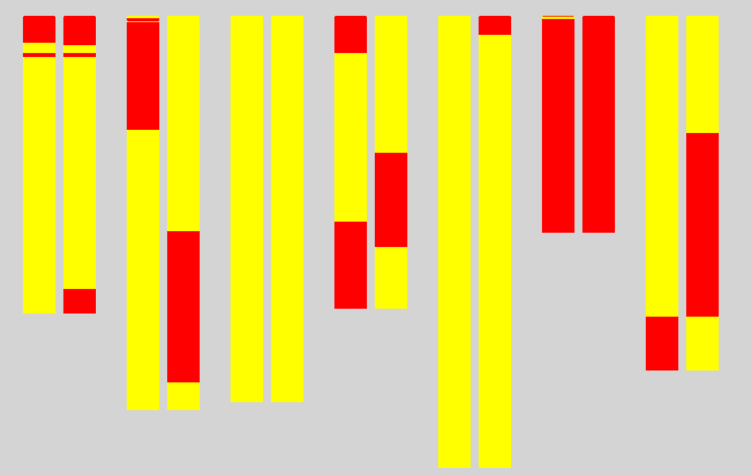
1H 2H 3H 4H 5H 6H 7H
DH158 DH95
Franklin type
Tam407227 type
Fig. S1. Genotypes of the two DH lines used for qS7.1 fine mapping
Left: salinity sensitive DH line (DH158) with salinity damage score 5.08; Right: salinity tolerance line(DH95) with salinity damage score 1.94;
Yellow: allele from Franklin, Red, allele from Tam407227.

Slide 2
Tam407227 × Franklin
DH population
163 lines
salinity damage score
Na⁺ content
Two DH lines
MAS
F1
MAS
F3
MAS
Recombinations selection
Genotyping by additional markers
progeny F3 families
Genotyping and salinity tolerance investigating
Fine mapping
Fig.S2 Fine mapping strategy

Slide 3
Fig. S3 The transcriptions of HVP10 in Franklin and TAM407227 in roots under salinity stress

Slide 4
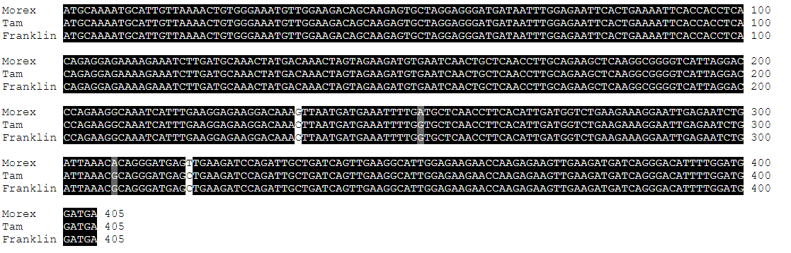
Fig. S4 The CDS sequence of HORVU.MOREX.r3.7HG0665490 in Morex, Franklin and TAM407227

