Slide 1
Supplementary File
Original Western blot

Slide 2
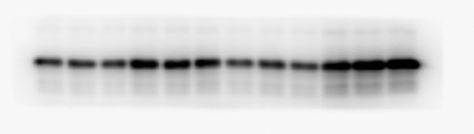
Figure2 B
IB: BAX

Slide 3
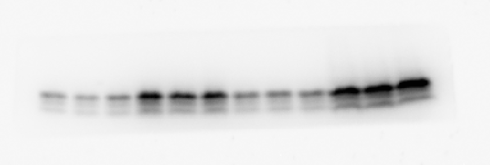
Figure2 B
IB: Cleaved-C3

Slide 4

Figure2 B
IB: Tubulin

Slide 5
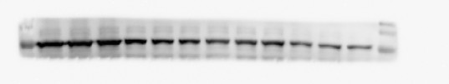
Figure2 D
IB: WWP2

Slide 6
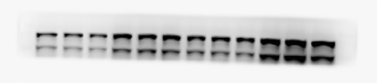
Figure2 D
IB: PARP1

Slide 7

Figure2 D
IB: Tubulin

Slide 8

Figure2 G
IP: PARP1
IB: WWP2

Slide 9
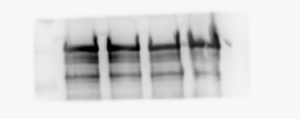
Figure2 G
IP: PARP1
IB: PARP1

Slide 10
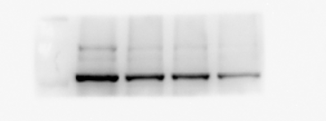
Figure2 G
Input
IB: WWP2

Slide 11
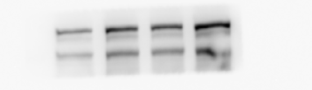
Figure2 G
Input
IB: PARP1

Slide 12

Figure2 G
Input
IB: Tubulin

Slide 13

Figure3 B
IB: WWP2

Slide 14
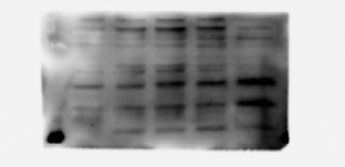
Figure3 B
IB: BAX

Slide 15
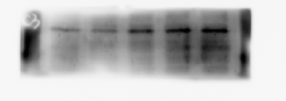
Figure3 B
IB: Cleaved-C3

Slide 16

Figure3 B
IB: Tubulin

Slide 17

Figure3 E
IB: WWP2

Slide 18
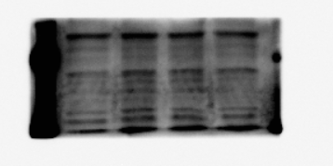
Figure3 E
IB: BAX

Slide 19
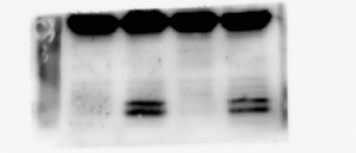
Figure3 E
IB: Cleaved-C3

Slide 20

Figure3 E
IB: Tubulin

Slide 21
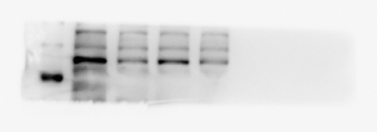
Figure3 H
IB: WWP2

Slide 22
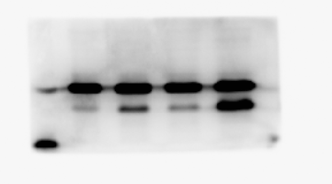
Figure3 H
IB: BAX

Slide 23
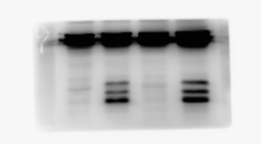
Figure3 H
IB: Cleaved-C3

Slide 24
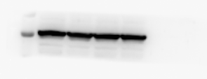
Figure3 H
IB: Tubulin

Slide 25

Figure4 A
IP: WWP2
IB: PARP1

Slide 26

Figure4 A
IP: WWP2
IB: WWP2

Slide 27

Figure4 A
Input: IB: PARP1

Slide 28

Figure4 A
Input: IB: WWP2

Slide 29

Figure4 A
Input: IB: Tubulin

Slide 30

Figure4 B
Ip: PARP1
IB: WWP2

Slide 31

Figure4 B
Ip: PARP1
IB: PARP1

Slide 32

Figure4 B
Input
IB: WWP2

Slide 33

Figure4 B
Input
IB: PARP1

Slide 34

Figure4 B
Input
IB: Tubulin

Slide 35
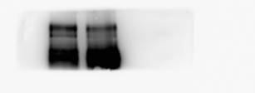
Figure4 C
IP: WWP2
IB: PARP1

Slide 36

Figure4 C
IP: WWP2
IB: WWP2

Slide 37
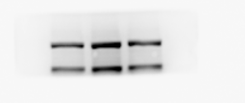
Figure4 C
Input
IB: PARP1

Slide 38

Figure4 C
Input
IB: WWP2

Slide 39

Figure4 C
Input
IB: Tubulin

Slide 40

Figure4 D
IP: PARP1
IB: WWP2

Slide 41

Figure4 D
IP: PARP1
IB: PARP1

Slide 42
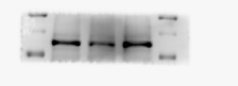
Figure4 D
Input
IB: WWP2

Slide 43

Figure4 D
Input
IB: PARP1

Slide 44

Figure4 D
Input
IB: Tubulin

Slide 45
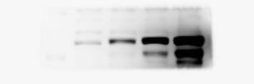
Figure4 E
IB: WWP2

Slide 46

Figure4 E
IB: PARP1

Slide 47
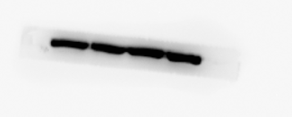
Figure4 E
IB: Tubulin

Slide 48

Figure4 F
IB: WWP2

Slide 49
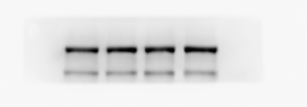
Figure4 F
IB: PARP1

Slide 50

Figure4 F
IB: Tubulin

Slide 51

Figure4 G
IB: PARP1

Slide 52

Figure4 G
IB: Tubulin

Slide 53
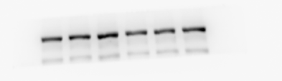
Figure4 H
IB: PARP1

Slide 54

Figure4 H
IB: Tubulin

Slide 55

Figure4 I
IB: PARP1

Slide 56

Figure4 I
IB: Tubulin

Slide 57
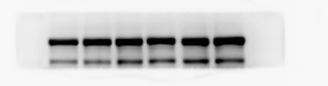
Figure4 J
IB: PARP1

Slide 58
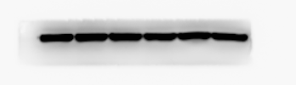
Figure4 J
IB: Tubulin

Slide 59

Figure5 A
IP: WWP2
IB: PARP1

Slide 60

Figure5 A
IP: WWP2
IB: WWP2

Slide 61

Figure5 A
Input
IB: PARP1

Slide 62
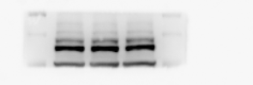
Figure5 A
Input
IB: WWP2

Slide 63

Figure5 A
Input
IB: Input

Slide 64

Figure5 B
IP: HA
IB: Input

Slide 65

Figure5 B
IP: HA
IB: HA

Slide 66

Figure5 B
Input
IB: PARP1

Slide 67

Figure5 B
Input
IB: HA

Slide 68

Figure5 B
Input
IB: Tubulin

Slide 69
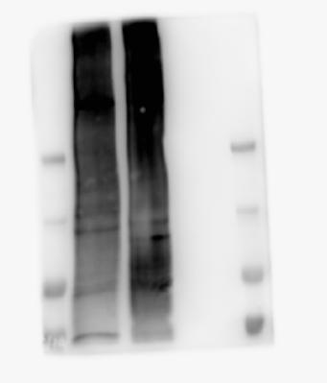
Figure5 C
IP: PARP1
IB: HA-Ub

Slide 70
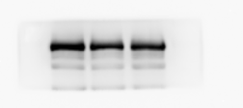
Figure5 C
Input
IB: PARP1

Slide 71
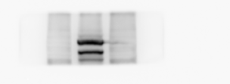
Figure5 C
Input
IB: HA

Slide 72

Figure5 C
Input
IB: Tubulin

Slide 73
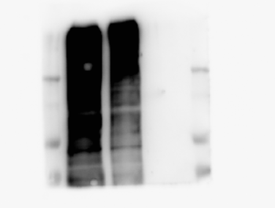
Figure5 D
IP: PARP1
IB: HA-Ub

Slide 74
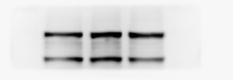
Figure5 D
Input
IB: PARP1

Slide 75
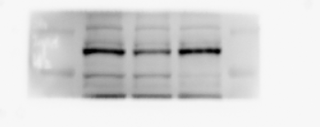
Figure5 D
Input
IB: WWP2

Slide 76

Figure5 D
Input
IB: Tubulin

