Slide 1
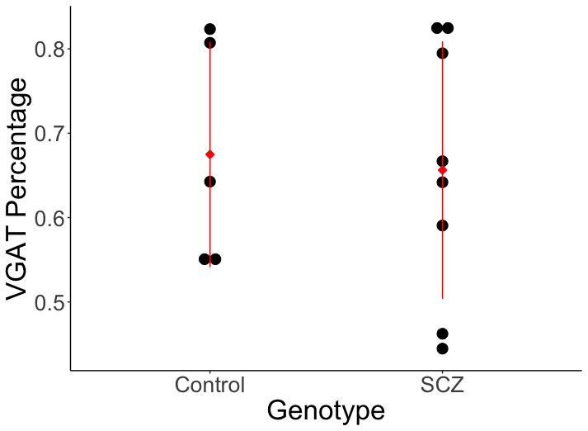
Supplementary figure 1: VGAT percentage of SCZ and control neurons co-cultured with rat astrocytes. Percentage based on VGAT and Synaptophysin positive puncta on MAP2 ICC, analyzed using automated system.
Antibody | Company | Dilution | Host
CD44 | Hybridoma bank | 1:100 | Mouse
Nestin | BD Bioscience | 1:1000 | Mouse
GFAP | DAKO | 1:1000 | rabbit
GFAP | Sigma-Aldrich | 1:1000 | mouse
MAP2 | Abcam | 1: 10000 | Chicken
Smi312 | Covance | 1:1000 | Mouse
VGAT | Sysy | 1:500 | Rabbit
Synaptophysin | SySy | 1:1000 | Guinea pig
VGLUT2 | SySy | 1:1000 | Rabbit
ID3 | Cell Signalling | 1:250 | Rabiit
SOX9 | CellSignalling | 1:250 | Rabbit
S100b | ProteinTech | 1:1000 | Rabbit
GC2 | Hybridoma bank | 1:50 | Mouse
Alexa Fluor 488 | ThermoFisher | 1:1000 | Goat
Alexa Fluor 594 | ThermoFisher | 1:1000 | Goat
Alexa Fluor 647 | ThermoFisher | 1:1000 | Goat

