Slide 1
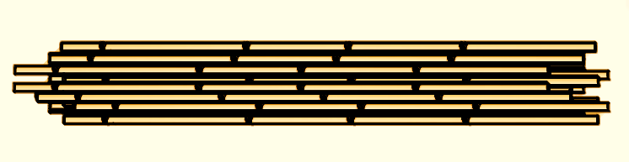
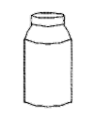


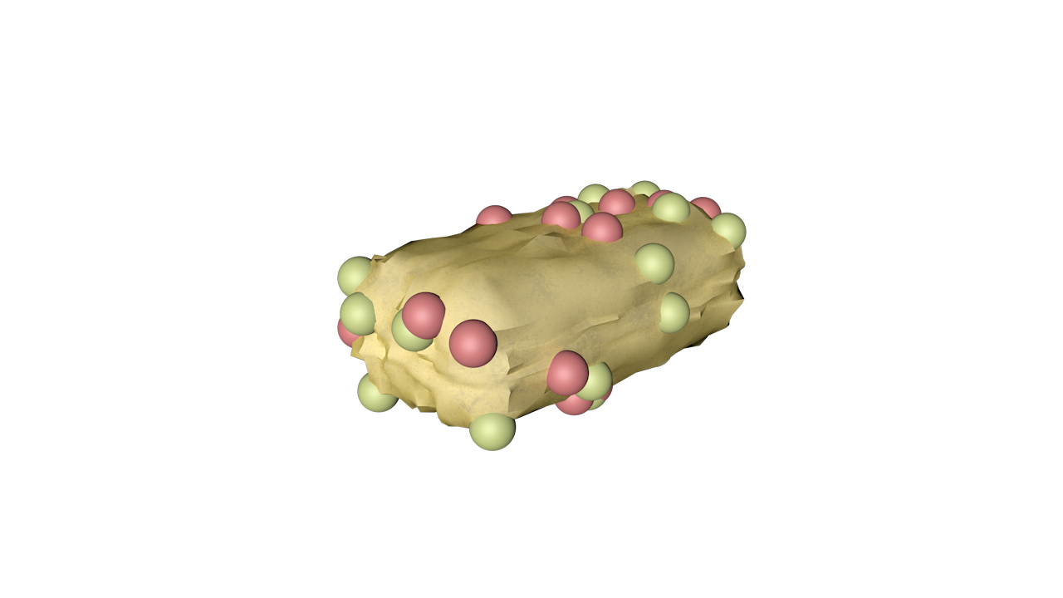
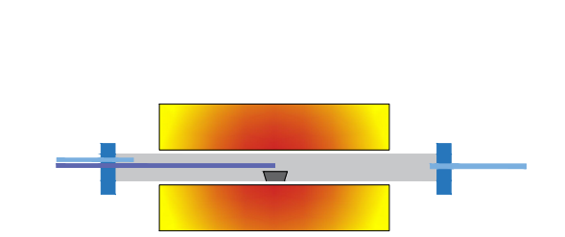
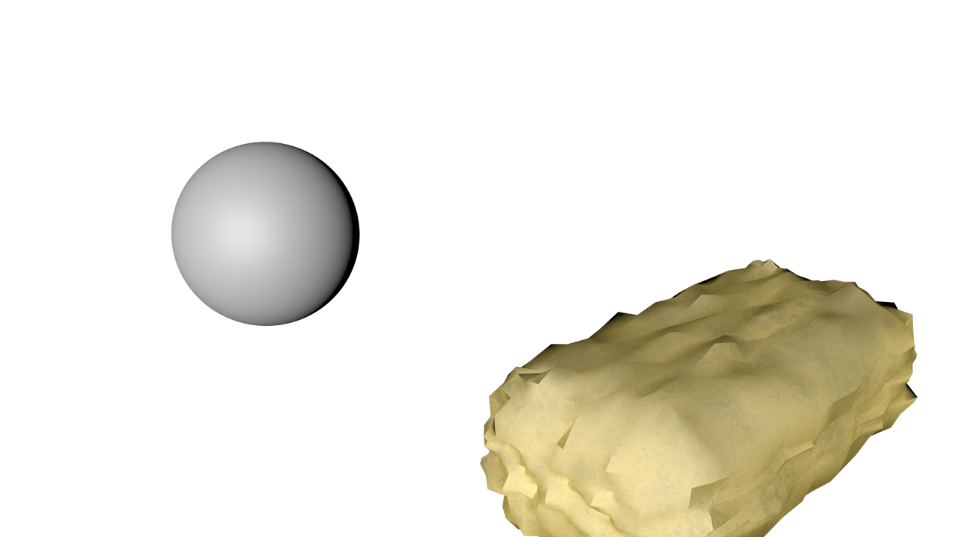

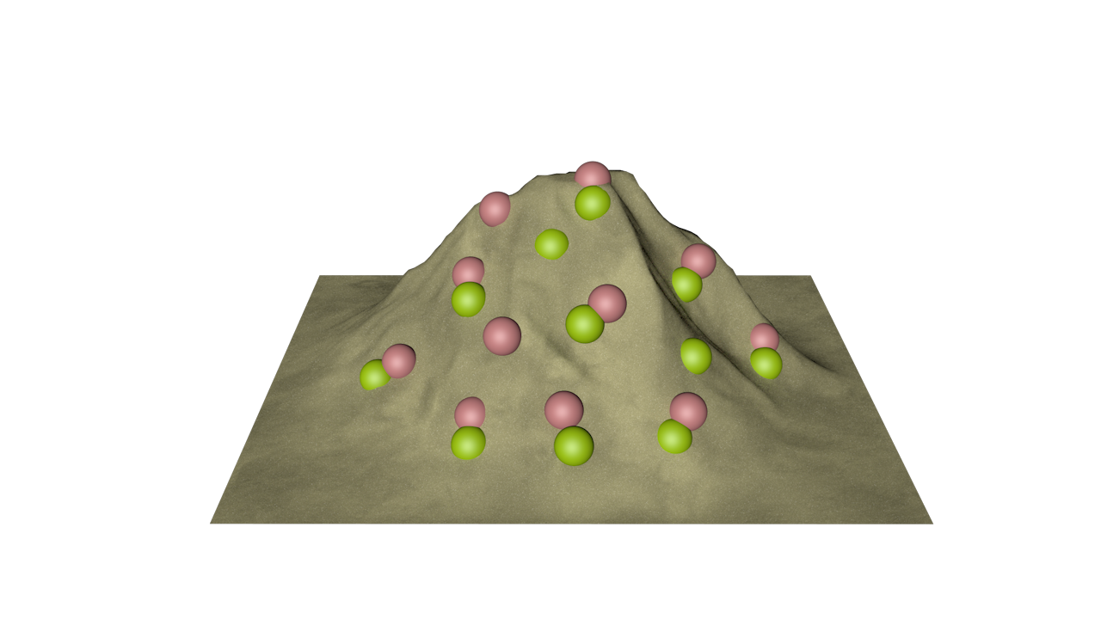
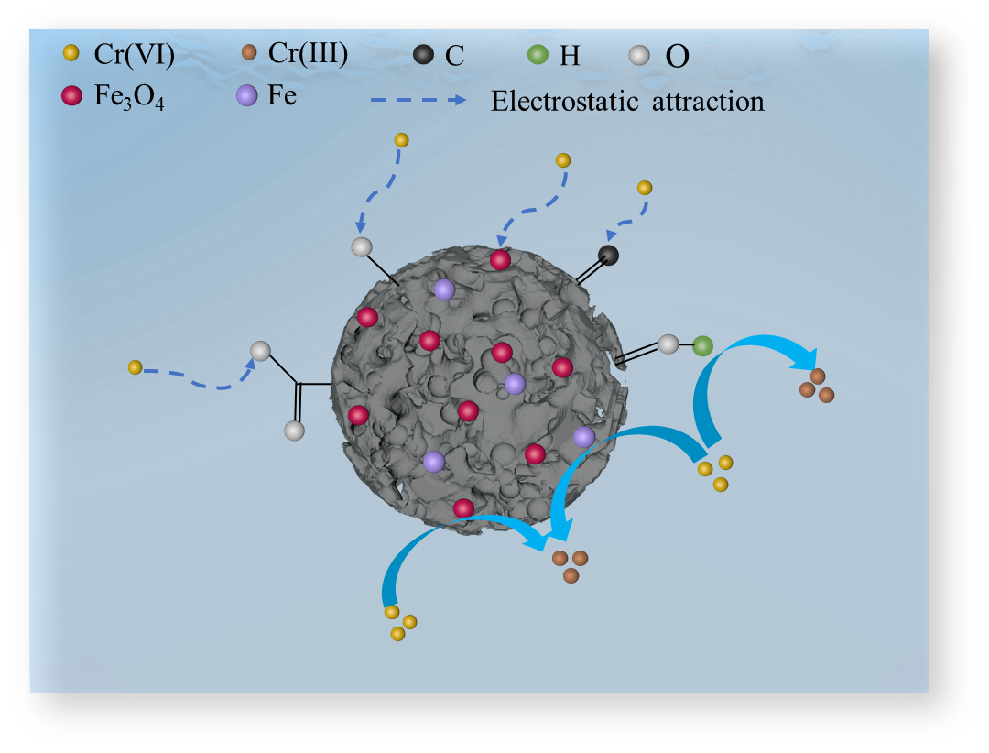

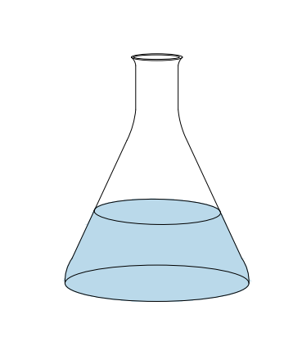
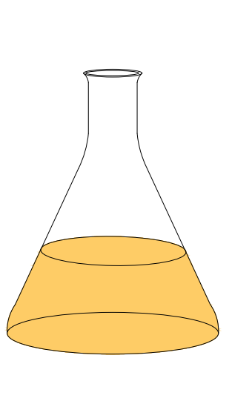
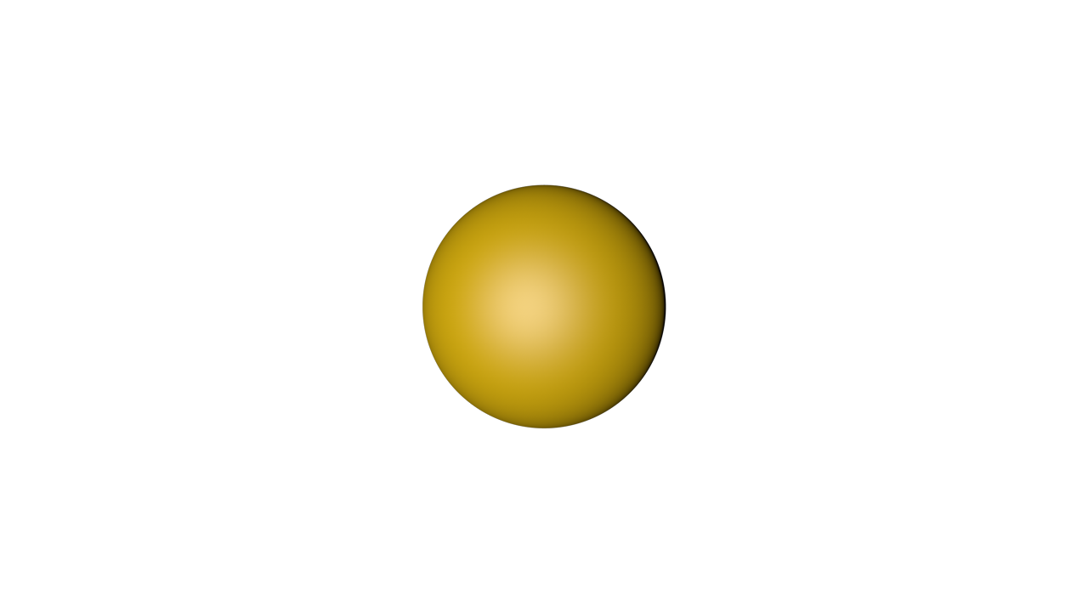
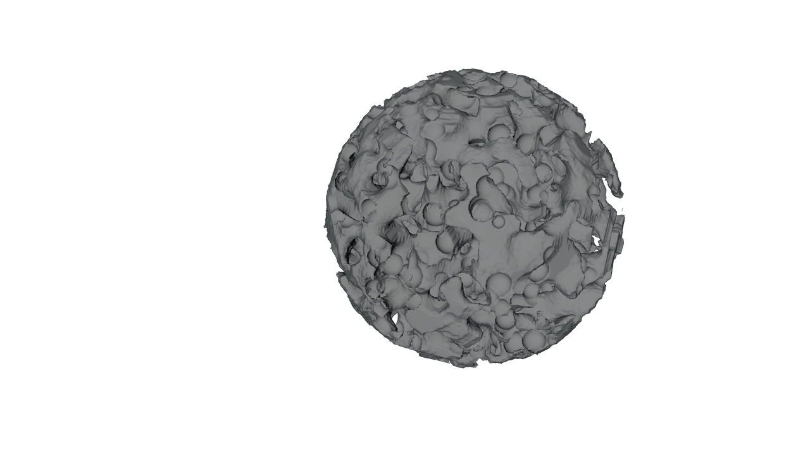
KOH
1 mol/L
Washed and ground
Reed straws
Washed and dryed
N₂
Acid treatment
EFD&C precursor
Calcined at 600 ºC in 2 h
Magnetic EFD&C
Electric furnace dust (EFD)
After adsorption
Before adsorption
Graphical abstract: Magnetic EFD&C from reed straw and electric furnace dust was used to remove hexavalent chromium with the maximum Cr(VI) adsorption capacity of 111.94 mg/g.

