Slide 1
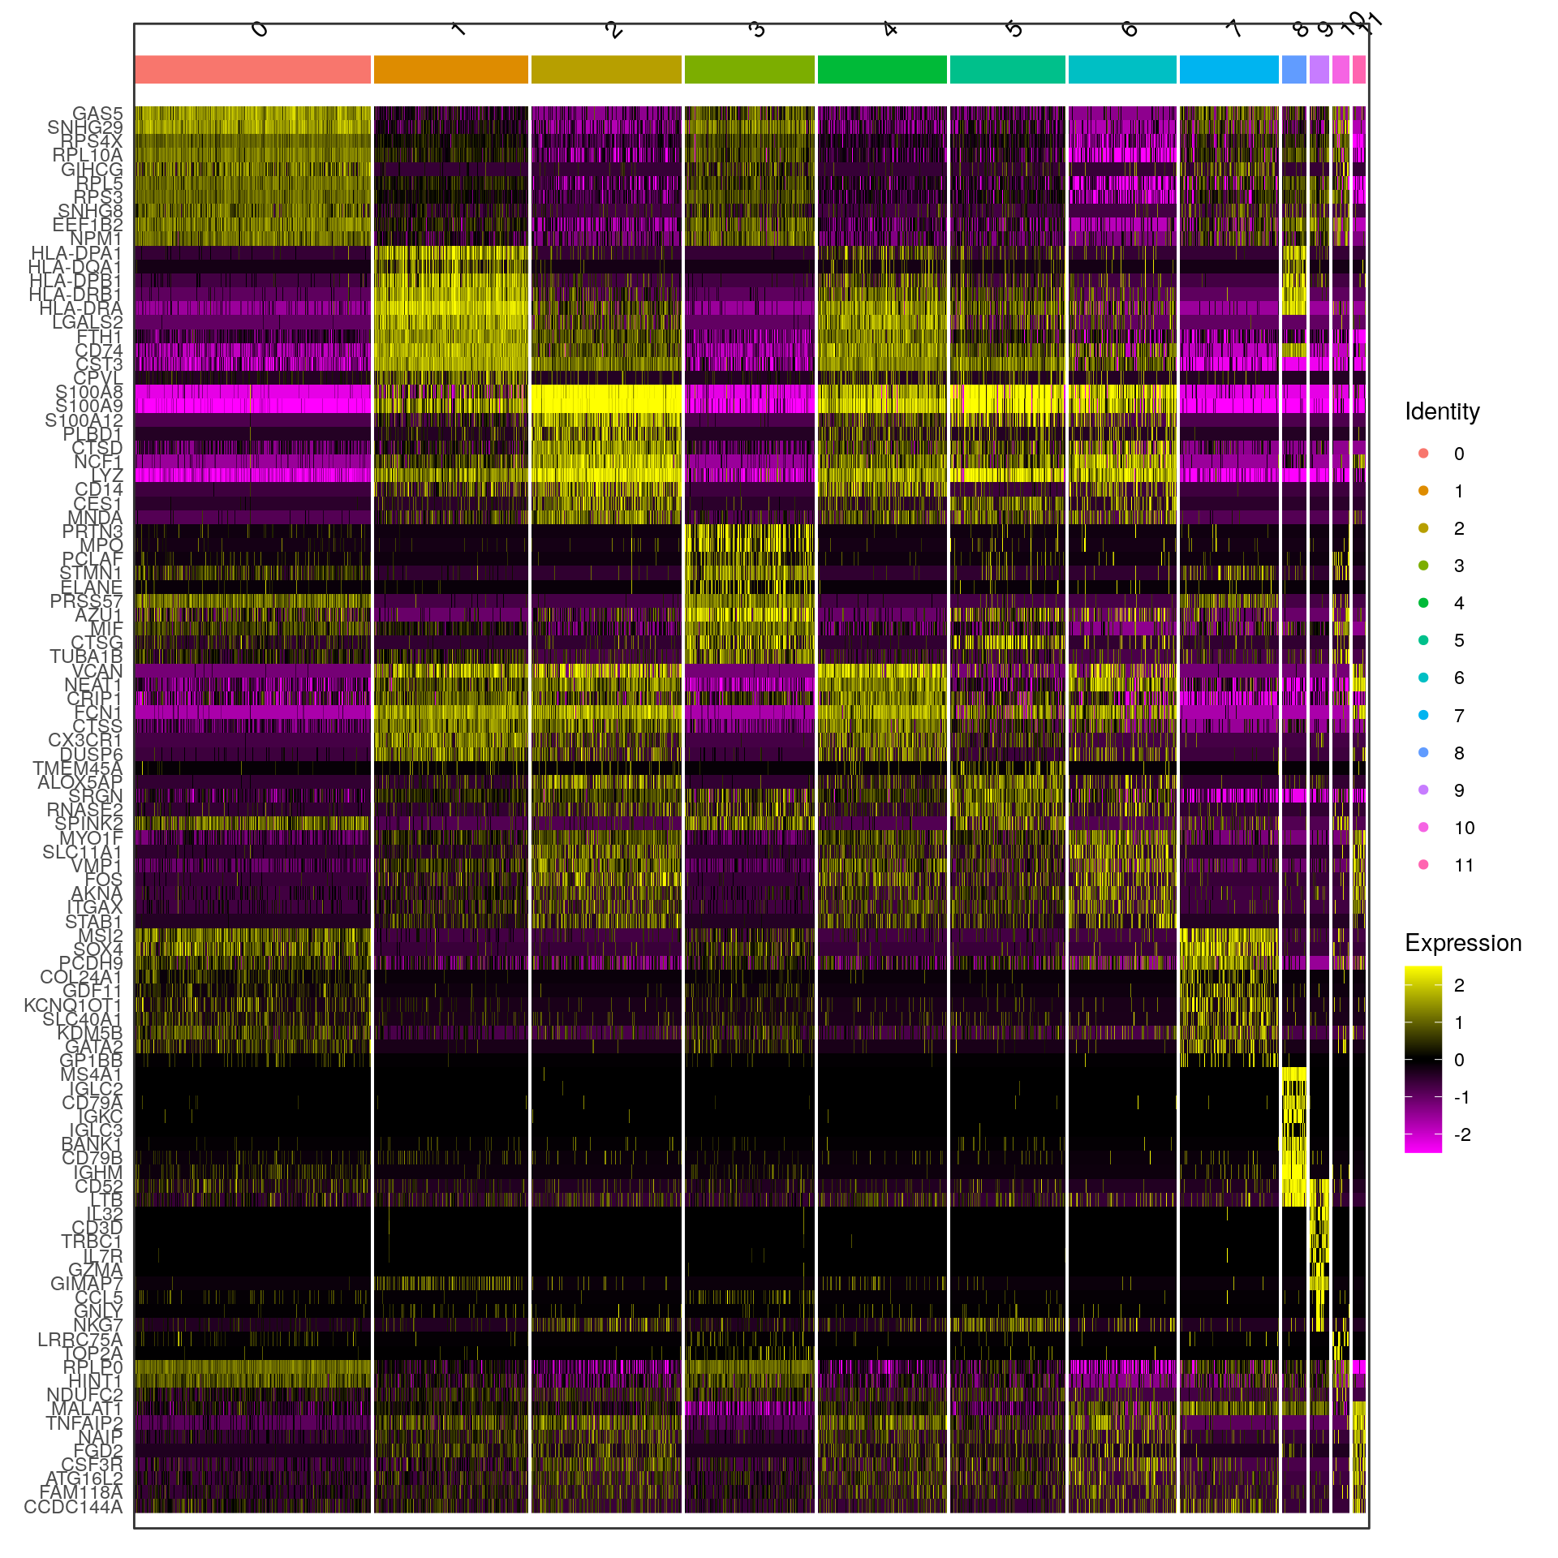
Supplementary data 1a
UPN23 SC
a

Slide 2
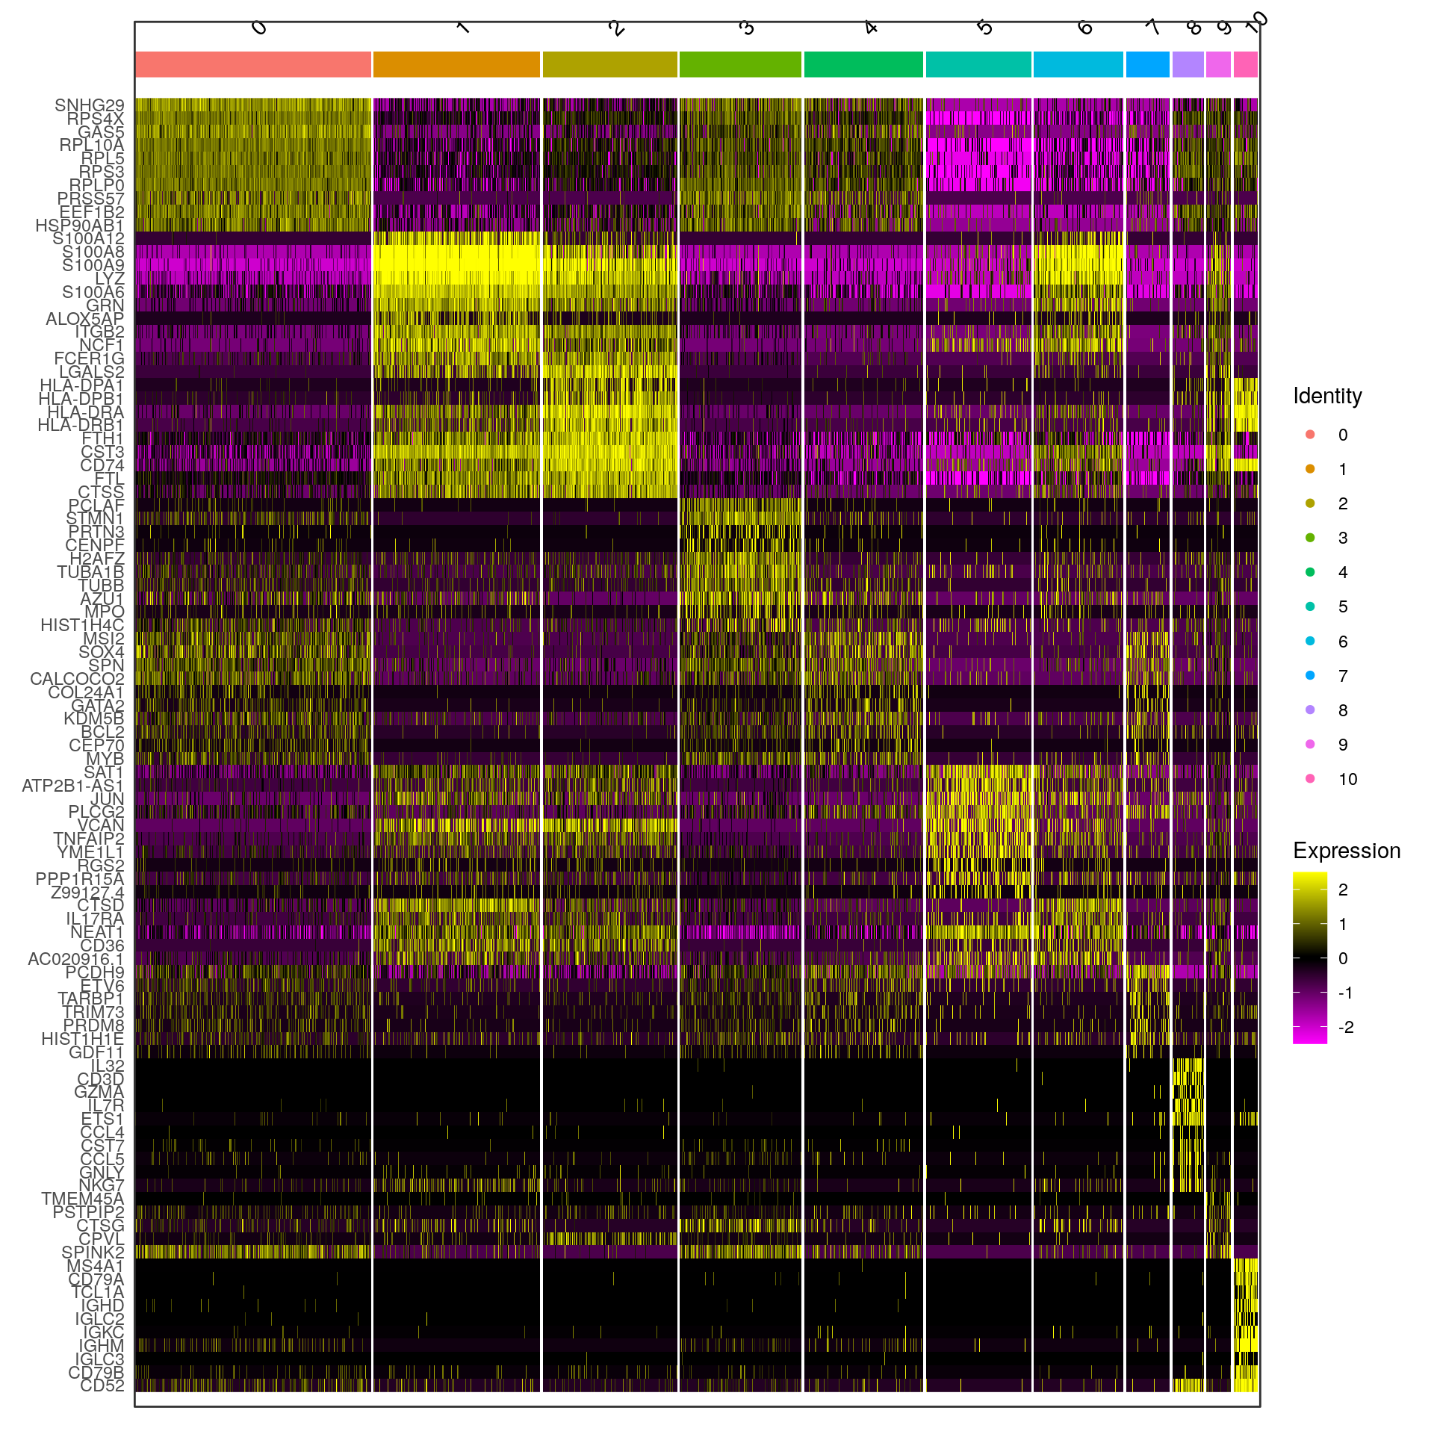
Supplementary data 1b
UPN23 SC_m
b

Slide 3
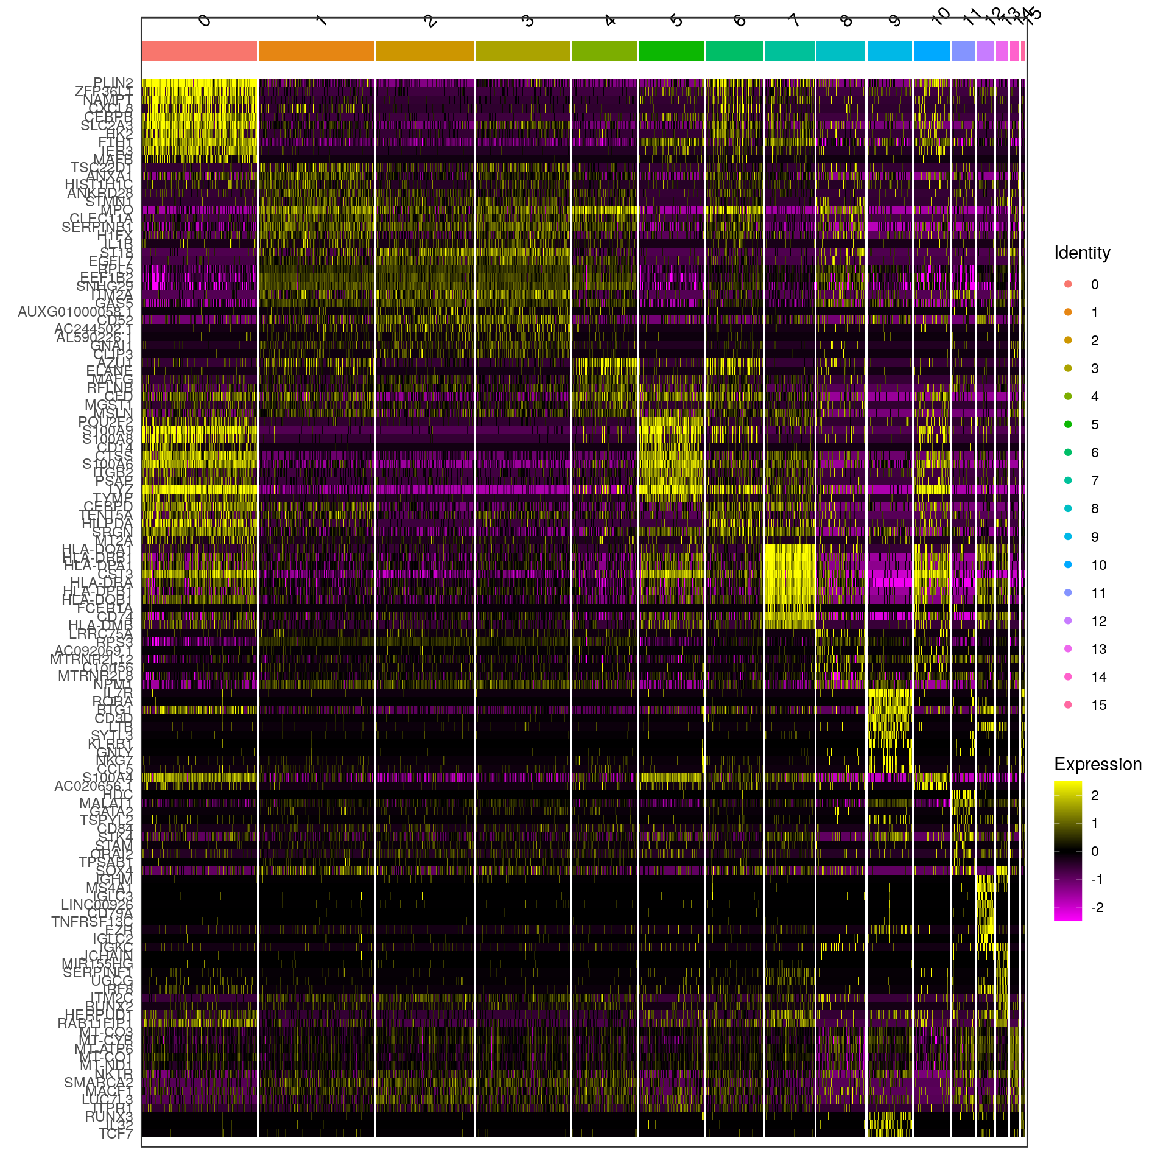
Supplementary data 1c
UPN29 SC
c

Slide 4
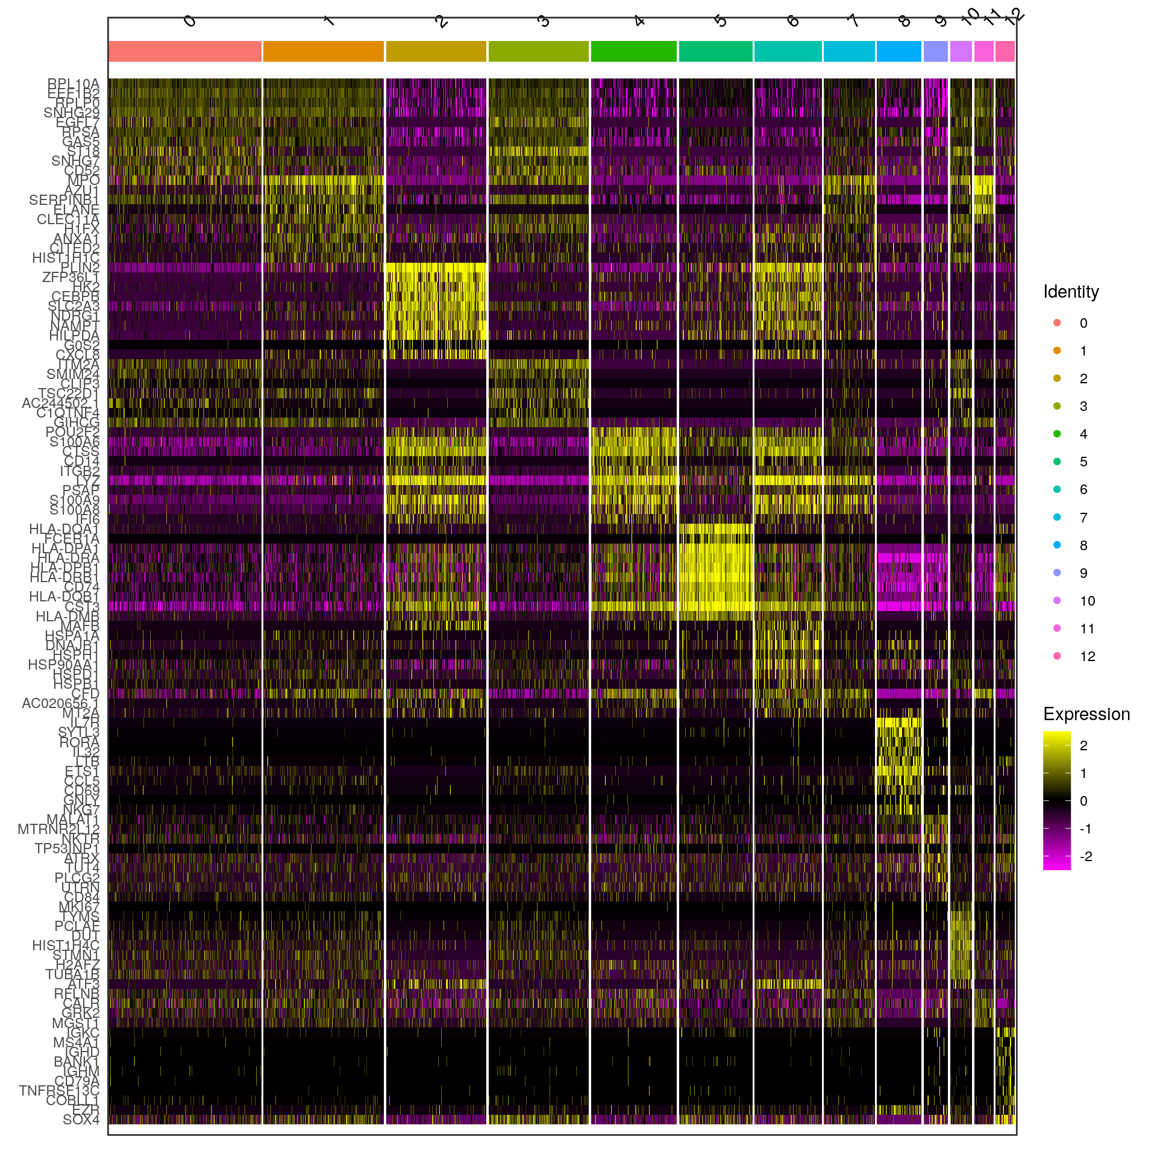
Supplementary data 1d
UPN29 SC_m
d

