Slide 1
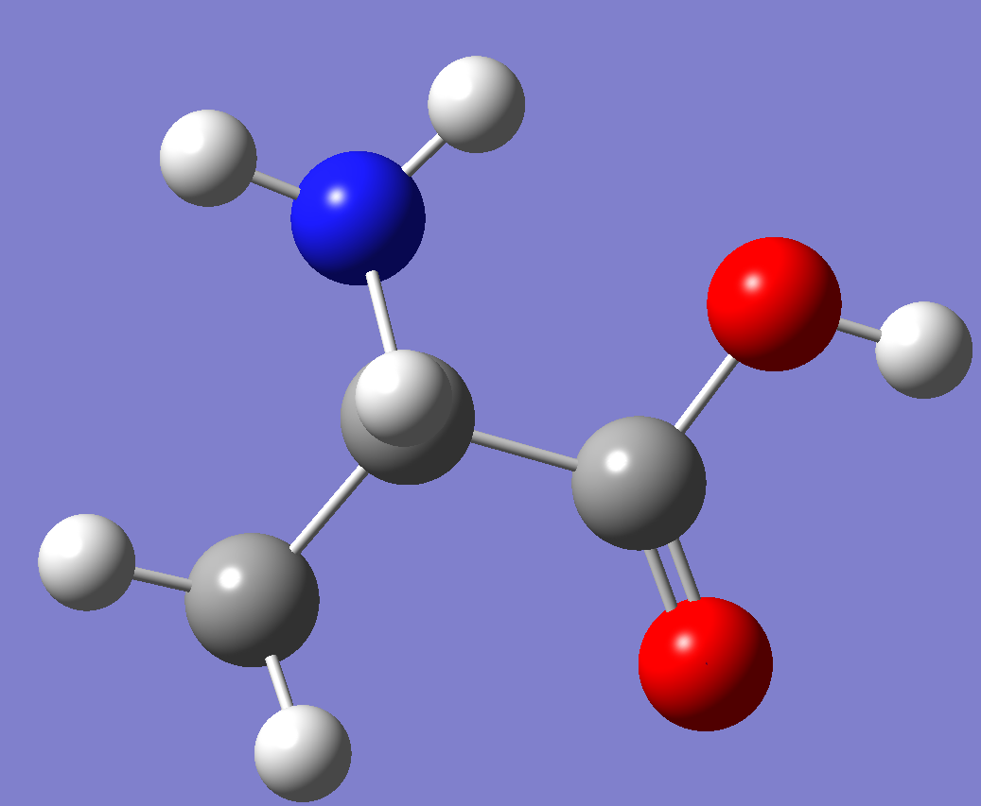
Supplementary material
Fig S1 Amino acid L-alanine chemical structure; (b)The optimized amino acid L-alanine molecular structure performed using basis set B3LYP at 6-31G(d).

Slide 2
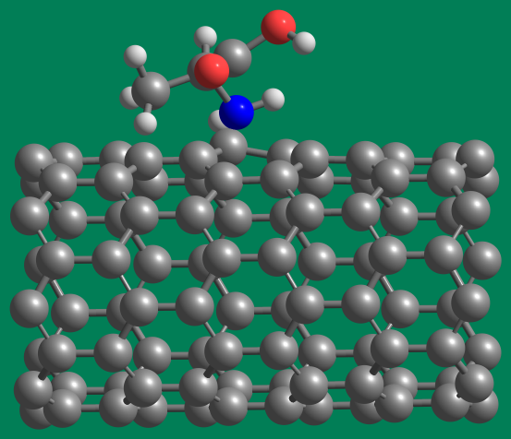
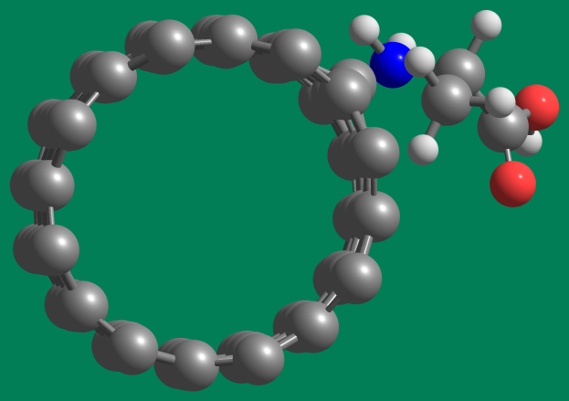
a
b
FigsS2 adsorption mechanism of Alanine on surface of Single walled carbon nanotubes SWNT (4,4) semiconducting front view (a) and side view (b)

Slide 3
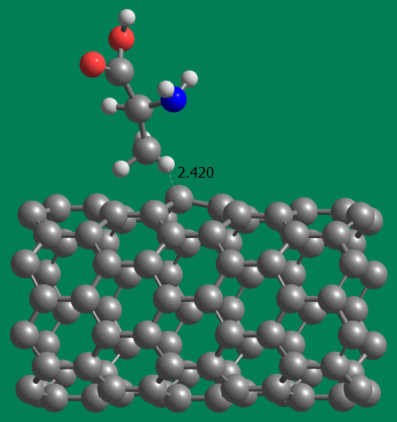
Fig S3 Alanine with methyl group adsorption on surface of Single walled carbon nanotubes SWNT (8,0) conducting

Slide 4
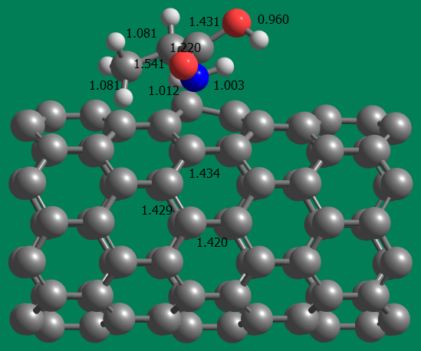
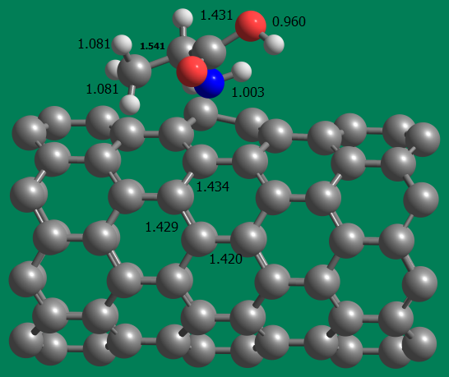

a
b
c
FigsS4 adsorption mechanism of Alanine on surface of Single walled carbon nanotubes SWNT (8,0) semiconducting a,b and c.

Slide 5
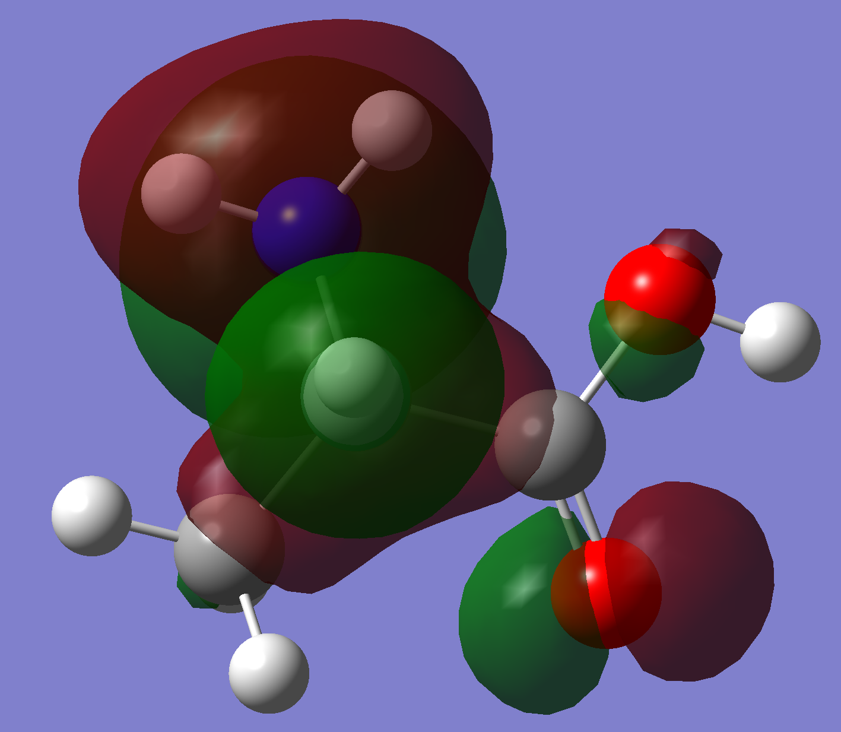
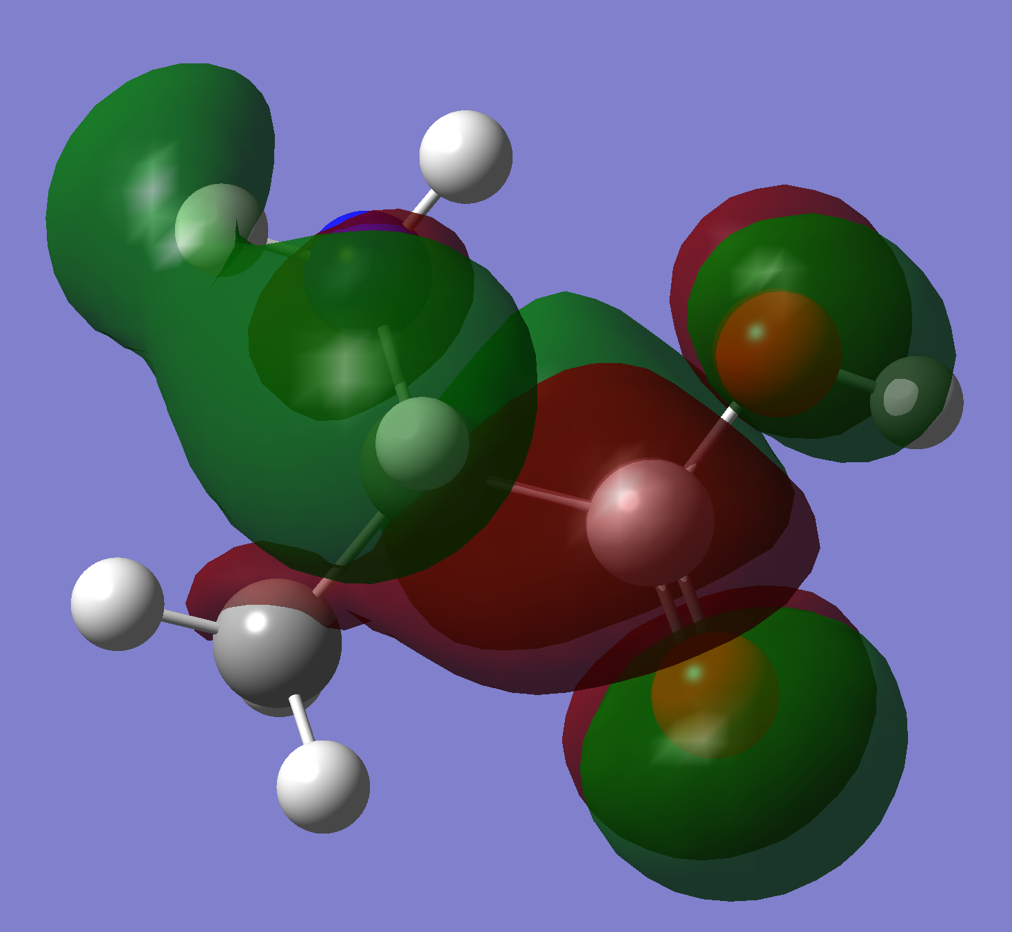
a
a
FigS5.L-alanine-HOMO (a) and L-alanine –LUMO (b)

Slide 6
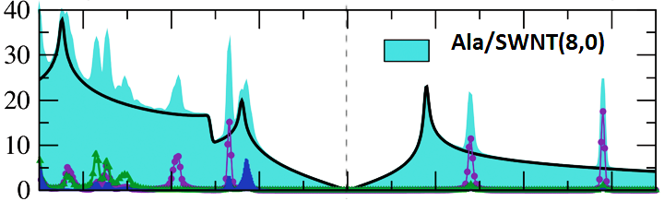
PDOS (states Vol⁻¹eV⁻¹
E(eV)
Projected PDOS for –COOH,NH2 & SWNT(8,0)

