Slide 1
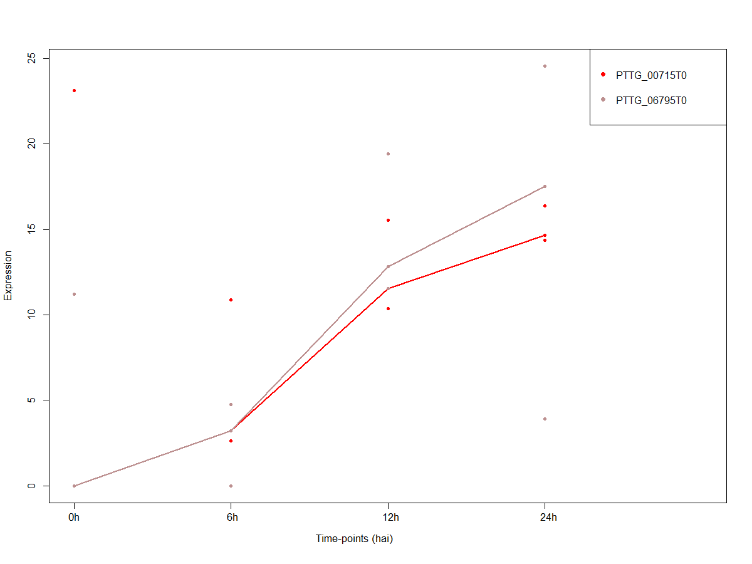
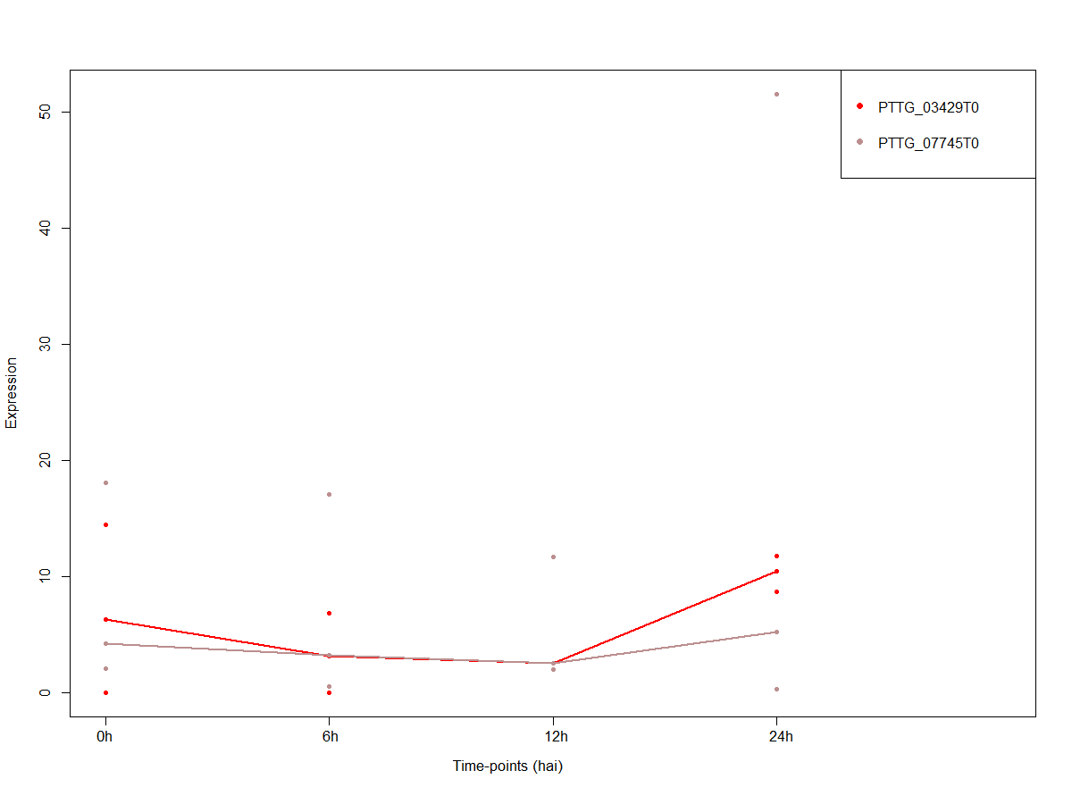
A
A
B

Slide 2
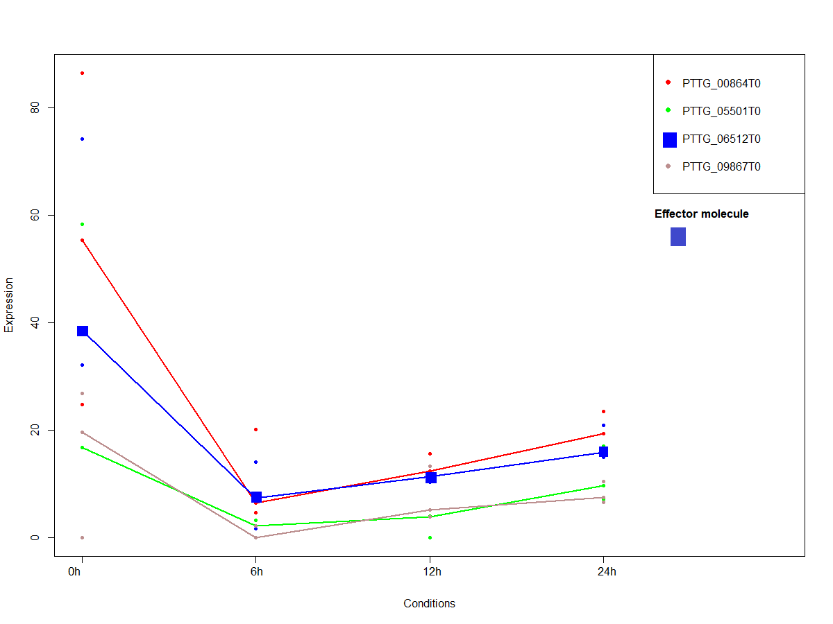
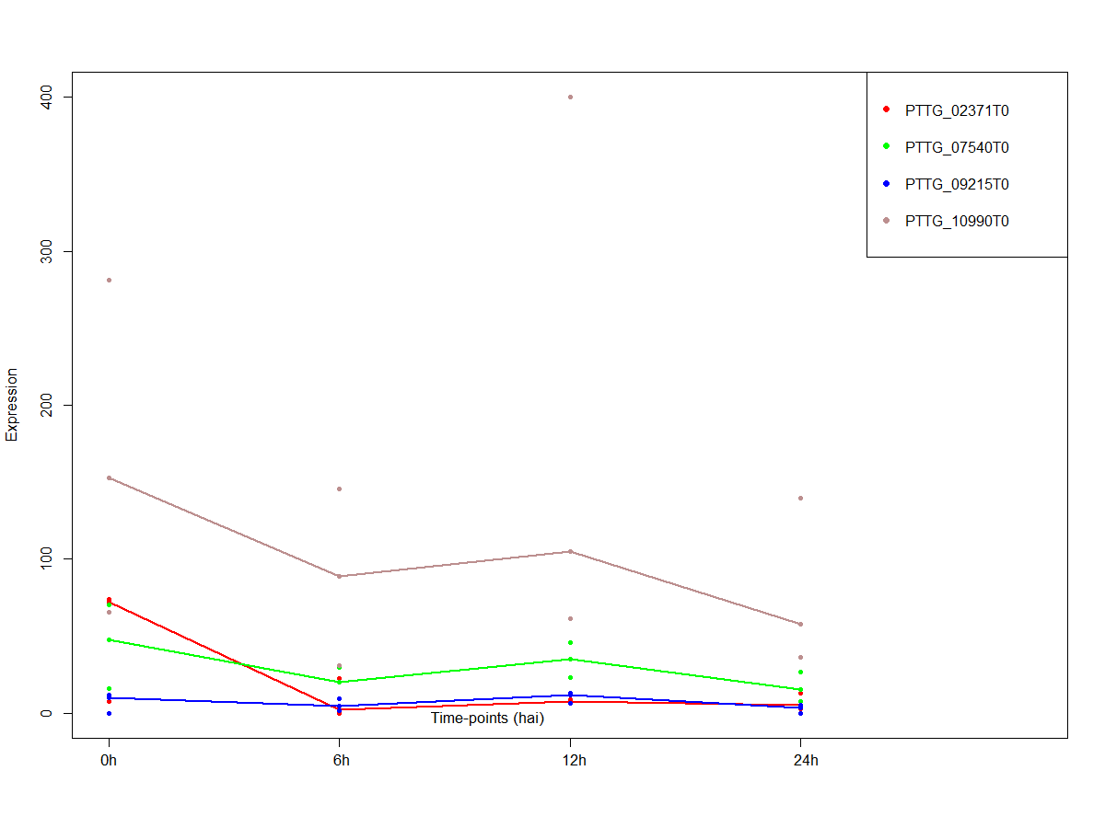
C
D

Slide 3
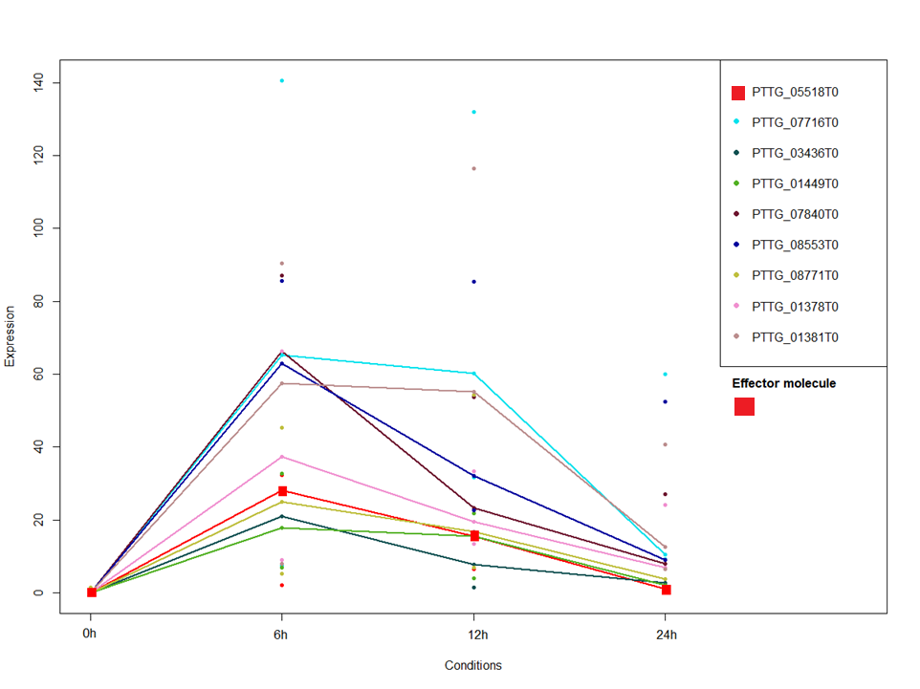
E.1

Slide 4
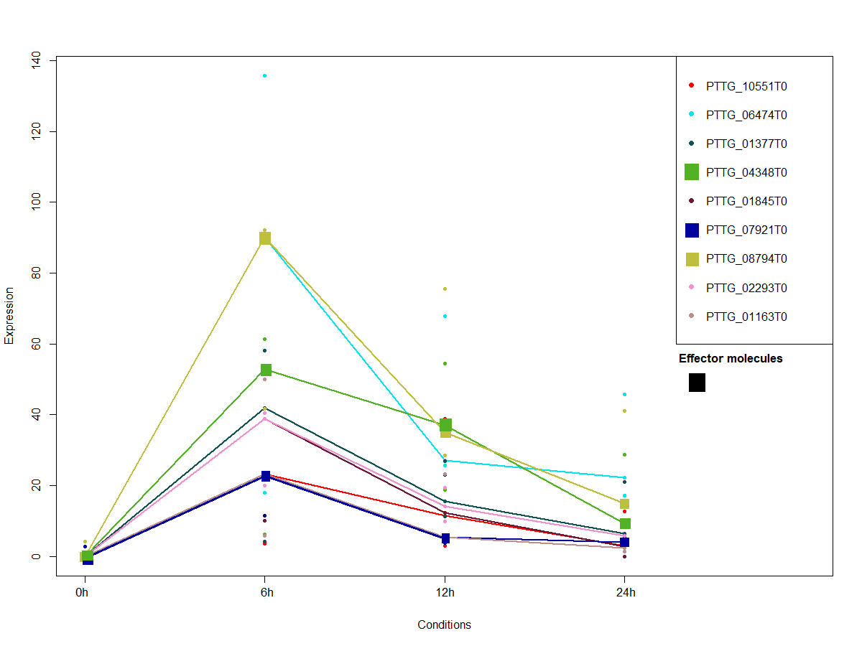
E.2

Slide 5
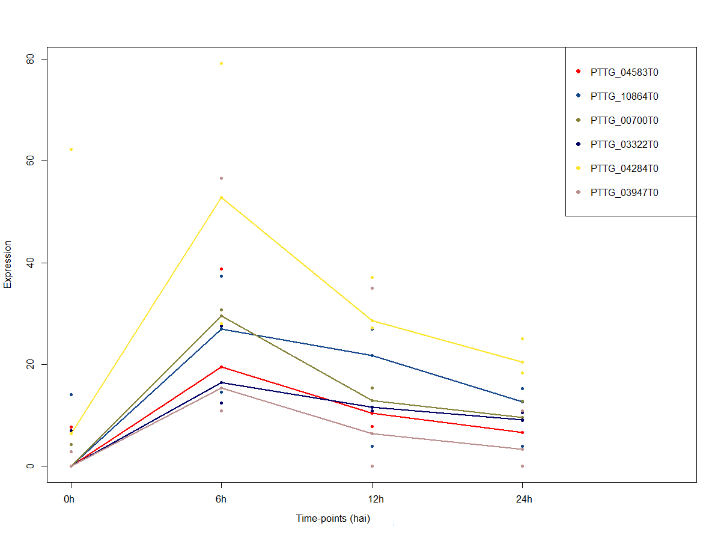
E.3

Slide 6
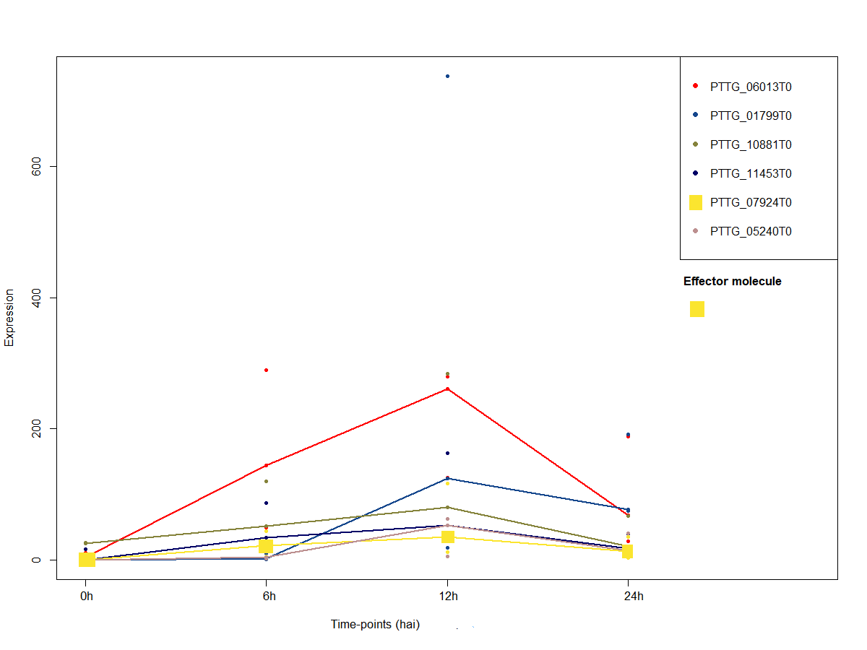
F.1

Slide 7
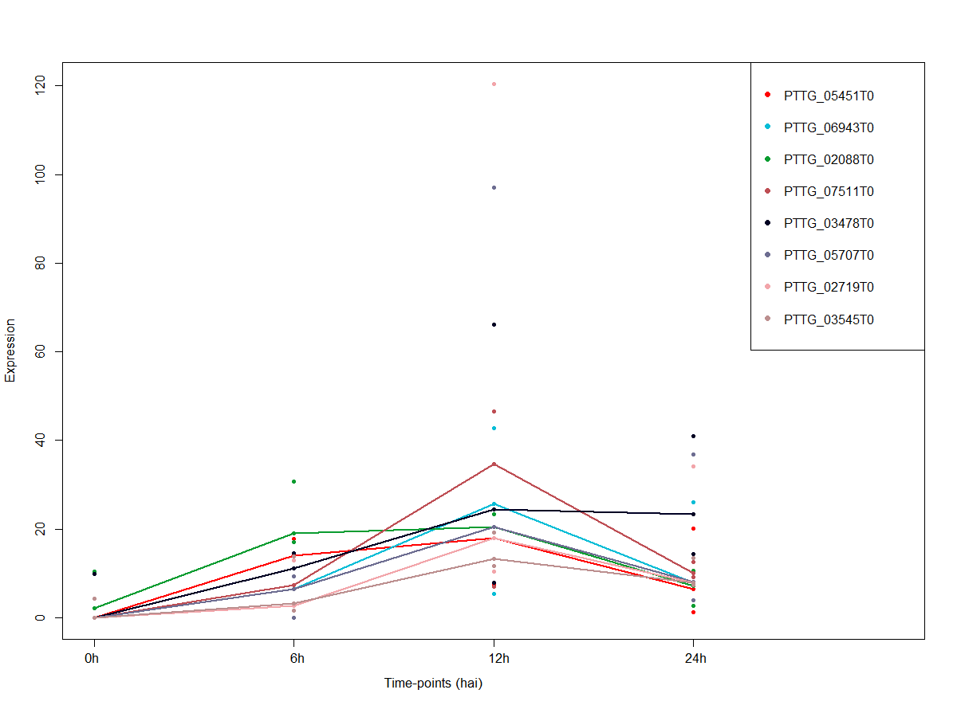
F.2

Slide 8
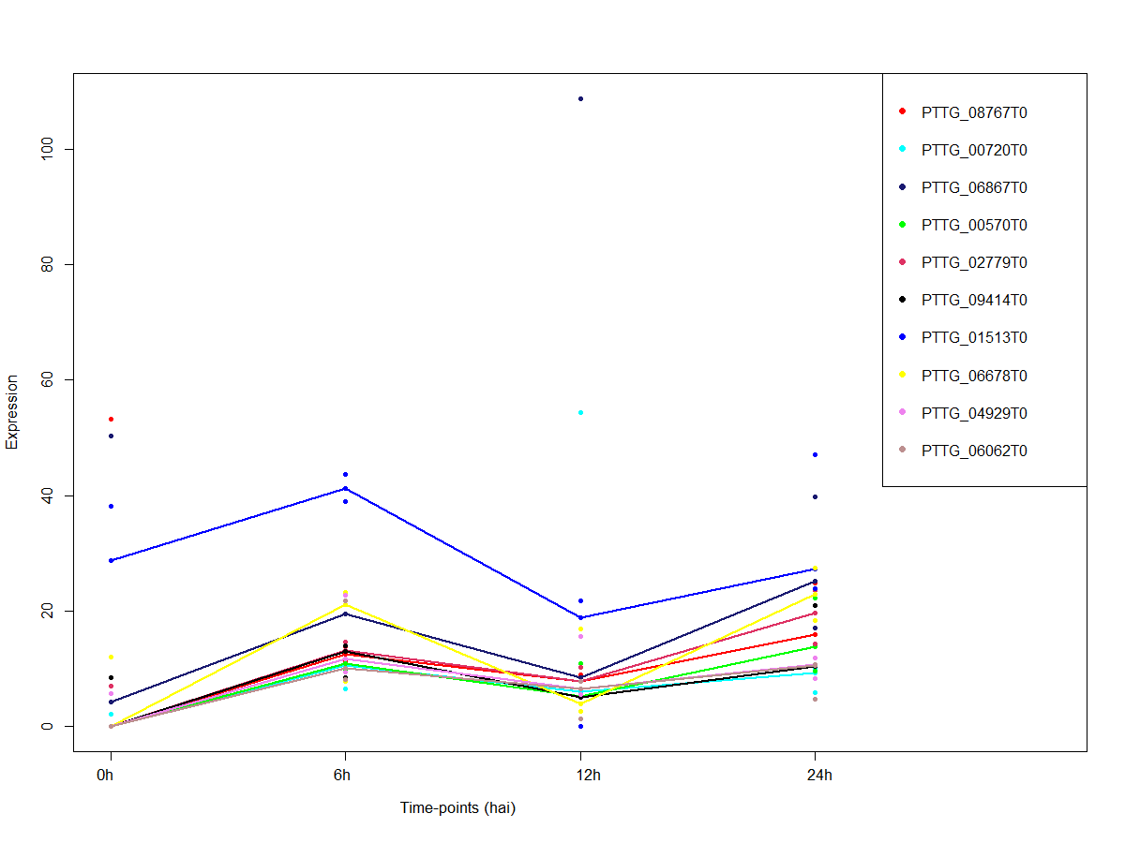
G

Slide 9
Additional file 14: Expression patterns of 60 Puccina triticina (Pt) genes expressed in the wheat variety Toropi, over a 24 hour period, following inoculation with the Pt isolate race MDT-MR. Groups A-G show cluster analysis results based on common expression patterns.

