Slide 1
Comprehensive study of anomalous hysteresis behavior in Perovskite-based solar cells
Mehran Minbashiª, Elnaz Yazdaniª*,
ªDepartment of Physics, Tarbiat Modares University, P.O. Box 14115-175, Tehran, Iran
elnaz.yazdani@modares.ac.ir

Slide 2

Boundary condition
$n_{1}.J_{n1}=−q\left(1+δ_{njn}\right)\left(v_{n1}n_{1}\exp\left(−\frac{E_{c2}−E_{c1}}{k_{B}T}\right)−v_{n2}n_{2}\right)=−n_{2}.J_{n2 },1,2 chosen such that E_{c2}≥E_{c1}$ (1)
$v_{n1,n2}=A_{n}^{∗}\frac{T^{2}}{qN_{c1,c2}}, A_{n}^{∗}=\frac{4π min⁡(m_{e1},m_{e2})k_{B}^{2}q}{h^{3}}$ (2)
$n_{1}.J_{p1}=+q\left(1+δ_{njp}\right)\left(v_{p1}p_{1}\exp\left(−\frac{E_{v2}−E_{v1}}{k_{B}T}\right)−v_{p2}p_{2}\right)=−n_{2}.J_{p2 }, 1,2 chosen such that E_{c2}≥E_{c1}$ (3)
$v_{p1,p2}=A_{p}^{∗}\frac{T^{2}}{qN_{v1,v2}}, A_{n}^{∗}=\frac{4π min⁡(m_{h1},m_{h2})k_{B}^{2}q}{h^{3}}$ (4)
$D_{1}=D_{2}$ (5)

Slide 3
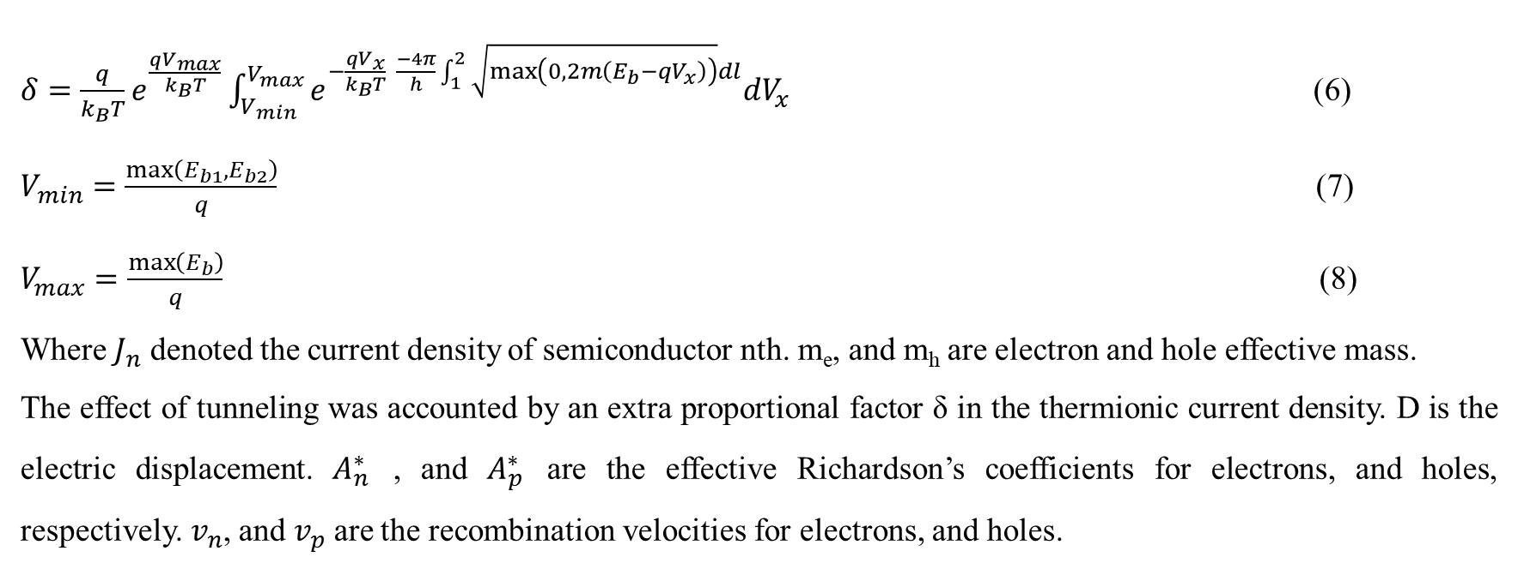
$δ=\frac{q}{k_{B}T}e^{\frac{qV_{max}}{k_{B}T}}\int_{V_{min}}^{V_{max}}{e^{−\frac{{qV}_{x}}{k_{B}T} \frac{−4π}{h}\int_{1}^{2}{\sqrt{\max\left(0,2m\left(E_{b}−qV_{x}\right)\right)}dl}}dV_{x}}$ (6)
$V_{min}=\frac{\max\left(E_{b1},E_{b2}\right)}{q}$ (7)
$V_{max}=\frac{\max\left(E_{b}\right)}{q}$ (8)
Where $J_{n}$ denoted the current density of semiconductor nth. m_{e}, and m_{h} are electron and hole effective mass.
The effect of tunneling was accounted by an extra proportional factor δ in the thermionic current density. D is the electric displacement. $A_{n}^{∗}$ , and $A_{p}^{∗}$ are the effective Richardson’s coefficients for electrons, and holes, respectively. $v_{n}$, and $v_{p}$ are the recombination velocities for electrons, and holes.

Slide 4
Figure S1: Heterostructure band diagram illustrating the vacuum energy level, E₀, and valence band (Ev₁, Ev₂) energies and the conduction band (Ec₁, Ec₂) for the two semiconductors. The electron (E_{fn1}, E_{fn2}) and hole (E_{fp1}, E_{fp2}) quasi Fermi levels are also shown. Also, material band gaps (Eg₁, Eg₂) and affinities (χ₁, χ₂) were shown..

Slide 5
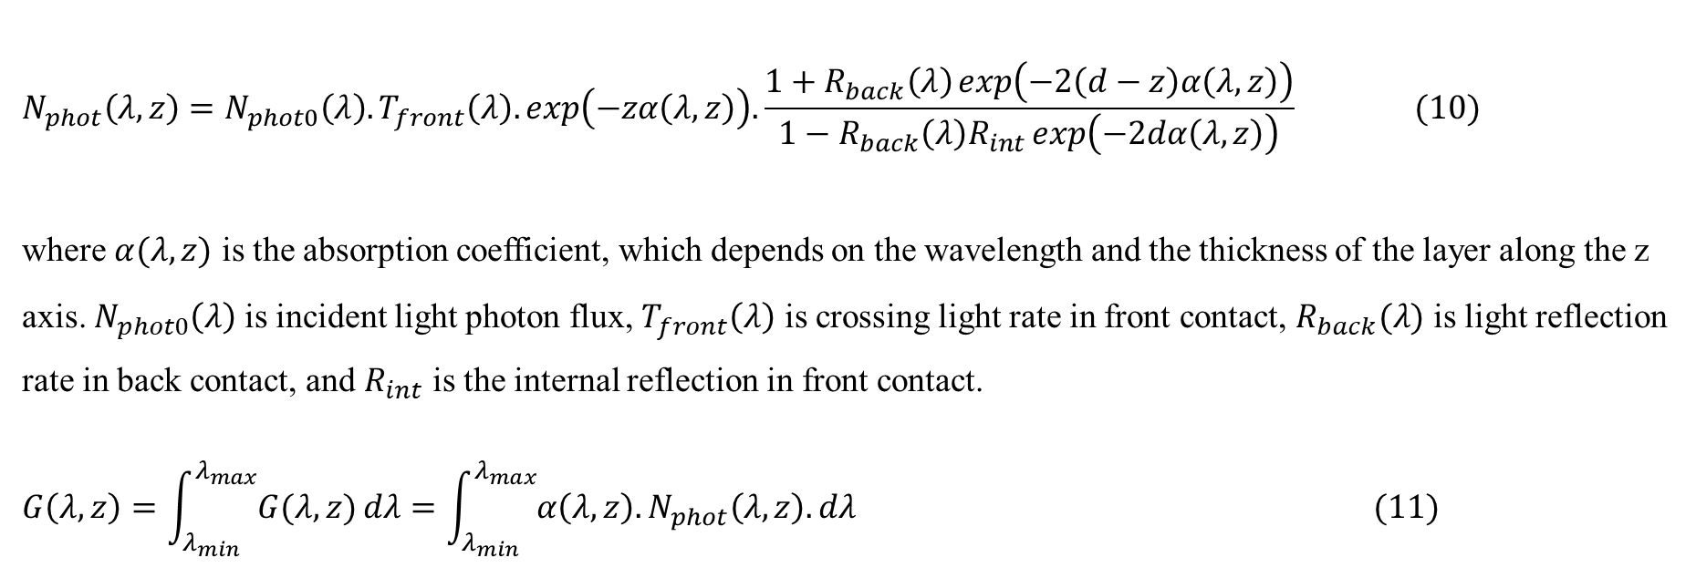
Calculation of generation rate G
$α\left(λ,z\right)=A+\frac{B}{hυ}\sqrt{E_{g}−hυ}$ (9)
A and B are optical constants.
$$N_{phot}\left(λ,z\right)=N_{phot0}\left(λ\right).T_{front}\left(λ\right).exp\left(−zα\left(λ,z\right)\right).\frac{1+R_{back}\left(λ\right)\exp\left(−2\left(d−z\right)α\left(λ,z\right)\right)}{1−R_{back}\left(λ\right)R_{int}\exp\left(−2dα\left(λ,z\right)\right)} (10)$$
where $α(λ,z)$ is the absorption coefficient, which depends on the wavelength and the thickness of the layer along the z axis. $N_{phot0}\left(λ\right)$ is incident light photon flux, $T_{front}\left(λ\right)$ is crossing light rate in front contact, $R_{back}(λ)$ is light reflection rate in back contact, and $R_{int}$ is the internal reflection in front contact.
$$G\left(λ,z\right)=\int_{λ_{min}}^{λ_{max}}{G(λ,z)}dλ=\int_{λ_{min}}^{λ_{max}}{α\left(λ,z\right).N_{phot}\left(λ,z\right).}dλ (11)$$

Slide 6
Simulation condition
For this simulation, both anions and cations were considered in the model. The mesh was very fine in all of the layers, and the number of mesh vertices was 1065 (the lowest mesh vertex index was 0), this number of mesh guarantees the mesh spacing was very fine and lower than 1 nm and lower than Debye length that is too fine to achieve accurate results. The time-dependent study has been used for all of the simulations with relative tolerance between 10⁻⁴ and 10⁻⁵. The time step (∆t) for all studies was t_{dr}/100. The effect of ion free was investigated (Figure S1) and no evidence of hysteresis was seen. For the simulation of the experiment case (Figure 2.d), both anion and cation were considered with mobility of 10⁻¹² cm²/(V×s), and 4×10¹⁰ cm²/(V×s), respectively. As can be seen in table 2, in all of the simulations (except Figure 2), the mobility and the density of anions and cations were the same .

Slide 7
Effect of No-Ion on perovskite solar cell
Figure S2: J–V characteristics for no-Ion

Slide 8
No-Ion
Scan rate is not effect on J-V characteristics and Hysteresis not seen in this case.
Table S1. J-V characteristics of PSC vs different scan rate for No-Ion model
Parameters | Jsc (mA/cm²) | Voc (V) | FF (%) | eta (%)
FS-0.001V/s | 21.29 | 1.13 | 56.11 | 13.5
BS-0.001V/s | 21.29 | 1.13 | 56.11 | 13.5
FS-0.1V/s | 21.29 | 1.13 | 56.11 | 13.5
BS-0.1V/s | 21.29 | 1.13 | 56.11 | 13.5
Table S2. characteristic of HI vs scan rate for No-Ion model
S (V/s) | HI
0.001 | 0
0.01 | 0

Slide 9
Cation migration
Different Scan Rate
Table S3. J-V characteristics of PSC vs different scan rate for cation migration model
Parameters | Jsc (mA/cm²) | Voc (V) | FF (%) | eta (%)
FS-(S=0.0001V/s) | 20.96246 | 1.260 | 0.724771 | 19.1431562
BS-(S=0.0001V/s) | 20.96657 | 1.273 | 0.736358 | 19.6537292
FS-(S=0.001V/s) | 21.31671 | 1.233 | 0.689134 | 18.11284272
BS-(S=0.001V/s) | 20.97703 | 1.2563 | 0.791796 | 20.86654752
FS-(S=0.01V/s) | 21.31684 | 1.18 | 0.552966 | 13.9092282
BS-(S=0.01V/s) | 21.07436 | 1.21 | 0.751151 | 19.15433856
FS-(S=0.1V/s) | 21.31691 | 1.149 | 0.525173 | 12.8631412
BS-(S=0.1V/s) | 21.3171 | 1.144 | 0.543664 | 13.25821056
FS-(S=1V/s) | 21.3176 | 1.1367 | 0.555907 | 13.47059144
BS-(S=1V/s) | 21.3157 | 1.133 | 0.540986 | 13.06517864
FS-(S=10V/s) | 21.31729 | 1.134 | 0.561235 | 13.5671956
BS-(S=10V/s) | 21.31785 | 1.1292 | 0.559753 | 13.47445048
FS-(S=100V/s) | 21.31284 | 1.110 | 0.573371 | 13.56437608
BS-(S=100V/s) | 21.3227 | 1.151 | 0.553026 | 13.57259256

Slide 10
Cation migration
Different Scan Rate
Table S4. characteristic of HI vs scan rate for cation migration model.
S (V/s) | HI
0.0001 | 0.0260
0.001 | 0.1320
0.01 | 0.2738
0.1 | 0.0298
1 | -0.0310
10 | -0.0069
100 | 6.0537×10⁻⁴

Slide 11
Cation migration
S= 100 V/s
Different Perovskite mobility
Table S5. J-V characteristics of PSC vs different perovskite mobility for cation migration model
Parameters | Jsc (mA/cm²) | Voc (V) | FF (%) | eta (%)
FS-(µ=10⁻⁵ cm²/(V*s)) | 0.29 | 1.11 | 0.199338 | 0.064167
BS-(µ=10⁻⁵ cm²/(V*s)) | 0.4 | 1.19 | 0.27555 | 0.131162
FS-(µ=10⁻⁴ cm²/(V*s)) | 1.182 | 1.18 | 0.236319 | 0.329608
BS-(µ=10⁻⁴ cm²/(V*s)) | 1.21 | 1.19 | 0.313647 | 0.451621
FS-(µ=10⁻³ cm²/(V*s)) | 5.81 | 1.14 | 0.186354 | 1.234294
BS-(µ=10⁻³ cm²/(V*s)) | 5.88 | 1.18 | 0.180803 | 1.254482
FS-(µ=10⁻² cm²/(V*s)) | 16.55 | 1.07 | 0.241881 | 4.283352
BS-(µ=10⁻² cm²/(V*s)) | 16.58 | 1.18 | 0.21907 | 4.285981
FS-(µ=10⁻¹ cm²/(V*s)) | 20.69 | 1.07 | 0.396094 | 8.76884976
BS-(µ=10⁻¹ cm²/(V*s)) | 20.74 | 1.18 | 0.358057 | 8.76280944
FS-(µ=10⁰ cm²/(V*s)) | 21.25 | 1.1 | 0.541121 | 12.64869336
BS-(µ=10⁰ cm²/(V*s)) | 21.27 | 1.17 | 0.508653 | 12.65829816
FS-(µ=10¹ cm²/(V*s)) | 21.31 | 1.11 | 0.64157 | 15.17575096
BS-(µ=10¹ cm²/(V*s)) | 21.32 | 1.135 | 0.631014 | 15.26940624
FS-(µ=10² cm²/(V*s)) | 21.316 | 1.12 | 0.706261 | 16.86122784
BS-(µ=10² cm²/(V*s)) | 21.326 | 1.13 | 0.710854 | 17.13042292
Figure S3: Effect of different Perovskite mobility on J-V hysteresis for cation migration model.

Slide 12
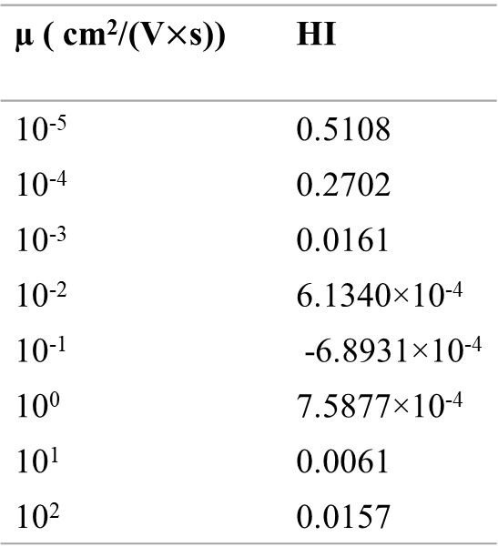
Cation migration
S= 100 V/s
Different Perovskite mobility
Table S6. characteristic of HI vs Perovskite mobility for cation migration model
µ ( cm²/(V$×$s)) | HI
10⁻⁵ | 0.5108
10⁻⁴ | 0.2702
10⁻³ | 0.0161
10⁻² | 6.1340×10⁻⁴
10⁻¹ | -6.8931×10⁻⁴
10⁰ | 7.5877×10⁻⁴
10¹ | 0.0061
10² | 0.0157
Figure S4: Hysteresis index vs perovskite mobility for cation migration model

Slide 13
Cation migration
S= 100 V/s
Different pre-bias voltage
Table S7. J-V characteristics of PSC vs different pre-bias voltage for cation migration model
Parameters | Jsc (mA/cm2) | Voc (V) | FF (%) | eta (%)
FS-(Vpre=0 V) | 21.21 | 1.132 | 0.526796 | 12.6482328
BS-(Vpre=0 V) | 21.22 | 1.166 | 0.516421 | 12.7775536
FS-(Vpre=0.1 V) | 21.23 | 1.13 | 0.525538 | 12.60760788
BS-(Vpre=0.1 V) | 21.25 | 1.16 | 0.515855 | 12.7158136
FS-(Vpre=0.5 V) | 21.292 | 1.11 | 0.563215 | 13.31110144
BS-(Vpre=0.5 V) | 21.293 | 1.15 | 0.545379 | 13.35465768
FS-(Vpre=0.7 V) | 21.29 | 1.1 | 0.605392 | 14.17767624
BS-(Vpre=0.7 V) | 21.3 | 1.15 | 0.577429 | 14.14412272
FS-(Vpre=0.9 V) | 21.28 | 1.137 | 0.652742 | 15.79332692
BS-(Vpre=0.9 V) | 21.29 | 1.167 | 0.632614 | 15.7175592
FS-(Vpre=1.1 V) | 20.97 | 1.15 | 0.667943 | 16.10778848
BS-(Vpre=1.1 V) | 21.06 | 1.178 | 0.647131 | 16.05447592
Figure S5: Effect of different pre-bias voltage on J-V hysteresis for cation migration model.

Slide 14
Cation migration
S= 100 V/s
Different pre-bias voltage
Table S8. characteristic of HI vs pre-bias voltage for cation migration model
V_{pre} ( V) | HI
0 | 0.0101
0.1 | 0.0085
0 .5 | 0.0033
0 .7 | -0.0024
0.9 | -0.0048
1.1 | -0.0033
Figure S6: Hysteresis index vs pre-bias voltage for cation migration model

Slide 15
Both Anions and Cations

Slide 16
Anions and cations migration
Same mobility
Different Scan Rate
Table S9. characteristics of PSC vs different scan rate for cation and anion migration model.
Parameters | Jsc (mA/cm²) | Voc (V) | FF (%) | eta (%)
FS-(S=0.0001V/s) | 21.05 | 1.153 | 0.614917 | 14.924436
BS-(S=0.0001V/s) | 21.08 | 1.155 | 0.640548 | 15.5956752
FS-(S=0.001V/s) | 21.29 | 1.139 | 0.578444 | 14.02686264
BS-(S=0.001V/s) | 21.16 | 1.143 | 0.676205 | 16.3546236
FS-(S=0.01V/s) | 21.28 | 1.136 | 0.540624 | 13.06908168
BS-(S=0.01V/s) | 21.293 | 1.138 | 0.602618 | 14.60230944
FS-(S=0.1V/s) | 21.291 | 1.133 | 0.558502 | 13.472568
BS-(S=0.1V/s) | 21.292 | 1.134 | 0.563063 | 13.59523848
FS-(S=1V/s) | 21.2916 | 1.130 | 0.563822 | 13.565268
BS-(S=1V/s) | 21.2917 | 1.131 | 0.562371 | 13.5424008
FS-(S=10V/s) | 21.2910 | 1.1282 | 0.564985 | 13.5712296
BS-(S=10V/s) | 21.2923 | 1.324 | 0.48126 | 13.5671976
FS-(S=100V/s) | 21.286 | 1.11 | 0.573346 | 13.54671134
BS-(S=100V/s) | 21.296 | 1.151 | 0.553941 | 13.57803112

Slide 17
Anions and cations migration
Same mobility
Different Scan Rate
Table S10. characteristic of HI vs pre-bias voltage for cation and anion migration model
S (V/s) | HI
0.0001 | 0.0430
0.001 | 0.1423
0.01 | 0.1050
0.1 | 0.0090
1 | -0.0017
10 | -2.9719×10⁻⁴
100 | 0.0023

Slide 18
Anions and cations migration
Same mobility
S= 1 V/s
Different Perovskite mobility
Table S11. characteristics of PSC vs different perovskite mobility for the model of cation and anion migration.
Parameters | Jsc (mA/cm2) | Voc (V) | FF (%) | eta (%)
FS-(µ=10⁻² cm²/(V×s)) | 16.369 | 1.3 | 0.200941 | 4.2759654
BS-(µ=10⁻² cm²/(V×s)) | 16.586 | 1.3 | 0.200061 | 4.3136772
FS-(µ=10⁻¹ cm²/(V×s)) | 20.718 | 1.182 | 0.357574 | 8.75652316
BS-(µ=10⁻¹ cm²/(V×s)) | 20.695 | 1.186 | 0.353946 | 8.68735784
FS-(µ=1 cm²/(V×s)) | 21.261 | 1.135 | 0.523779 | 12.639431
BS-(µ=1 cm²/(V×s)) | 21.258 | 1.137 | 0.521331 | 12.600749
FS-(µ=10¹ cm²/(V×s)) | 21.325 | 1.1258 | 0.633809 | 15.21628724
BS-(µ=10¹ cm²/(V×s)) | 21.316 | 1.1266 | 0.633823 | 15.22101308
FS-(µ=10² cm²/(V×s)) | 21.331 | 1.124 | 0.708277 | 16.9816822
BS-(µ=10² cm²/(V×s)) | 21.321 | 1.125 | 0.709592 | 17.0203712

Slide 19
Anions and cations migration
Same mobility
S= 1 V/s
Different Perovskite mobility
Table S12. characteristic of HI vs pre-bias voltage for cations and anions migration model.
µ (cm²/(V*s)) | HI
10⁻³ | 0.0625
10⁻² | 0.0087
10⁻¹ | -0.0080
10⁰ | -0.0031
10¹ | 3.1048×10⁻⁴
10² | 0.0023

Slide 20
Anions and cations migration
Same mobility
S= 1 V/s
Different pre-bias voltage
Table S13. J-V characteristics of PSC vs different pre-bias voltage for cation and anion migration model.
Parameters | Jsc (mA/cm²) | Voc (V) | FF (%) | eta (%)
FS-(V_{pre}=0 V) | 21.06808 | 1.153 | 0.512132 | 12.4404504
BS-(V_{pre}=0 V) | 21.27996 | 1.152 | 0.567205 | 13.90475736
FS-(V_{pre}=0.1 V) | 21.18028 | 1.1493 | 0.512178 | 12.46769568
BS-(V_{pre}=0.1 V) | 21.28094 | 1.1492 | 0.571581 | 13.9786068
FS-(V_{pre}=0.3 V) | 21.26935 | 1.144 | 0.518675 | 12.6204672
BS-(V_{pre}=0.3 V) | 21.28267 | 1.143 | 0.585056 | 14.23211736
FS-(V_{pre}=0.5 V) | 21.28586 | 1.1390 | 0.533734 | 12.94016136
BS-(V_{pre}=0.5 V) | 21.28397 | 1.1378 | 0.599899 | 14.52768624
FS-(V_{pre}=0.7 V) | 21.29753 | 1.1352 | 0.552571 | 13.35949464
BS-(V_{pre}=0.7 V) | 21.28523 | 1.1343 | 0.610629 | 14.74293288
FS-(V_{pre}=0.9 V) | 21.30325 | 1.1304 | 0.58459 | 14.0776272
BS-(V_{pre}=0.9 V) | 21.28844 | 1.1319 | 0.635173 | 15.30537984
FS-(V_{pre}=1.1 V) | 21.304 | 1.130 | 0.621267 | 14.95609344
BS-(V_{pre}=1.1 V) | 21.2906 | 1.134 | 0.652804 | 15.760998

Slide 21
Anions and cations migration
Same mobility
S= 1 V/s
Different pre-bias voltage
Table S14. characteristic of HI vs different pre-bias voltage for cation and anion migration model.
V_{pre} (V) | HI
0 | 0.1053
0.1 | 0.1081
0.3 | 0.1132
0 .5 | 0.1093
0 .7 | 0.0938
0.9 | 0.0802
1.1 | 0.0511

Slide 22
Flux of anions and cations to HTL and ETL, respectively.

Slide 23
Flux of anions and cations to HTL and ETL, respectively.
Table S15. J-V characteristics of PSC vs diffrent g_{ah} and g_{ce} (1/cm².s) for the model of ion flux (anion to HTL and cation to ETL ).
Parameters | Jsc (mA/cm²) | Voc (V) | FF (%) | eta (%)
FS-(g_{ah}=5×10¹⁵, g_{ce}=5×10¹⁵) | 21.32887 | 1.127 | 0.575777 | 13.8403152
BS-(g_{ah}=5×10¹⁵, g_{ce}=5×10¹⁵) | 21.31938 | 1.128 | 0.592211 | 14.2416432
FS-(g_{ah}=1×10¹⁶, g_{ce}=1×10¹⁶) | 21.32897 | 1.118 | 0.592621 | 14.13150624
BS-(g_{ah}=1×10¹⁶, g_{ce}=1×10¹⁶) | 21.31746 | 1.124 | 0.635705 | 15.23202816
FS-(g_{ah}=5×10¹⁶, g_{ce}=5×10¹⁶) | 21.32977 | 1.155 | 0.708167 | 17.446314
BS-(g_{ah}=5×10¹⁶, g_{ce}=5×10¹⁶) | 21.31036 | 1.160 | 0.763267 | 18.86797224

Slide 24
Flux of anions and cations to HTL and ETL, respectively.
Table S16. characteristic of HI vs different g_{ah} and g_{ce} (1/cm².s) for the model of ion flux (anion to HTL and cation to ETL ).
Case/Parameters | HI
g_{ah}=5×10¹⁵, g_{ce}=5×10¹⁵ | 0.0282
g_{ah}=1×10¹⁶, g_{ce}=1×10¹⁶ | 0.0723
g_{ah}=5×10¹⁶, g_{ce}=5×10¹⁶ | 0.0753

Slide 25
Flux of anions and cations to ETL and HTL, respectively

Slide 26
Flux of anions and cations to ETL and HTL, respectively
Table S17. characteristics of PSC vs different g_{ae} and g_{ch} ((1/cm².s)) for the model of ion flux (cations to HTL and anions to ETL ).
Parameters | Jsc (mA/cm²) | Voc (V) | FF (%) | eta (%)
FS-(g_{ae}=1×10¹⁵, g_{ch}=1×10¹⁵) | 21.32875 | 1.130 | 56.0382 | 13.506048
BS-(g_{ae}=1×10¹⁵, g_{ch}=1×10¹⁵) | 21.31359 | 1.131 | 55.25 | 13.3183944
FS-(g_{ae}=5×10¹⁵, g_{ch}=5×10¹⁵) | 21.32867 | 1.132 | 53.6468 | 12.95251128
BS-(g_{ae}=5×10¹⁵, g_{ch}=5×10¹⁵) | 21.1295 | 1.133 | 45.9274 | 10.99489152
FS-(g_{ae}=1×10¹⁶, g_{ch}=1×10¹⁶) | 21.32856 | 1.132 | 48.7208 | 11.76312456
BS-(g_{ae}=1×10¹⁶, g_{ch}=1×10¹⁶) | 12.80607 | 1.134 | 57.4759 | 8.34669792

Slide 27
Flux of anions and cations to ETL and HTL, respectively
Table S18. characteristic of HI vs different g_{ae} and g_{ch} ((1/cm².s)) for the model of ion flux (anion to HTL and cation to ETL ).
Case/Parameters | HI
g_{ae}=1×10¹⁵, g_{ch}=1×10¹⁵ | -0.0141
g_{ae}=5×10¹⁵, g_{ch}=5×10¹⁵ | -0.1780
g_{ae}=1×10¹⁶, g_{ch}=1×10¹⁶ | -0.4093

Slide 28
With ionic flux
Flux of anions and cations to ETL and HTL, respectively
Figure S7: Effect of different flux (g_{ae}, and g_{ch}) on (a) Light and (b) dark J-V hysteresis. Graphs were taken at S= 1 V/s and t=2.4 s.

Slide 29
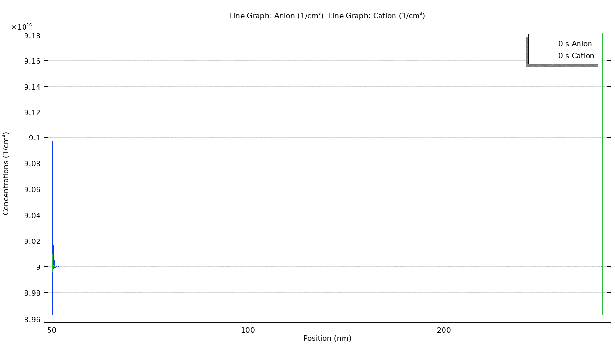
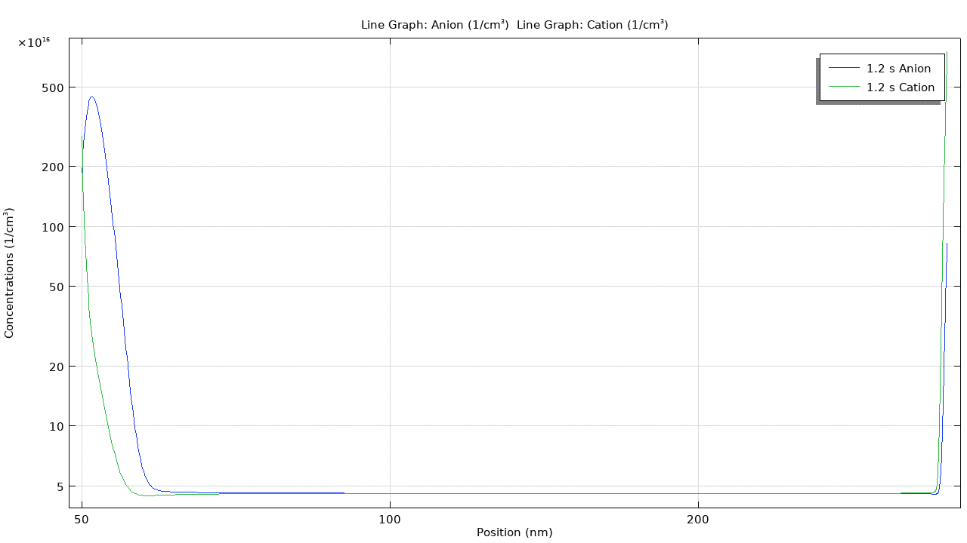


Flux of anions and cations to ETL and HTL, respectively
V1. Animation video for anion and cation concentration distribution in FS direction.
V2. Animation video for anion and cation concentration distribution in BS direction.

Slide 30
With ionic flux
Flux of anions and cations to ETL and HTL, respectively
V=0.3 V FS (t=0.296 s)
V= 0.3 V BS (t=2.104 s)
Figure S8: Electron and hole distribution. Graphs were taken at S= 1 V/s.

Slide 31
With ionic flux
Flux of anions and cations to ETL and HTL, respectively
V=0.3 V FS (t=0.296 s)
V= 0.3 V BS (t=2.104 s)
Figure S9: Anion and cation distribution. Graphs were taken at S= 1 V/s.

Slide 32
With ionic flux
Flux of anions and cations to ETL and HTL, respectively
V=0 V (t=0 s (FS) , 2.4 s (BS) )
V= 1.2 V (t=1.2 s (FS))
Figure S10: Electron and hole distribution. Graphs were taken at S= 1 V/s.

Slide 33
With ionic flux
Flux of anions and cations to ETL and HTL, respectively
V=0 V (t=0 s (FS) , 2.4 s (BS) )
V= 1.2 V (t=1.2 s (FS))
Figure S11: Anion and cation distribution. Graphs were taken at S= 1 V/s.

Slide 34
Without ionic flux
V=0 V (t=0 s (FS) , 2.4 s (BS) )
V= 1.2 V (t=1.2 s (FS))
Figure S12: Electron and hole distribution. Graphs were taken at S= 1 V/s.

Slide 35
Without ionic flux
V=0 V (t=0 s (FS) , 2.4 s (BS) )
V= 1.2 V (t=1.2 s (FS))
Figure S13: Anion and cation distribution. Graphs were taken at S= 1 V/s.

