Slide 1
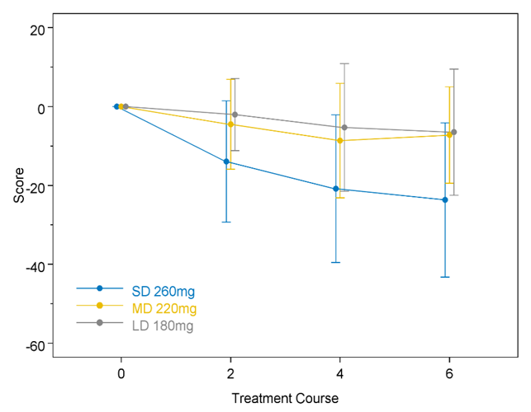
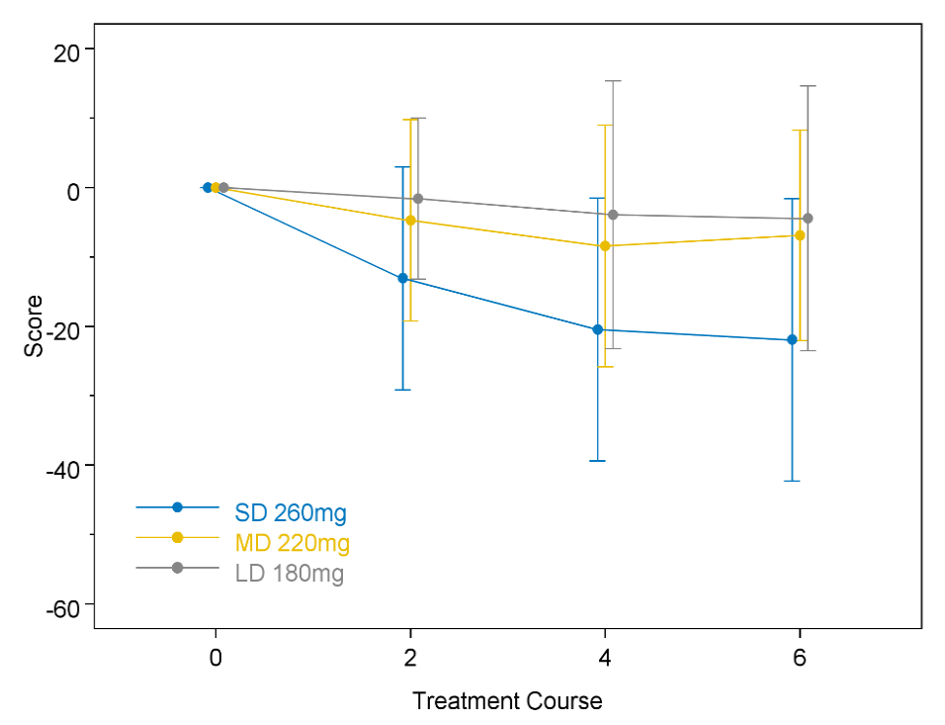
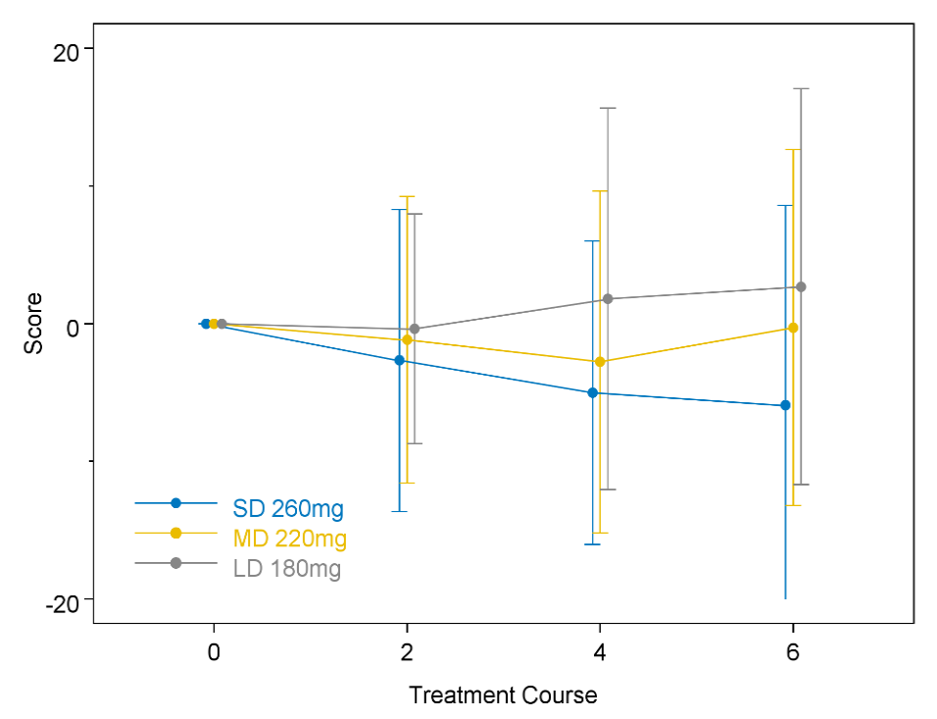
Appendix Figure A1. Mean change from baseline score (FACT-Taxane)
A) FACT-taxane TOI
B) FACT-taxane total score
C) FACT-G total score
D) Taxane sub-scale
Treatment by course (vs. SD 260mg) P-value
MD 220mg by course 0.333
LD 180mg by course 0.011
Appendix Figure A1. Mean changes and 95% confidence interval from baseline for A) Functional Assessment of Cancer Therapy-Taxane trial outcome index (FACT-Taxane TOI), B) FACT-Taxane total, C) FACT-General total, and D) Taxane subscale scores.

Slide 2
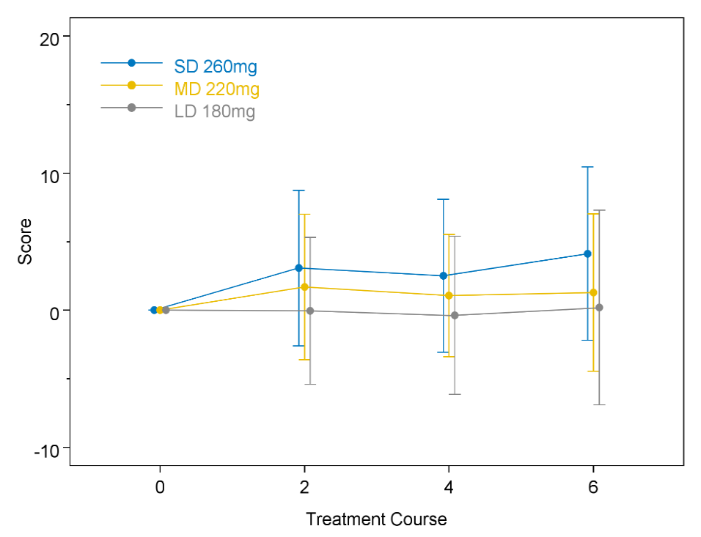
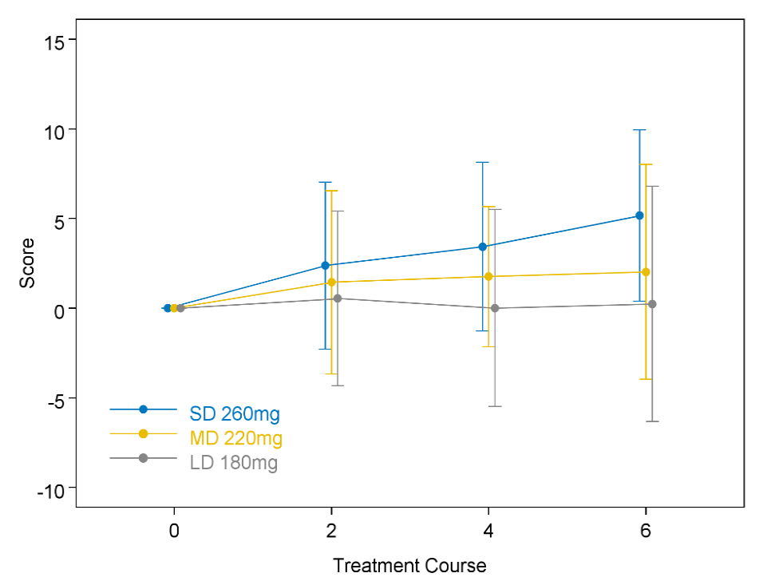
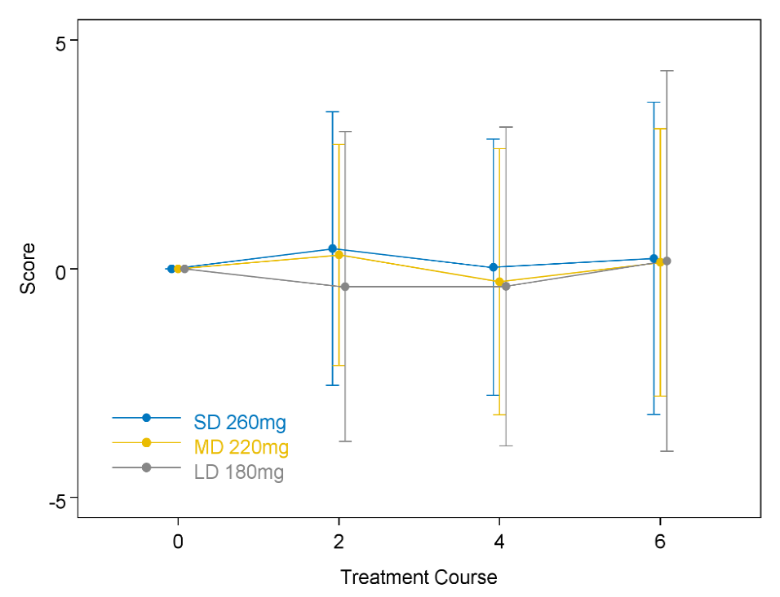
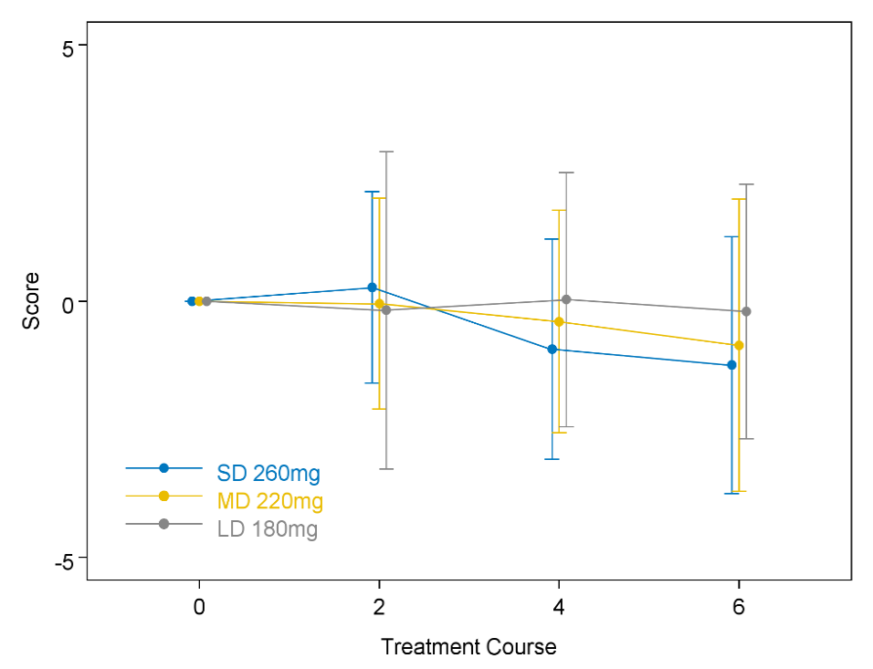
Appendix Figure A2. Mean change from baseline score (CFS)
A) CFS total
B) Physical
C) Affective
D) Cognitive
Appendix Figure A2. Mean changes and 95% confidence interval from baseline for A) Cancer Fatigue Scale (CFS) total, B) Physical, C) Affective, and D) Cognitive subscale scores.

