Slide 1
Supplementary figures

Slide 2
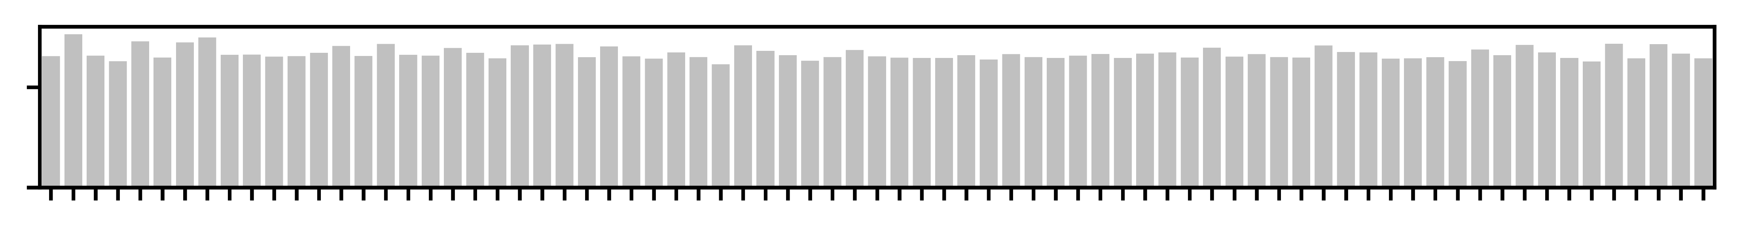
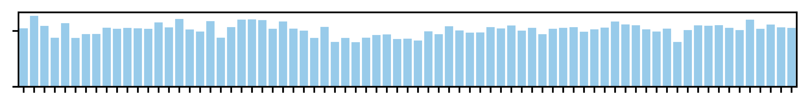
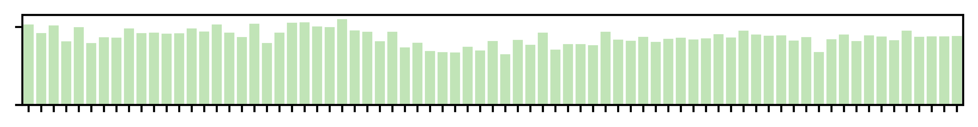
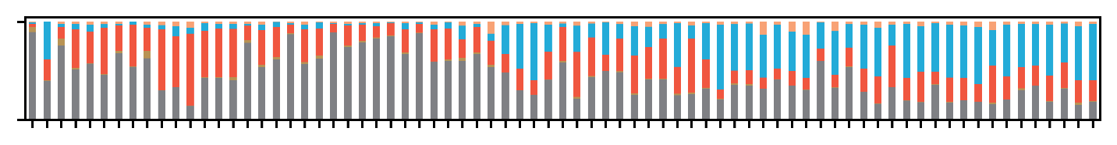
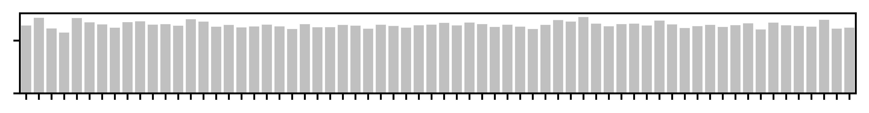
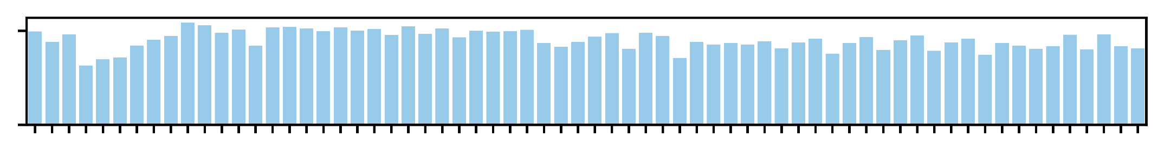
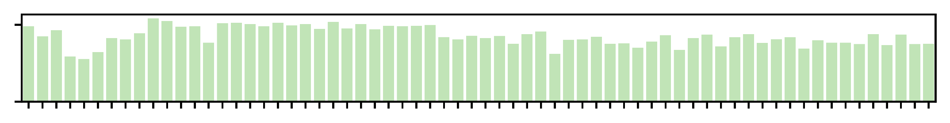
Supplementary Figure 1
A
BCR
Immune-related
Others
Gastric
Small intestine
Large intestine
# Raw
5
# Consensus
0
X 10^{n}
5
# Clone
0
5
0
100
IgM
Clone Fraction (%)
IgD
IgG
IgA
0
CM1
IgE
CM2
CM3
CM1
CM2
CM3
CM1
CM2
CM3
CM1
CM2
CM3
CM1
CM2
CM3
CM1
CM2
CM3
CM1
CM2
CM3
CM1
CM2
CM3
CM1
CM2
CM3
CM1
CM2
CM3
CM1
CM2
CM3
CM1
CM2
CM3
CM1
CM2
CM3
CM1
CM2
CM3
CM1
CM2
CM3
CM1
CM2
CM3
CM1
CM2
CM3
CM1
CM2
CM3
CM1
CM2
CM3
CM1
CM2
CM3
CM1
CM2
CM3
CM1
CM2
CM3
CM1
CM2
CM3
CM1
CM2
CM3
CM1
CM2
CM3
SLN
ALN
HLN
ILN
PBMC
Spleen
Tonsil
MLN
Liver
Ileum
Thymus
Jejunum
Cecum
Rectum
Gallbladder
Gastric body
Duodenum
Bone marrow
Parotid gland
Gastric cardia
Gastric pylorus
Ascending colon
Sigmoid colon
Transverse colon
Descending colon
B
TCR
Immune-related
Gastric
Small intestine
Large intestine
# Raw
5
# Consensus
0
X 10^{n}
5
# Clone
0
5
0
CM1
CM2
CM3
CM1
CM2
CM3
CM1
CM2
CM3
CM1
CM2
CM3
CM1
CM2
CM3
CM1
CM2
CM3
CM1
CM2
CM3
CM1
CM2
CM3
CM1
CM2
CM3
CM1
CM2
CM3
CM1
CM2
CM3
CM1
CM2
CM3
CM1
CM2
CM3
CM1
CM2
CM3
CM1
CM2
CM3
CM1
CM2
CM3
CM1
CM2
CM3
CM1
CM2
CM3
CM1
CM2
CM3
CM1
CM2
CM3
CM1
CM2
CM3
CM1
CM2
CM3
PBMC
Spleen
Tonsil
SLN
ALN
HLN
MLN
ILN
Ileum
Thymus
Jejunum
Cecum
Rectum
Bone marrow
Gastric body
Duodenum
Gastric cardia
Gastric pylorus
Ascending colon
Sigmoid colon
Transverse colon
Descending colon
Supplementary Figure 1. Overview of the pan-tissue datasets acquired via ultra-deep AIRR sequencing, related to Figure 1
(A and B) Summary of BCR (A) and TCR (B) data along the bioinformatics pipeline. The y-axis shows log10-transformed numbers. The x-axis shows the samples. Isotypes of BCR are color coded as shown in the bottom right. The labels on top of the bar plots show the tissue groups. PBMC, Peripheral blood mononuclear cell.

Slide 3
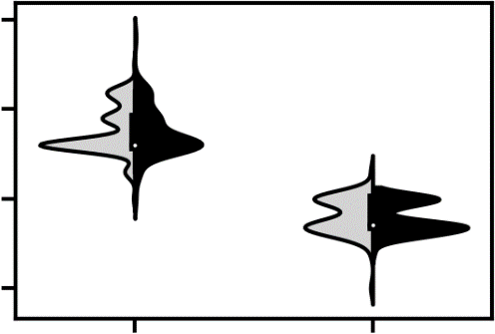
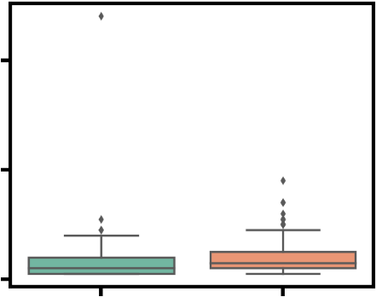
Supplementary Figure 2
A
310
B
Known
300
Novel
40
The length of IGHV and TRBV alleles
Number of SNP(s)
290
20
280
0
IGHV
TRBV
IGHV
TRBV
C
15
76 IGHVs
10
FR1
CDR1
FR2
CDR2
FR3
5
0
1
31
61
91
121
151
181
211
241
271
301
Number of novel alleles with SNP(s)
114 TRBVs
15
FR1
CDR1
FR2
CDR2
FR3
10
5
0
1
31
61
91
121
151
181
211
241
271
301
IMGT positions
D
76 IGHVs
E
114 TRBVs
100
SNP
4
SNP
250
SNP
5
SNP
80
SAP
3
SAP
200
SAP
4
SAP
60
150
3
Length normalized numbers of SNP and SAP
Total numbers of SNP and SAP
Length normalized numbers of SNP and SAP
Total numbers of SNP and SAP
2
100
40
1
2
20
50
1
0
0
0
0
FR1
CDR1
FR2
CDR2
FR3
FR1
CDR1
FR2
CDR2
FR1
FR3
CDR1
FR2
CDR2
FR3
FR1
CDR1
FR2
CDR2
FR3
Supplementary Figure 2. Characteristics of the novel IGHV and TRBV alleles, related to Figure 2
(A) Comparisons of the length distributions of known (light gray) and novel (black) alleles.
(B) Distributions of SNP numbers in novel alleles.
(C) The positional distribution of the number of polymorphic alleles along with the V genes for IGHV (top) and TRBV (bottom) in CM. The x-axis shows the position according to the IMGT numbering system (Lefranc 2003). The y-axis shows the number of novel allele(s) with SNP(s). Frame reading and complementarity diversity regions are marked on the top.
(D and E) Unnormalized (left) and length normalized (right) distributions of SNPs (light gray) and SAPs (dark gray) with regard to different regions of IGHV (D) and TRBV (E). The left y-axis shows the total number (left panel) and length-normalized number (right panel) of SNPs and SAPs. Note that the 5’ most 24bp overlap with the PCR primers and were not counted (See STAR Methods).

Slide 4
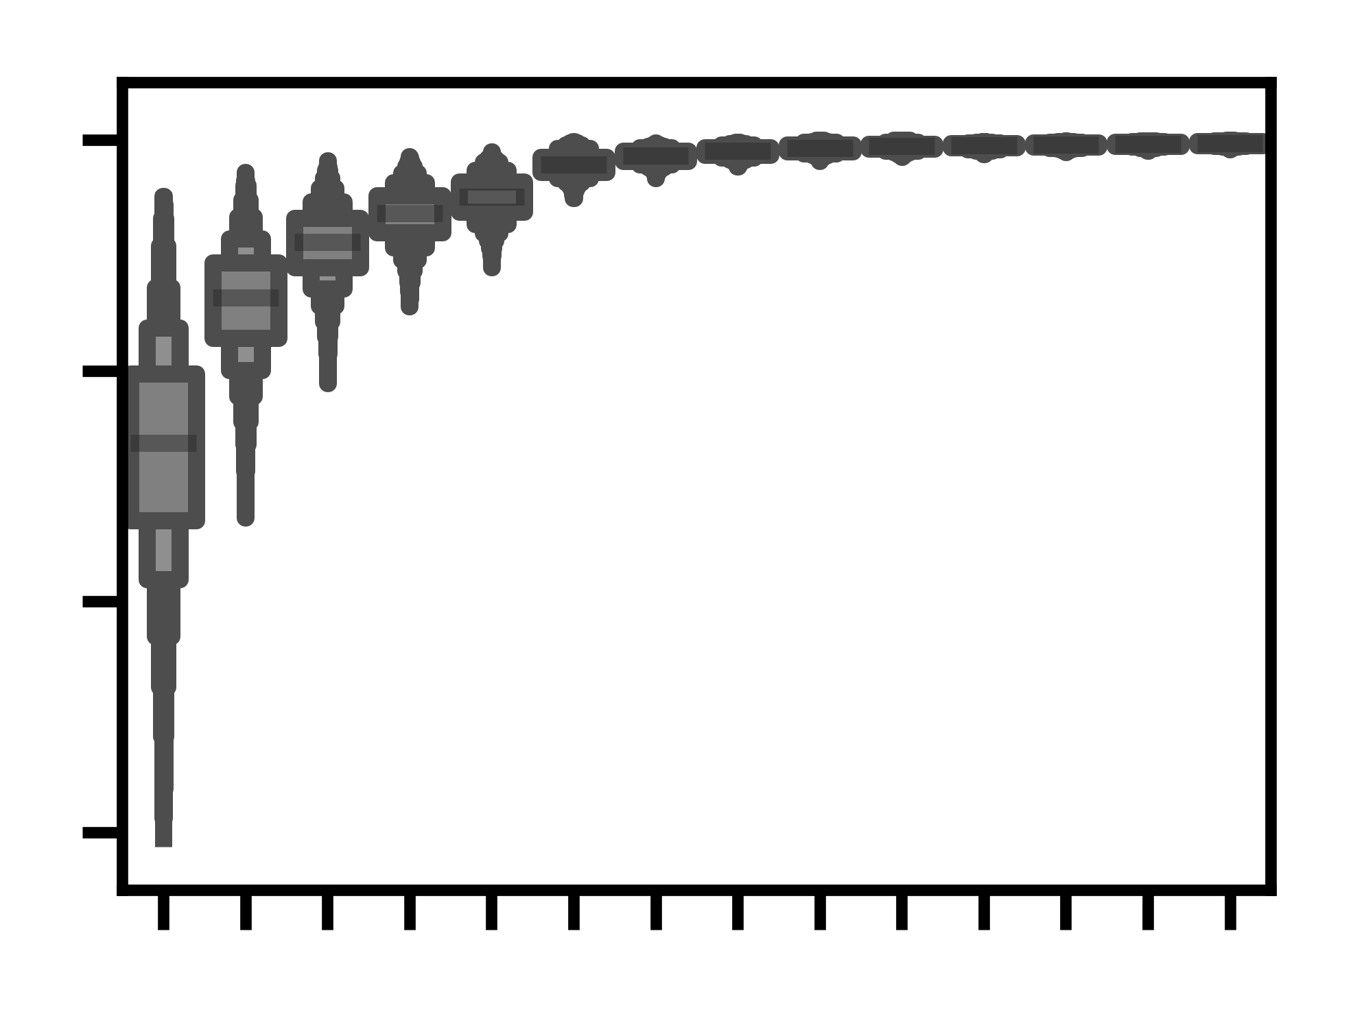
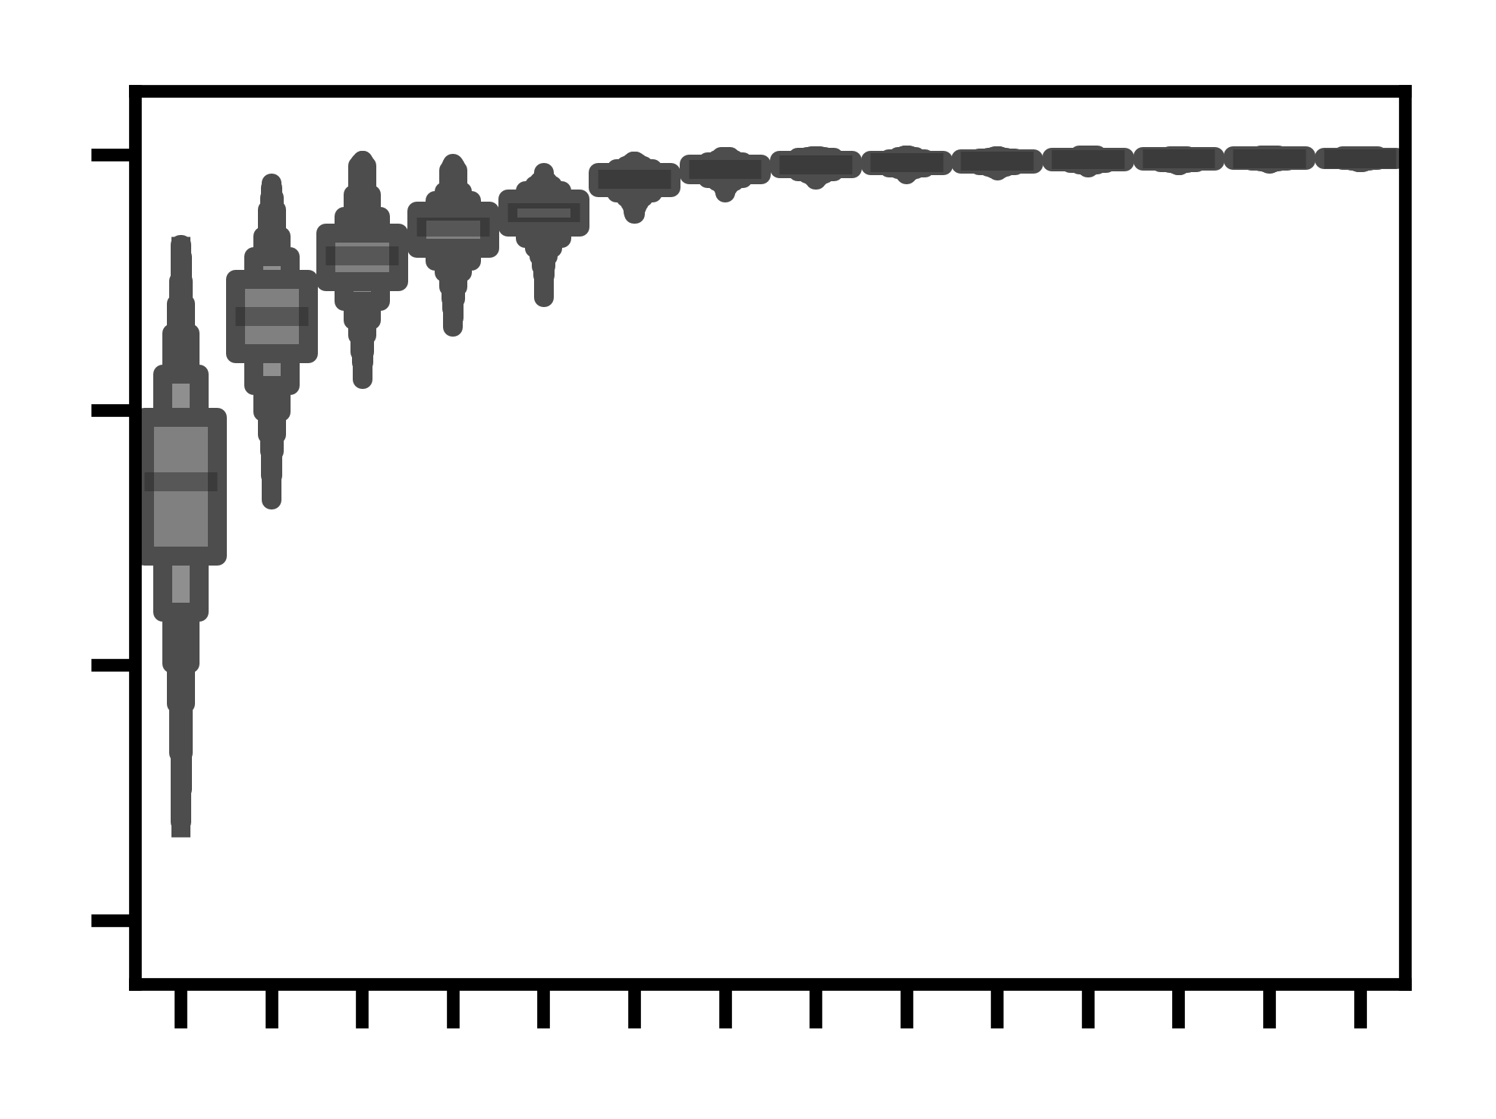
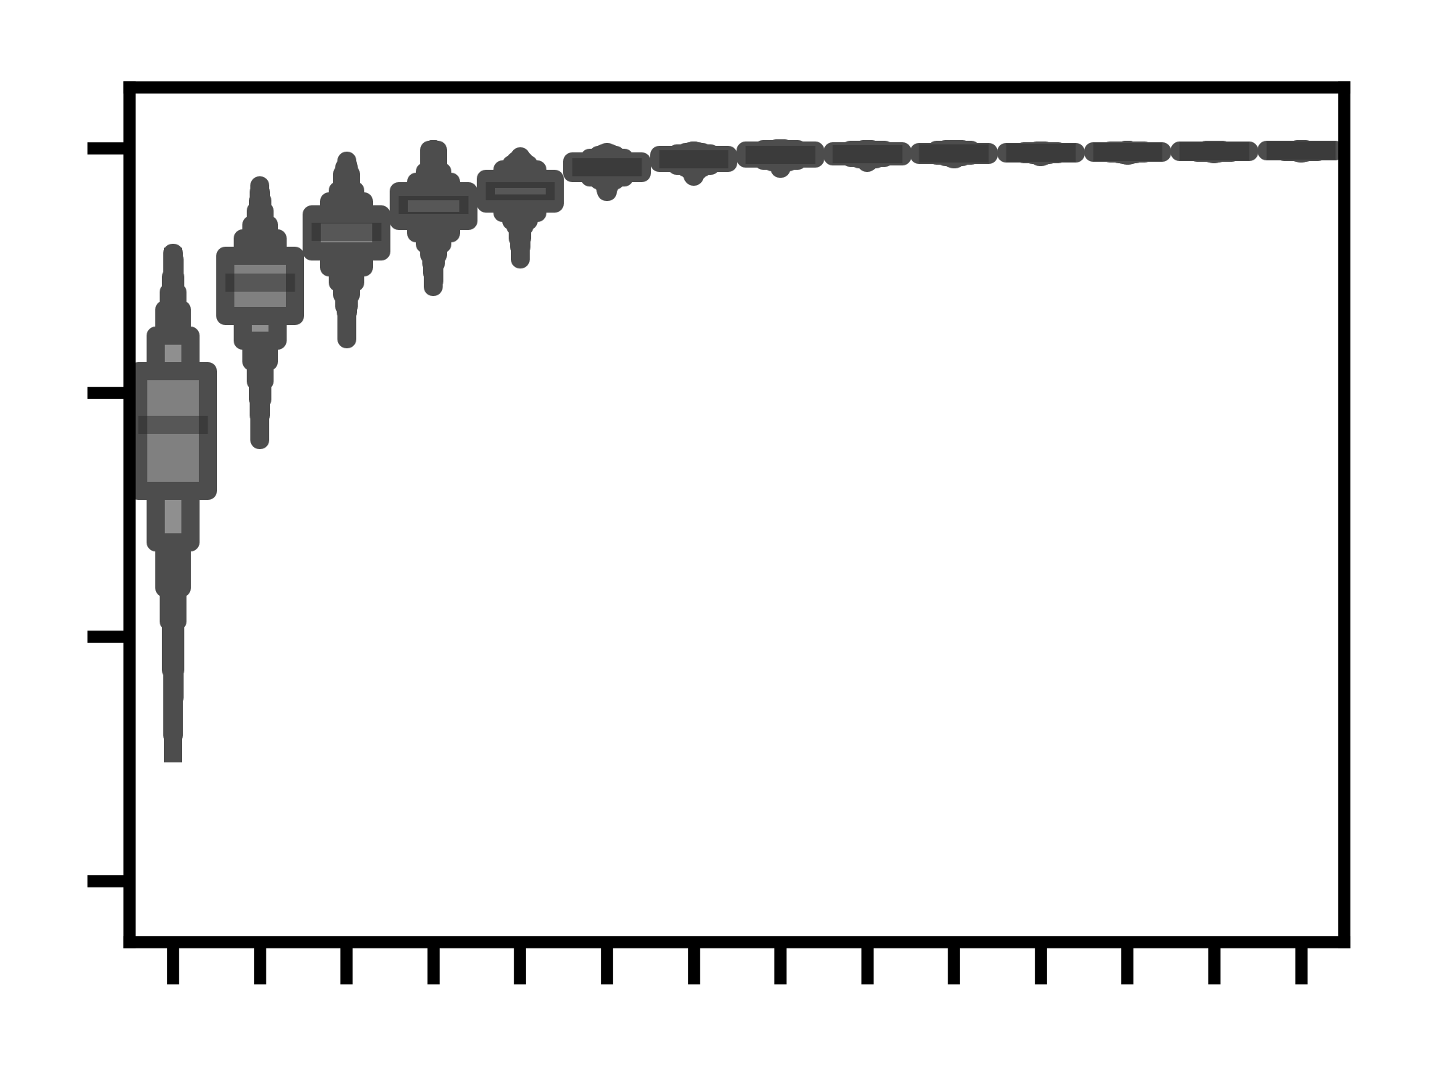
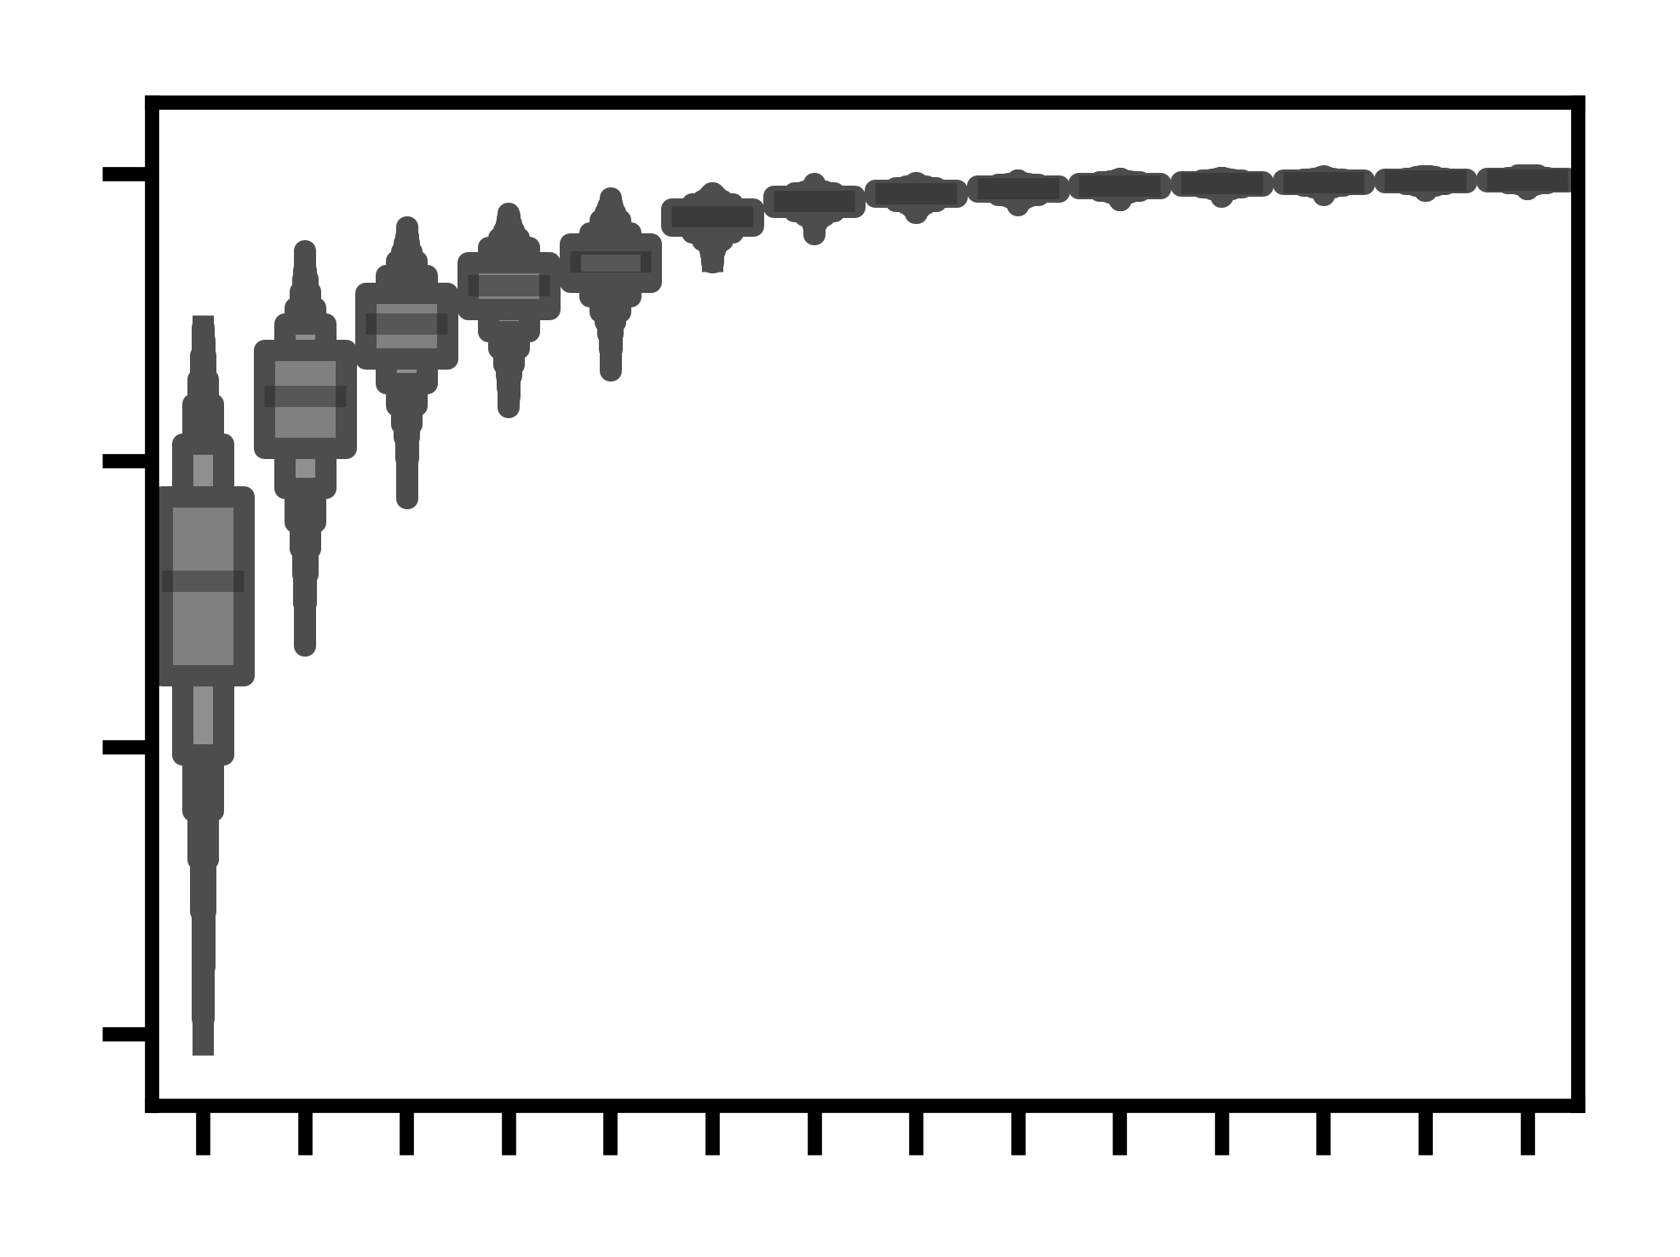
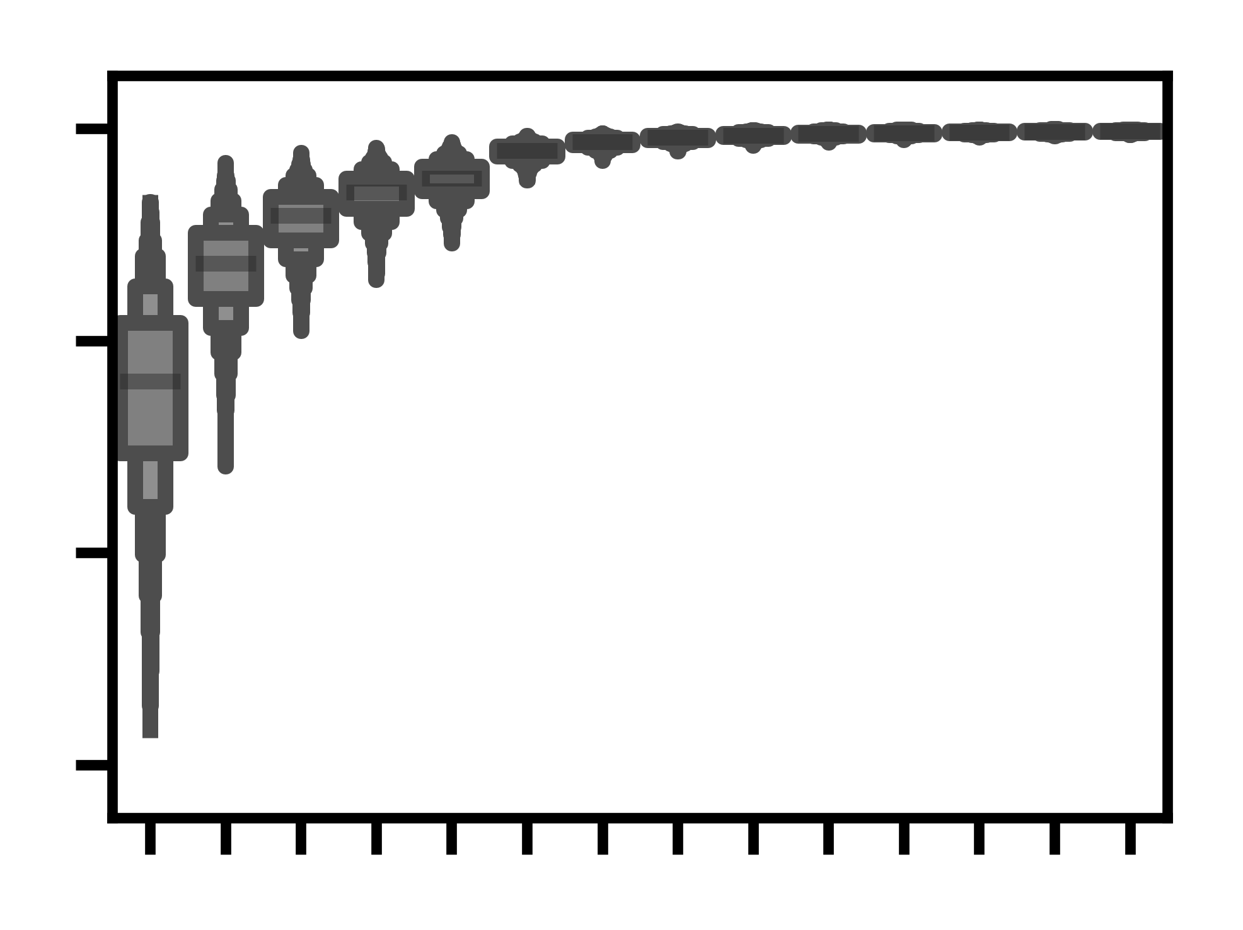
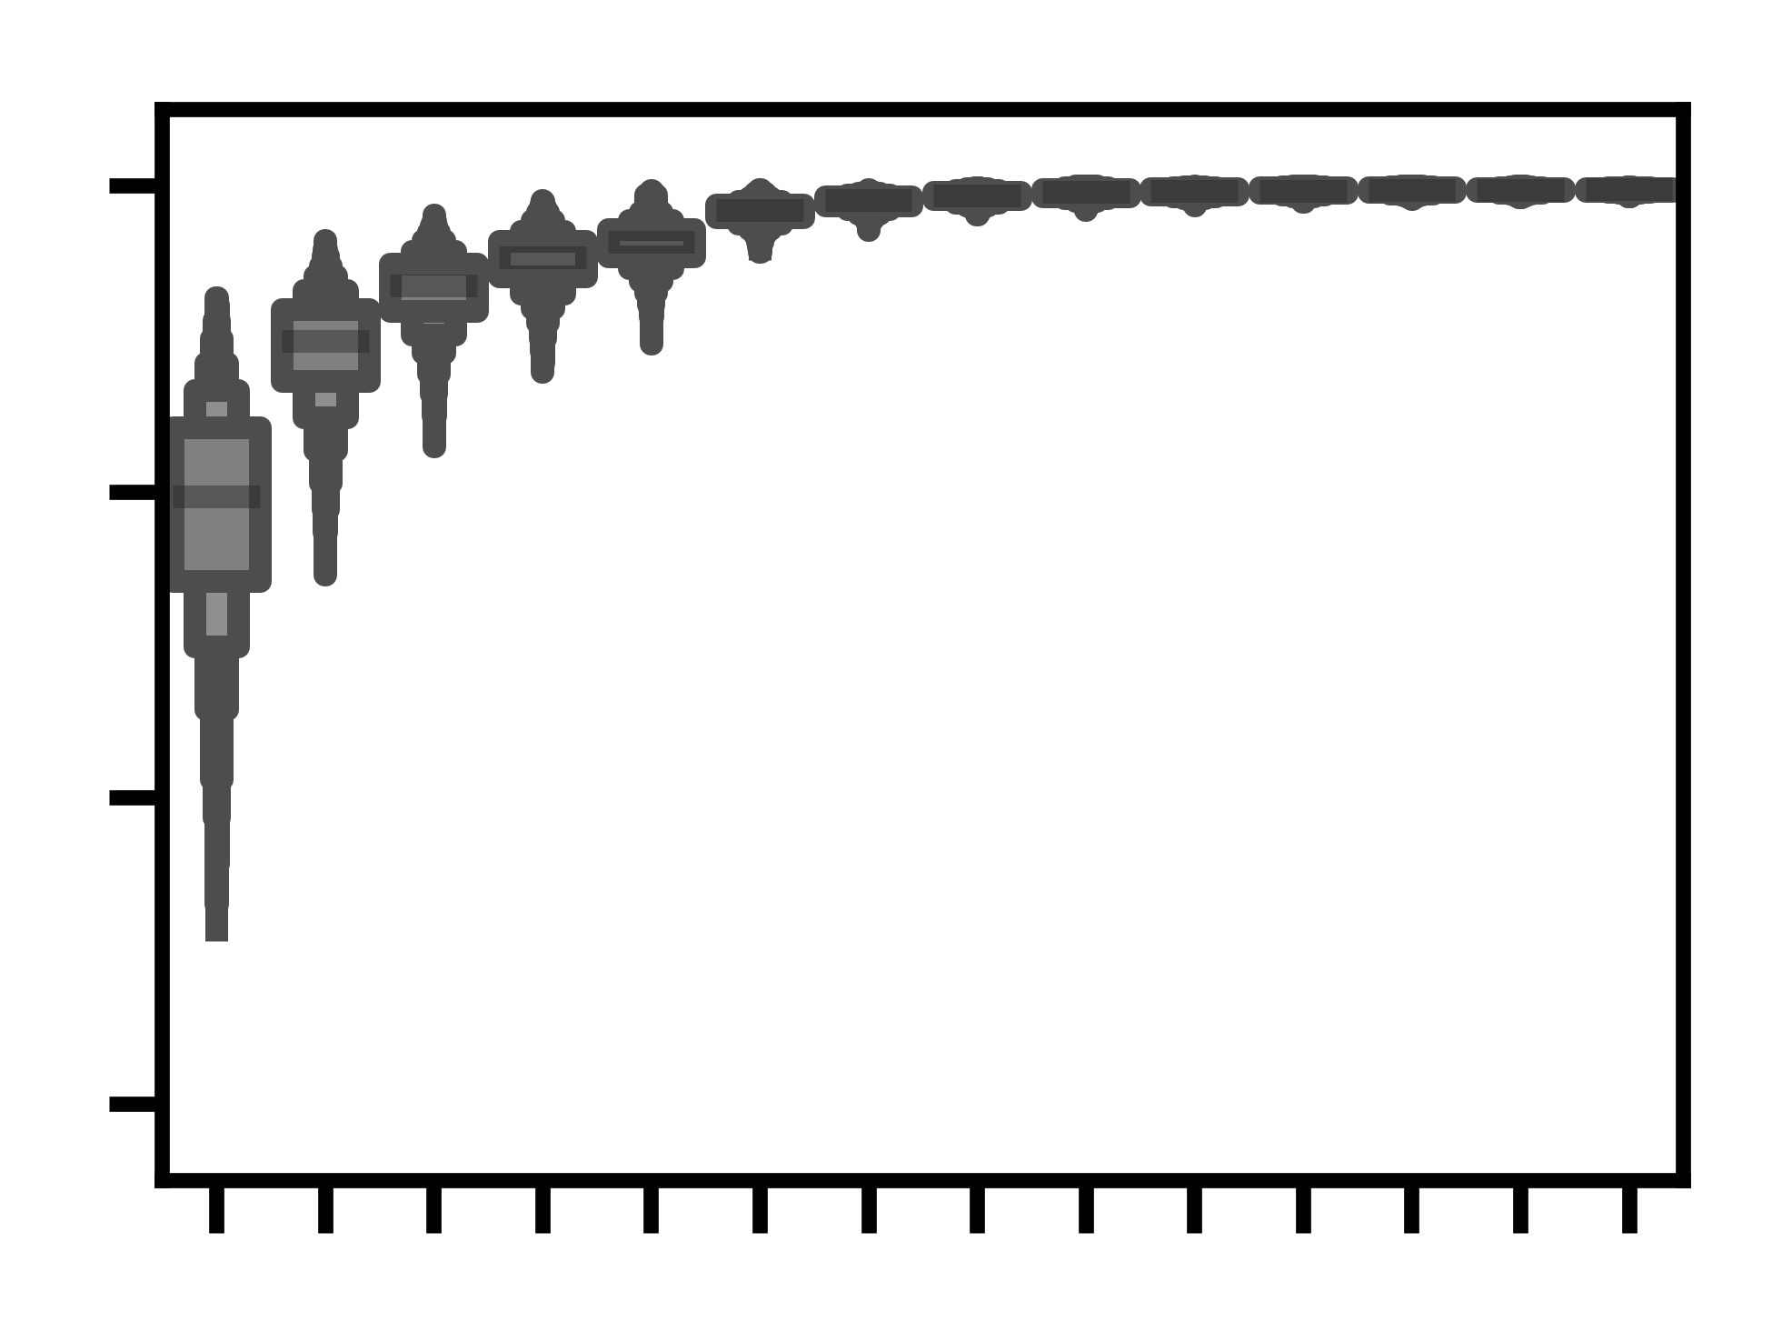
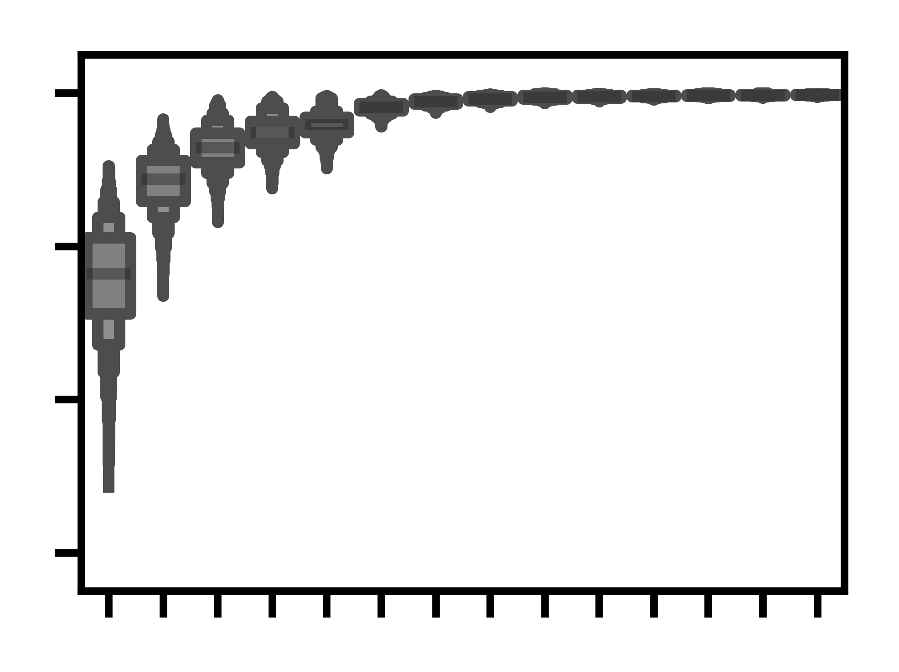





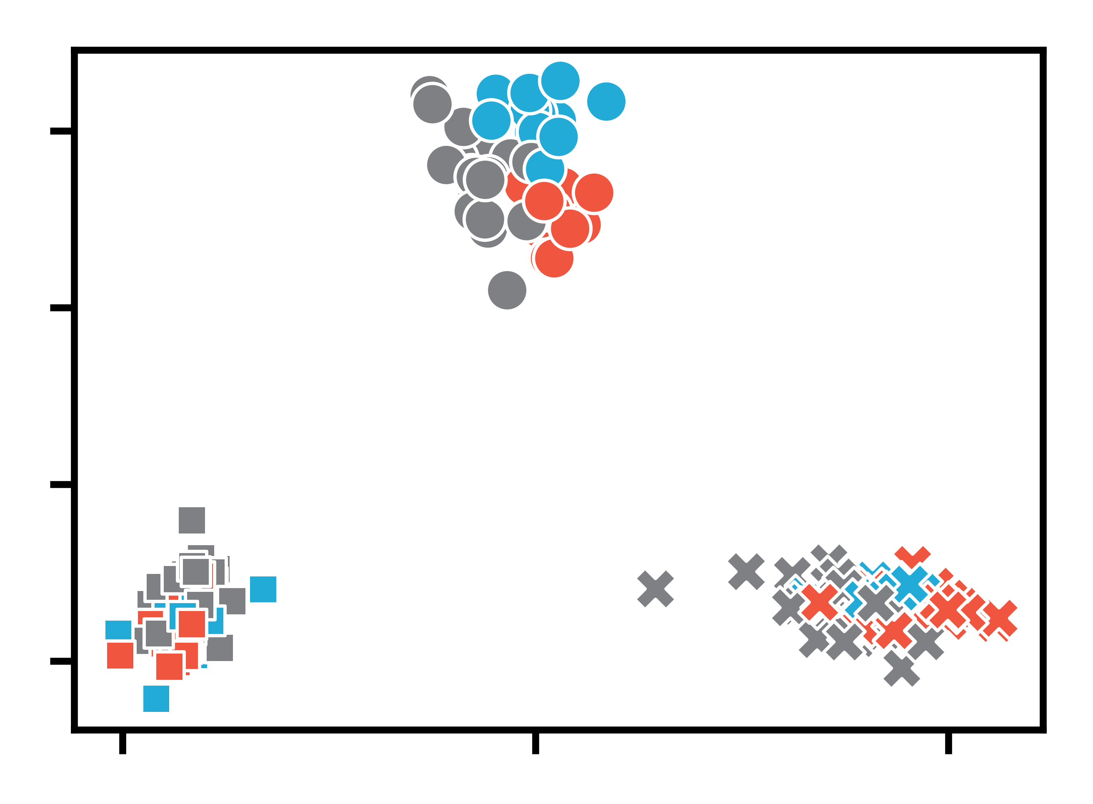
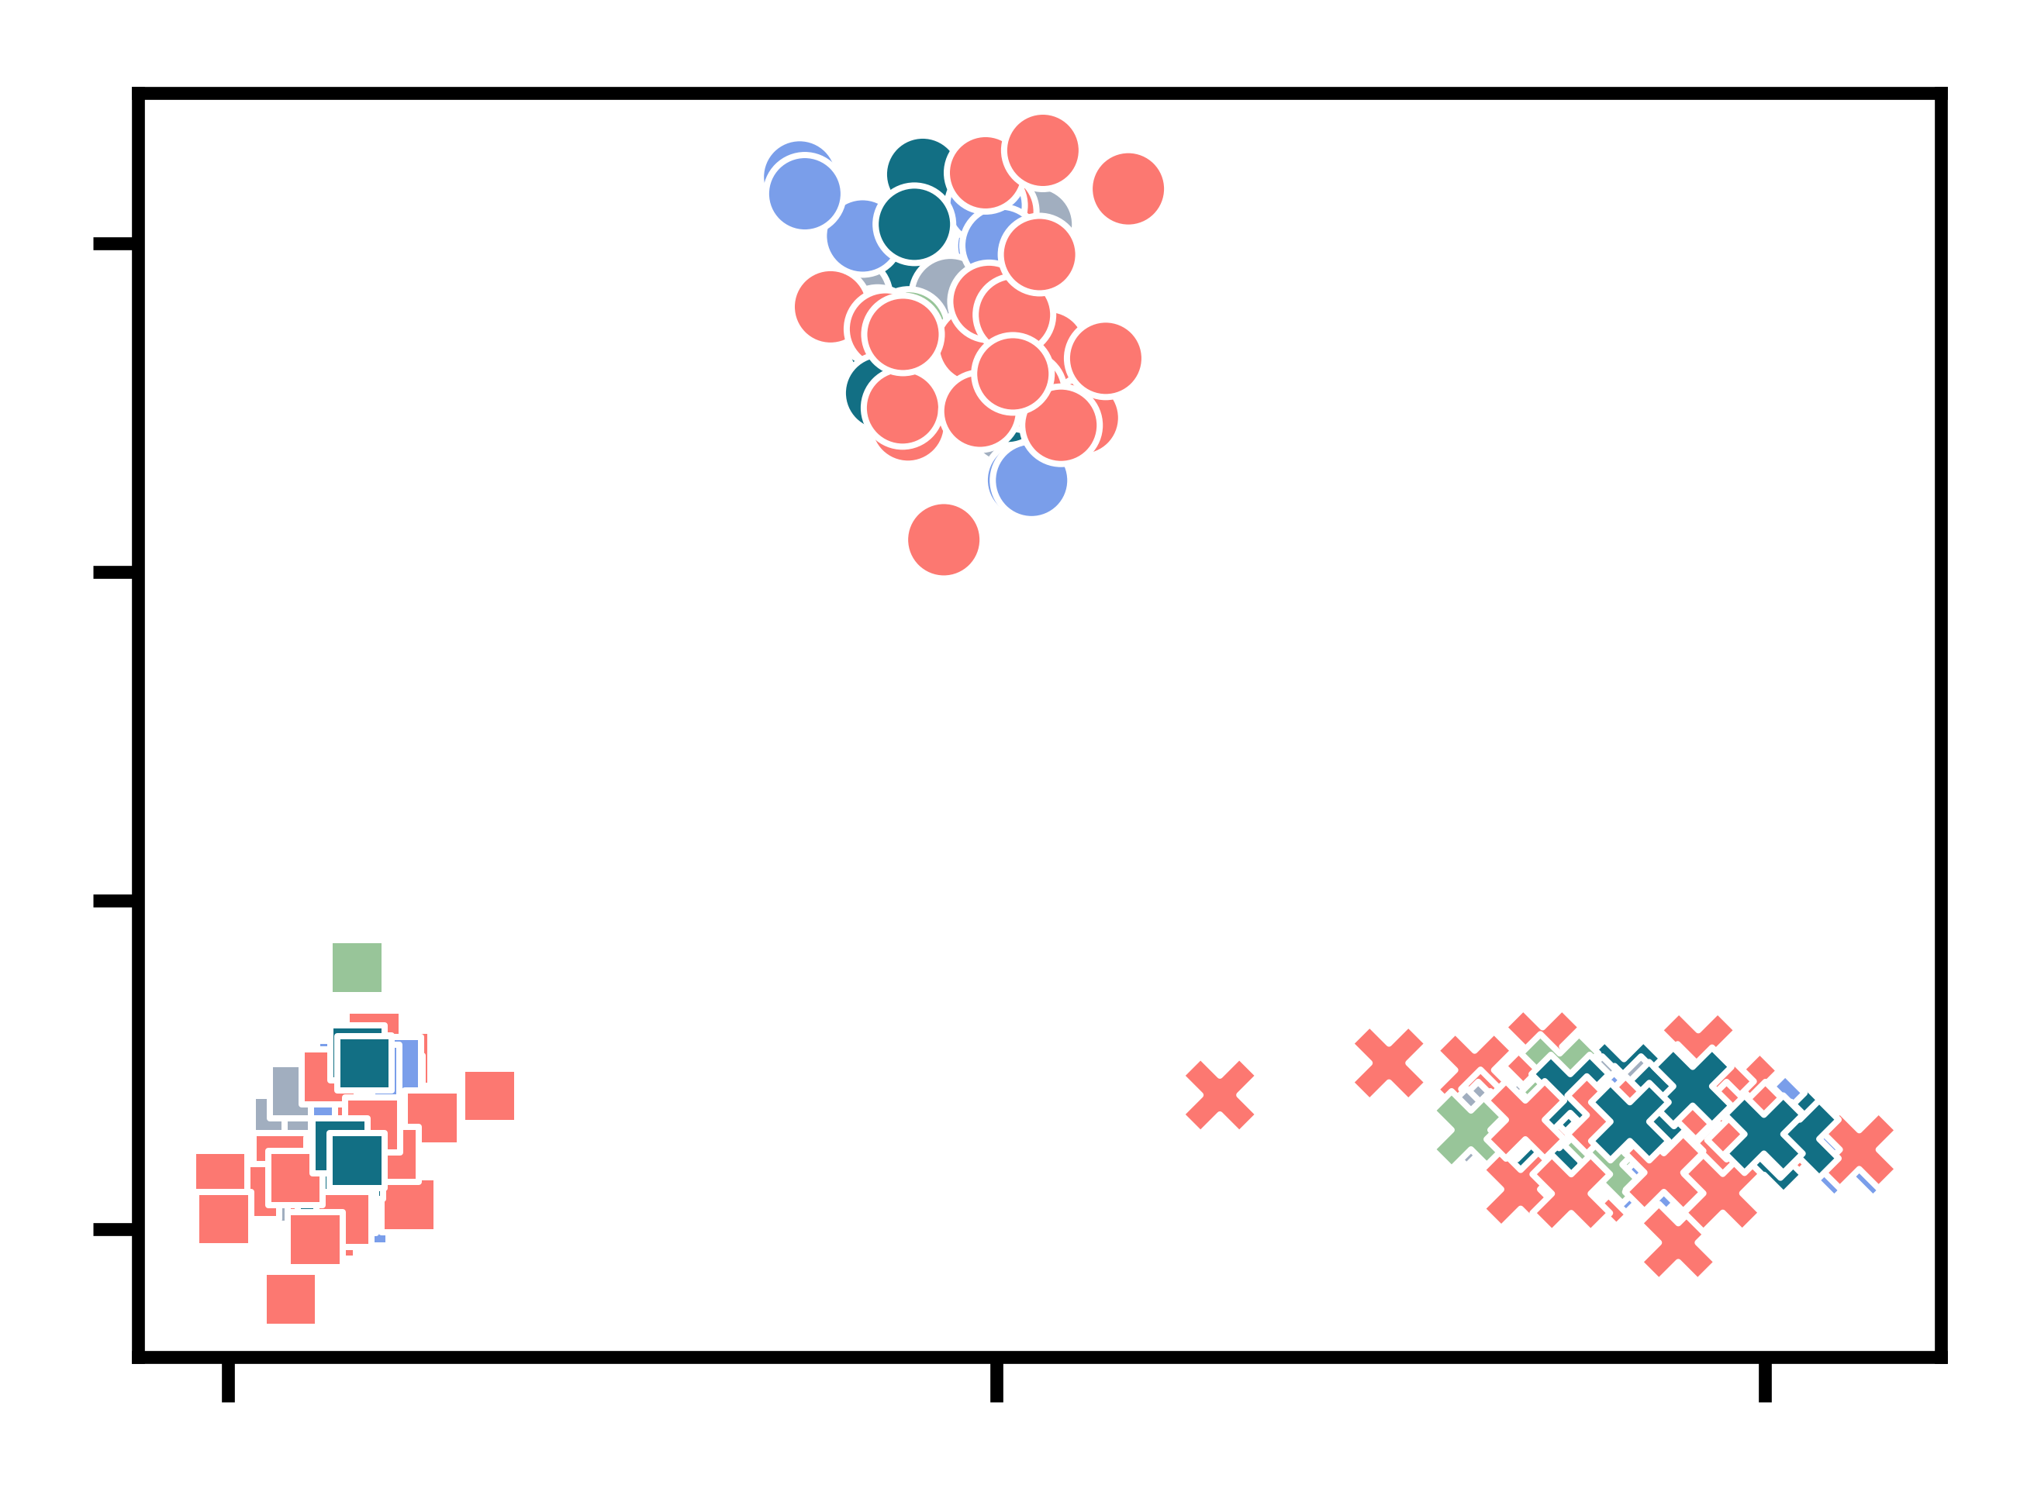
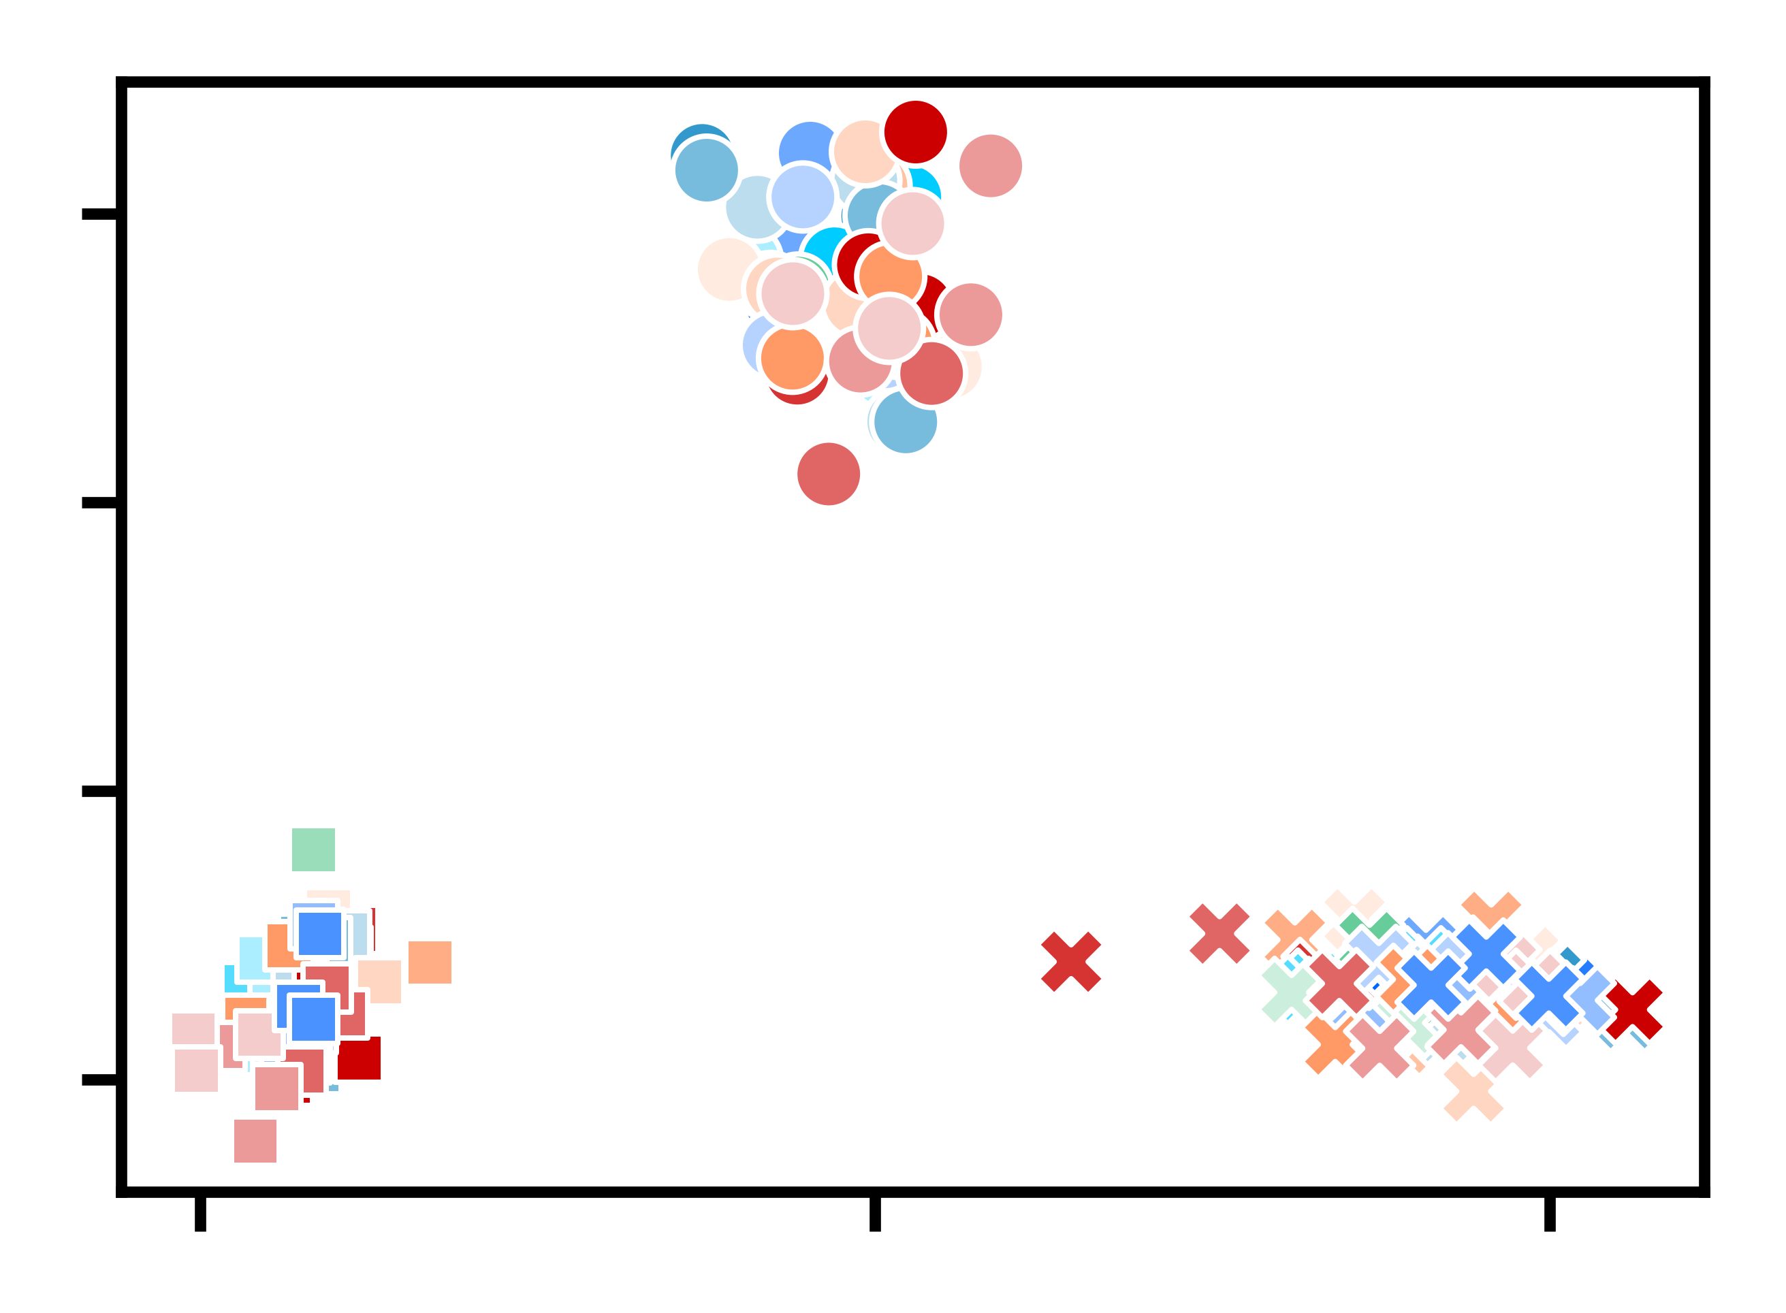
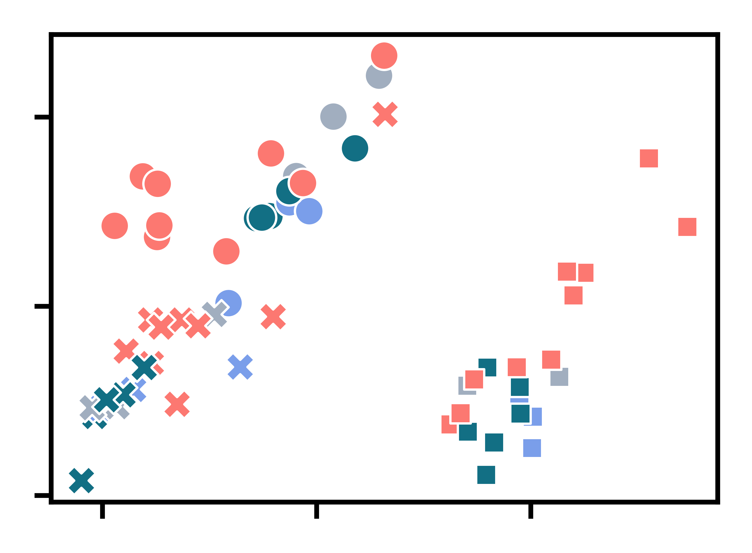
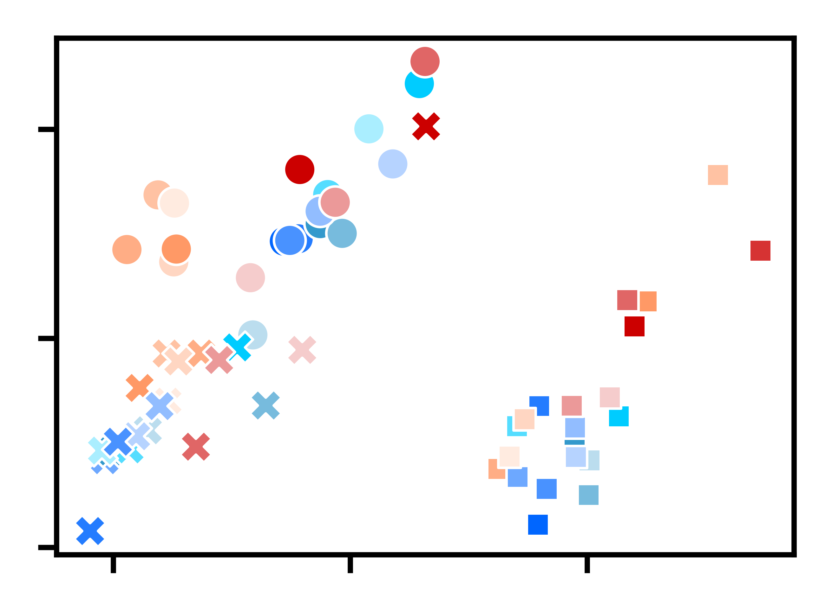

Supplementary Figure 3
A
IgM
IgG
IgA
TRB
1.0
0.8
CM1
0.6
0.4
1.0
0.8
The Pearson correlation coefficient of V gene usage
between each subsample and sample
CM2
0.6
0.4
1.0
0.8
CM3
0.6
0.4
100
200
300
400
500
100
200
300
400
500
100
200
300
400
500
100
200
300
400
2500
5000
5000
5000
500
5000
3000
3500
4000
4500
2500
3000
3500
4000
4500
2500
3000
3500
4000
4500
2500
3000
3500
4000
2000
2000
2000
2000
4500
1500
1500
1500
1500
1000
1000
1000
1000
Number of clones sampled
B
Isotype (BCR)
C
Tissue group (BCR)
D
Tissue (BCR)
0.10
0.10
0.10
PC2 (26.83%)
PC2 (26.83%)
PC2 (26.83%)
0.05
0.05
0.05
0.00
0.00
0.00
-0.05
-0.05
-0.05
-0.10
0.00
0.10
-0.10
0.00
0.10
-0.10
0.00
0.10
PC1 (43.54%)
PC1 (43.54%)
PC1 (43.54%)
E
F
Isotype
Immune-related
Tissue group (TCR)
Tissue (TCR)
IgM
IgG
0.05
0.05
IgA
Donor
ALN
HLN
MLN
PBMC
Spleen
SLN
ILN
Thymus
PC2 (20.13%)
PC2 (20.13%)
CM1
Bone marrow
Tonsil
CM2
0.00
0.00
CM3
Small
intestine
Large
intestine
Others
Gastric
-0.05
-0.05
0.00
0.05
-0.05
-0.05
0.00
0.05
Liver
Ileum
PC1 (39.45%)
PC1 (39.45%)
Gallbladder
Jejunum
Cecum
Rectum
Gastric cardia
Duodenum
Sigmoid colon
Gastric body
Parotid gland
Gastric pylorus
Ascending colon
Transverse colon
Descending colon
Supplementary Figure 3. Analysis of the factors that affect V gene usage, related to Figure 3
(A) Pearson correlation coefficient of V gene usage between each subsample and sample. The x-axis represents the subsample size, and the y-axis represents the Pearson correlation coefficient (see STAR Methods).
(B-F) PCA results for the features that affect the V gene usages. The X and Y axes show principal components 1 and 2, and the numbers in the parenthesis indicate the percent variation. Group information is shown at the bottom right.

Slide 5
Supplementary Figure 4
Public clones
A
All clones
B
20
20
Percentage of clones (%)
Percentage of clones (%)
15
IgM
15
10
IgD
10
5
IgG
5
IgA
0
IgE
0
≤5
10
15
20
≥25
≤5
10
15
20
≥25
CDR3 length (aa)
CDR3 length (aa)
Supplementary Figure 4. CDR3 length distribution of BCR repertoire, related to Figure 4
(A and B) Isotype-specific CDR3 length distributions for all (A) and public clones (B) (aa: amino acid).

Slide 6
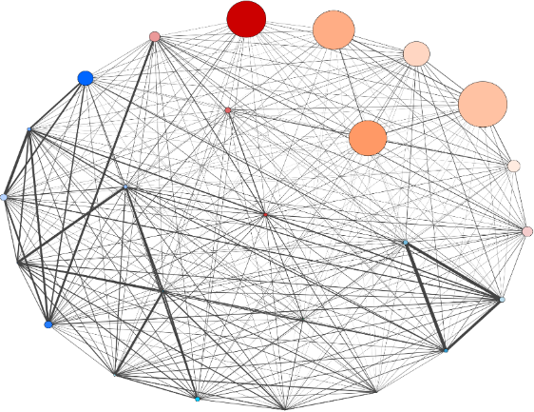
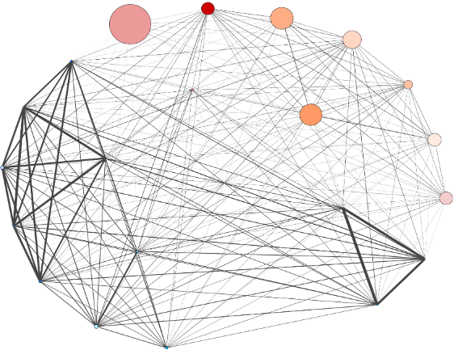
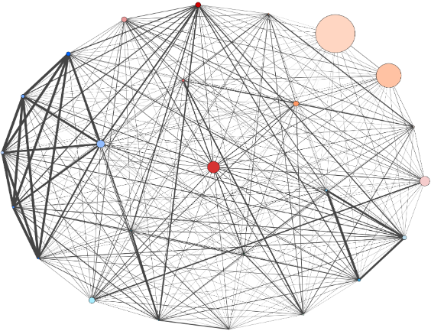
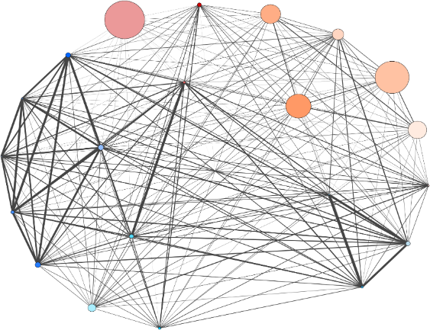
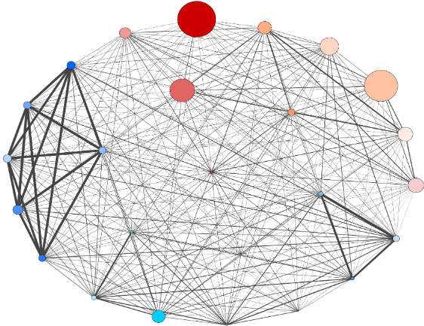
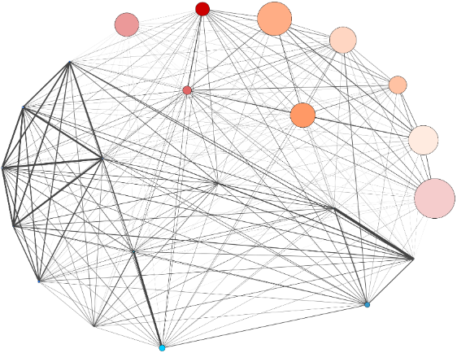
BCR
Supplementary Figure 5
BCR
TCR
Thymus
PBMC
ALN
Thymus
PBMC
ALN
MLN
Cecum
Spleen
MLN
Cecum
Spleen
HLN
Descending colon
SLN
HLN
Descending colon
SLN
Rectum
Sigmoid colon
ILN
Rectum
Sigmoid colon
ILN
CM1
Bone marrow
Jejunum
Tonsil
Bone marrow
Jejunum
Tonsil
Transverse colon
Gastric body
Ileum
Transverse colon
Gastric body
Ileum
Ascending colon
Liver
Duodenum
Ascending colon
Duodenum
Gastric pylorus
Parotid gland
Gastric pylorus
Gastric cardia
Gallbladder
Gastric cardia
Thymus
PBMC
ALN
Thymus
PBMC
ALN
Cecum
MLN
Cecum
MLN
Descending colon
Spleen
SLN
HLN
Descending colon
Spleen
SLN
HLN
Rectum
Sigmoid colon
ILN
Rectum
Sigmoid colon
ILN
CM2
Bone marrow
Jejunum
Tonsil
Bone marrow
Jejunum
Tonsil
Transverse colon
Gastric body
Ileum
Transverse colon
Gastric body
Ileum
Ascending colon
Liver
Duodenum
Ascending colon
Gastric pylorus
Parotid gland
Gastric pylorus
Duodenum
Gastric cardia
Gastric cardia
Gallbladder
Thymus
PBMC
ALN
Thymus
PBMC
ALN
MLN
Cecum
MLN
Cecum
Spleen
HLN
Descending colon
Spleen
SLN
HLN
Descending colon
SLN
CM3
Rectum
Sigmoid colon
Bone marrow
ILN
Rectum
Sigmoid colon
Bone marrow
ILN
Transverse colon
Jejunum
Tonsil
Transverse colon
Jejunum
Tonsil
Ascending colon
Gastric body
Liver
Ileum
Ascending colon
Gastric body
Ileum
Gastric pylorus
Duodenum
Gastric pylorus
Duodenum
Gastric cardia
Parotid gland
Gastric cardia
Gallbladder
Gallbladder
Supplementary Figure 5. Characteristics of clonal distribution similarities between tissues for different individuals, related to Figure 5
Network diagrams showing the clonal distribution similarities (Sørensen-Dice index) between each pair of tissues in the BCR (left) and TCR (right) repertoires for each CM. Each node represents a tissue, and the node size represents the number of clones in each tissue. The width of the line represents the degree of similarity between repertoires from two tissues.

Slide 7
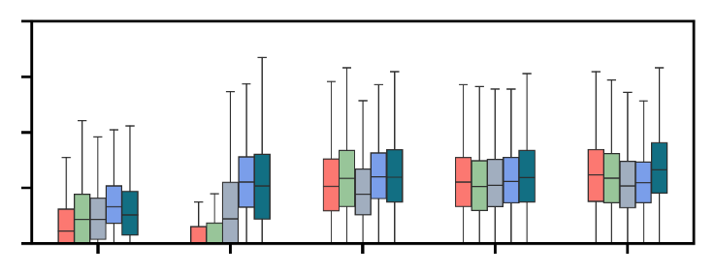
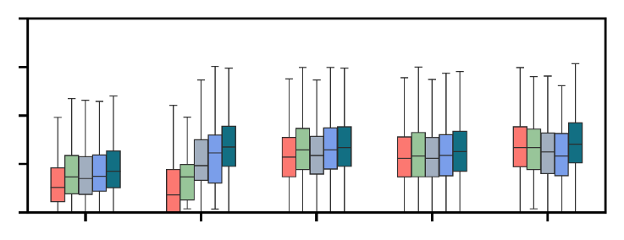
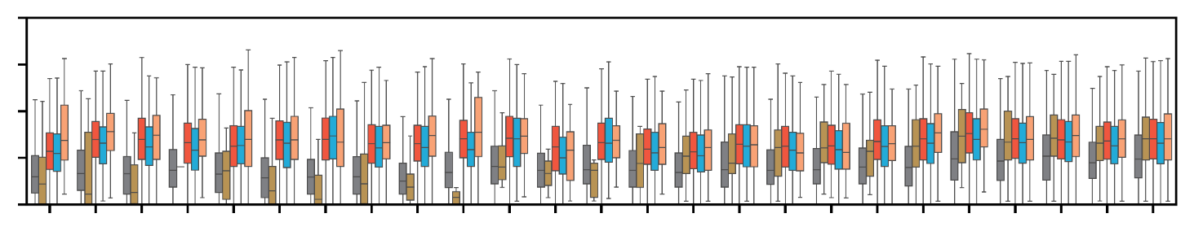
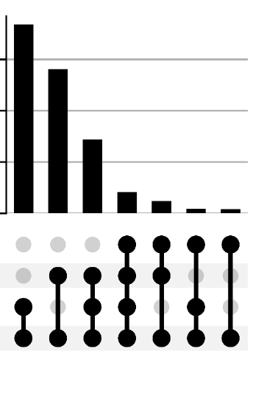

Supplementary Figure 6
Public clones
A
All clones
B
SHM rate (%)
20
20
15
SHM rate (%)
15
10
10
5
5
0
IgM
IgD
IgG
IgA
IgE
0
IgM
IgD
IgG
IgA
IgE
Immune-related
Others
Gastric
Small intestine
Large intestine
C
Immune-related
Others
Gastric
Small intestine
Large intestine
20
SHM rate (%)
15
IgM
10
IgD
5
IgG
IgA
0
Bone marrow
Thymus
Gallbladder
Parotid gland
Gastric cardia
Gastric body
Gastric pylorus
Duodenum
Jejunum
Ascending colon
Transverse colon
Descending colon
Sigmoid colon
IgE
PBMC
Spleen
Tonsil
SLN
ALN
HLN
MLN
ILN
Liver
Ileum
Cecum
Rectum
D
E
0.43%
# Clones (× 10⁴)
0.5
Supplementary Figure 6. Somatic hypermutation rate of BCR repertoires, related to Figure 6
(A and B) The isotype-specific SHM rate distribution of all clones (A) and public clones (B) for different tissue groups (color codes shown below).
(C) The isotype-specific SHM rate distributions for each tissue. Isotypes are color-coded as shown to the right. Tissue groups are indicated on the top.
(D) The distribution of clones shared among IgMD and switched isotypes for individual specific clones. The dots connected with lines indicate clones shared in different isotypes labeled to the left. The bar chart to the left showing the total number of clones in each isotype and the bar chart on the top indicating the clone numbers for different combinations of isotypes.
(E) Bar chart showing the percentage of known clones collected in RAPID of inter-tissue shared (light blue) and tissue-specific (gray) public clones.
1.5
Percentage of known clones in RAPID (%)
1.0
0.4
0.5
0.3
0.24%
0
0.2
IgE
0.1
IgG
0
IgA
Inter-tissue shared
Tissue specific
IgMD
2.5
0
# Clones
(× 10⁴)

