Slide 1
Additional file 1: Table S1 Correlation coefficients of floral traits
Traits | Spikelets with exserted stigma | Stigma length | Pistil length | Internal angle of stigma lobes
Spikelets with exserted stigma (%) | 1.00 | 0.86** | 0.78* | -0.38*
Stigma length |  | 1.00 | 0.95** | -0.52**
Pistil length |  |  | 1.00 | -0.52**
Internal angle of stigma lobes |  |  |  | 1.00
* α=0.05 level of significance and ** α=0.01 level of significance

Slide 2
Additional file 2: Table S2 List of newly designed polymorphic InDel markers with their sequence and product sizes
Marker name | Forward primer sequence (5´ to 3´) | Reverse primer sequence (5´ to 3´) | Expected product size for Nipponbare (bp) | Expected product size for OL (bp)
PA08-01 | TCCAGCTCAGAATGTGCTCAG | AGTGCTATCAACTGTCGAGT | 312 | 274
PA08-02 | TGGCCATCCCATGAATGCTG | AGTGGGTCTAGCTAGGTTAC | 237 | 191
PA08-03 | GCTCTCTACATGCCCTCGTC | CCGTGTGTTGGTAGGTCAGA | 190 | 147
PA08-05 | AATTGTTCCGGTGGACTCAT | TTAGAATGCACCCCATGTTCT | 276 | 230
PA08-06 | GGTGGCGACGTTAGCTTAAA | AAAAAGCCAGAGCAGCATGT | 224 | 201
PA08-09 | ATGCGTCCACTCACGAAATGG | GCTAGTATATAGTTCGTACGCACG | 198 | 161
PA08-11 | GTGCTGCATGTGAGGACAAT | TCTGTTCCTGTAACGCATCG | 205 | 177
PA08-12 | ACTCCACAAAAGGCAGTTGG | AATGGTCCAAGGTGTGCATT | 263 | 236
PA08-16 | TGCCCATTTTTCAATTCTACG | ACTAAACCACCATGCCGTTG | 141 | 113
PA08-17 | TGTTGGGTATTCTTCCAGACG | AAGAGTTTTTGGCGGGCTAT | 257 | 233
PA08-18 | GATCAATGTTTGGTCACCATCC | GTAGTCTCCTGCAATATCCC | 220 | 188
PA08-19 | GGTGTTGTAGGTTGCCGTTT | CTGGCAAGCTACTGTTTTAG | 215 | 188
PA08-20 | GATTGCATCTGCATCACTGC | CCACCTGACCAACCTGTTTT | 190 | 154
PA08-21 | CCCTTTTCCTTCTTCCACCT | GAAGCTGGCATTGAAGAGTT | 282 | 255

Slide 3
Additional file 3: Table S3 Background genotyping analysis of the improved maintainer and CMS lines using high resolution Infinium 7K SNP chip
NILs | Recurrent parent | No. of polymorphic SNPsª | No. of SNP alleles |  |  | Percent recurrent parent genome recovery | Stigma length (mm)
 |  |  | Recurrent parent | OL | Hetero SNPs
91A-18 | IR58025B | 1536 | 1407 | 129 | 17 | 92.21 | 2.18
91B-12 |  | 1536 | 1415 | 121 | 1 | 92.43 | 2.43
91B-42 |  | 1536 | 1416 | 120 | 1 | 92.43 | 2.22
107A-35 | IR68897B | 1549 | 1386 | 163 | 154 | 94.48 | 2.61
107B-12 |  | 1549 | 1373 | 166 | 7 | 90.35 | 2.08
W70B-12 |  | 1549 | 1280 | 269 | 8 | 83.87 | 2.38
W70B-42 |  | 1549 | 1282 | 267 | 8 | 83.89 | 2.14
ª Total number of polymorphic SNPs between donor and recurrent parents

Slide 4
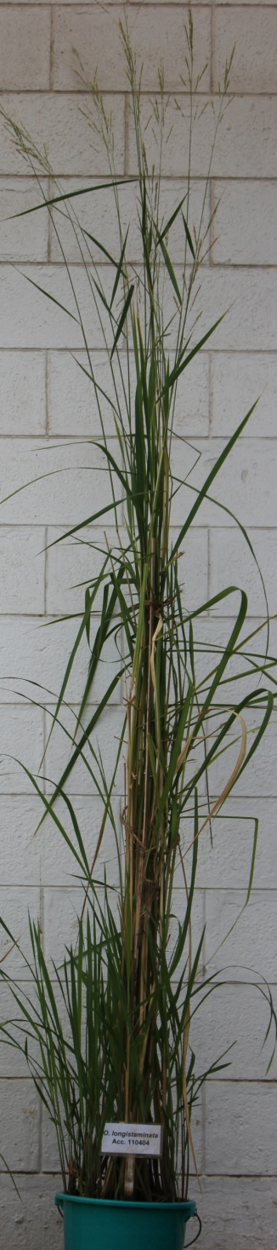
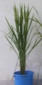
IR64
×
O. longistaminata (IRGC110404)
F₁
×
IR64
BC₁F₁
×
IR64
BC₂F₁
BC₂F₂
(357)
Additional file 4: Figure S1 Breeding scheme depicting the development of mapping population derived from IR64 × OL(IRGC110404)

Slide 5
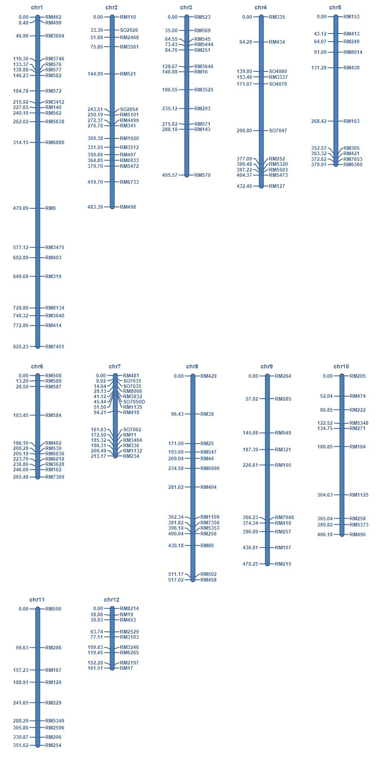
Additional file 5: Figure S2 Genetic map of BC₂F₂ mapping population derived from IR64 × OL (IRGC110404). Left side of each linkage group indicates the position of each marker in cM, whereas right side of the linkage group indicate markers name

Slide 6
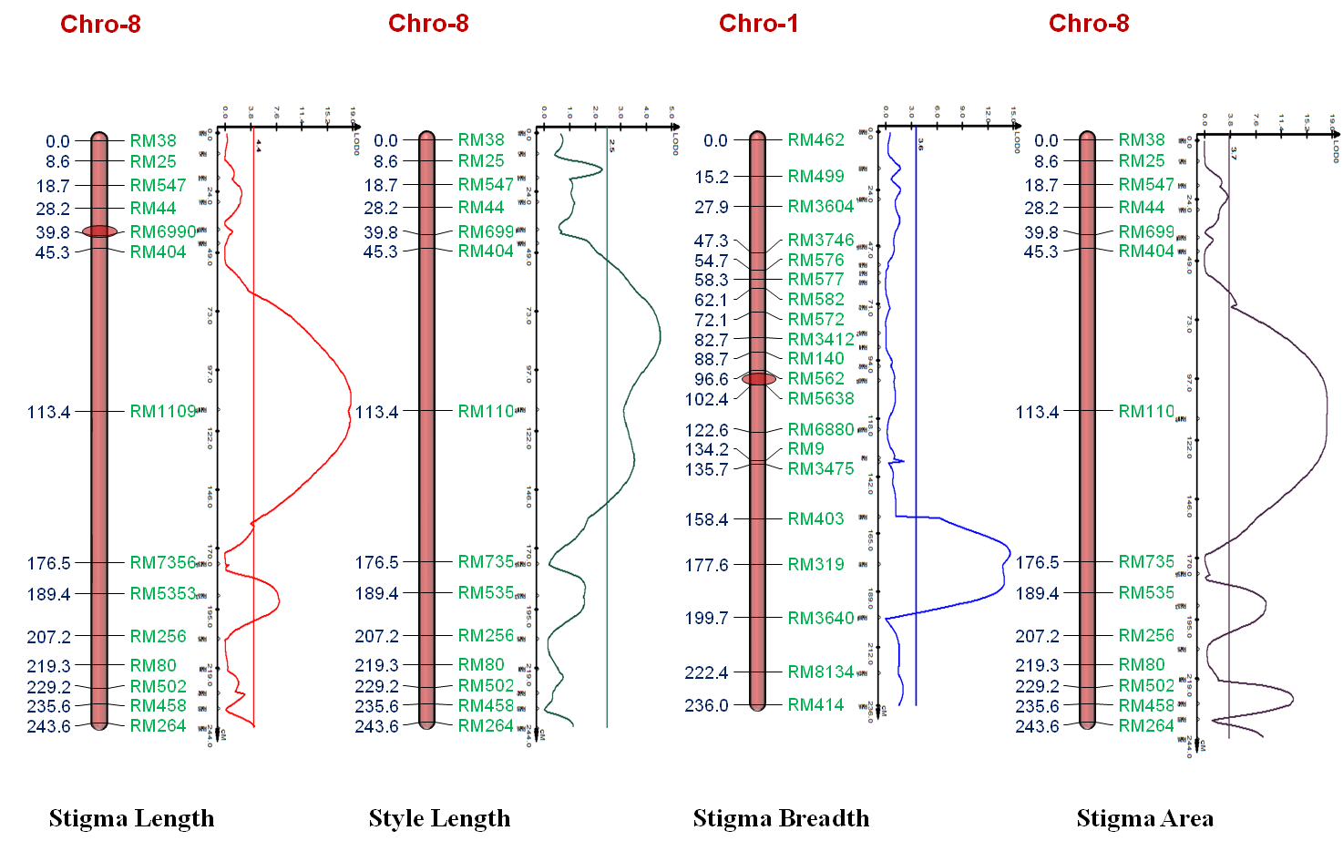
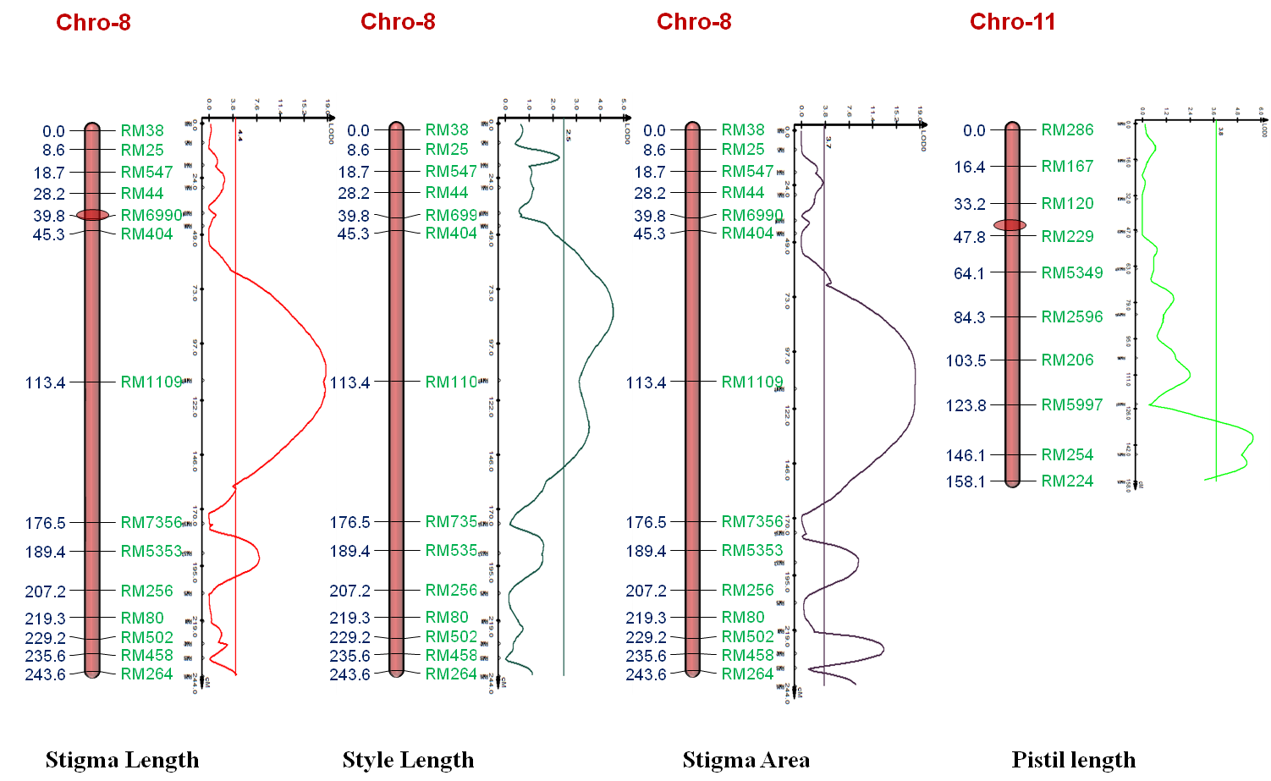
a
LOD
b
LOD
c
LOD
12
9
6
3
0
15
11
7
3
0
4
3
2
1
0
d
LOD
54
48
36
24
12
0
Chromosome-11
Chromosome-8
Chromosome-1
Chromosome-8
Additional file 6: Figure S3 QTLs detected from 357 BC₂F₂ genotypes derived from an IR64 × OL cross conferring (a) style length, (b) stigma breadth, (c) stigma area, and (d) pistil length using 164 SSR and STS markers.

Slide 7
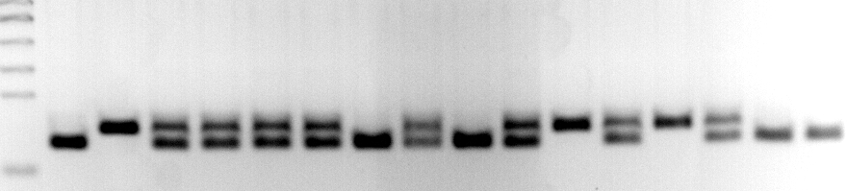
OL
Ladder
BC2F3-1
BC2F3-2
BC2F3-3
BC2F3-4
BC2F3-5
BC2F3-6
BC2F3-7
BC2F3-8
BC2F3-9
BC2F3-10
BC2F3-11
BC2F3-12
BC2F3-13
BC2F3-14
IR-64
220bp
188bp
GENOTYPE
B A H H H H B H B H A H A H B B
Long
Short
Long
Long
Long
Long
Long
Long
Long
Long
Short
Long
Long
Long
Long
Long
PHENOTYPE
(Stigma length)
Additional file 7: Figure S4 Agarose (3%) gel image showing the BC₂F₃ co-segregation pattern of the new PA08-18 InDel marker predicted to link to qSTGL8.0. Marker alleles were scored as A for IR64 alleles, B for OL alleles, and H for heterozygous alleles of IR64 and OL for genotype score assessment. Phenotype below the genotype scores indicates length of the phenotype of the respective BC₂F₃ individuals.

Slide 8
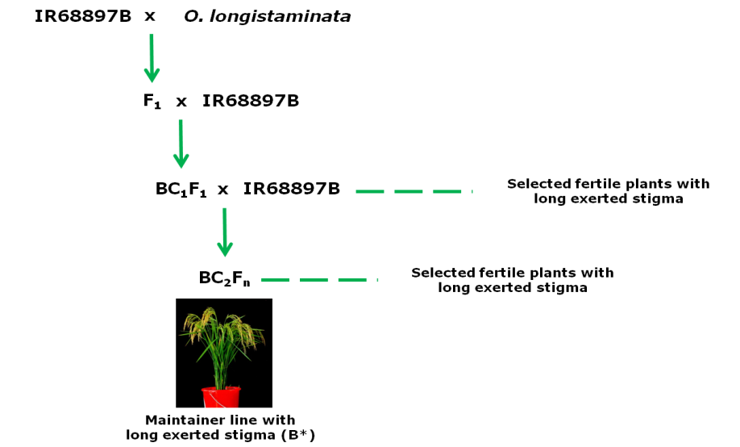
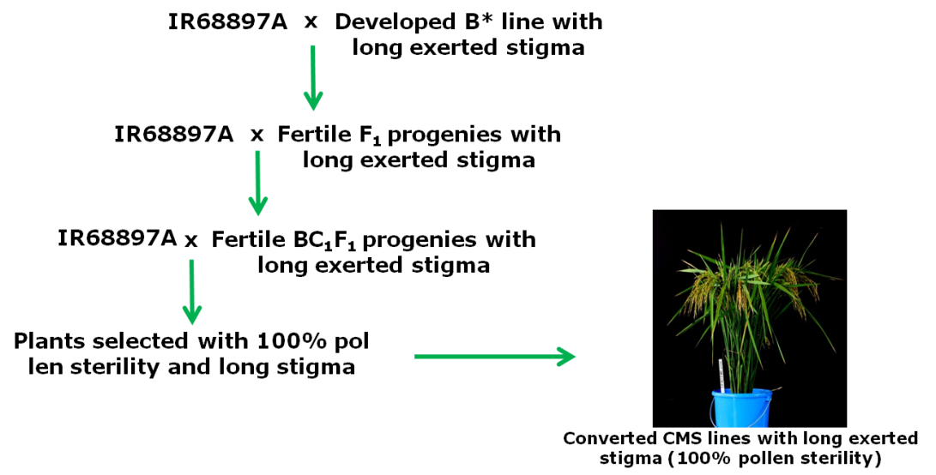
a
(IRGC92664)
b
Additional file 8: Figure S5 Schematic diagram showing the breeding scheme of an IR68897B × OL (IRGC92664) cross for the development of improved maintainer (a) and CMS lines (b) with long-exserted stigma and higher outcrossing rate than recurrent parents IR68897B and IR68897A, respectively. The same breeding scheme was used for an IR58025B × OL (IRGC110404) cross to develop long-exserted stigma lines in IR58025B and IR58025A backgrounds.

Slide 9
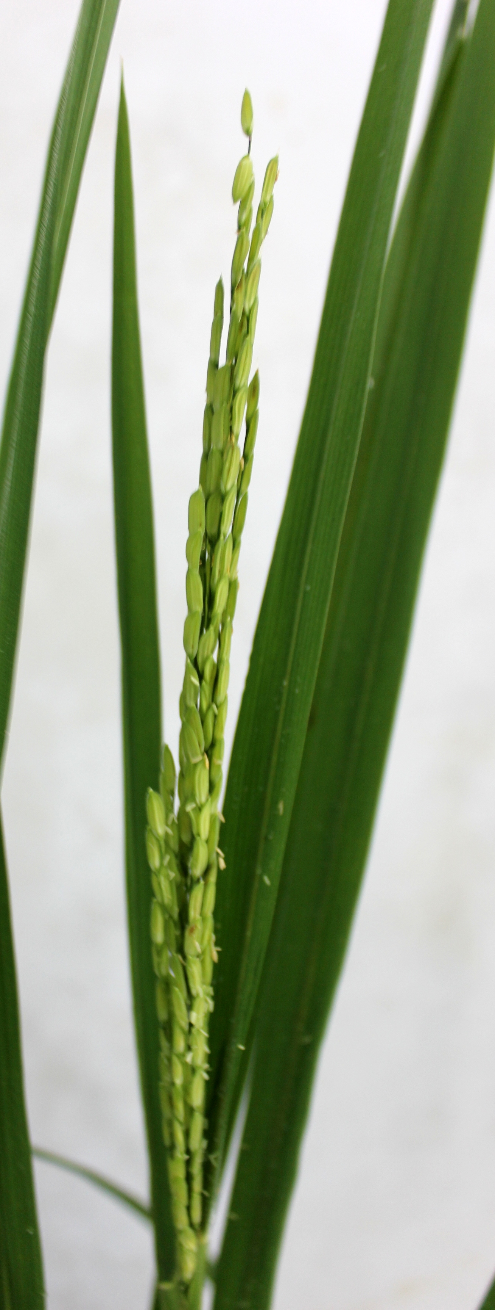
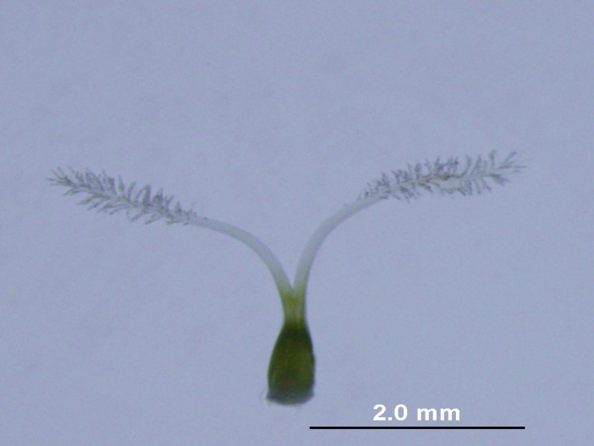
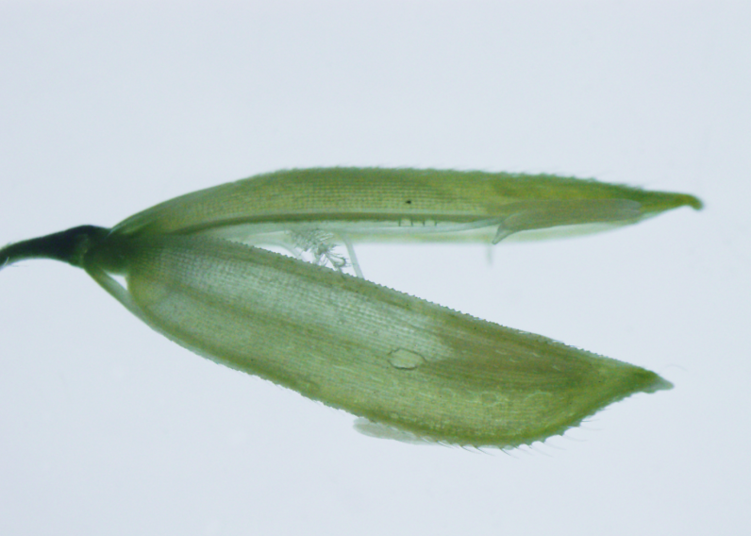
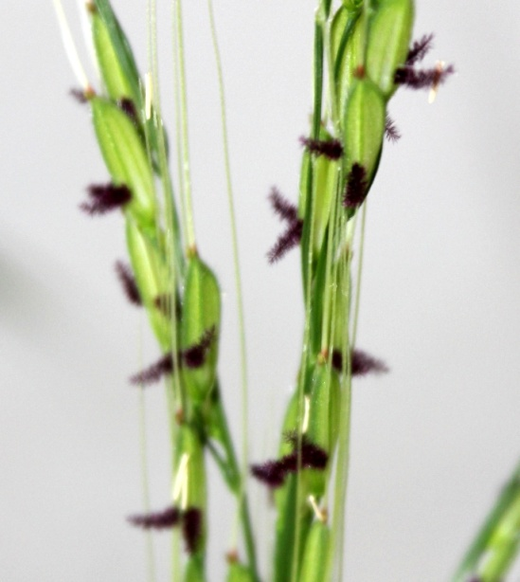
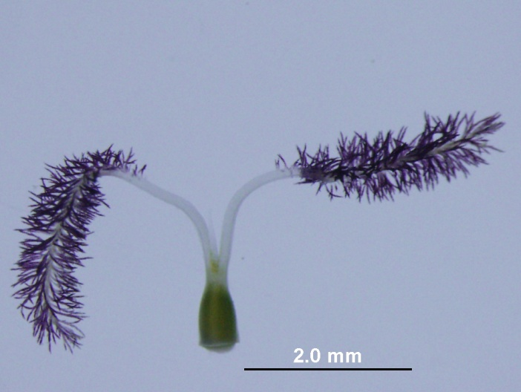
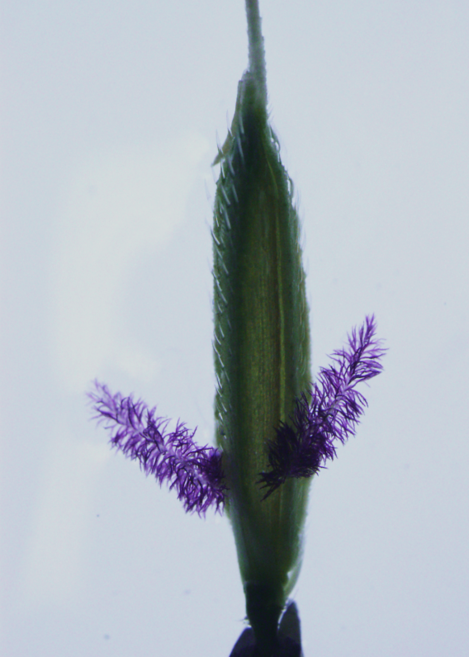
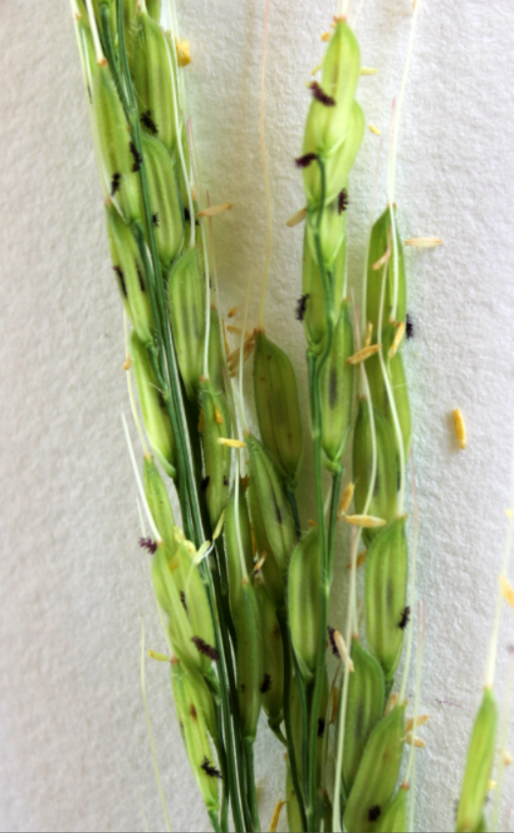
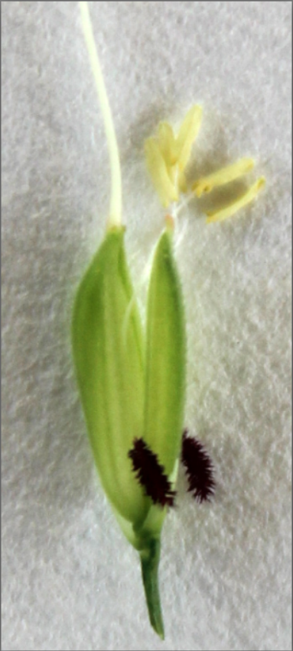
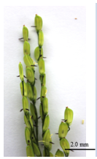
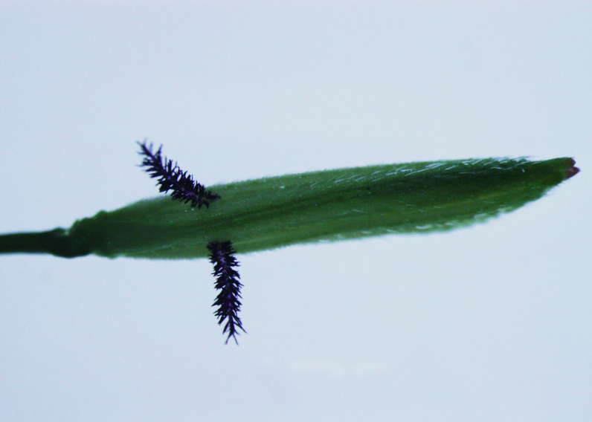
a
b
c
d
Additional file 9: Figure S6 Phenotypes of panicle, floret, and stigma. (a) IR68897B. (b) OL (IRGC110404). (c) The improved IR58025B possessing qSTGL8.0 (IRGC110404). (d) The improved IR68897B possessing qSTGL8.0 (IRGC92664). Red arrows point to the exserted stigma in each genotype.

Slide 10
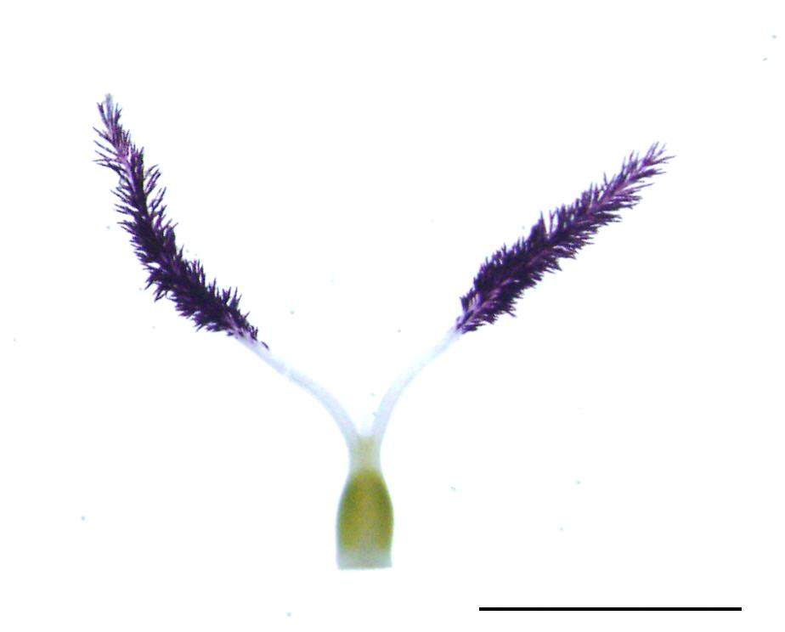
b
c
f
a
d
e
Additional file 10: Figure S7 Schematic diagram showing the different parts of the typical OL female reproductive organ (pistil). The letters a, b, c, d, e, and f denote non-brushy parts of the stigma, brushy parts of the stigma, stigma, style, ovary, and pistil, respectively.

