Slide 1
Supplementary Information
Plasmonics
Nitazoxanide and Azithromycin for the early Treatment of Covid-19: A Multi-Spectroscopic, Biochemical and Computational Drug-Drug Interaction Study
Syed Abid Ali ^{1,§,*}, Muhammad Abid ^{1,§}, Ayaz Ahmed ², Abdul Wadood ³ and Shakil Ahmed ¹
¹ Third World Center for Science and Technology, H.E.J. Research Institute of Chemistry, University of Karachi, Karachi 75270, Pakistan
² Dr. Panjwani Center for Molecular Medicine and Drug Research, International Center for Chemical and Biological Sciences, University of Karachi, Karachi 75270, Pakistan
³ Department of Biochemistry, Abdul Wali Khan University, Mardan 23200, Pakistan
* Corresponding author. Prof. Dr. Syed Abid Ali, at Third World Center for Science and Technology, H.E.J. Research Institute of Chemistry, University of Karachi, Karachi-75270, Pakistan. Email addresses: abid.ali@iccd.edu.

Slide 2
Fig. S1
(a)
Absorbance [a. u.]
Wavelength [nm]
Notes:
Fig. S1. Time-dependent interaction analysis between NTZ and AZT followed by UV/Vis spectroscopy at room temperature for 90 min (λmax = 420 nm).

Slide 3
Fig. S2
(a)
Intrinsic fluorescence [A.U.]
Wavelength [nm]
Notes:
Fig. S2. (a) Emission spectra of HSA, NTZ, AZT alone and in the presence of carrier protein HSA with NTZ, AZT, and NTZ: AZT complex. (b) Far-UV CD spectra of the HSA alone and its interaction with NTZ, AZT, NTZ: AZT complex and NTZ and AZT competition binding sample (at ~25 °C). Insert table: Secondary structure of HSA alone and after interaction drugs and drugs complex were calculated using the online K2D3 server. (c) 10% native polyacrylamide gel electrophoresis (Native-PAGE) of the same set of samples. HSA and BSA alone was used as controls, while arrow indicates the direction of electrophoretic mobility.

Slide 4
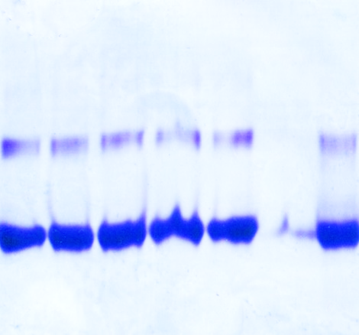
(c)
4 3 2 1 HSA BSA
Dimer
Monomer
30
(b)
Sample | α helix % | β strand %
HSA (alone) | 67.98 | 8.65
(1) HSA :AZT | 49.04 | 13.45
(2) HSA :NTZ | 65.54 | 9.34
(3) HSA :(AZT+NTZ) | 60.91 | 10.05
(4) HSA :AZT:NTZ | 43.49 | 14.41
0
CD [mdeg]
HSA
HSA:NTZ
HSA:AZT
HSA (NTZ:AZT)
(HSA:NTZ:AZT)
-40
200
220
240
250
Wavelength [nm]

Slide 5
Fig. S3
(a)
Absorbance [a. u.]
Notes:
Fig. S3. Concentration dependent interaction analysis between NTZ and AZT. Establishing the calibration curve of NTZ and AZT interaction keeping one drug concentration constant (i.e., 100 µM) and other with variable concentrations (i.e., 1–100 µM). The interaction was followed spectroscopically at 420 nm (a, b; NTZ and AZT, respectively). From the established calibration lines, the limit of detection and quantification (LOD/ LOQ) of each were also calculated.

Slide 6
(b)
Absorbance [a. u.]
Conc. Of AZT (µM)

Slide 7
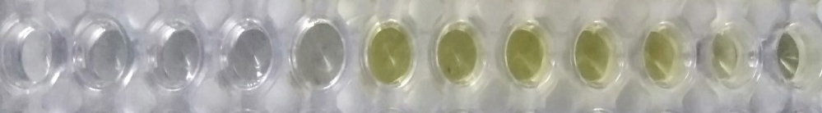
Fig. S4
(a) NTZ
pH 2
346 nm
Absorbance [a. u.]
420 nm
Wavelength [nm]
Notes:
Fig. S4. Effect of variable pH (pH 2-13) on the drug NTZ alone (a) and after interaction with AZT (b) measured spectroscopically in the range of 300-700 nm. Insert: illustrates the change in color from colorless to yellow observed as moving from acidic to alkaline conditions. In contrast, effect of variable pH on the drug AZT alone revealed no effect (c). Thermal stability of the NTZ: AZT interaction complex followed by UV/Vis spectroscopy at variable temperature i.e., 25 to 100 °C (d), where no change in color was observed. Likewise, effect of the ionic strength of the medium (variable salt concentrations i.e., 0.05 to 2 M) on the NTZ: AZT interaction complex (e) revealed no significant effect on absorption.

Slide 8

(b) NTZ: ATZ Complex
pH 2
pH 13
346 nm
Absorbance [a. u.]
420 nm
Wavelength [nm]

Slide 9
(c) ATZ
Absorbance [a. u.]
Wavelength [nm]

Slide 10
(d)
Absorbance [a. u.]
Wavelength [nm]

Slide 11
(e)
Absorbance [a. u.]
Wavelength [nm]

Slide 12
Fig. S5
(a)
Absorbance [a. u.]
Wavelength [nm]
Notes:
Fig. S5. Real sample analysis by spiking the drugs NTZ and AZT (alone), and their interaction complex (NTZ: AZT; 1:1) in fresh human urine (a) and plasma (b). Measurement was followed spectroscopically (300-700 nm) at room temperature. Urine sample was used as such, while the plasma sample was diluted 10 times with DI before measurements.

Slide 13
(b)
Absorbance [a. u.]
Wavelength [nm]

