Slide 1
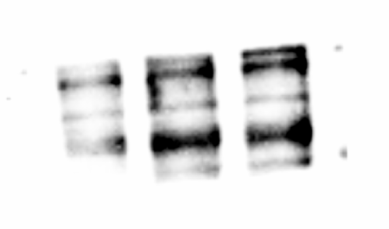
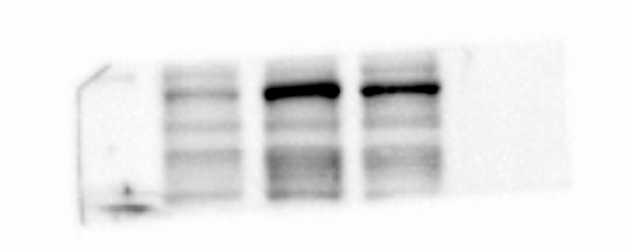
Figure3
NCM460
LoVo
Hct116
PPFIA1
BIOSS(136KD)
PPFIA3
ABclonal(132KD)
LoVo
Hct116
NCM460

Slide 2
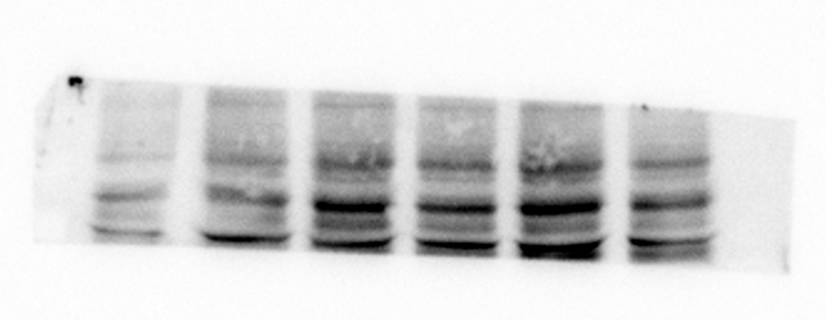
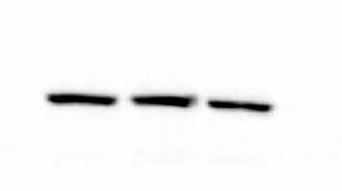
Figure3
NCM460
LoVo
Hct116
PPFIA4
biorbyt(134KD)
NCM460
LoVo
Hct116
β-actin
CST(43KD)

Slide 3
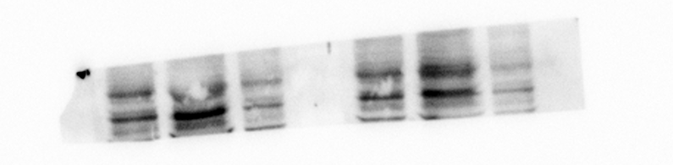
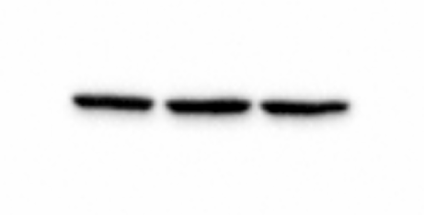
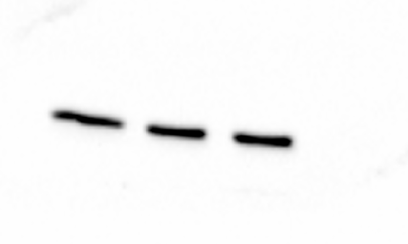
Figure7
NCM460
LoVo
Hct116
NCM460
LoVo
Hct116
PPFIA4
biorbyt(134KD)
NCM460
LoVo
Hct116
NCM460
LoVo
Hct116
β-actin
CST(43KD)

