Slide 1
Table S1
Table S1 Primers used in this study.
Function | Gene | Forward primer | Reverse primer | Product length (bp)
q-PCR | CsaV3_4G024970(Actin) | CTGGAGATGGTGTCAGTCAC | AGTCAAGGGCAATGTAGGC | 204
 | CsaV3_1G009130 | CCAAGGACAATGAAGAGAAGG | AAGGTAGGCAATCCACAGG | 226
 | CsaV3_1G041400 | GCACCAGAGAGTGAGTGGAAG | AGCAACGAGAGCCCTTTC | 202
 | CsaV3_3G019090 | TGTTGTAGCCTTCTCTCTCACC | CGAATCGTTTCATCTTGGAG | 225
 | CsaV3_4G034970 | CAATCACACGCAGAGTCATC | AATGGGCTTTGAACCTCG | 201
 | CsaV3_6G039530 | CGTAAGGTGTCTTTGGTGAGAG | CAGTGTAAACGAGAACGAAGG | 202
 | CsaV3_5G023870(CsGORK) | TTGTGGGAGGAGAGAGGAGG | AAGCGGGAAGAGTAGTTGCC | 206
 | CsaV3_1G029650(CsAKT1) | GTTCACTGTGCCGCATGTTT | CAAATCGCCGTAGCCAACAG | 174
 | CsaV3_7G028990(CsHAK5;3) | AAAGTCGGGTTGATACCAAG | AACGGAGATGGAAGGAGTG | 210
Subcellular localization of CsAKT1 | CsaV3_1G029650(CsAKT1) | ATGGACGAGCTGTACAGATCT ATGGACACCCTTAGAAACAGAGG | GCCGGGCGGCCGCTTT TGTGGTTCTTCCATCACTGACA | 2622
Heterologous expression of CsAKT1 in yeast |  | AGGGAATATTAAGCTT ATGGACACCCTTAGAAACAGAGG | ACCCCCCATGGTAAGCTT TTATGTGGTTCTTCCATCACTGACA | 2622
Hi-TOM sequencing of CsAKT1 |  | ggagtgagtacggtgtgcAGGAGGAGGAATAAGGCATAC | gagttggatgctggatggTTGACTCTGCGATTGCTTC | 240

Slide 2
Figure S1
a
b
PNC/Leaf
25
a
40
Ctrl
PNC/Root
20
30
a
15
20
Total ce content per dry weight
(mg/g DW)
Ce content per dry weight
(mg/g DW)
b
10
b
10
c
5
PNC/Leaf
PNC/Root
d
e
75 mM NaCl
c
e
0
Ctrl
75 mM NaCl
0
Leaf
Root
Figure S1. Leaf and root cerium content in salt stressed (75 mM NaCl, Day 7) cucumber plants with foliar sprayed or root applied PNC. Total cerium content (a), leaf cerium content and root cerium content (b). Mean ± SE (n = 3). Different letters indicate significant differences among different treatments at the P < 0.05 level. Ctrl, control cucumber plants under 75 mM NaCl (7 days); PNC/Leaf, cucumber plants with leaf PNC application under 75 mM NaCl (7 days); PNC/Root, cucumber plants with leaf PNC application under 75 mM NaCl (7 days).

Slide 3
Figure S2
a
360
b
1500
Total area of leaf (cm²)
a
Total length of root (cm)
1200
a
270
b
b
180
c
900
c
90
600
Ctrl
PNC/Leaf
PNC/Root
300
Ctrl
PNC/Leaf
PNC/Root
0
75 mM NaCl
0
75 mM NaCl
c
300
d
6
Total surface area of root (cm²)
a
Root volume (cm³)
a
200
c
b
4
b
100
2
c
0
Ctrl
PNC/Leaf
PNC/Root
0
Ctrl
PNC/Leaf
PNC/Root
75 mM NaCl
75 mM NaCl
Figure S2. The phenotypic parameters in salt stressed (75 mM NaCl, Day 7) cucumber plants with foliar delivery or root application of PNC. Total area of leaf (a), total length of root (b), total surface area of root (c), root volume (d). Mean ± SE (n = 3). Different lowercase letters indicate significant differences among different treatments at the P < 0.05 level. Ctrl, control cucumber plants under 75 mM NaCl (7 days); PNC/Leaf, cucumber plants with leaf PNC application under 75 mM NaCl (7 days); PNC/Root, cucumber plants with leaf PNC application under 75 mM NaCl (7 days).

Slide 4
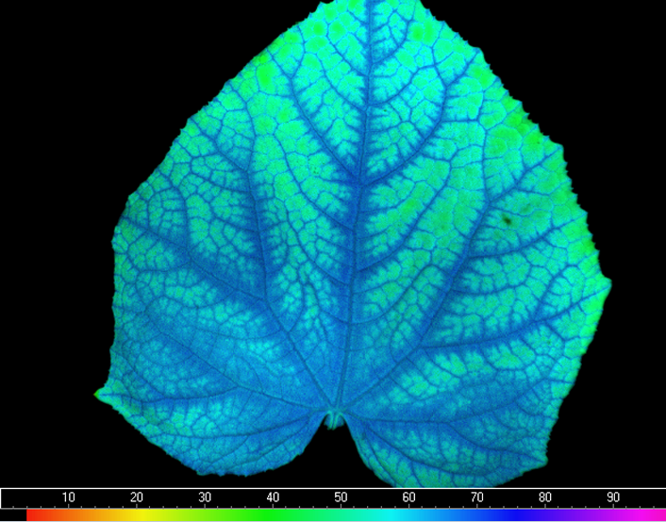
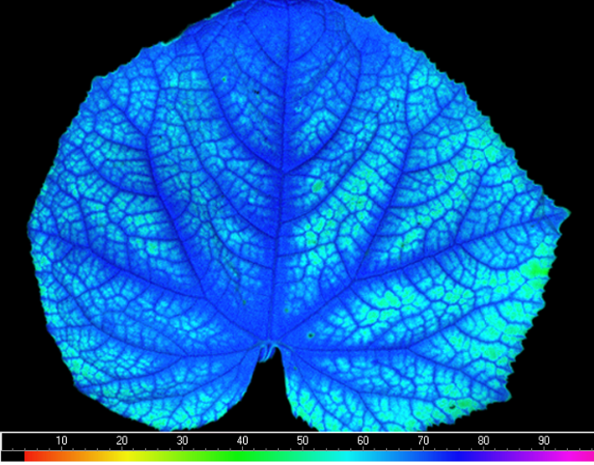
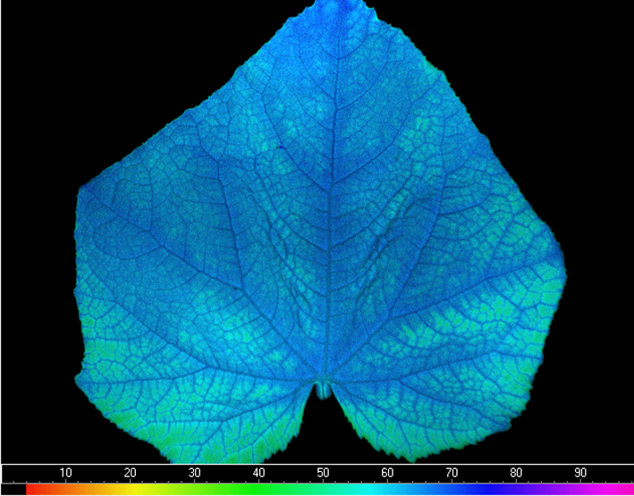
Figure S3
Ctrl
PNC/Leaf
PNC/Root
a
2 cm
2 cm
2 cm
b
10
Tr (mmol H₂O m⁻² s⁻¹)
8
6
a
b
4
c
2
PNC/Leaf
PNC/Root
0
Ctrl
75 mM NaCl
Figure S3. Fv/Fm and transpiration rate (Tr) in salt stressed (75 mM NaCl, Day 7) cucumber plants with foliar delivery or root application of PNC. a, after salt stress (75 mM NaCl, 7 days), leaf Fv/Fm in control cucumber plants, cucumber plants with foliar PNC delivery and cucumber plants with root PNC application. b, after salt stress (75 mM NaCl, 7 days), leaf Tr in control cucumber plants, cucumber plants with foliar PNC delivery and cucumber plants with root PNC application. Mean ± SE (n = 3). Different lowercase letters indicate significant differences among different treatments at the P < 0.05 level. Ctrl, control cucumber plants under 75 mM NaCl (7 days); PNC/Leaf, cucumber plants with leaf PNC application under 75 mM NaCl (7 days); PNC/Root, cucumber plants with leaf PNC application under 75 mM NaCl (7 days).

Slide 5
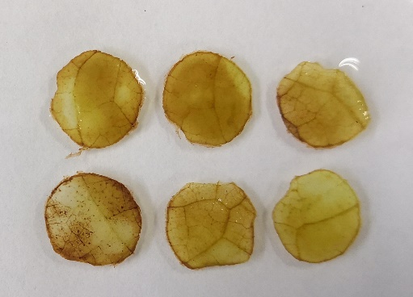
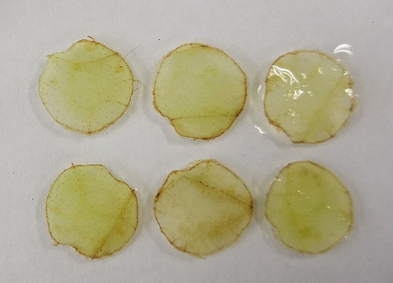
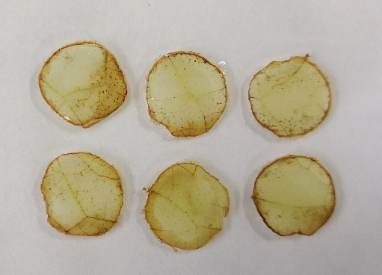
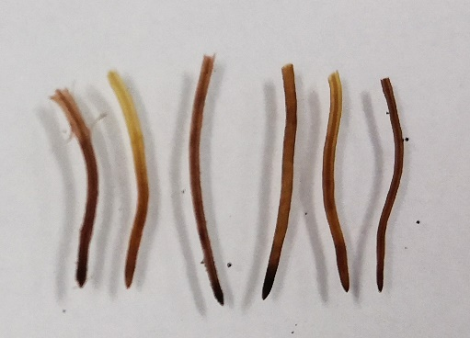
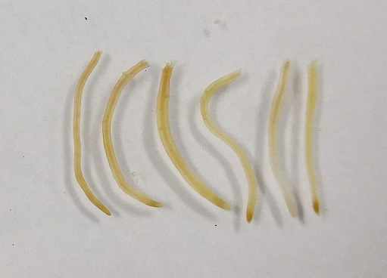
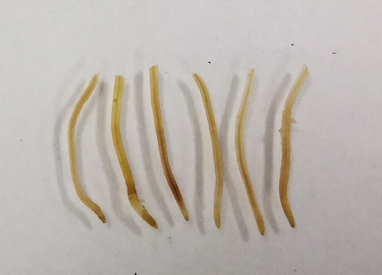
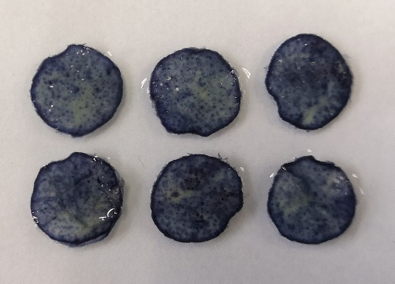
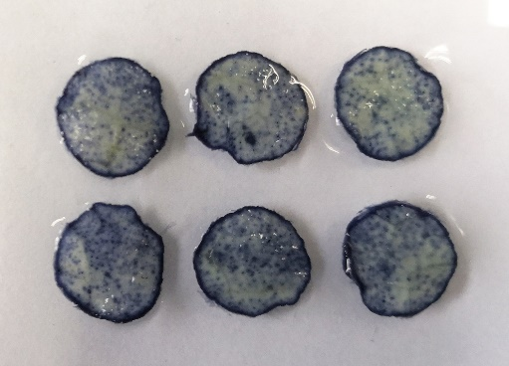
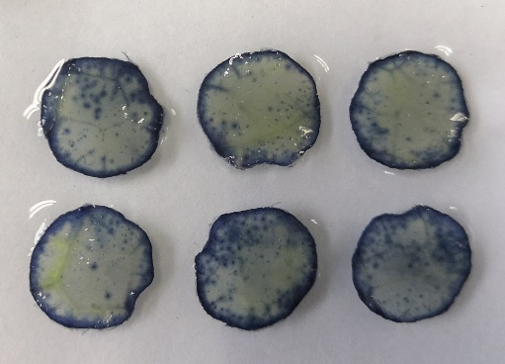
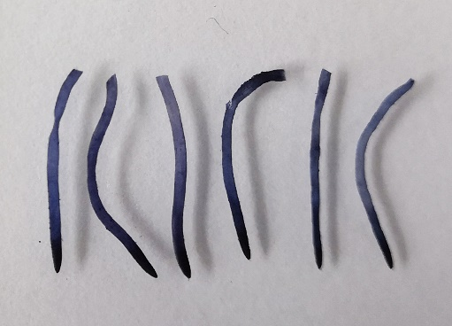
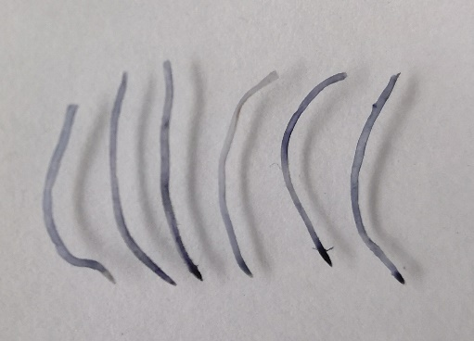
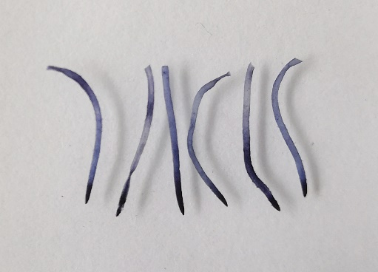
a
3.0
PNC/Leaf
b
PNC/Leaf
Figure S4
Ctrl
PNC/Root
12
Ctrl
PNC/Root
2.5
10
2.0
a
8
a
H₂O₂ content
(mmol/g FW)
b
O₂⁻ content
(mmol/g FW)
b
1.5
6
1.0
c
4
c
0.5
d
2
d
f
e
f
e
c
0.0
Leaf
Root
d
0
Leaf
Root
PNC/Leaf
PNC/Leaf
8
Ctrl
PNC/Root
120
Ctrl
PNC/Root
6
100
a
a
80
a
MDA content
(nmol/g FW)
b
b
REC (%)
60
b
b
4
c
d
c
2
d
40
e
20
0
Leaf
Root
0
Leaf
Root
e
Ctrl
PNC/Leaf
PNC/Root
Leaf
H₂O₂ Staining
Root
f
Leaf
O₂⁻ Staining
Root
1 cm
Figure S4. The ROS level, MDA content and REC (relative electric conductivity) in salt stressed (75 mM NaCl, Day 7) cucumber plants with foliar delivery or root application of PNC. Contents of H₂O₂ (a) and •O₂— (b) , MDA content (c) and REC (d) in cucumber leaves and roots of plant with foliar sprayed or root applied PNC. DAB staining (e, indicating H₂O₂ level) and NBT staining (f, indicating •O₂— level) of leaves and roots of cucumber plants with foliar sprayed or root applied PNC. Different lowercase letters indicate significant differences among different treatments at the P < 0.05 level.

Slide 6
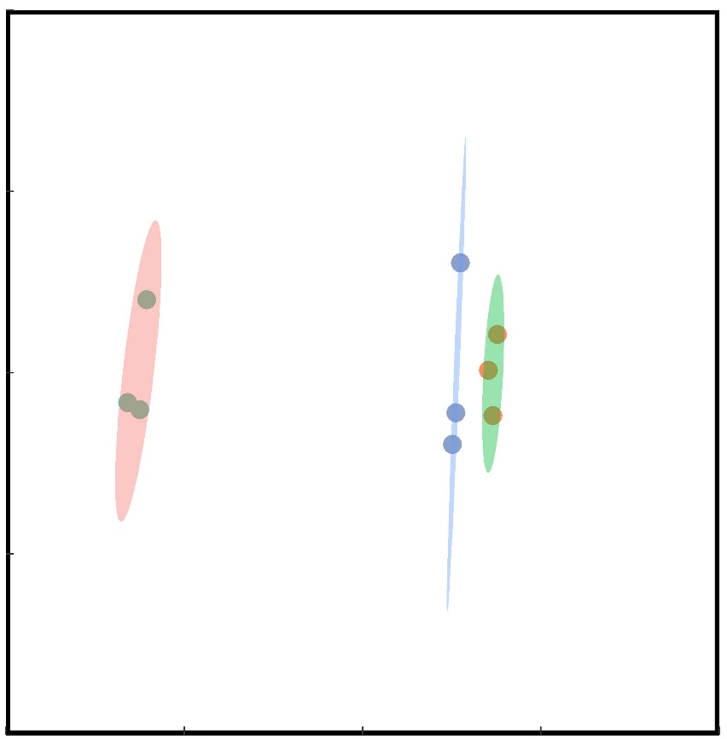
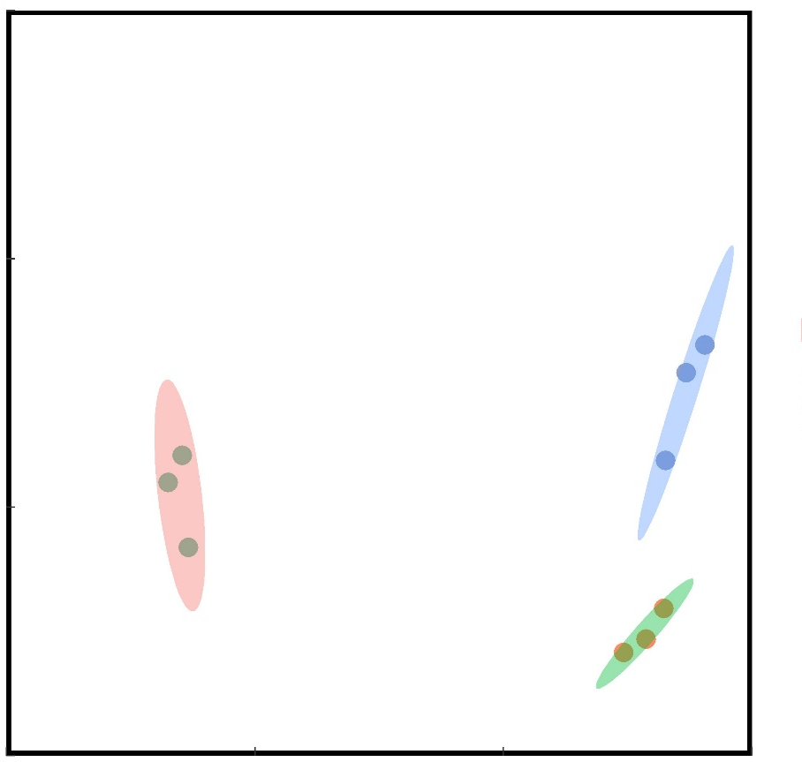

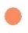
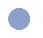
Ctrl
Ctrl
Figure S5
a
40000
PNC/Leaf
Leaf
b
20000
PNC/Leaf
Root
PNC/Root
PNC/Root
20000
10000
PC2(10.6%%)
0
PC2(16.1%%)
-20000
y=0.137+0.885x R²_{adj}=0.93 P<0.001
0
-40000
-40000
-40000
0
20000
40000
-10000
-20000
-10000
0
10000
c
PC1(84.0%)
PC1(76.2%)
4
RNAseq
3
qRT-PCR
2
1
0
Log2 fold change
-1
-2
-3
-4
-5
-6
CsaV3_1G009130(FA-L)
CsaV3_1G009130(FA-R)
CsaV3_1G009130(RA-L)
CsaV3_1G009130(RA-R)
CsaV3_1G041400(FA-L)
CsaV3_1G041400(FA-R)
CsaV3_1G041400(RA-L)
CsaV3_1G041400(RA-R)
CsaV3_3G019090(FA-L)
CsaV3_3G019090(FA-R)
CsaV3_3G019090(RA-L)
CsaV3_3G019090(RA-R)
CsaV3_4G034970(FA-L)
CsaV3_4G034970(FA-R)
CsaV3_4G034970(RA-L)
CsaV3_4G034970(RA-R)
CsaV3_6G039530(FA-L)
CsaV3_6G039530(FA-R)
CsaV3_6G039530(RA-L)
CsaV3_6G039530(RA-R)
d
4
3
y=0.137+0.885x R²_{adj}=0.93 P<0.001
2
1
0
qRT-PCR log2 ratio
-1
-2
-3
-4
-5
-6
-5
-4
-3
-2
-1
0
1
2
3
4
Figure S5. Transcriptome quality analysis of cucumber leaves and roots with leaf and root PNC application. PCA analysis of transcriptomic data from cucumber leaves (a) and roots (b). qPCR analysis (c) and correlation analysis (d) of cucumber leaves and roots. FA-L(R): leaves (root) of cucumber with leaf PNC application, RA-L(R): leaves (root) of cucumber with root PNC application.
RNA-seq log2 ratio

Slide 7
Figure S6
a
b
5000
5000
Up
Up
4000
Down
4000
3706
3638
Down
3408
3203
3146
Number of genes in leaf
Number of genes in root
2932
3000
2714
2567
3000
2000
2000
1000
PNC/Leaf
Ctrl vs PNC/Leaf
1000
PNC/Leaf
Ctrl vs PNC/Leaf
PNC/Root
PNC/Root
0
0
c
1500
d
200
183
171
1200
1132
150
900
99
Number of DEGs in leaf
100
93
600
Number of DEGs in root
392
296
50
66
58
47
41
300
289
165
146
35
33
0
89
89
71
61
0
Catalytic activity
Cation binding
Heme binding
Iron ion binding
RNA binding
Metal ion binding
Transporter activity
Hydrolase activity
Isomerase activity
Metal ion binding
Tetrapyrrole binding
Calcium ion binding
Peroxidase activity
Oxidoreductase activity
Ctrl vs PNC/Root
Transferase activity
Antioxidant activity
Ctrl vs PNC/Root
Transition metal ion binding
Structural molecule activity
Methyltransferase activity
Structural constituent of ribosome
e
1200
f
1200
1000
1058
1000
1099
800
800
600
Number of DEGs in leaf
Number of DEGs in root
600
400
348
265
258
400
253
200
150
141
80
80
68
51
200
152
148
109
99
80
50
48
38
0
0
Cation binding
Heme binding
Catalytic activity
Antioxidant activity
Catalytic activity
Metal ion binding
Transporter activity
Iron ion binding
Transporter activity
Calcium ion binding
Oxidoreductase activity
Transition metal ion binding
Tetrapyrrole binding
Calcium ion binding
Oxidoreductase activity
Structural molecule activity
Methyltransferase activity
Structural constituent of ribosome
Transmembrane transporter activity
Hydrolase activity, acting on glycosyl bonds
Figure S6. GO enrichment analysis of cucumber leaves and roots with leaf and root PNC application (75 mM NaCl, Day 7). GO enrichment analysis of differential expressed genes in leaves of cucumber plants with foliar sprayed (c) or root applied (d) PNC. GO enrichment analysis of differential expressed genes in roots of cucumber plants with foliar sprayed (e) or root applied (f) PNC.

Slide 8
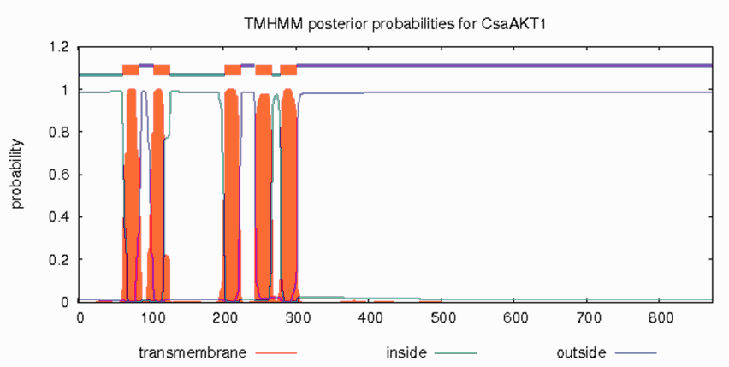
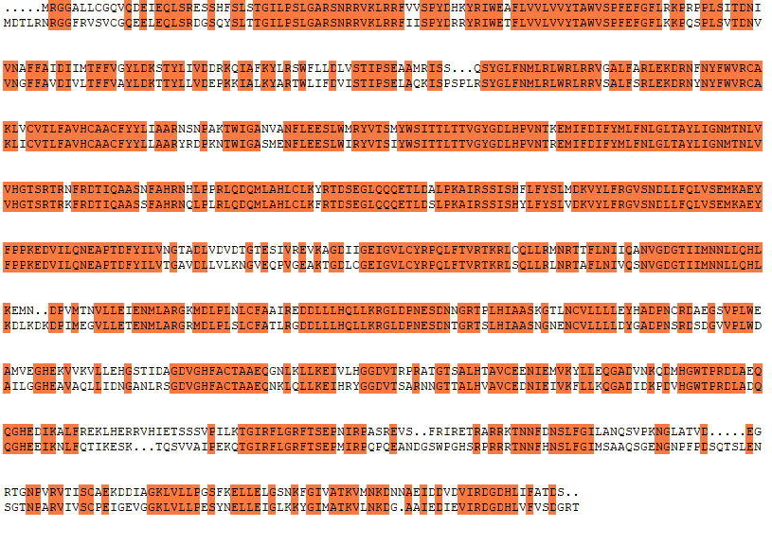
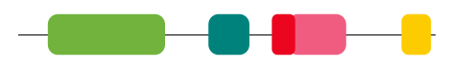
Figure S7
a
1.2
TMHMM posterior probabilities for CsAKT1
1.0
0.8
inside
Probability
transmembrane
0.6
outside
0.4
0.2
0
0
100
200
300
400
500
600
700
800
b
T1
AtAKT1
95
CsAKT1
T2
100
AtAKT1
192
CsAKT1
T3
T4
T5
200
AtAKT1
292
CsAKT1
300
AtAKT1
392
CsAKT1
400
AtAKT1
492
CsAKT1
500
AtAKT1
590
CsAKT1
600
AtAKT1
690
CsAKT1
700
AtAKT1
783
CsAKT1
797
AtAKT1
857
CsAKT1
872
c
Ion_trans
cNMP_binding
Ank_4
Ank_2
KHA
CsAKT1
5’
3’
0
872aa
Figure S7. Structural analysis of CsAKT1. Prediction of transmembrane structure of CsAKT1 (a).Multiple alignment of AKT1 amino acid sequences from Arabidopsis and cucumber (b). Prediction of conserved domain of CsAKT1 (c).

Slide 9
Figure S8
a
300
b
1200
EV
EV
Csakt1
900
a
Csakt1
200
a
b
b
Total length of root
(cm)
c
c
b
Total area of leaf
(cm²)
c
c
600
e
d
100
d
300
0
Ctrl
PNC/Leaf
PNC/Root
0
Ctrl
PNC/Leaf
PNC/Root
75 mM NaCl
75 mM NaCl
c
d
300
EV
5
EV
a
Csakt1
4
a
Csakt1
200
b
3
cd
c
b
c
Root volume
(cm³)
Total surface area of root
(cm²)
e
c
d
2
d
100
1
e
0
Ctrl
PNC/Leaf
PNC/Root
0
Ctrl
PNC/Leaf
PNC/Root
75 mM NaCl
75 mM NaCl
Figure S8. The phenotypic parameters of salt stressed (75 mM NaCl, Day 7) CsAKT1 knockout cucumber plants with foliar delivery or root application of PNC. Total area of leaf (a), total length of root (b), total surface area of root (c) and root volume (d) of root knockout of CsAKT1 cucumber seedlings with leaf application and root application of PNC under salt stress. Mean ± SE (n = 3). Different lowercase letters indicate significant differences among different treatments at the P < 0.05 level. Ctrl, control cucumber plants under 75 mM NaCl (7 days); PNC/Leaf, cucumber plants with leaf PNC application under 75 mM NaCl (7 days); PNC/Root, cucumber plants with leaf PNC application under 75 mM NaCl (7 days).

