Slide 1
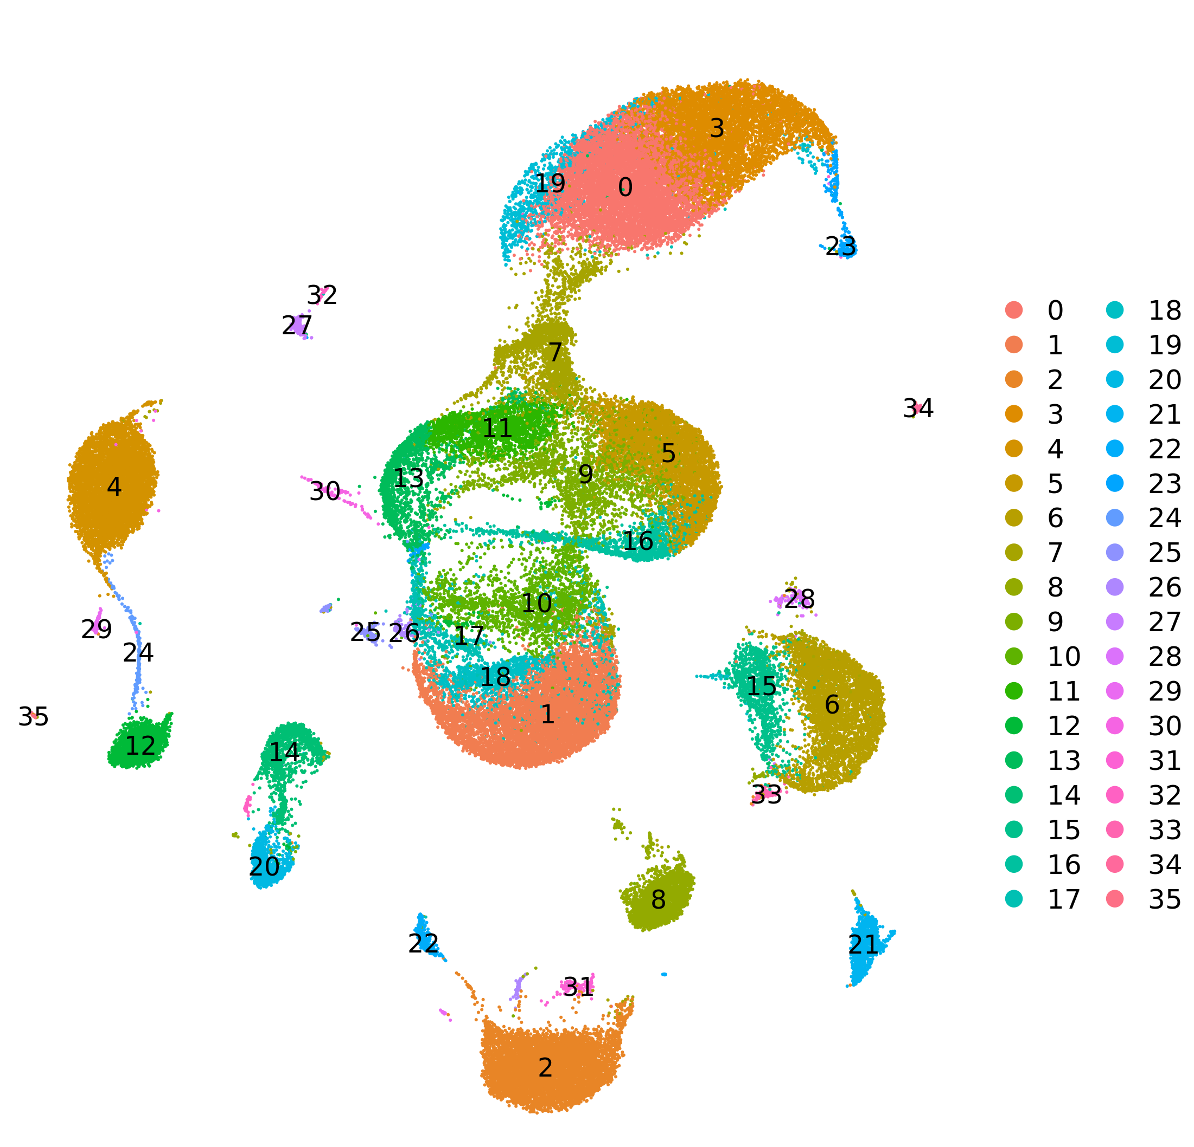
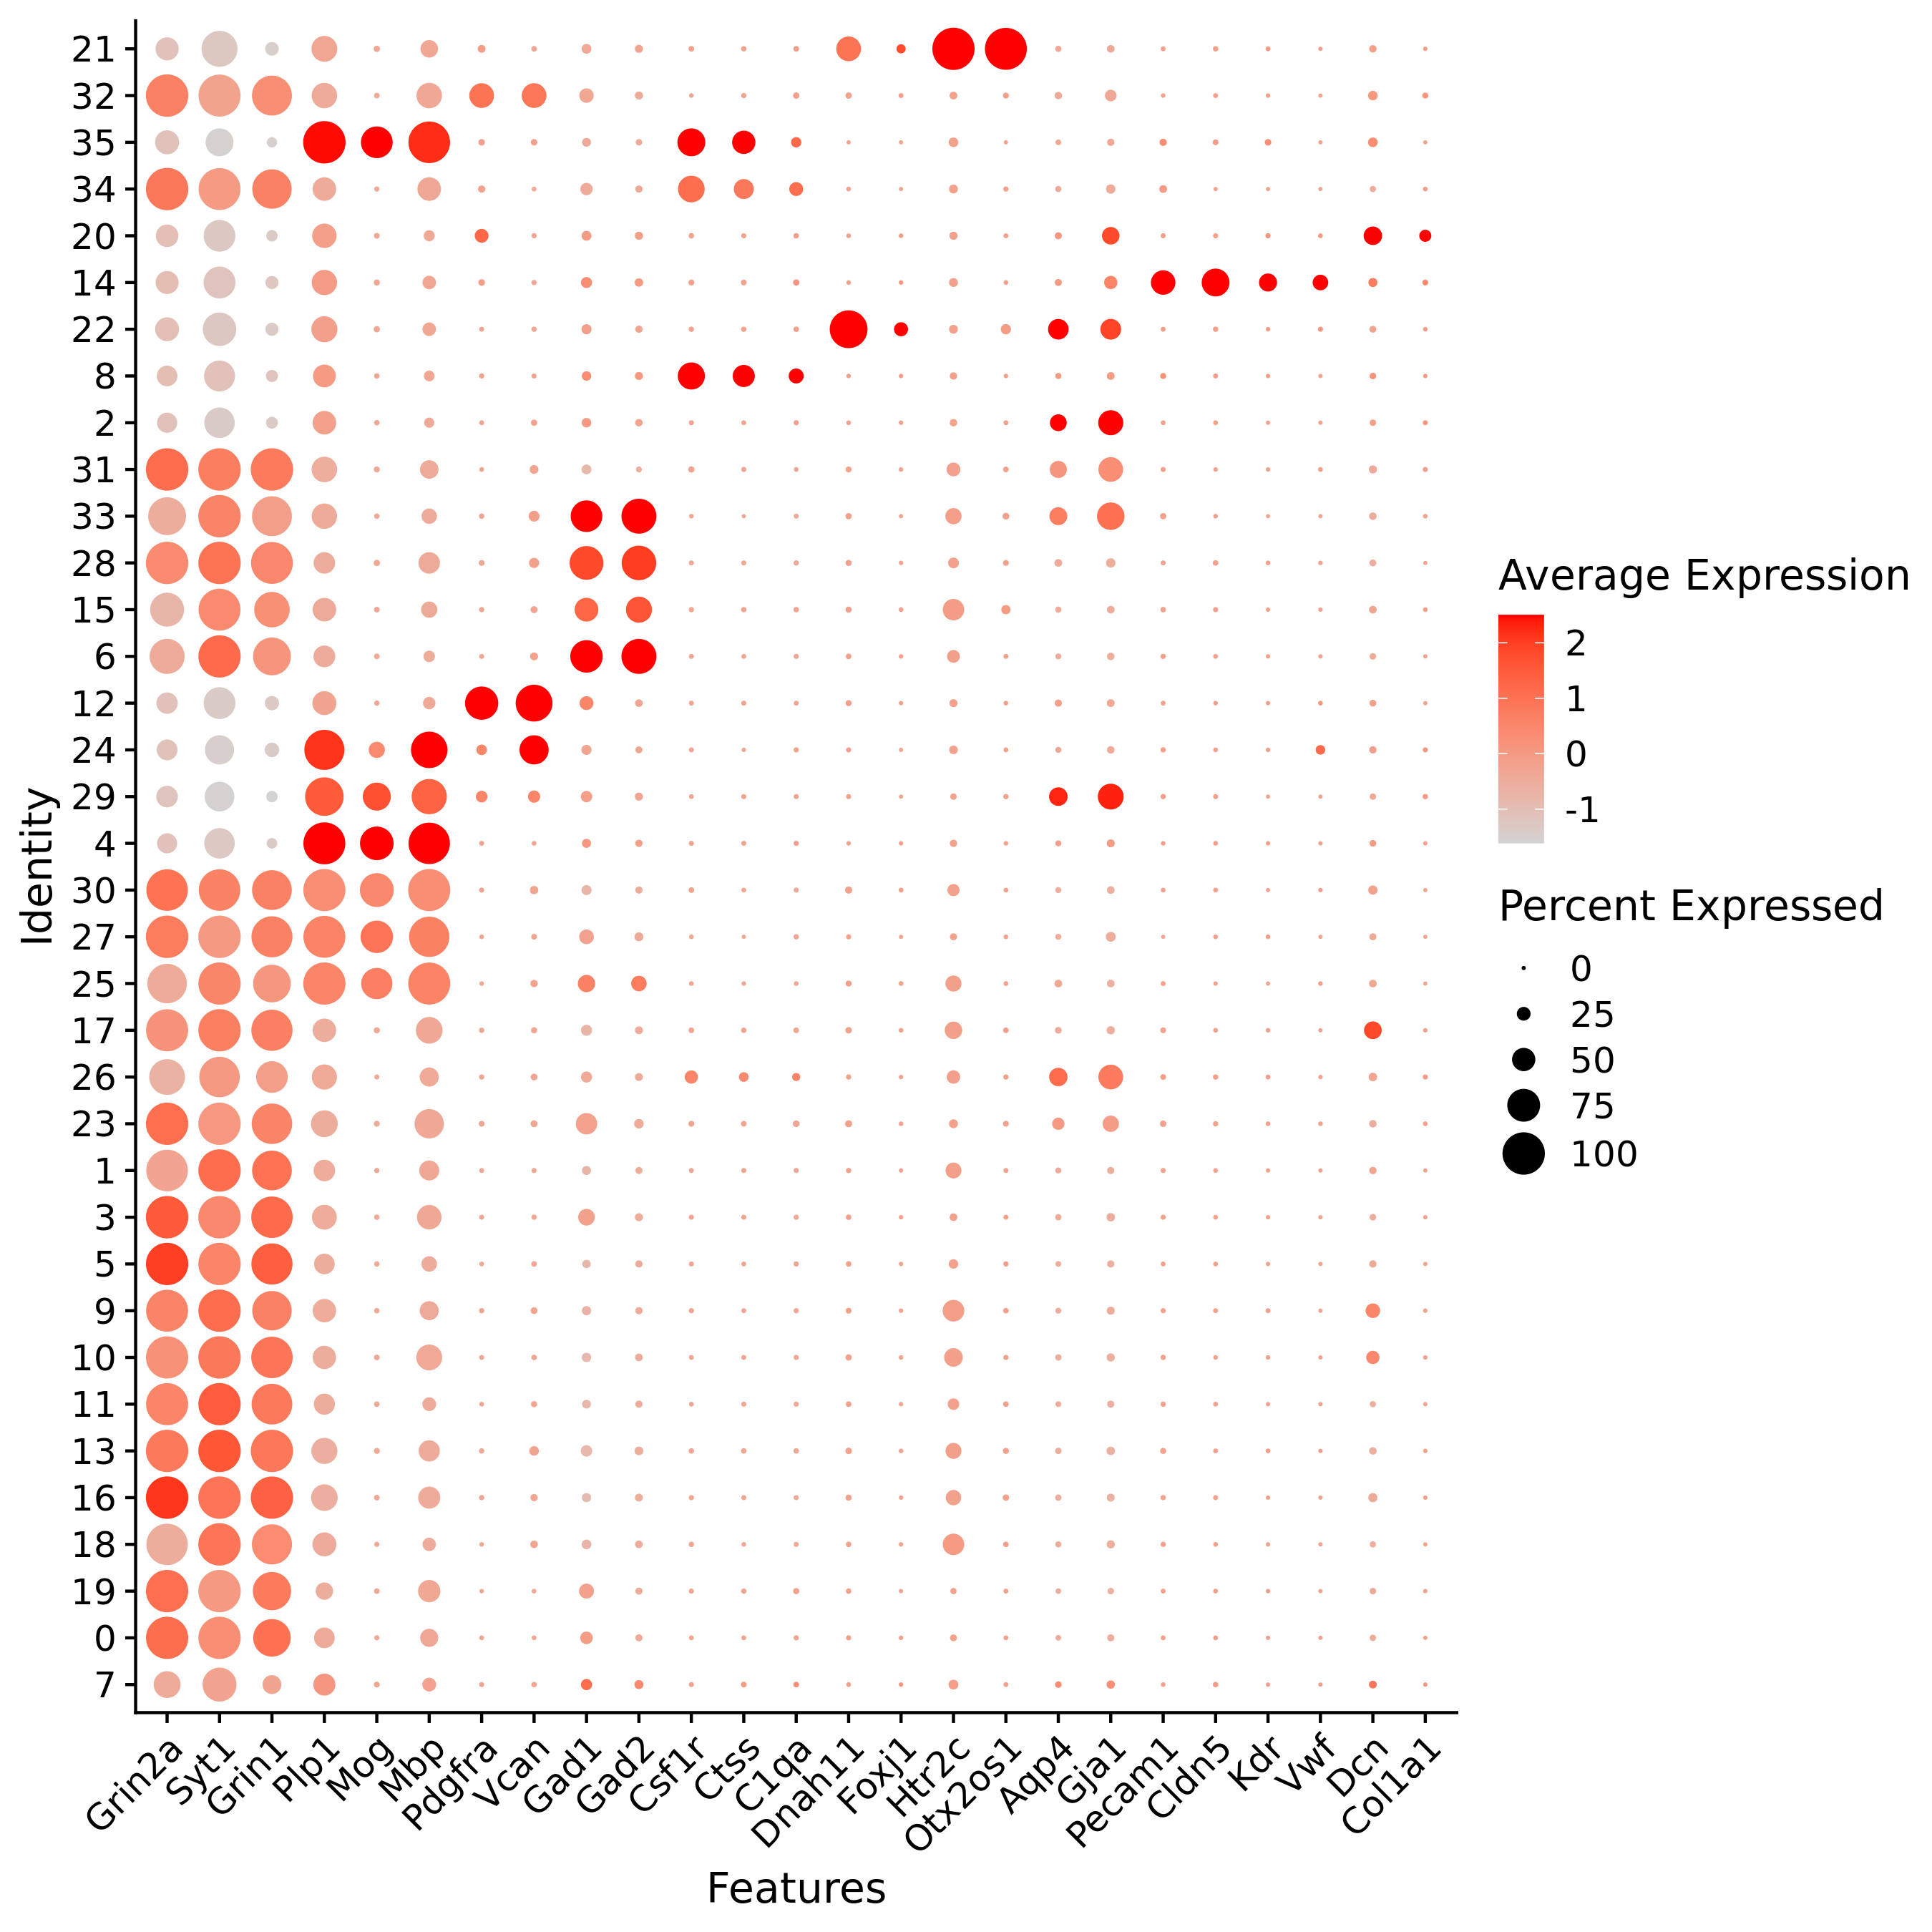
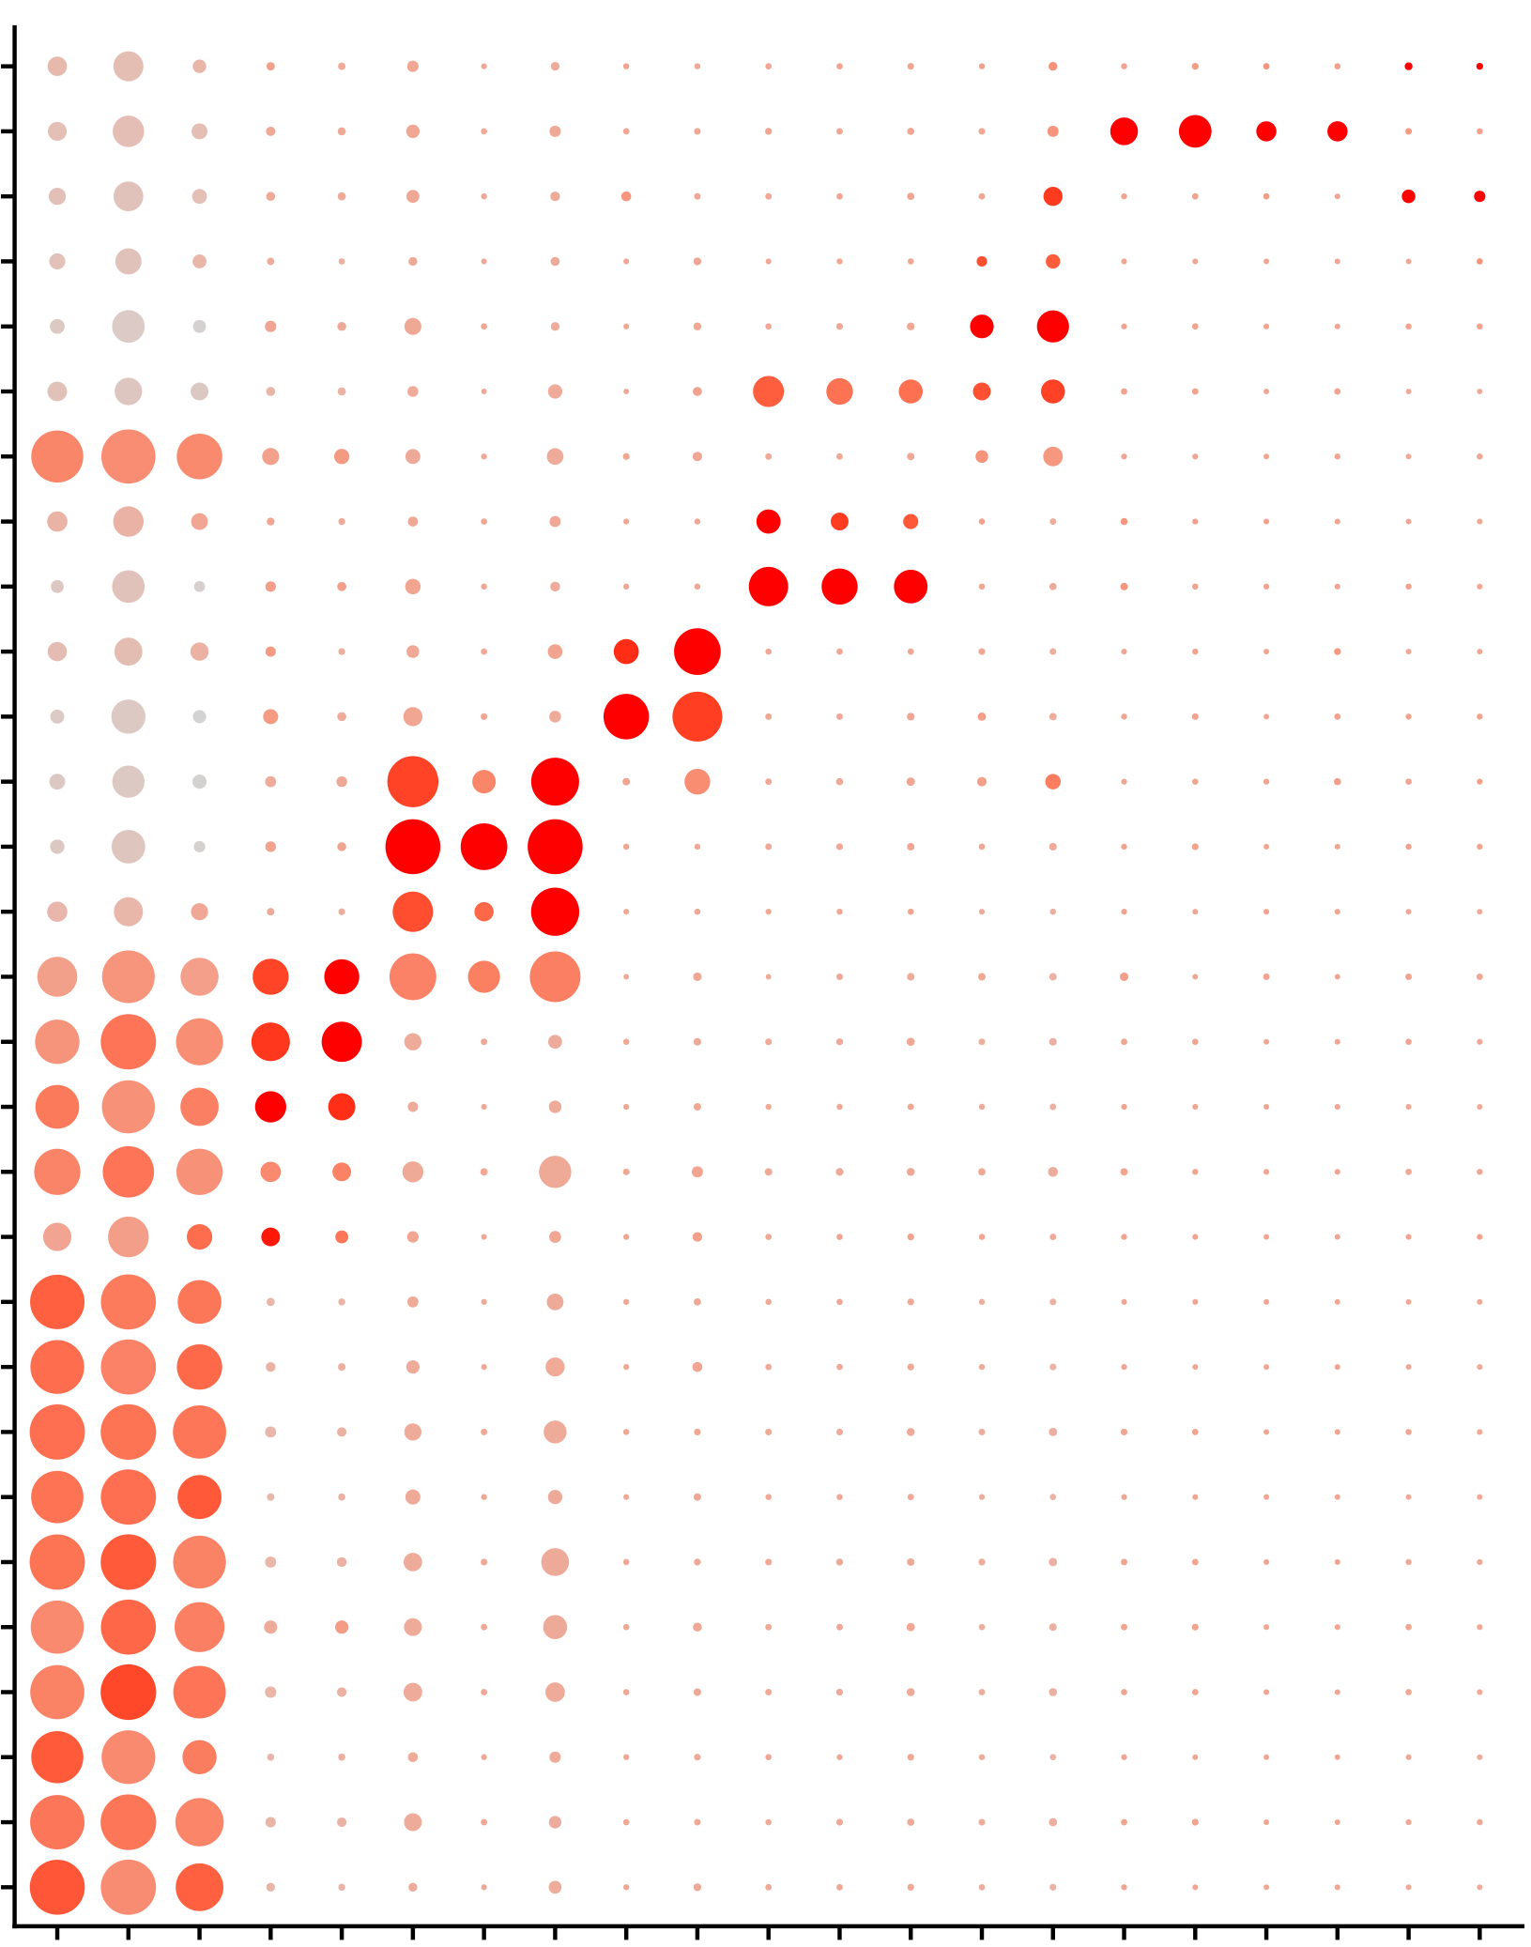
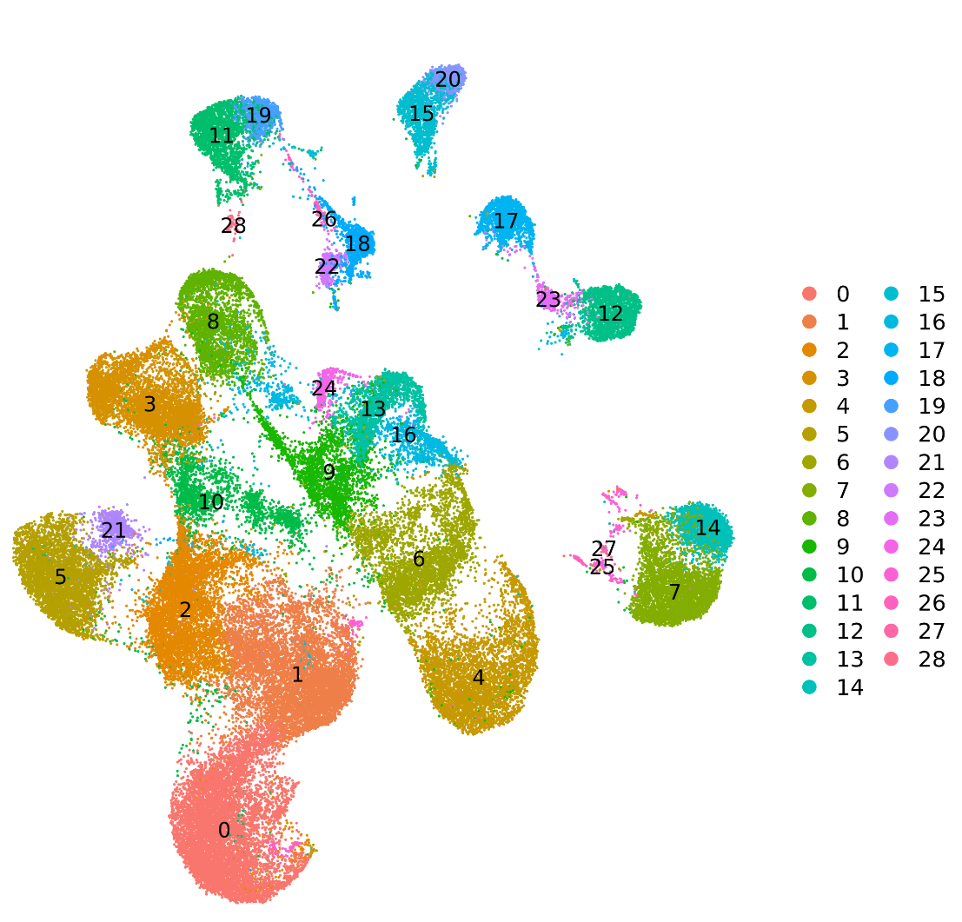
Sup Figure 1.
a
4w
8w
GF
GF
Cohousing
CGF
SPF
SPF
b
d
21
Avg. exp. scale
32
2
35
34
1
20
0
14
22
-1
8
2
Pct. exp.
31
0
33
25
28
50
15
75
6
100
12
24
29
4
30
Excitatory neuron
27
25
Interneuron
17
Oligodendrocyte
26
23
OPC
1
3
Microglia
5
9
Astrocyte
10
Endo&SMC&Fibro
11
13
Ependymal
16
18
Unknown
19
0
c
e
7
Ctss
Kdr
Mog
Foxj1
Gja1
Dcn
Mbp
Csf1r
Vwf
Plp1
Vcan
C1qa
Syt1
Htr2c
Grin1
Gad2
Aqp4
Cldn5
Gad1
Dnah11
Grin2a
Pdgfra
Otx2os1
Pecam1
Col1a1
23
17
Avg. exp. scale
12
2
7
1
14
0
27
-1
25
15
Pct. exp.
20
18
0
22
25
26
50
19
75
11
100
28
8
Excitatory neuron
3
Interneuron
16
10
Oligodendrocyte
1
OPC
2
4
Microglia
5
Astrocyte
6
Endo&SMC&Fibro
9
13
21
24
0
Vwf
Mog
Kdr
Dcn
Syt1
Plp1
Mbp
Ctss
Grin1
Csf1r
Gja1
Gad1
C1qa
Grin2a
Gad2
Vcan
Aqp4
Cldn5
Pdgfra
Pecam1
Col1a1
Notes:
b,

Slide 2
Sup Figure 2.
a
b
Hip
Microglia
Oligodendrocyte
PFC
Microglia
Interneuron
Regulate
Up
Down
-log₁₀ P adj value
-log₁₀ P adj value
-log₁₀ P adj value
-log₁₀ P adj value
Avg logFC
Avg logFC
Avg logFC
Avg logFC
Astrocyte
OPC
Astrocyte
Excitatory neuron
-log₁₀ P adj value
-log₁₀ P adj value
-log₁₀ P adj value
-log₁₀ P adj value
Avg logFC
Avg logFC
Avg logFC
Avg logFC
Excitatory neuron
Interneuron
Oligodendrocyte
OPC
-log₁₀ P adj value
-log₁₀ P adj value
-log₁₀ P adj value
-log₁₀ P adj value
c
Avg logFC
Avg logFC
Avg logFC
Avg logFC
d
e
Microglia
Count of DEGs（GF vs SPF） in Hip
Count of DEGs（GF vs SPF） in PFC
Astrocyte
1200
OPC
Astrocyte
1250
OPC
Astrocyte
Oligodendrocyte
900
1000
OPC
750
Excitatory neuron
600
Interneuron
300
500
Excitatory
neuron
Regulate
250
Excitatory
neuron
Regulate
0
Oligodendrocyte
Up
0
Oligodendrocyte
Up
Down
Down
Microglia
Interneuron
Microglia
Interneuron
f
-log FDR
g
GO term of DEGs in Hip
GO term of DEGs in PFC
-log FDR
ATP hydrolysis coupled proton transport
ATP metabolic process
ATP biosynthetic process
ATP synthesis coupled proton transport
translation
translational elongation
ATP catabolic process
positive regulation of calcium-transporting ATPase activity
ATP hydrolysis coupled proton transport
ATP synthesis coupled proton transport
translation
regulation of translation
Astrocyte
Microglia
OPC
Interneuron
Astrocyte
Microglia
OPC
Interneuron
Excitatory neuron
Excitatory neuron
Oligodendrocyte
Oligodendrocyte

Slide 3
Sup Figure 3.
a
b
Canonical pathway enriched in Hip
Canonical pathway enriched in PFC
Neuroinflammation Signaling Pathway
Complement System
White Adipose Tissue Browning Pathway
PI3K/AKT Signaling
Signaling by Rho Family GTPases
Phagosome Formation
RhoGDI Signaling
Senescence Pathway
Synaptogenesis Signaling Pathway
Acute Phase Response Signaling
Th1 Pathway
L-DOPA Degradation
Dopamine Receptor Signaling
IL-7 Signaling Pathway
NADH Repair
Role of Pattern Recognition Receptors in Recognition of Bacteria and Viruses
Phagosome Maturation
Th1 and Th2 Activation Pathway
Virus Entry via Endocytic Pathways
Chondroitin and Dermatan Biosynthesis
iNOS Signaling
Melatonin Signaling
Axonal Guidance Signaling
Protein Kinase A Signaling
GNRH Signaling
Synaptic Long Term Potentiation
Opioid Signaling Pathway
Dopamine-DARPP32 Feedback in cAMP Signaling
Neuropathic Pain Signaling In Dorsal Horn Neurons
Clathrin-mediated Endocytosis Signaling
Corticotropin Releasing Hormone Signaling
Chemokine Signaling
ERK/MAPK Signaling
nNOS Signaling in Neurons
G-Protein Coupled Receptor Signaling
IL-8 Signaling
Antiproliferative Role of Somatostatin Receptor 2
CREB Signaling in Neurons
IL-15 Production
IL-12 Signaling and Production in Macrophages
Role of MAPK Signaling in the Pathogenesis of Influenza
Sertoli Cell-Sertoli Cell Junction Signaling
TGF-β Signaling
Germ Cell-Sertoli Cell Junction Signaling
Wnt/Ca+ pathway
B Cell Receptor Signaling
Neurotrophin/TRK Signaling
PTEN Signaling
LPS-stimulated MAPK Signaling
IL-1 Signaling
IL-17 Signaling
Synaptic Long Term Depression
ILK Signaling
p38 MAPK Signaling
Endocannabinoid Developing Neuron Pathway
Nucleotide Excision Repair Pathway
Methylglyoxal Degradation I
Assembly of RNA Polymerase II Complex
Role of BRCA1 in DNA Damage Response
Unfolded protein response
NER (Nucleotide Excision Repair, Enhanced Pathway)
Huntington's Disease Signaling
Dermatan Sulfate Biosynthesis (Late Stages)
eNOS Signaling
Chondroitin Sulfate Biosynthesis
Regulation of Actin-based Motility by Rho
Neuregulin Signaling
Rac Signaling
GPCR-Mediated Integration of Enteroendocrine Signaling Exemplified by an L Cell
Dolichyl-diphosphooligosaccharide Biosynthesis
Cholecystokinin/Gastrin-mediated Signaling
γ-glutamyl Cycle
Reelin Signaling in Neurons
14-3-3-mediated Signaling
Leukotriene Biosynthesis
Telomere Extension by Telomerase
Aldosterone Signaling in Epithelial Cells
D-myo-inositol (1,4,5)-Trisphosphate Biosynthesis
-log P
RhoGDI Signaling
Fcγ Receptor-mediated Phagocytosis in Macrophages and Monocytes
Signaling by Rho Family GTPases
IL-8 Signaling
Integrin Signaling
Rac Signaling
B Cell Receptor Signaling
CXCR4 Signaling
PI3K Signaling in B Lymphocytes
Phagosome Formation
Axonal Guidance Signaling
ERK/MAPK Signaling
Gαq Signaling
Neuregulin Signaling
GNRH Signaling
Synaptic Long Term Potentiation
Phagosome Maturation
IL-3 Signaling
Natural Killer Cell Signaling
CDK5 Signaling
PAK Signaling
Reelin Signaling in Neurons
14-3-3-mediated Signaling
ERK5 Signaling
P2Y Purigenic Receptor Signaling Pathway
PI3K/AKT Signaling
HMGB1 Signaling
Phospholipase C Signaling
Semaphorin Signaling in Neurons
ErbB4 Signaling
Agrin Interactions at Neuromuscular Junction
G Protein Signaling Mediated by Tubby
Estrogen Receptor Signaling
Ephrin B Signaling
Th1 and Th2 Activation Pathway
mTOR Signaling
Calcium Signaling
Regulation of eIF4 and p70S6K Signaling
Chemokine Signaling
LPS-stimulated MAPK Signaling
Huntington's Disease Signaling
ErbB Signaling
ErbB2-ErbB3 Signaling
Complement System
Senescence Pathway
STAT3 Pathway
IL-12 Signaling and Production in Macrophages
Amyotrophic Lateral Sclerosis Signaling
nNOS Signaling in Neurons
G Beta Gamma Signaling
GABA Receptor Signaling
Corticotropin Releasing Hormone Signaling
Glutamate Receptor Signaling
Aldosterone Signaling in Epithelial Cells
Gustation Pathway
Antioxidant Action of Vitamin C
Neuropathic Pain Signaling In Dorsal Horn Neurons
UVA-Induced MAPK Signaling
Wnt/Ca+ pathway
Endothelin-1 Signaling
Gap Junction Signaling
EIF2 Signaling
NRF2-mediated Oxidative Stress Response
Sirtuin Signaling Pathway
Glioma Signaling
Amyloid Processing
EGF Signaling
IL-6 Signaling
Granulocyte Adhesion and Diapedesis
p38 MAPK Signaling
LXR/RXR Activation
Atherosclerosis Signaling
Phosphatidylcholine Biosynthesis I
Heme Biosynthesis II
Remodeling of Epithelial Adherens Junctions
Adrenomedullin signaling pathway
FAT10 Signaling Pathway
IL-7 Signaling Pathway
-log P
4
6
2
4
0
2
0
OPC
Astrocyte
OPC
Microglia
Microglia
Astrocyte
Interneuron
Interneuron
Oligodendrocyte
Oligodendrocyte
Excitatory neuron
Excitatory neuron

Slide 4
Sup Figure 4.
a
Hip-down
PFC-down
b
Hip-up
PFC-up
-log P val
Sperm Motility
IL-15 Production
EIF2 Signaling
Regulation of eIF4 and p70S6K Signaling
mTOR Signaling
Protein Ubiquitination Pathway
NRF2-mediated Oxidative Stress Response
Iron homeostasis signaling pathway
BAG2 Signaling Pathway
Phagosome Maturation
Unfolded protein response
Synaptogenesis Signaling Pathway
Netrin Signaling
Synaptic Long Term Potentiation
Circadian Rhythm Signaling
Axonal Guidance Signaling
Calcium Signaling
Opioid Signaling Pathway
Ephrin Receptor Signaling
Epithelial Adherens Junction Signaling
RAC Signaling
Neurovascular Coupling Signaling Pathway
Glutamate Receptor Signaling
Endocannabinoid Neuronal Synapse Pathway
Synaptic Long Term Depression
Neuropathic Pain Signaling In Dorsal Horn Neurons
GABA Receptor Signaling
CREB Signaling in Neurons
Gustation Pathway
Dopamine-DARPP32 Feedback in cAMP Signaling
nNOS Signaling in Skeletal Muscle Cells
Neuroinflammation Signaling Pathway
nNOS Signaling in Neurons
Mitochondrial Dysfunction
Oxidative Phosphorylation
GDP-mannose Biosynthesis
Colanic Acid Building Blocks Biosynthesis
D-mannose Degradation
Inflammasome pathway
Role of PKR in Interferon Induction and Antiviral Response
NADH Repair
Methylglyoxal Degradation I
Hypusine Biosynthesis
UVA-Induced MAPK Signaling
D-myo-inositol (1,4,5)-Trisphosphate Biosynthesis
Actin Nucleation by ARP-WASP Complex
Integrin Signaling
ERK5 Signaling
Cholecystokinin/Gastrin-mediated Signaling
Fcγ Receptor-mediated Phagocytosis in Macrophages and Monocytes
PI3K Signaling in B Lymphocytes
Role of MAPK Signaling in Promoting the Pathogenesis of Influenza
fMLP Signaling in Neutrophils
Molecular Mechanisms of Cancer
Regulation of Actin-based Motility by Rho
Actin Cytoskeleton Signaling
ERK/MAPK Signaling
Insulin Receptor Signaling
Up
10
0
Microglia
in Hip
Microglia
in PFC
Down
10
563
370
694

Slide 5
Sup Figure 5.
a
Number of
interactions
Hip _microglia
20 | 10 | 17 | 12 | 12 | 13
15 | 11 | 11 | 10 | 10 | 12
18 | 9 | 11 | 12 | 12 | 14
9 | 2 | 6 | 2 | 4 | 2
3 | 0 | 2 | 1 | 2 | 1
3 | 0 | 2 | 3 | 6 | 6
15 | 9 | 9 | 11 | 13 | 13
8 | 4 | 4 | 2 | 7 | 7
11 | 7 | 7 | 8 | 7 | 7
0 | 0 | 0 | 0 | 0 | 0
Number of
interactions
PFC _microglia
b
GO term of reversed gene of microglia in Hip
c
-log FDR
GO term of reversed gene of microglia in PFC
-log FDR

Slide 6
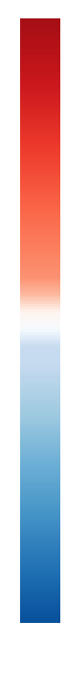
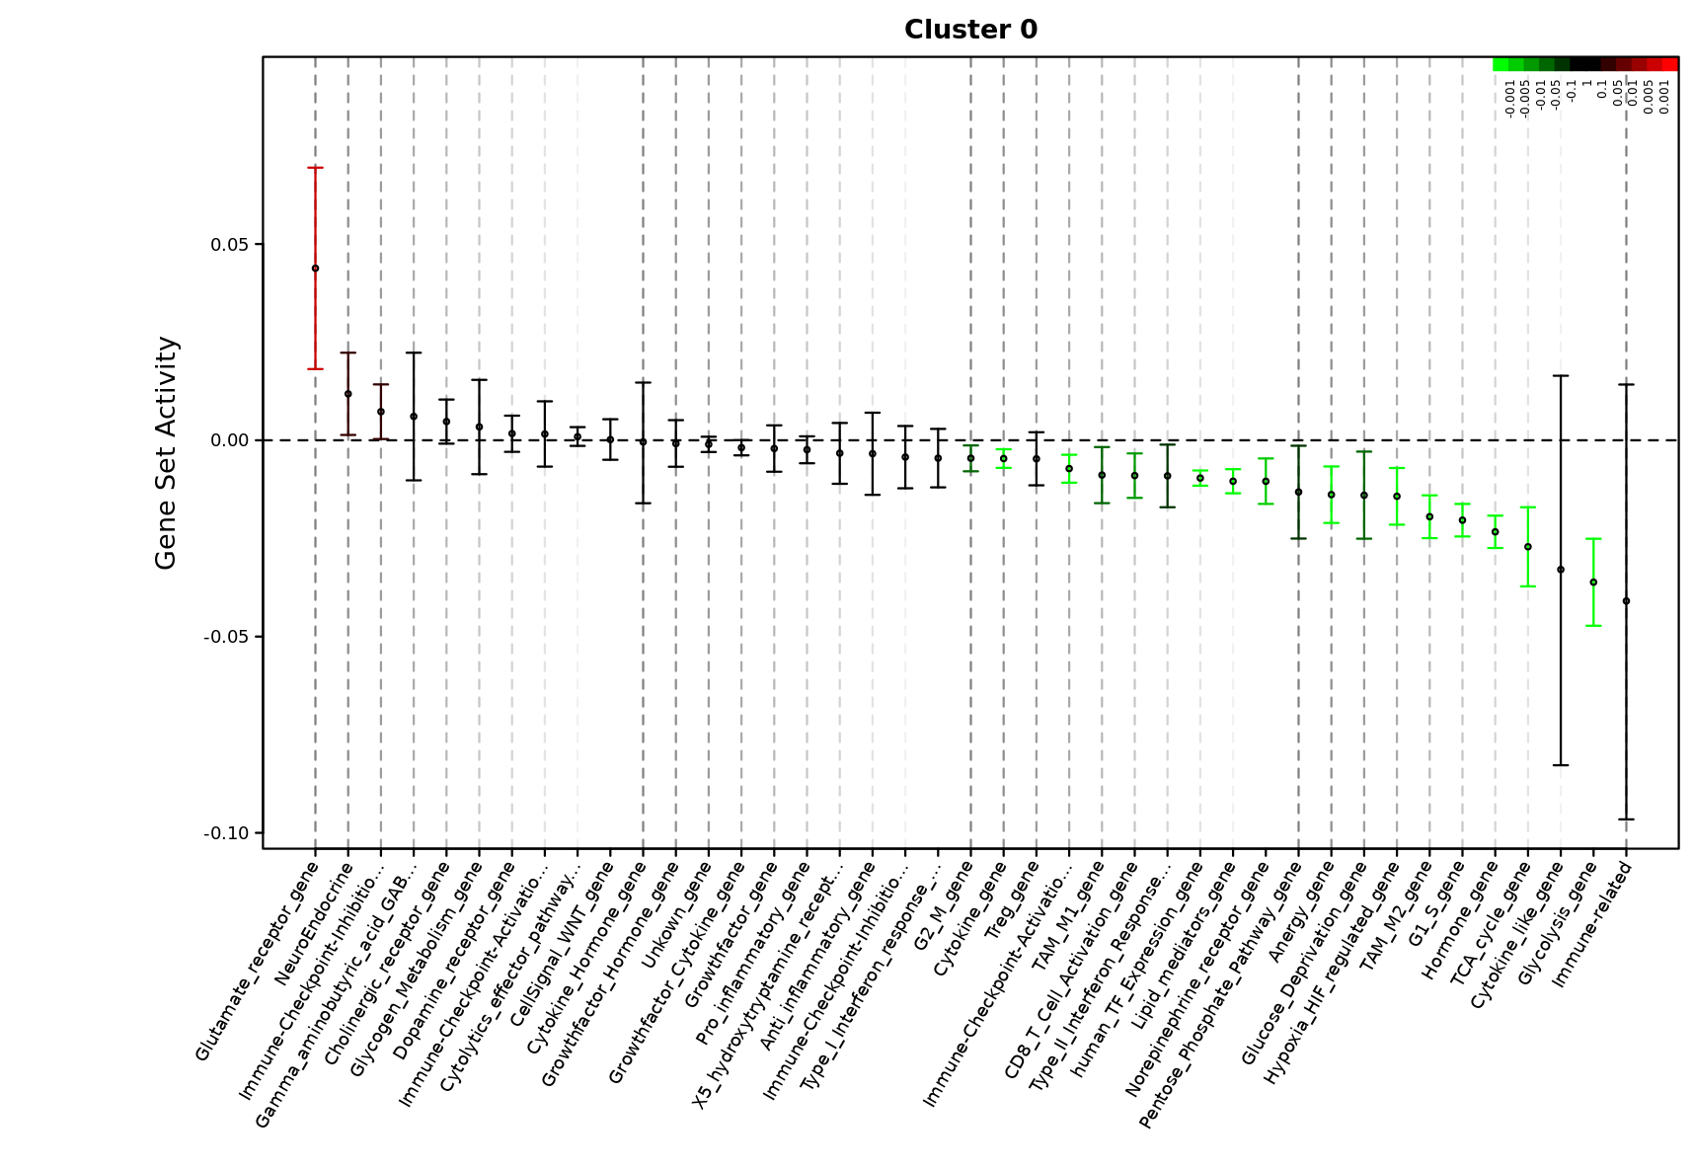
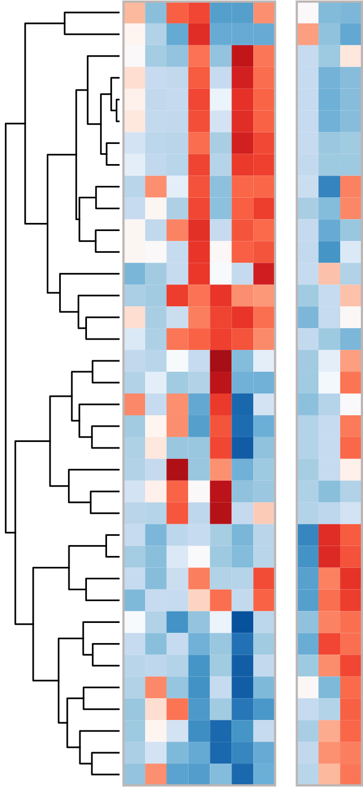
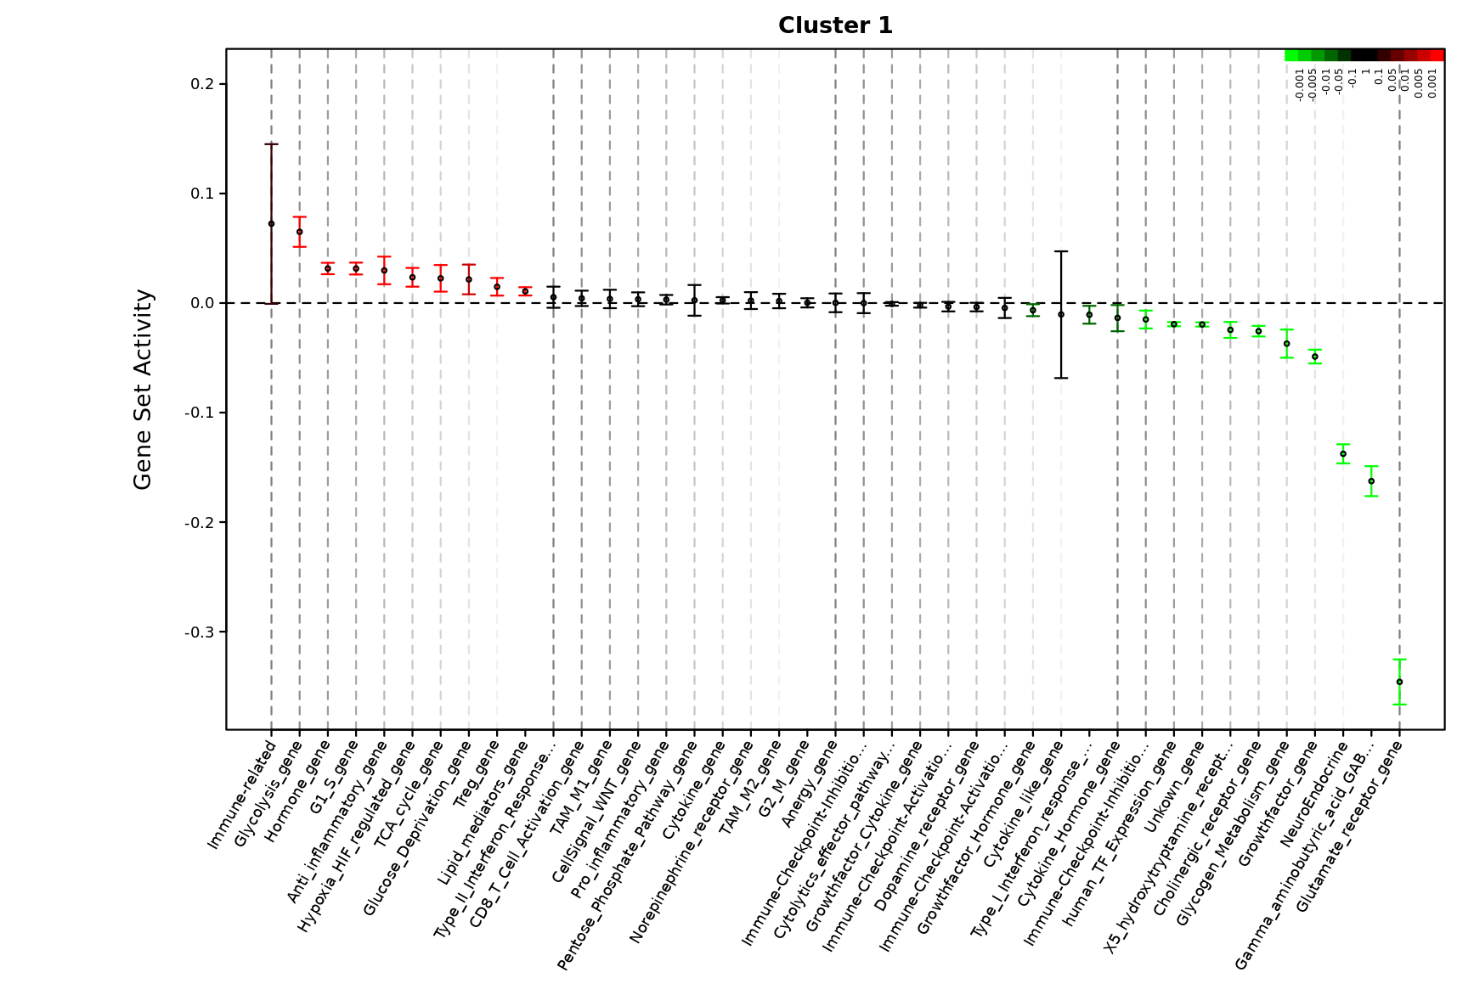
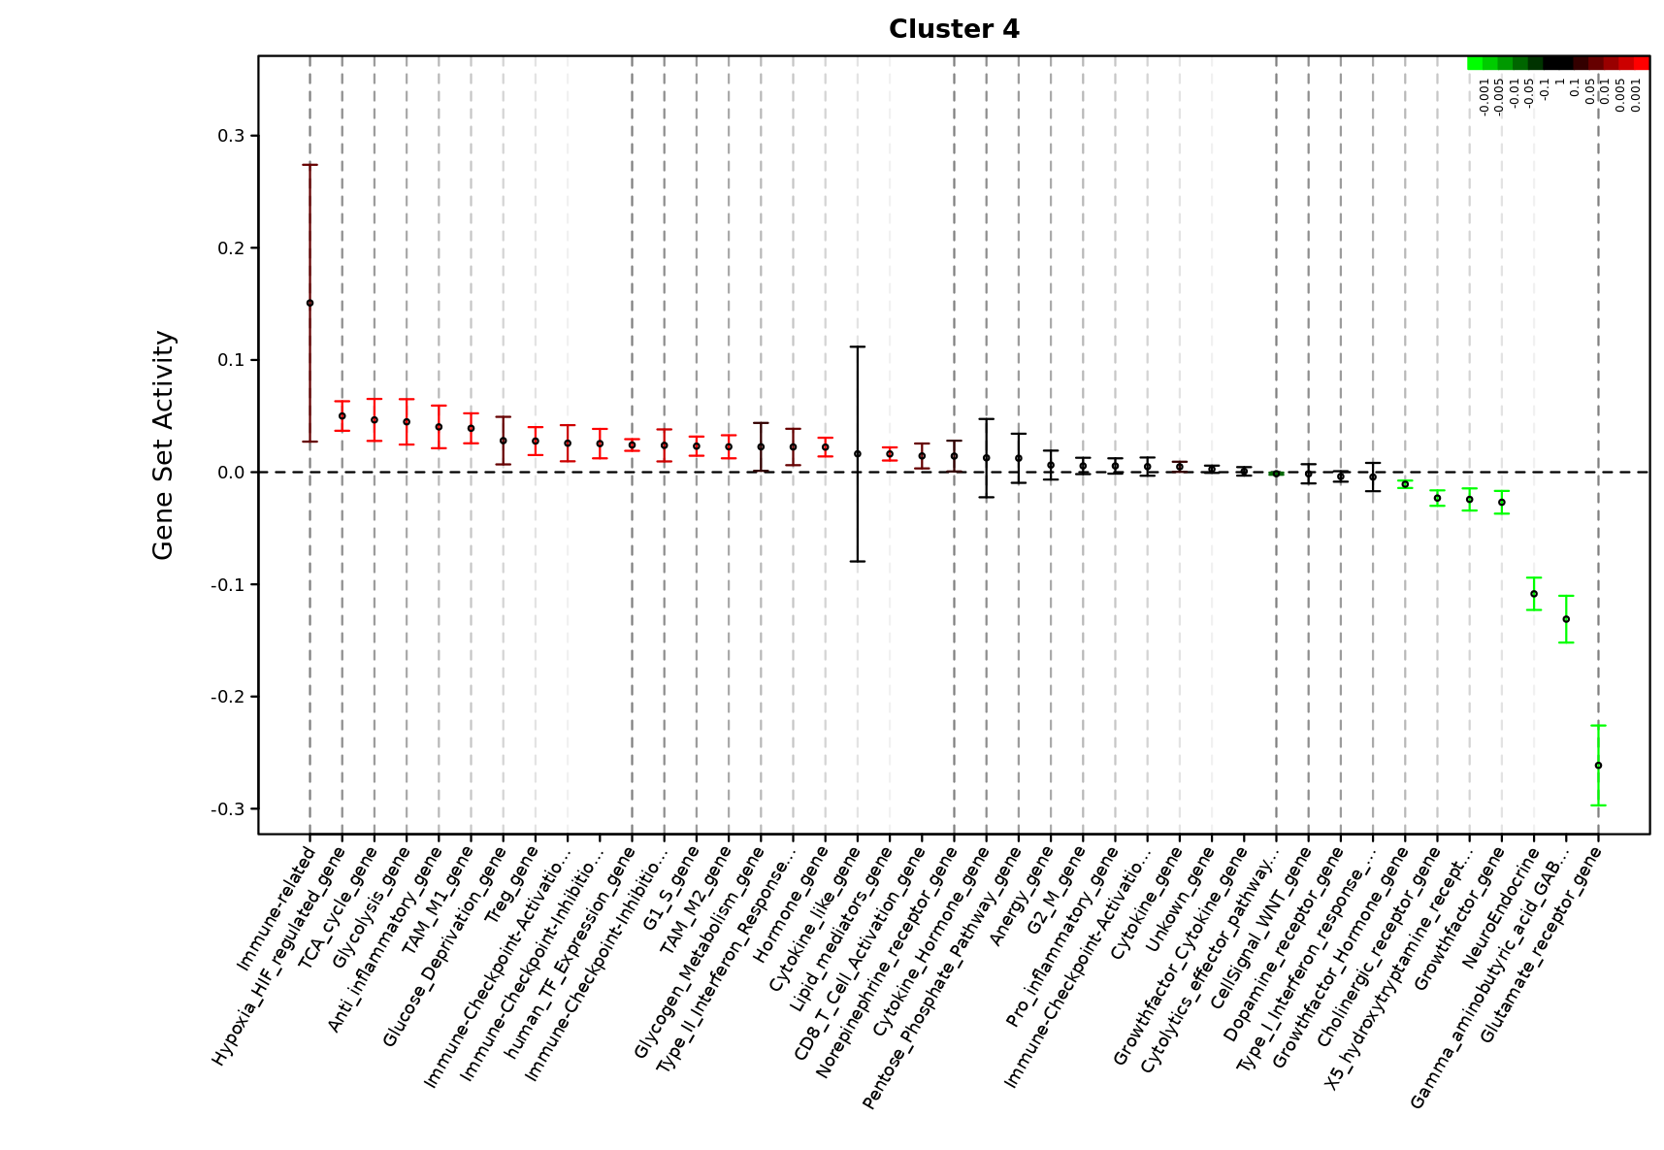
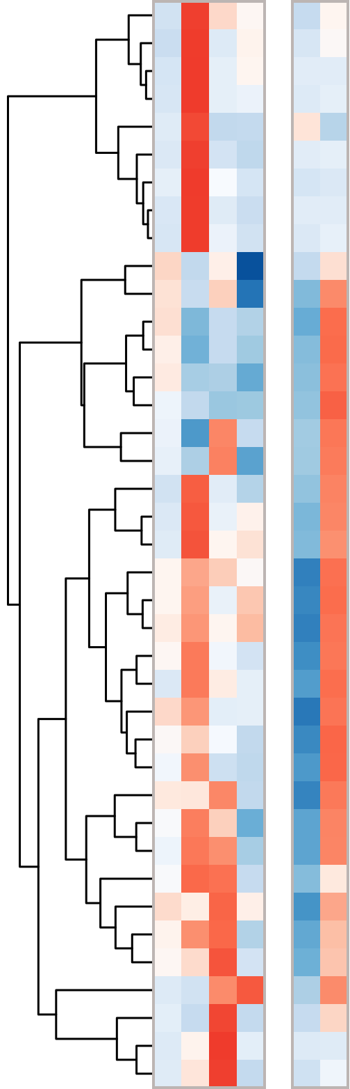
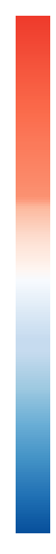
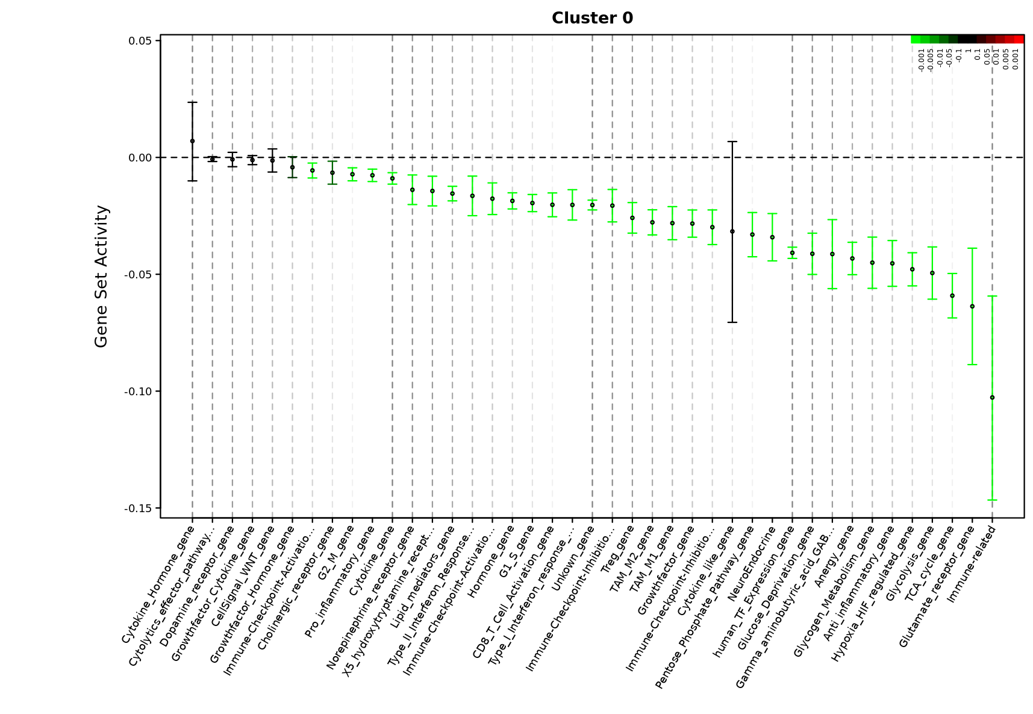
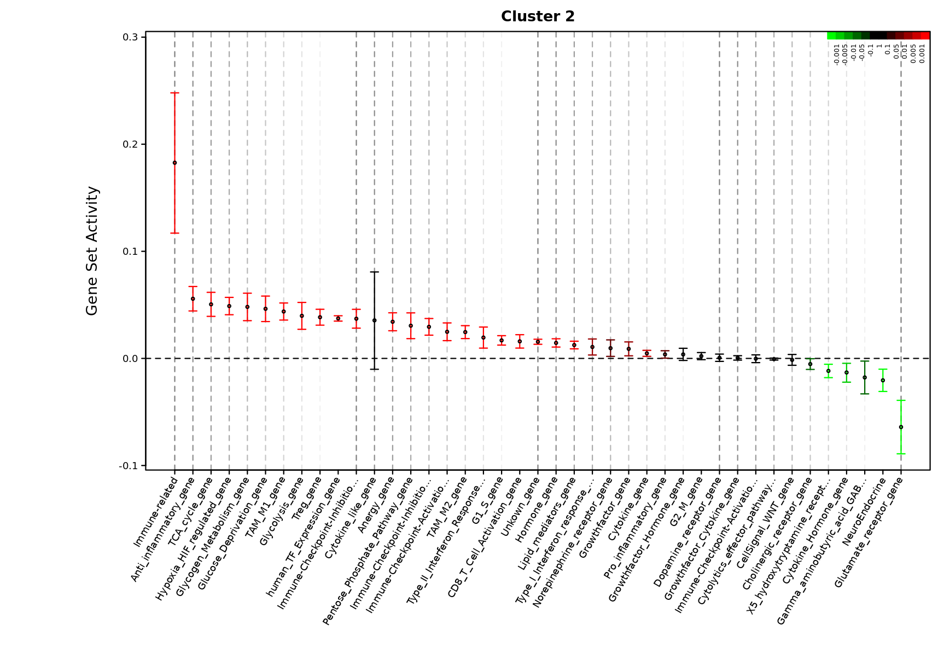
Sup Figure 6.
b
a
Hip_M0
Dopamine_receptor_gene
Cytolytics_effector_pathway_gene
Cytokine_Hormone_gene
Gamma_aminobutyric_acid_GABA_receptor_gene
Glutamate_receptor_gene
NeuroEndocrine
Cholinergic_receptor_gene
X5_hydroxytryptamine_receptor_gene
Glycogen_Metabolism_gene
human_TF_Expression_gene
Growthfactor_gene
Unkown_gene
CellSignal_WNT_gene
G2_M_gene
Anergy_gene
Growthfactor_Hormone_gene
CD8_T_Cell_Activation_gene
Type_II_Interferon_Response_gene
Cytokine_like_gene
TAM_M1_gene
Immune−Checkpoint−Inhibition−Ligand−Gene
TAM_M2_gene
Type_I_Interferon_response_gene
Immune−Checkpoint−Activation−Receptor−Gene
Hormone_gene
G1_S_gene
TCA_cycle_gene
Lipid_mediators_gene
Glucose_Deprivation_gene
Glycolysis_gene
Hypoxia_HIF_regulated_gene
Immune−Checkpoint−Inhibition−Receptor−Gene
Immune−Checkpoint−Activation−Ligand−Gene
Immune−related
Anti_inflammatory_gene
Treg_gene
High
Low
c
Hip_M1
d
Hip_M4
Hip_M2
Hip_M3
Hip_M5
Hip_M6
Hip_M7
Hip_M8
Hip_M9
Hip_M1
Hip_M4
Hip_M0
e
Growthfactor_gene
Growthfactor_Cytokine_gene
Glutamate_receptor_gene
NeuroEndocrine
Cytokine_Hormone_gene
Cholinergic_receptor_gene
X5_hydroxytryptamine_receptor_gene
CellSignal_WNT_gene
Gamma_aminobutyric_acid_GABA_receptor_gene
Dopamine_receptor_gene
Growthfactor_Hormone_gene
Anti_inflammatory_gene
Treg_gene
Immune−Checkpoint−Inhibition−Receptor−Gene
Immune−related
TAM_M1_gene
Immune−Checkpoint−Activation−Ligand−Gene
Cytokine_like_gene
human_TF_Expression_gene
Unkown_gene
G1_S_gene
Pentose_Phosphate_Pathway_gene
Lipid_mediators_gene
TCA_cycle_gene
Glycogen_Metabolism_gene
Hormone_gene
Hypoxia_HIF_regulated_gene
Glucose_Deprivation_gene
CD8_T_Cell_Activation_gene
Glycolysis_gene
Anergy_gene
G2_M_gene
Pro_inflammatory_gene
Type_I_Interferon_response_gene
Cytokine_gene
Type_II_Interferon_Response_gene
TAM_M2_gene
Cytolytics_effector_pathway_gene
Immune−Checkpoint−Activation−Receptor−Gene
High
f
PFC_M0
Low
g
PFC_M2
PFC _M1
PFC _M3
PFC _M4
PFC _M5
PFC _M0
PFC_M2

Slide 7
Sup Figure 7.
a
b
c
d
e
f

Slide 8
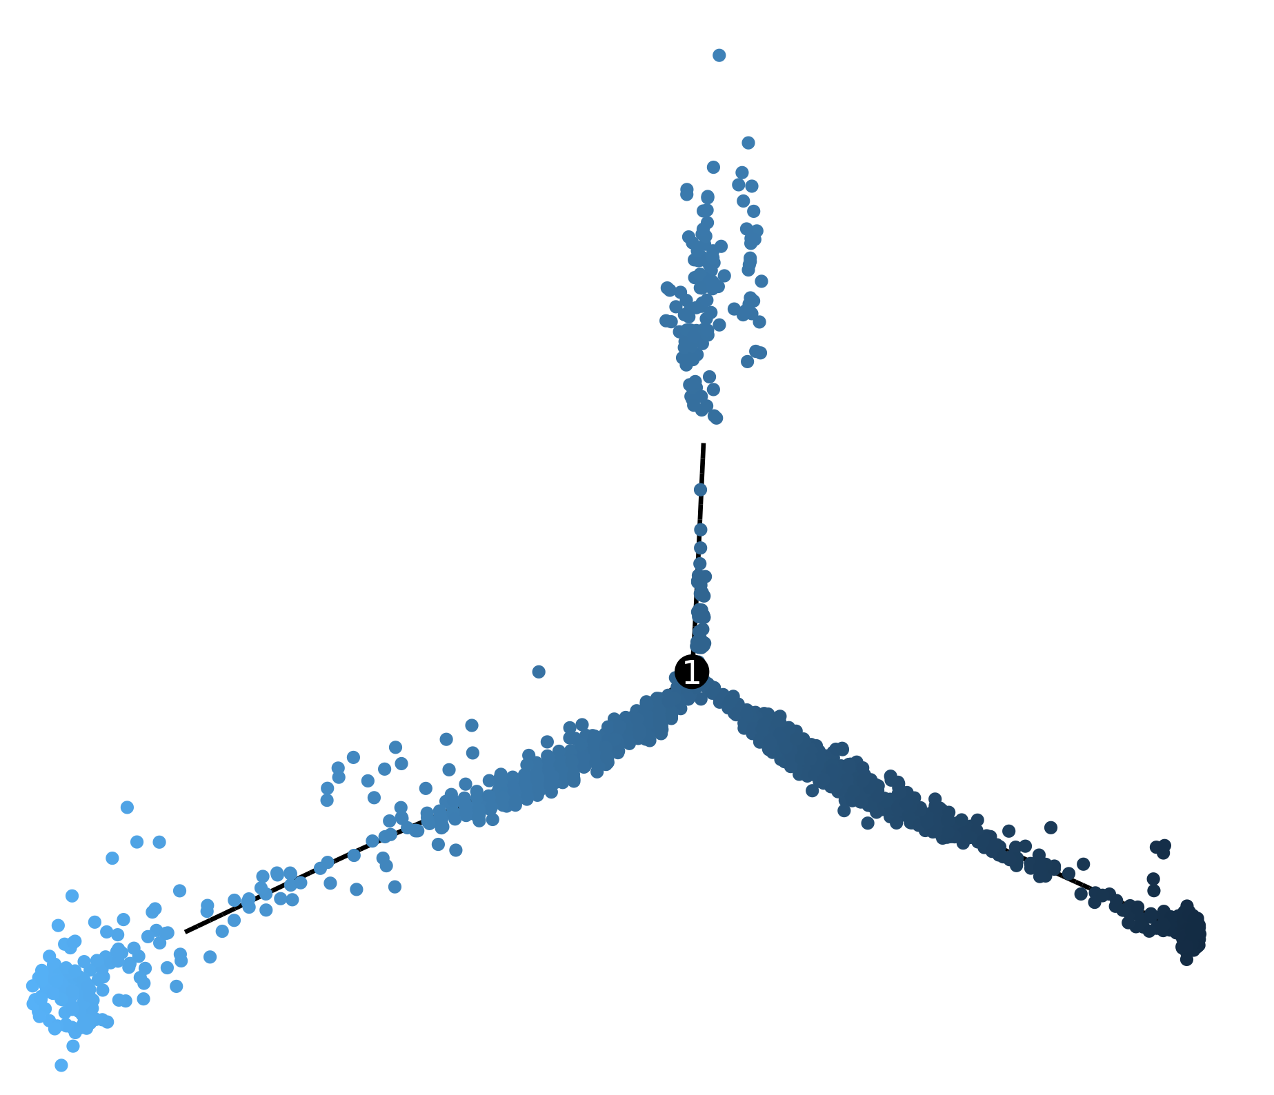
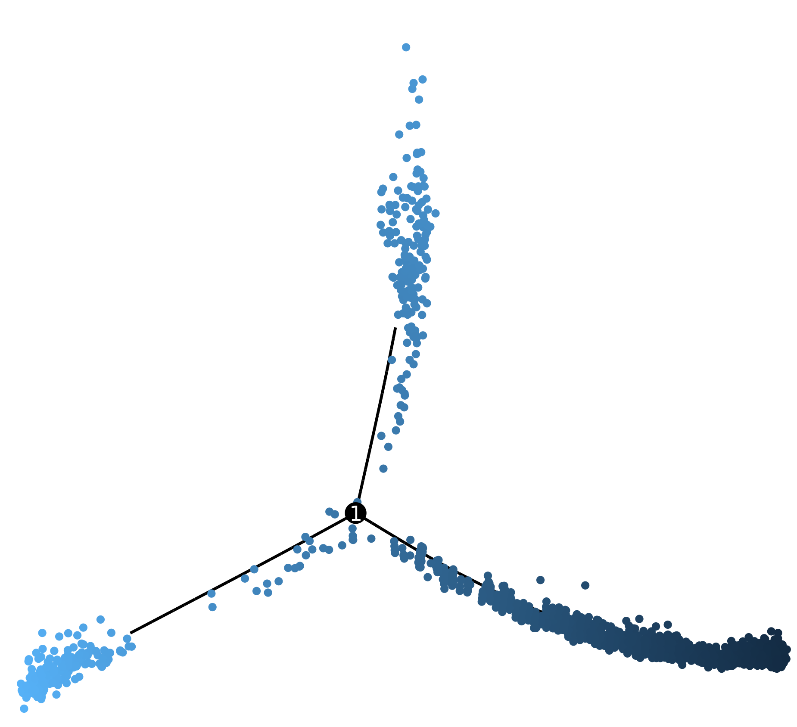
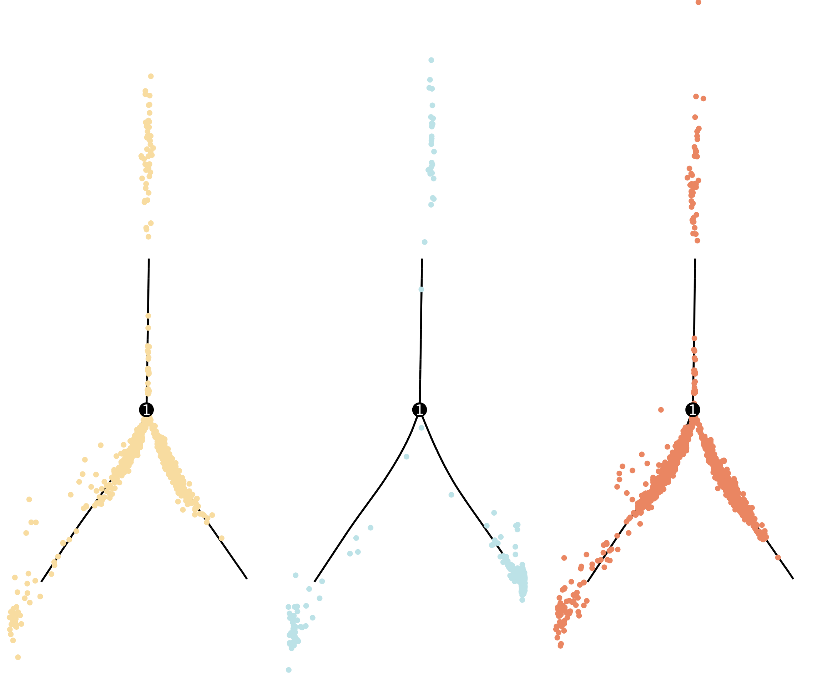
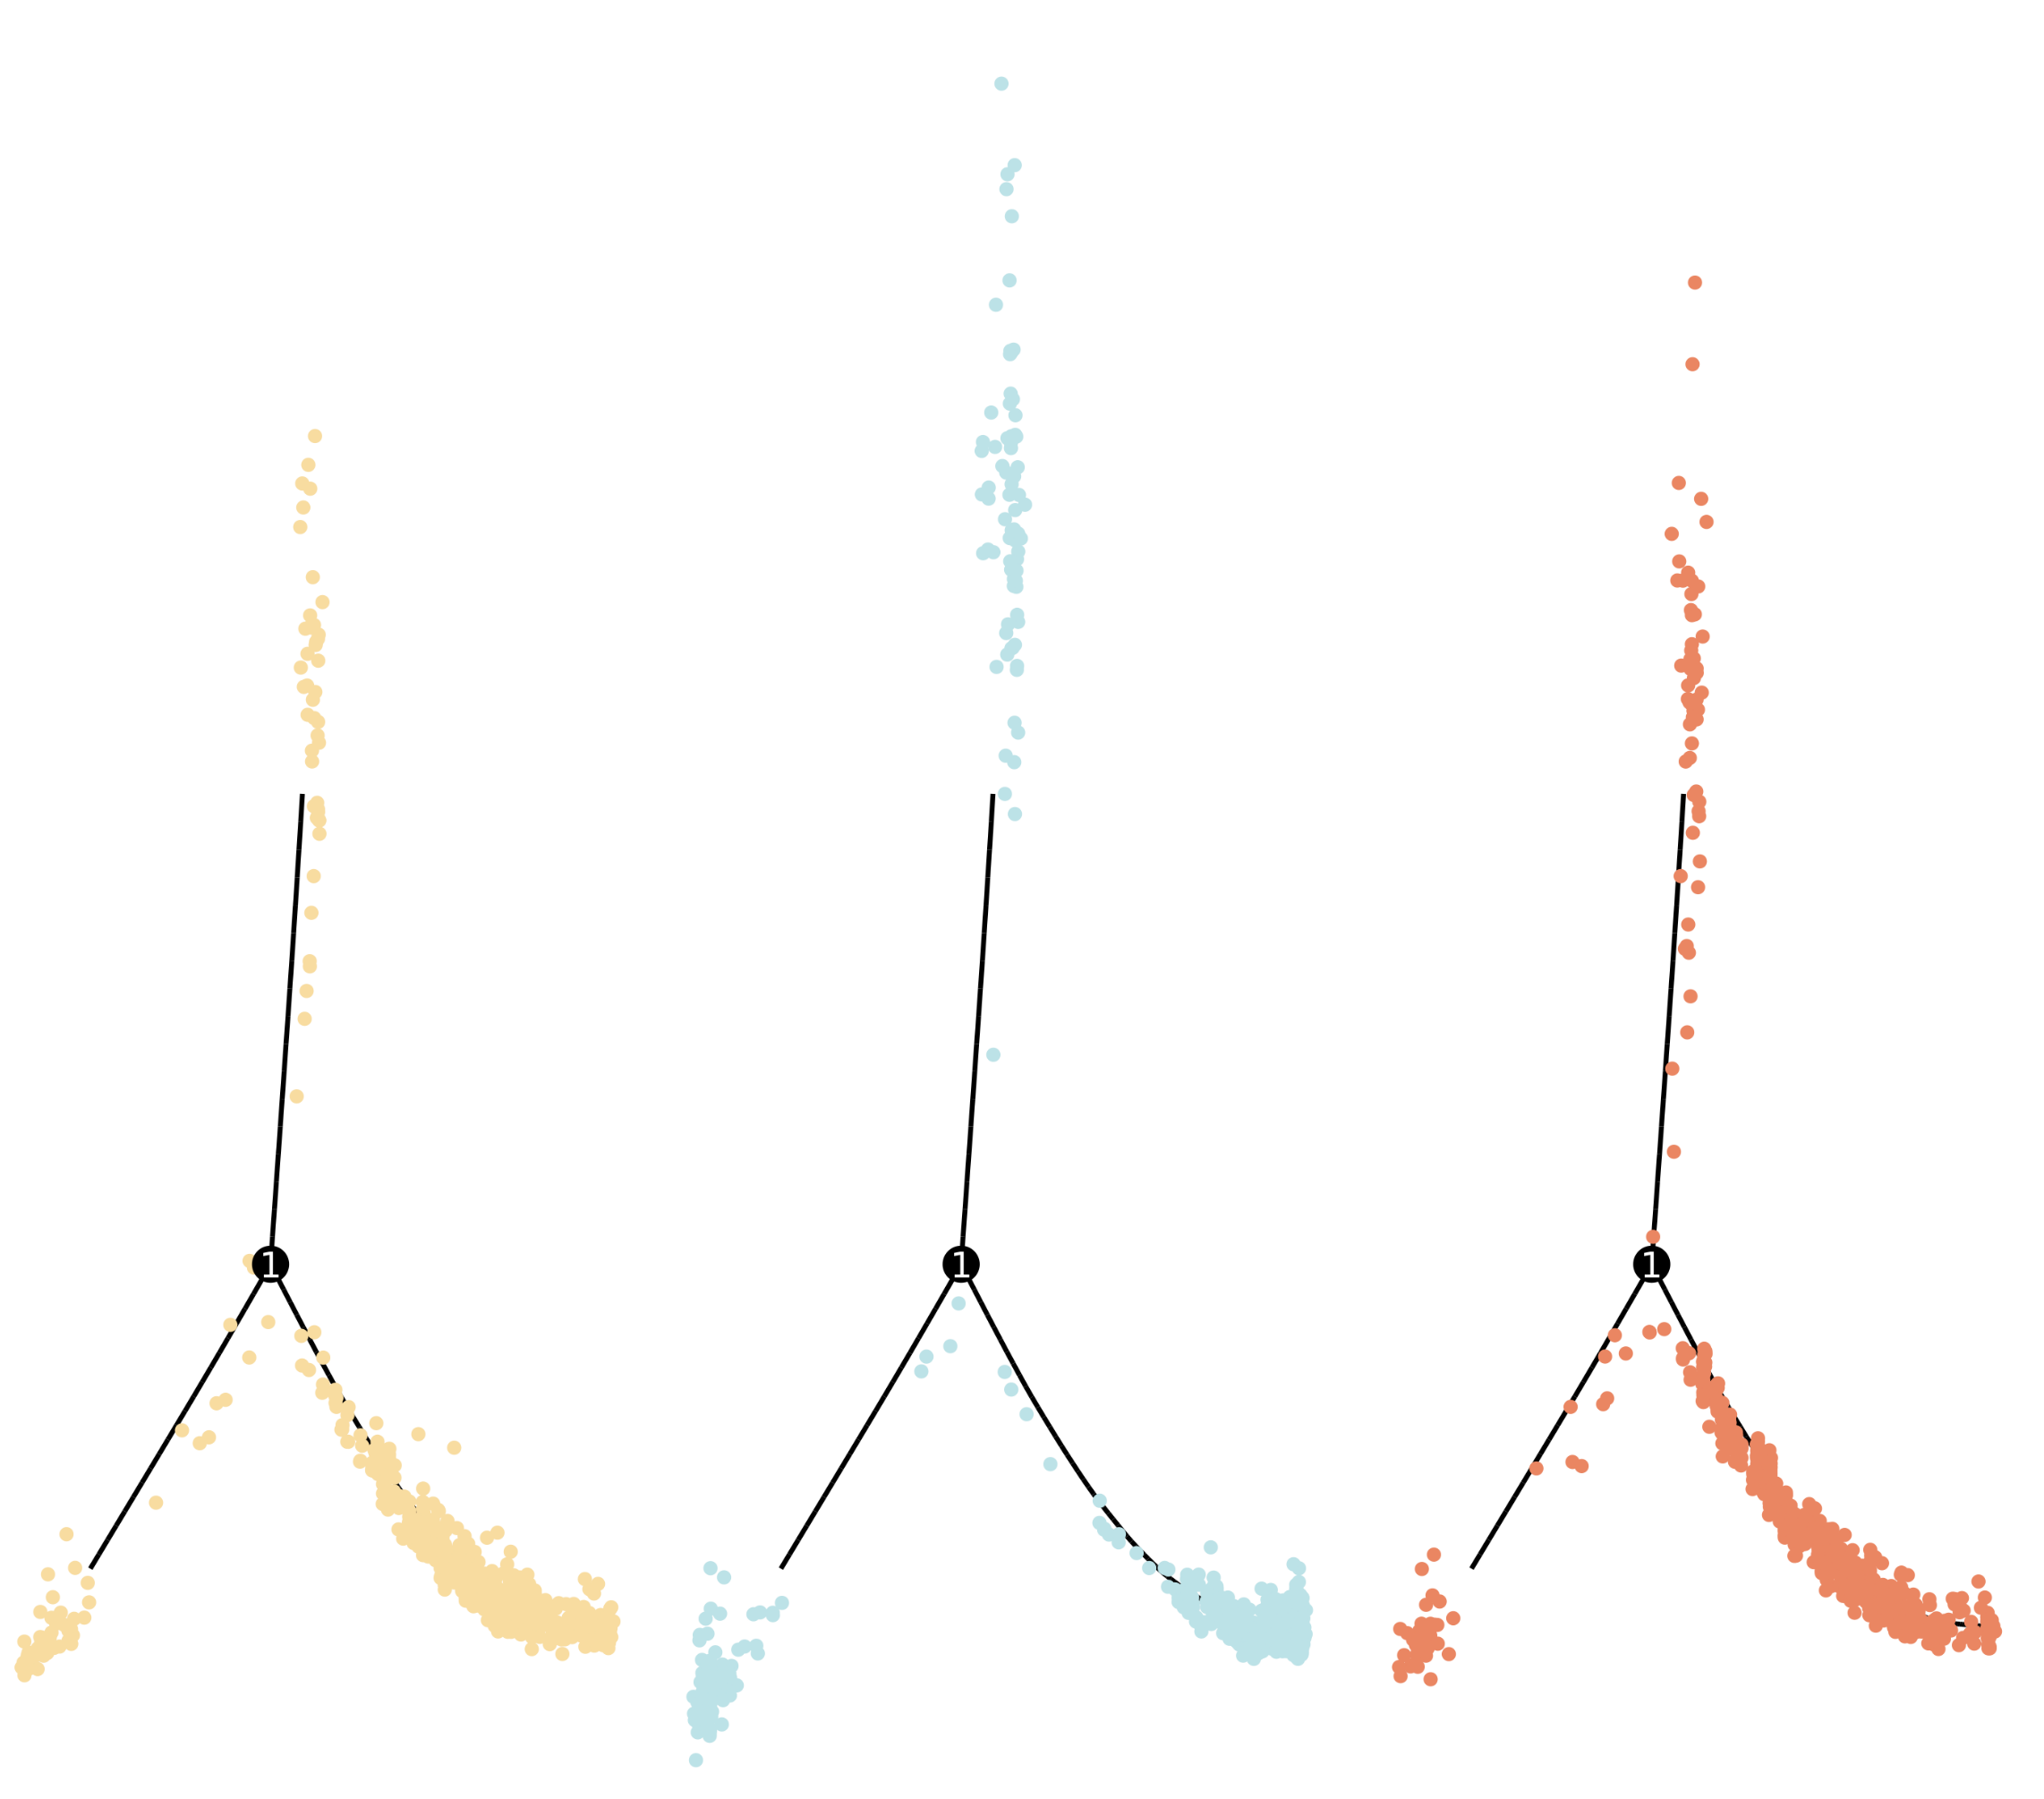
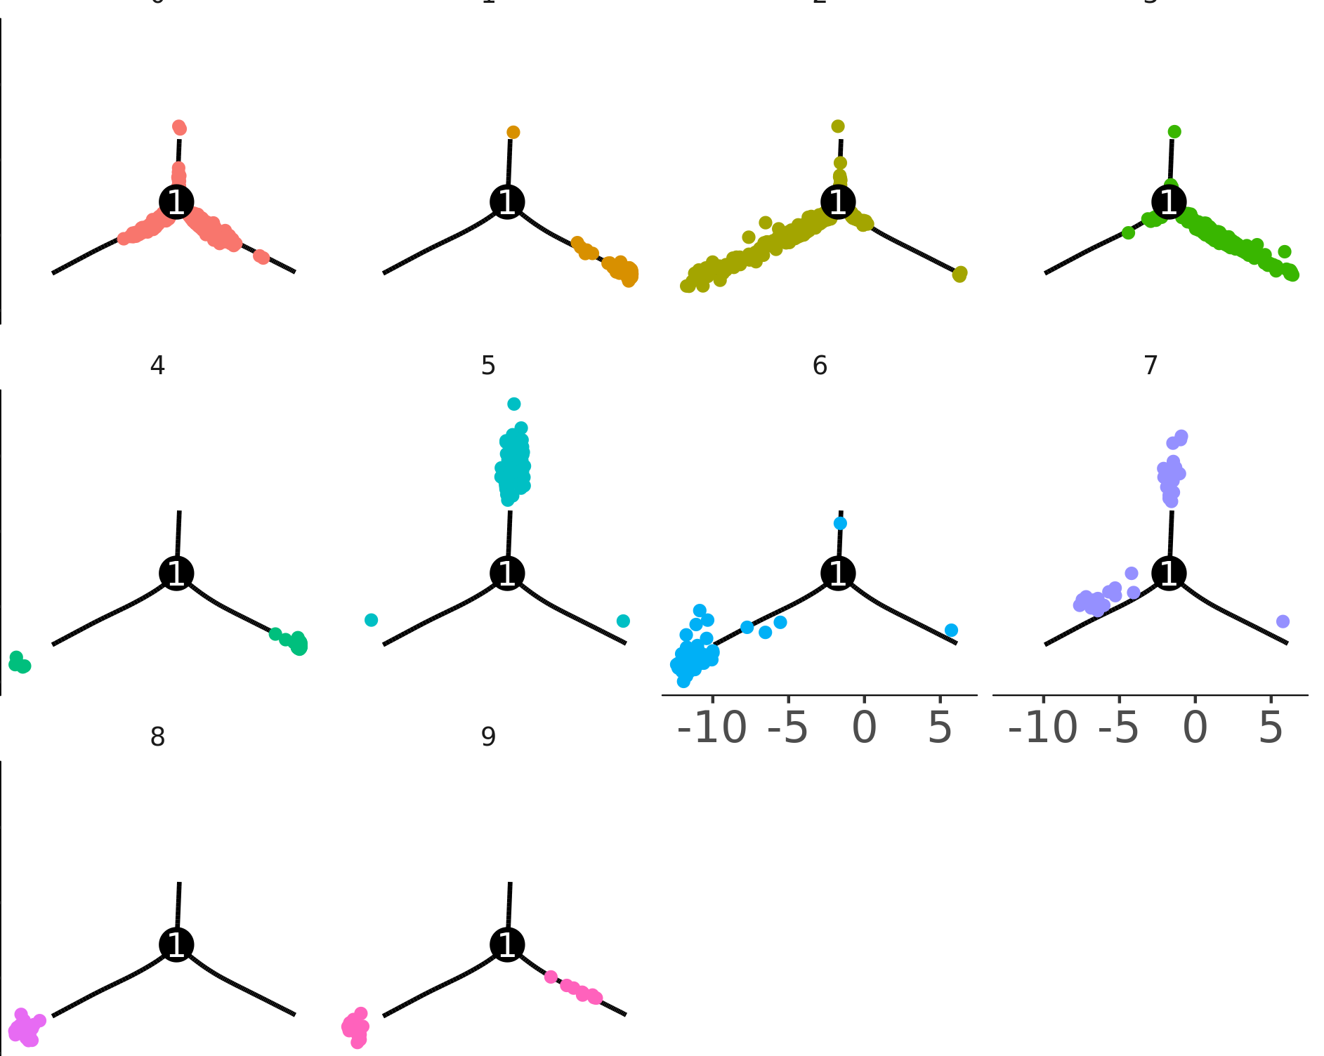
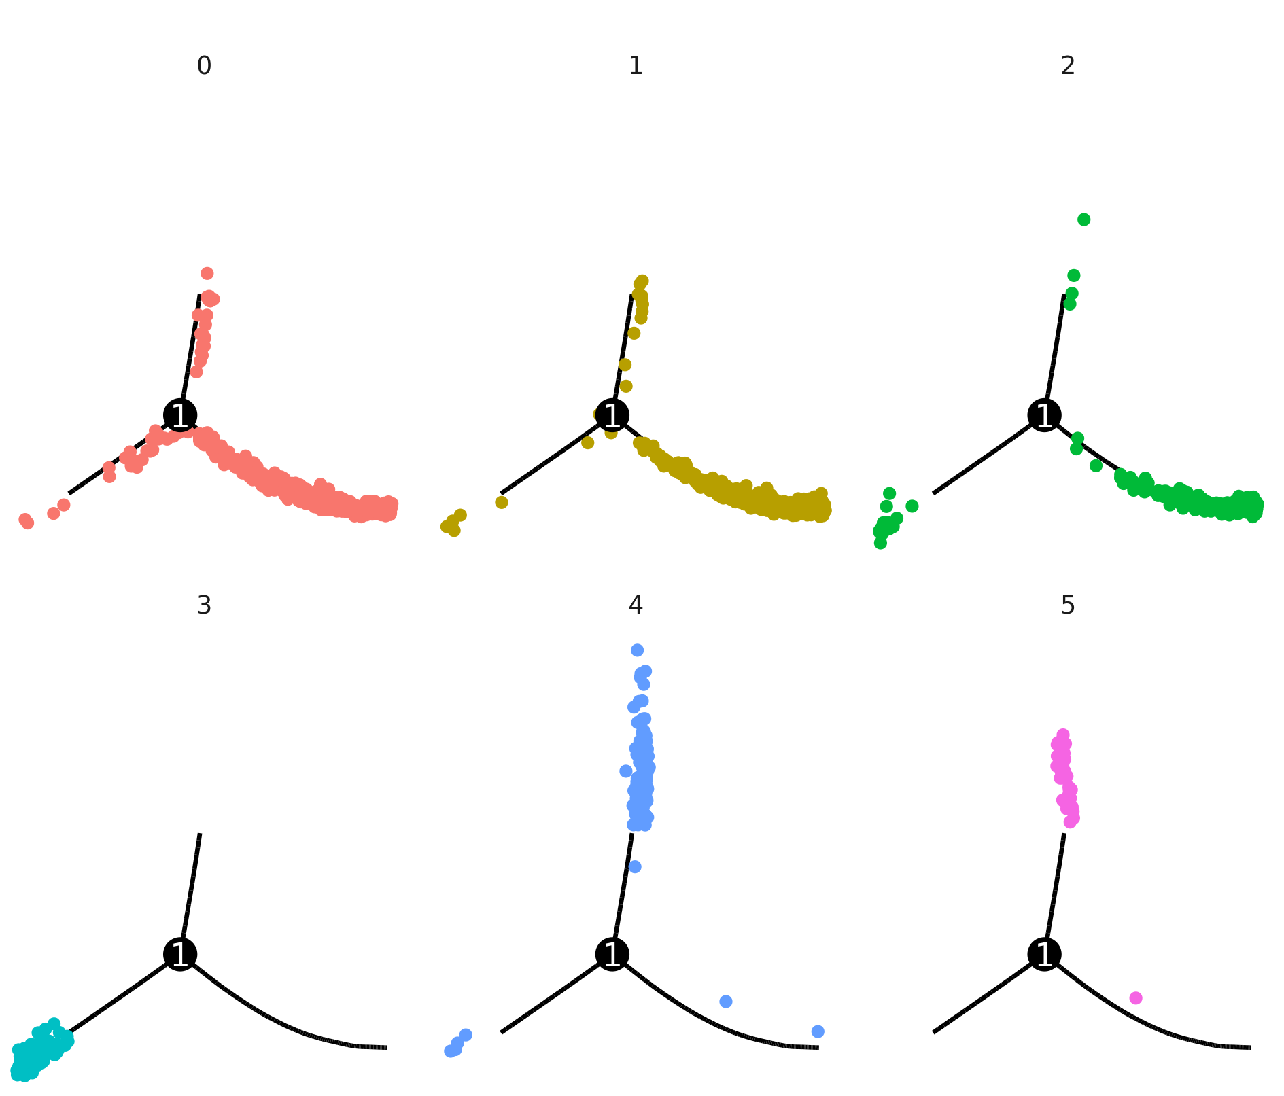
Sup Figure 8.
a
b
State 2
State 2
Start
End
Start
End
Component1
Component1
State 3
State 1
State 3
State 1
c
Component2
d
Component2
CGF
GF
SPF
CGF
GF
SPF
Fate 2
Fate 2
Fate 2
Fate 2
Fate 2
Fate 2
Component1
Component1
Fate 3
Fate 1
Fate 3
Fate 1
Fate 3
Fate 1
Fate 3
Fate 1
Fate 3
Fate 1
Fate 3
Fate 1
e
Component2
f
Component2
H_M0
H_M1
H_M2
H_M3
P_M0
P_M1
P_M2
H_M4
H_M5
H_M6
H_M7
Component1
Component1
P_M3
P_M4
P_M5
H_M8
H_M9
Component2
Component2

