Slide 1

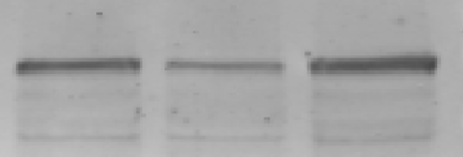





The original photos of Western blot assays for Fig. 1C and 1G.
Fig 1C
Fig 1G
E-cadherin
Collagen-1
α-SMA
Collagen-4
Vimentin
GAPDH
GAPDH

