Slide 1
Supplemental figures legend：
Fig. S1. Seeding morphology characteristics of waxy maize seedling plants exposed to 10 days normal temperature
(25℃, NT) and low temperature (13 ℃, LT) treatment, foliar sprayed with varied Se dose.
Fig. S2. Correlations between leaf membrane stability index (MSI) and mixed data of (a) leaf AsA content, and (b) leaf
GSH content which were grown under normal temperature (NT) and low temperature (LT) conditions in waxy
maize plants. Mean values ± SE for each combination of MSI value and AsA content or GSH content are
shown (n = 4). ** indicates differences significant at 0.01 level.

Slide 2
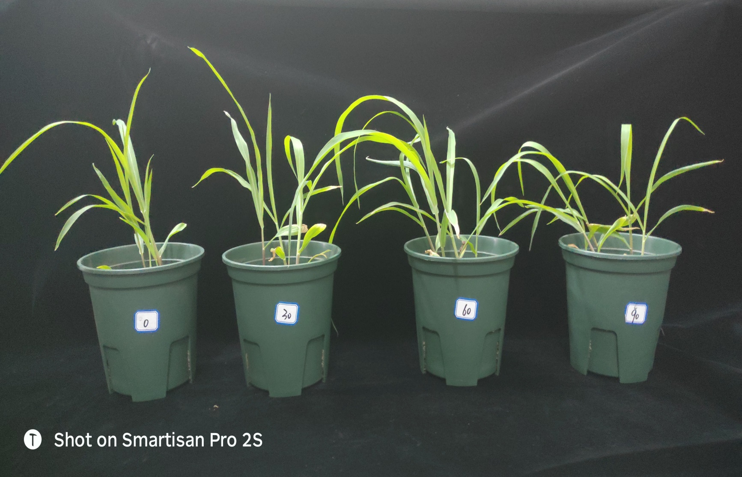
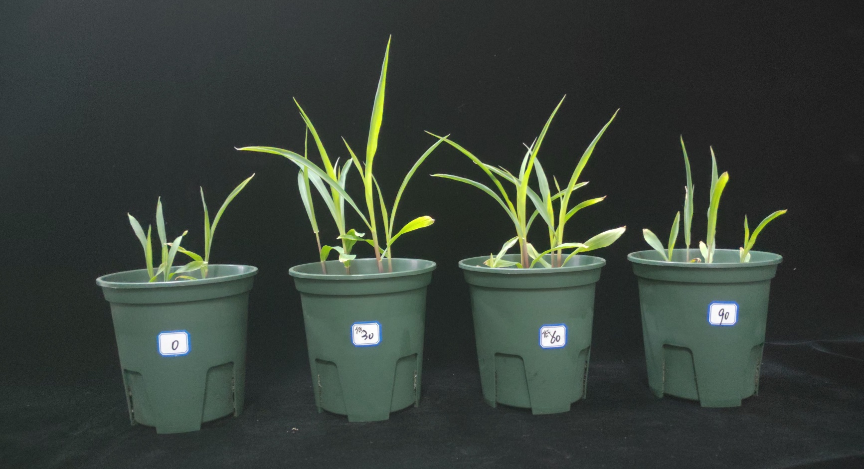
NT
LT
0 mg/L 30 mg/L 60 mg/L 90 mg/L
Fig. S1. Seeding morphology characteristics of waxy maize seedling plants exposed to 10 days normal temperature (25℃, NT) and low temperature (13 ℃, LT) treatment, foliar sprayed with varied Se dose.

Slide 3
Fig. S2. Correlations between leaf membrane stability index (MSI) and mixed data of (a) leaf AsA content, and (b) leaf GSH content which were grown under normal temperature (NT) and low temperature (LT) conditions in waxy maize plants. Mean values ± SE for each combination of MSI value and AsA content or GSH content are shown (n = 4). ** indicates differences significant at 0.01 level.

