Slide 1
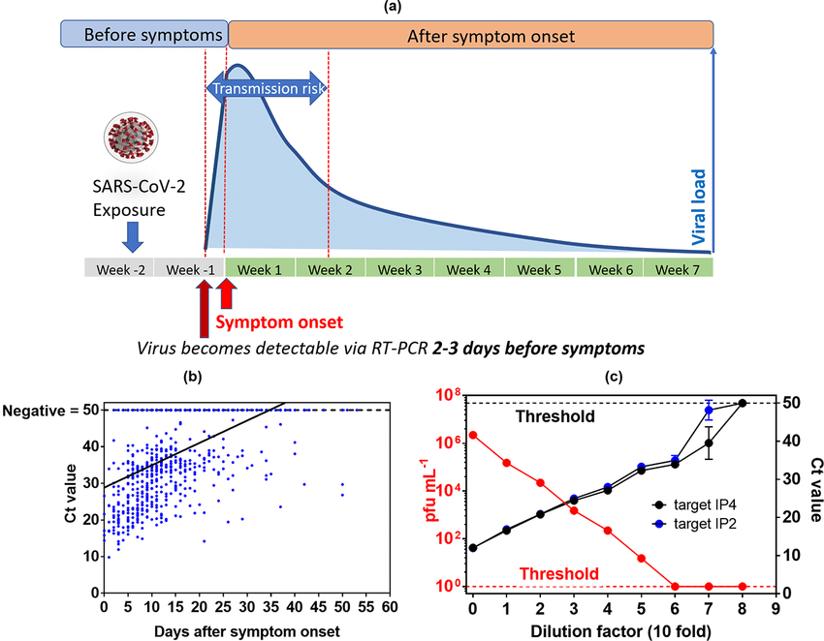
10⁸
10⁷
10⁶
10⁵
10⁴
10³
10²
10¹
DNA conc.
ARMS PCR
StexS PCR
TaqMan PCR
MGB-TaqMan PCR
StexS II PCR
Supplementary Figure 1. Comparison between methods of PCR viable in various DNA concentration and characteristics of SARS-CoV-2 as a RNA based environment

