Slide 1
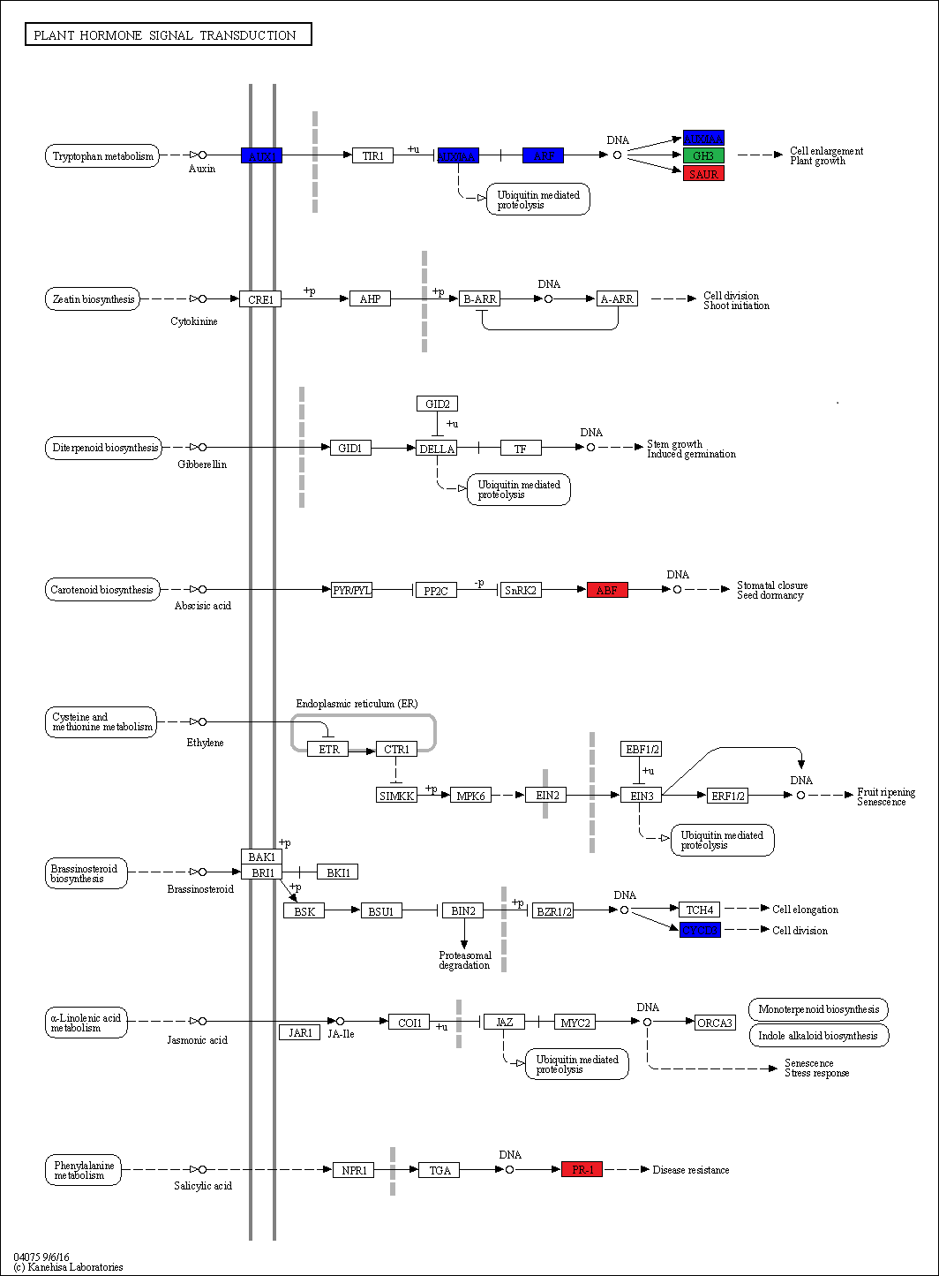
(A)
3 -4.9
1 -4.0
1 -2.5
1 -4.0
1 +1.6
1/1 +1.2
1 +1.9
2 -6.6
2 +5.8

Slide 2
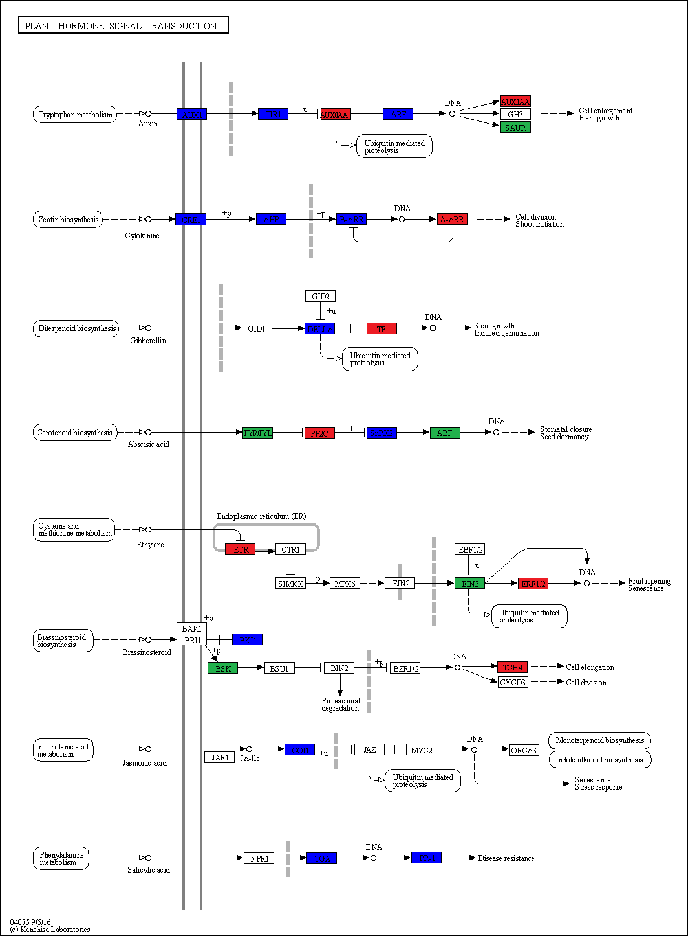
(B)
1 -4.1
1 -2.1
2 +2.1
2 -1.7
2 +2.1
3/3 +0.5
1 -1.8
1 -1.6
1 -1.7
1 +6.0
1 +1.9
1 -2.0
1/1 -0.2
3 +2.6
1 -1.9
1/1 +0.1
2 +2.1
2 +4.7
1/1 2.9
1 -1.8
2 +3.7
1/1 -0.2
1 -1.5
2 -2.7
1 -1.5
Figure S4 – KEGG orthology map for plant hormone signal transduction. The KEGG orthology maps (pvu04075) of BAT93 (A) and JaloEEP558 (B) highlight DEGs that were induced (red), repressed (blue), or both induced and repressed (green) 48 h after inoculation with Xanthomonas phaseoli pv. phaseoli. The number of DEGs (colored numbers) and the average Log2FC (black numbers) are indicated above the boxes.

