Slide 1
Figure S1 Plots of average linkage disequilibrium values (r²) against physical distances in increments of 10 kb. Gray curves show local polynomial fits obtained using kernel smoothing regression. Dotted lines indicate the genetic distance at which r² fell below 0.2
Title: Genome-wide association study of individual sugar content and sugar conversion in fruit of Japanese pear (Pyrus spp.)
Authors: Sogo Nishio¹*, Takeshi Hayash^{i2}, Kenta Shirasawa³, Toshihiro Saito¹, Shingo Terakami¹, Norio Takada¹, Yukie Takeuchi¹, Shigeki Moriya⁴ & Akihiko Itai⁵
Authors’ addresses:
¹Institute of Fruit Tree and Tea Science, NARO, 2-1 Fujimoto, Tsukuba, Ibaraki, Japan
²Research Center for Agricultural Information Technology, NARO 3-1-1 Kannondai, Tsukuba, Ibaraki 305-8666, Japan
³Kazusa DNA Research Institute, 2-6-7 Kazusa-Kamatari, Kisarazu, Chiba 292-0818, Japan
⁴Apple Research Station, Institute of Fruit Tree Science, NARO, Morioka, Iwate 020-0123, Japan
⁵Graduate School of Life and Environmental Sciences, Kyoto Prefectural University, 74 Kitainayazuma, Seika, Kyoto 619-0244, Japan
*Corresponding author: Sogo Nishio, Institute of Fruit Tree and Tea Science, NARO, 2-1 Fujimoto, Tsukuba, Ibaraki 305-8605, Japan; Tel: +81-88-656-9310 nishios@affrc.go.jp

Slide 2
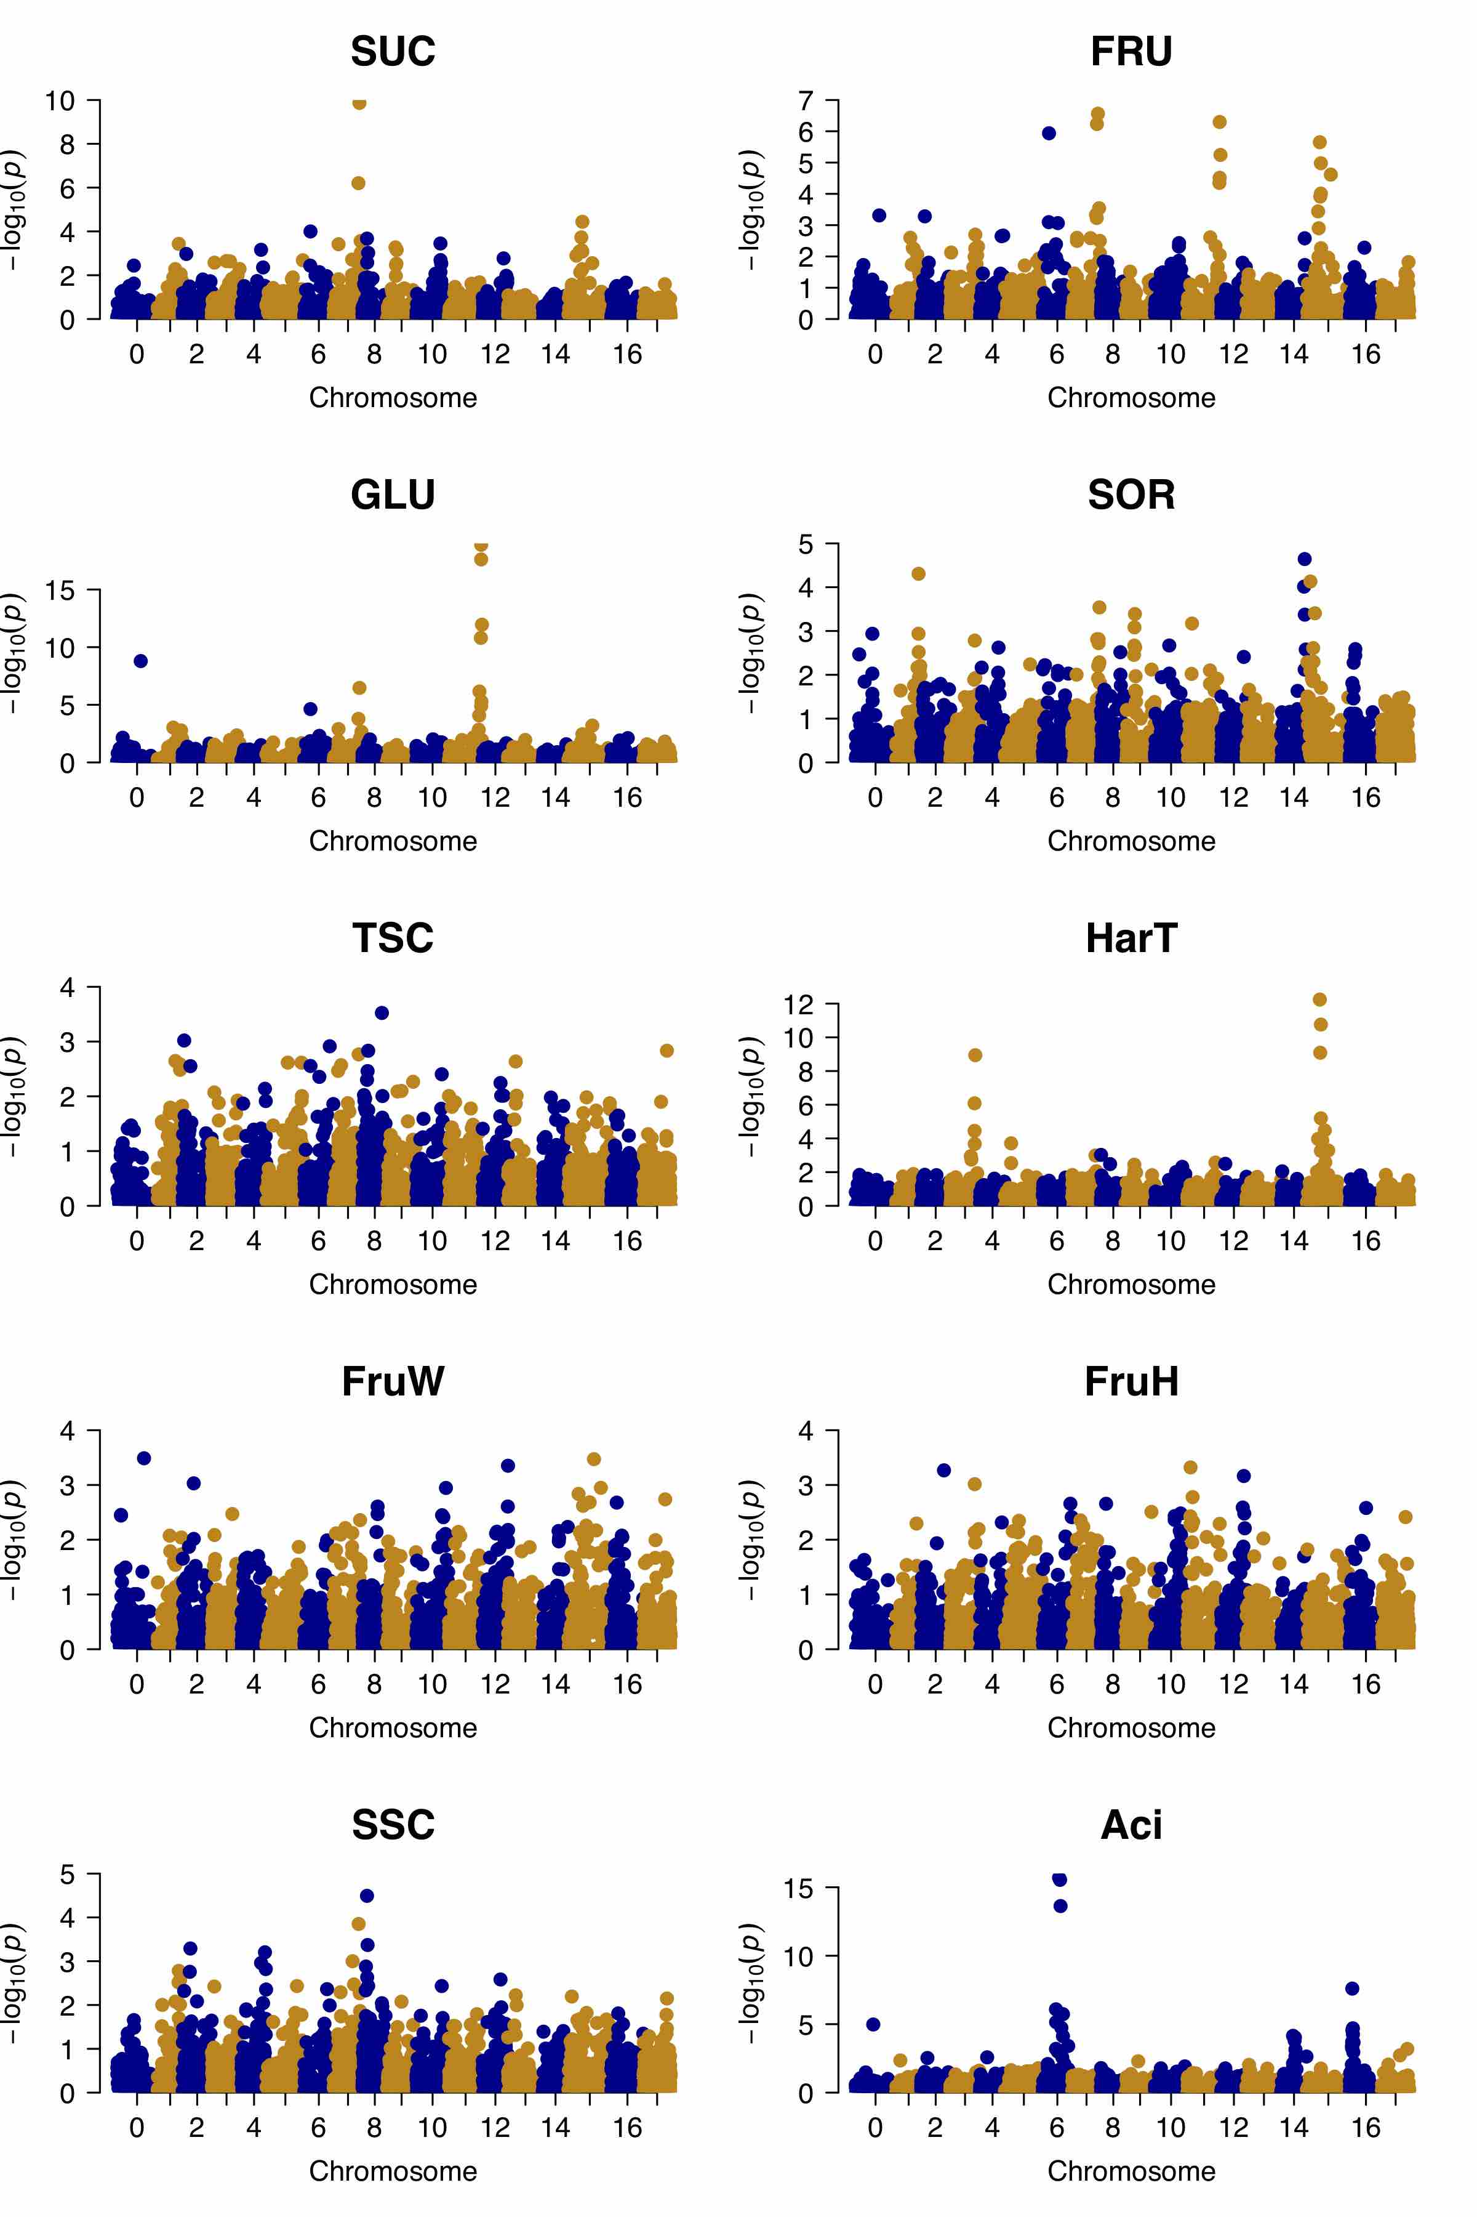
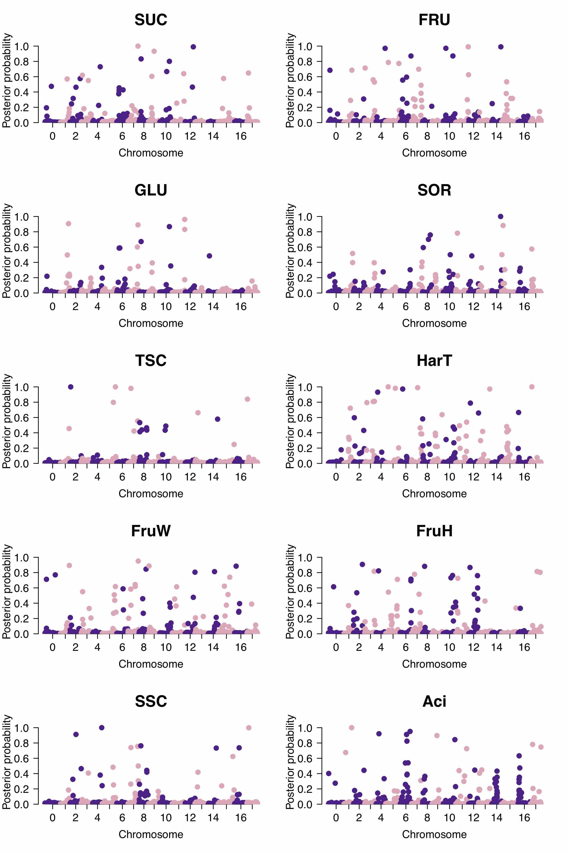
(a)
MLM
(b)
vBayesB
Figure S2 Summary of the result of genome-wide association studies using two different models. a Manhattan plots of −log10(p) values based on a MLM for 10 fruit traits. Red lines indicate a false discovery rate of 0.05. Chromosome location information is based on GDDH13 Version 1.1. The fictive chromosome 0 contains all unassigned scaffolds. b Posterior probability of having a QTL based on vBayesB, estimated for 10 fruit traits
Title: Genome-wide association study of individual sugar content and sugar conversion in fruit of Japanese pear (Pyrus spp.)
Authors: Sogo Nishio¹*, Takeshi Hayash^{i2}, Kenta Shirasawa³, Toshihiro Saito¹, Shingo Terakami¹, Norio Takada¹, Yukie Takeuchi¹, Shigeki Moriya⁴ & Akihiko Itai⁵
Authors’ addresses:
¹Institute of Fruit Tree and Tea Science, NARO, 2-1 Fujimoto, Tsukuba, Ibaraki, Japan
²Research Center for Agricultural Information Technology, NARO 3-1-1 Kannondai, Tsukuba, Ibaraki 305-8666, Japan
³Kazusa DNA Research Institute, 2-6-7 Kazusa-Kamatari, Kisarazu, Chiba 292-0818, Japan
⁴Apple Research Station, Institute of Fruit Tree Science, NARO, Morioka, Iwate 020-0123, Japan
⁵Graduate School of Life and Environmental Sciences, Kyoto Prefectural University, 74 Kitainayazuma, Seika, Kyoto 619-0244, Japan
*Corresponding author: Sogo Nishio, Institute of Fruit Tree and Tea Science, NARO, 2-1 Fujimoto, Tsukuba, Ibaraki 305-8605, Japan; Tel: +81-88-656-9310 nishios@affrc.go.jp

Slide 3
SUC
FRU
GLU
SOR
TSC
SUC
FRU
GLU
SOR
TSC
SUC
FRU
GLU
SOR
TSC
Figure S3 Average value and distribution of individual sugar contents for each genotype of three SNPs for 1218 individuals. Error bars show 95% confidence intervals
Title: Genome-wide association study of individual sugar content and sugar conversion in fruit of Japanese pear (Pyrus spp.)
Authors: Sogo Nishio¹*, Takeshi Hayash^{i2}, Kenta Shirasawa³, Toshihiro Saito¹, Shingo Terakami¹, Norio Takada¹, Yukie Takeuchi¹, Shigeki Moriya⁴ & Akihiko Itai⁵
Authors’ addresses:
¹Institute of Fruit Tree and Tea Science, NARO, 2-1 Fujimoto, Tsukuba, Ibaraki, Japan
²Research Center for Agricultural Information Technology, NARO 3-1-1 Kannondai, Tsukuba, Ibaraki 305-8666, Japan
³Kazusa DNA Research Institute, 2-6-7 Kazusa-Kamatari, Kisarazu, Chiba 292-0818, Japan
⁴Apple Research Station, Institute of Fruit Tree Science, NARO, Morioka, Iwate 020-0123, Japan
⁵Graduate School of Life and Environmental Sciences, Kyoto Prefectural University, 74 Kitainayazuma, Seika, Kyoto 619-0244, Japan
*Corresponding author: Sogo Nishio, Institute of Fruit Tree and Tea Science, NARO, 2-1 Fujimoto, Tsukuba, Ibaraki 305-8605, Japan; Tel: +81-88-656-9310 nishios@affrc.go.jp≈

Slide 4
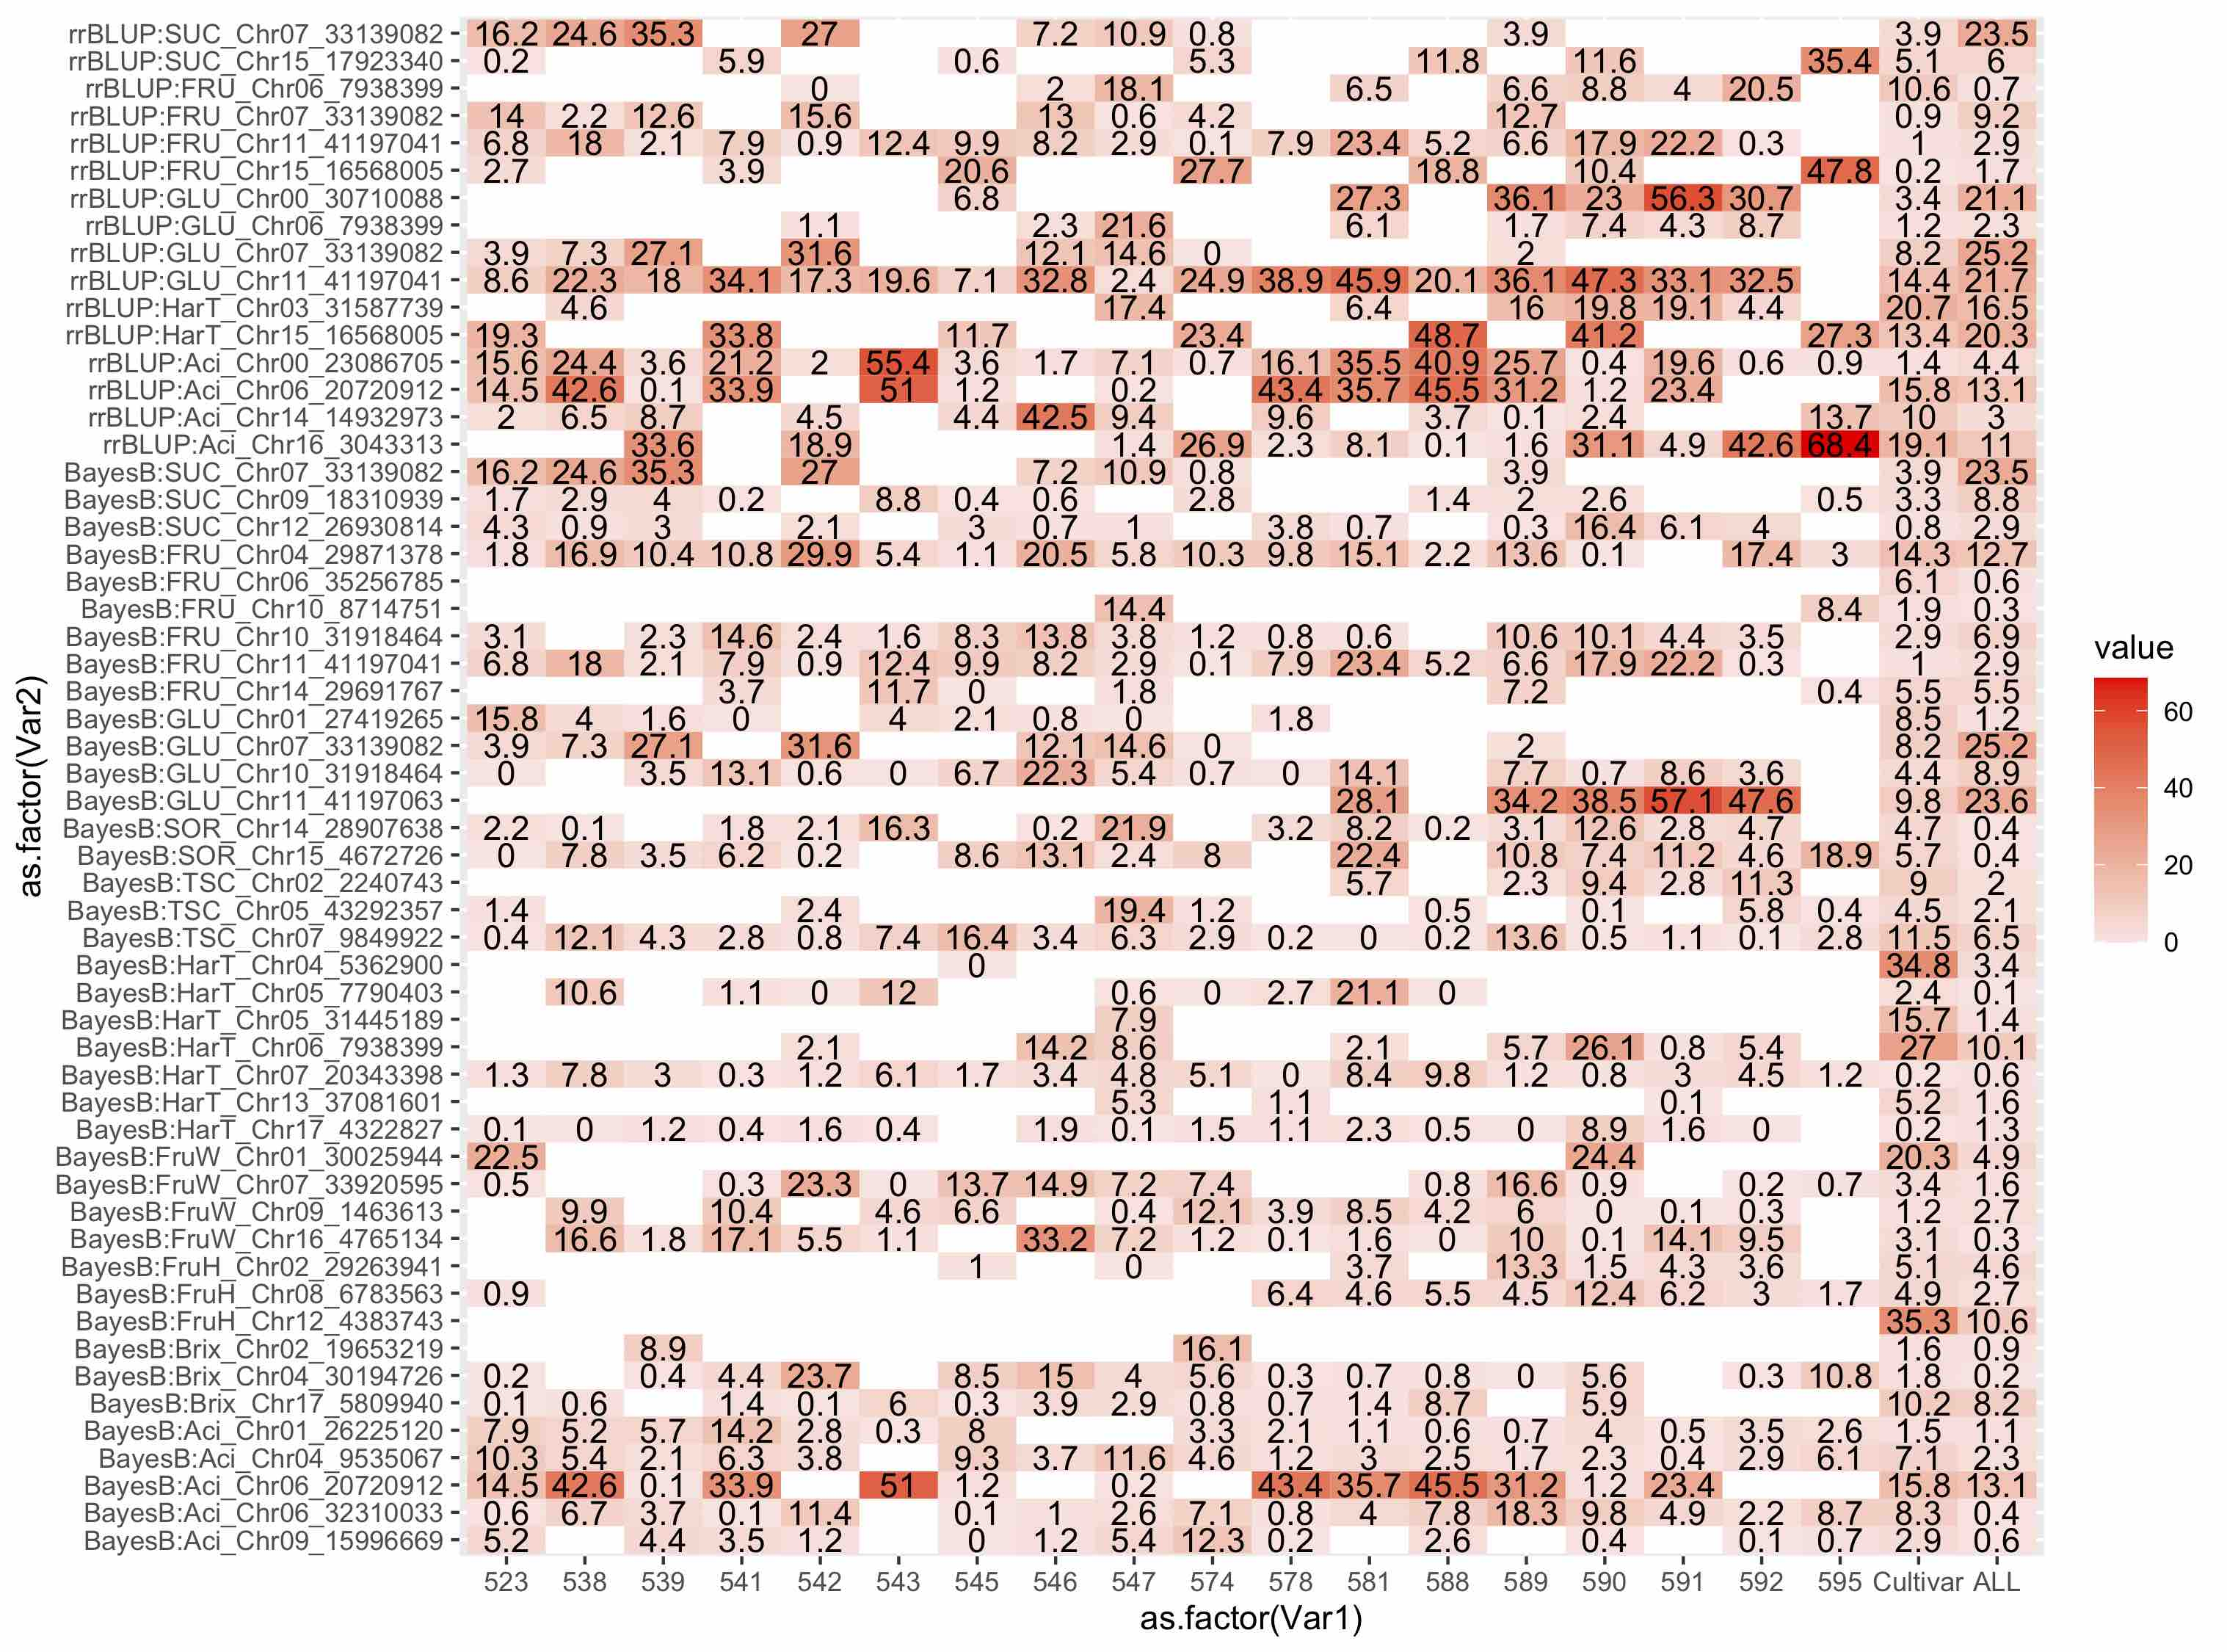
Figure S4 Heatmap showing the percentage of the phenotypic variance explained by each QTL in each population. The percentages for the cultivar collection (designated as “Cultivar”) and for all 1218 accessions including the populations and cultivars (designated as “ALL”) are shown on the right. The prefix rrBLUP indicates the SNPs identified in the MLM-based GWAS analysis; BayesB indicates those identified in the vBayesB-based GWAS. A blank indicates that the population showed no segregation for the SNPs
Title: Genome-wide association study of individual sugar content and sugar conversion in fruit of Japanese pear (Pyrus spp.)
Authors: Sogo Nishio¹*, Takeshi Hayash^{i2}, Kenta Shirasawa³, Toshihiro Saito¹, Shingo Terakami¹, Norio Takada¹, Yukie Takeuchi¹, Shigeki Moriya⁴ & Akihiko Itai⁵
Authors’ addresses:
¹Institute of Fruit Tree and Tea Science, NARO, 2-1 Fujimoto, Tsukuba, Ibaraki, Japan
²Research Center for Agricultural Information Technology, NARO 3-1-1 Kannondai, Tsukuba, Ibaraki 305-8666, Japan
³Kazusa DNA Research Institute, 2-6-7 Kazusa-Kamatari, Kisarazu, Chiba 292-0818, Japan
⁴Apple Research Station, Institute of Fruit Tree Science, NARO, Morioka, Iwate 020-0123, Japan
⁵Graduate School of Life and Environmental Sciences, Kyoto Prefectural University, 74 Kitainayazuma, Seika, Kyoto 619-0244, Japan
*Corresponding author: Sogo Nishio, Institute of Fruit Tree and Tea Science, NARO, 2-1 Fujimoto, Tsukuba, Ibaraki 305-8605, Japan; Tel: +81-88-656-9310 nishios@affrc.go.jp≈

