Slide 1
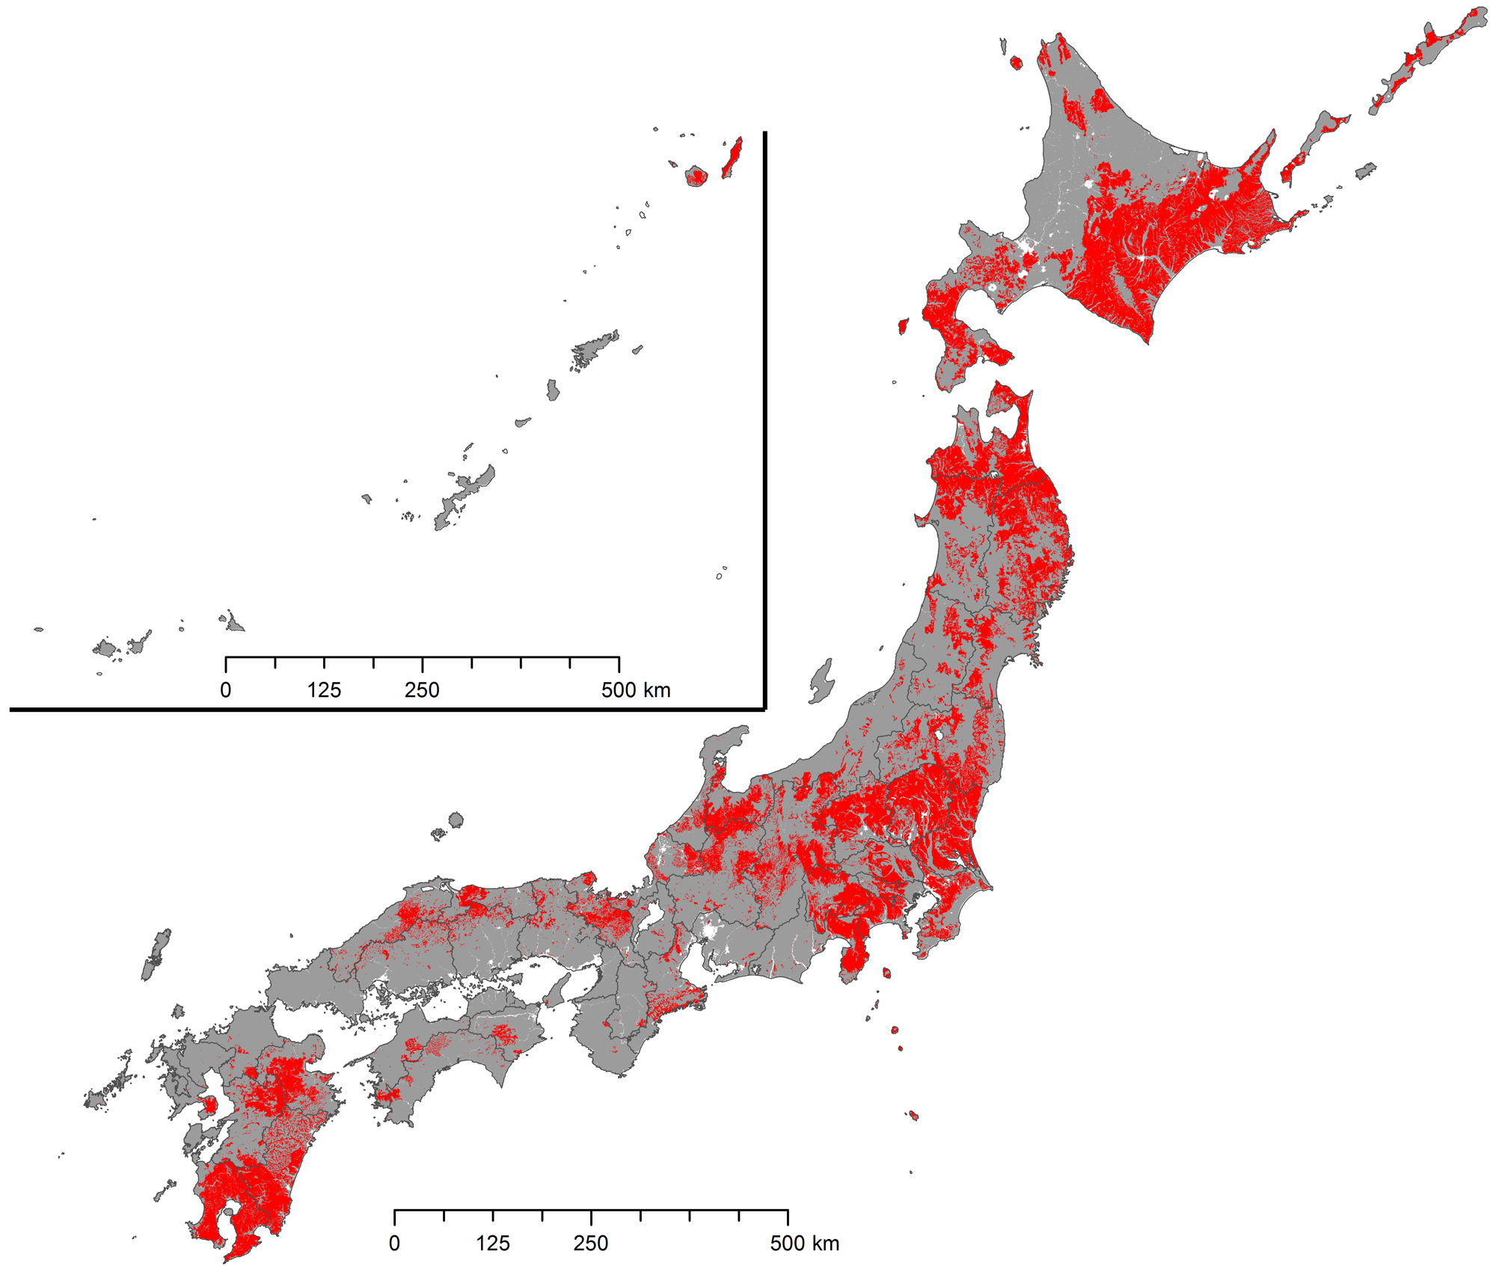
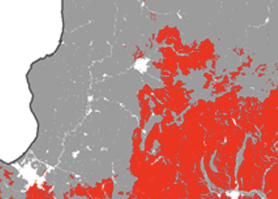
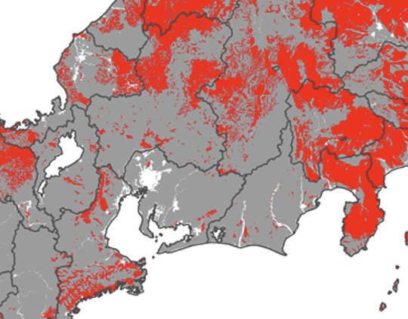
E
f
D
c
e
d
b
C
B
a
A
Supplemental Fig. 1. Andosol area of Japan and sampling points of three kinds of plants (white clover, mugwort, yoshino cherry). Andosol area is indicated in red color. A-E: sampling points of non-volcanic ash soil areas; a-f: sampling points of Andosol areas. A: Uda (Nara pref.), B: Ogaki (Gifu pref.), C: Yogo (Shiga Pref.), D: Echizen (Fukui Pref.) E: Hokuryu (Hokkaido). a: Fujinomiya (Shizuoka pref.), b: Hokuto (Yamanashi pref.), c: Suwa (Nagano pref.), d: Ina (Nagano pref.), e: Kisofukushima (Nagano pref.), f: Kamifurano (Hokkaido).

Slide 2
e
e
ce
bc
ab
a
Supplemental Fig. 2. Water content of herbarium after various stock period. Periods after herbarium making (drying) and herbarium number are shown under each column. Different letters indicate significant differences according to Kruskal-Wallis test (P ≤ 0.05)
Notes:
Supplemental Figure 2. Water content of herbarium after various stock period. Periods after herbarium making (drying) and herbarium number are shown under each column. Different letters indicate significant differences according to Kruskal-Wallis test (P ≤ 0.05)

Slide 3
(A)
(B)
(C)
(D)
Supplemental Fig. 3. Correlation and mean value comparison of ICP-MS and XRF data. Same herbarium samples were analyzed their S and P concentration by XRF and ICP (A and C) , and their mean values with S. D. were shown in B and D.

Slide 4
Supplimental Fig. 4. Correlations between sulfur and phosphorus concentration in 14 species of wild plants.

Slide 5
Supplimental Fig. 4 (continued). Correlations between sulfur and phosphorus concentration in 14 species of wild plants.

