Slide 1
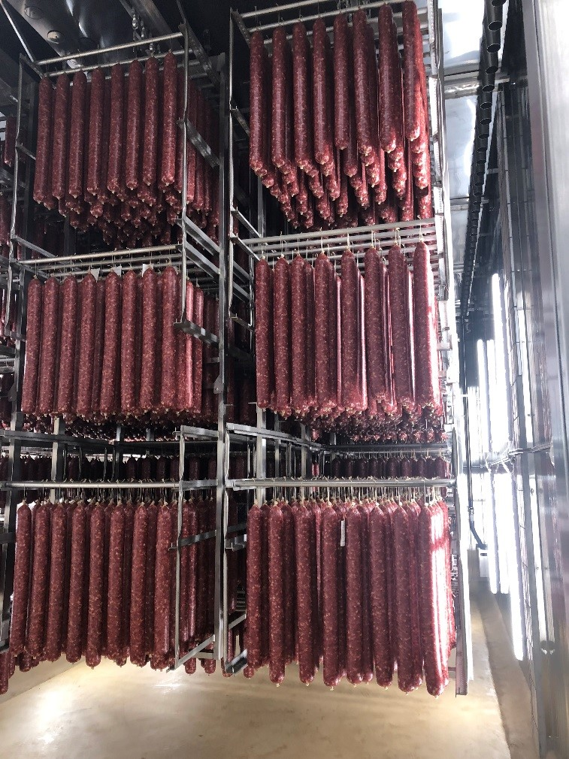
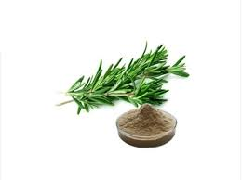
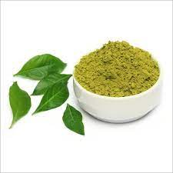
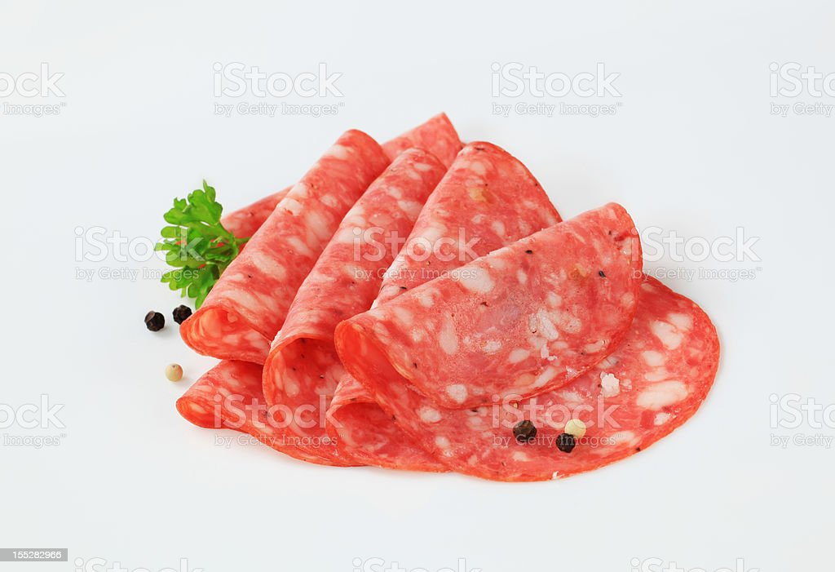
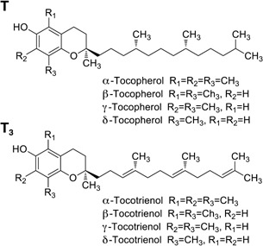
Natural antioxidants
rosemary extract + curry leaf extract
Lipid oxidation
Physicochemical characteristics Sensory characteristics
Shelf life
33.3% increase in shelf life
Sliced salami
Mixture of d-alpha, d-beta, d-gamma and d-delta tocopherols

