Slide 1

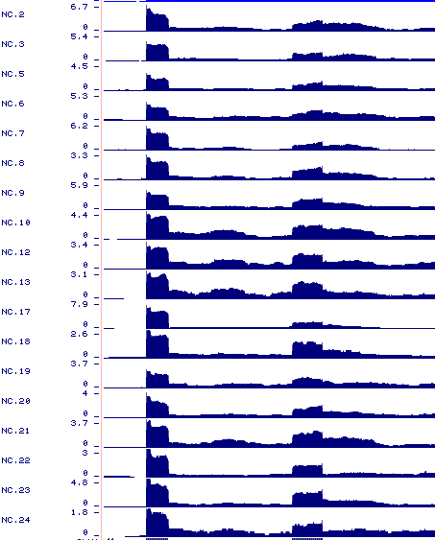
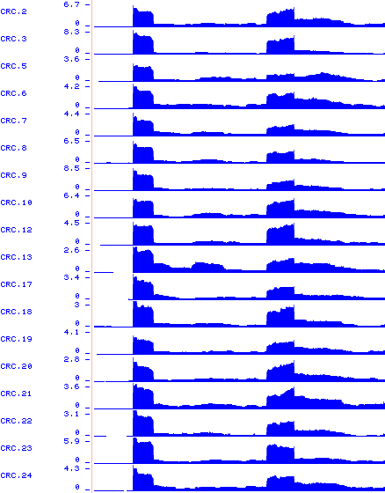
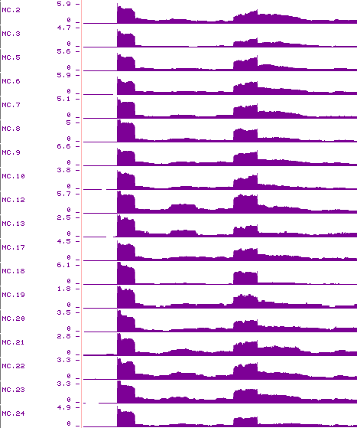
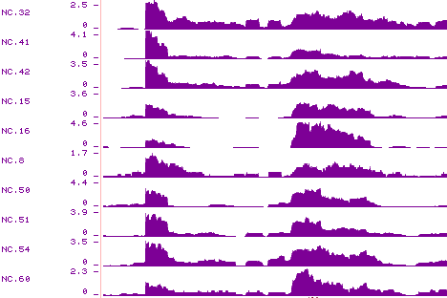
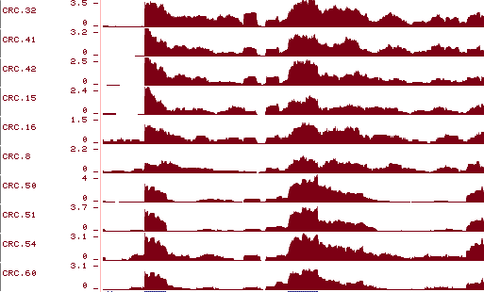
Figure S1. RNA-seq read coverage of CLK1 exon 4 and 5 (E4, E5) for all samples in CRC18P and CRC10P datasets. E4 showed more inclusion in CRC and MC samples (labeled in red).
CRC18P
CRC10P
NC
CRC
MC
NC
CRC
E5
E4
E5
E4
E5
E4
E5
E4
E5
E4
CLK1

Slide 2

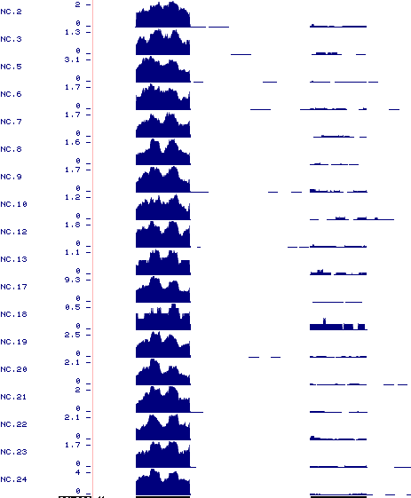
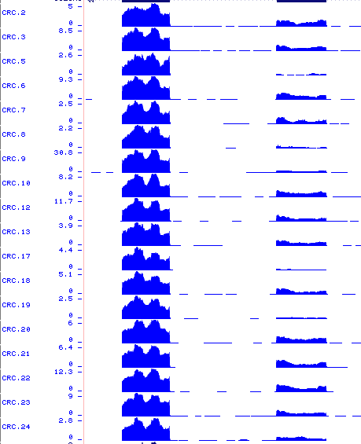
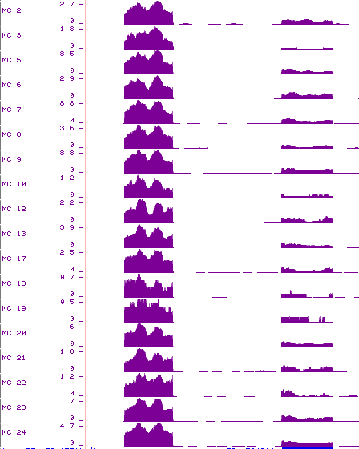
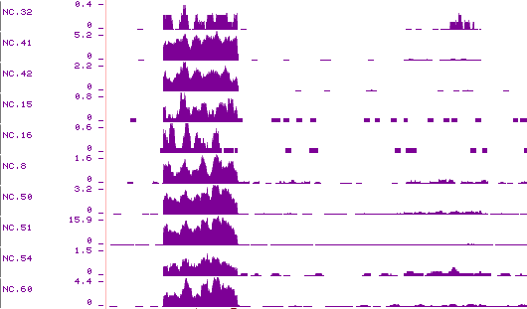
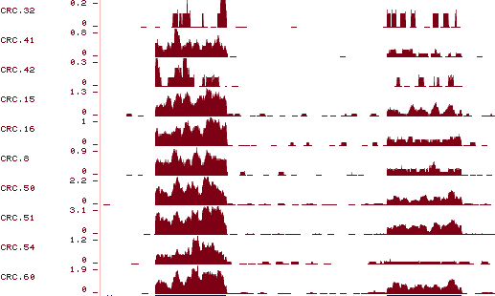
Figure S2. RNA-seq read coverage of COL6A3 exon 6 and 7 (E6, E7) for all samples in CRC18P and CRC10P datasets. E6 showed more inclusion in CRC and MC samples (labeled in red).
CRC18P
CRC10P
NC
CRC
MC
NC
CRC
E7
E6
E7
E6
E7
E6
E7
E6
E7
E6
COL6A3

Slide 3

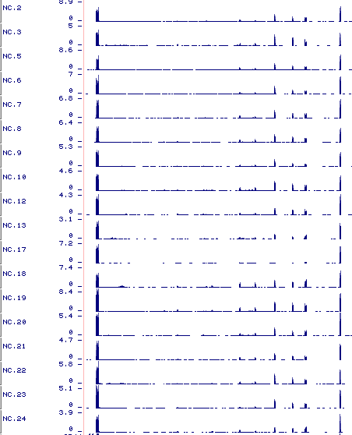
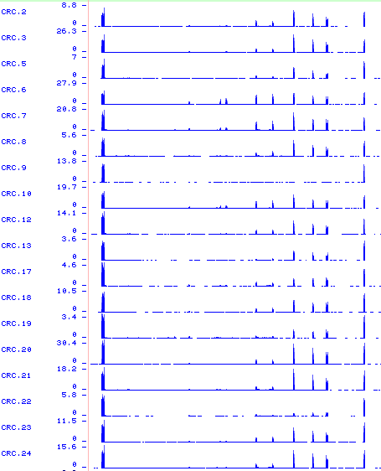
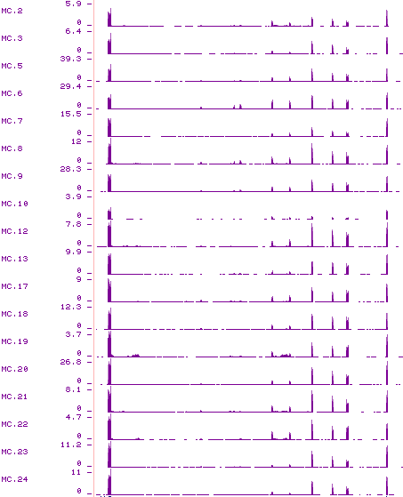
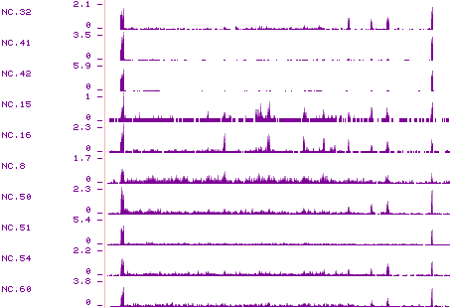
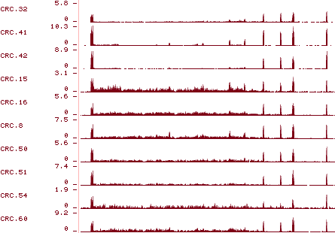


Figure S3. RNA-seq read coverage of CD44 exon 5 to exon 16 for all samples in CRC18P, CRC10P and CRC3P datasets. Exons v8-10 showed more inclusion in CRC and MC samples (labeled in red).
CD44
NC
CRC
MC
E5
V8-10
E16
E5
V8-10
E16
E5
V8-10
E16
CRC18P
CRC10P
CRC3P

Slide 4
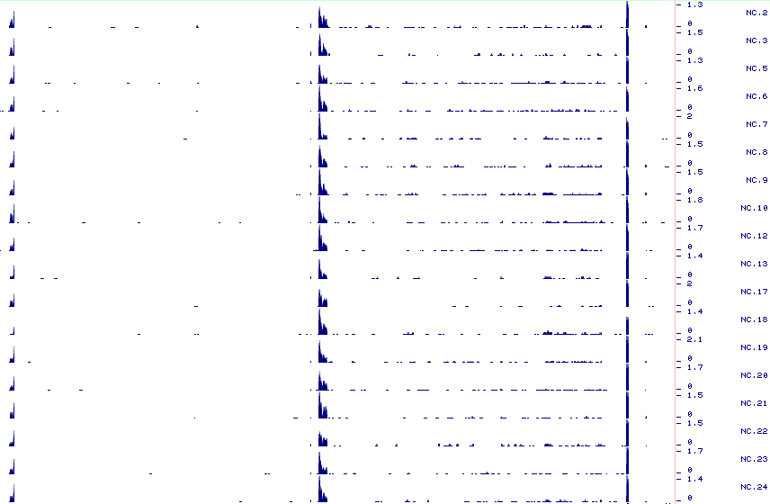
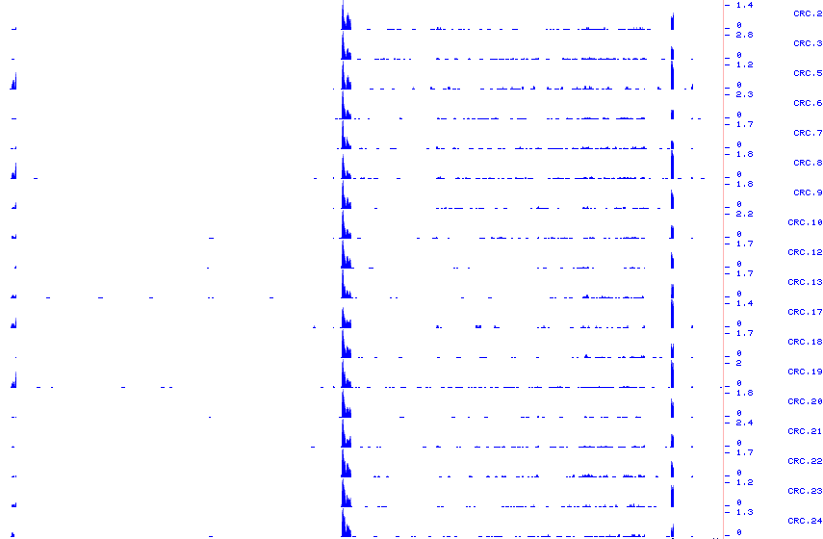
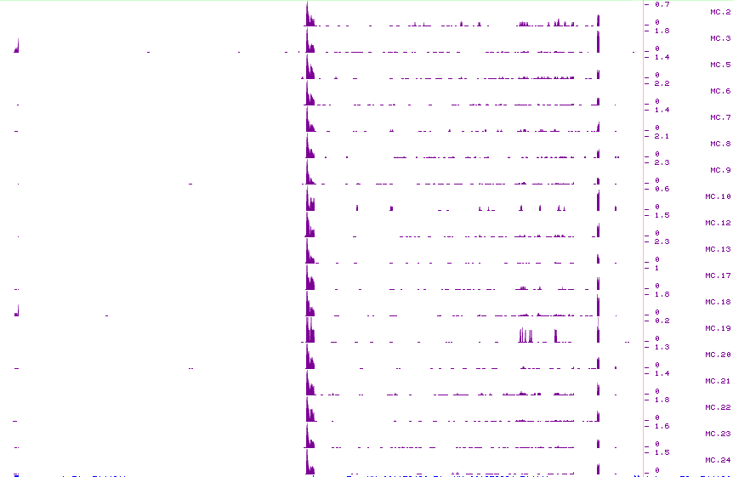
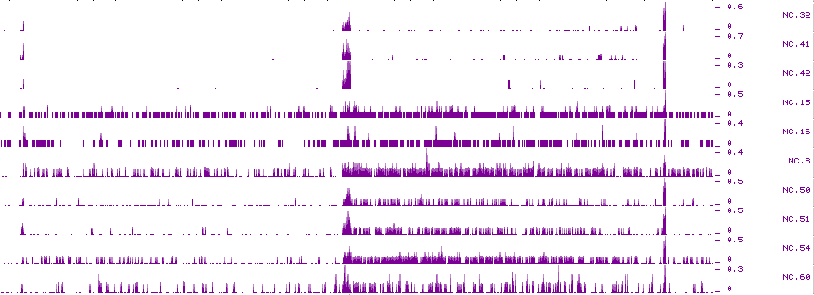
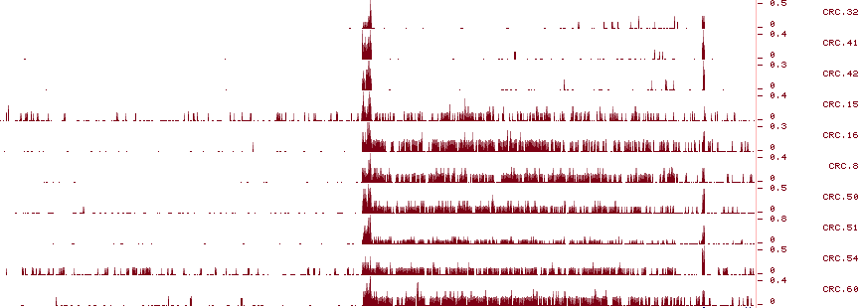
Figure S4. RNA-seq read coverage of ARHGEF9 alternative first exons in CRC18P and CRC10P datasets. Exon E1a showed more exclusion/downregulation in CRC and MC samples (labeled in blue).
NC
CRC
MC
ARHGEF9
E1a
E2
E1a
E2
E1a
E2
E1b
E1b
E1b
CRC18P
CRC10P

Slide 5
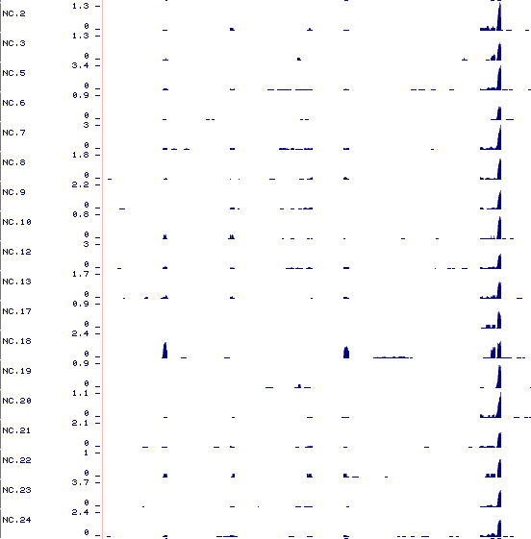
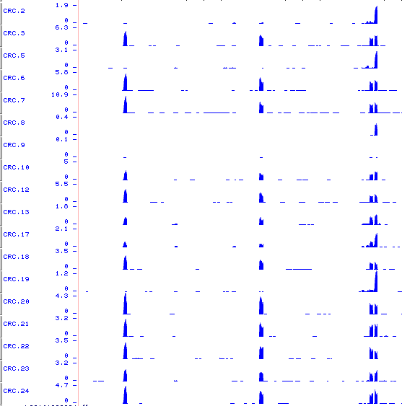
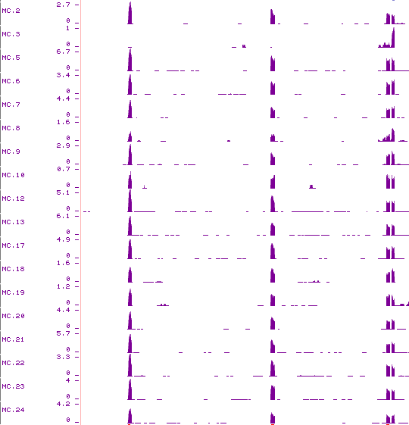
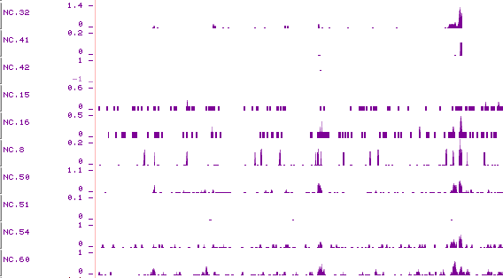
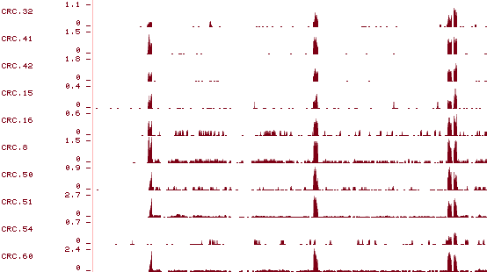
Figure S5. RNA-seq read coverage of HKDC1 alternative first exons in CRC18P and CRC10P datasets. Exons E1a, E2a and E3a showed more inclusion/upregulation in CRC and MC samples (labeled in red).
NC
CRC
MC
HKDC1
E3a
E1b
E1a
E2a
E3a
E1b
E1a
E2a
E3a
E1b
E1a
E2a
CRC18P
CRC10P

Slide 6

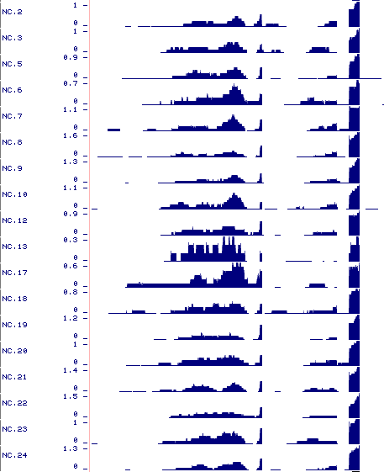
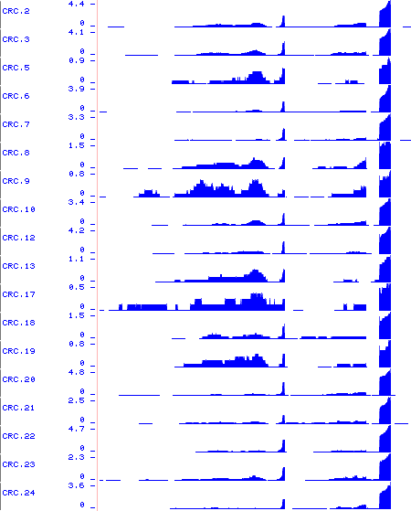
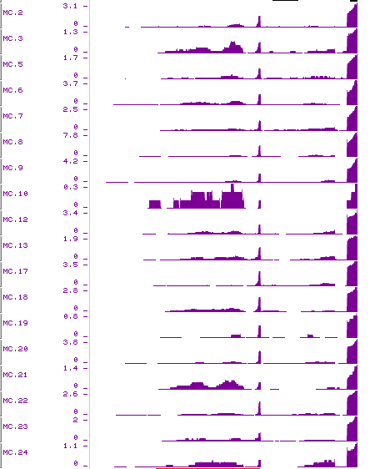
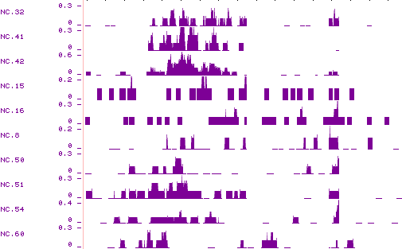
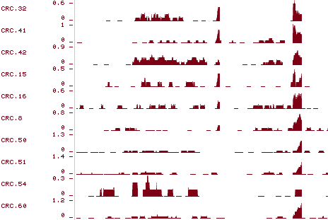
Figure S6. RNA-seq read coverage of CHEK1 alternative first exons in CRC18P and CRC10P datasets. Exon E1a showed more exclusion/downregulation in CRC and MC samples (labeled in blue).
NC
CRC
MC
E1a
E1b
E2
E1a
E1b
E2
E1a
E1b
E2
CHEK1
CRC18P
CRC10P

Slide 7
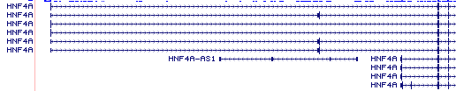
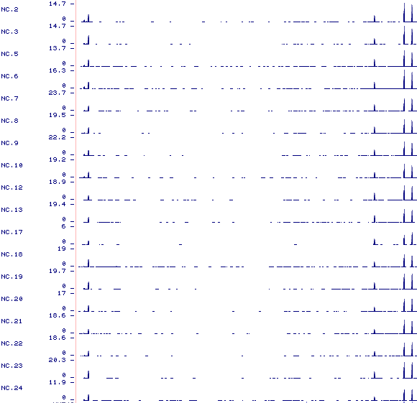
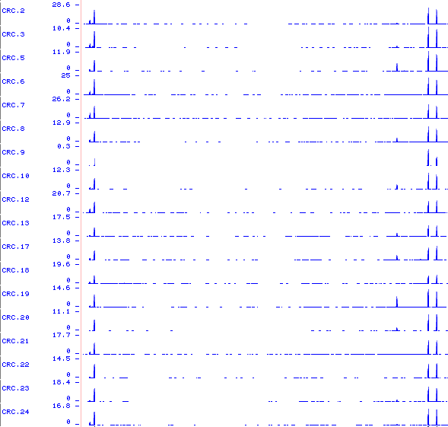
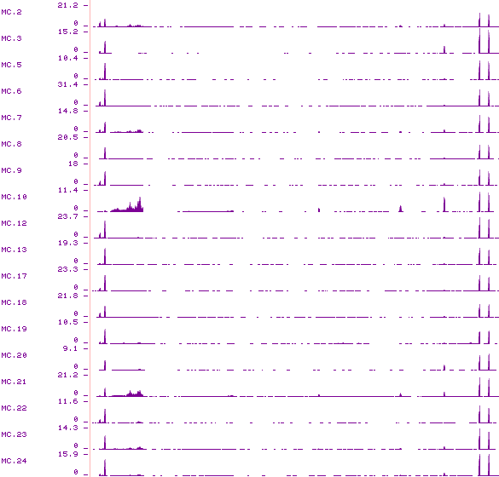
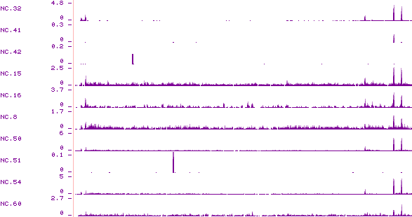
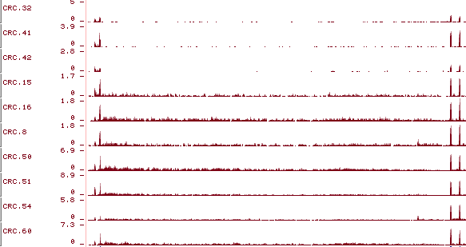
Figure S7. RNA-seq read coverage of HNF4A alternative first exons in CRC18P and CRC10P datasets. Exon 1A showed more exclusion/downregulation in CRC and MC samples (labeled in blue).
NC
CRC
MC
1D
1A
1D
1A
1D
1A
HNF4A
CRC18P
CRC10P

Slide 8
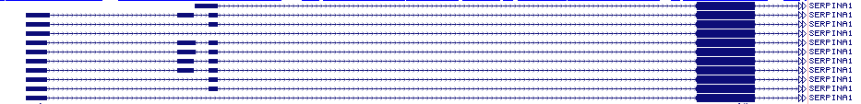
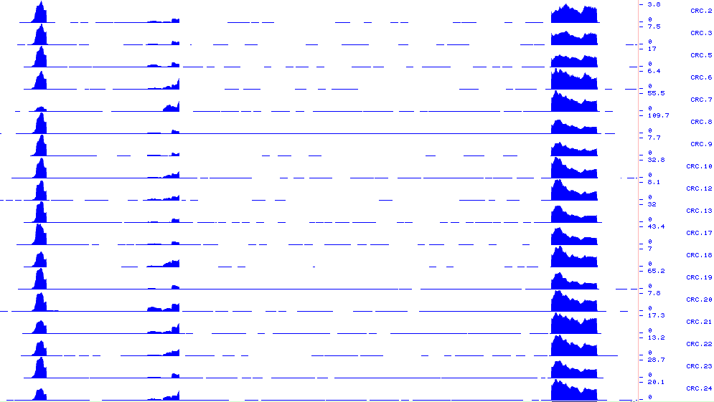
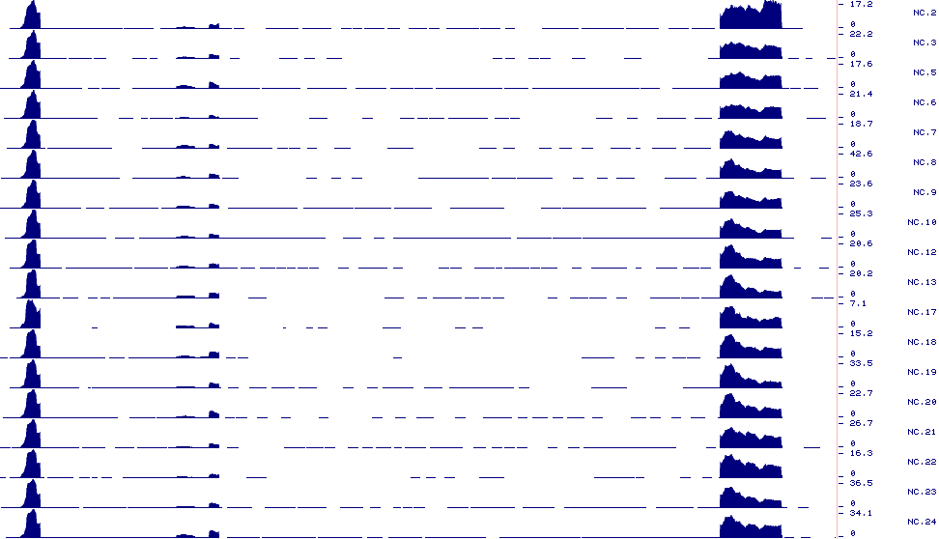
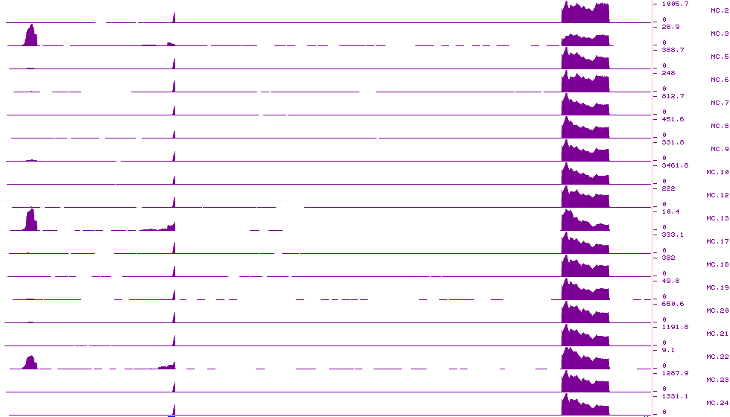
Figure S8. RNA-seq read coverage of SERPINA1 exon 1 to exon 4 in CRC18P dataset. Exon E1a showed more exclusion/downregulation in MC samples (labeled in blue).
NC
CRC
MC
E1a
E1b
E4
E1a
E1b
E4
E1a
E1b
E4
SERPINA1
CRC18P

Slide 9

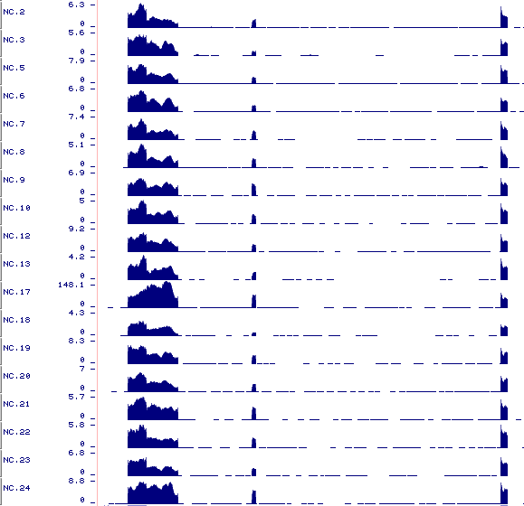
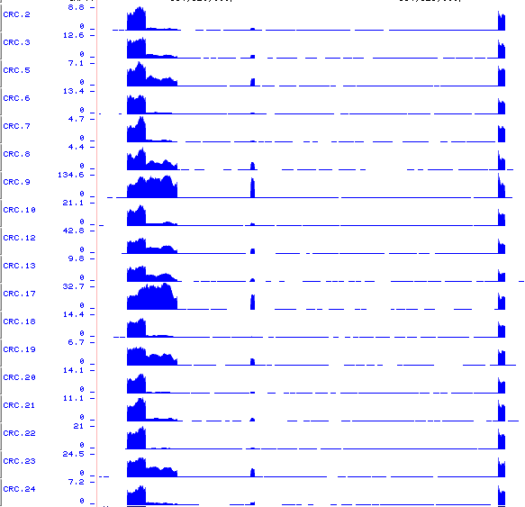
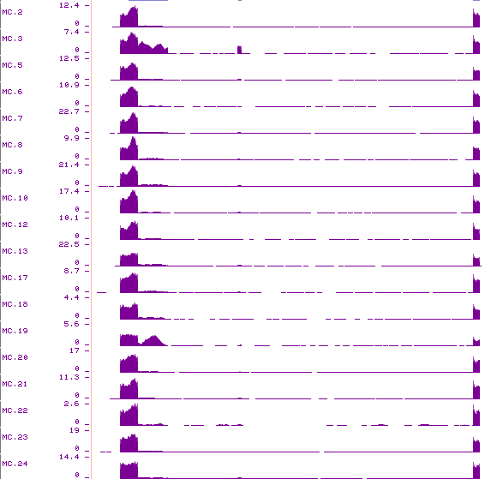
Figure S9. RNA-seq read coverage of CALD1 exon 5 to exon 7 in CRC18P dataset. Exons E5b and E6 showed more exclusion/downregulation in MC samples (labeled in blue).
NC
CRC
MC
E5a
E5b
E6
E7
E5a
E5b
E5a
E5b
E6
E7
E6
E7
CALD1
CRC18P

Slide 10
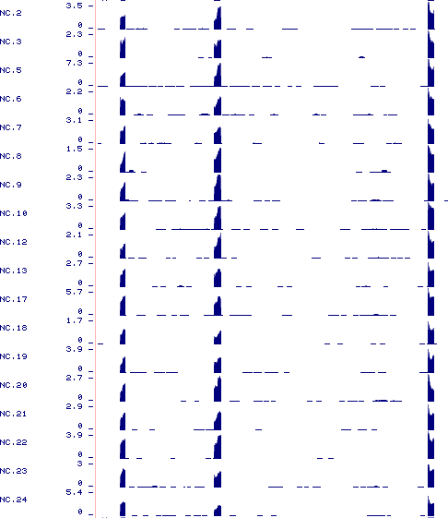
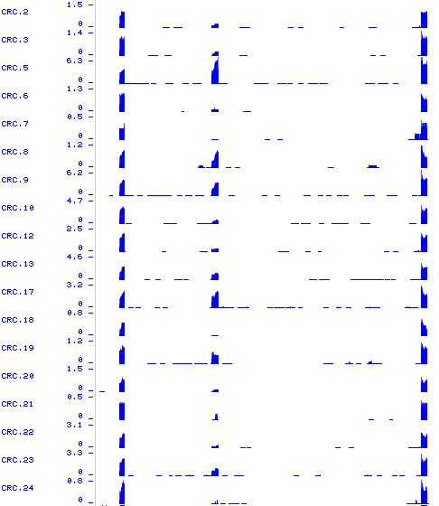
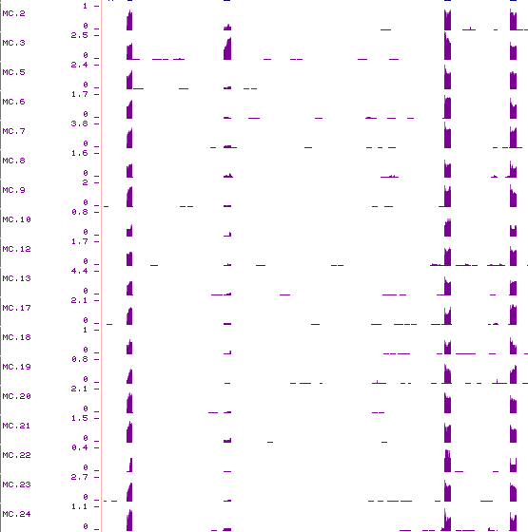
Figure S10. RNA-seq read coverage of FBLN2 exon 8 to exon 10 in CRC18P dataset. Exon E9 showed more exclusion/downregulation in MC samples (labeled in blue).
NC
CRC
MC
FBLN2
E8
E9
E10
E8
E9
E10
E8
E9
E10
CRC18P

Slide 11
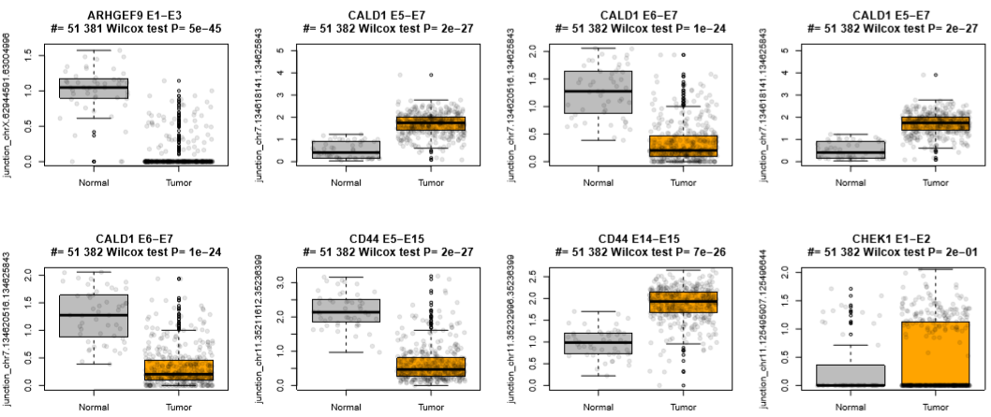
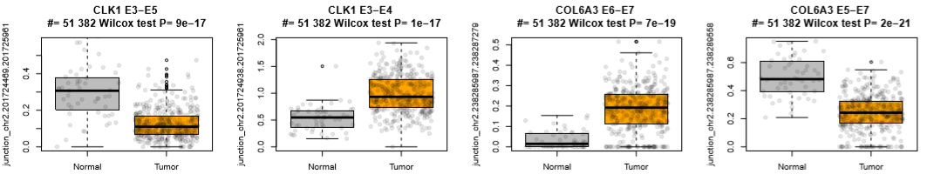
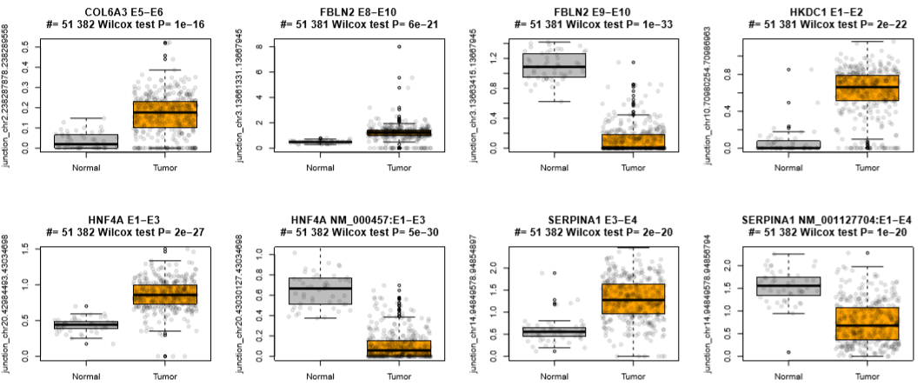
Figure S11. Splicing events identified in this study confirmed by TCGA junction expression data. Boxplots of junction usage of 20 junctions of 10 genes in 51 normal tissue and 382 CRC or metastatic tissue (tumor). P-values are based on Wilcoxon Rank-Sum Test. Dots in the boxplot represent individual patient in TCGA.

