Slide 1
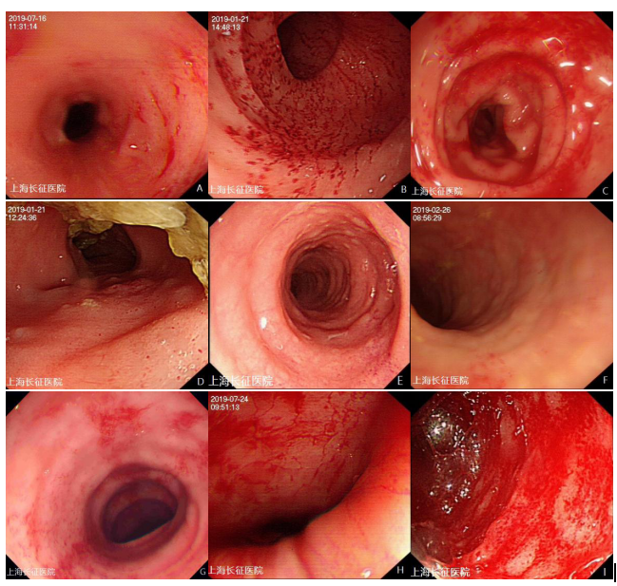
Figure S1. Examples of endoscopic scoring of different severity in DC
Note: A-C: Mucosal Hemorrhage (A: 1; B: 2; C: 3) ; D-F: Edema (D: 1; E: 2; F: 3) ; G-I: Contact Hemorrhage

