Slide 1
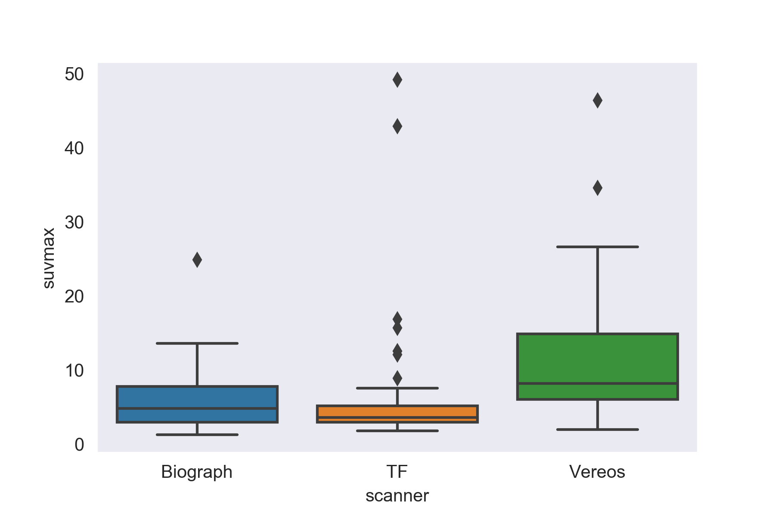
Supplementary Fig. 1
P<0.01
NS
P<0.05
SUVmax
SUVmax was significantly higher in Vereos than the other scanners.

Slide 2
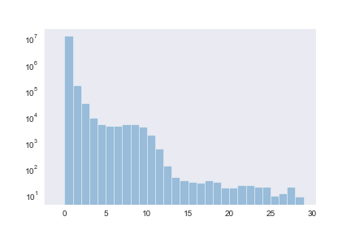
Supplementary Fig. 2
Number of voxels
SUV
The number of voxels having a given SUV span (semi-log plot).

