Slide 1
Network of hepato/pancreatic co-stem/progenitors
in the biliary tree and duodenum of postnatal pigs;
comparison with the human network
Supplementary figures

Slide 2
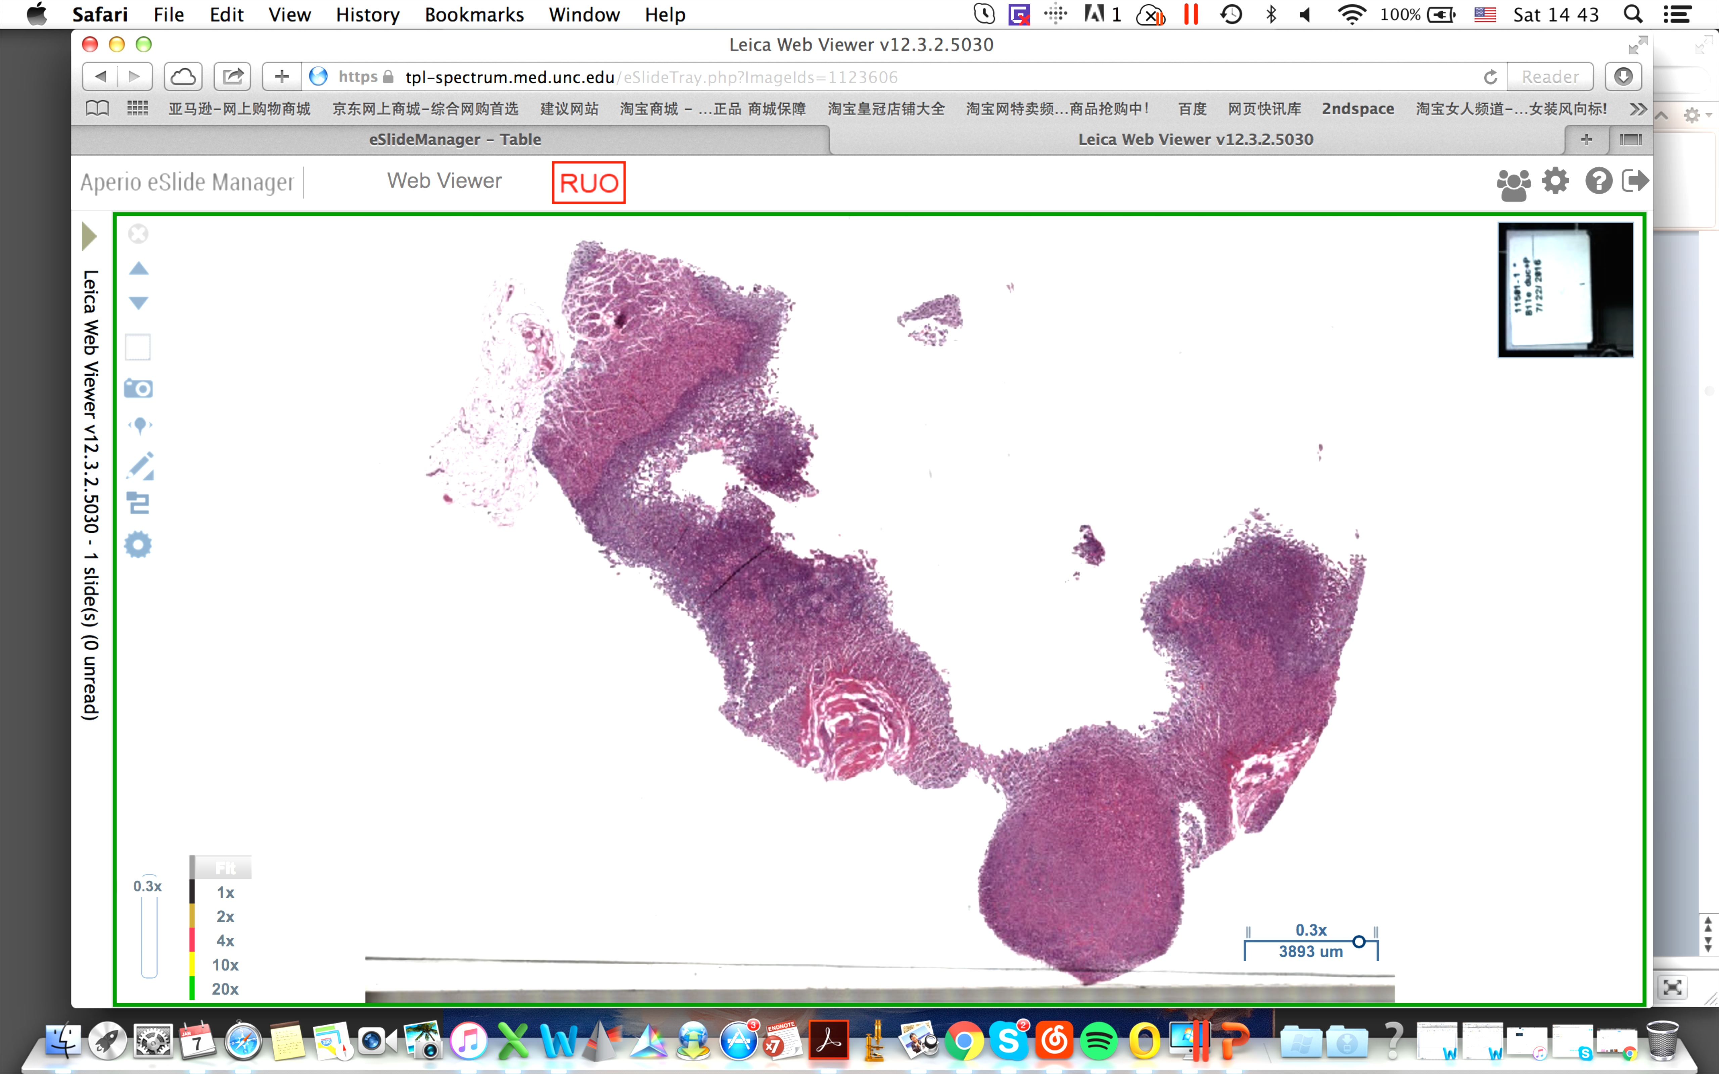
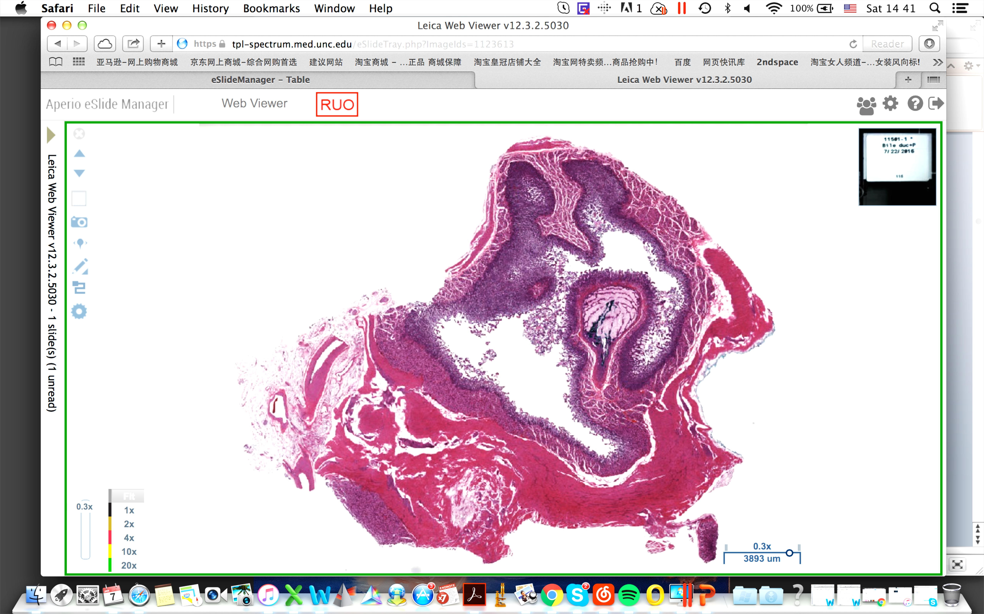
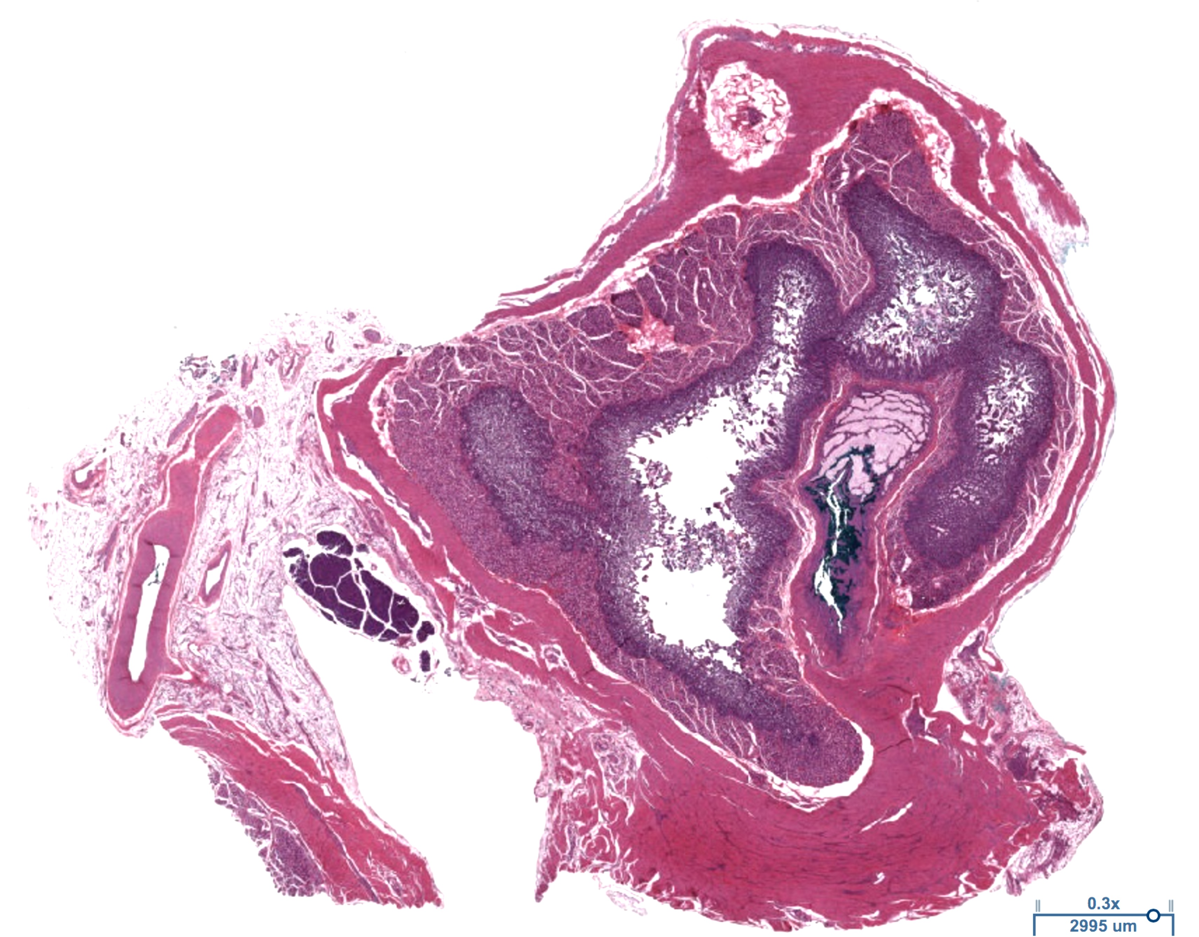
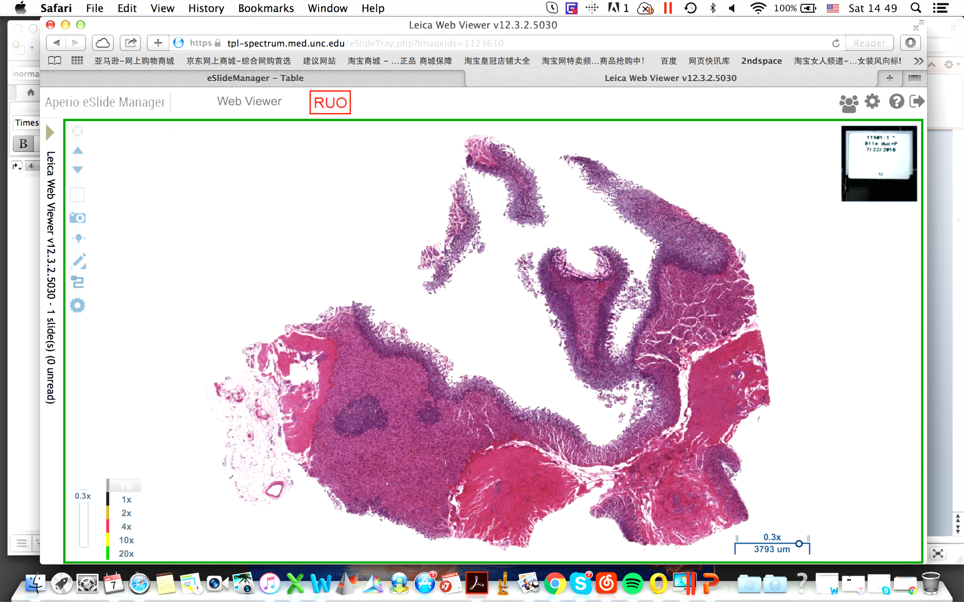
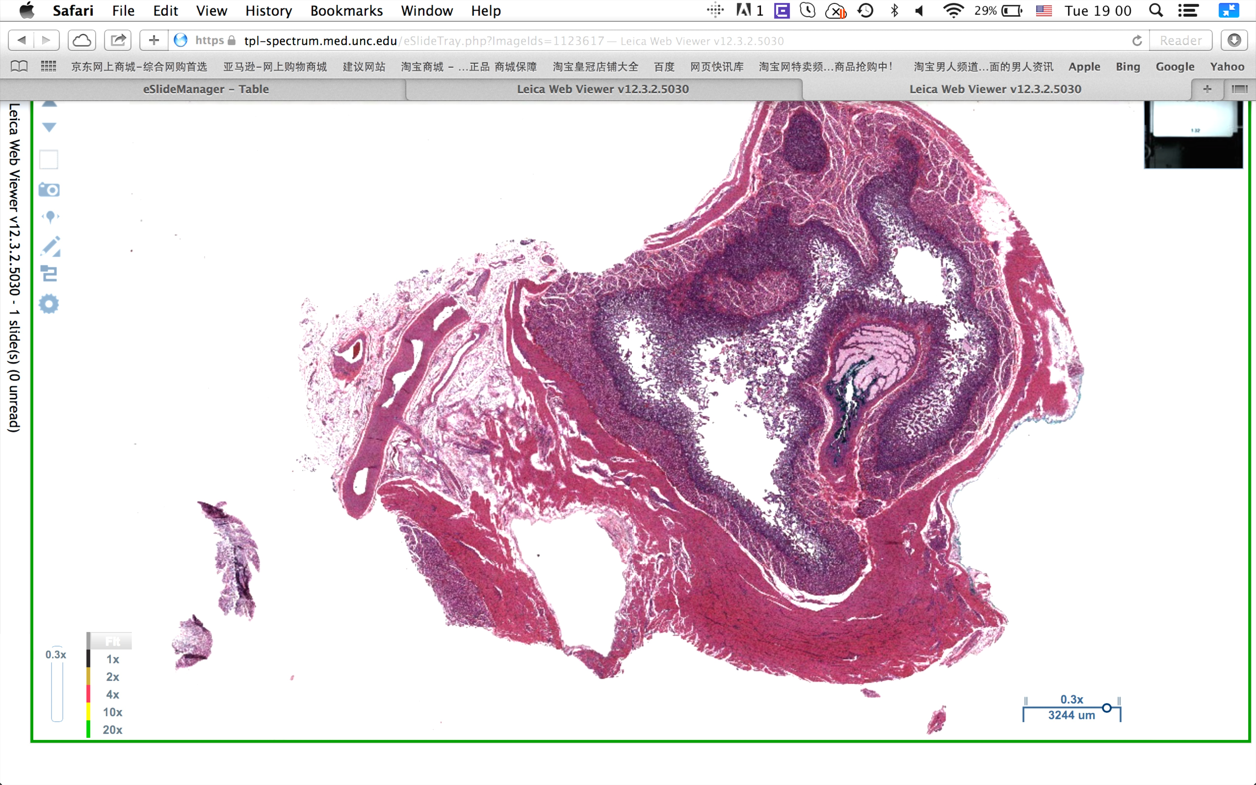
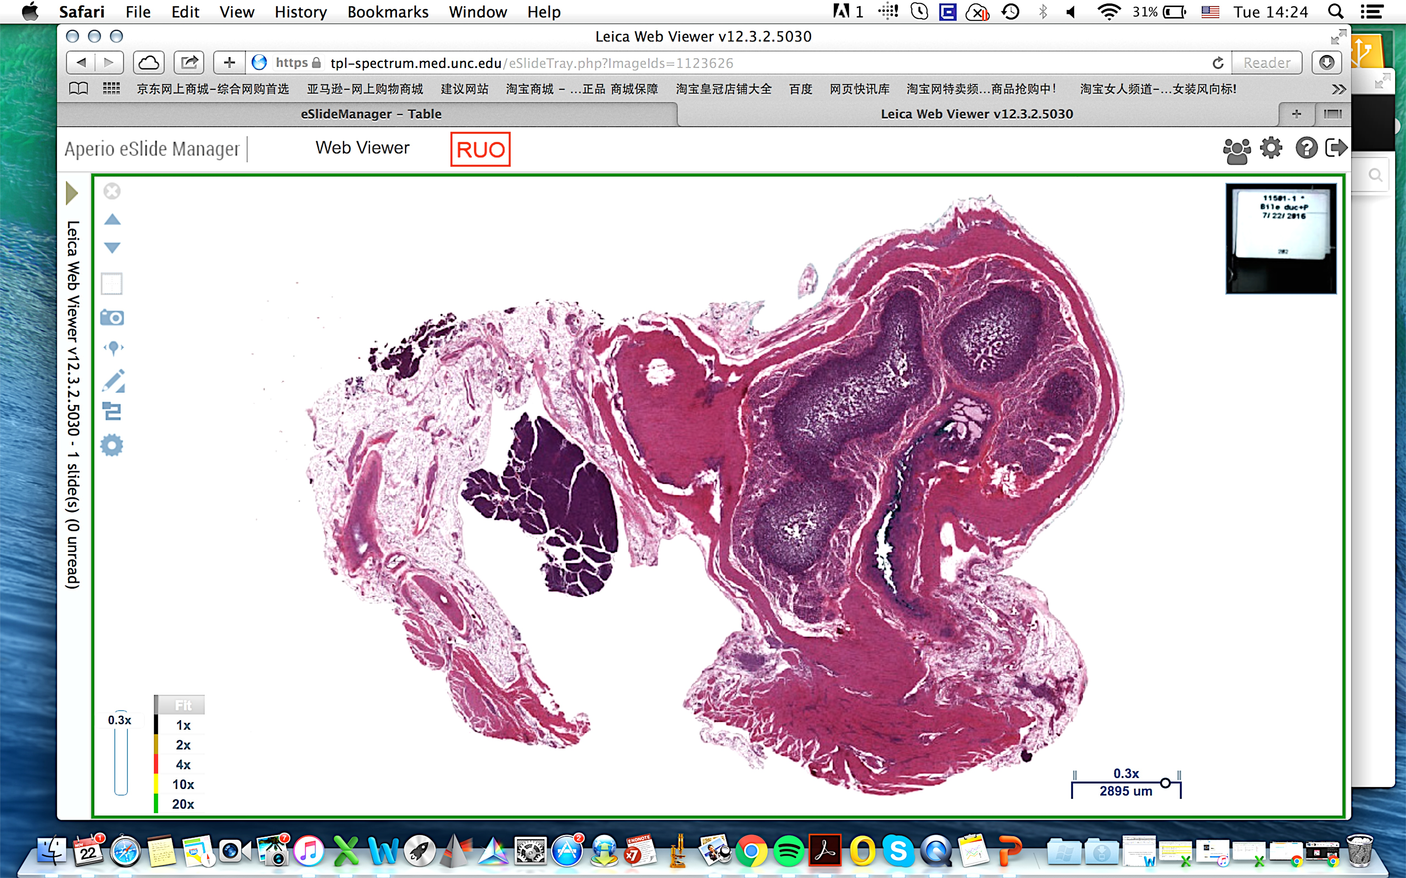
Fig S2
A
Bile duct
Tissue dyes
Serial sections
Grossing
Embedding
paraffin
Duodenum
Bile duct
Histology staining and scanning
Pancreas
Pancreas
#300
Duodenum
#200
B
#100
#1
#1
#118
#208
#168
#282
#50

Slide 3
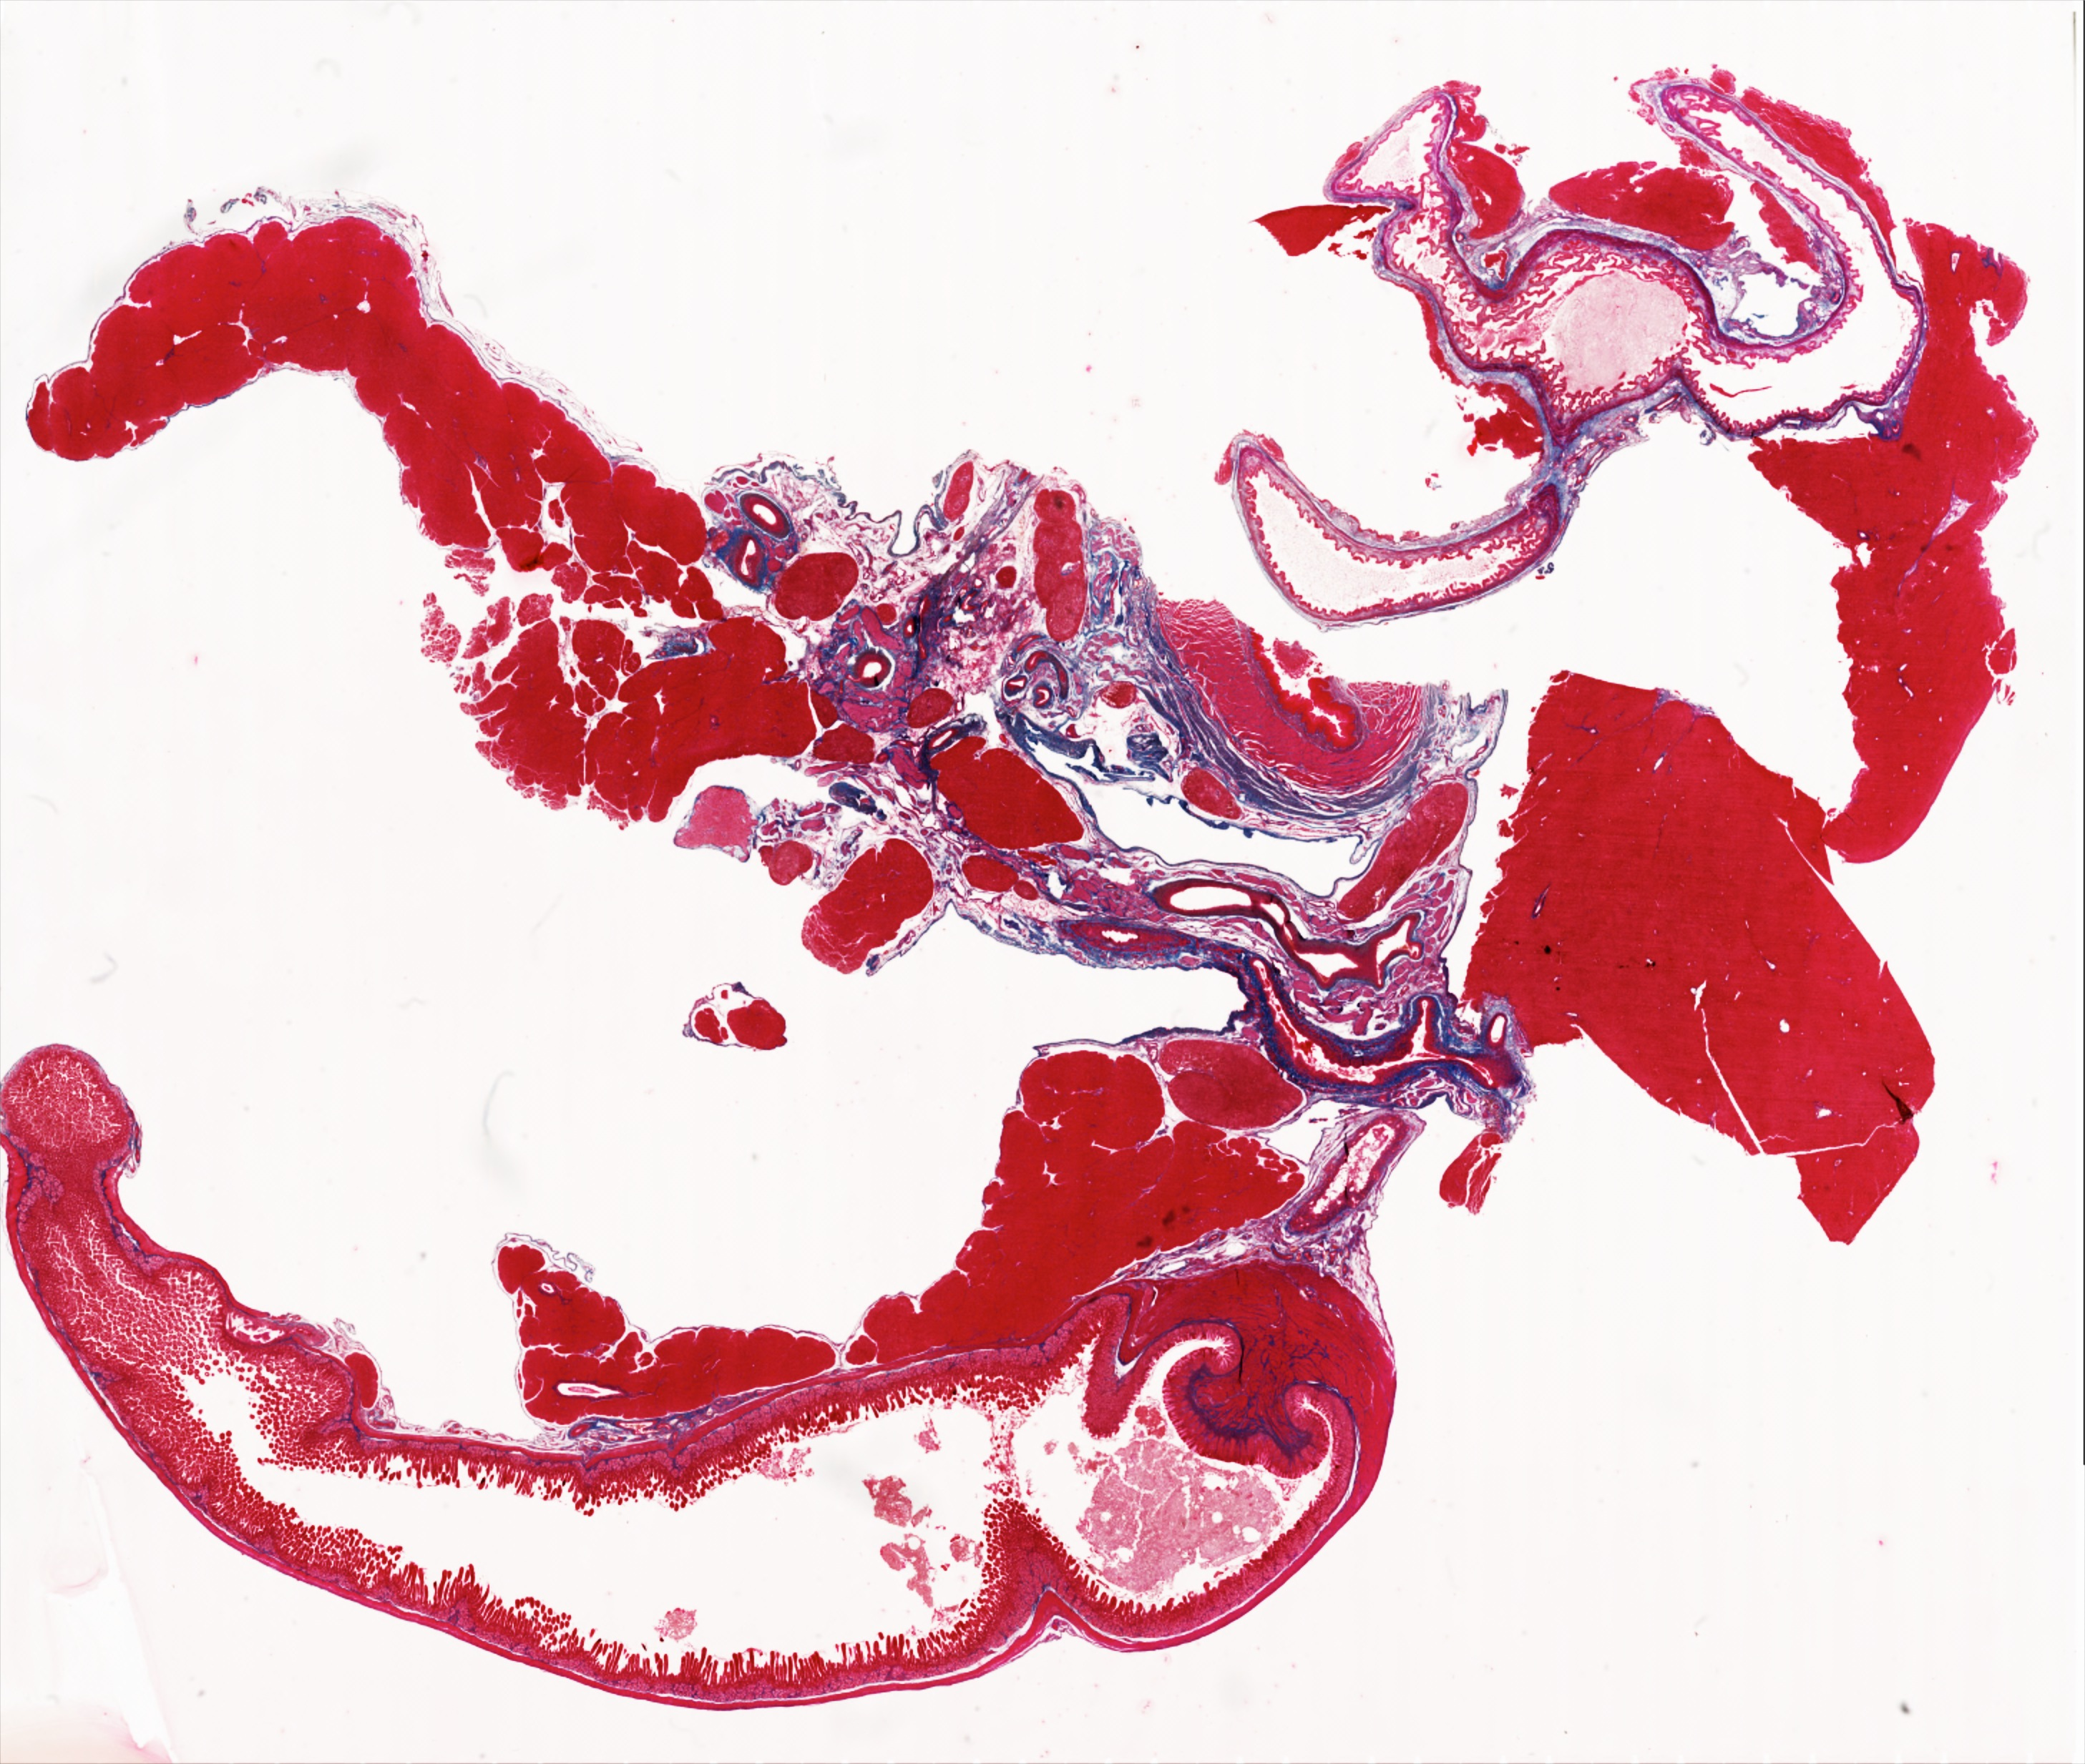
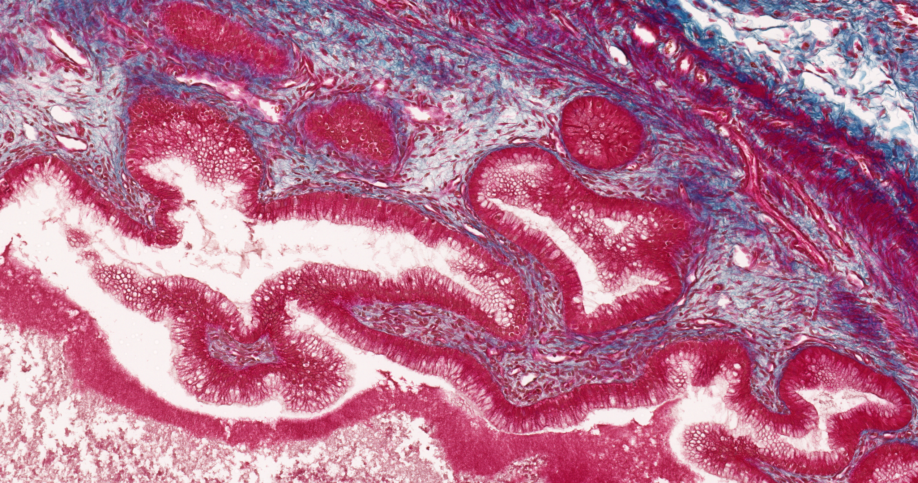
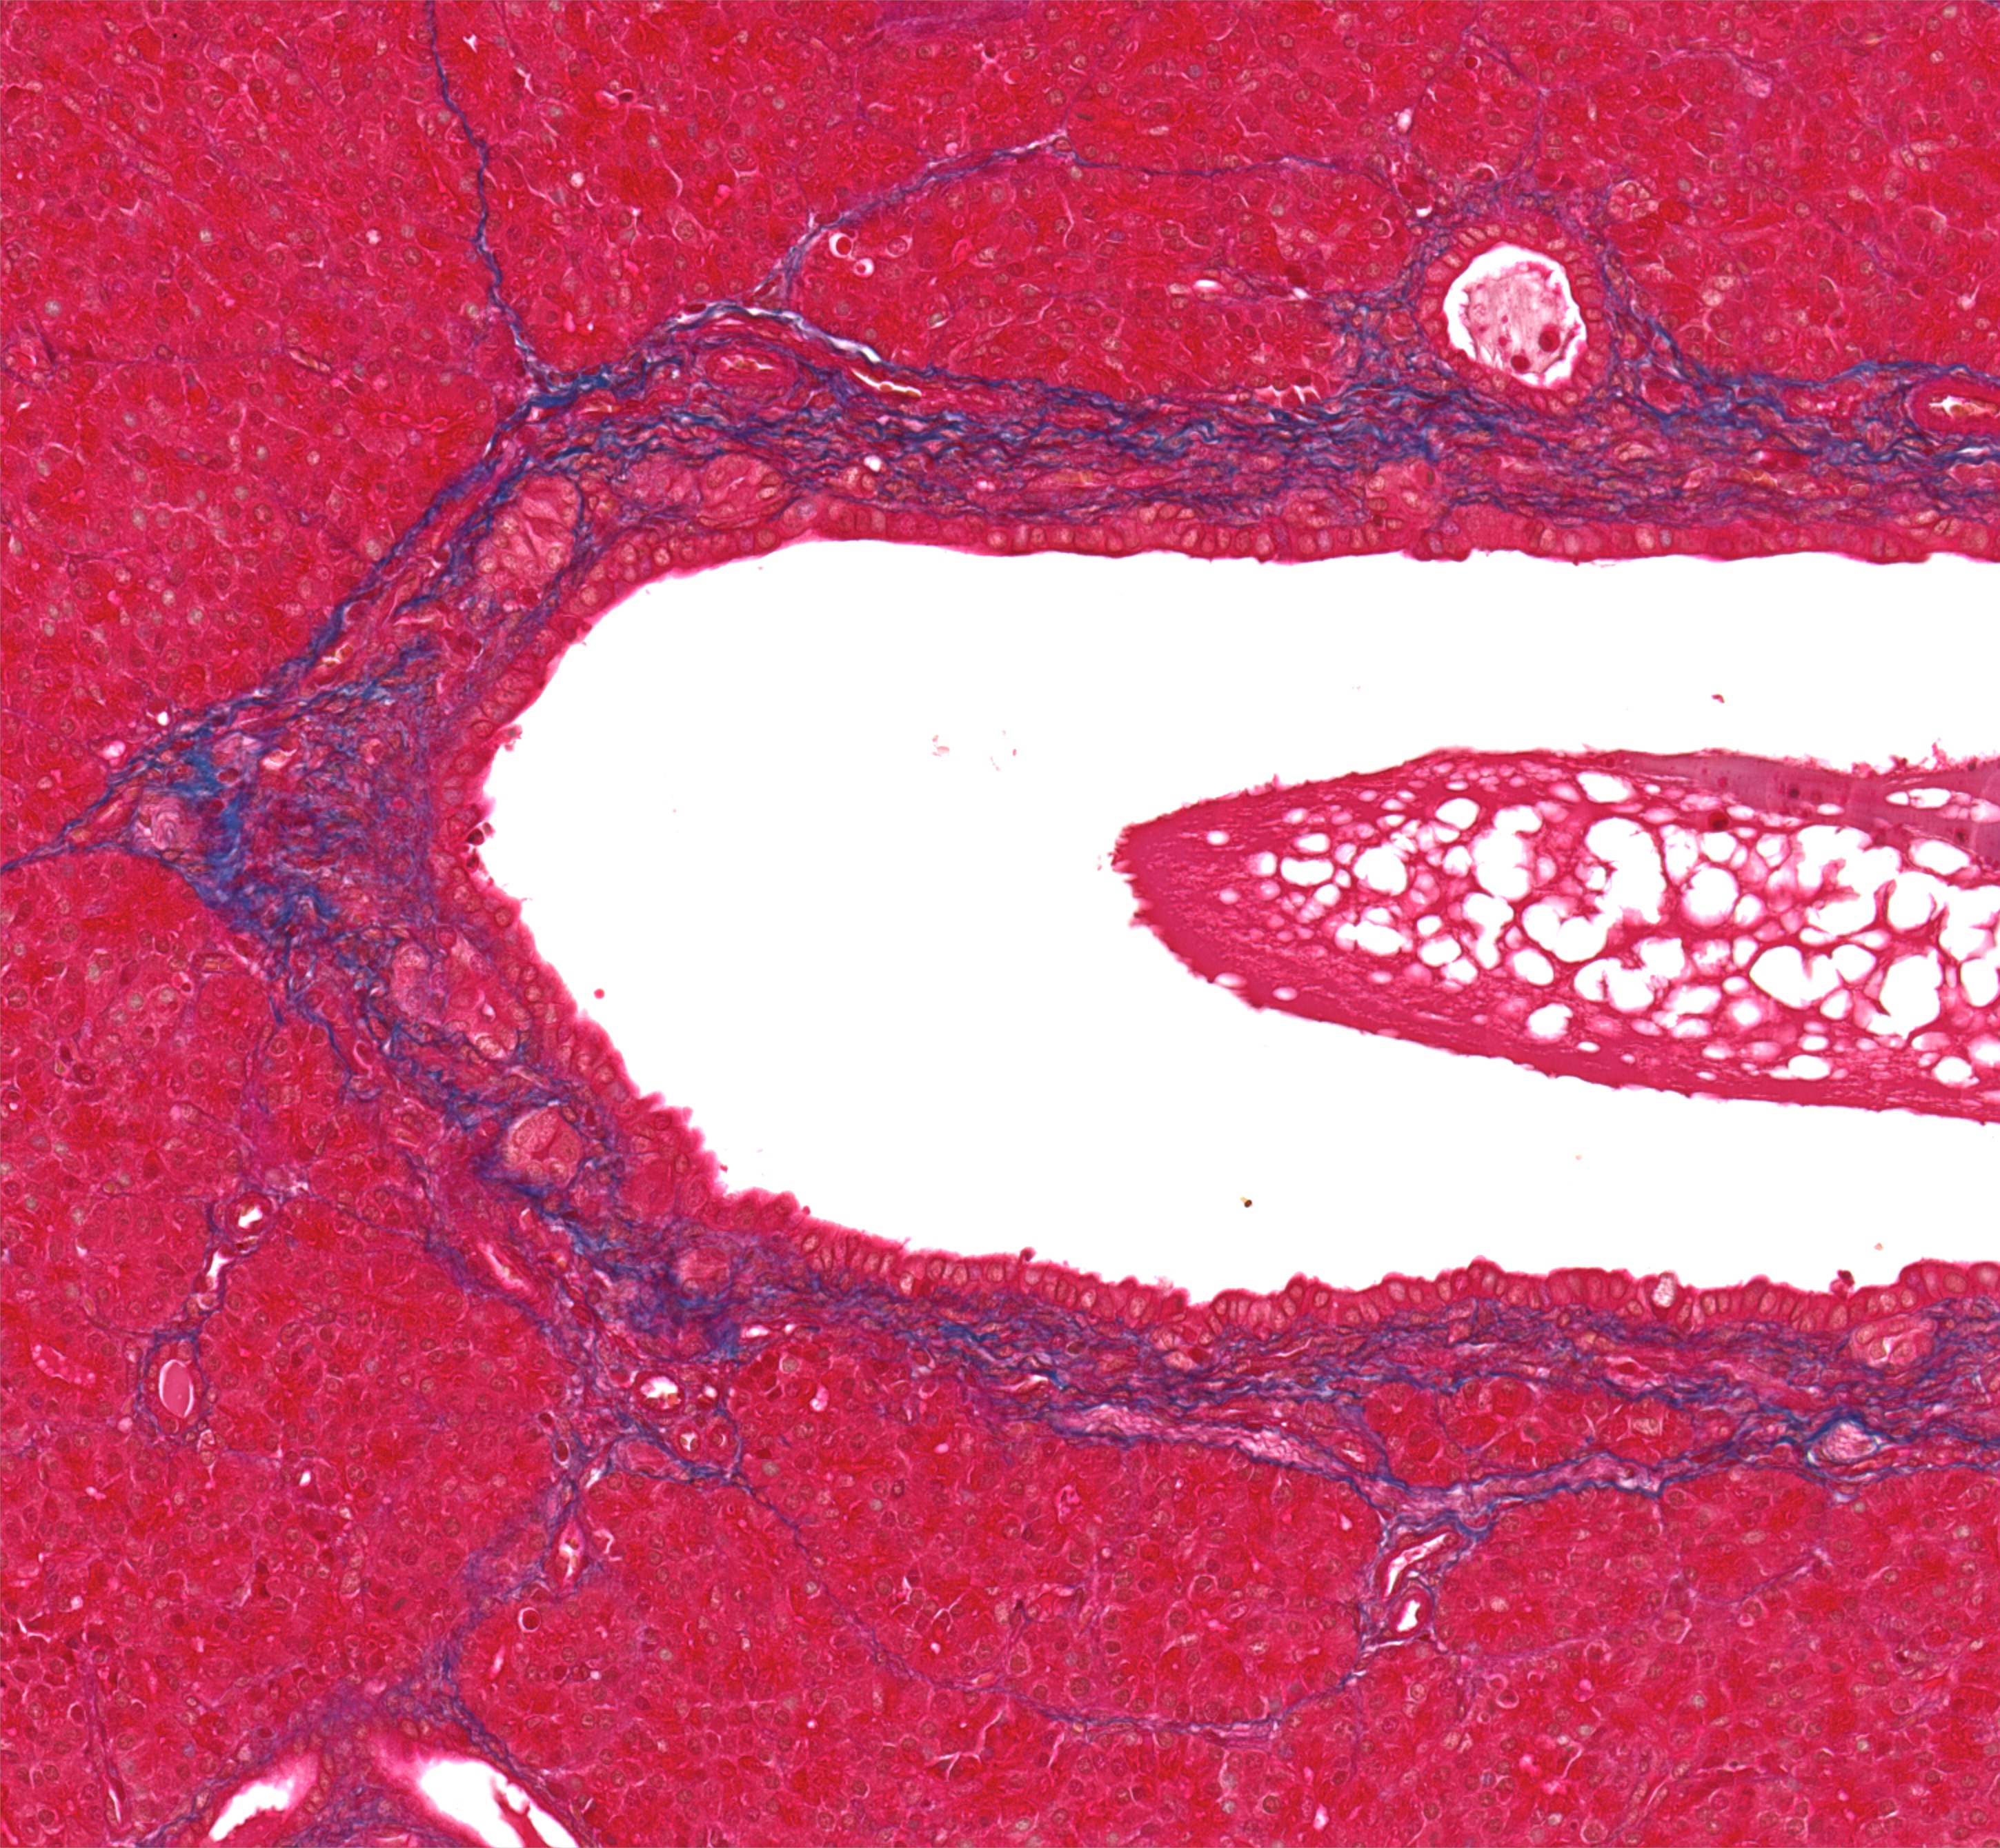
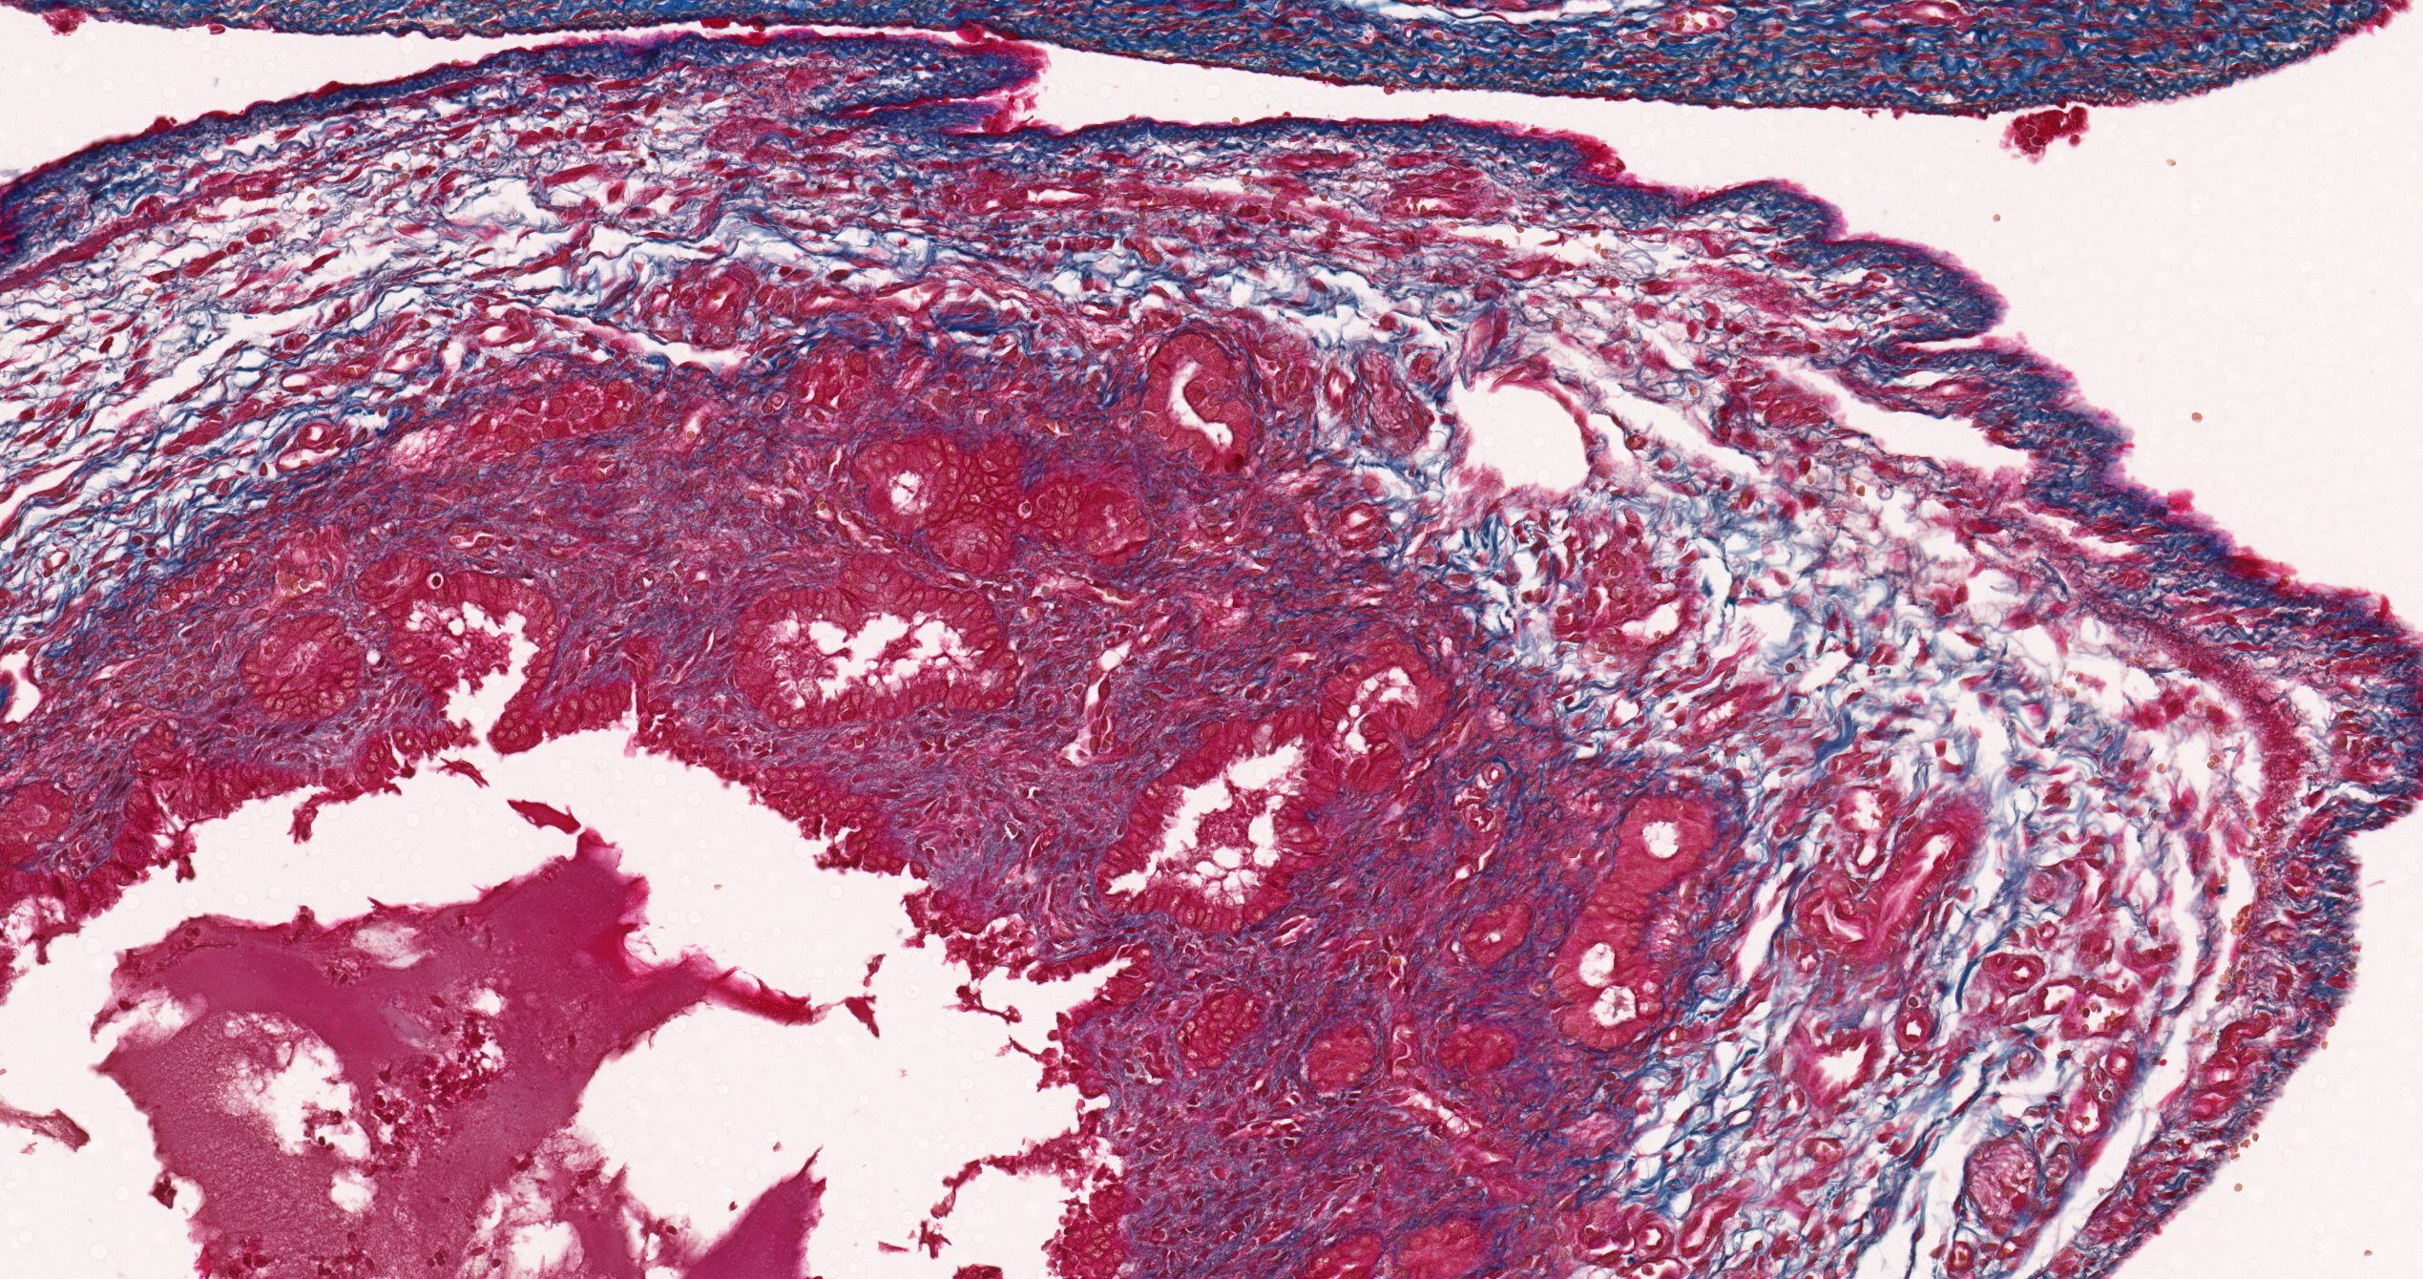
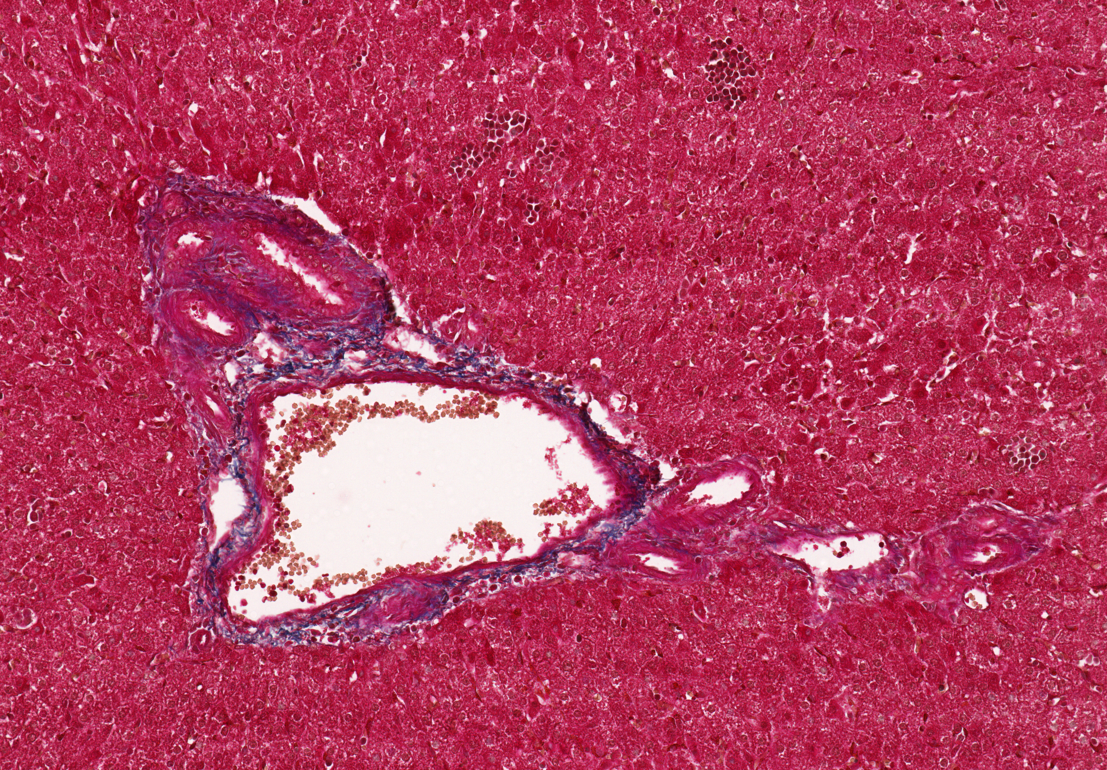
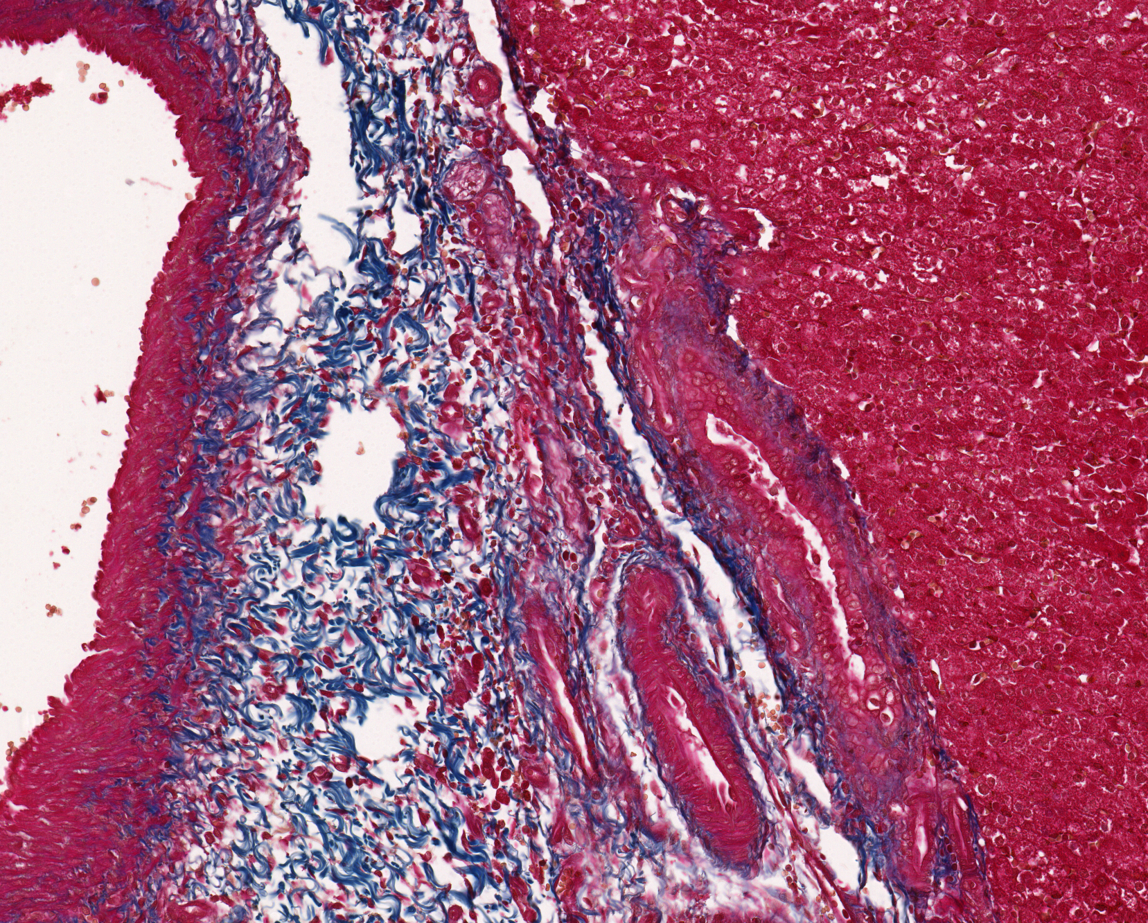
Fig S3
A
7 weeks old pig
a
Gallbladder
b
Pancreatic duct
a
d
c
b
e
B
Duodenum
e
common bile duct
c
Intra-hepatic duct
d
Extra-hepatic duct

Slide 4
Fig S4
A
Common duct
Duodenum
Liver
Gallbladder
Cystic duct
B
Duodenum
Pancreas

Slide 5
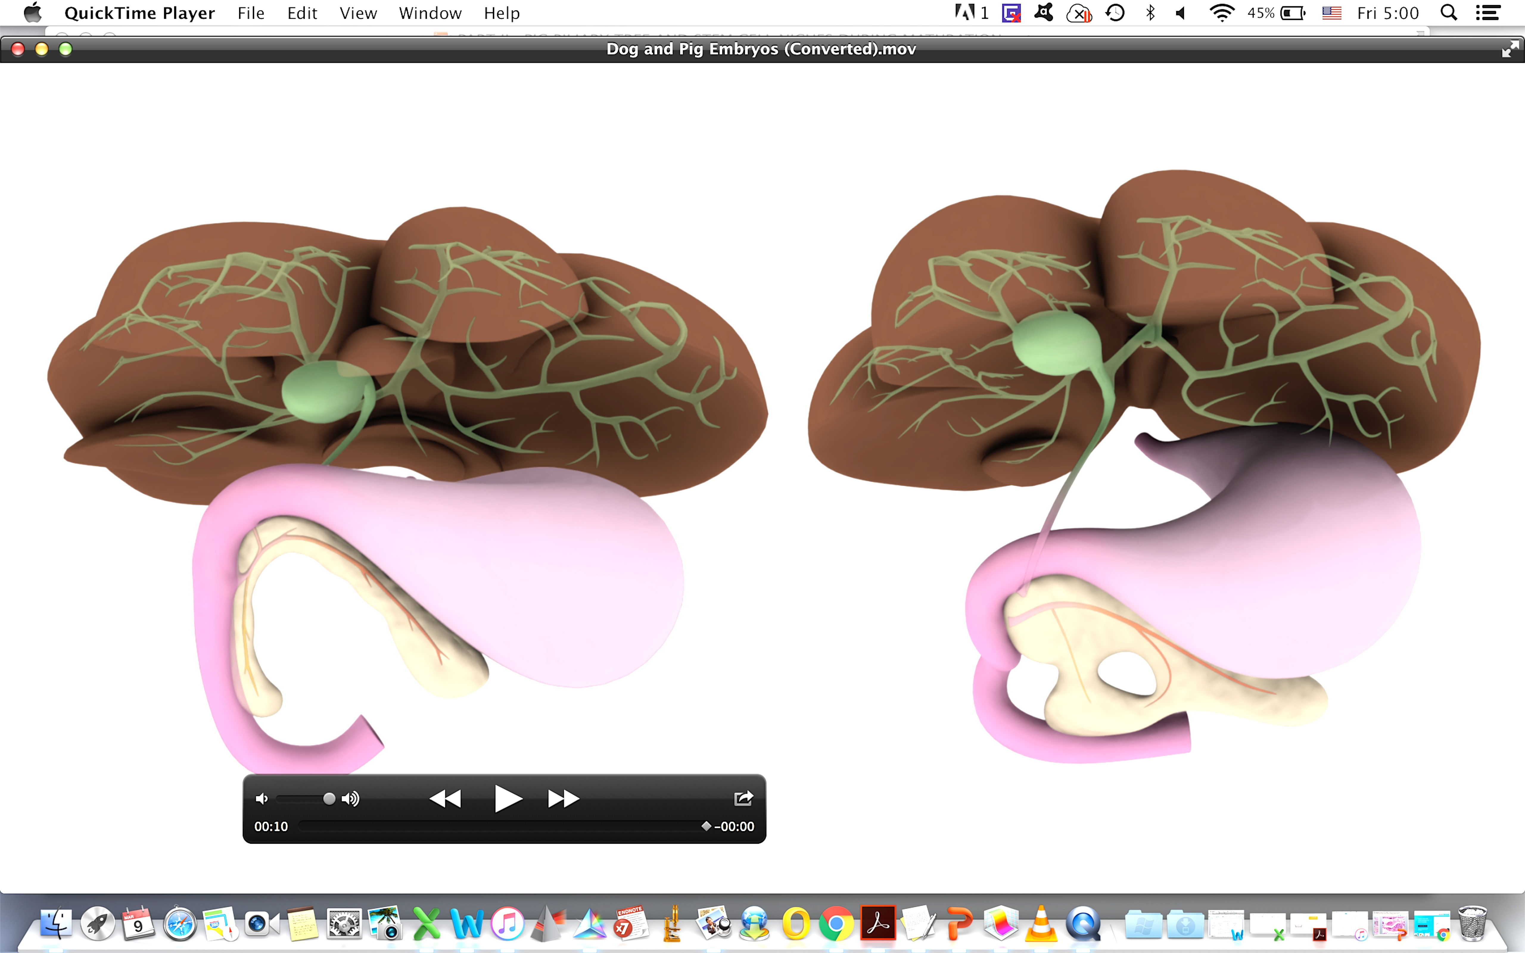
Fig S1
LML
CL, caudate lobe RLL, right lateral lobe RML, right medial lobe LML, left medial lobe LLL, left lateral lobe G, gallbladder
RML
G
LLL
RLL
CL
UB Represents the dorsal anlage
LB Ventral anlage
H
-Thyng (1908)
D
UB
S
LB
S, stomach; D, duodenum;
H, head of pancreas;
T, tail of pancreas;
Pr, Descending process;
UB, upper bridge; LB, lower bridge
T
Pr

Slide 6
Fig S5
A
B
All cells top 3,000 SD cutree
C
-log10(adj.P-Value)
Log (Fold Change)

Slide 7
Fig S6
A
B
All cells all genes SD cutree
All cells top 3,000 SD cutree

Slide 8
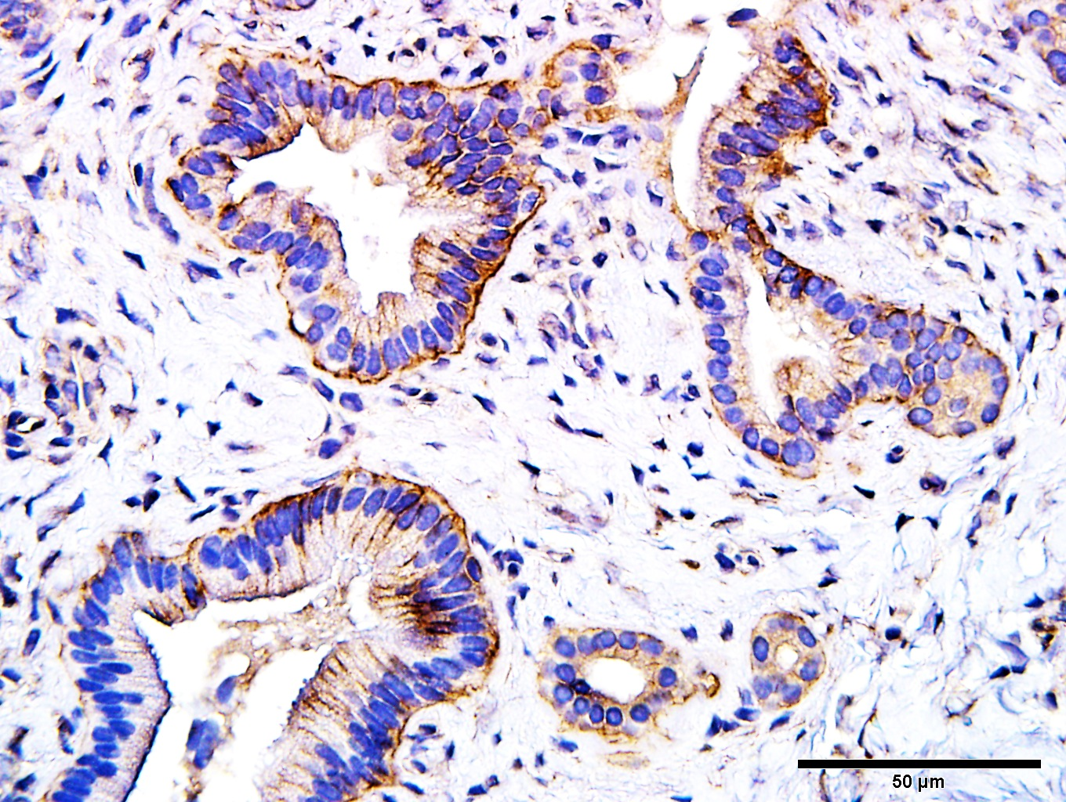
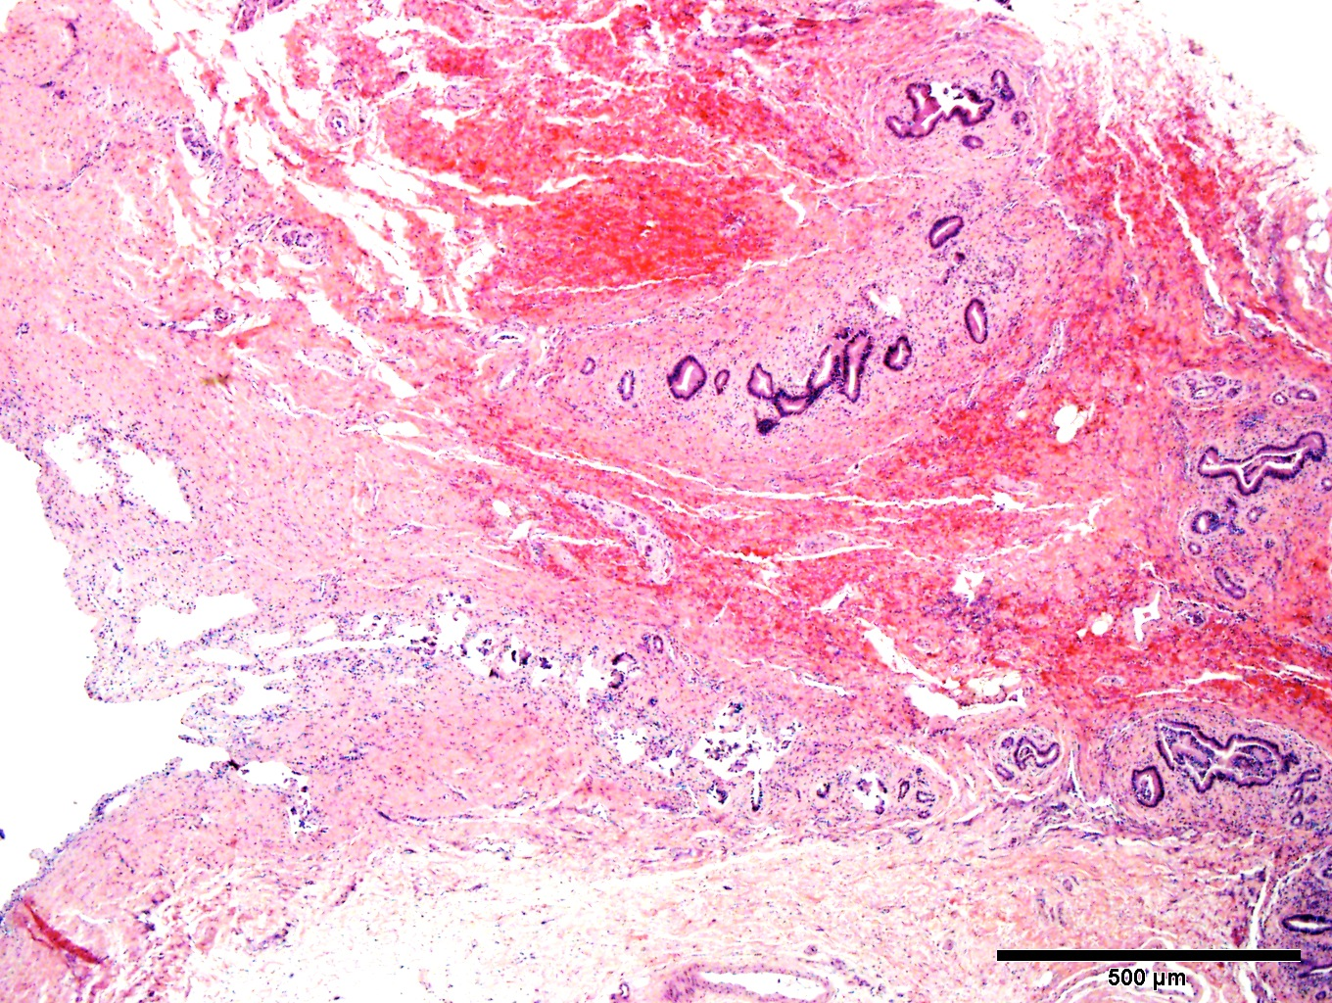
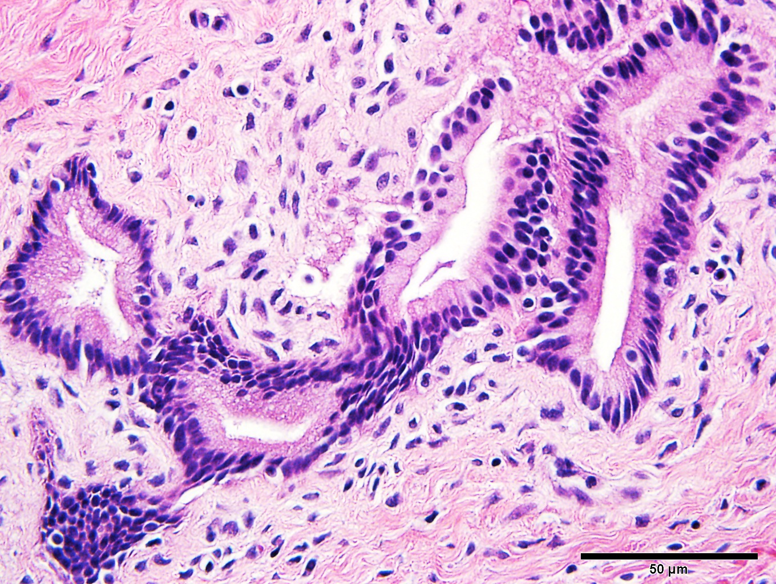
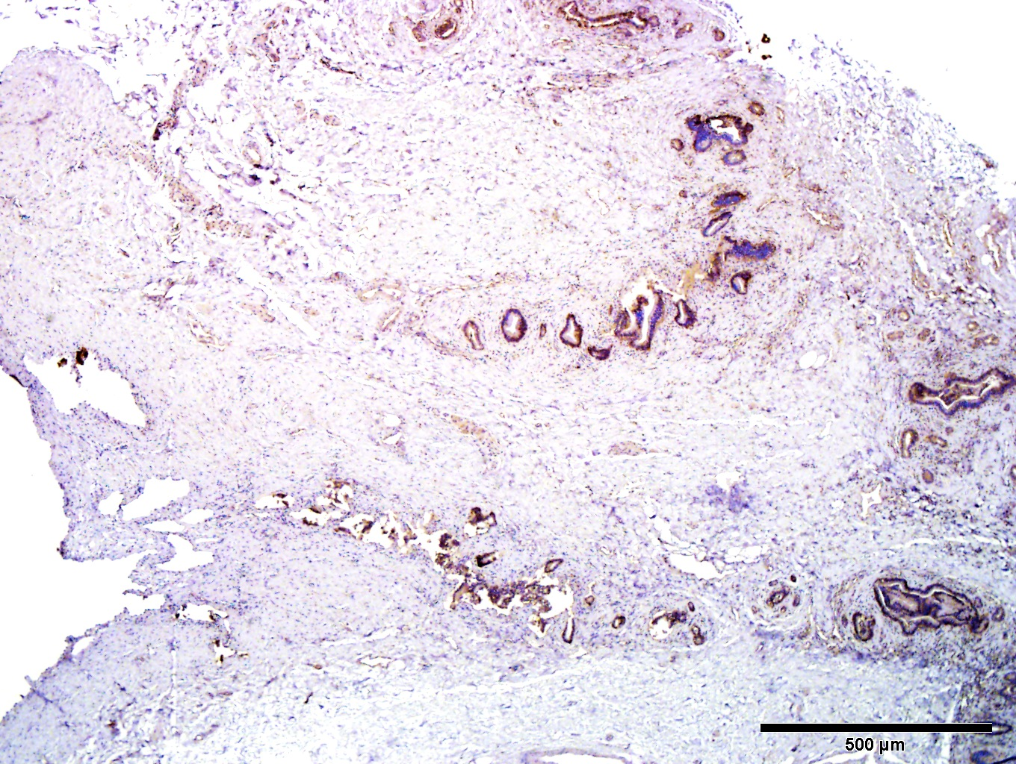
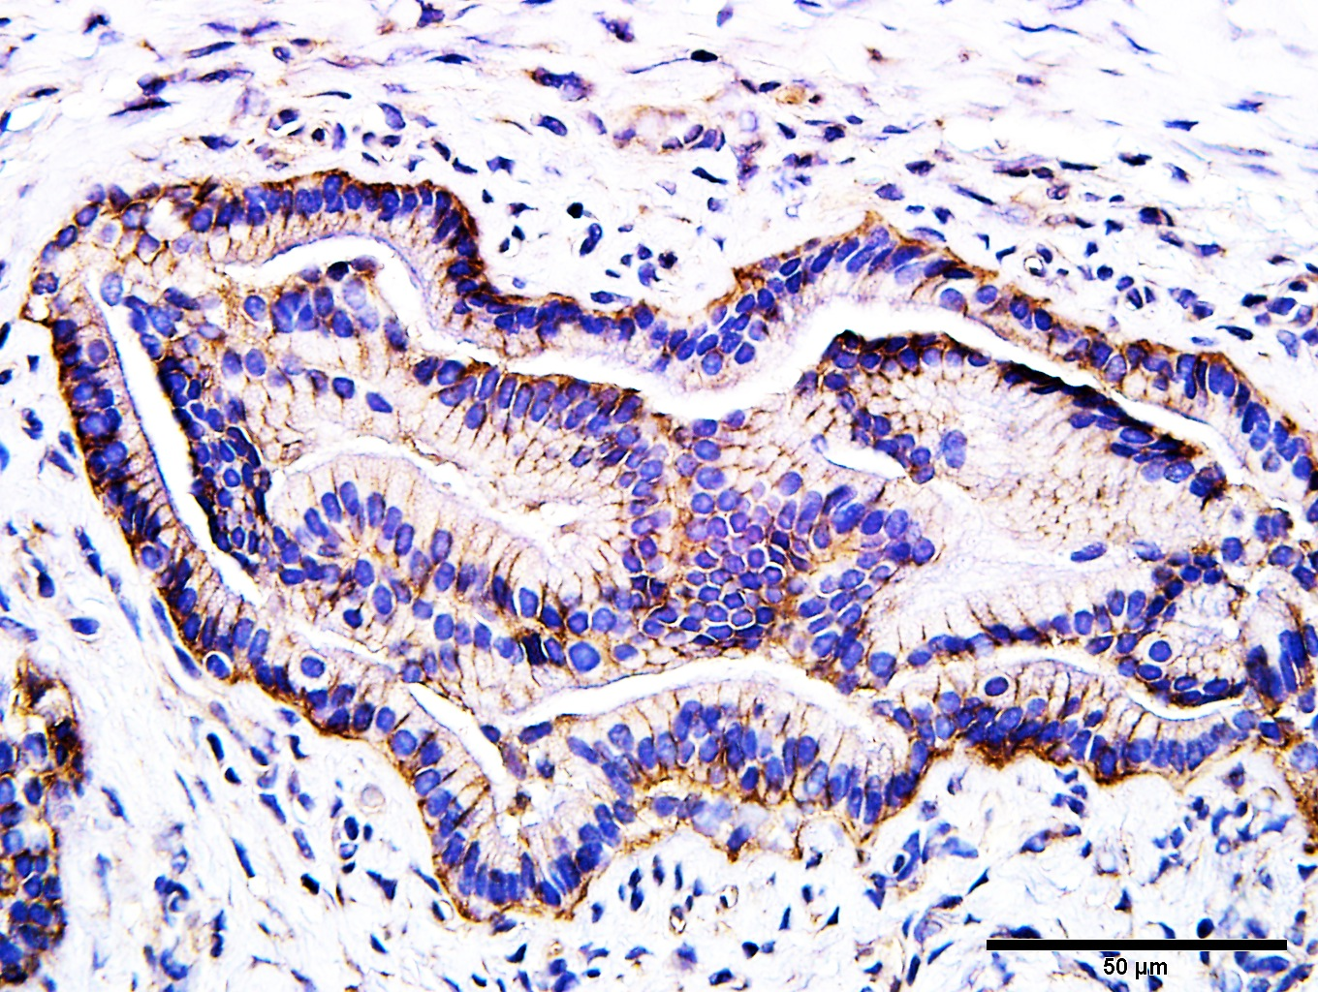
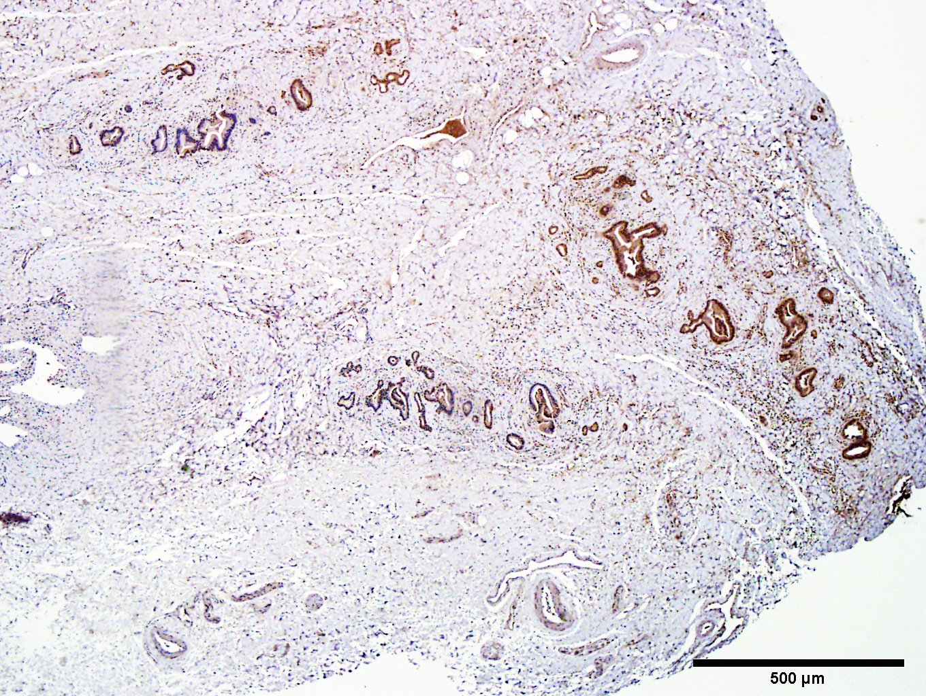
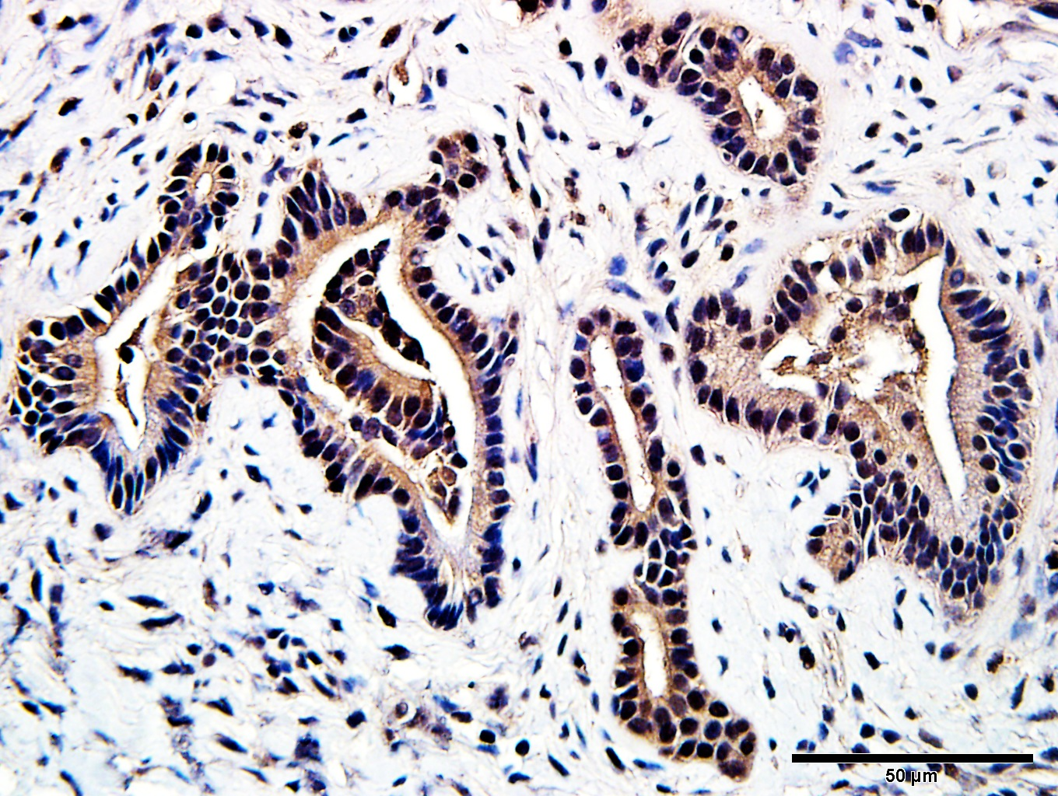
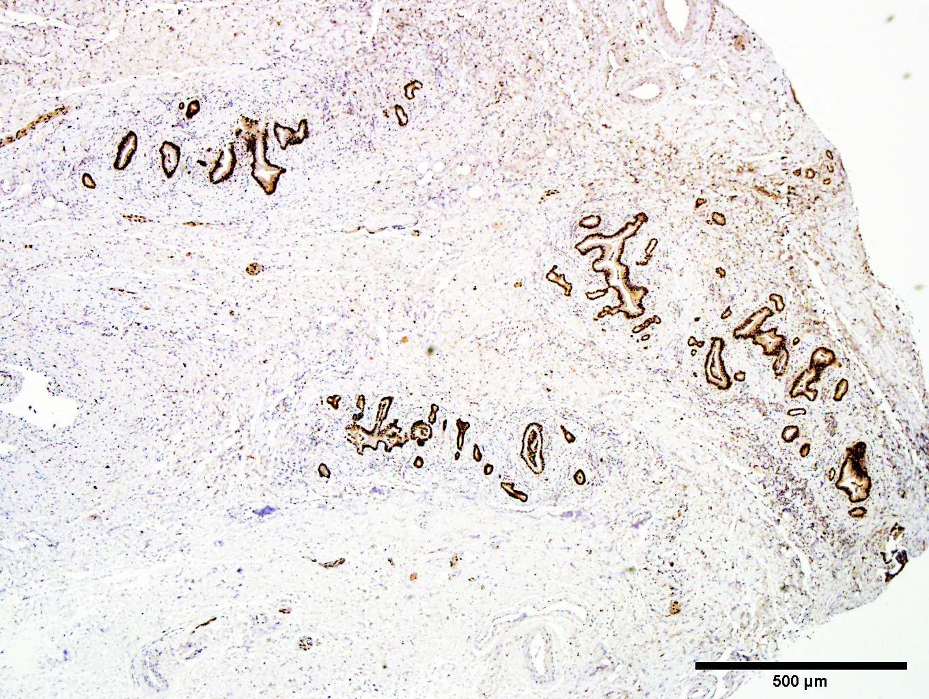
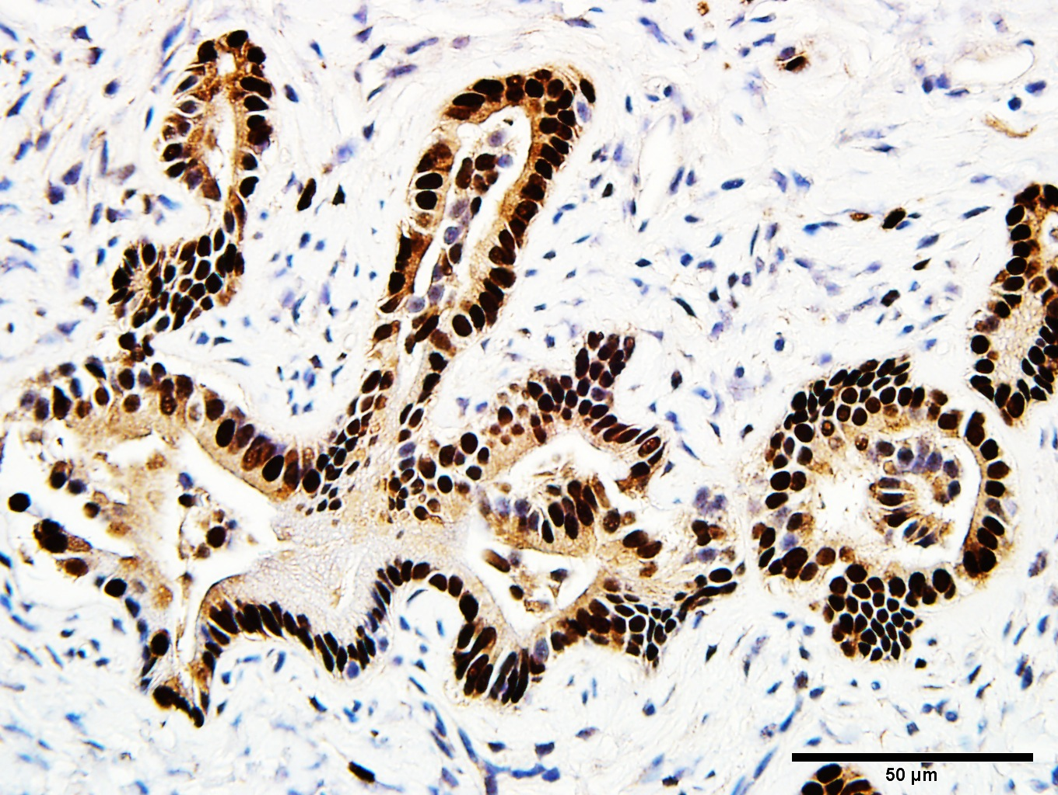
Fig S7
A
Table 1. Lineage markers for human biliary tree stem cells and hepatic-/pancreatic- mature cells
B
HUMANCELL TYPES/LINEAGE | LINEAGE/STAGES SPECIFIC MARKERS
Pluripotent Stem Cells | SOX2 NANOG SALL4
Biliary Tree Stem Cells | EpCAM NIS FOXA2 CD44 SOX17 PDX1 SOX9 CXCR4
Hepatic lineage | HNF4A AFP ALBUMIN TF
Pancreatic Lineage | RGS8/16 INSULIN TRYPSIN
Cystic/Cholangiocytes | CFTR Aquaporin-1 Aquaporin-9
Duodenal Cell Types | PDX1 CK8 CK9 MUC5
C
H&E
EpCAM
Sox2
Sox9

