Slide 1
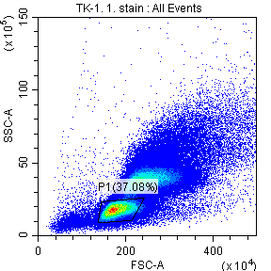
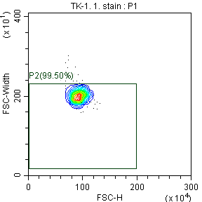
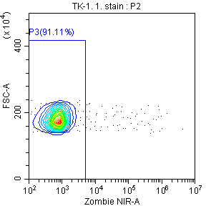
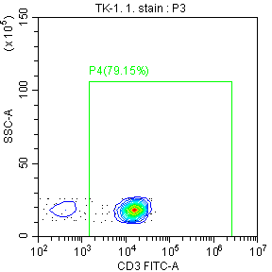
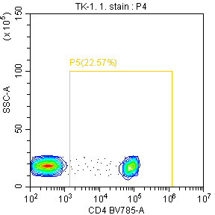
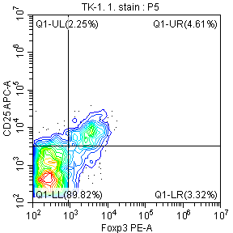
Lymphocyte
Singlet
Viable cell
T cell
CD4⁺ T cell
CD25⁺FOXP3⁺ Treg
Online Resource 1

Slide 2
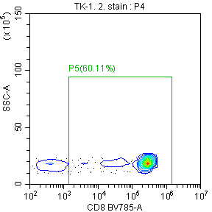
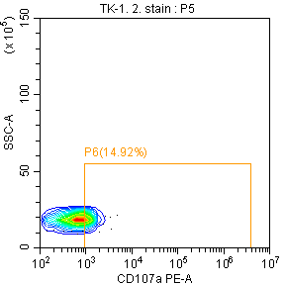
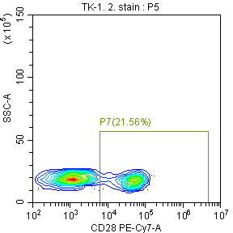
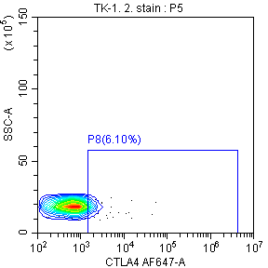
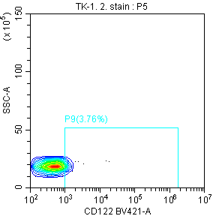
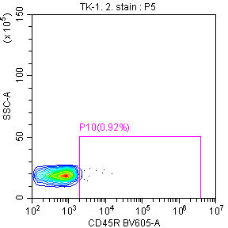
CD8⁺ T cell
CD8⁺CD107a⁺ T cell
CD8⁺CD28⁺ T cell
CD8⁺CTLA4⁺ T cell
CD8⁺CD122⁺ T cell
CD8⁺CD45R⁺ T cell
Online Resource 2

Slide 3
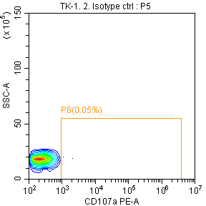
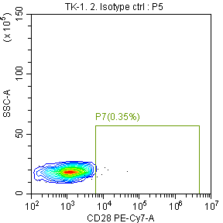
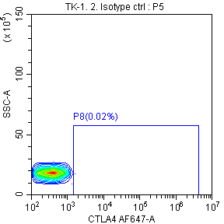
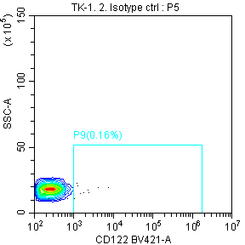
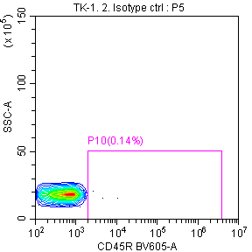
Isotype
control
CD8⁺CD107a⁺ T cell
CD8⁺CD28⁺ T cell
CD8⁺CTLA4⁺ T cell
Stained
Isotype
control
CD8⁺CD122⁺ T cell
CD8⁺CD45R⁺ T cell
Stained
Online Resource 3

