Slide 1

“AN EXPERIMENTAL STUDY ON UPLIFT CAPACITY OF AXISYMMETRIC PLATE ANCHORS IN WELL GRADED SAND AT DIFFERENT RELATIVE DENSITY AND EMBEDMENT RATIO.”
DEPARTMENT OF CIVIL ENGINEERING
DHARMSINH DESAI UNIVERSITY
NADIAD – 387001
APRIL - 2018
GUIDED BY:
PROF. S.P. Parmar
PREPARED BY:
SONI VIVEK .A. (16MGPOS005)

Slide 2
CONTENTS OF PRESENTATION
INTRODUCTION
REVIEW OF LITERATURE
AIM AND SCOPE OF WORK
OUTCOME OF LITERATURE REVIEW
WELL GRADED SAND SAMPLE PREPARATION AND COLLECTION
RESULT ANALYSIS & GRAPHICAL REPRESENTATION
UPLIFT FORCE BY FEM USING PLAXIS
SCHEDULE OF WORK DONE
FUTURE SCOPE
REFERENCES

Slide 3

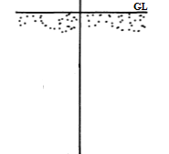



INTRODUCTION TO SOIL ANCHORS
The best choice of foundation systems has an important and crucial role in design and overall stability of many structures, to ensure they resist vertical uplift or horizontal pullout forces.
Generally structures like sea-walls, transmission tower, buried pipelines, and retaining walls are subjected to uplift or pullout forces and over turning moments.
Thus the way to improve the performance of foundation system is the development of proper way for design and installation of anchor systems.
The fundamental reason for using the anchor system in construction is to transmit the outwardly-directed load to the soil at a greater depth or farther away from the structure.
The pullout capacity of soil anchor is due to shear strength of surrounding soil, embedded depth, dead weight of plate, etc.
Usually soil anchors are used to transmit forces from structure to the ground, in order to resist overturning moment and pullout forces which are major condition for failure and which can endanger the structure’s stability.

Slide 4
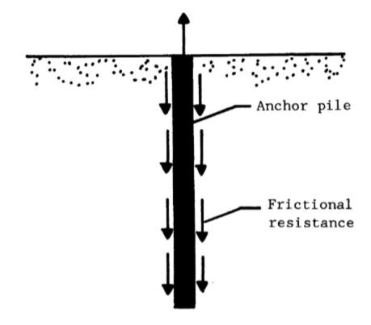
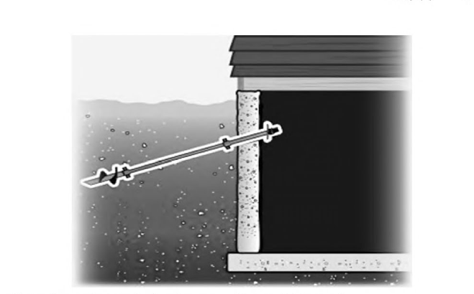
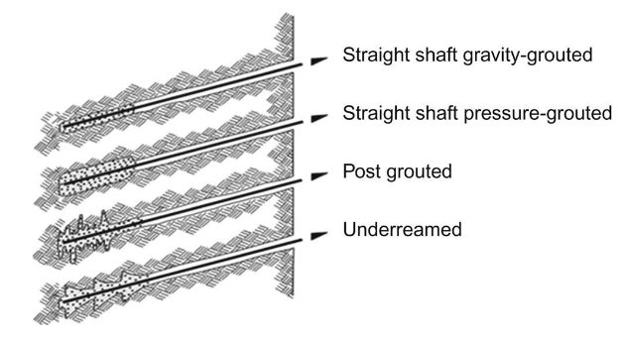
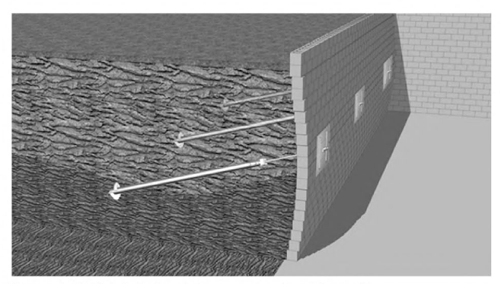
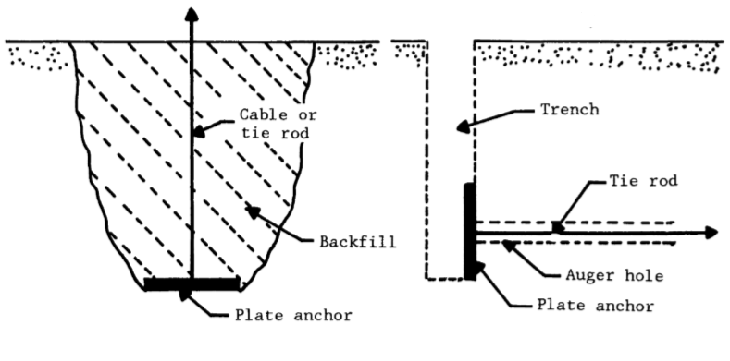
TYPES OF SOIL ANCHORS
According to the method of load transfer from the anchor to the surrounding soil, types of soil anchors in geotechnical engineering can be categorized as:
Grouted Anchors
Helical Anchors
Anchor Plates
Anchor Piles

Slide 5
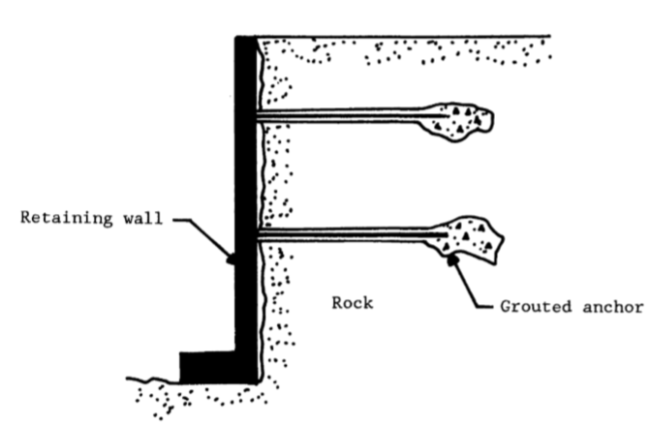
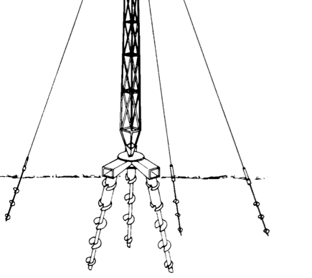
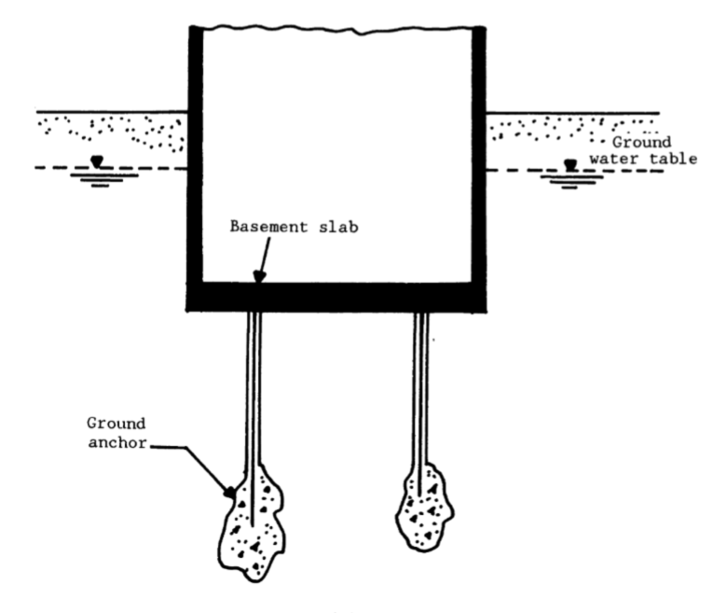
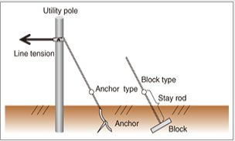
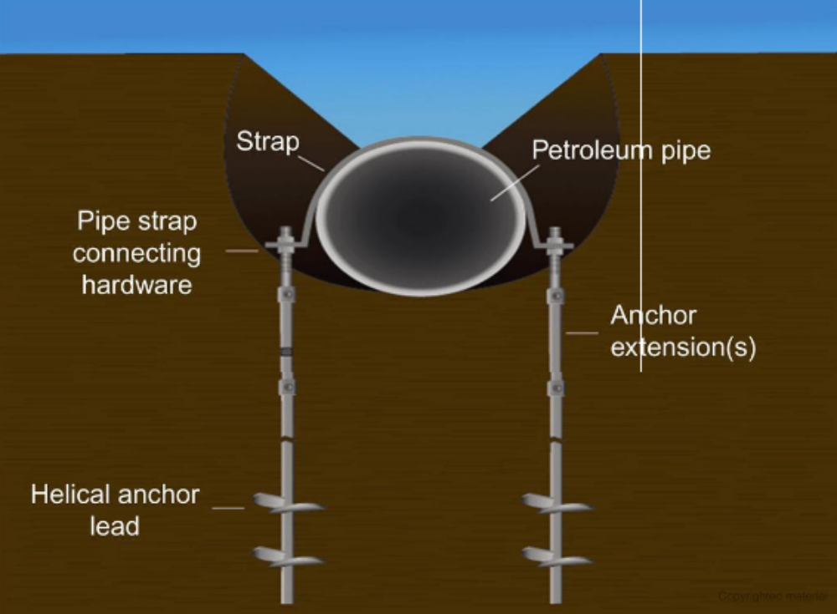
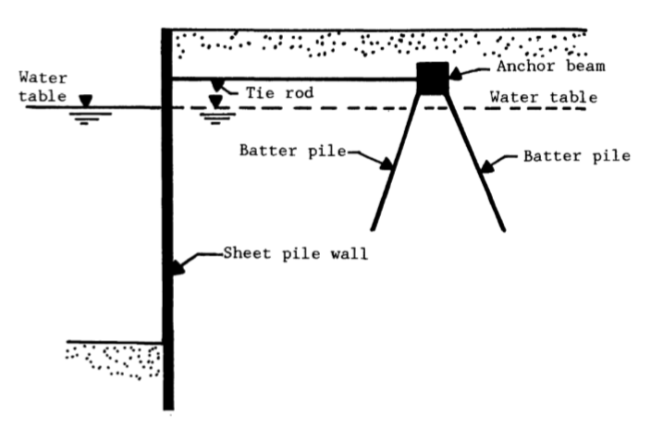
APPLICATIONS OF ANCHORS
Anchor systems are having wide range of applications in structures such as:
  Transmission Towers
  Retaining Walls
  Sea Walls
  Foundations in buoyancy condition
  Pipelines
  Utility Poles
  Aircraft & Vessels Moorings

Slide 6
ANCHOR PLATE
Soil anchor plates are having the tedious way of installation, but they are widely used owe to their wide range of applications in various geotechnical projects, however their importance in most geotechnical projects is crucial.
The installation process depends on direction of load applied and it includes, excavation of soil up to the required depth and then backfilled with good soil after placing anchor plate.
Anchor plates may be placed horizontal to resist vertically-directed uplifting load, inclined to resist axial pullout load, or vertical to resist horizontally-directed pullout load for various geotechnical projects.
Anchor plates are made of various materials such as Steel plates, Timber sheets, Precast concrete slab, etc.

Slide 7
TYPES OF ANCHOR PLATE
Soil Anchor plates are generally categorized based on two aspect.
Anchor
Plate
A. According to Shape
B. According to Application
1.Horizontal Plate Anchor
3.Vertical Plate Anchor
2.Inclined Plate Anchor
1.Circular Anchor
2.Square Anchor
3.Rectangular/
Strip Anchor

Slide 8
According To Shape
Circular
Anchor
Square
Anchor
Rectangular/Strip
Anchor

Slide 9
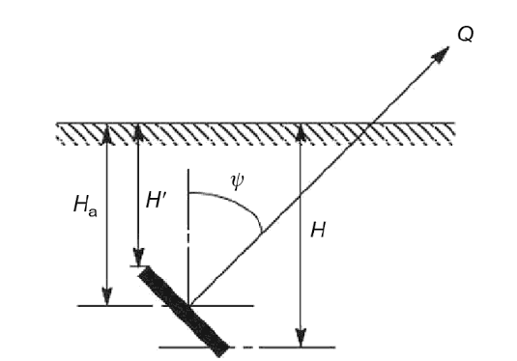
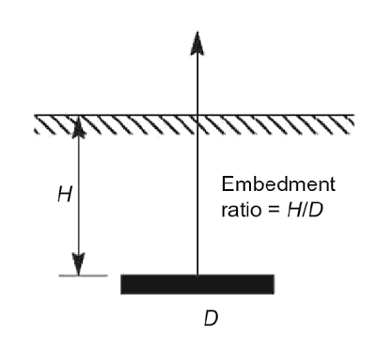
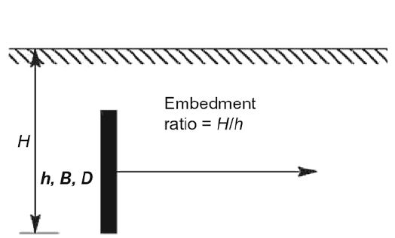
According To Application
Horizontal Plate Anchor to resist vertically-directed uplift load,
Inclined Plate Anchor to resist axial pullout load, or
Vertical Plate Anchor to resist horizontally-directed pullout load.

Slide 10
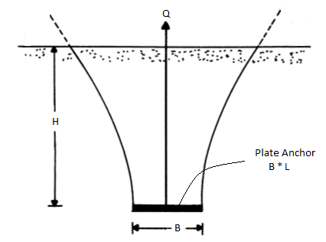
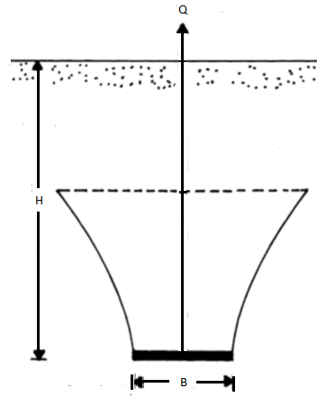
HORIZONTAL PLATE ANCHORS
Horizontal anchors embedded in various types of soils, like
(i) Plate anchors in sand
(ii) Plate anchors in clay.
These anchors can be classified as either shallow or deep anchor plates, determined by the embedment ratio. The embedment ratio is the ratio of H / B (where H is the embedment depth and B is the plate width/diameter).
A)
B)

Slide 11
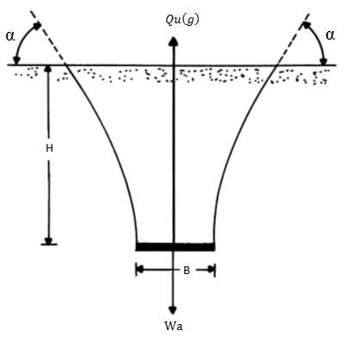
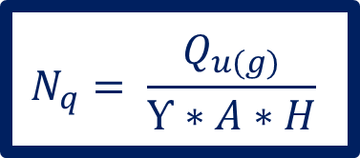
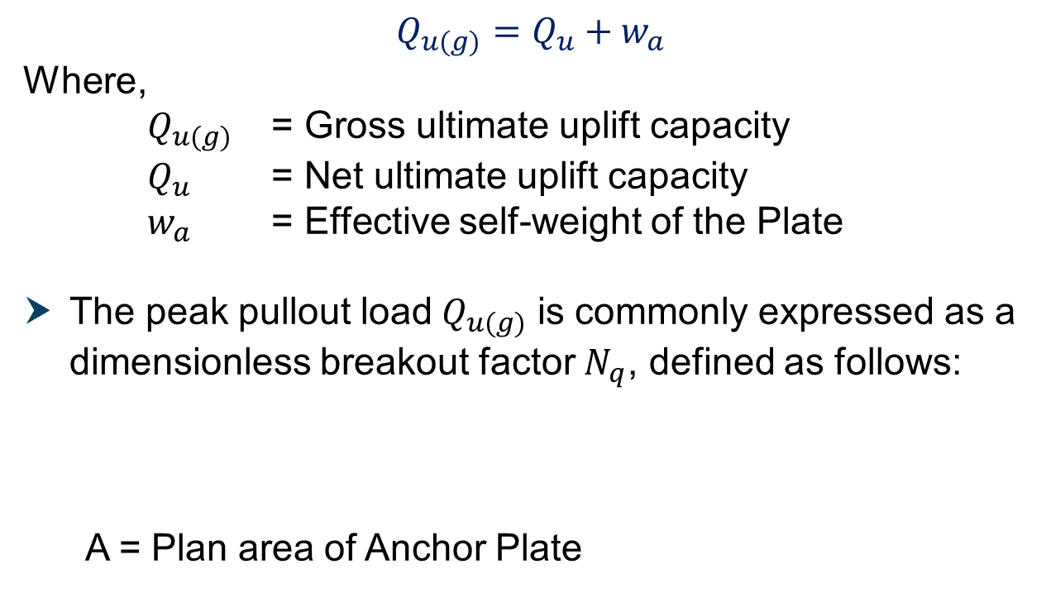
The angle α at which the failure surface intersects the horizontal ground surface may be equal to 90° for very loose sand & for medium to very dense sand it may be vary between (45 – Φ/4) to (45 – Φ/2).
For a given anchor, the gross ultimate uplift capacity can be defined as,
$$Q_{u(g)}=Q_{u}+w_{a}$$
Where,
$Q_{u(g)}$ = Gross ultimate uplift capacity
$Q_{u}$ = Net ultimate uplift capacity
$w_{a}$ = Effective self-weight of the Plate
The peak pullout load${ Q}_{u(g)}$ is commonly expressed as a dimensionless breakout factor $N_{q}$, defined as follows:
  A = Plan area of Anchor Plate
$$N_{q}= \frac{Q_{u(g)}}{Ƴ∗A∗H}$$

Slide 12
VARIOUS THEORIES TO ANALYSE PULLOUT CAPACITY OF ANCHORS
Mors (1959)
Balla’s (1961)
Friction Cylinder Method (1963)
Ireland (1963)
Mariupol'skii (1965)
Downs and Chieurzzi (1966)
Baker and Kondner's (1966)
Meyerhof and Adams (1968)
Veesaert and Clemence’s (1977)
Saeedy‘s (1987)

Slide 13
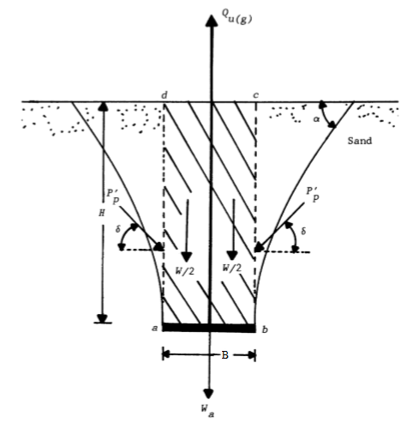
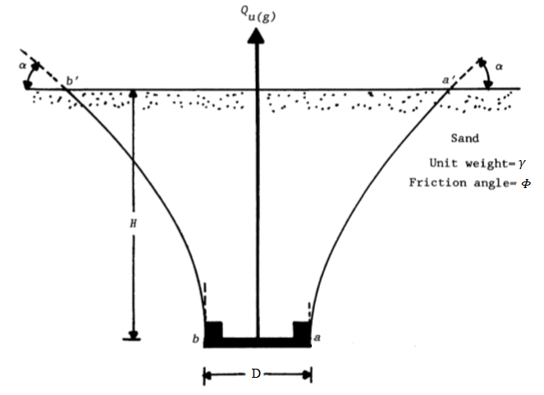
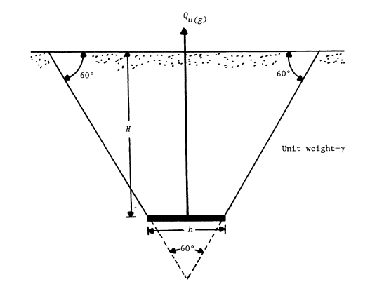
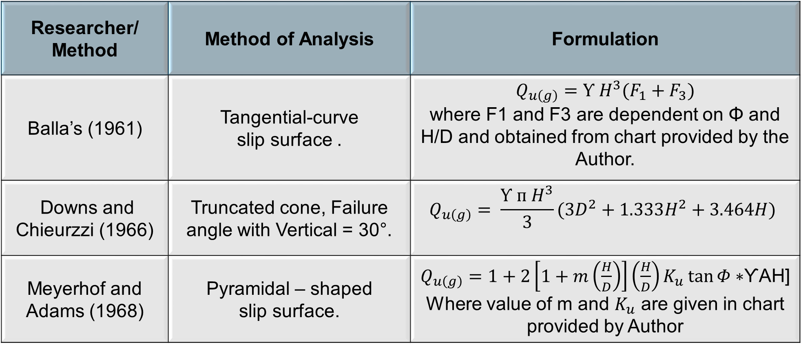
Recent Theories used for Analytical Calculations for Anchor Plate in Sand.
Researcher/ Method | Method of Analysis | Formulation
Balla’s (1961) | Tangential-curve slip surface . | $$Q_{u\left(g\right)}=Ƴ H^{3}(F_{1}+F_{3})$$ where F1 and F3 are dependent on Φ and H/D and obtained from chart provided by the Author.
Downs and Chieurzzi (1966) | Truncated cone, Failure angle with Vertical = 30°. | $$Q_{u\left(g\right)}= \frac{Ƴ ᴨ H^{3}}{3}(3D^{2}+1.333H^{2}+3.464H)$$
Meyerhof and Adams (1968) | Pyramidal – shaped slip surface. | $Q_{u\left(g\right)}=$ $1+2\left[1+m\left(\frac{H}{D}\right)\right]\left(\frac{H}{D}\right)K_{u}\tan{Φ∗}$ƳAH] Where value of m and $K_{u}$ are given in chart provided by Author

Slide 14
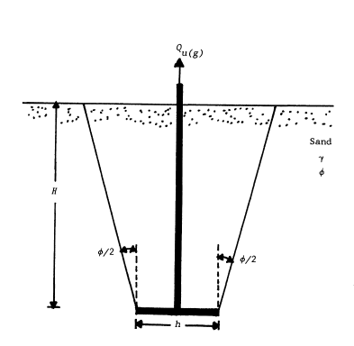
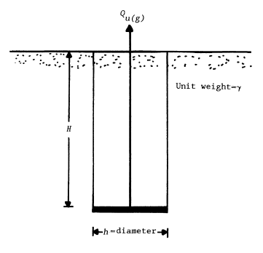
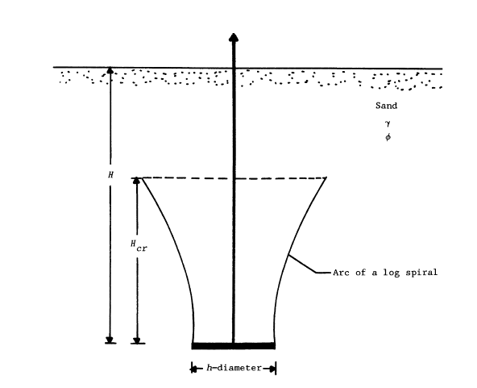
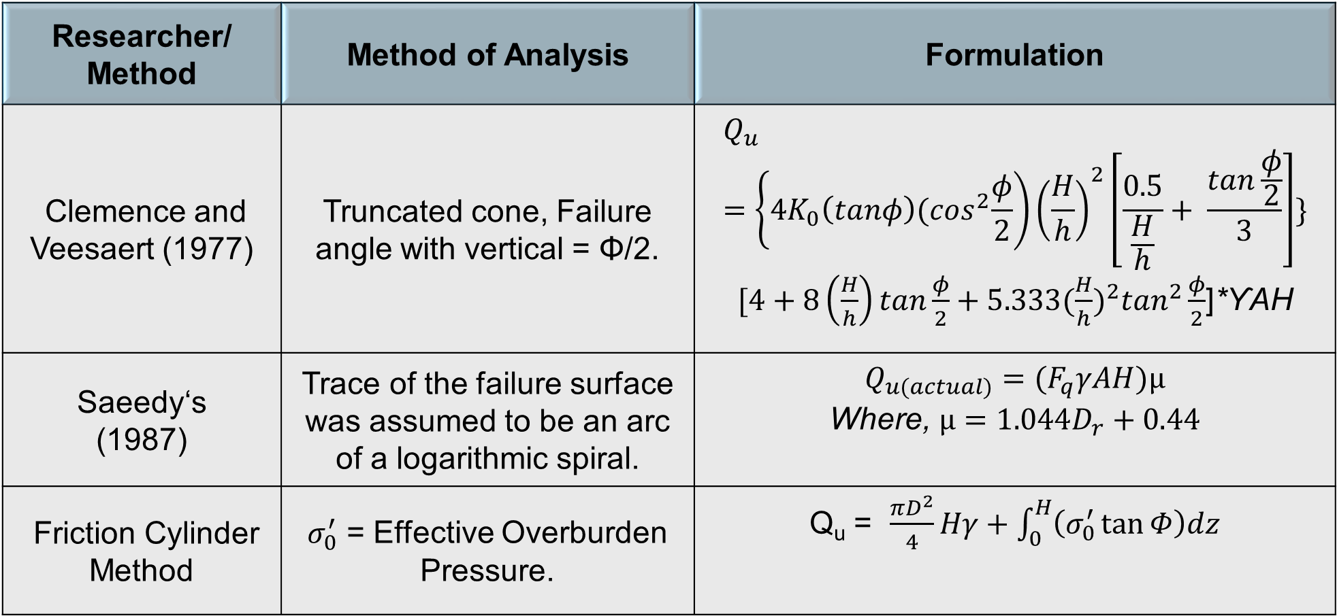
Researcher/ Method | Method of Analysis | Formulation
Clemence and Veesaert (1977) | Truncated cone, Failure angle with vertical = Φ/2. | $$Q_{u}=\left\{4K_{0}\left(tanφ\right){(cos}^{2}\frac{φ}{2}\right){\left(\frac{H}{h}\right)}^{2}\left[\frac{0.5}{\frac{H}{h}}+ \frac{tan\frac{φ}{2}}{3}\right]\}$$ $[4+8\left(\frac{H}{h}\right)tan\frac{φ}{2}+5.333{(\frac{H}{h})}^{2}\tan^{2}\frac{φ}{2}$]*ƳAH
Saeedy‘s (1987) | Trace of the failure surface was assumed to be an arc of a logarithmic spiral. | $$Q_{u(actual)}=(F_{q}γAH)µ$$ Where, $µ=1.044D_{r}+0.44$
Friction Cylinder Method | $σ_{0}^{′}$ = Effective Overburden Pressure. | Q_{u} = $\frac{πD^{2}}{4}Hγ+\int_{0}^{H}{\left(σ_{0}^{′}\tan{Φ}\right)dz}$

Slide 15
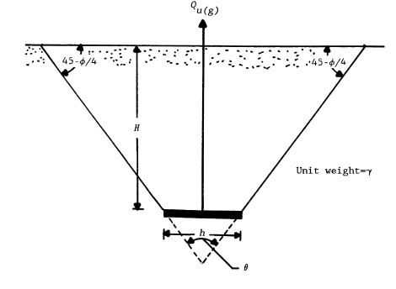
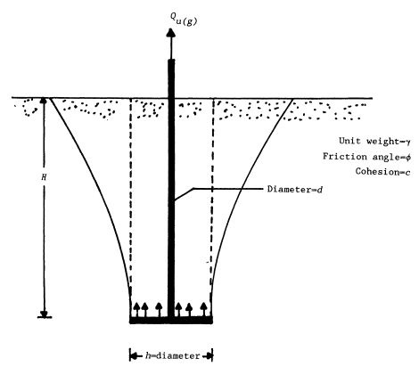
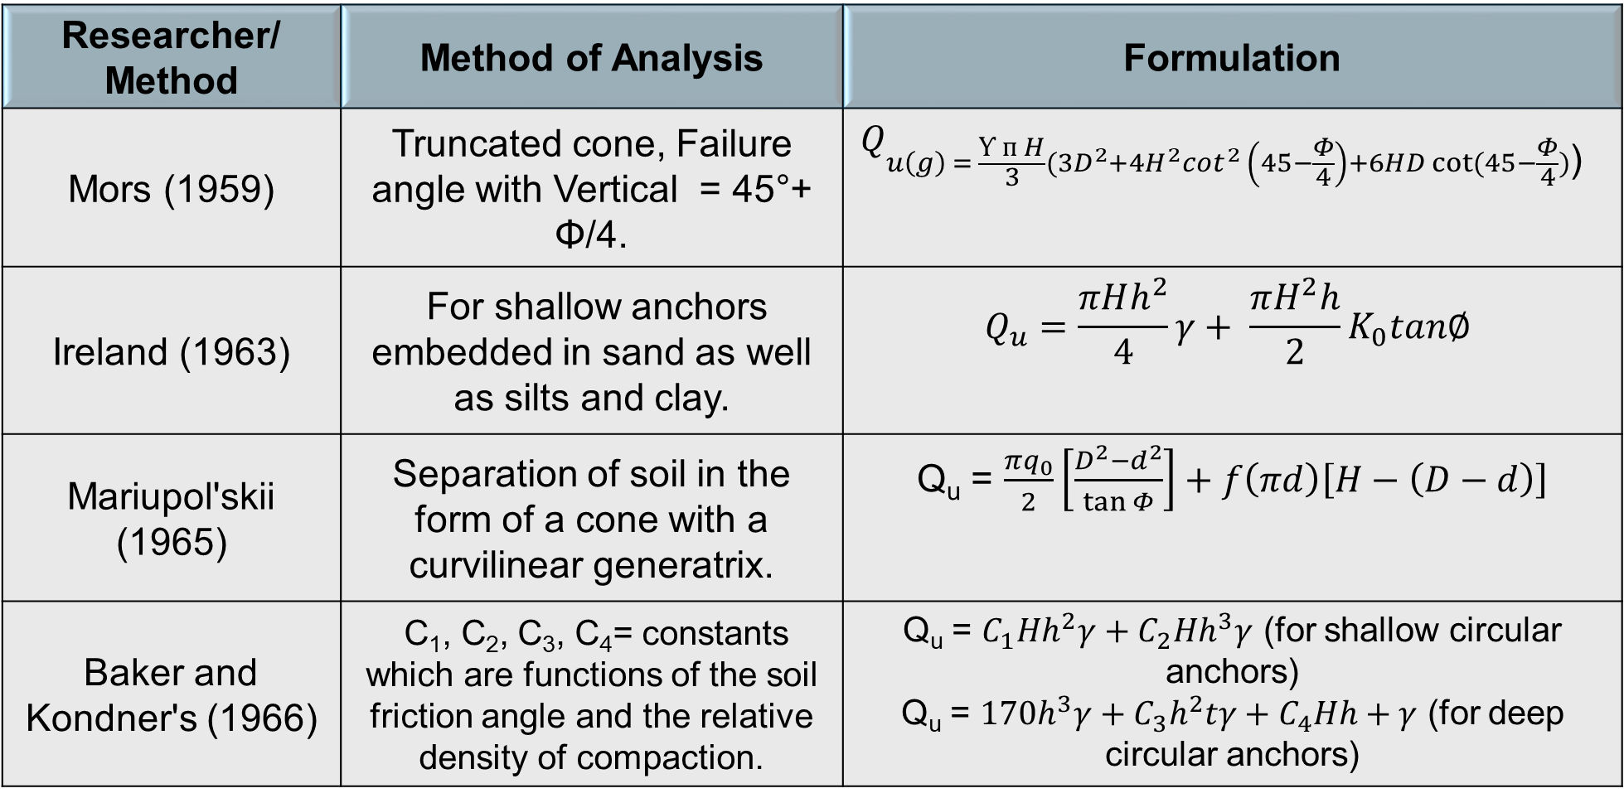
Researcher/ Method | Method of Analysis | Formulation
Mors (1959) | Truncated cone, Failure angle with Vertical = 45°+ Φ/4. | $$Q_{u\left(g\right) = \frac{Ƴ ᴨ H}{3}(3D^{2}+4H^{2}\cot^{2} \left(45−\frac{Φ}{4}\right)+6HD cot⁡(45−\frac{Φ}{4})\text{)} }$$
Ireland (1963) | For shallow anchors embedded in sand as well as silts and clay. | $$Q_{u}=\frac{πHh^{2}}{4}γ+ \frac{πH^{2}h}{2}K_{0}tan∅$$
Mariupol'skii (1965) | Separation of soil in the form of a cone with a curvilinear generatrix. | Q_{u} = $\frac{πq_{0}}{2}\left[\frac{D^{2}−d^{2}}{\tan{Φ}}\right]+f\left(πd\right)\left[H−\left(D−d\right)\right]$
Baker and Kondner's (1966) | C₁, C₂, C₃, C₄= constants which are functions of the soil friction angle and the relative density of compaction. | Q_{u} = $C_{1}Hh^{2}γ+C_{2}Hh^{3}γ$ (for shallow circular anchors) Q_{u} = $170h^{3}γ+C_{3}h^{2}tγ+C_{4}Hh+γ$ (for deep circular anchors)

Slide 16
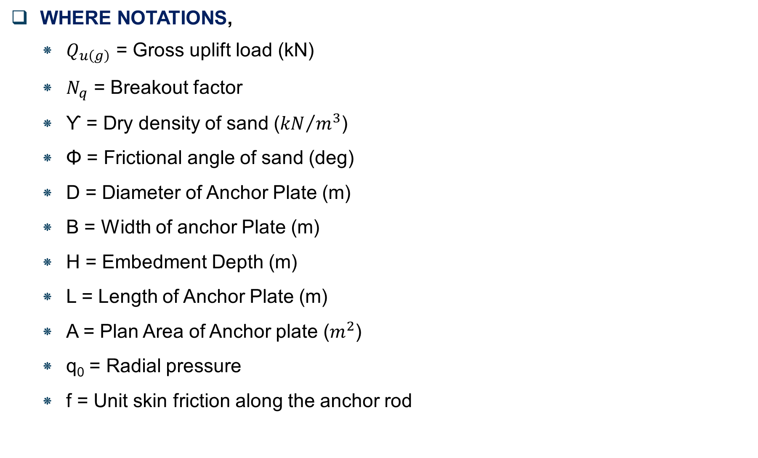
WHERE NOTATIONS,
  $Q_{u\left(g\right)}$ = Gross uplift load (kN)
  $N_{q}$ = Breakout factor
  Ƴ = Dry density of sand (${kN}/{m^{3}}$)
  Φ = Frictional angle of sand (deg)
  D = Diameter of Anchor Plate (m)
  B = Width of anchor Plate (m)
  H = Embedment Depth (m)
  L = Length of Anchor Plate (m)
  A = Plan Area of Anchor plate ($m^{2}$)
  q₀ = Radial pressure
  f = Unit skin friction along the anchor rod

Slide 17
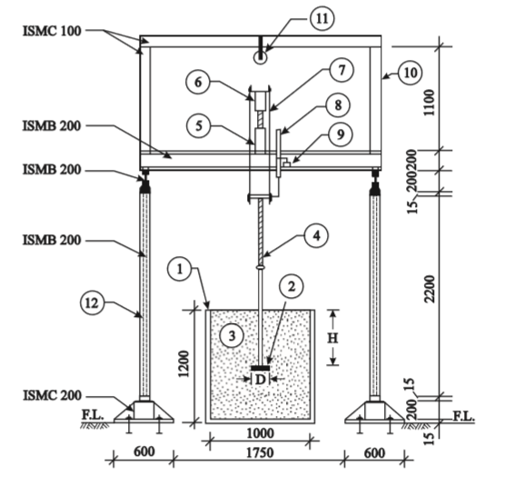
Review of Literature
“Experimental investigation of the uplift behaviour of circular plate anchors embedded in sand”.(2002)
By- K. Ilamparuthi, E.A. Dickin, and K. Muthukrisnaiah
Experimental Investigation
Type/Size of Plate - Circular plate anchors up to 400 mm in diameter.
Type of Soil - loose, medium-dense, and dense dry sand
Tank Dimensions - 1.0 m × 0.5 m × 1.2 m
Properties of Palar River Sand - Uniformity coefficient, Cu - 2.24,
Coefficient of curvature, Cc - 0.96
Maximum dry unit weight, γdmax (kN/m³) - 18.2,
Minimum dry unit weight, γdmin (kN/m³) - 14.3
In tests, failure surface make an angle of Φ/2 approximately to the Vertical.

Slide 18
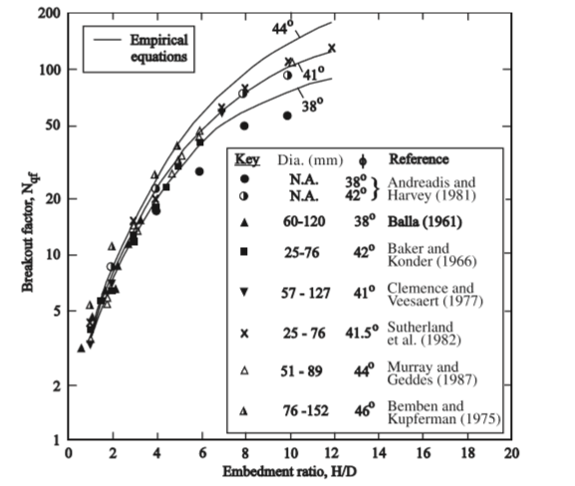
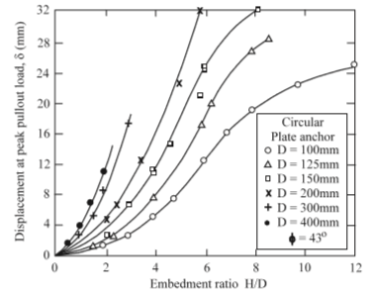
They concluded that,
  Uplift capacity is strongly influenced by Anchor Diameter, Embedment Ratio, and Sand Density.
  The value of Vesic (1971) for dense sand is about 50% higher.
  The values of Meyerhof and Adams (1968) are in good agreement for loose and medium-dense sands but are about 10–20% higher for dense sand.
  The values of Clemence and Veesaert (1977) are about 21% lower.
Comparison of breakout factors from empirical equations and previous experimental research for circular plate anchors in medium-dense to dense sand.
Displacement at peak pullout load for circular plate anchors at various embedment ratios in dense sand.

Slide 19
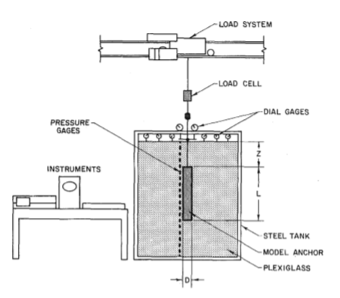
“Uplift Testing of Model Anchors”(1988).
By - Weizhi Su, Richard J. Fragaszy
Experimental Investigation
The results of model tests of 18 ground anchors vertically buried.
Comparison tests were done to determine the influence of factors such as diameter, fixed anchor length, and buried depth on the uplift capacity of anchors.
Model Tanks Size -1) A large sand tank, 2 m deep, 2 m wide, and 1 m long, was used for the large-scale anchor tests, thickness of 6 mm. All the other sides were made from steel with a thickness of 4 mm. 2) A cylindrical sand tank, 1.2 m deep and 0.8 m in diameter (40 anchor diameters), was used for additional tests to determine effects of various anchor parameters
Soil properties – Poor Graded Sand, Φ = 38° (Direct Shear test), Density = 16.55 kN/m³, D60 = 0.6 mm, D30 = 0.21 mm, D10 = 0.11 mm, Cu = 5.5 and Cc = 0.7.

Slide 20
Based on the results of 18 vertical buried model anchors, the following conclusions were drawn:
  Two types of failures were observed in the tests when the ground anchors were uplifted, namely, deep failure and shallow failure.
  The peak values of top and skin resistances do not occur simultaneously. Peak skin resistance is obtained with very little anchor movement, while peak top resistance typically requires considerably more movement.
  An expansive plastic sphere was observed on the top of a deep buried anchor. Vesic's theory of expansive cavities can explain this phenomenon; therefore, his method is recommended to determine the ultimate top resistance.

Slide 21
OUTCOME OF LITERATURE REVIEW
Variables Observed for Dissertation Work :
For Experimental Investigations
  Shape of Anchor Plates – Axisymmetric
  Size(Diameter) of Anchor Plates – 1) 0.15m, 2) 0.30m
  Density to be achieved – 1) 70% (Dense), 2) 85% (Very Dense)
  Embedment Depth – 1) 0.3m 2) 0.45m 3) 0.6m
  Soil to be used – Well Graded Sand (SW)
Analytical Methods to be used for comparision of Uplift load
  Balla’s 2. Meyerhof & Adams 3. Downs & Chieurzzi 4. Veesaert & Clemence’s
  Saeedy’s
Software to be used for finding Uplift Forces - PLAXIS

Slide 22
AIM AND SCOPE OF WORK
The Aim of this dissertation is to finding out Effect of Relative Density, Embedment Ratio & Size of Plate on Uplift load and Break-out factor,
  By Analytical Calculation.
  By Performing Experimental Model Test.
  By FEM using PLAXIS Software.
By using Empirical Formulas, Analytical calculation for Break-out factor and Uplift Load has been carried out.
For Model test, Pull-out tests are performed in Laboratory by applying Effect of Relative Density, Scale of plate & Embedment Ratio and then Peak Uplift load and Relative Displacement are find out.

Slide 23
SAND SAMPLE COLLECTION
GRADATION TEST
SOIL CHARACTERIZATION
RELATIVE DENSITY TEST
DIRECT SHEAR TEST
FOR 70% D_{r}
FOR 85% D_{r}
SPECIFIC GRAVITY TEST
Sand Sample
Collection
Soil
Characterization
Analytical
Calculations
Experimental
Pullout
F.E.A. in
PLAXIS
Analysis of Results
& Discussions
Conclusions

Slide 24
PULL-OUT TEST DETAILS
Sr No. | Plate Size D (m) | Density Type | Relative Density (%) | Embedment Depth (m)
1. | 0.15 | Dense | 70 | 0.3, 0.45, 0.60
 |  | Very Dense | 85 | 0.3, 0.45, 0.60
2. | 0.30 | Dense | 70 | 0.3, 0.45, 0.60
 |  | Very Dense | 85 | 0.3, 0.45, 0.60

Slide 25
LIST OF EXPERIMENTS
SR. NO. | NAME OF EXPERIMENT | NO. OF EXPERIMENT
1. | Sand Classification (Grain size analysis Test & Specific Gravity Test) | 1
2. | Density Index Test | 1
3. | Direct Shear Test | 2
4. | Pull out Test | 12

Slide 26
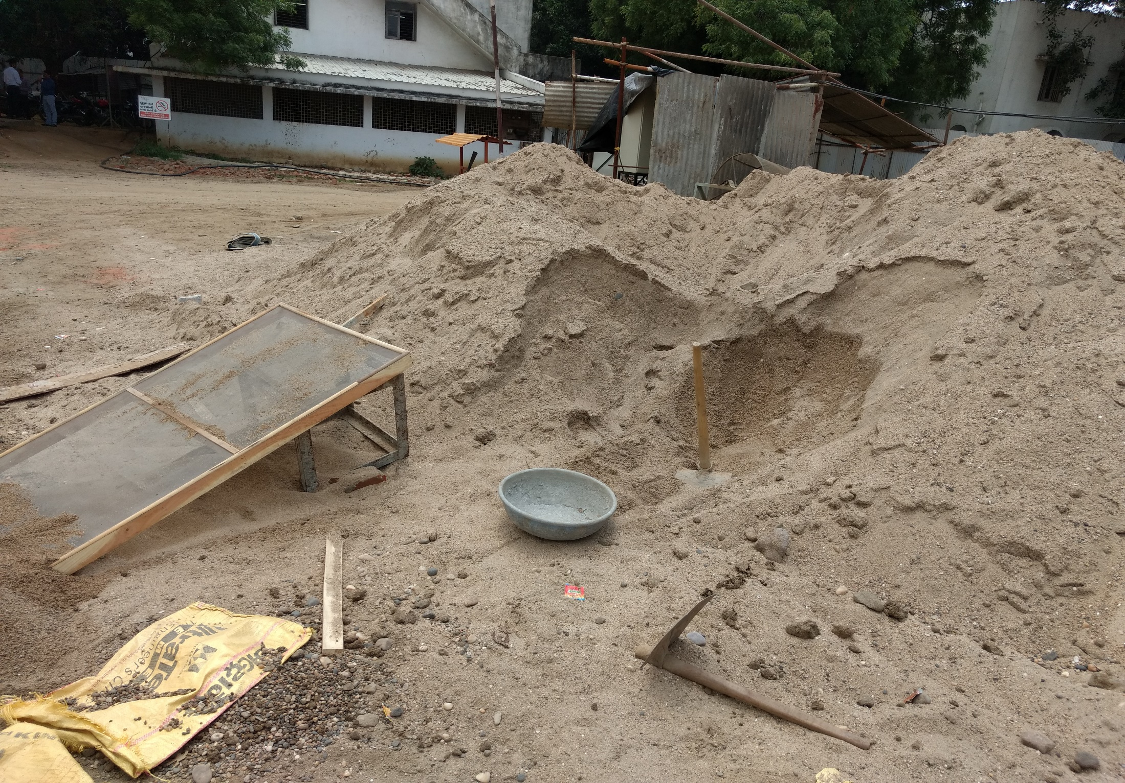
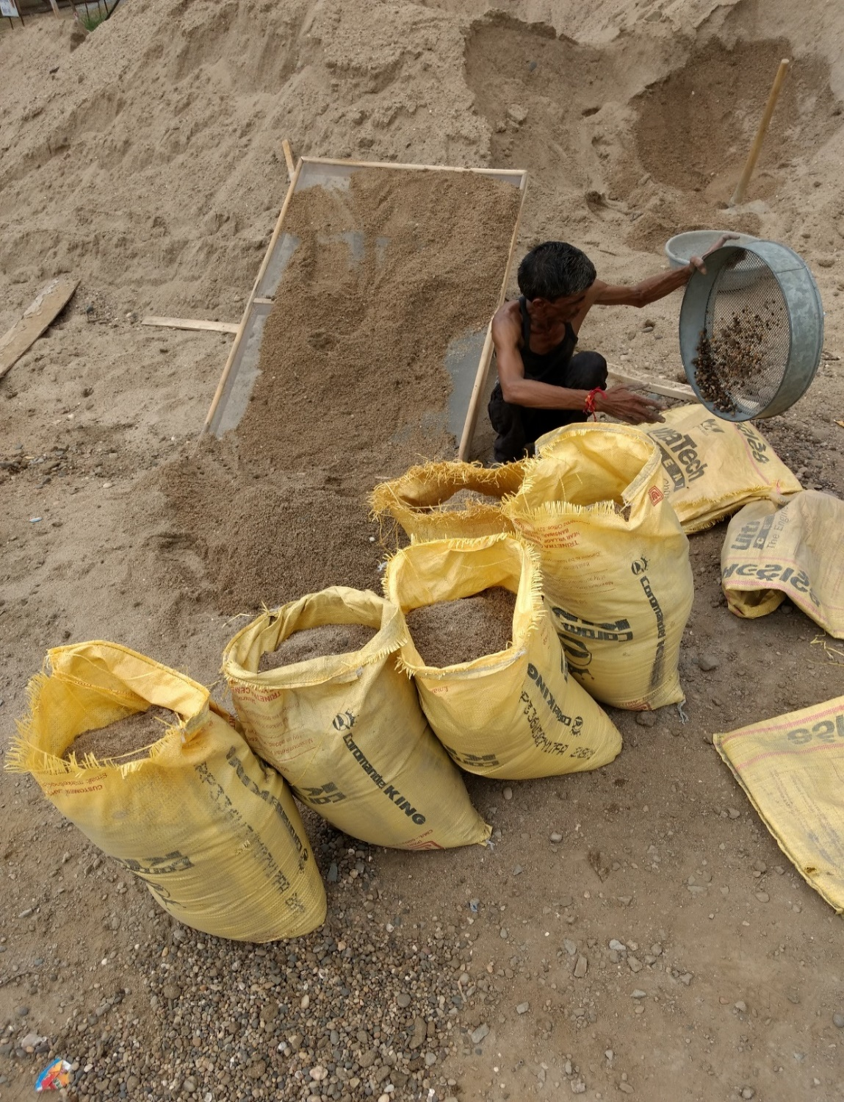
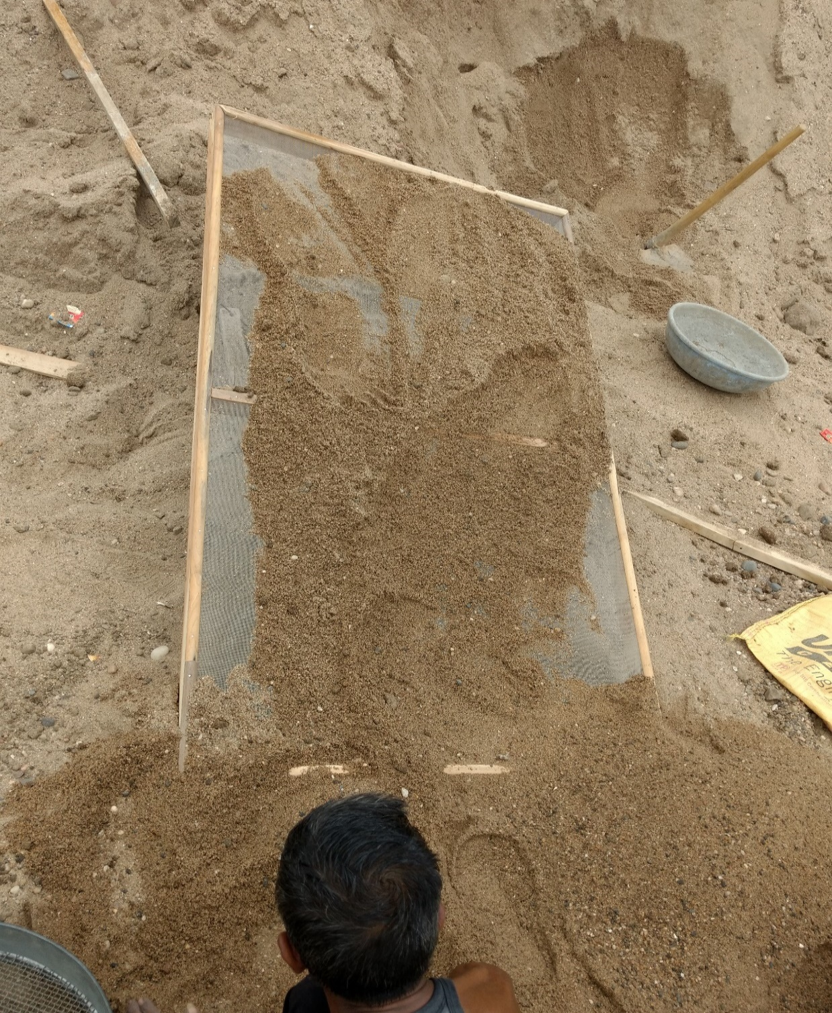
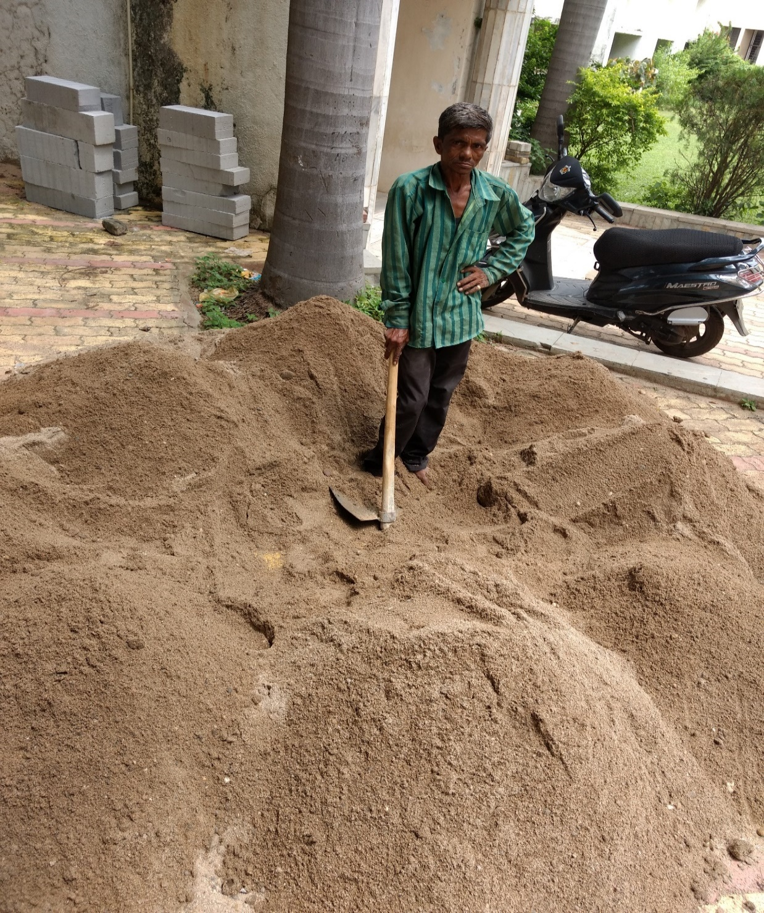
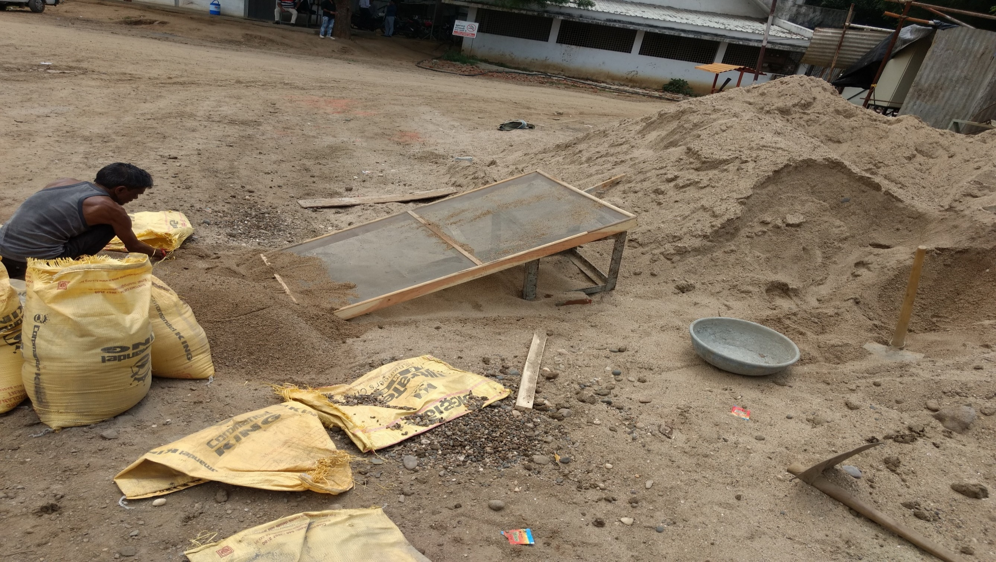
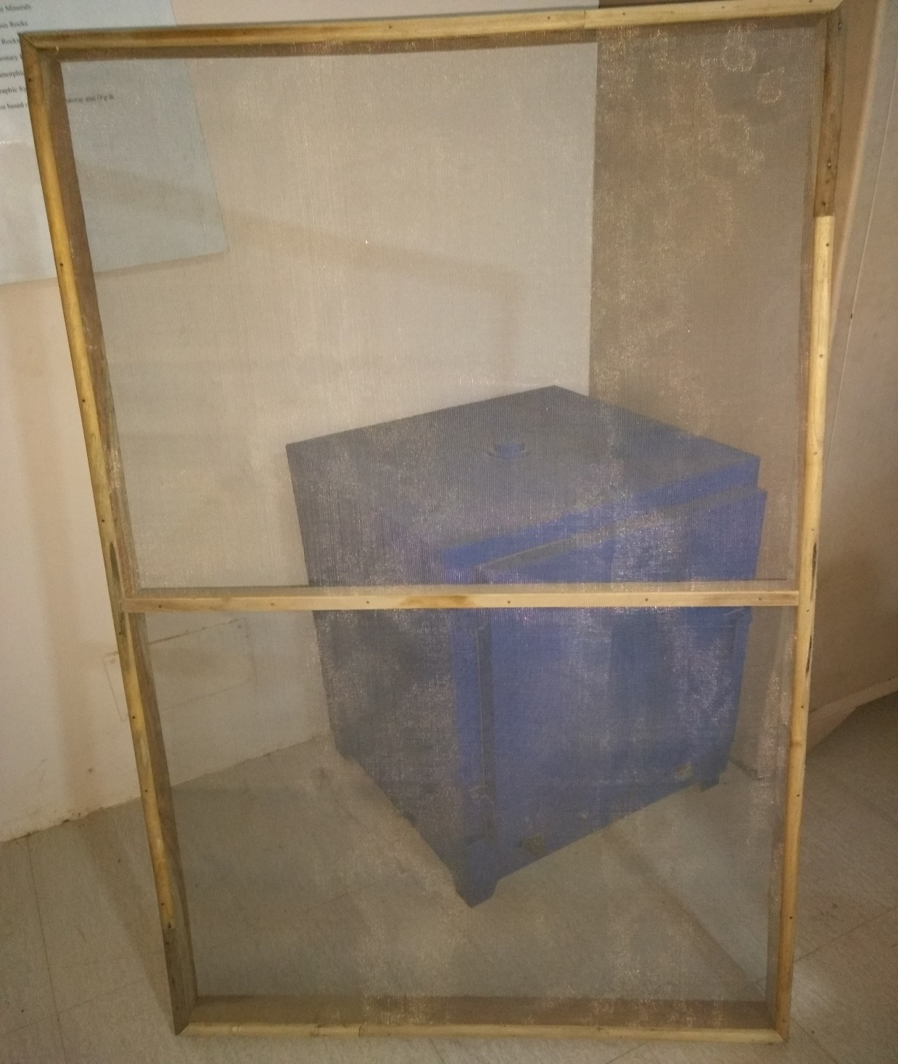
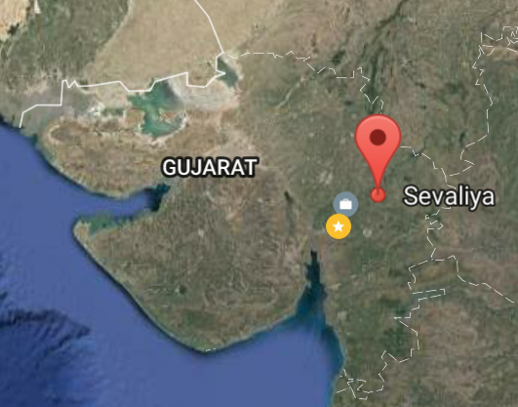
Well Graded Sand Sample Preparation and Collection
Sand Sample from Sevaliya, Gujarat

Slide 27
WELL GRADED SAND SAMPLE PREPARATION AND COLLECTION
Cu | 8.333333
Cc | 1.216033
So, it is Well Graded Sand.
(Reference 10)

Slide 28
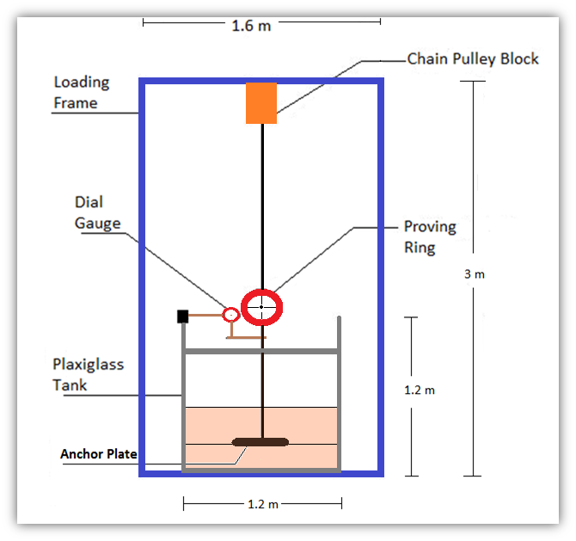
LINE DIAGRAM OF
LABORATORY MODEL SETUP

Slide 29
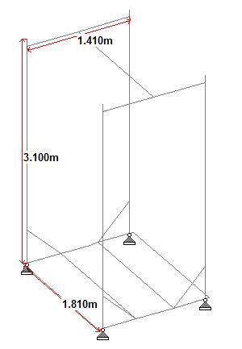
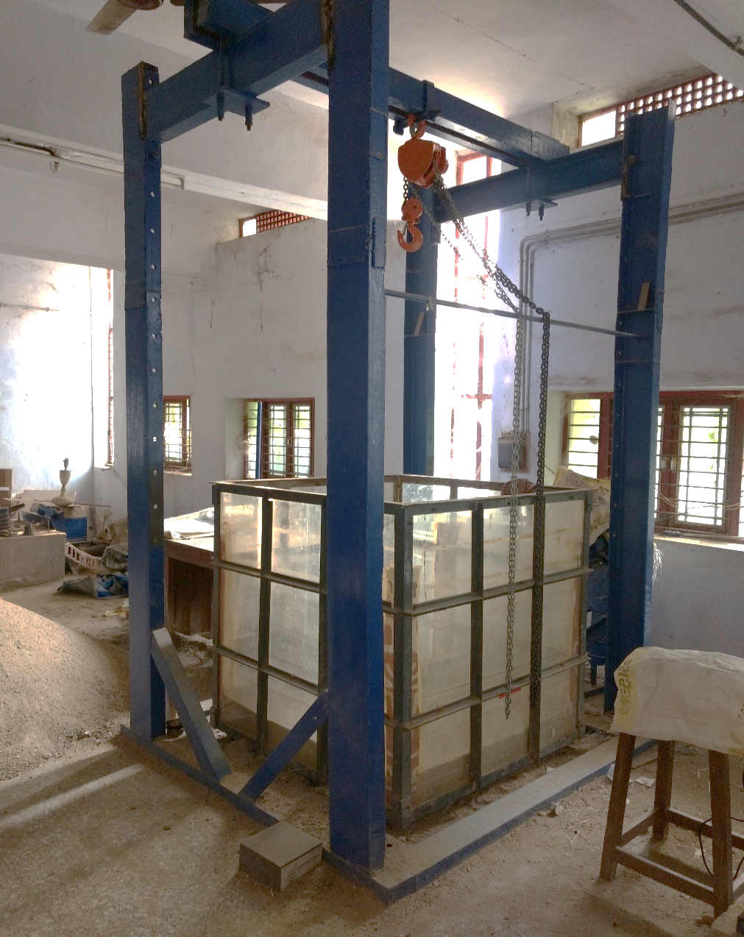
BY PERFORMING MODEL TEST
For Laboratory Experimental tests,
creation of model is done and its details are given.
Loading Frame
For 50 KN Uplift Load.

Slide 30
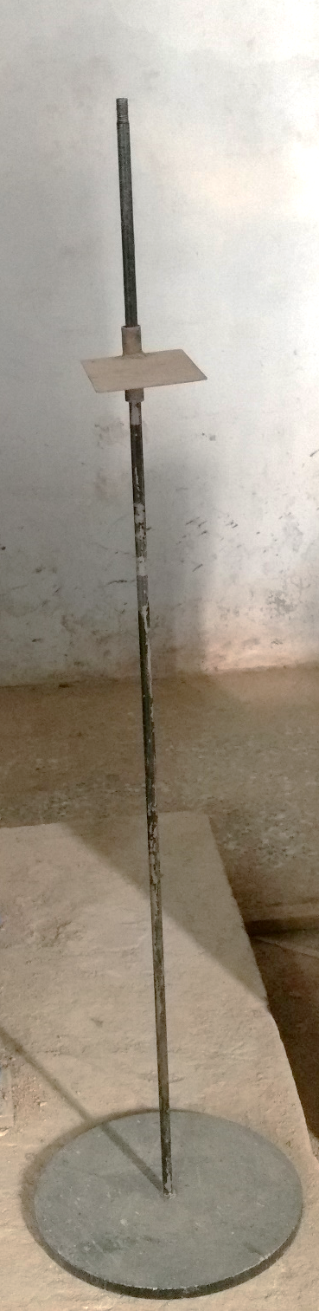
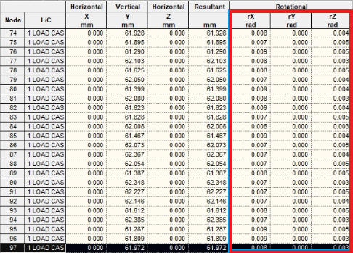
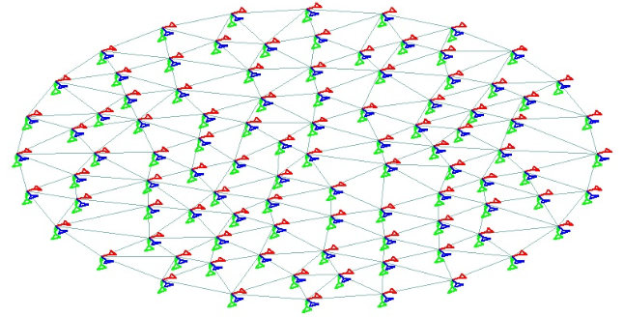

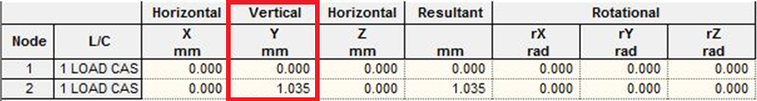
Plate with anchor Rod
For 30 KN Load

Slide 31


Laboratory Model Setup

Slide 32






Demonstration of Pullout Test

Slide 33
GRAPHICAL REPRESENTATION OF
PULLOUT TEST RESULTS
LOAD v/s DISPLACEMENT FOR 15cm PLATE WITH ALL RELATIVE DENSITIES AND EMBEDMENT DEPTHS
LOAD v/s DISPLACEMENT FOR 30cm PLATE WITH ALL RELATIVE DENSITIES AND EMBEDMENT DEPTHS
Fig. 4.17 Load v/s Displacement for 30cm plate with all Relative Densities & Embedment Depths.

Slide 34
RESULT ANALYSIS AND GRAPHICAL REPRESENTATION.
Graphs are shown for Uplift Load (Qu) v/s Displacement for Various Analytical theories and Experimental Pullout Tests.
Meyerhof & Adams Theory v/s Experimental
Balla’s Theory v/s Experimental
Downs & Cheiurzzi Theory v/s Experimental
Veesaert & Clemence’s Theory v/s Experimental
Saeedy’s Theory v/s Experimental

Slide 35

MEYERHOF & ADAMS THEORY v/s EXPERIMENTAL:
Comparison of results obtained from experimental uplift force and force from analytical equations.

Slide 36

BALLA’S THEORY v/s EXPERIMENTAL:
Comparison of results obtained from experimental uplift force and force from analytical equations.

Slide 37

DOWNS & CHEIURZZI THEORY v/s EXPERIMENTAL:
Comparison of results obtained from experimental uplift force and force from analytical equations.

Slide 38

VEESAERT & CLEMENCE’S THEORY v/s EXPERIMENTAL:
Comparison of results obtained from experimental uplift force and force from analytical equations.

Slide 39

SAEEDY’S THEORY v/s EXPERIMENTAL:
Comparison of results obtained from experimental uplift force and force from analytical equations.

Slide 40




UPLIFT FORCE BY FEM USING PLAXIS
OUT PUT AXIAL FORCE
Data
Height | 1.5 | m
Width | 1.5 | m
Diameter of Plate | 0.15 | m
Embedment Depth | 0.3 | m
Sand Type | Well Graded Sand
Relative Density | 70 | %
Density | 1.808 | gm/cc
c | 0.0295 | gm/cm²
PREPARATION OF AXISYMMETRIC MODEL IN PLAXIS
MESH GENERATION
CALCULATION STAGE
Axial force to be multiplied with 2*π.
So, 0.03531*2* π
So, Output Axial Force on Anchor Plate = 0.22 KN
Sand
Type | UnDrained
Model | Mohr Coulomb
kx | 1 m/day
ky | 1 m/day
E | 1)9600 kN/m² 2)7000 kN/m²
ν (nu) | 0.3
c | 0 kN/m²
Angle of Friction | 1)46.45° 2)41.28°
Angle of Dilatancy | 1)16.45° 2)11.28°
Plate
E | 2.10E+06 | kN/m²
A | 0.015 | m²
EA | 3.15*10^4 | kN
I | 2.8125E-07 | m³
EI | 5.91E-01 | kN*m²/m
w | 1.156759835 | kN/m³
v | 0.3

Slide 41
UPLIFT FORCE BY FEM USING PLAXIS
Data
Height | 1.5 | m
Width | 1.5 | m
Diameter of Plate | 0.15 | m
Embedment Depth | 0.3 | m
Sand Type | Well Graded Sand
Relative Density | 70 | %
Density | 1.808 | gm/cm³
c | 0.0295 | gm/cm²

Slide 42
Graphical Representation
1.Expermental Uplift Load
2.Analytical Uplift Load
3.PLAXIS Software Based Uplift Load

Slide 43
Plate Size = 0.30m, Relative Density = 70%
Plate Size = 0.30m, Relative Density = 85%
Plate Size = 0.15m, Relative Density = 70%
Plate Size = 0.15m, Relative Density = 85%

Slide 44
Work | Time Period | Work Status
Deciding the Dissertation Topic. | June-July | Completed
Literature Review | July-August | Completed
Well Graded Sand Sample Preparation & Collection | August-September | Completed
Model Set-up for Experimental investigation | September-October | Completed
Demonstration of Pullout Test | November | Completed
Analytical Calculation of Uplift forces by various methods. | November-December | Completed
Total 12 No. of Pullout Test | December-25th January | Completed
PLAXIS Software Implementation | 25th January-March | Completed
SCHEDULE OF WORK DONE.

Slide 45
OBSERVATIONS
Observations During Fixing Proving Ring and Dial Guage
Proving ring should be properly attached to chain pulley block by mechanical arrangements.
Dial guage should be fixed properly to the rod connecting both sides of tank.
It should properly touch to the arrangement made in anchor rod connected to plate so that it can measure the displacement accurately.
Observations During Fixing Axisymmetric Anchor Plate
At the time of fixing the plate with proving ring it should be properly fixed.
The plate should be exactly placed at the center of tank above the first 15cm layer of sand.
At the time filling new layers of sand care must be taken that the plate is exactly at its position.
Observations During Filling Tank
To achieve dense condition (D_{r} = 70%) in tank free fall & compaction (at every 15cm) is required.
To achieve very dense condition (D_{r} = 85%) in tank free fall & compaction (at every 5cm – 10cm) is required.
Proper care should be taken to achieve uniform density throughout the tank.
Top level of sand in tank should be properly levelled so that during applying uplift load proper heave is clearly visible.
Observations During Applying Uplift Load
Loading must be applied at uniform rate.
During failure, load in proving ring may be decreasing or constant.
Observations After Failure
Heave formed on the top surface of the sand after failure is circular in shape as per the shape of plate for both the plates but size varies as per size of the plate.
Heave was formed for 0.15m plate at shallow depth of 0.30m.

Slide 46


Heave formed on Top Surface of Sand after Failure.
i) 0.15m Plate
ii) 0.30m Plate

Slide 47
CONCLUSIONS
Meyerhof & Adams analytical results are 20% to 35% higher than experimental results for dense and very dense sand conditions.
Balla’s analytical results are in good agreement to experimental results for both dense and very dense sand conditions.
Downs and Chieurzzi analytical results are 15% to 50% higher than experimental results for dense and very dense sand conditions.
Saeedy’s analytical results are 10% to 20% higher than experimental results for dense and very dense sand conditions.
Analytical theories during calculation took higher frictional angle (to the vertical) which give larger passive zone compared with actually occurred in tank during experimental model test, so analytical results are higher than experimental results.
Plaxis software uses Mohr-Coulomb Model which is used for first approximation of soil behavior and it takes account of young’s modulus (E), which remains constant with embedment depth, so there is just linear increase in results coming from Plaxis, so they are much lesser compared to experimental results.
As per the Pullout Test results, it clearly indicates that for axisymmetric anchor plates the failure angle to the vertical increases with decrease in Size of Plate, and with increase in Relative Density & Embedment Ratio.
Veesaert & Clemence's analytical results are 10% to 20% lower than experimental results for dense and very dense sand conditions.
Experimental Pullout Test clearly indicates that the Uplift Load (Qu) increases with increase in Plate Size, Relative Density and Embedment Depth.
Displacement corresponding to Peak Uplift Load (Qu) increases with increase in Embedment Ratio.
The experimental results are 30% to 75% higher than results obtained from F.E.M based software PLAXIS for dense and very dense sand conditions.

Slide 48


Following are the proposed equations for failure angle, θ for any frictional angle, Φ.
Plate size 0.15 m, θ = 0.55Φ + 4.43
Plate size 0.30 m, θ = 0.55 Φ + 1.03
Proposed Failure Mechanism in Pullout test

Slide 49
FUTURE SCOPE
Experimental study of Pullout Test can be performed by using different shape of plate like rectangular, square, or irregular.
Vertical Pullout Test can be performed on sand of different gradations for Dry condition as well as for submerged condition.
F.E.M based software Plaxis provides options for using various models and can create user defined model for analysis of uplift force in soil medium, so comparison can be done with results of F.E.M based software Plaxis and experimental results.
Horizontal Pullout Test can also be performed with some additional mechanical arrangements
In this era, Geosynthetics are playing a major role in geotechnical engineering problems, so the experimental Pullout Test can also be performed by keeping different types of Geosynthetic materials. (Every Geosynthetic material has its own properties, so it is important to find out this material’s engineering property in laboratory).
A Linear Variable Displacement Transducer (LVDT) can be placed at the top of axisymmetric anchor plate holder to measure the vertical displacement and predict the movement of the anchor plate.

Slide 50
REFERENCES
Das, B.M. [1990], “EARTH ANCHORS”, Elsevier.
Geddes, J.D., Murray, E. J., (1994), “Plate anchor groups pulled vertically in sand”, ASCE, Journal Geotechnical Engineering, Vol. 122, No.7, July, 1996. CASCE, ISSN 0733-9410/96/0007-0509-0516.
Ilamparuthi, K., Dickin, E.A., Muthukrisnaiah, K., (2002), “Experimental investigation of the uplift behaviour of circular plate anchors embedded in sand”, NRC Canada Research Press- Can. Geotech J. 39: 648–664.
IS: 2720 – Part IV, (1985). “Grain Size Analysis”.
IS: 2720 – Part III/See 2, (1980). “Determination of Specific Gravity for fine, medium & coarse grain Soil”.
IS: 2720 – Part XIV, (1983). “Determination of Density Index (Relative Density) of Cohesionless Soil”.

Slide 51
IS: 2720 – Part XIII, (1986). “Direct Shear Test”.
Kanakapura, S.R. I, Kumar, J., (1992), “Vertical uplift capacity of horizontal anchors”, Journal of Geotechnical Engineering, Vol. 120, No. 7.
Merifield, R.S., Sloan, S.W., (2006) “The ultimate pullout capacity of anchors in frictional soils”, NRC Canada-Can. Geotech. J. 43: 852–868.
Murthy, V.N.S, “Principles and practices of soil mechanics and foundation engineering”, Chapter-3,3.9, Page-62,63 & 3.3.11, Page-64.
Niroumand, H., Kassim, K.A [2016], “Design and construction of soil anchor Plates”, Elsevier.
Niroumand, H., Kassim, K.A [2013], “Uplift response of symmetrical anchor plates in reinforced cohesionless soil”, Saudi Society for Geosciences 2013.
Tho, K.K., Chen, Z., Leung, F.C., and Chow, K. Y., (2014), “Pullout behaviour of plate anchor in clay with linearly increasing strength”, NRC Can, Geotech. J. 51: 92–102.
Weizhi, S., Fragaszy, R., (1988), “Uplift testing of model anchors”, Journal of Geotechnical Engineering, Vol. 114, No. 9, ©ASCE, ISSN 0733-9410/88/0009-0961.

Slide 52
THANK YOU

