Slide 1
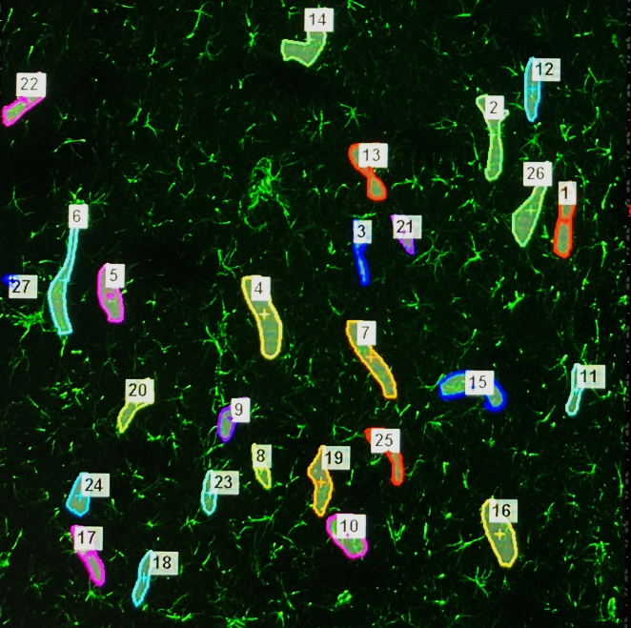



Supplementary Fig 1.
Analysis of astrocyte end feet coverage around brain vasculature
GFAP
SMI 71
DAPI
Analysis: Selected around 25 vessels (red channel_SMI 71) from each animal (n=3/group) and measured the astrocyte mean intensity (green channel_GFAP) and back ground subtracted.

