Slide 1
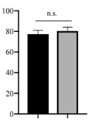
B
IgG
TY101
Collage IV/DNase I digested cells
A
Live/ dead cells fluorescence (MFI)
0
0
77.1
Relative cell NO.
A
TY101
IgG
Live/dead staining
Fig S1. MACS-purified CD4 T cells were cultured with IL-2 (10ng/ml) and TY101(10μg/ml) for 72 hours. A). Summary data of Treg viability B). Representative date from A

Slide 2
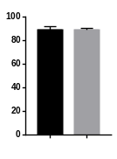
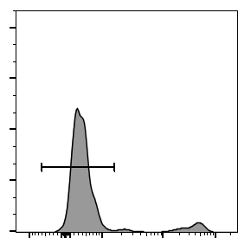
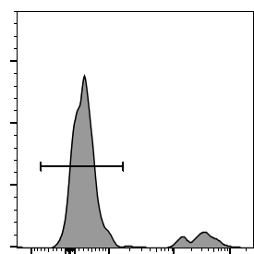
A
N.S.
B
WT
TNFR2^{-/-}
Treg viability (%)
WT
TNFR2^{-/-}
LIVE/DEAD™ Fixable Near-IR Stain (Gated on TCR-β⁺CD4⁺Foxp3⁺ T cells)
Fig S2. Lymphocyte from WT mice and TNFR2^{-/-} mice were cultured with IL-2 alone A). Summary data of Treg viability. B). Representative FACS analysis data of A.

Slide 3
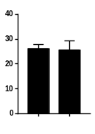
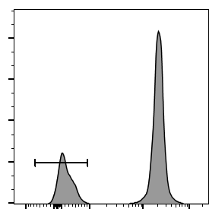
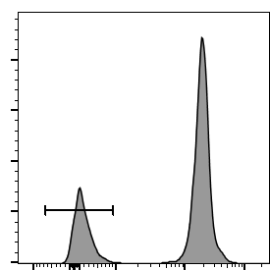
A
B
N.S.
Teff viability (%)
Dex+IL2+TNF
LIVE/DEAD™ Fixable Near-IR Stain (Gated on TCR-β⁺CD4⁺Foxp3⁻ T cells)
Dex+IL2
Fig S3. Lymphocyte from WT were cultured with Dex plus IL2 or Dex plus IL-2 and TNF A). Summary data of Treg viability. B). Representative FACS analysis data of A.

