Slide 1
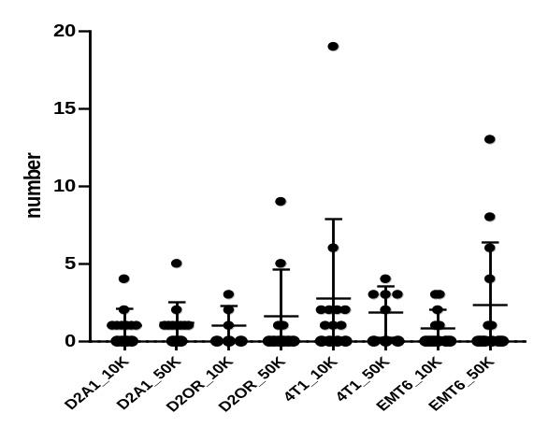
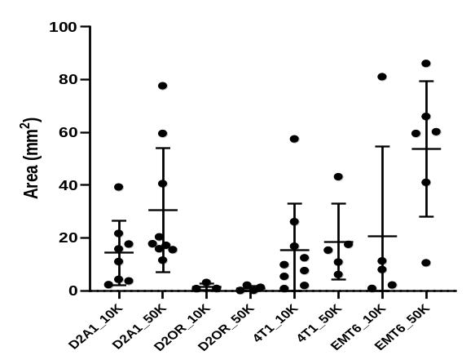
A
Total number of lesions per injected mammary gland
B
Average lesion area per mammary gland
Number
Area (mm²)
Supplementary Figure 1: The total number and average area of lesions that developed following intraductal injection of mammary cell lines into BALB/c immune-competent hosts. Murine mammary cell lines D2A1, D2.OR, 4T1, and EMT6 were intraductally injected into the 4th mammary glands of BALB/c mice at either or 1×10⁴ (10K) or 5×10⁴ (50K) cells in 2µL. Mammary glands were collected when the first tumor became palpable. (A) The average number of lesions per mammary gland. (B) The average area of lesions. Results presented as mean±stdev. Dots represent individual mice. Differences in tumor number and area were assessed using Student’s T-test. No data were statistically significant.

Slide 2
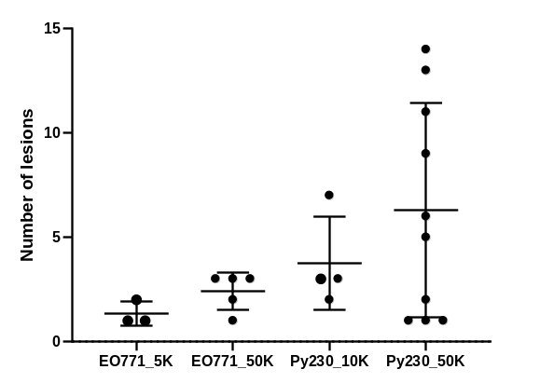
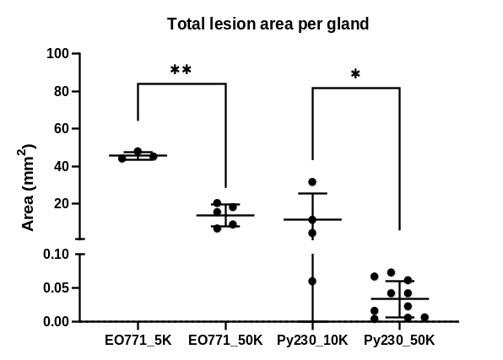
A
Total number of lesions per injected mammary gland
B
Average lesion area per mammary gland
Number
Area (mm²)
Supplementary Figure 2: The total number and average area of lesions that developed following intraductal injection of mammary cell lines into C57BL/6 immune-competent hosts. Murine mammary cancer cell lines EO771 and Py230 were intraductally injected into the 4th mammary glands of C57BL/6 mice at various concentrations: EO771 (5×10³ (5K) or 1×10⁴ (10K) cells in 2µL) or Py230 (1×10⁴ (10K) or 5×10⁴ (50K) cells in 2µL). Mammary glands were collected either 35 days (EO771) or 14 days (Py230) post-injection and assessed for tumors. (A) The average number of lesions per mammary gland. (B) The average area of lesions. Results presented as mean±stdev. Dots represent individual mice. Differences in tumor number and area were assessed using Student’s T-test. **p=<0.005; *p<0.05

Slide 3
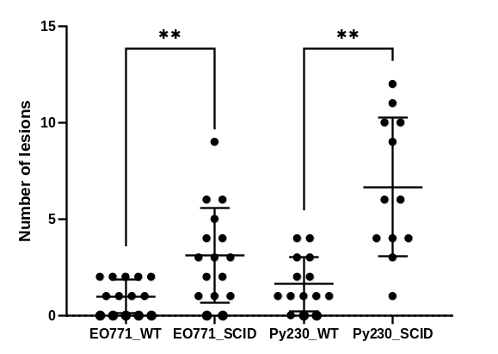
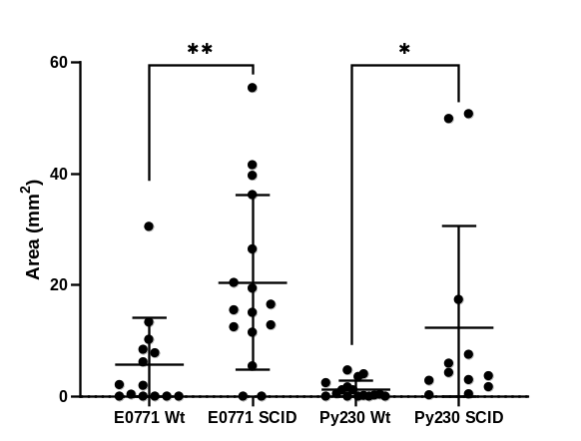
A
Total number of lesions per injected mammary gland
B
Average lesion area per mammary gland
Number
Area (mm²)
Supplementary Figure 3: The total number and average area of lesions that developed following intraductal injection of mammary cell lines into C57BL/6/SCID immunocompromised hosts. Murine mammary cell lines EO771 (5×10⁴ cells in 2µL) or Py230 (5×10⁴ cells in 2µL) were intraductally injected into the 4th right mammary glands of C57BL/6/SCID (SCID) mice or wild-type C57Bl/6 (WT) mice. Mammary glands were collected 2 weeks later and assessed for tumors. (A) The average number of lesions per mammary gland. (B) The average area of lesions. Results presented as mean±stdev. Dots represent individual mice. Differences in tumor number and area were assessed using Student’s T-test. **p=<0.005; *p<0.05

Slide 4
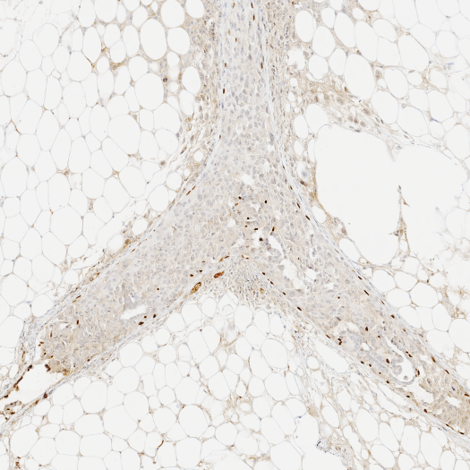
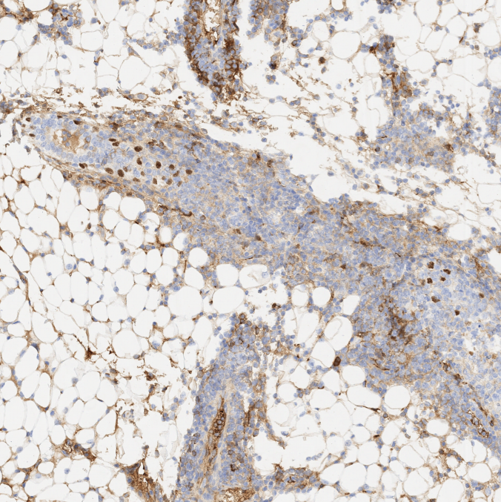
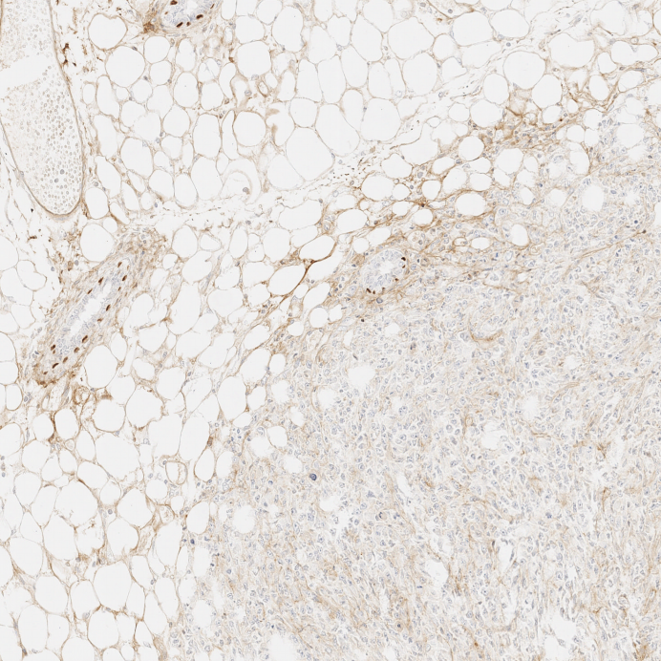
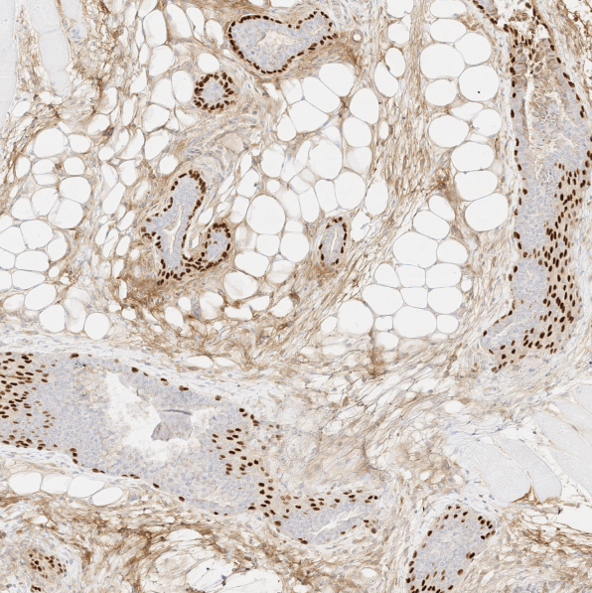
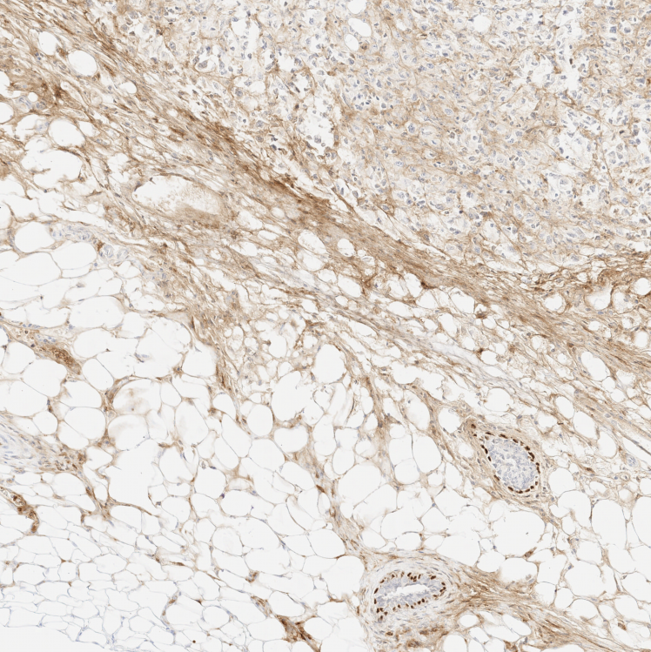
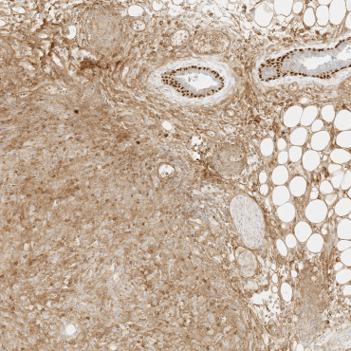
EO771
Py230
C57BL/6
200um
200um
D2A1
D2OR
200um
200um
BALB/c
4T1
EMT6
200um
200um
Supplementary Figure 4: p63 staining in intraductal tumors collected from C57BL/6 (EO771, Py230) and BALB/c (D2A1, D2OR, 4T1, EMT6) mice.

Slide 5
Cell line | Strain | Intrinsic Subtype | Ref.
D2A1 | BALB/c | Luminal B | (Yang et. al., 2017)
D2OR | BALB/c | Basal-like | (Prunier et. al., 2021)
4T1 | BALB/c | Luminal A | (Yang et. al., 2017)
EMT6 | BALB/c | Luminal A | (Yang et. al., 2017)
EO771 | C57BL/6 | Luminal B | (Yang et. al., 2017)
Py230 | C57BL/6 | Luminal A, Her2+, Basal-like | (Bao et al., 2015)
Supplementary Table 1: Intrinsic subtypes of the murine mammary cancer cell lines used in the study.

Slide 6
 |  | MAMMARY GLAND |  |  |  | LESIONS
 | Cell line | MG injected | Injections resulting in DCIS | Injections resulting in IDC | Injections resulting in no lesions | Total lesions across | Total DCIS lesions | Total IDC lesions | Average lesion size (mm²) | Days to euthanasia
C57BL/6 | EO771 5K | 12 | 0/12 (0) | 3/12 (25) | 9/12 (75) | 4 | 0/4 (0) | 4/4 (100) | 45.58 | 35
 | EO771 50K | 14 | 0/14 (0) | 5/14 (36) | 9/14 (64) | 12 | 0/12 (0) | 12/12 (100) | 17.78 | 35
 | Py230 10K | 5 | 0/5 (0) | 4/5 (80) | 1/5 (20) | 15 | 0/15 (0) | 15/15 (100) | 11.74 | 14
 | Py230 50K | 11 | 1/11† (9) | 10/11 (91) | 1/11 (9) | 63 | 6/63 (10) | 57/63 (90) | 0.322 | 14
BALB/c | D2A1 10K | 12 | 0/12 (0) | 8/12 (67) | 4/12 (33) | 12 | 0/12 (0) | 12/12 (100) | 14.40 | 33
 | D2A1 50K | 12 | 0/12 (0) | 9/12 (75) | 3/12 (25) | 14 | 0/14 (0) | 14/14 (100) | 30.59 | 33
 | D2OR 10K | 6 | 0/6 (0) | 3/6 (50) | 3/6 (50) | 6 | 0/6 (0) | 6/6 (100) | 1.55 | 15
 | D2OR 50K | 10 | 0/10 (0) | 4/10 (40) | 6/10 (60) | 16 | 0/16 (0) | 16/16 (100) | 0.86 | 15
 | 4T1 10K | 10 | 1/10† (10) | 9/10 (90) | 1/10 (10) | 36 | 3/36 (8) | 33/36 (92) | 15.32 | 11
 | 4T1 50K | 5 | 0/5 (0) | 5/5 (100) | 0/5 (0) | 15 | 0/15 (0) | 15/15 (100) | 18.54 | 11
 | EMT6 10K | 11 | 1/11† (9) | 5/11 (45) | 6/11 (55) | 10 | 1/10 (10) | 9/10 (90) | 20.58 | 14
 | EMT6 50K | 8 | 0/8 (0) | 6/8 (75) | 2/8 (25) | 33 | 0/33 (0) | 33/33 (100) | 53.81 | 14
Supplementary Table 2: Summary of the number of ductal carcinoma in situ and invasive ductal carcinoma lesions that developed following intraductal injection of mammary carcinoma cell lines into immune-competent mice. Murine mammary cancer cell lines were intraductally injected into the 4th mammary glands of either C57BL/6 (cell lines EO771, Py230) or BALB/c (cell lines D2A1, D2OR, 4T1, EMT6) mice. Cells were delivered in a total volume of 2µL per mammary gland. Various cell concentrations were investigated, including 5×10³ cells (5K), 1×10⁴ cells (10K), or 5×10⁴ cells (50K). Intraductal injections that resulted in both DCIS and IDC lesions in the same mammary gland are identified by †. Abbreviations MG = mammary gland; IDC = invasive ductal carcinoma; DCIS = ductal carcinoma in situ.

Slide 7
 |  | MAMMARY GLAND |  |  |  | LESIONS
 | Cell line | MG injected | Injections resulting in DCIS | Injections resulting in IDC | Injections resulting in no lesions | Total lesions across | Total DCIS lesions | Total IDC lesions | Average lesion size (mm²) | Days to euthanasia
C57BL/6 | EO771 WT | 14 | 0/14 (0) | 9/14 (64) | 5/14 (36) | 9 | 0/9 (0) | 9/9 (100) | 5.77 | 26
 | EO771 SCID | 16 | 0/16 (0) | 14/16 (88) | 2/16 (12) | 64 | 0/64 (0) | 64/64 (100) | 20.51 | 26
 | Py230 WT | 14 | 1/14† (7) | 11/14 (79) | 3/14 (21) | 23 | 3/23 (13) | 20/23 (87) | 1.25 | 11
 | Py230 SCID | 12 | 0/12 (0) | 12/12 (100) | 0/12 (0) | 80 | 0/80 (0) | 80/80 (100) | 12.29 | 11
Supplementary Table 3: Summary of the number of ductal carcinoma in situ and invasive ductal carcinoma lesions following intraductal injection of mammary carcinoma cell lines into immunocomprimised mice. Murine mammary cell lines EO771 (5×10⁴ cells in 2µL) or Py230 (5×10⁴ cells in 2µL) were intraductally injected into the 4th right mammary glands of C57BL/6/SCID (SCID) mice or wild-type C57Bl/6 (WT) mice. Mammary glands were collected 2 weeks later and assessed for tumors. Intraductal injections that resulted in both DCIS and IDC lesions in the same mammary gland are identified by †. Abbreviations MG = mammary gland; IDC = invasive ductal carcinoma; DCIS = Ductal Carcinoma in situ.

