Slide 1
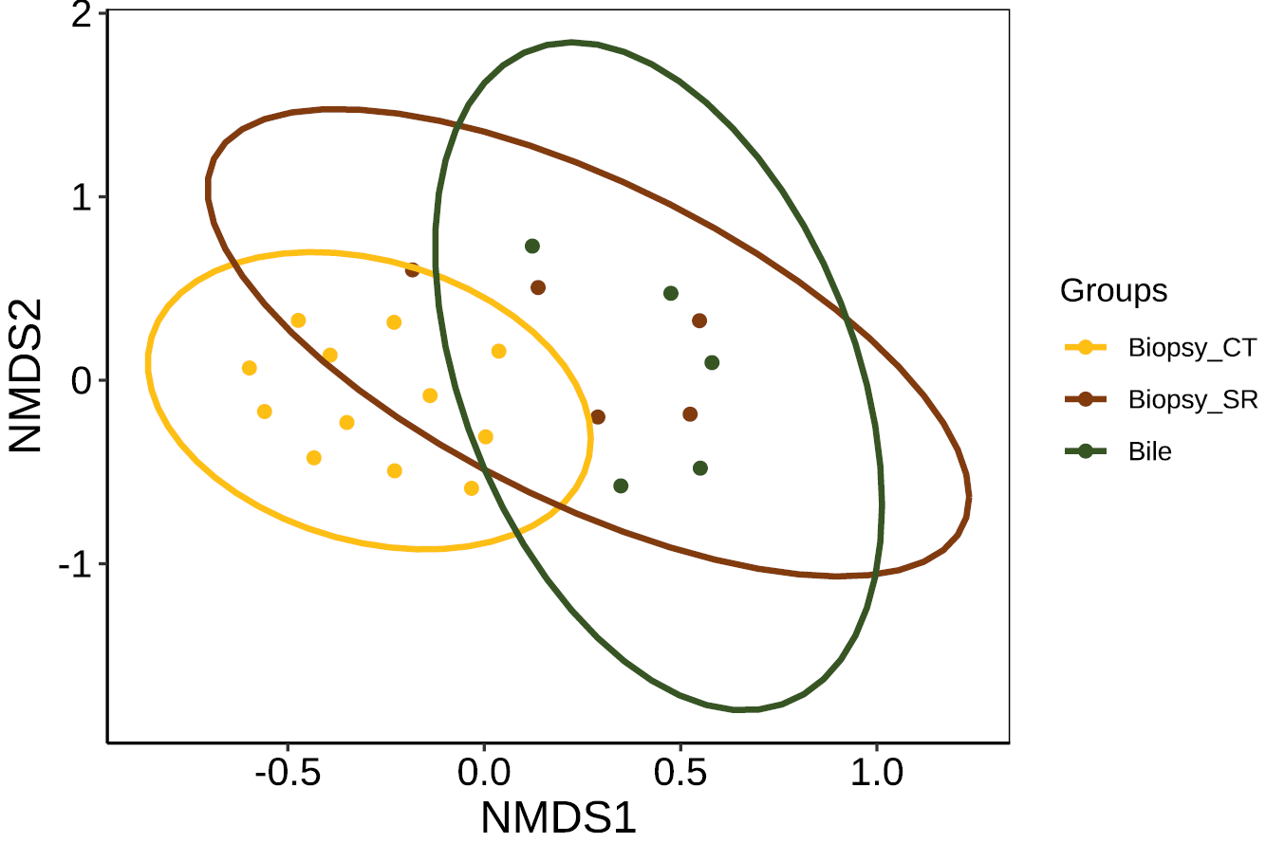
Supplementary figure 1.
p value < 0.001
NMDS2
Duodenal biopsy (Gastric ulcer patients)
Duodenal biopsy (SR patients)
Bile fluid (SR patients)
NMDS1
Notes:
Supplementary Figure 1. NMDS ordination of beta-diversity analyses at the ASV level between the SR, NSR, and control groups

