Slide 1
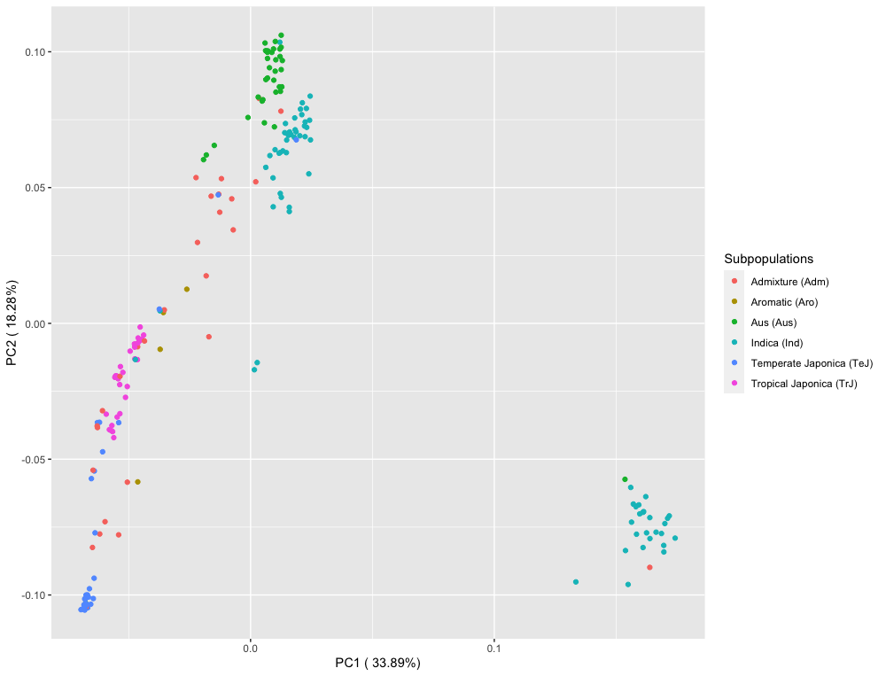
A
Supplemental Figure 8.A

Slide 2
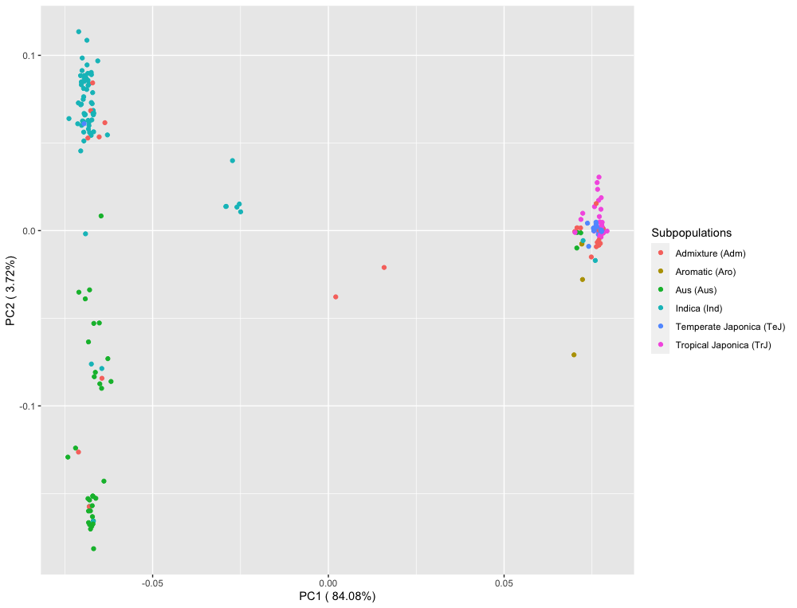
B
Supplemental Figure 8.B

Slide 3
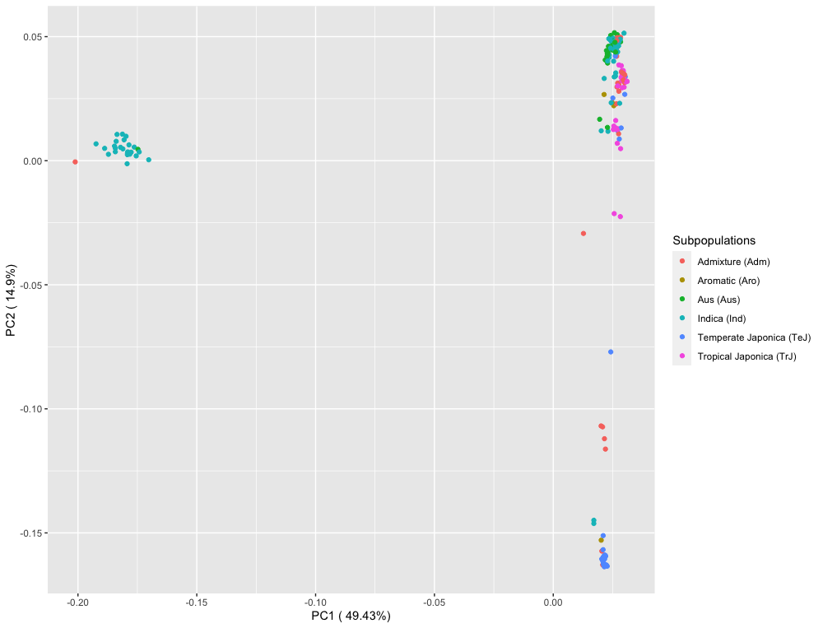
C
Supplemental Figure 8.C

