Slide 1
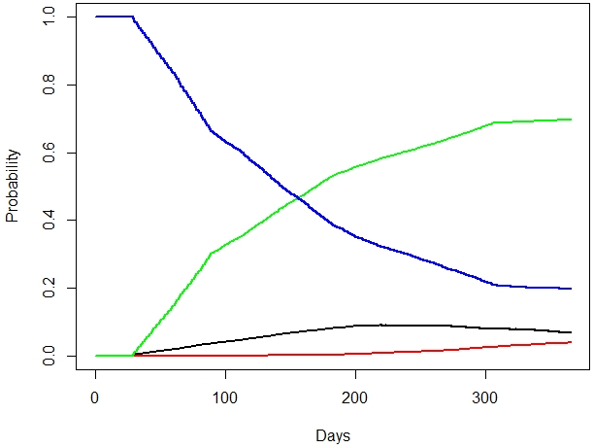
Persistence, Use of Resources and Costs in Patients Under Migraine Preventive Treatment: the PERSEC Study
Pablo Irimia, David García-Azorín, Mercedes Núñez, Sílvia Díaz, Pepa García de Polavieja, Tommaso Panni, Aram Sicras-Navarro, Antoni Sicras-Mainar, Antonio Ciudad
Figure S3
First line of treatment
Third line of treatment
Second line of treatment
Discontinuation

