Slide 1
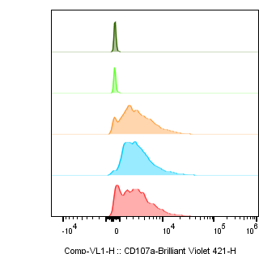
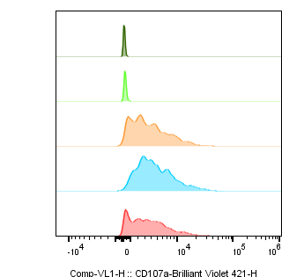
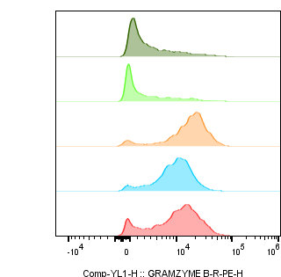

Supplementary Figure 2
A.
TRAC-δ-TCRγδ
TRAC-γ-TCRγδ
TRAC-δ-TCRγδ
TRAC-γ-TCRγδ
T cells only
A549 KO
A549 WT
MDA-MB231
Count
Count
SKMEL5
CD107a
Granzyme B
B.
TRAC-δ-TCRγδ
TRAC-γ-TCRγδ

