Slide 1
Supplementary Material
Fig. S1: SC144 suppresses IL-6- and OSM-induced STAT3 phosphorylation in L3.6pl human pancreatic cancer cells.
All original Western blots used for densitometry and presented within the manuscript are shown. Impact of SC144 on IL-6-induced STAT3 phosphorylation (a) after 3 h challenge and (b) 24 h challenge in L3.6pl cells. Impact of SC144 on OSM-induced STAT3 phosphorylation (c) after 3 h challenge and (d) 24 h challenge in L3.6pl cells.

Slide 2
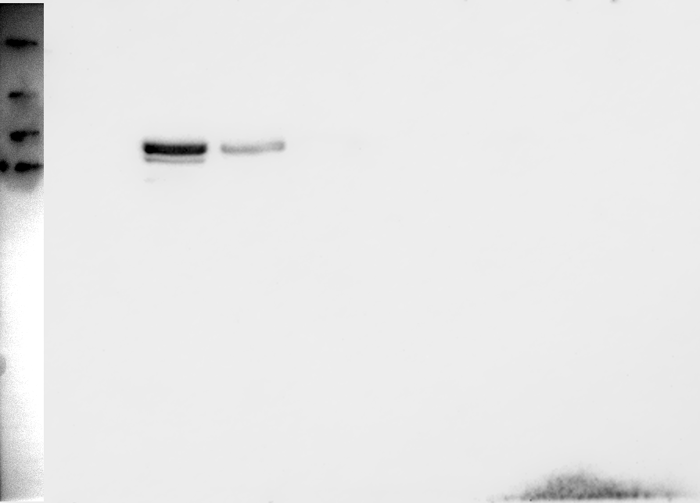
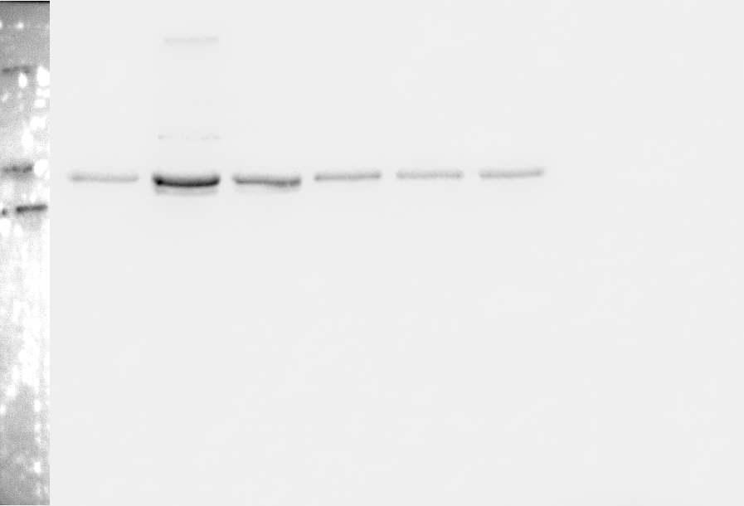
Fig. 3a (6h IL-6)
IL-6 (100 ng/ml)
-
+
+
+
+
+
SC144 (µm)
0
0
1
2
3
5
pSTAT3
STAT3

Slide 3
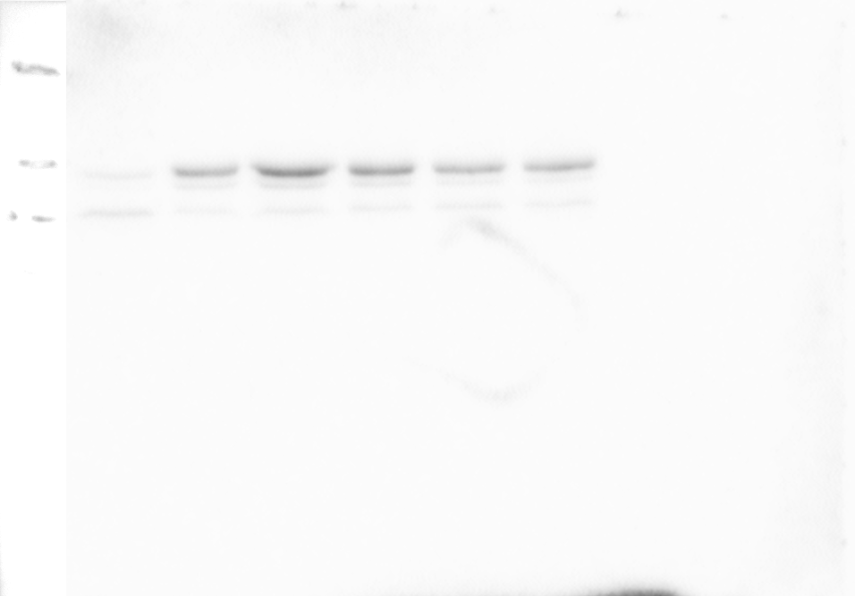
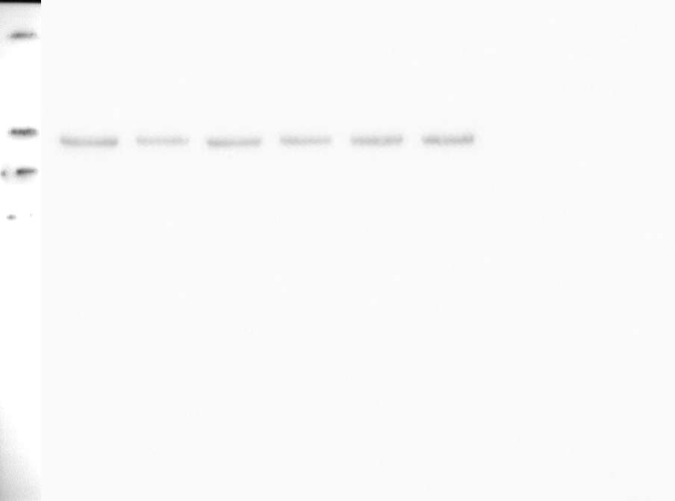
Fig. 3a (6h IL-6)
IL-6 (100 ng/ml)
-
+
+
+
+
+
SC144 (µm)
0
0
1
2
3
5
pSTAT3
STAT3

Slide 4
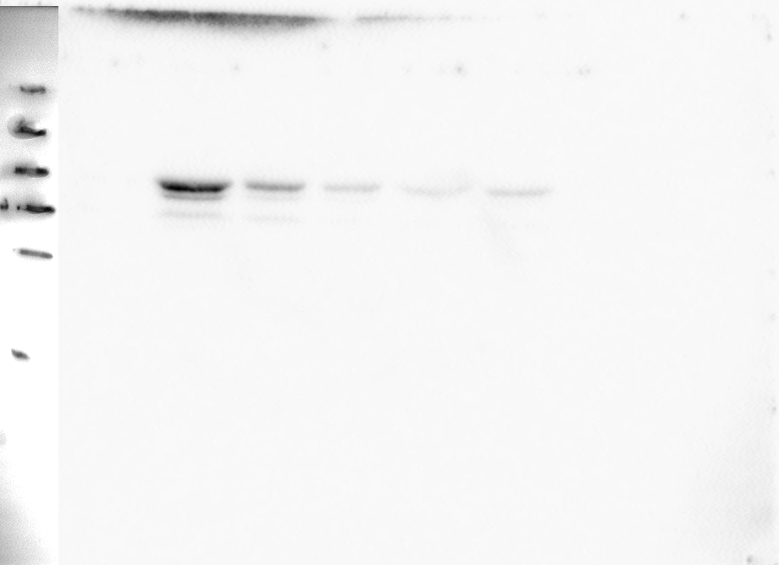
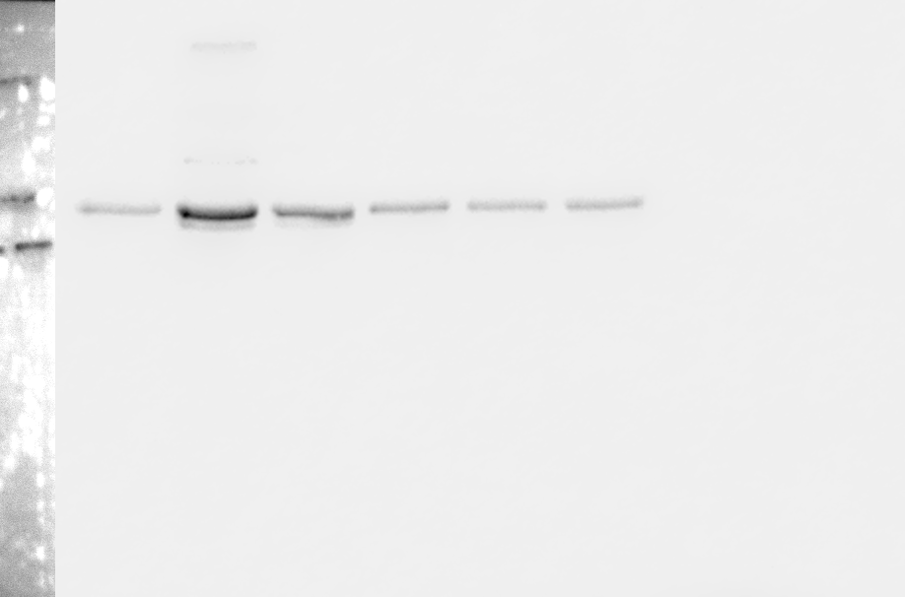
Fig. 3a (6h IL-6)
IL-6 (100 ng/ml)
-
+
+
+
+
+
SC144 (µm)
0
0
1
2
3
5
pSTAT3
STAT3

Slide 5
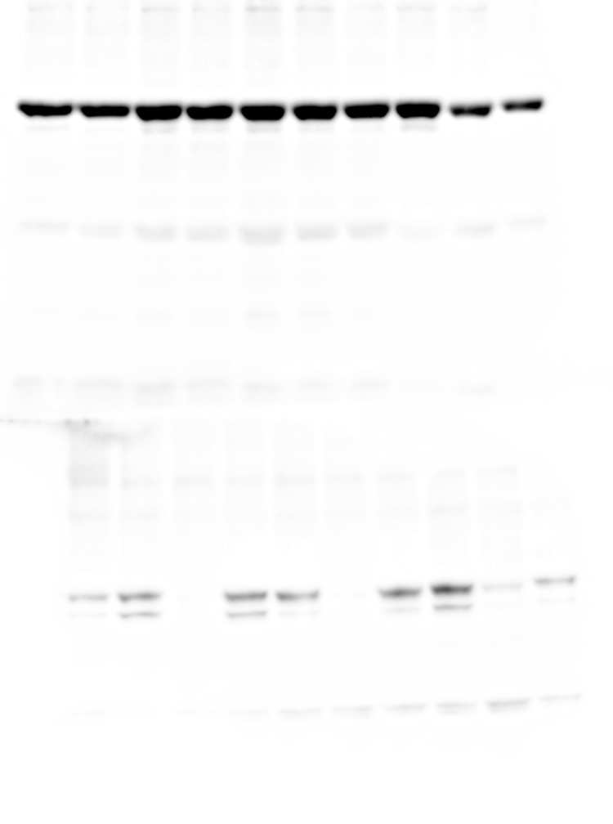
Fig. 3a and b (6h and 24h IL-6)
IL-6 (100 ng/ml)
-
+
-
+
+
-
+
+
-
+
SC144 (µm)
-
-
2
2
-
2
2
-
2
2
h
24 h
3 h
3 h
3 h
6 h
6 h
6 h
24 h
24 h
24 h
STAT3
pSTAT3

Slide 6
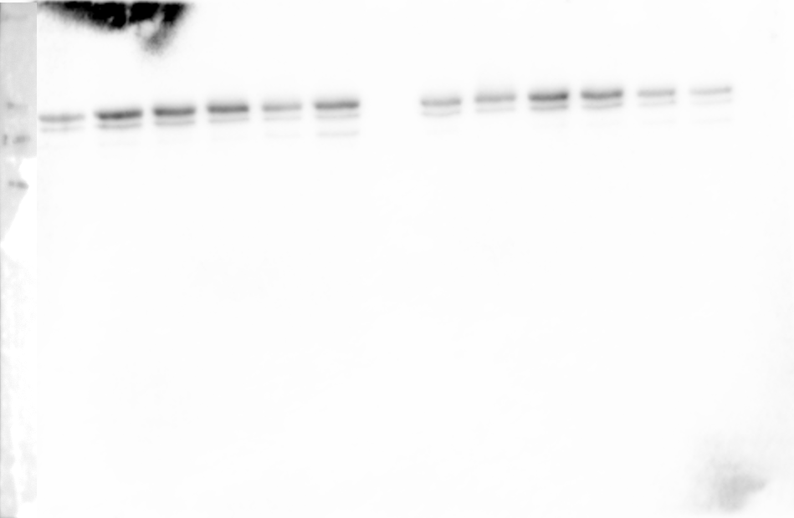
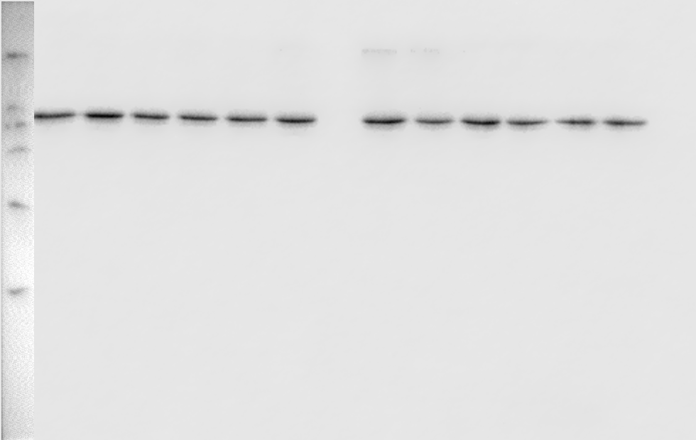
Fig. 3b (24h IL-6)
IL-6 (100 ng/ml)
-
+
+
+
+
+
-
+
+
+
+
+
SC144 (µm)
0
0
1
2
3
5
0
0
1
2
3
5
pSTAT3
STAT3

Slide 7
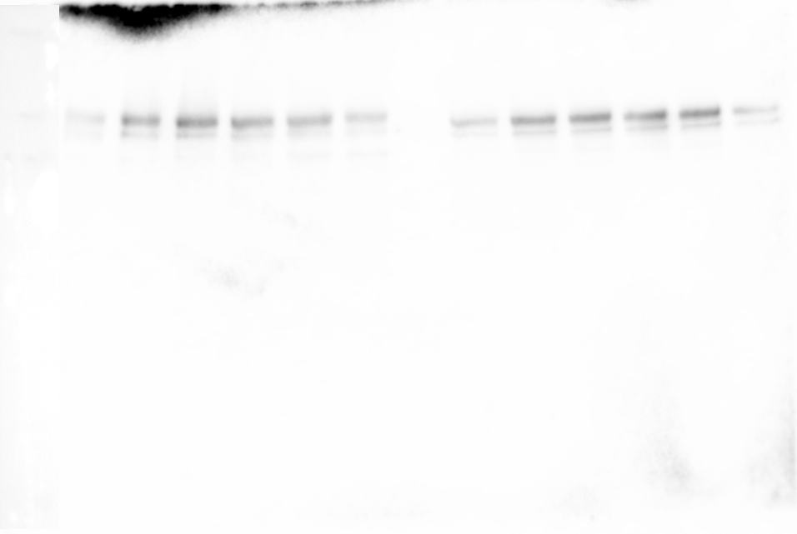
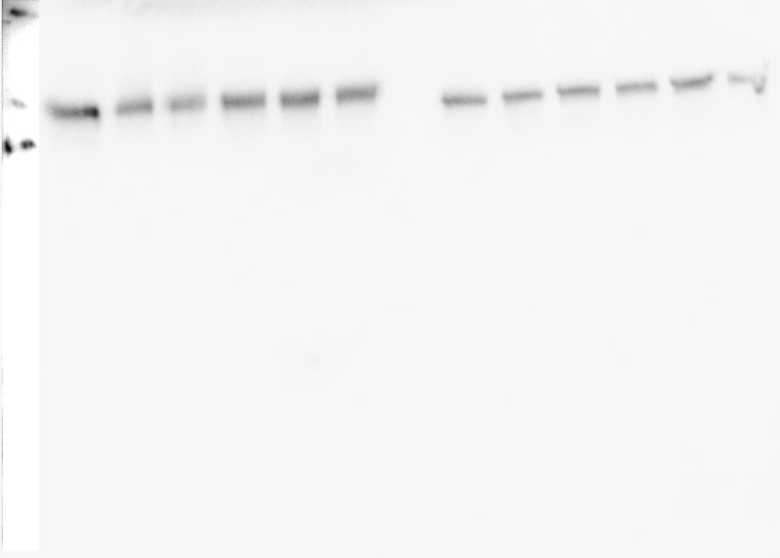
Fig. 3b (24h IL-6)
IL-6 (100 ng/ml)
-
+
+
+
+
+
-
+
+
+
+
+
SC144 (µm)
0
0
1
2
3
5
0
0
1
2
3
5
pSTAT3
STAT3

Slide 8
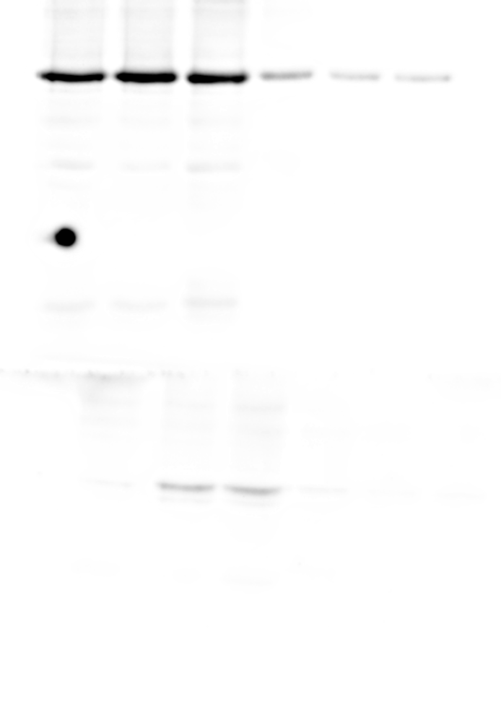
Fig. 3b (24h IL-6)
IL-6 (100 ng/ml)
-
+
+
+
+
+
SC144 (µm)
0
0
1
2
3
5
STAT3
pSTAT3

Slide 9
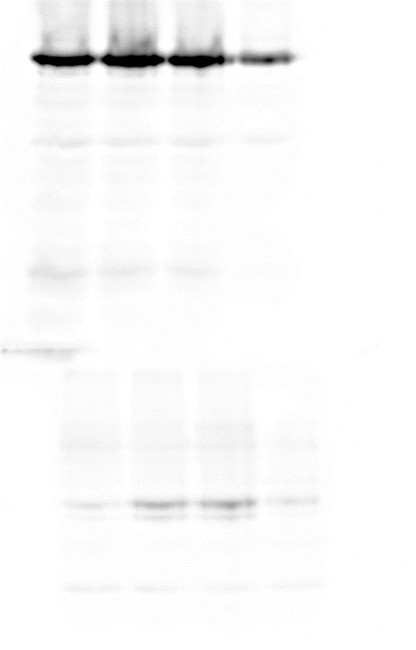
Fig. 3b (24h IL-6)
IL-6 (100 ng/ml)
-
+
-
+
SC144 (µm)
-
-
0.5
2
STAT3
pSTAT3

Slide 10
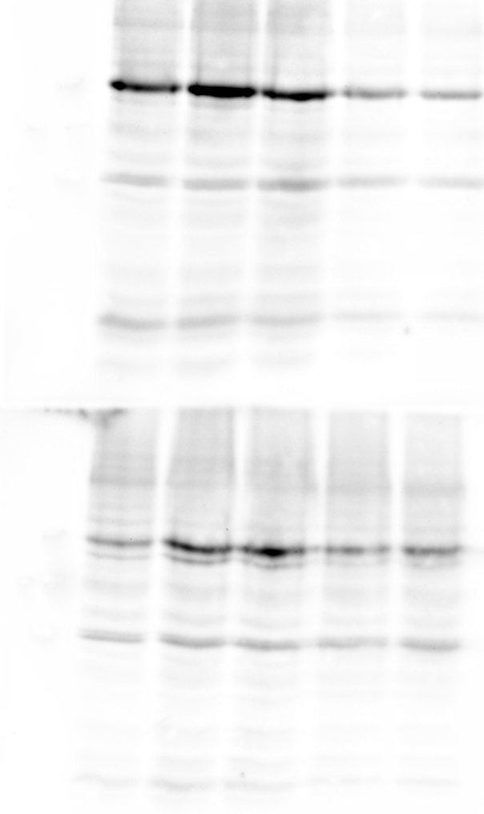
Fig. 3b (24h IL-6)
IL-6 (100 ng/ml)
-
+
-
+
+
SC144 (µm)
-
-
1
2
5
STAT3
pSTAT3

Slide 11
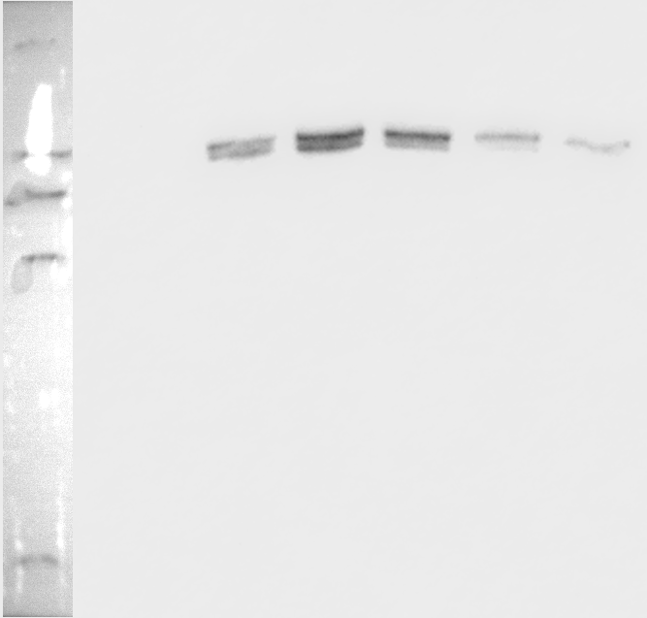
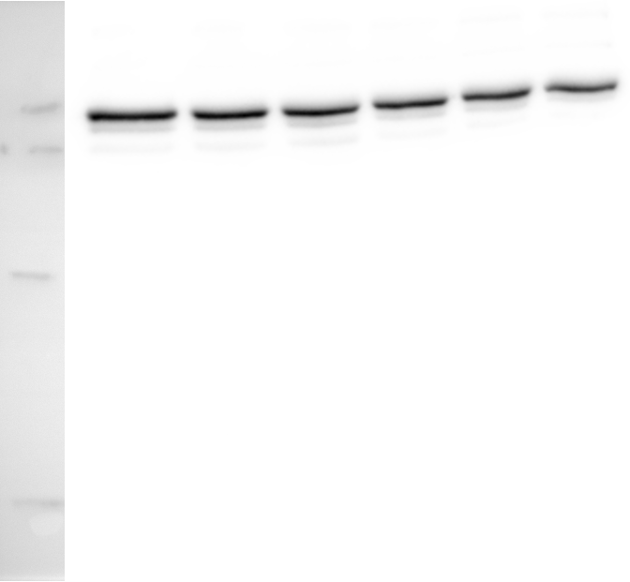
Fig. 3c (6h OSM)
OSM (50 ng/ml)
-
+
+
+
+
+
SC144 (µm)
0
0
1
2
3
5
pSTAT3
STAT3

Slide 12
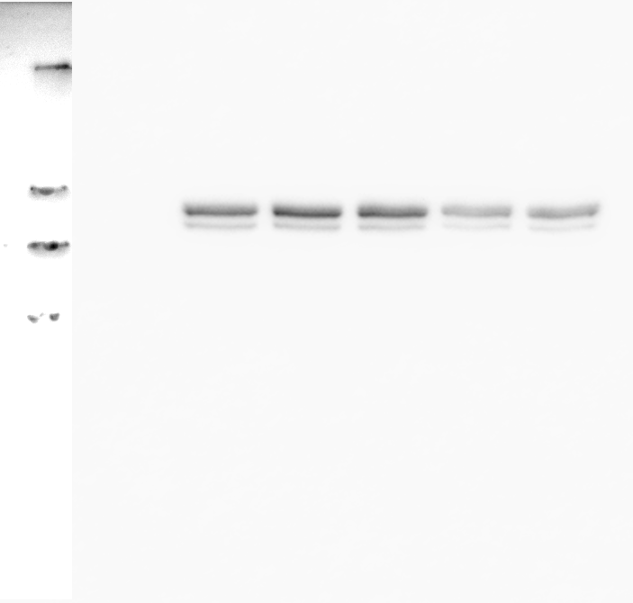
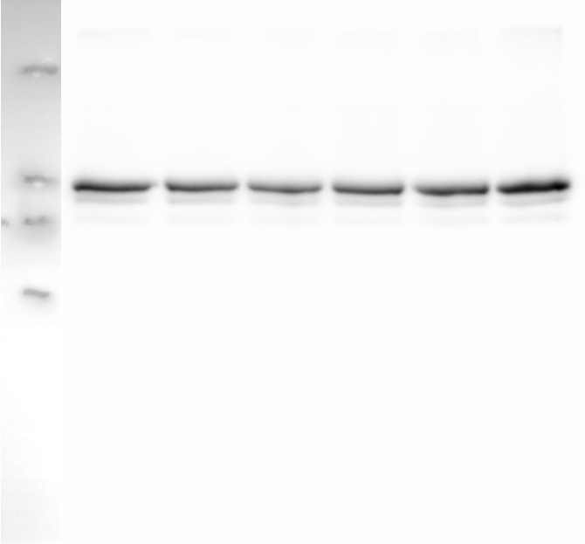
Fig. 3c (6h OSM)
OSM (50 ng/ml)
-
+
+
+
+
+
SC144 (µm)
0
0
1
2
3
5
pSTAT3
STAT3

Slide 13
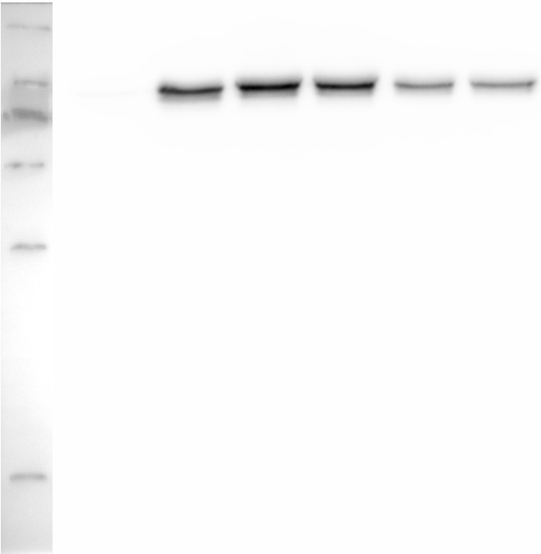
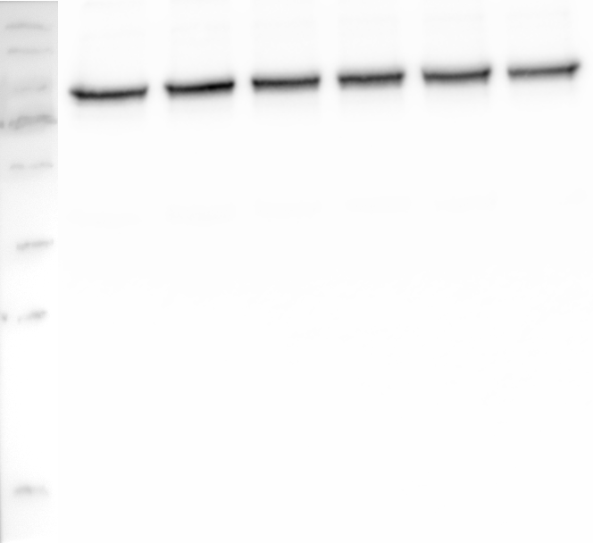
Fig. 3c (6h OSM)
OSM (50 ng/ml)
-
+
+
+
+
+
SC144 (µm)
0
0
1
2
3
5
pSTAT3
STAT3

Slide 14
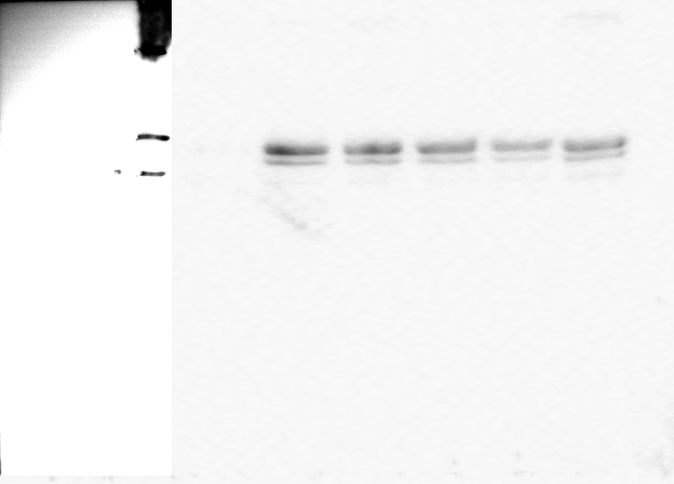
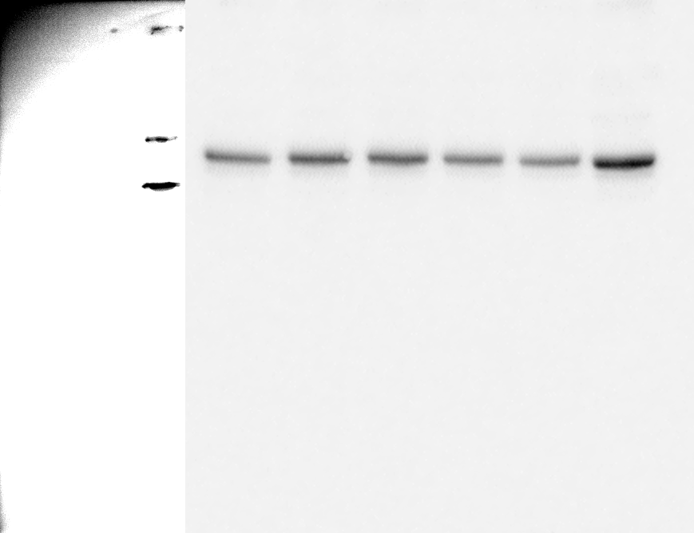
Fig. 3c (6h OSM)
OSM (50 ng/ml)
-
+
+
+
+
+
SC144 (µm)
0
0
1
2
3
5
pSTAT3
STAT3

Slide 15
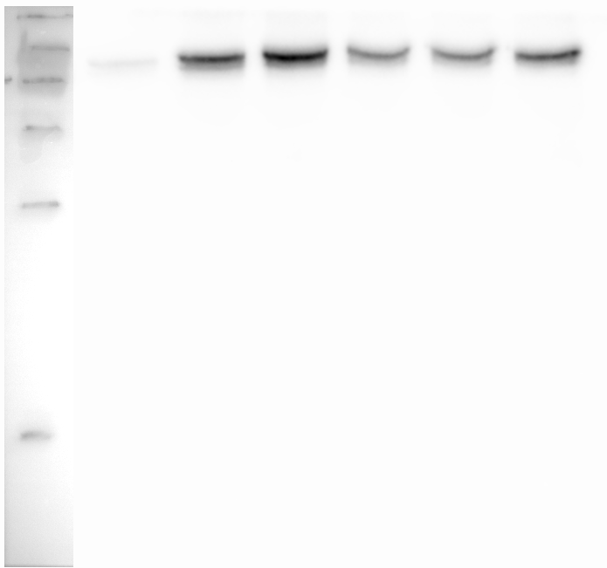
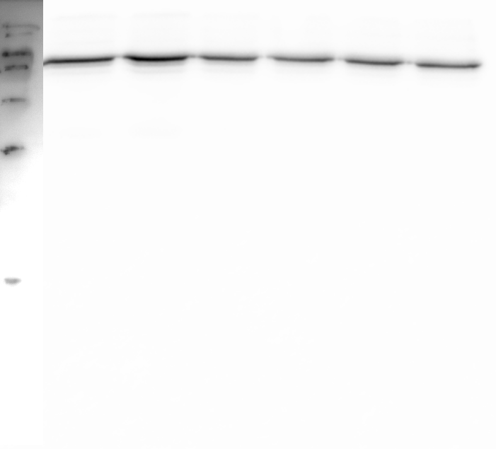
Fig. 3d (24h OSM)
OSM (50 ng/ml)
-
+
+
+
+
+
SC144 (µm)
0
0
1
2
3
5
pSTAT3
STAT3

Slide 16
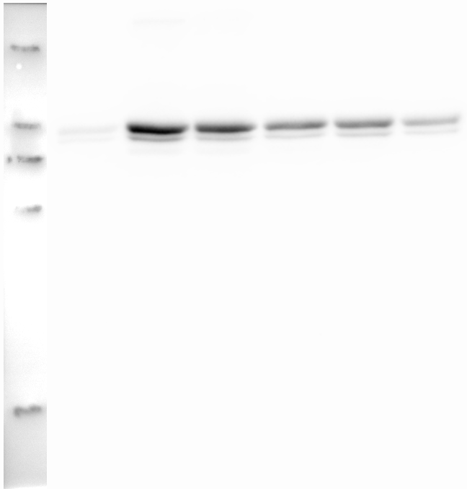
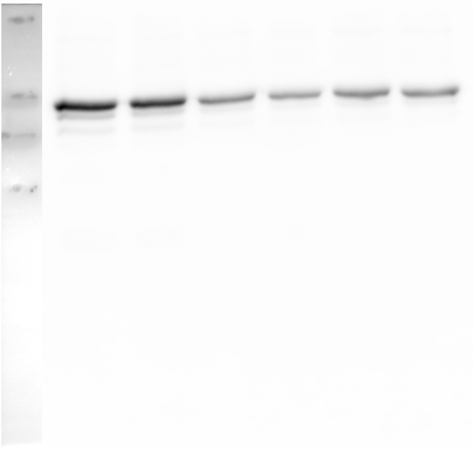
Fig. 3d (24h OSM)
OSM (50 ng/ml)
-
+
+
+
+
+
SC144 (µm)
0
0
1
2
3
5
pSTAT3
STAT3

Slide 17
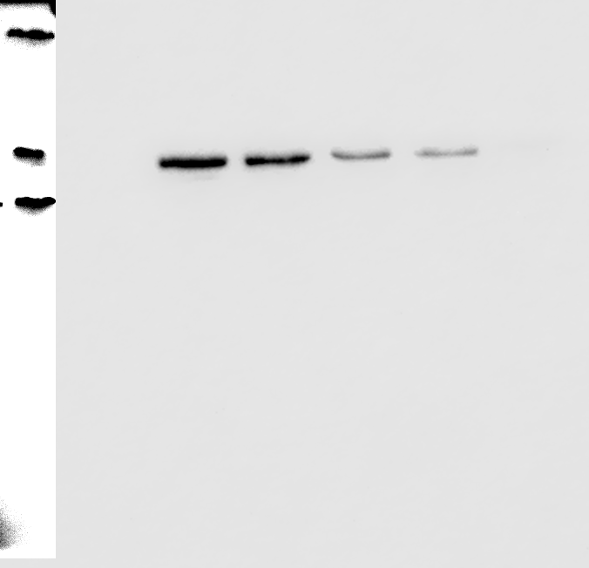
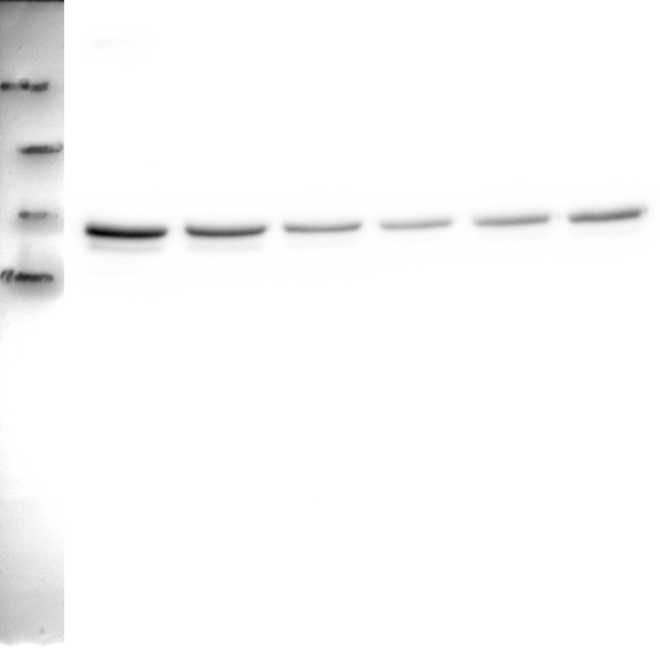
Fig. 3d (24h OSM)
OSM (50 ng/ml)
-
+
+
+
+
+
SC144 (µm)
0
0
1
2
3
5
pSTAT3
STAT3

Slide 18
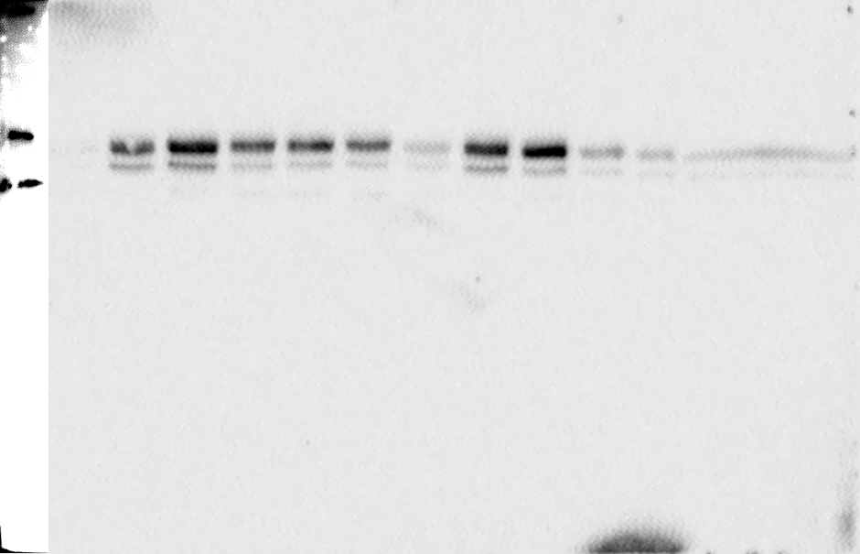
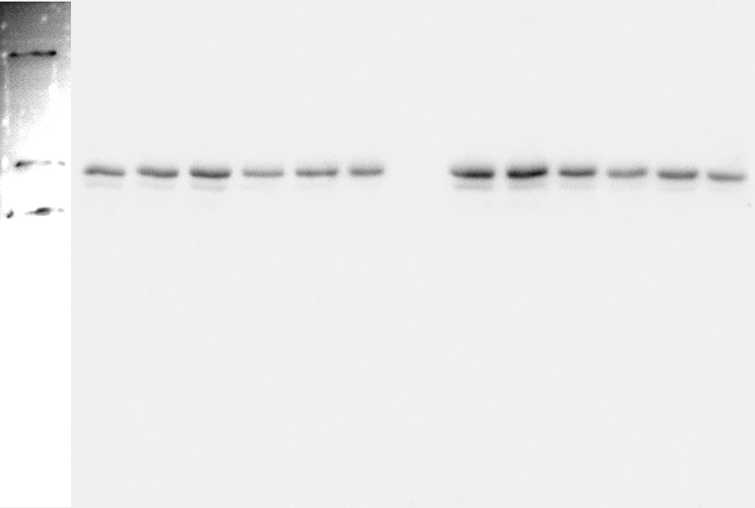
Fig. 3d (24h OSM)
OSM (50 ng/ml)
-
+
+
+
+
+
-
+
+
+
+
+
SC144 (µm)
0
0
1
2
3
5
0
0
1
2
3
5
pSTAT3
STAT3
STAT3

