Slide 1
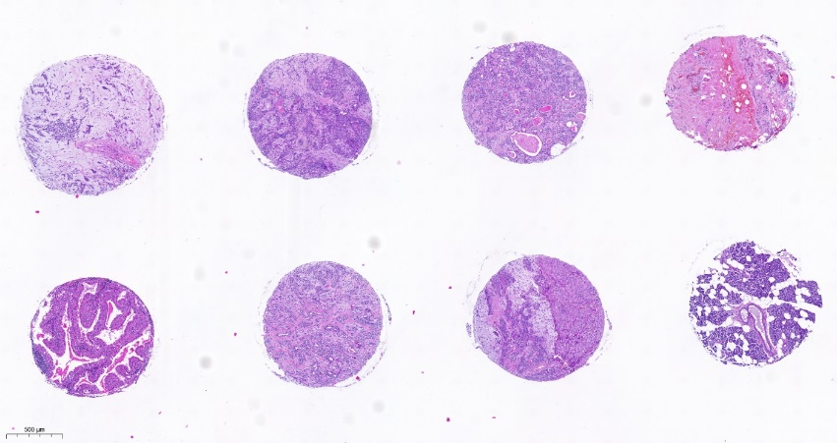
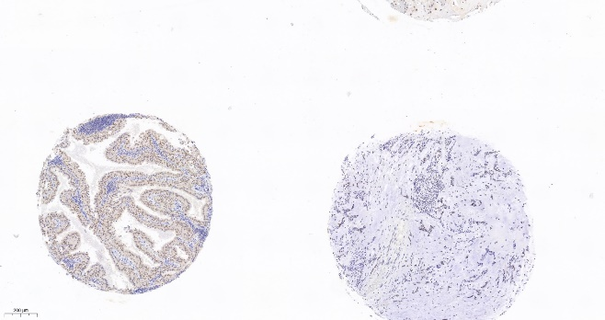
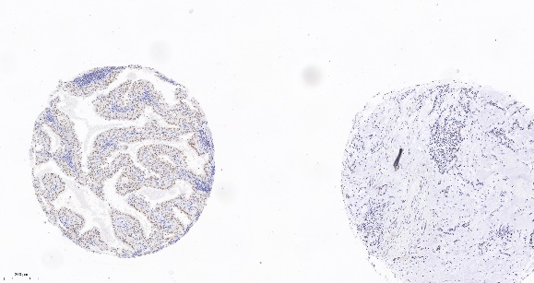
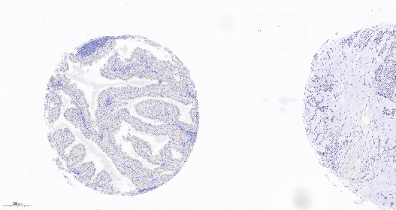
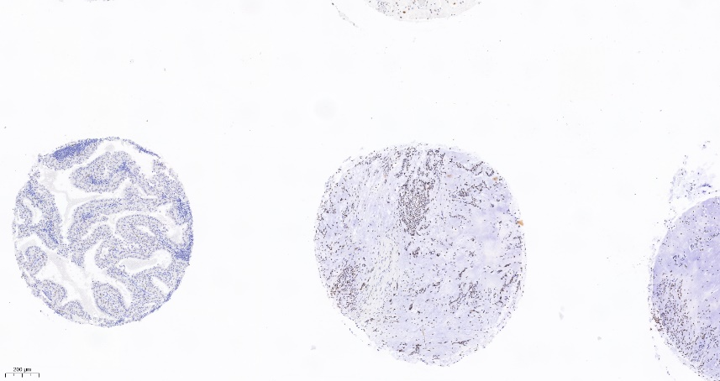
A
1
2
3
4
5
6
7
8
Supplementary Figure 2:
A: HE stained TMA with benign salivary gland neoplasms, scale: 500µm; 1 – 4: Pleomorphic adenomas; 5: Warthin tumor; 6, 7: Pleomorphic adenomas; 8: Non-neoplastic salivary gland tissue
B: Staining examples for MLH1, PMS2, MSH2 and MSH6 in a Warthin tumor, Scale: 200µm.
B
MLH1
PMS2
MSH2
MSH6

