Slide 1
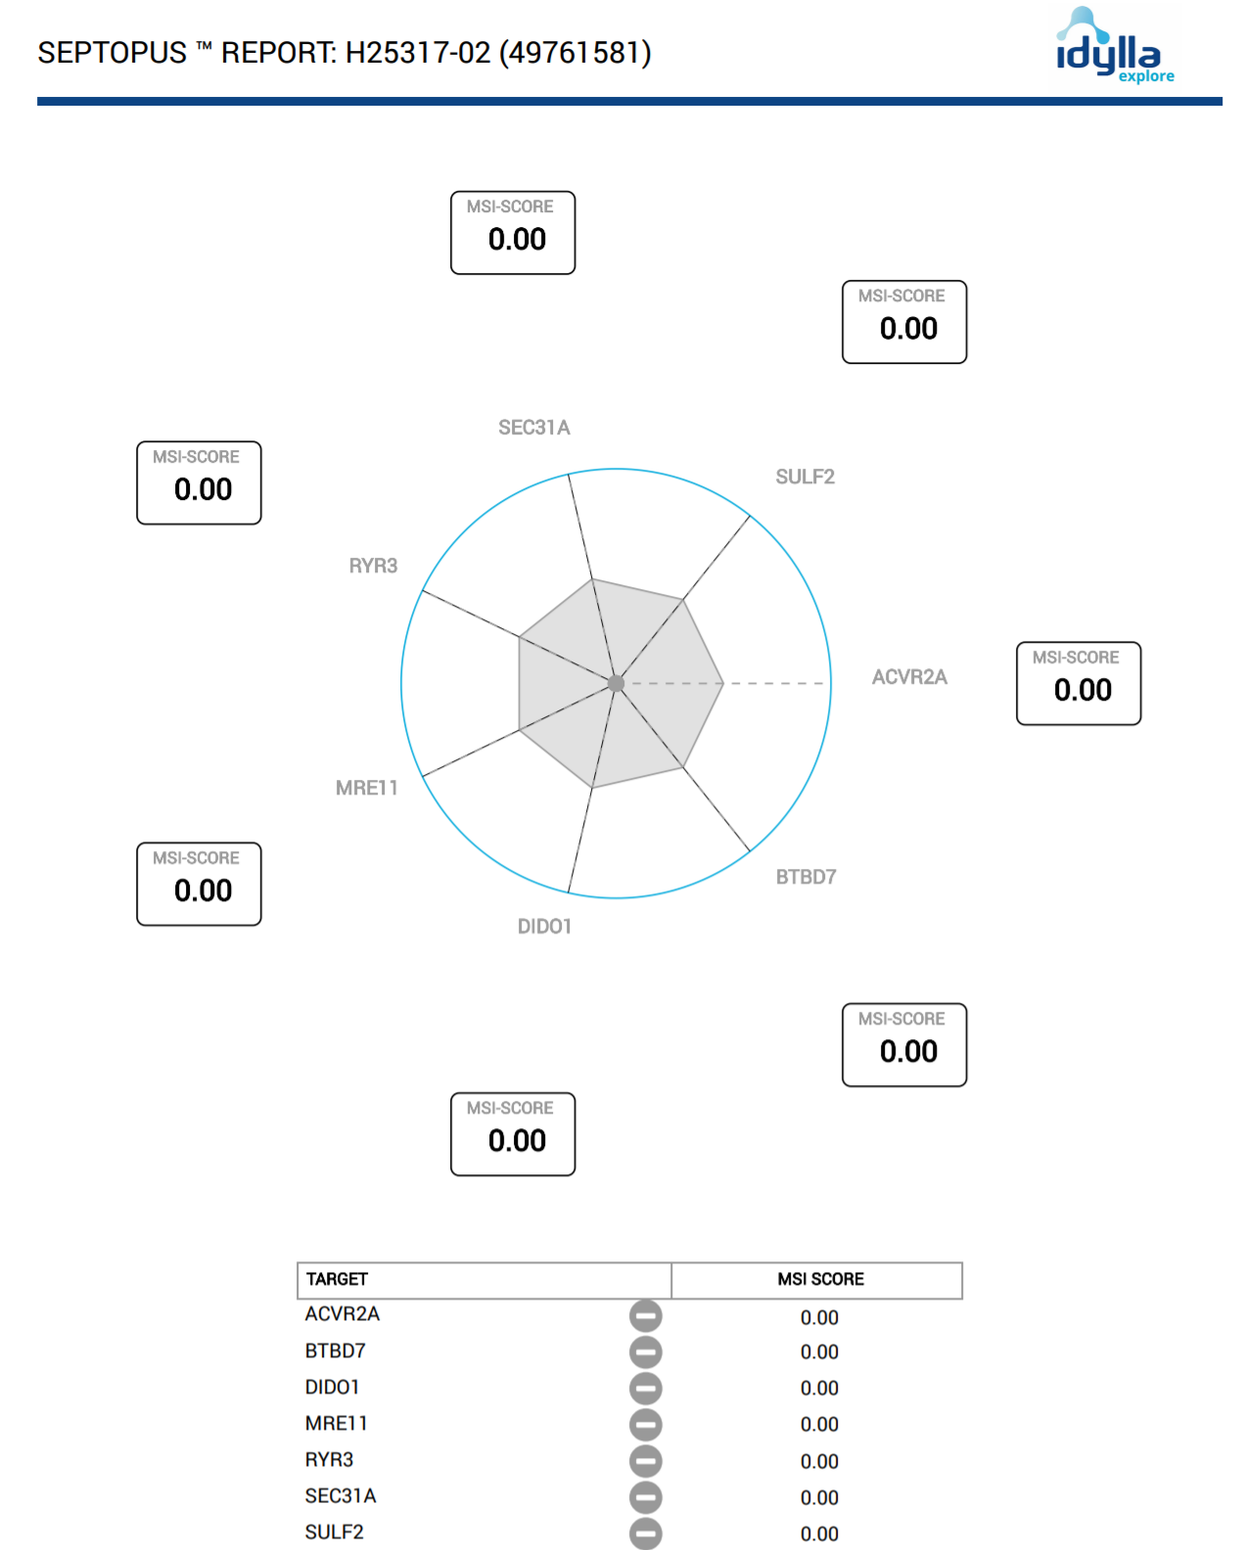
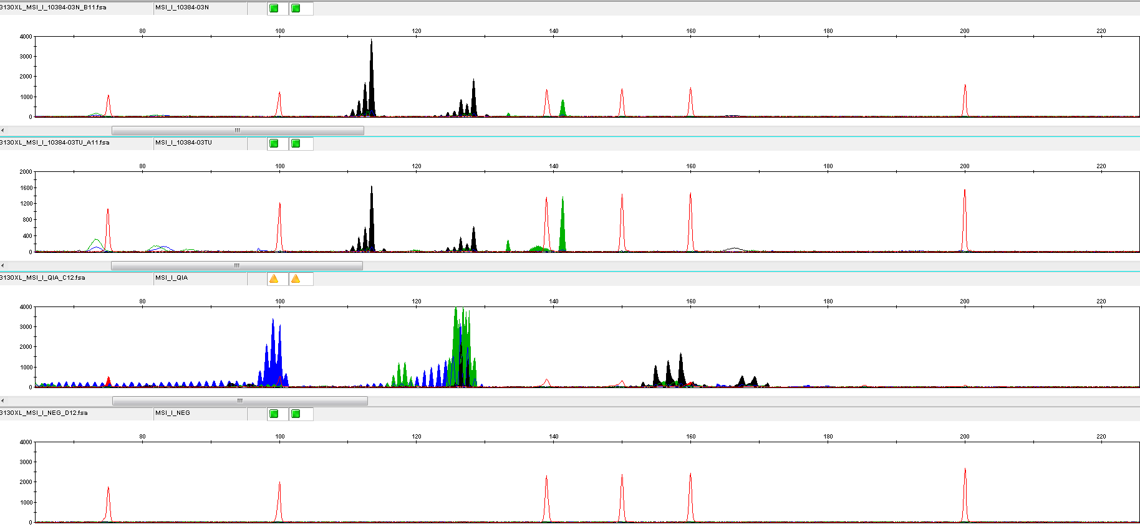
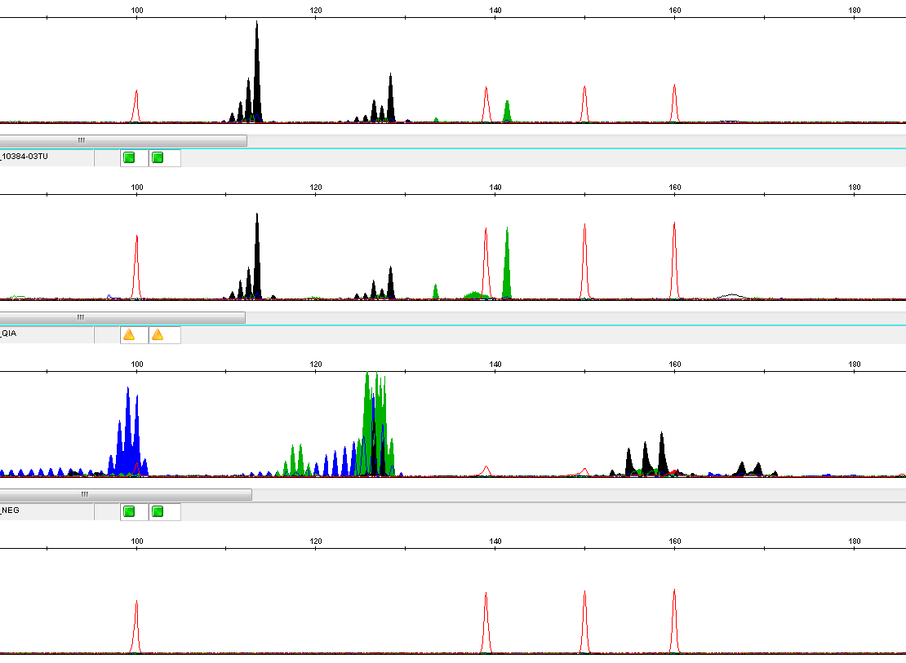
A
B
1
Sample 1
Sample 1
Sample 1
Positive control
Negative control
2
Sample 1
Sample 1
Positive control
Negative control
Supplementary Figure 1:
A Output example for MSI testing via fragment analysis based on the Bethesda panel. 1: Panel 1; 2: Panel 2.
B Output example for IdyllaTM MSI test.

