Slide 1
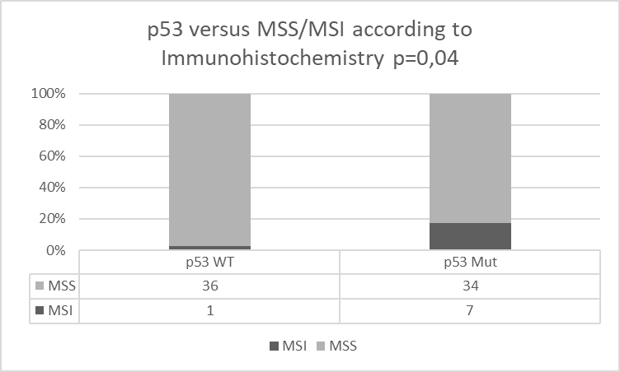
Supplementary Figure 3:
Cumulative bar chart displaying p53 versus MSS/MSI according to Immunohistochemistry, p=0,04.

