Slide 1
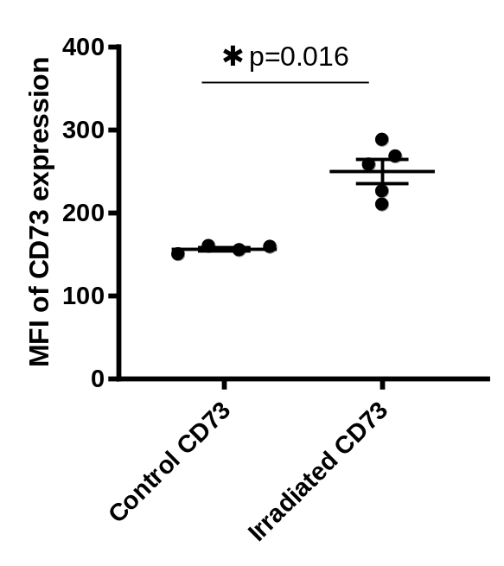
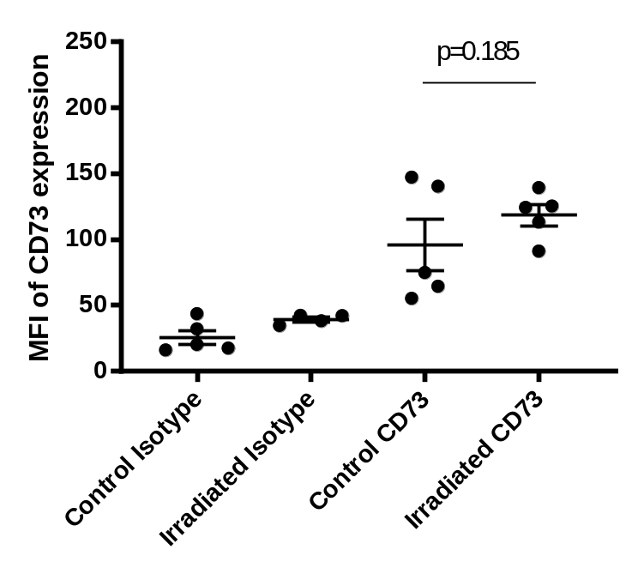
Figure S1
(A)
(B)
(A) Cultured LuM-1 cells were treated with or without 10 Gy RT using the MX-160 Labo (mediXtec), and incubated for an additional 24 hours. The cells were stained with anti-CD73 mAb and mean fluorescein intensities (MFI) in the 7AAD (-) live cell population were examined by FACS. Data in 5 different experiments were expressed.
(B) Two fractions of 4 Gy RT were delivered selectively to sc tumors of LuM-1 with the remainder of Balb/c mice shielded by a lead plate. Two days later, tumors were resected and single cell suspensions obtained using a Tumor Dissociation Kit (Miltenyi Biotec). The cells were stained with mAbs to CD73 and CD45, and MFI for CD73 were analyzed in live tumor cells defined by 7AAD (-) CD45(+) gated area. P value was calculated with one-way ANOVA followed by Tukey test.

Slide 2
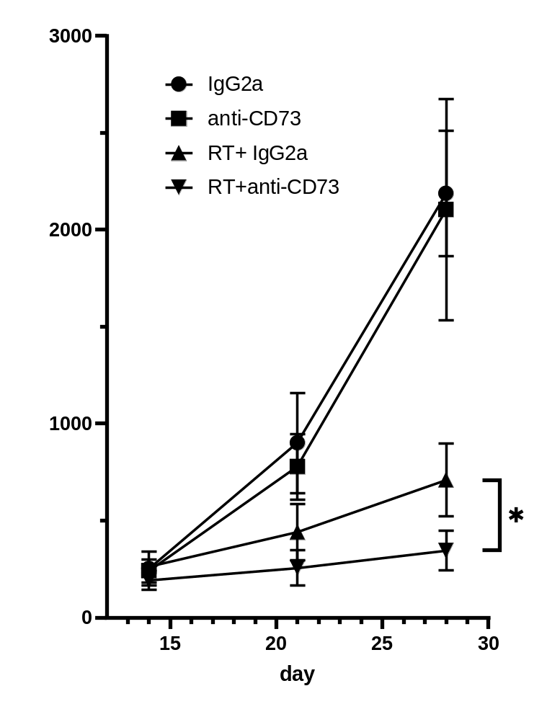
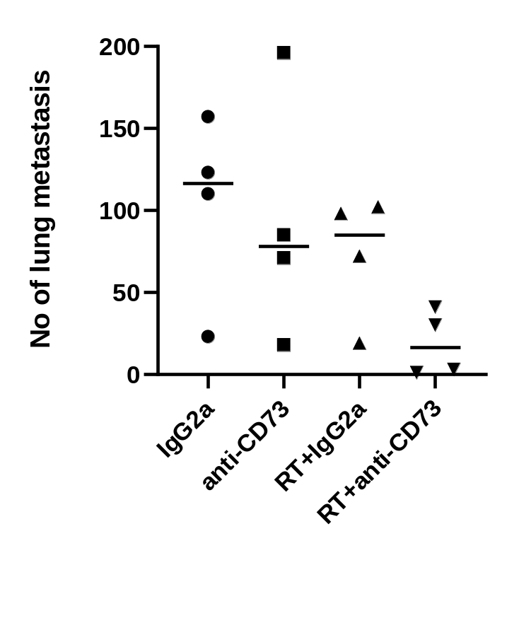
Figure S2
Tumor volume (mm3)
Tumor bearing mice received local RT to subcutaneous (sc) tumors (3 fractions of 4 Gy) on days 12, 14, 16 and/or an intraperitoneal injection of 200 μg anti-CD73 mAb or Rat IgG2a isotype control at days 12, 14, 16, 19, 22 and 25. The growth of subcutaneous tumors was evaluated by their volume calculated by length×width2/2 (left) . All mice were sacrificed on day 28, and the number of macroscopic metastatic nodules (right). p value were calculated with ANOVA with Tukey’s test and * shows p<0.05.

Slide 3
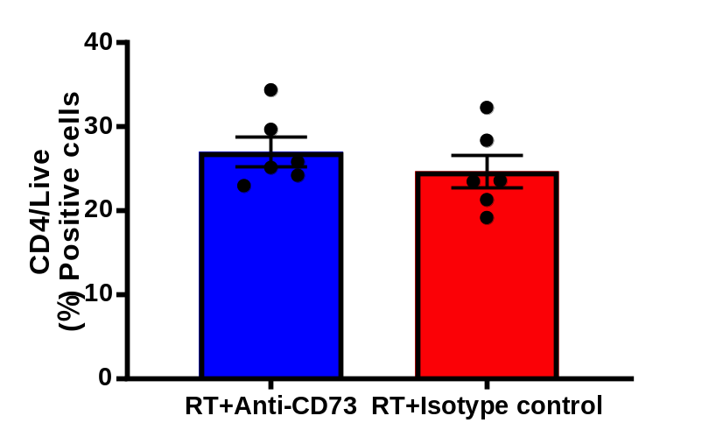
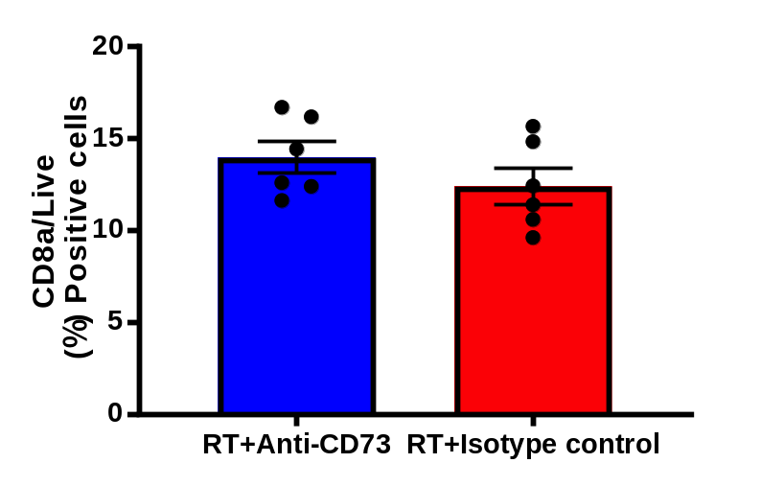
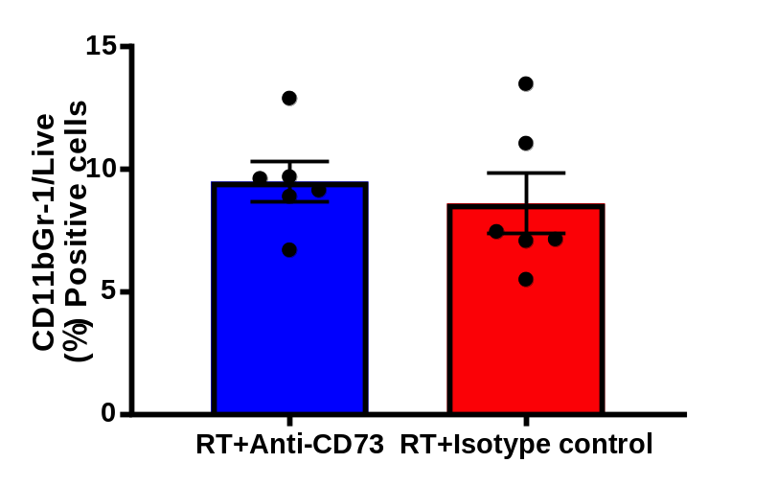
Figure S3
Tumor bearing mice received local RT to subcutaneous (sc) tumors (3 fractions of 4 Gy) as described above on days 12, 14, 16 and intraperitoneal injection of 200 μg anti-CD73 mAb or Rat IgG2a isotype control at days 12, 14, 16, 19, 22 and 25. All of the mice were sacrificed on day 28. Their splenocytes were stained with mAbs to CD4, CD8 and CD11b with 7-AAD and positive cells were calculated in 7-AAD(-) live cell population.
No significant differences were observed.

Slide 4
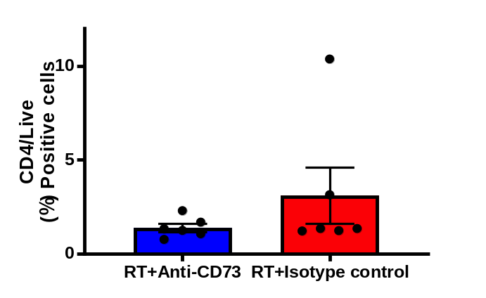
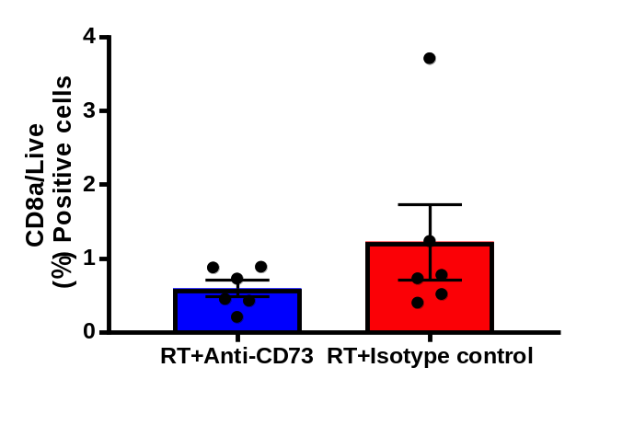
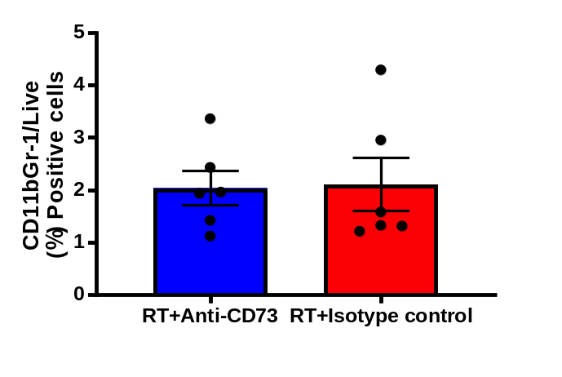
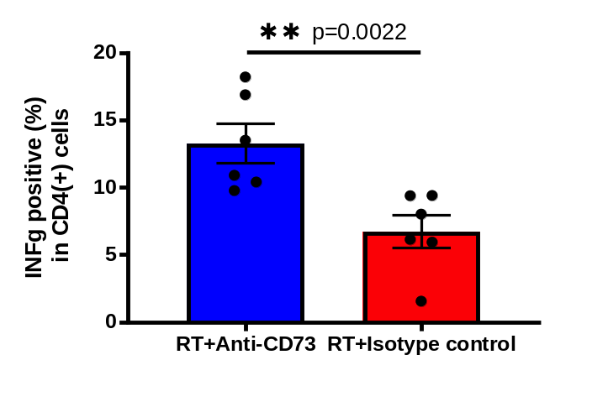
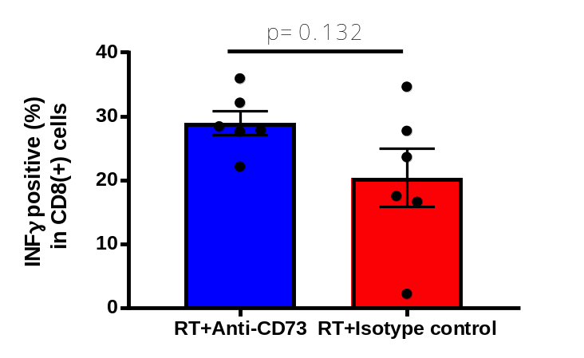
Figure S4
Tumor bearing mice received local RT to subcutaneous (sc) tumors (3 fractions of 4 Gy) as described above on days 12, 14, 16 and intraperitoneal injection of 200 μg anti-CD73 mAb or Rat IgG2a isotype control at days 12, 14, 16, 19, 22 and 25. All of the mice were sacrificed on day 28 and the subcutaneous tumors were dissociated with cell dissociation kit (Miltenyi) and the cells recovered from each tumor were stained with mAbs to CD4, CD8 and CD11b with 7-AAD and positive cells were calculated in 7-AAD(-) live cell population (upper panel). The cells were also cultured in RPMI-1640 + 10% FCS in the presence of brefeldin and then fixed, permeabilized and stained with PE-conjugated IFN-γ or isotype control and FITC-conjugated mAbs to CD4 or CD8 as well as FVS780 for dead cell exclusion. The ratio of IFN-γ positive cells were calculated in CD4(+) or CD8(+) gated area (lower panel).

Slide 5
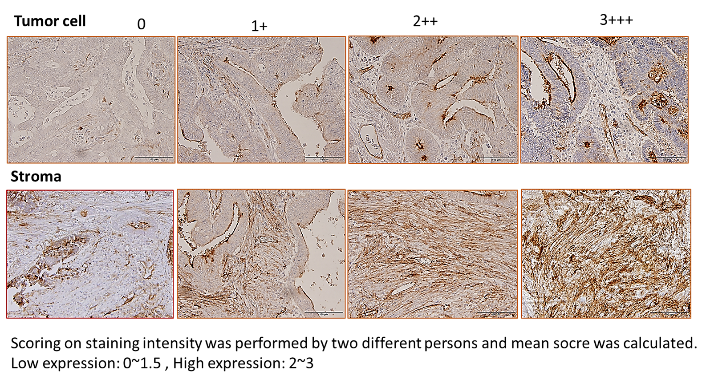
Figure S5
Classification of high and low expression of CD73. Staining intensities of CD73 were evaluated in remnant tumor cells or stroma separately by scoring (0, 1+, 2++, 3+++) determined by 2 evaluators and mean scores were calculated in each sample. The tumors were classified into high (mean score 2~3) and low (mean score 0~1.5) groups.

Slide 6
Figure S6. Univariate and Multivariate analysis on the correlation between clinicopathological variables and outcome.
Variable | RFS |  |  |  | OS
 | Univariate analysis |  | Multivariate analysis |  | Univariate analysis |  | Multivariate analysis
 | HR(95% CI) | p-value | HR (95% CI) | p-value | HR (95% CI) | p-value | HR (95% CI) | p-value
Age: 62y< vs ≧62y | 1.0(0.45-2.4) | 0.94 |  |  | 1.0(0.38-2.9) | 0.94
Gender: M vs F | 0.88(0.32-2.4) | 0.81 |  |  | 1.1(0.35-3.5) | 0.88
Histology: Differentiated vs Undifferentiated | 1.3(0.40-4.5) | 0.66 |  |  | 1.3(0.30-5.8) | 0.72
Lymphatic invasion:- vs + | 1.5(0.62-3.3) | 0.39 |  |  | 1.3(0.46-3.5) | 0.66
Venous invasion:- vs + | 1.2(0.49-3.0) | 0.68 |  |  | 0.87(0.31-2.5) | 0.79
Tumor Stage: T0,1,2 vs t3,4 | 3.2(0.94-11) | 0.063 | 3.0(0.90-10) | 0.074 | 2.8(0.64-13) | 0.17 | 2.5(0.56-11) | 0.23
N stage:- vs + | 0.91(0.37-2.3) | 0.84 |  |  | 1.2(0.44-3.5) | 0.68
Pathological response: Grade 0,1 vs 2,3 | 0.75(0.29-1.9) | 0.54 |  |  | 0.80(0.25-2.5) | 0.70
Combined chemotherapy: + vs - | 1.2(0.27-5.0) | 0.83 |  |  | 0.89(0.2-3.9) | 0.87
Adjuvant chemotherapy: + vs - | 0.93(0.38-2.3) | 0.87 |  |  | 1.0(0.36-3.1) | 0.94
CD73 expression levels: High expression both in tumor cells and stroma high vs Others | 3.2(1.3-7.6) | 0.01 | 2.8(1.2-6.8) | 0.022 | 3.9(1.4-11) | 0.008 | 3.3(1.2-9.2) | 0.021
OS: Overall Survival, RFS: Relapse Free Survival, HR: hazard ratio CI: confidence interval.
P-values were analyzed with cox proportional hazard model.

