Slide 1
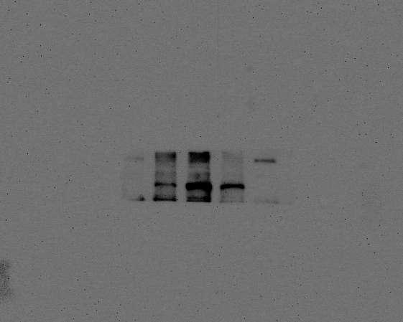
Figure1 NLRP3
Figure1 PKCɑ

Slide 2
Figure1 GAPDH
Figure1 P-PKCɑ

Slide 3
Figure 2 P-PKCɑ
Figure 2 ASC

Slide 4
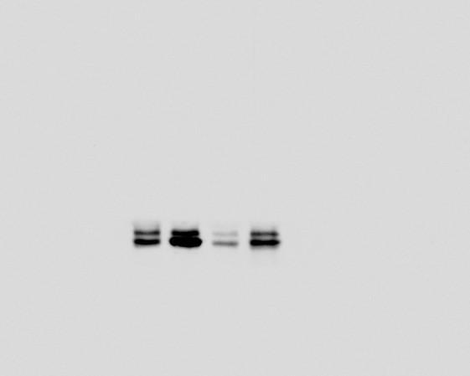
Figure2 Procaspase-1
Figure2 Caspase-1

Slide 5
Figure 2 proIL-1β
Figure 2 IL-1β

Slide 6
Figure2 ɑ-tubulin

Slide 7
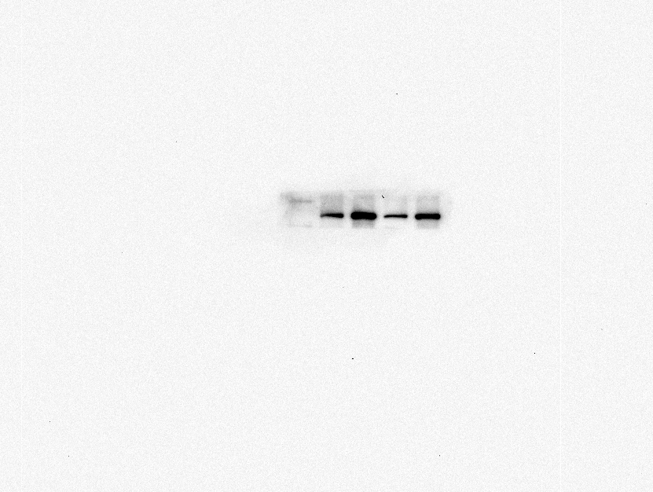
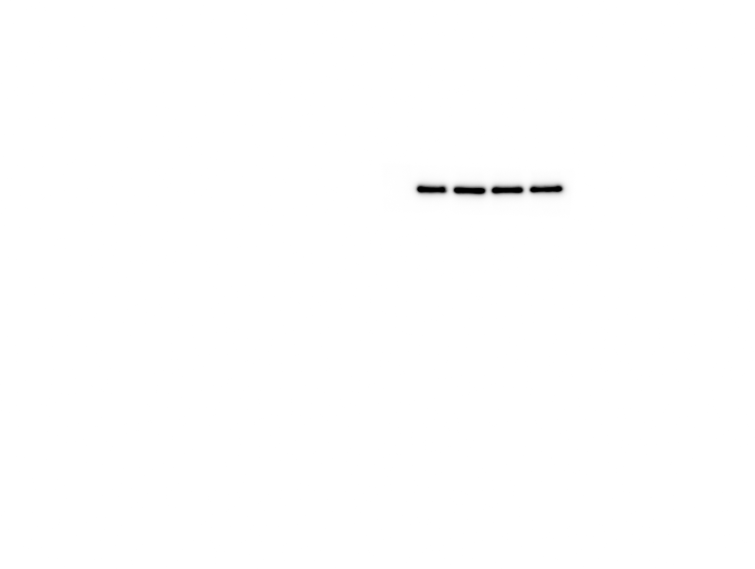
Figure3 GAPDH
Figure3 NLRP3

Slide 8
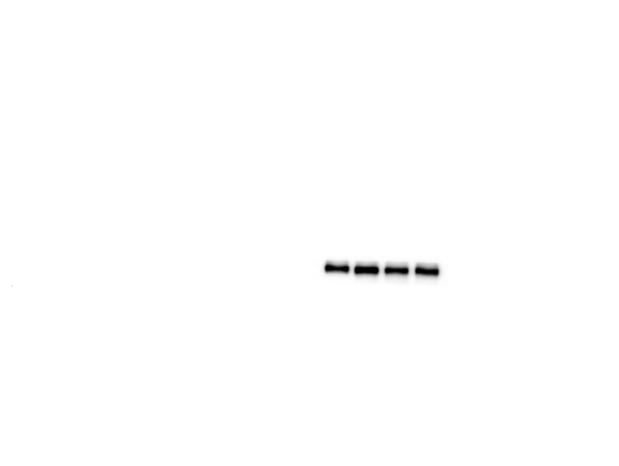
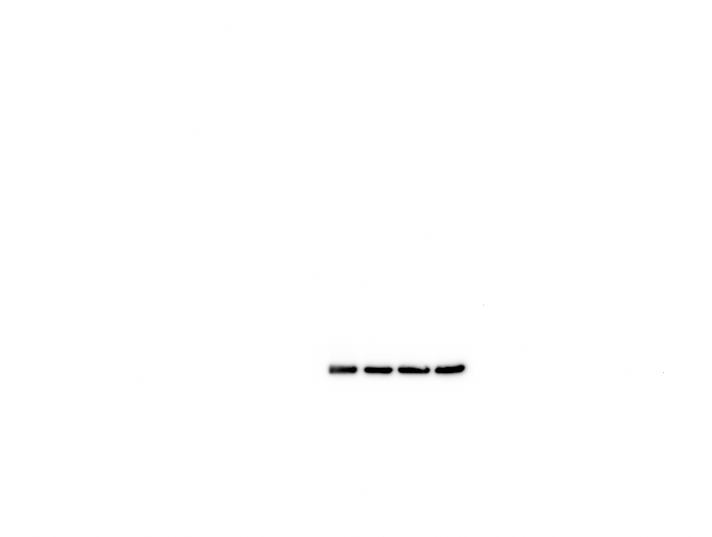
Figure3 PKCɑ
Figure3 GAPDH

Slide 9
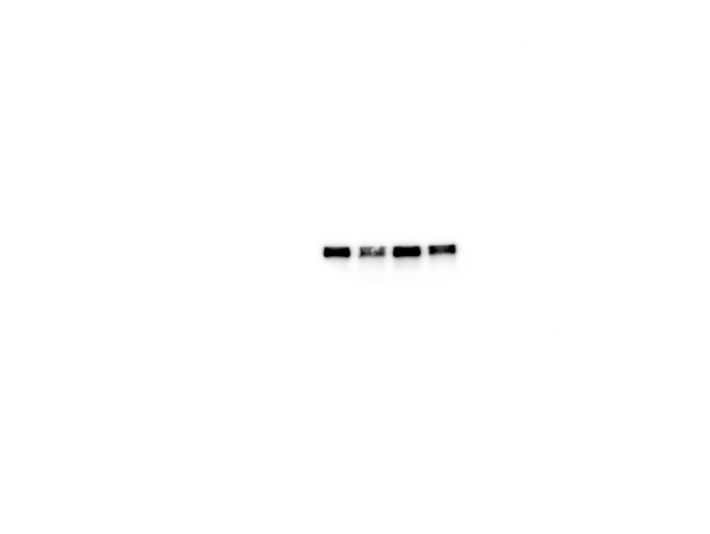

Figure3 Occludin
Figure3 GAPDH

