Slide 1
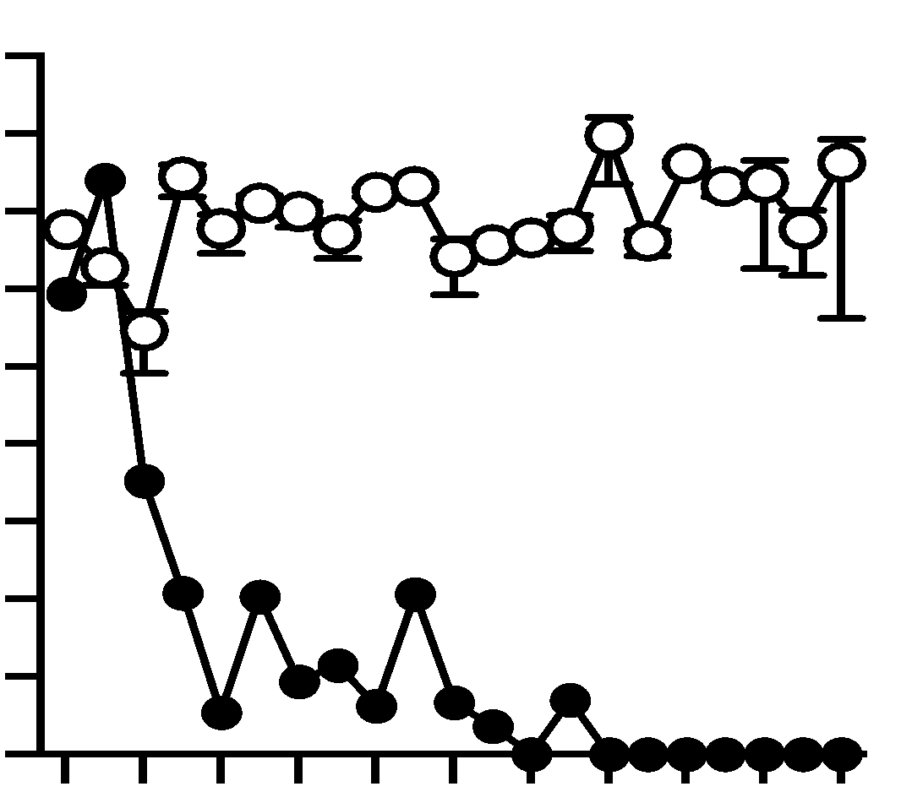
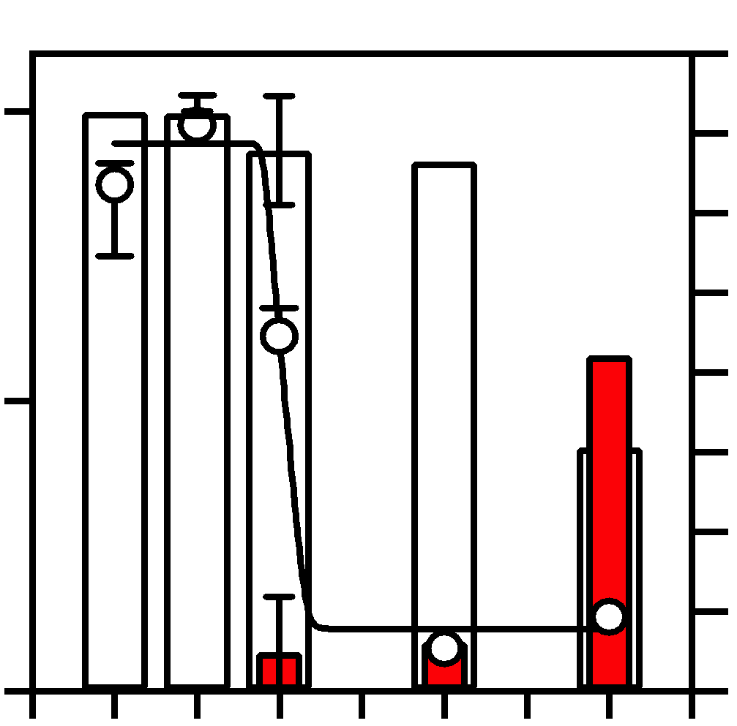
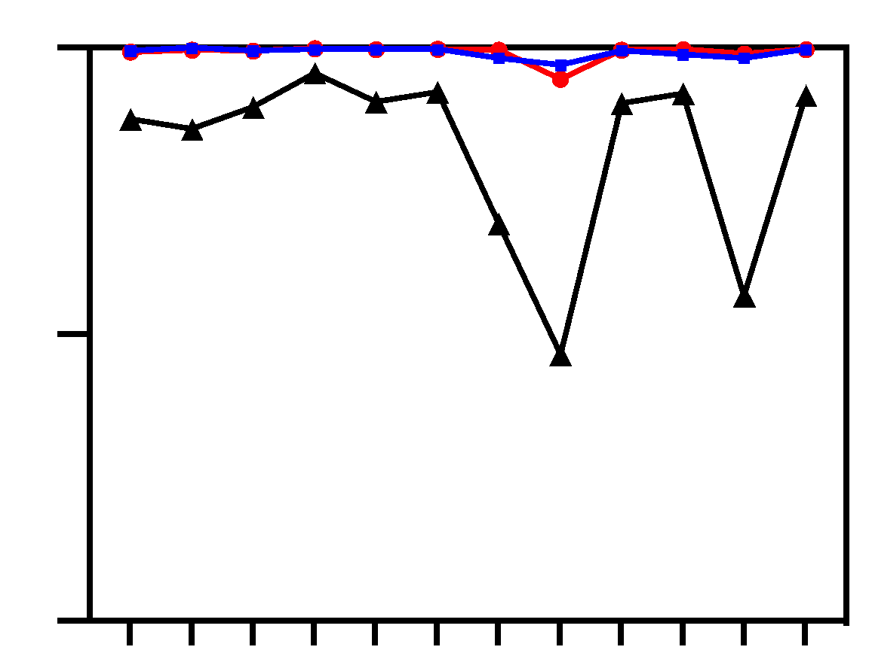
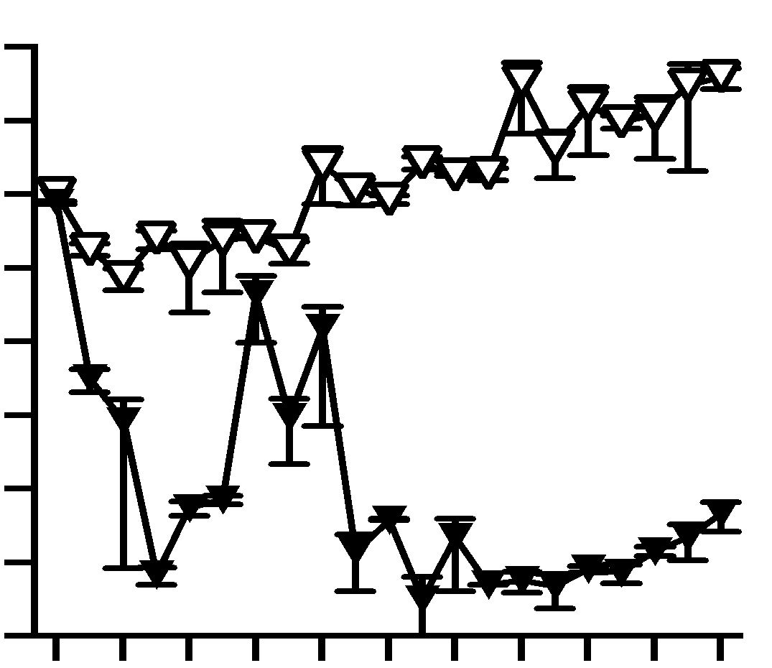
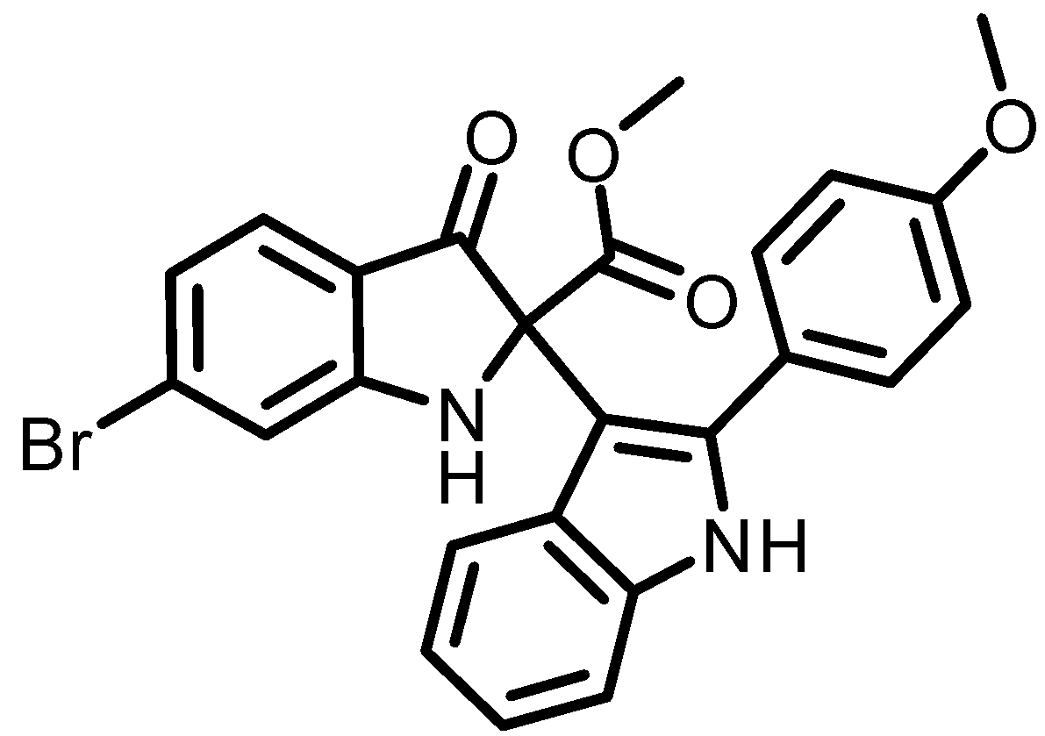
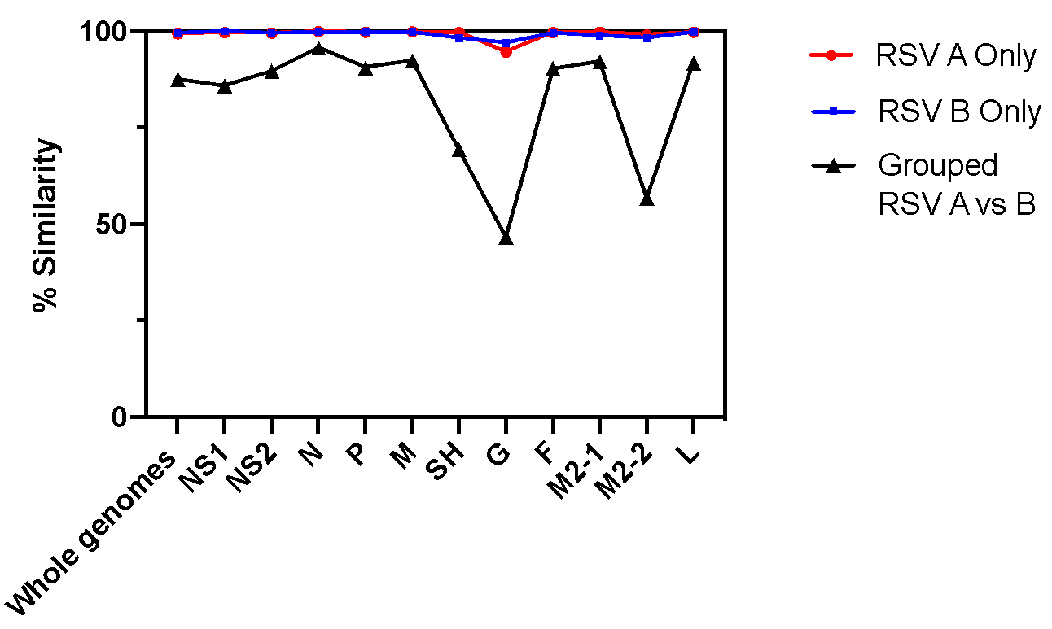
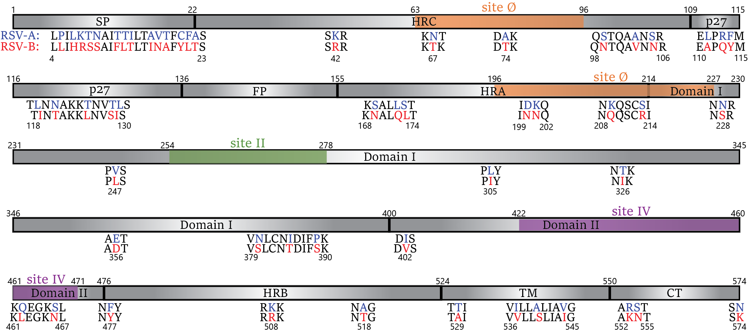
Figure 1
a
Control
b
Anti-RSV Antibody
Leucine
Isoleucine
RSV titer
10⁸
100
10⁷
10⁶
10⁶
10⁵
RT- qPCR Transcripts
50
10⁴
10³
10⁴
L305I
% L and I AA 305
RT-qPCR Transcripts
10²
10²
10¹
10⁰
0
10⁰
0
10
20
0
10^{–1}
0
1
3
5
Passage number
Passage number
c
10 μM
d
25 μM
100
10⁸
L305I
10⁶
% identity
RSVA
10⁴
50
RT-qPCR Transcripts
RSVB
10²
RSVA vs RSVB
P
F
10⁰
0
G
NS1
NS2
L
M2-1
0
10
20
N
M
M2-2
Genome
SH
Passage number
e
RSV-F A and B typic amino acids

Slide 2
Figure 1. Mutations in the RSV fusion protein occur at evolutionary bottlenecks under various selection pressures. a, RSV-A2 was passaged 20 times in the presence of anti-RSV antibody or 0.25% DMSO (control). Viral titer at each passage was determined via qRT-PCR and whole viral genomes were sequenced by NGS. Mutations are indicated at the passage numbers at which they first arose. b, The proportion of RSV-A reads with amino acids Leucine and Isoleucine at position 305 are plotted alongside viral titer at each corresponding passage. c, The same evolution experiment as described in Figure 1a was conducted in the presence of an RSV polymerase inhibitor (compound 5f, left) at a concentration of 10µM and 25µM d, Comparison of sequenced clinical isolates from Alberta, Texas, and Ohio. The percent identity is shown within and between each RSV subtype at the whole genome level and at each gene. e, Graphical representation of RSV-F amino acid differences in RSV-A (blue) and RSV-B (red). 3747 RSV-F amino acid sequences were obtained from NCIB and aligned. Consensus sequences of subtypes A and B were compared and positions with less than 65% sequence identity are shown. The RSV-F domains are displayed and bindings sites Ø (orange), II (green), and IV (purple) are highlighted.

Slide 3
Supplemental Table 1
Supplemental Table 1. RSV-A2 mutations under polyclonal anti-RSV selective pressure.
 |  | passage number
 |  | 0a | 0b | 1a | 1b | 3a | 5b
position No. | wt AA (codon) | alternate codon expressed (% of reads) |  |  |  |  |  | alt AA (codon)
66 | K (aaa) |  |  |  | 27.27% | 18.00% | 22.73% | E (gaa)
144 | V (gtt) | 38.65% | 26.63% | 30.30% | 22.12% | 10.01% | 13.59% | A (gca)
152 | V (gtt) |  |  |  | 10.23% |  | 31.82% | I (att)
276 | N (aac) |  |  |  | 13.18% | 15.19% | 36.92% | S (agc)
305⁺ | L (cta) |  |  |  | 13.45% | 8.55% | 57.97% | I (ata)
559 | L (cta) |  |  |  | 5.34% | 1.50% | 60.32% | L (ttg)
Mutations that arise at a >25% frequency in the evolution experiment described in Figure 1a are shown. The wildtype (wt) codon at each position is indicated on the left and was determined by sequencing of the original RW30 plasmid. Alternate (alt) codons are indicated on the right. Percentages indicate the proportion of reads expressing the alt codon. Each biological replicate of the experiment is denoted by ‘a’ or ‘b’ beside the passage number. Spaces have been left blank if alt codons were undetectable or if insufficient sequencing reads were obtained in the indicated passage number. + indicates positions that differe between RSV subtypes A and B.

Slide 4
Supplemental Table 2
Supplemental Table 2. Proportion of NCBI published RSV-F sequences containing differences in amino acid consensus sequences between RSVA and RSVB subtypes.
Position No. | Amino Acid | RSVA |  | RSVB
276 | N | 697 | 30.13% | 44 | 3.07%
 | S | 1602 | 69.26% | 1386 | 96.65%
305 | L | 2295 | 99.22% | 9 | 0.63%
 | I | 8 | 0.35% | 1416 | 98.74%
3747 complete RSV-F sequences were downloaded from The Virus Pathogen Resource (ViPR). Only sequences already sub typed into RSVA (2313) and RSVB (1434) were included in the analysis. Amino acid counts at the indicated positions were determined using Geneious Prime software. Total counts of sequence and percentage of total sequences containing a given amino acid are indicated for each RSV subtype.

Slide 5
Supplemental Table 3
Supplementary Table 3. Proportion of sequencing reads containing a Leucine or Isoleucine at amino acid position 305.
Passage No. | Leucine 305 | Isoleucine 305
0a | 100.00% | 0.00%
0b | 100.00% | 0.00%
1a | 100.00% | 0.00%
1b | 86.55% (663/766) | 13.45% (103/766)
3a | 91.45% (3371/3686) | 8.55% (315/3686)
5b | 42.03% (153/364) | 57.97% (211/364)
Sequencing reads obtained from the experiment described in Figure 1a with RSV-A2 under polyclonal anti-RSV selective pressure. Biological replicates are denoted ‘a’ and ‘b’ beside the passage number. The proportion of sequencing reads representing each amino acid are in parentheses where an alternate amino acid was observed.

Slide 6
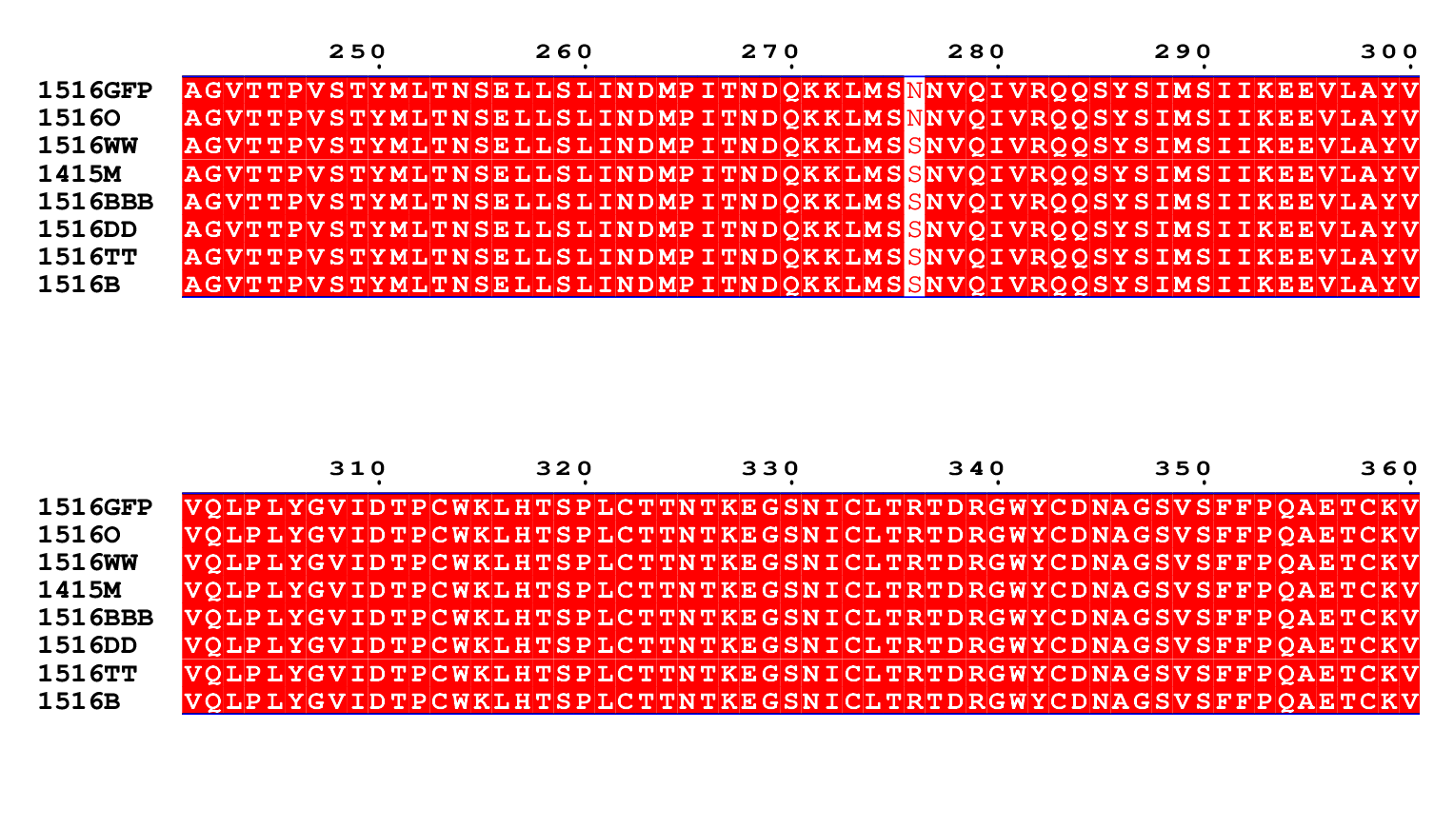
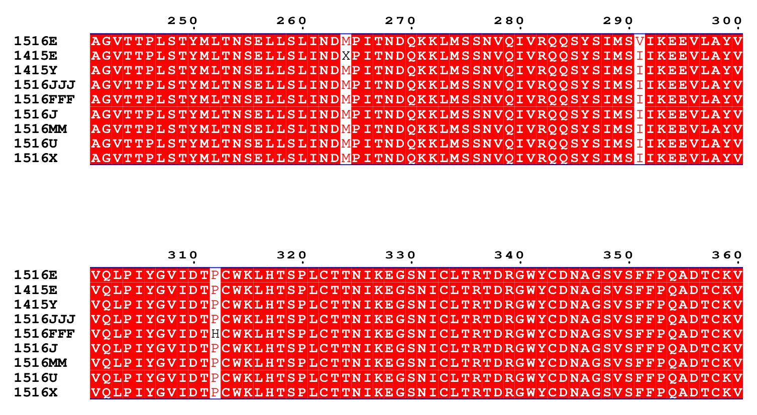
Supplementary Table 4. RSVA and B clinical isolate sequences of RSV-F from amino acid positions 241-360.
RSV A
Palivizumab binding site
305
RSV B
Palivizumab binding site
305

Slide 7
Supplemental Table 4
Clinical RSV isolates originating from Ohio, USA were subtyped via RT-qPCR and sequenced by NGS. Sequences were processed and aligned in Geneious Prime software. The trimmed portion of sequences is indicated for each isolate. Isoleucine and Leucine residues occupying position 305 are indicated in a black box. The Palivizumab binding site is indicated in a blue box. The RSV season from which the isolate was obtained is indicated in brackets beside the isolate name as follows: 1415 represents the 2014-2015 RSV season.

Slide 8
Supplemental Table 5
Supplementary Table 5. Amino acid percentage similarities between RSV-A and RSV-B subtypes isolated from Alberta, Canada and Ohio, USA.
RSV gene | RSV A | RSV B | RSV A vs B
Whole genomes | 99.4% | 99.5% | 87.6%
NS1 | 99.7% | 100% | 85.9%
NS2 | 99.5% | 99.5% | 89.7%
N | 99.95% | 99.8% | 95.7%
P | 99.8% | 99.8% | 90.6%
M | 99.9% | 99.8% | 92.4%
SH | 99.7% | 98.3% | 69.4%
G | 94.6% | 97.0% | 46.6%
F | 99.7% | 99.6% | 90.4%
M2-1 | 99.8% | 98.9% | 92.1%
M2-2 | 99.0% | 98.3% | 56.8%
L | 99.8% | 99.8% | 91.8%
RSV-A and -B isolates (n=34) were sequenced via NGS and aligned with Geneious Prime Sotware. Whole RSV genomes and each of the 11 RSV genes were individually compared both among and between the RSV subtypes. F protein statistics are highlighted in grey. Percent similarities between RSV-A and -B were calculated as follows: AB=(2)(Total)-(1/2)(AA+BB).

Slide 9
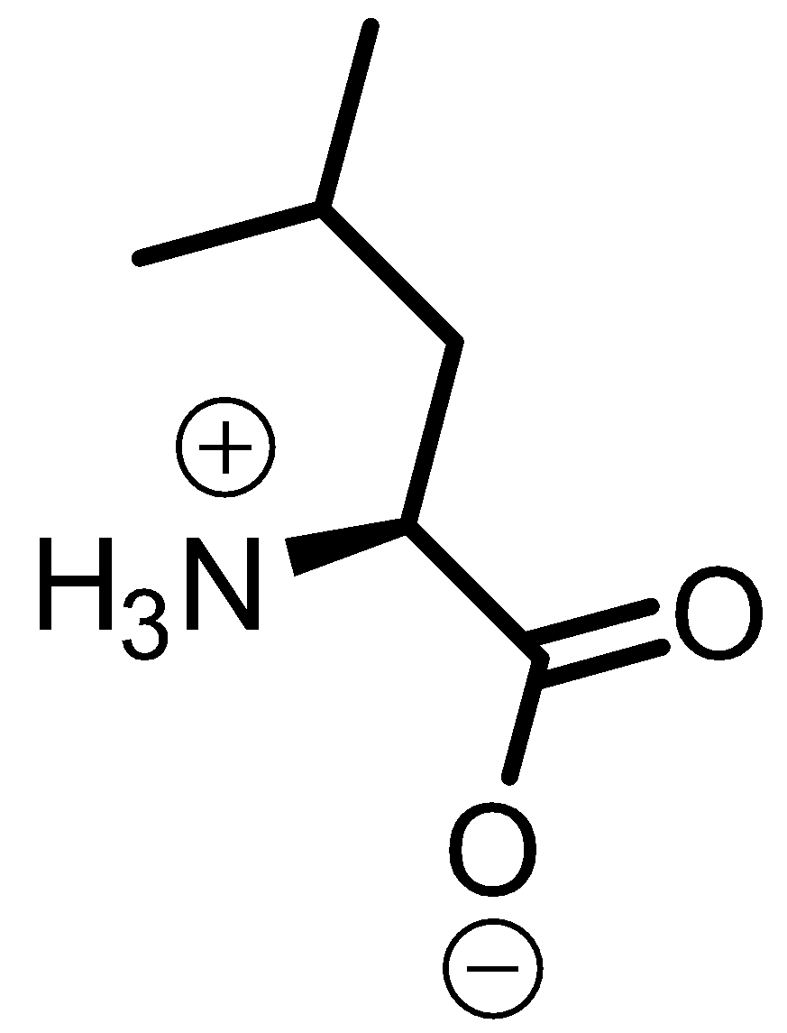
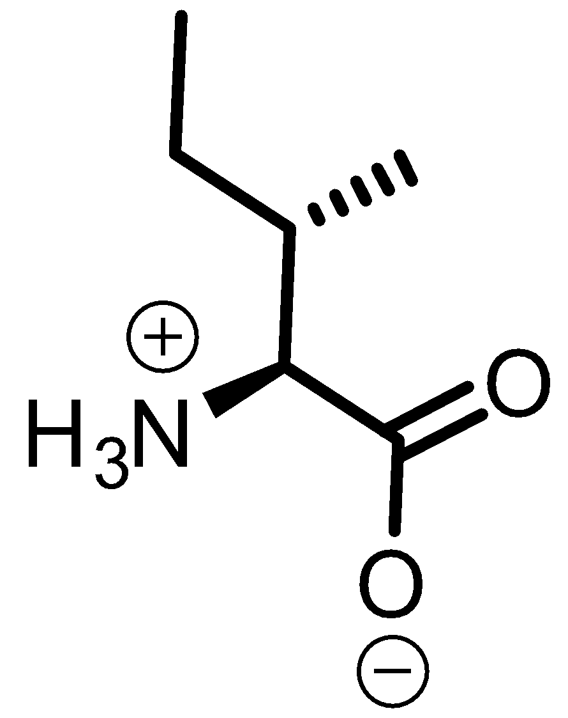
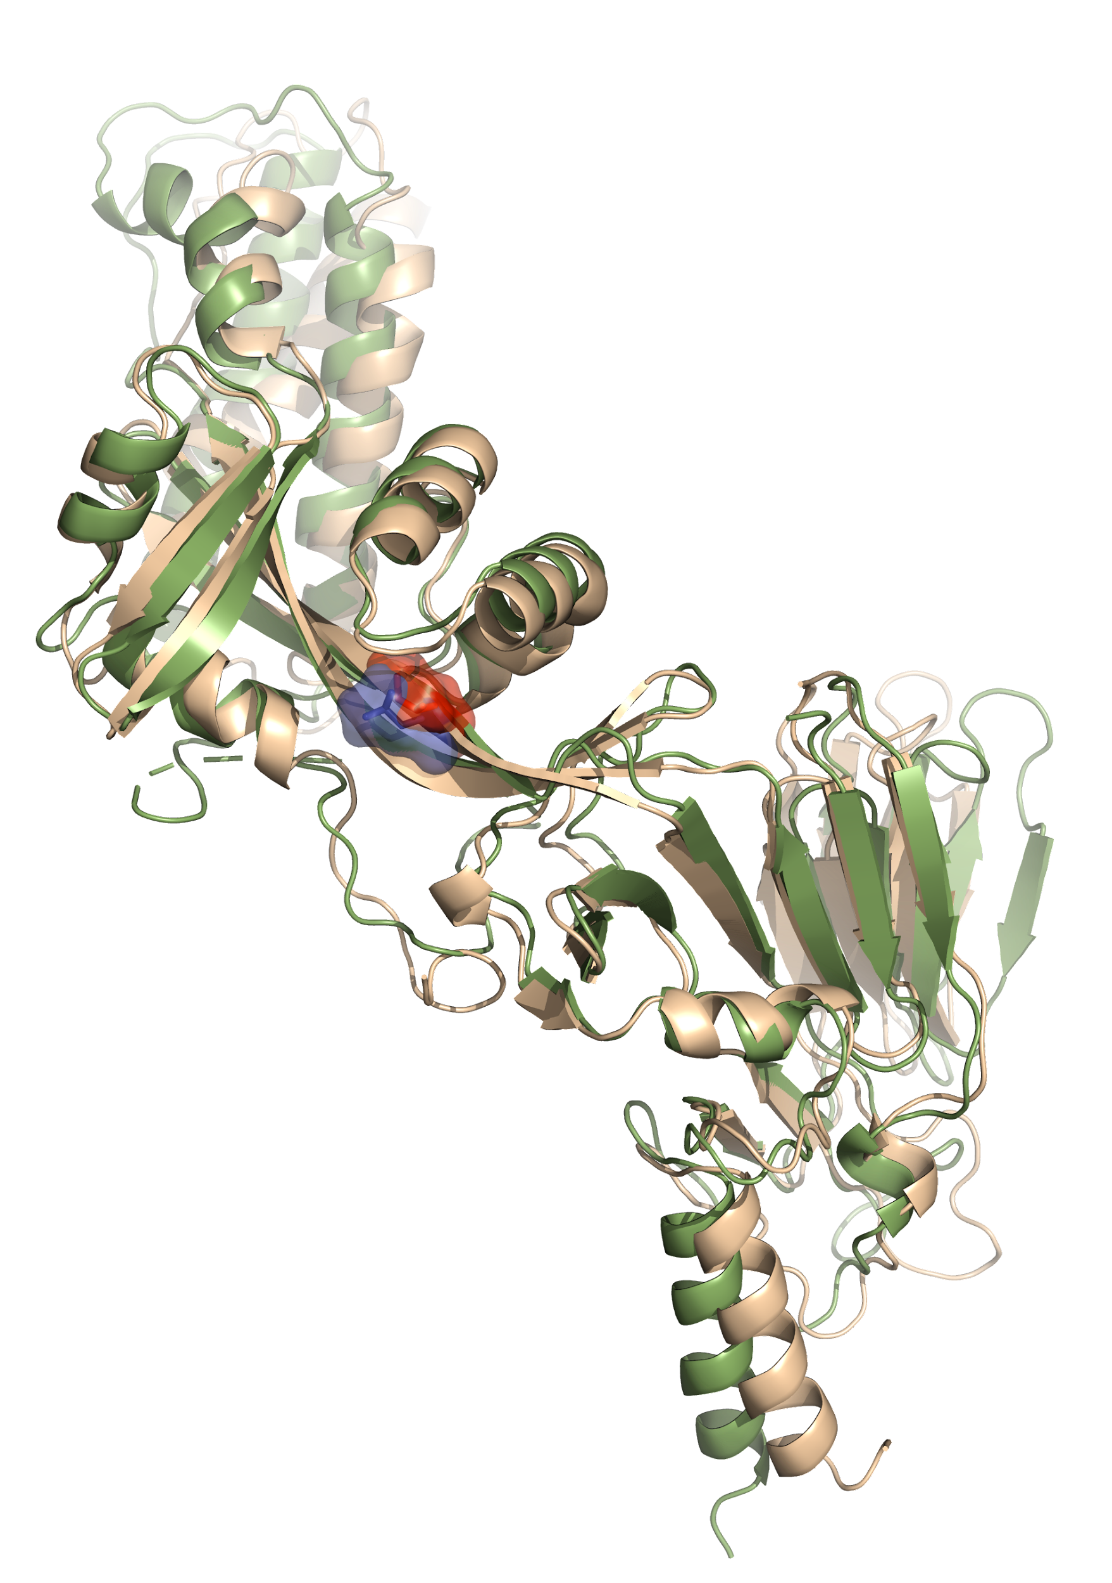
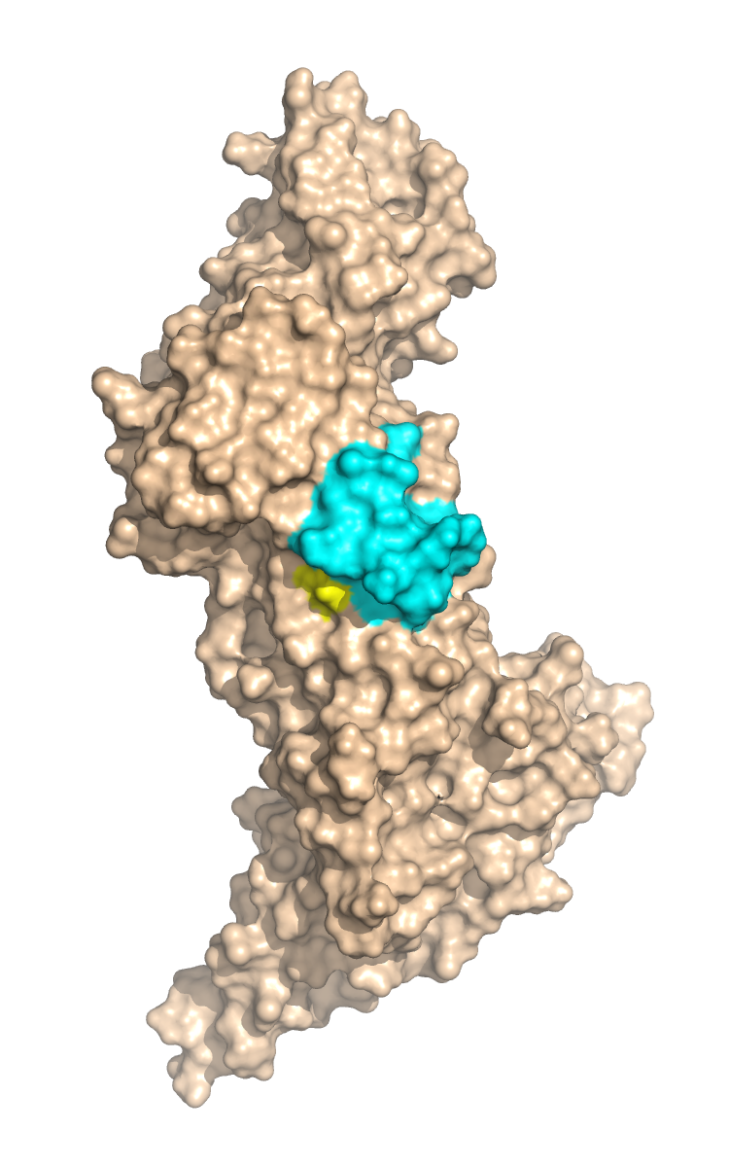
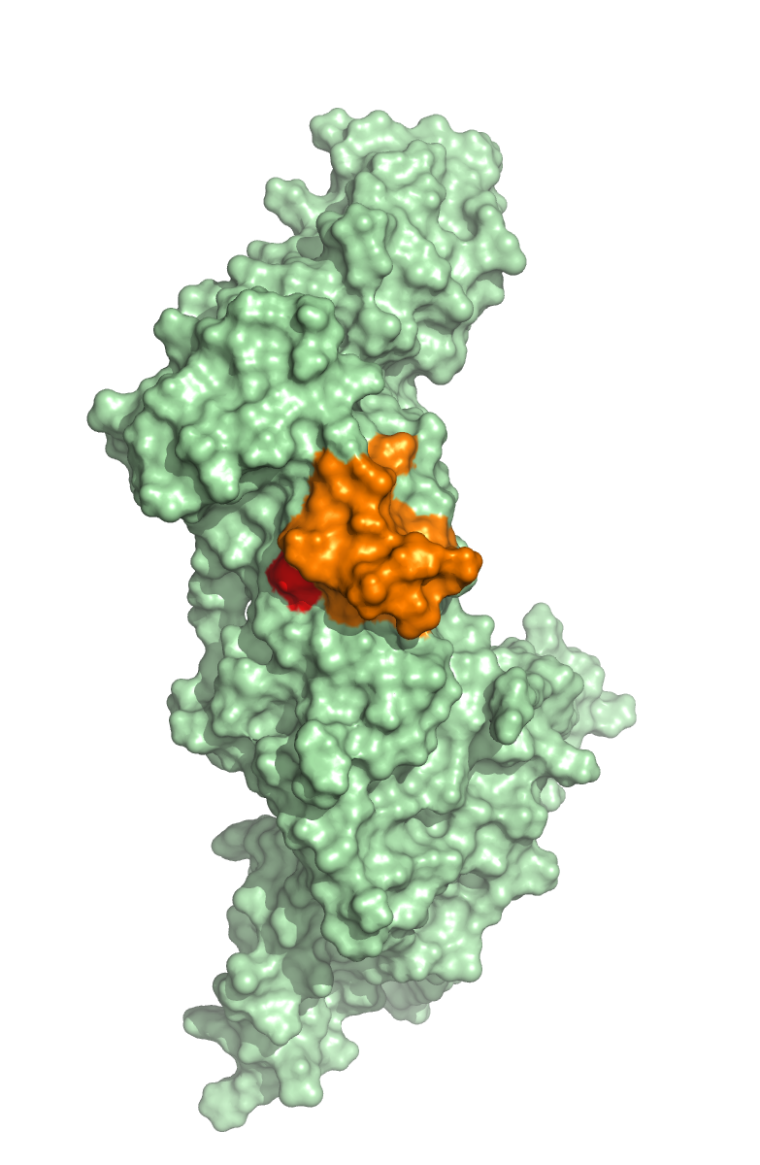
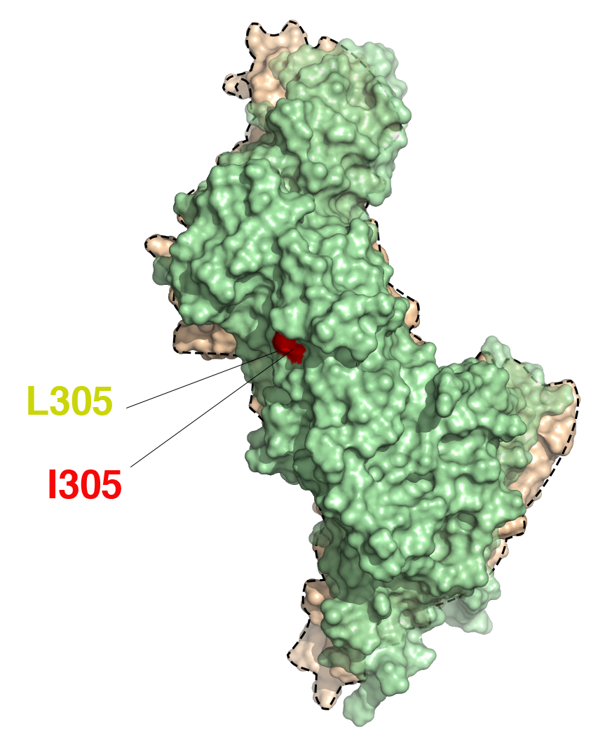
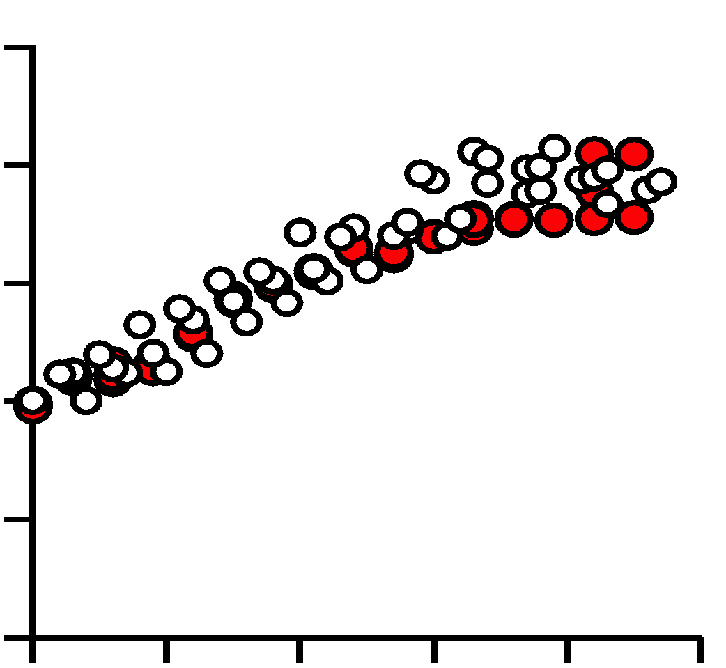
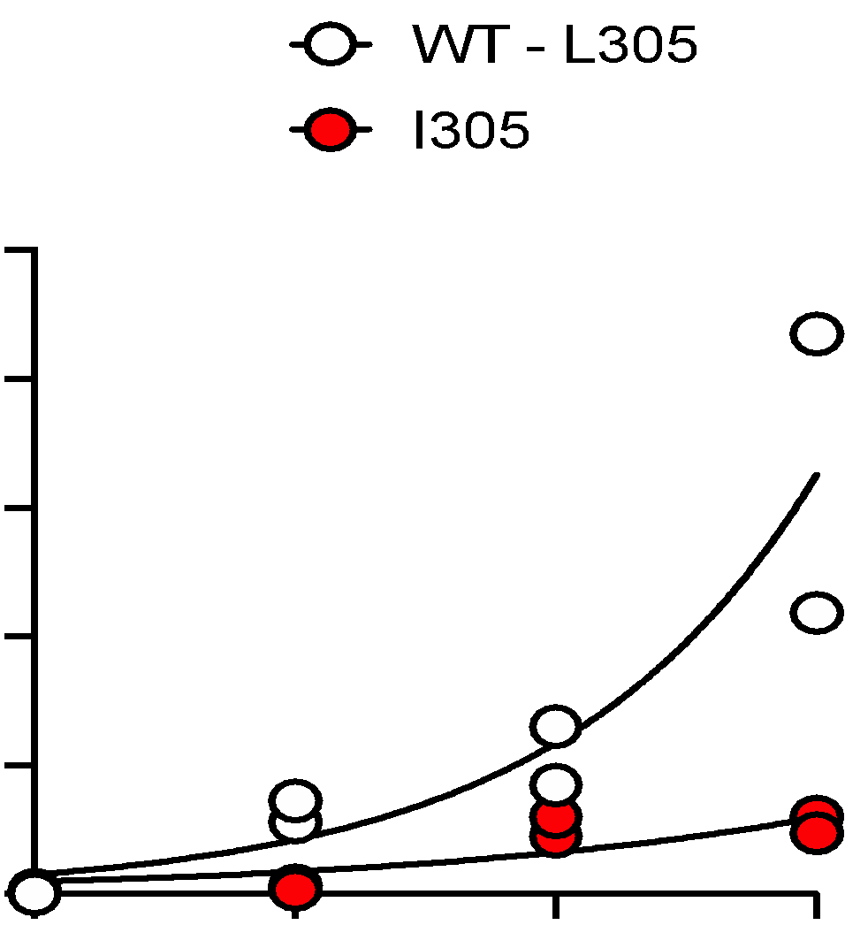
Figure 2
a
RSV-A
RSV-B
b
RSV-F^{L305I}
Site Ø
RSV-F^{L305}
Site II
Leucine (L)
Isoleucine (I)
c
Site IV
d
e
RSV^{WT}
RSV^{WT}
10
RSV^{L305I}
25
RSV^{L305I}
8
20
6
15
particle release (qRT-PCR Log₁₀)
Foci of infection (X 100)
4
10
2
5
0
0
0
20
40
60
80
100
0
1
2
3
hours post infection
days post infection

Slide 10
Figure 2. Computational modelling predicts that a Leucine to Isoleucine mutation at position 305 in the RSV-F protein alters protein shape and subsequently viral growth. a, Molecular structures of Leucine and Isoleucine. b, A single RSV-F protomer created by computational modeling using Schrödinger Small Molecule Discovery Suite. Overlay of RSV-A2 pre-fusion F protein: RSV-F^{L305} (WT, gold) and RSV-F^{I305} (L305I, green) showing the change in orientation of amino acids L (red) and I (yellow) at position 305, and subsequent effect on the overall shape of the protomer. c, Space filling models of RSV-F^{L305} and RSV-F^{I305} protomers indicated in peach and light green, respectively, with binding site II highlighted in teal and orange. To the right, the protomers are overlaid. d, One-step growth curve and e, a time course of viral spread of WT (white) and rgRSV^{L305I} (red) on indicator HeLa cells.

Slide 11
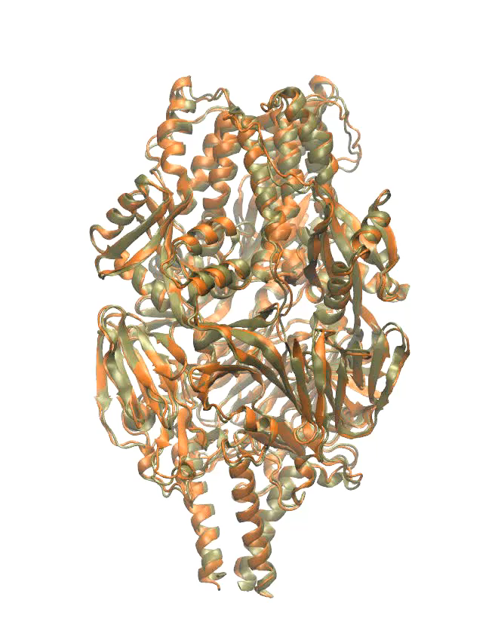
Supplemental Movie 1

Slide 12
Supplemental Movie 1. Molecular Dynamics of the RSV F trimer. Overlay of the RSV-F^{L305} (gold) and RSV-F^{L305I} (green) MD trajectories shows the conformational changes over time between the two trimers. The movie was generated using Chimera.

Slide 13
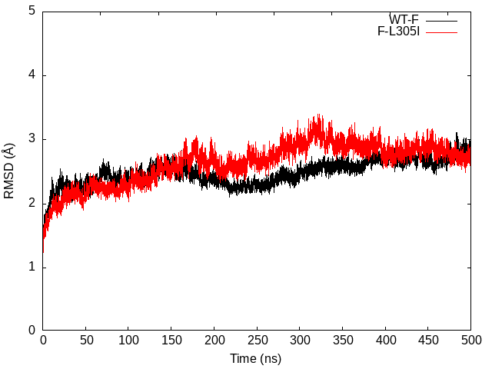
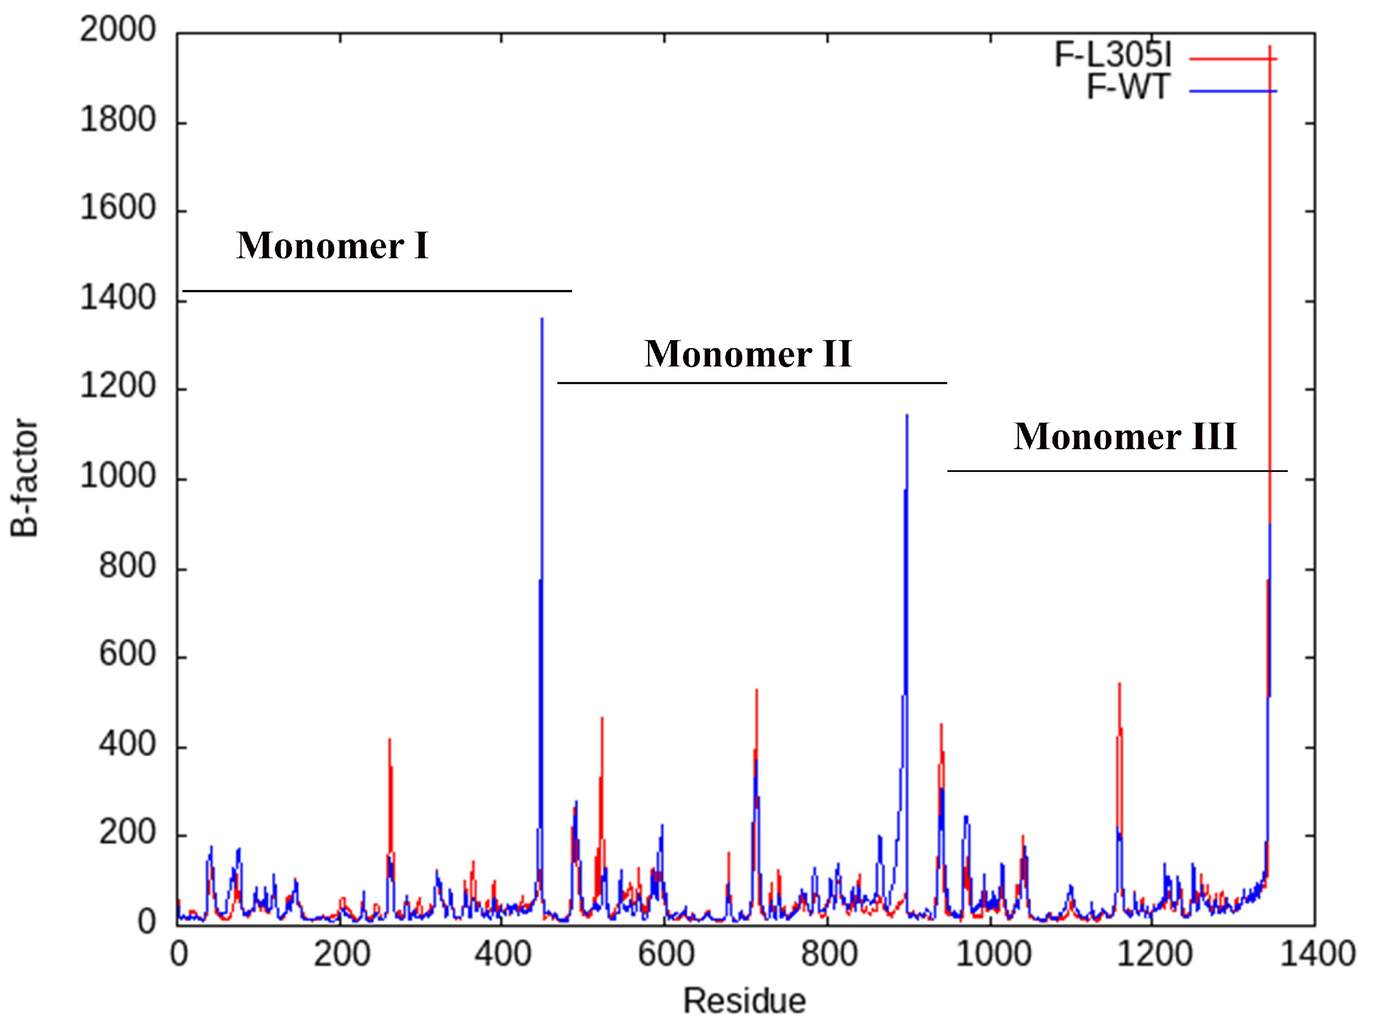
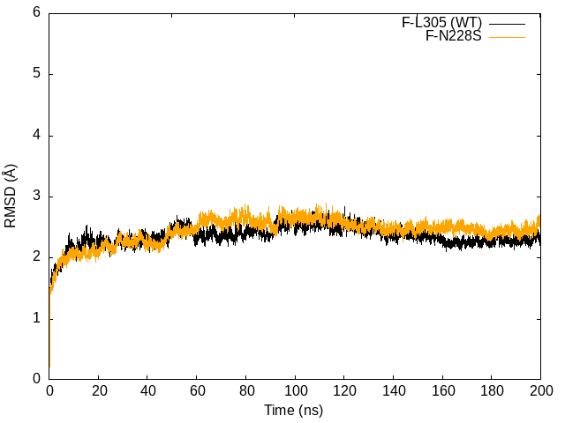
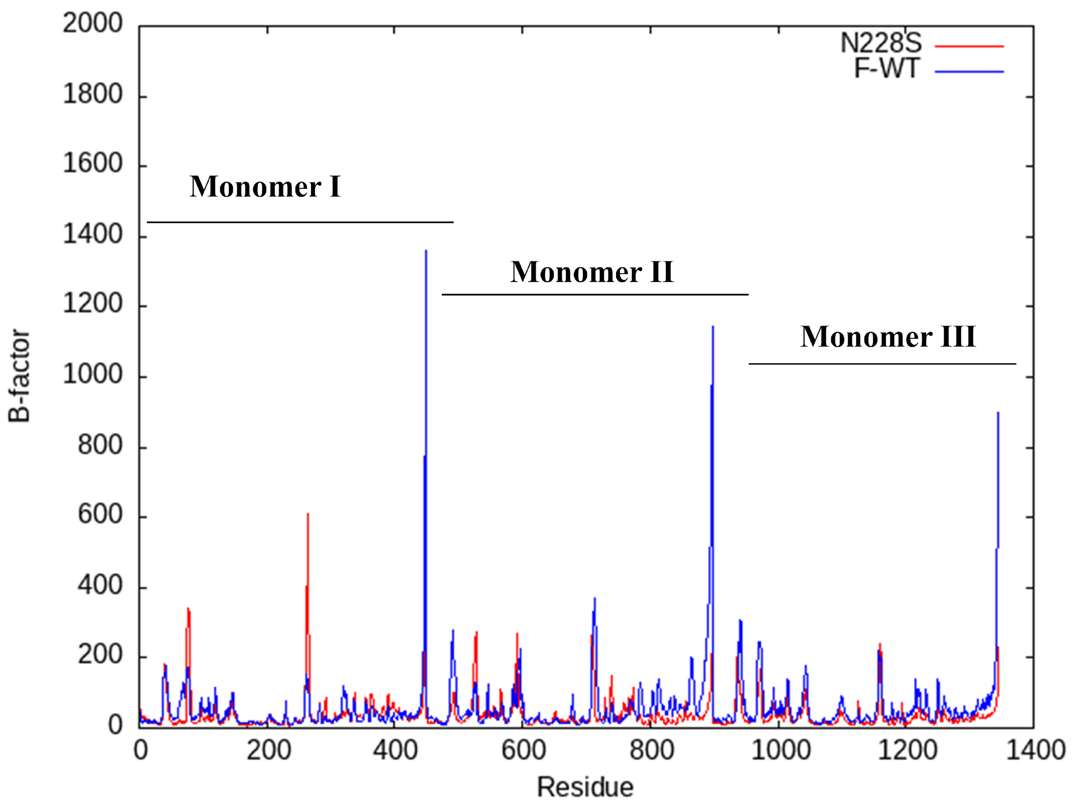
Supplemental Figure 1
a
b
c
d
Fig. S1. Analysis of RSV-F MD simulation. a, Root mean square deviation (RMSD) from initial structure coordinates for RSV-F WT and RSV-F^{L305I} mutant for 500 ns simulation time. b, Atomic fluctuation as a function of B-factor and residues of WT and RSV-F^{L305I} protein. c, RMSD trend of the RSV-F^{N228S} mutant during a 200 ns simulation vs WT. d, Atomic fluctuation as a function of the RSV F trimer backbone of the RSV-F^{N228S} mutant (red) compared to the WT (blue).

Slide 14
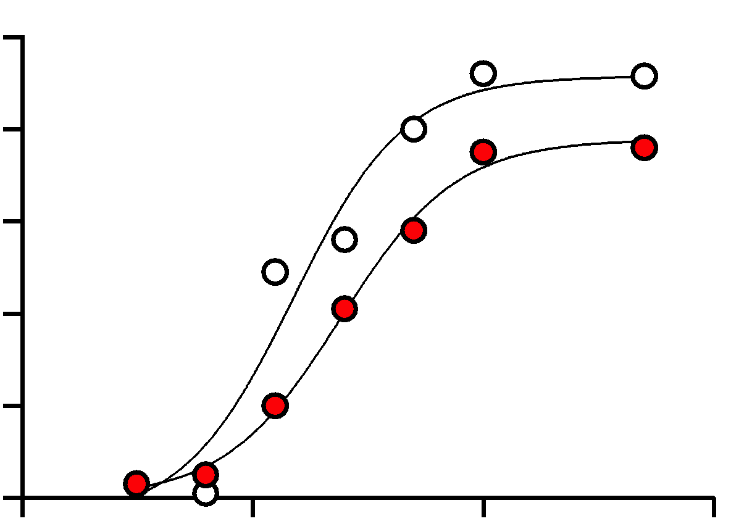
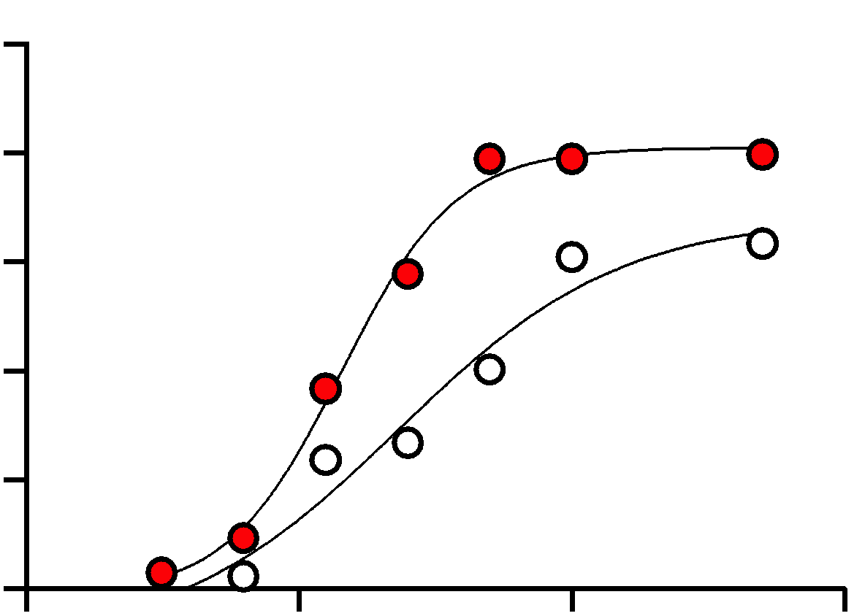
Figure 3
Patient serum A04
Patient serum B45
a
100
RSV^{WT} (EC₅₀ = 0.02)
b
100
RSV^{WT} (EC₅₀ = 0.02)
RSV^{L305I} (EC₅₀ = 0.04)
RSV^{L305I} (EC₅₀ = 0.07)
80
80
60
60
% inhibition
% inhibition
40
40
20
20
0
0.01
0.1
0
0.001
1
0.001
0.01
0.1
1
Serum dilution
Serum dilution
Figure 3. RSV^{WT} and RSV^{L305I} have different neutralization profiles against infant serum. Neutralization susceptibility of RSV^{WT} (white) and RSV^{L305I} (red) were compared with neutralizing sera collected from a, RSV-A and b, RSV-B infected infants. Virus was incubated with a series of serum dilutions followed by infection of HeLa cells. Infectious virus was determined by colorimetric immunostaining. EC₅₀ curves for sera a, A04, and b, B45 are shown and corresponding EC50 values expressed as the serum dilution factor are indicated.

Slide 15
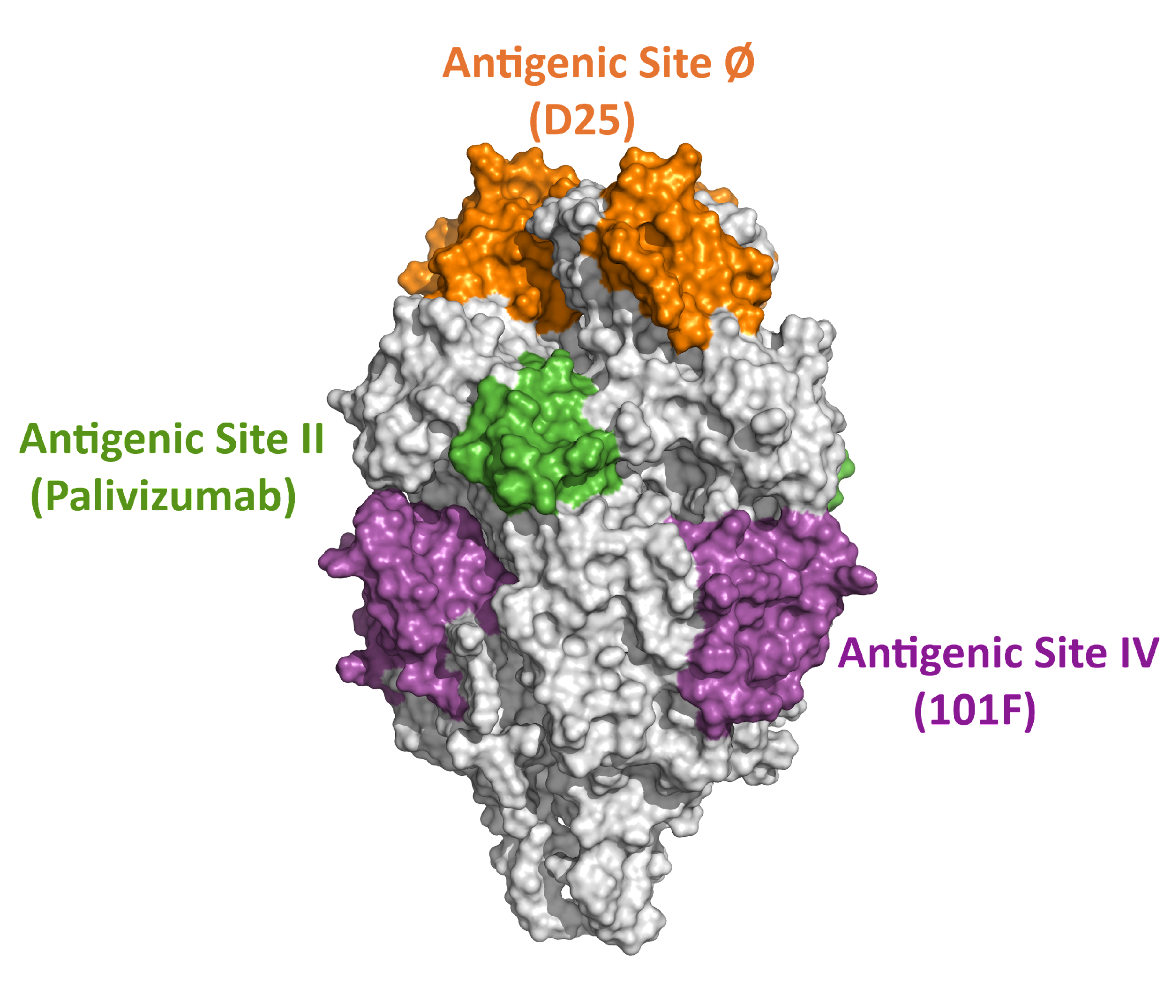
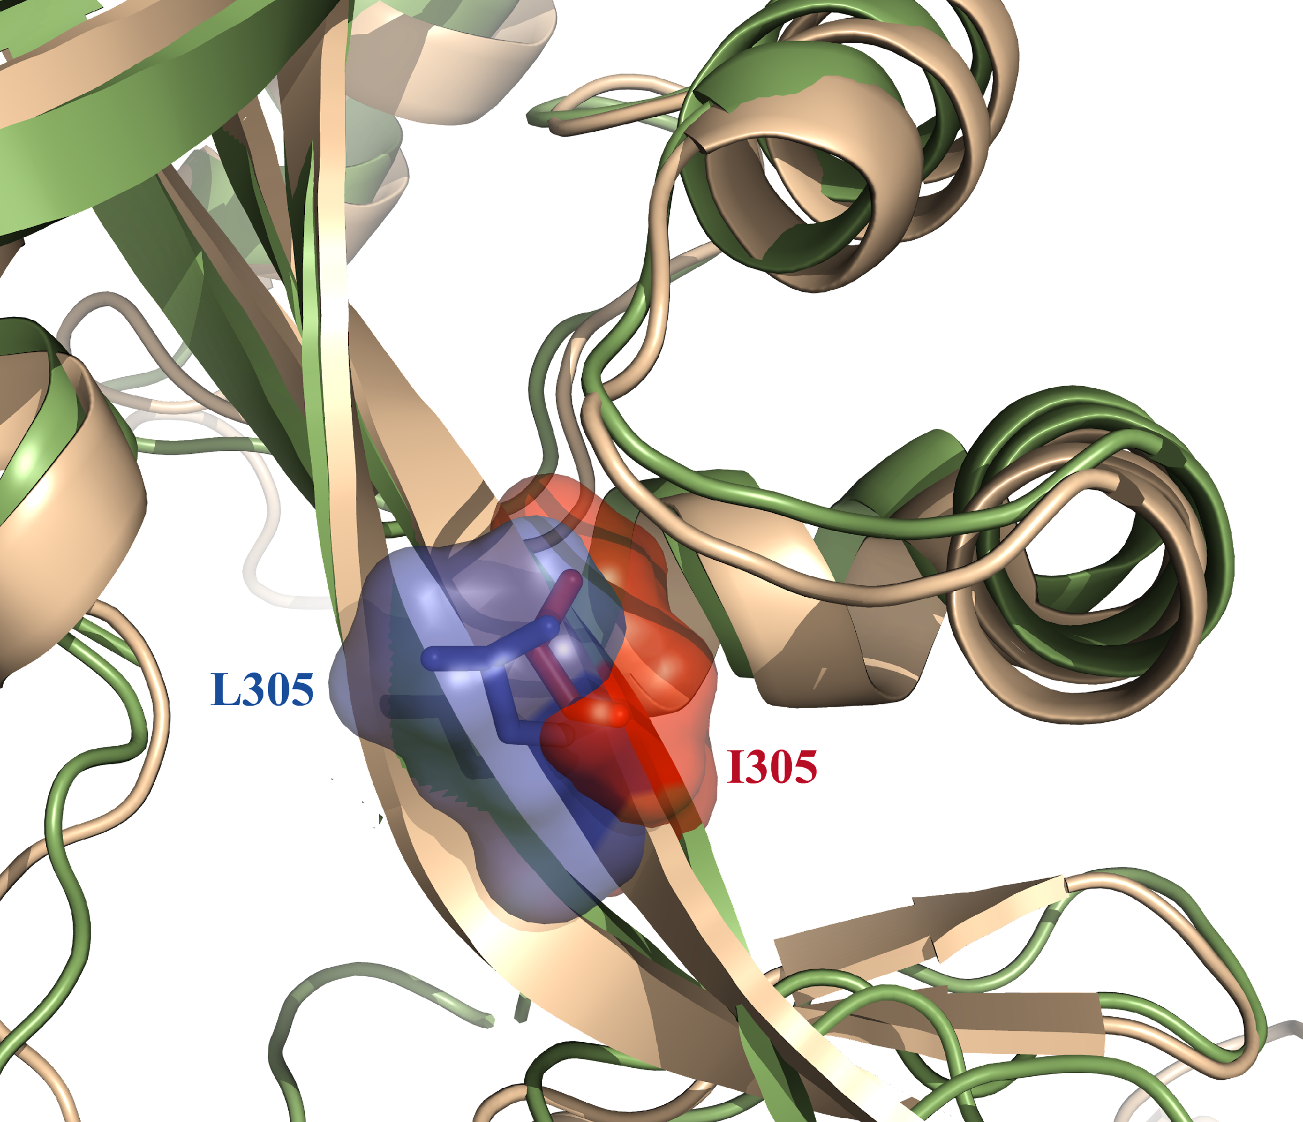
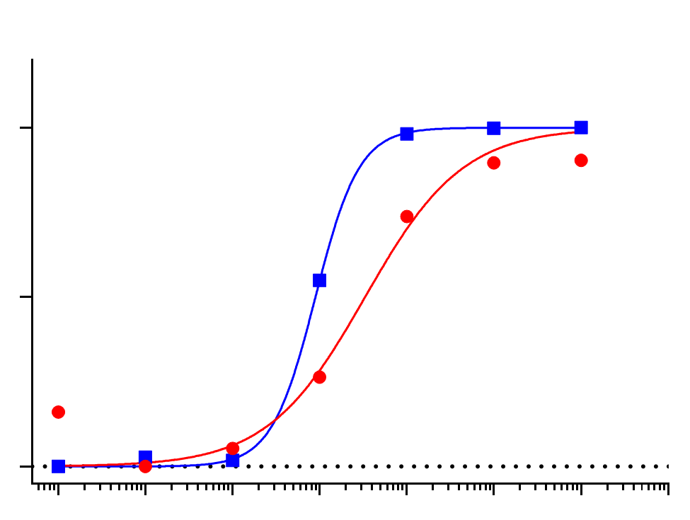
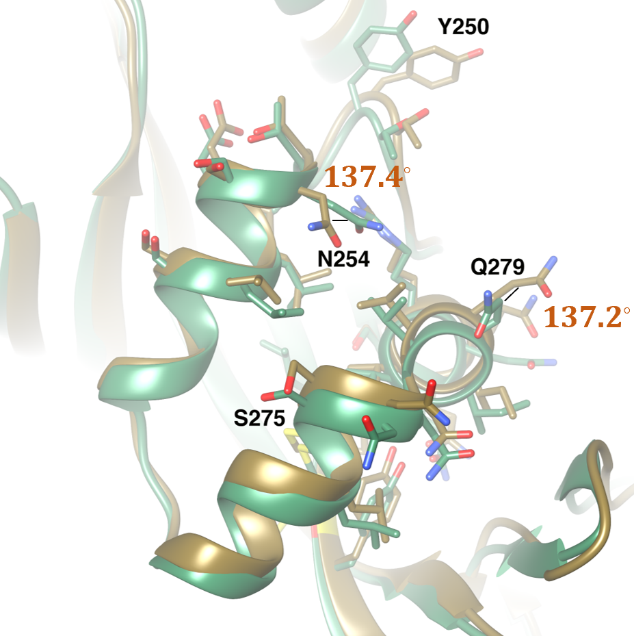
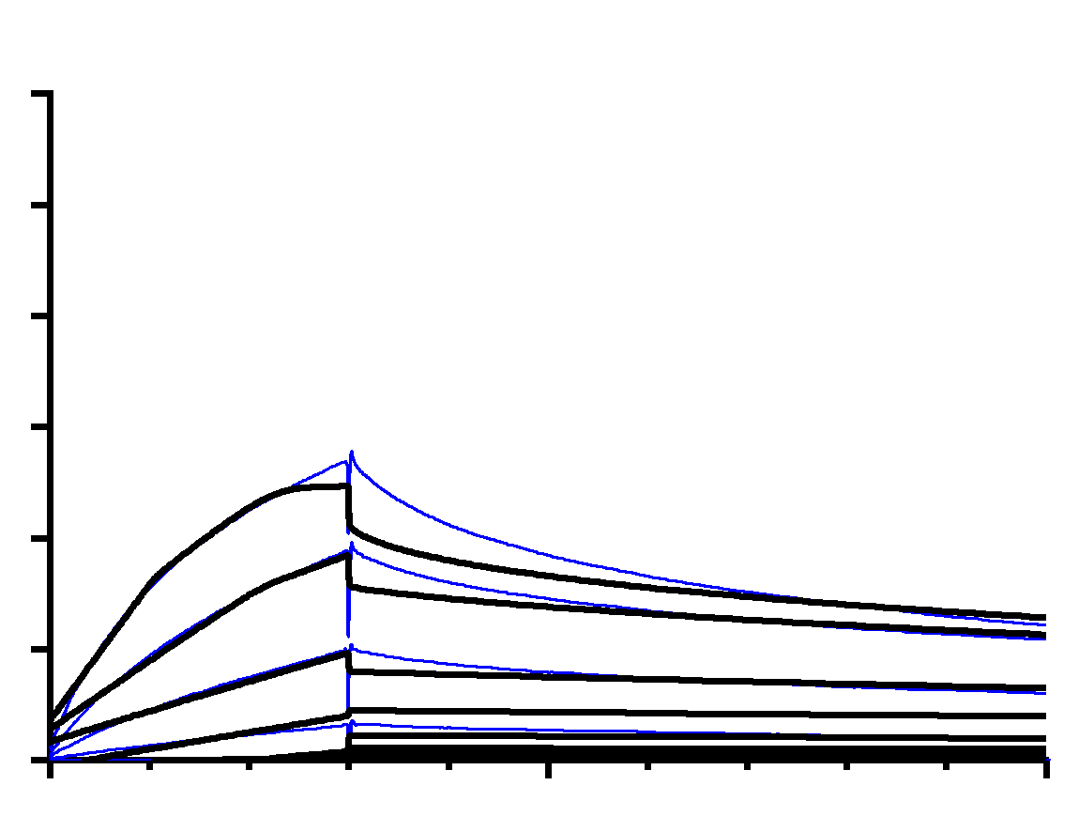
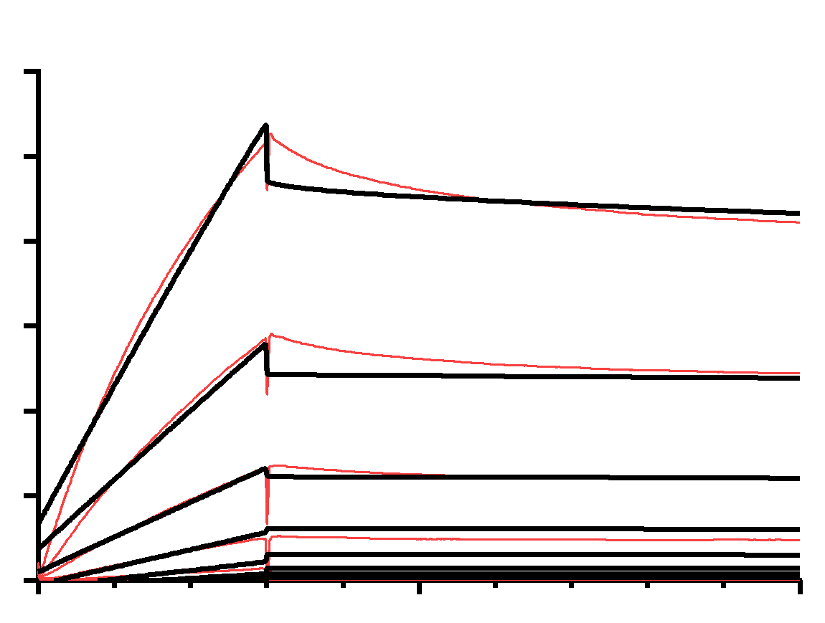
Figure 4
a
b
c
d
100
RSV^{WT} (89.35 ng/mL)
RSV^{L305I} (331.4 ng/mL)
50
% inhibition
0
10⁻¹
1
10¹
10²
10³
10⁴
10⁵
10⁶
Concentration (ng/mL)
e
f
60
DS-CAV1^{L305}
K_{D} = 1.06 nM
60
DS-CAV1^{I305}
K_{D} = 0.36 nM
50
50
40
40
PZMB Response (RU)
PZMB Response (RU)
30
30
20
20
10
10
0
0
0
50
100
0
50
100
Time (s)
Time (s)

Slide 16
Figure 4. RSV-F^{L305I} mutation alters the structure and function of the palivizumab binding site. a, Space filling structural model of the RSV-F trimer with antigenic sites Ø (orange), II (green), and IV (purple) highlighted. b, Computational modeling of the location of amino acid position 305 in RSV-F^{L305} (green) and RSV-F^{I305} (gold). The orientation of the leucine and isoleucine residues at position 305 are indicated in blue and red respectively. c, Computational model of changes to PZMB binding site IIa with the L305I mutation. Conformational changes in select amino acid residues surrounding position 305 are indicated. d, EC₅₀ curves of PZMB neutralization of RSV^{WT} (blue) and RSV^{L305I} (red) determined by flow cytometry. EC₅₀ values are indicated in parentheses. e and f, SPR binding curves of PZMB to DS-Cav1^{L305} and DS-Cav1^{I305} indicated in blue and red respectively. Fitted curves were determined using a 1:1 binding model and are indicated in black. K_{D} values are indicated for each curve.

Slide 17
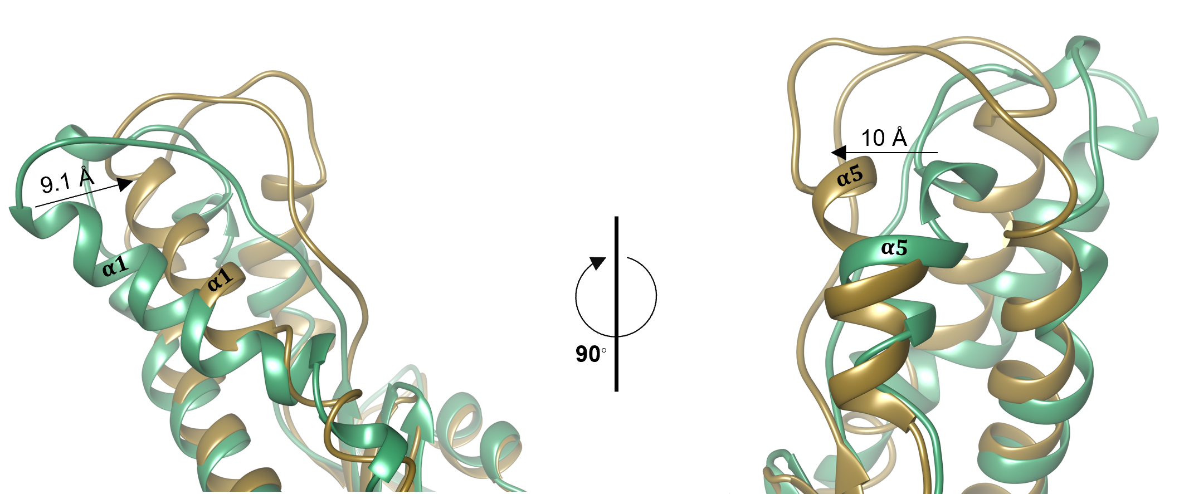
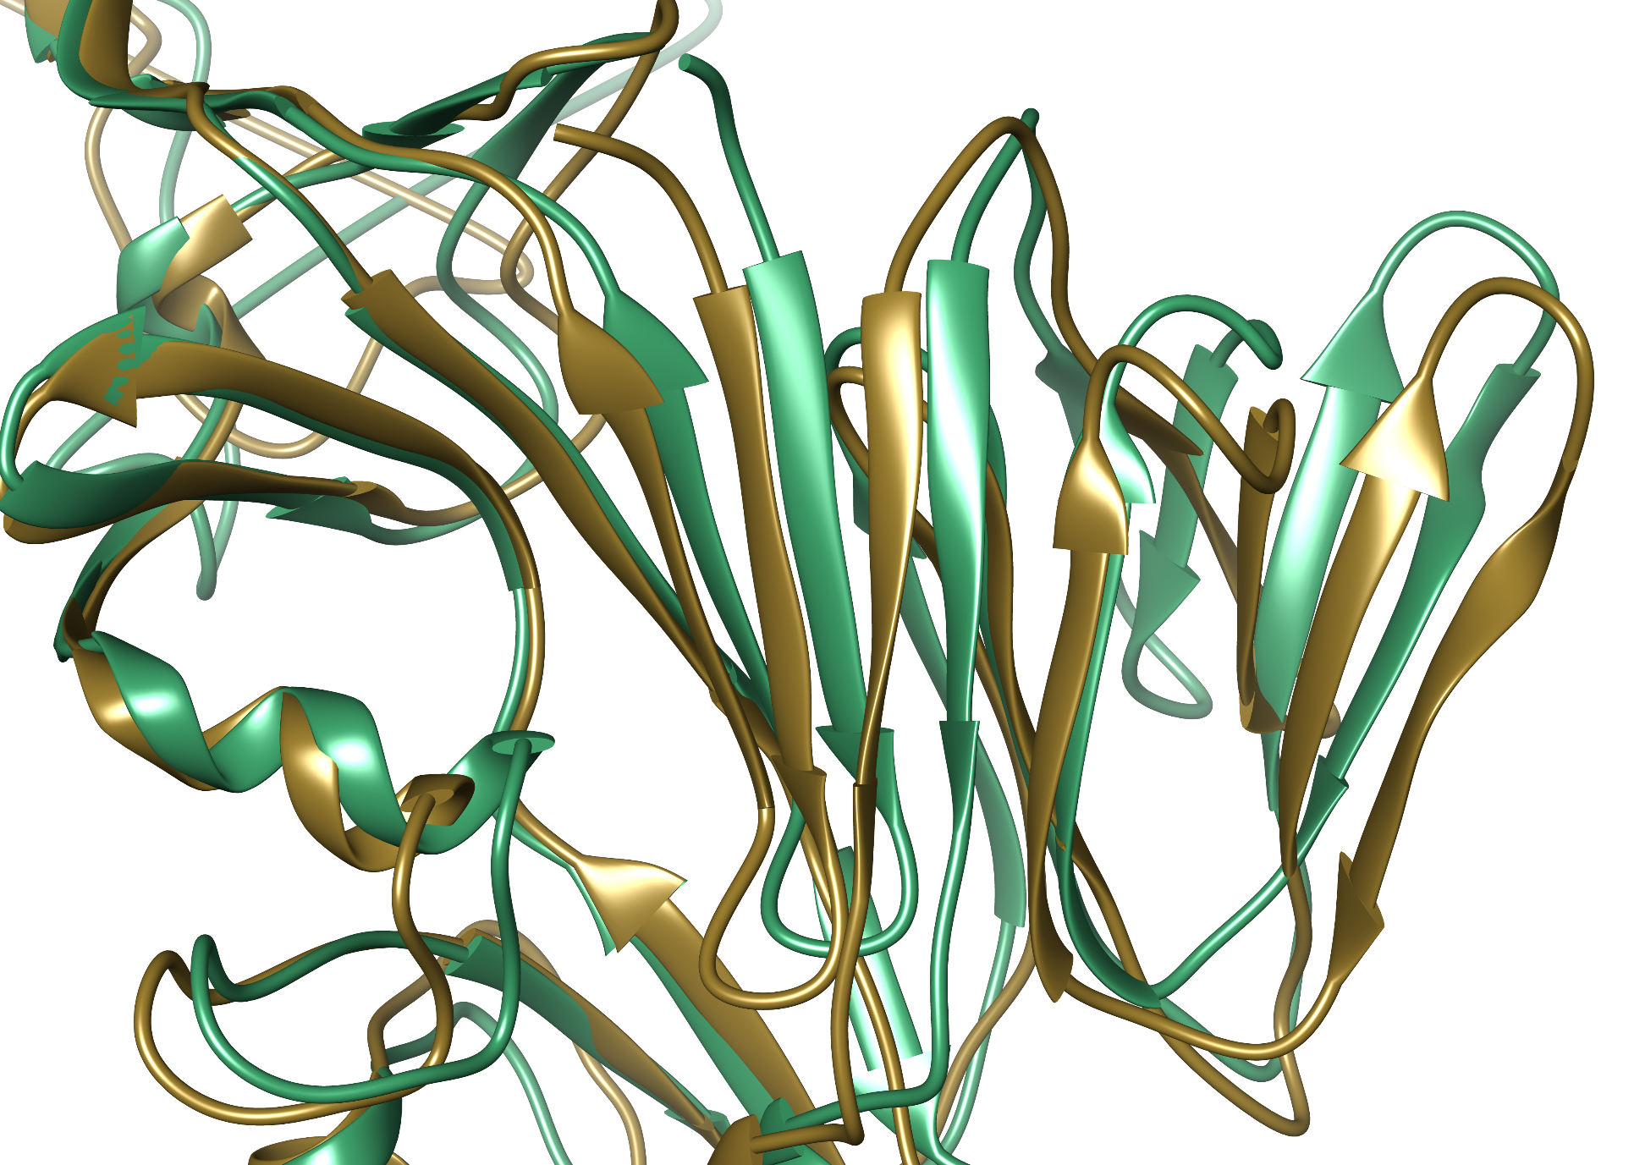
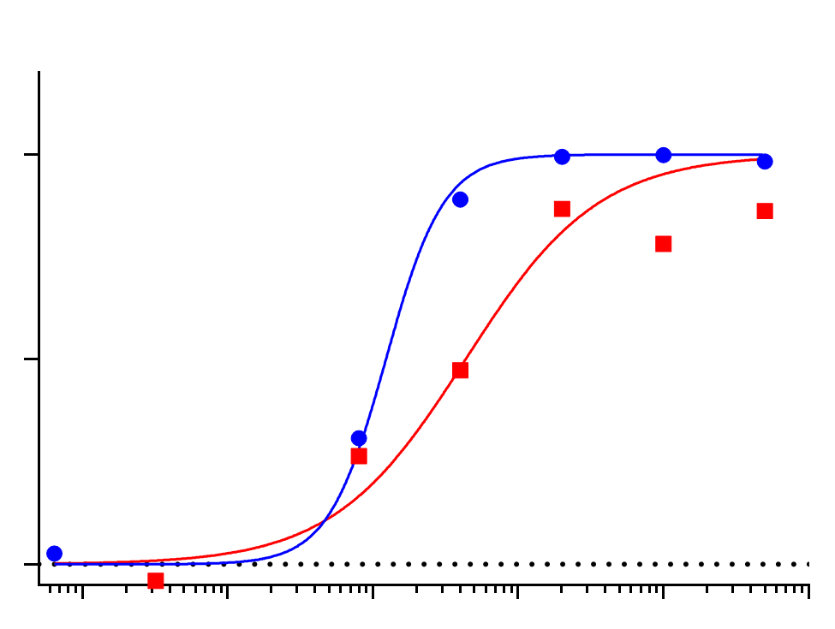
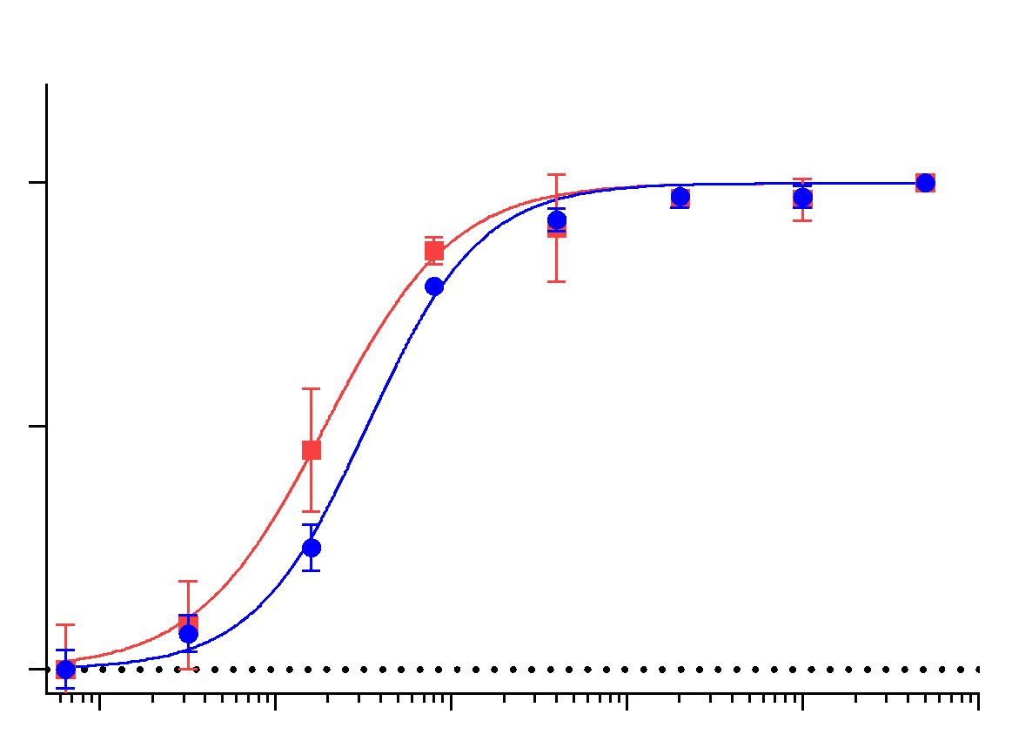
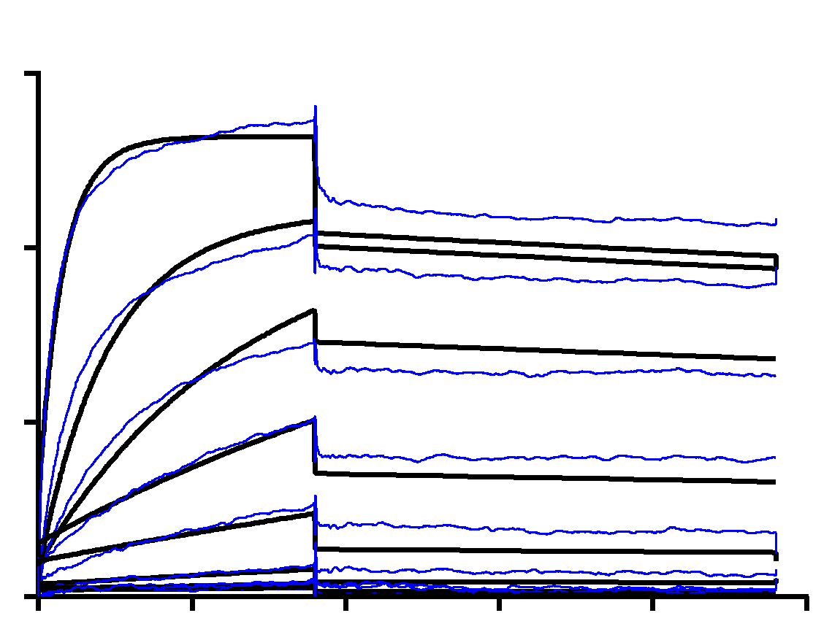
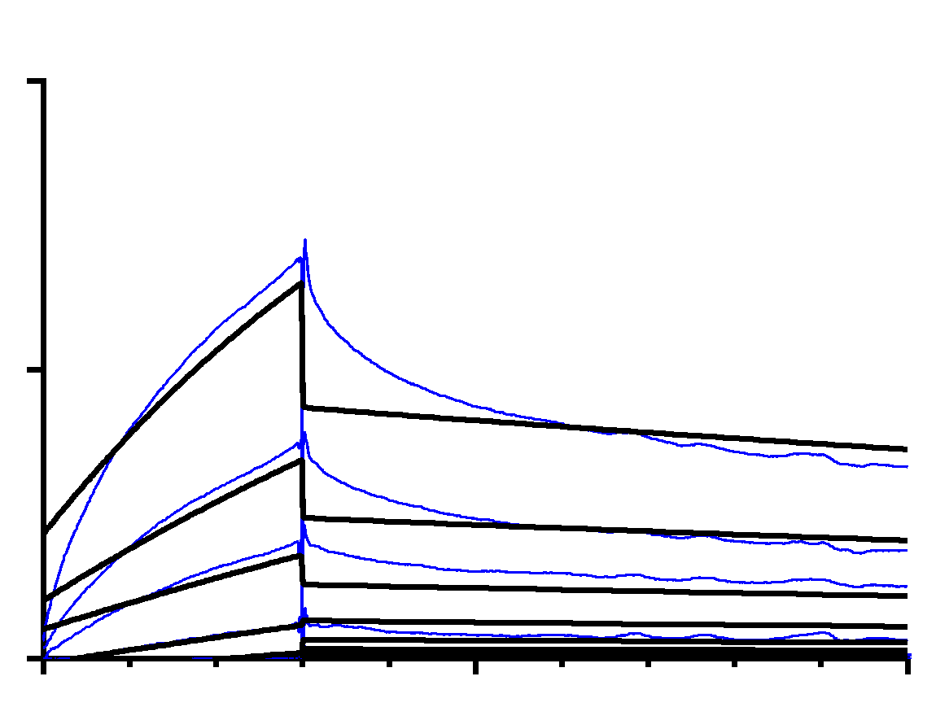
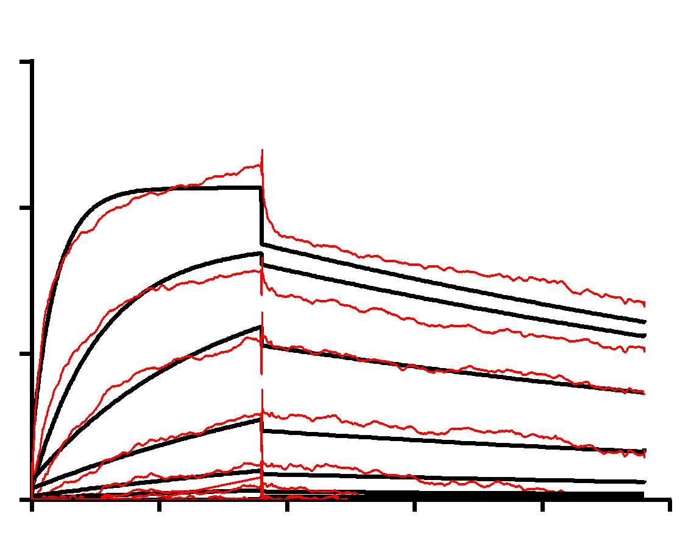
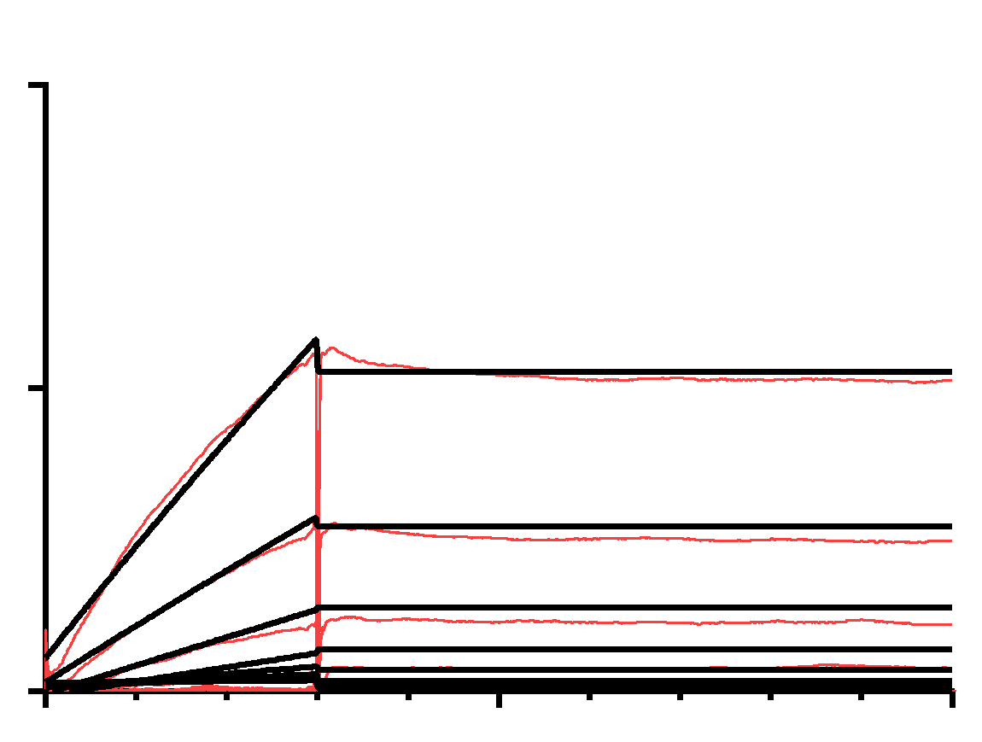
Figure 5
a
D25
b
101F
8.5 Å
RSV-F^{L305}
RSV-F^{I305}
c
RSV^{WT} (12.27 ng/mL)
d
RSV^{WT} (33.39 ng/mL)
100
RSV^{L305I} (43.42 ng/mL)
100
RSV^{L305I} (19.23 ng/mL)
% inhibition
% inhibition
50
50
0
0
10⁻¹
1
10¹
10²
10³
10⁴
1
10¹
10²
10³
10⁴
10⁵
Concentration (ng/mL)
Concentration (ng/mL)
e
15
DS-CAV1^{L305}
f
10
K_{D} = 0.72 nM
DS-CAV1^{L305}
K_{D} = 19.5 nM
10
D25 Response (RU)
5
101F Response (RU)
5
0
100
200
300
400
500
0
100
0
0
50
Time (s)
Time (s)
g
15
DS-CAV1^{I305}
h
10
DS-CAV1^{I305}
K_{D} = 4.40 nM
K_{D} = 0.13 nM
10
5
D25 Response (RU)
101F Response (RU)
5
0
0
100
0
100
200
300
400
500
0
50
Time (s)
Time (s)

Slide 18
Figure 5. RSV-F^{L305I} alters the structure and dynamics of binding sites Ø and IV. Representative structure from the MD simulation of RSV-F antigenic sites a, Ø and b, IV with RSV-F^{L305} and RSV-F^{I305} indicated in green and gold, respectively. Neutralization curves for c, D25 and d, 101F monoclonal antibodies against RSV^{WT} (blue) and RSV^{L305I} (red) determined by flow cytometry. EC₅₀ values are indicated in parentheses beside each virus. SPR sensorgram plots for e, D25 and f, 101F monoclonal antibodies against DS-Cav1^{L305} recombinant proteins in blue and g and h, DS-Cav1^{I305} recombinant proteins in red. Fitted curves are determined using a 1:1 binding model (black). K_{D} values are indicated for each curve.

Slide 19
Supplementary Table 6
Supplementary Table 6. Constants of the binding kinetics between monoclonal antibodies and DS-Cav1 recombinant proteins.
(mAb site) | constants | DS-Cav1^{L305} | DS-Cav1^{I305}
D25 (site Ø) | K_{D} (M) | 7.26 x 10⁻¹⁰ | 4.40 x 10⁻⁹
 | k_{on} (M⁻¹s⁻¹) | 2.64 x 10⁵ | 1.47 x 10⁵
 | k_{off} (s⁻¹) | 1.76 x 10⁻⁴ | 6.94 x 10⁻⁴
 | Χ² | 0.28 | 0.17
 | R_{max} (RU) | 12.33 | 7.66
PZMB (site II) | K_{D} (M) | 1.06 x 10⁻⁹ | 3.64 x 10⁻¹⁰
 | k_{on} (M⁻¹s⁻¹) | 5.10 x 10¹¹ | 6.71 x 10¹¹
 | k_{off} (s⁻¹) | 5.41 x 10² | 4.99 x 10¹
 | Χ² | 5.08 | 0.58
 | R_{max} (RU) | 22.34 | 39.85
101F (site IV) | K_{D} (M) | 1.95 x 10⁻⁸ | 1.33 x 10⁻¹⁰
 | k_{on} (M⁻¹s⁻¹) | 1.27 x 10⁵ | 1.88 x 10⁴
 | k_{off} (s⁻¹) | 2.48 x 10⁻³ | 2.50 x 10⁻⁶
 | Χ² | 0.20 | 0.07
 | R_{max} (RU) | 11.95 | 79.07
Equilibrium dissociation constant (K_{D}), Chi-squared value (Χ²), maximum response (R_{max}), dissociation constant (k_{off}), and association constant (k_{on}) from the binding affinity interactions of monoclonal antibodies D25, Palivizumab, and 101F to DS-Cav1^{L305} and DS-Cav1^{I305} recombinant proteins. Values are expressed as mean ± s.d.
Notes:
Anything that has replicates I included the average of the constants (including Chi² and RUs) I’m not sure if this is the correct way to display this data though

