Slide 1
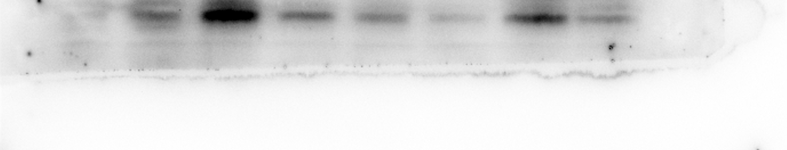
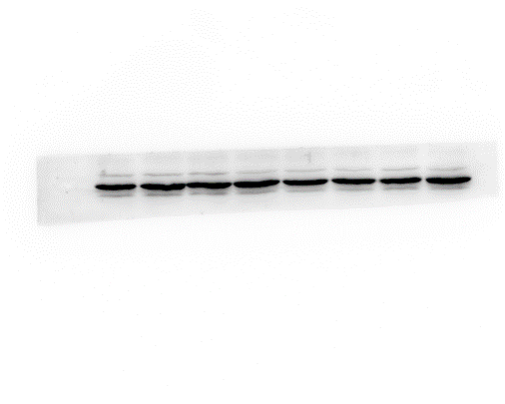
Full unedited gel for Figure 2E
CON
PA
CMS
CMS+PA
CON
PA
CMS
CMS+PA
IL-6
CON
PA
CMS
CMS+PA
CON
PA
CMS
CMS+PA
β-actin

Slide 2
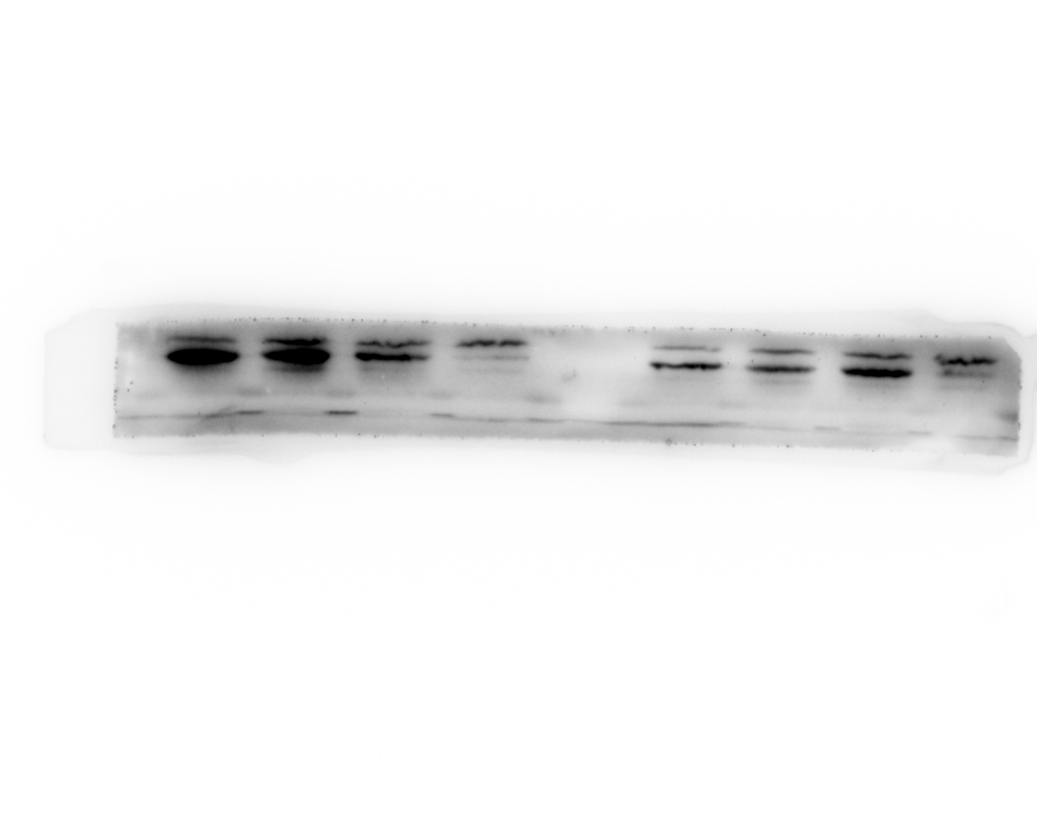
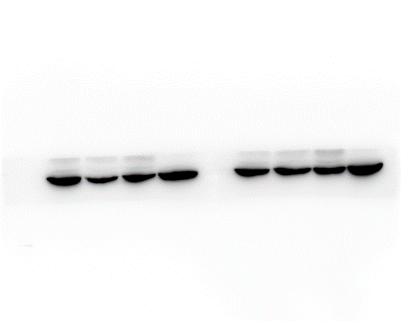
Full unedited gel for Figure 2E
CON
PA
CMS
CMS+PA
TNF-α
CON
PA
CMS
CMS+PA
β-actin

Slide 3
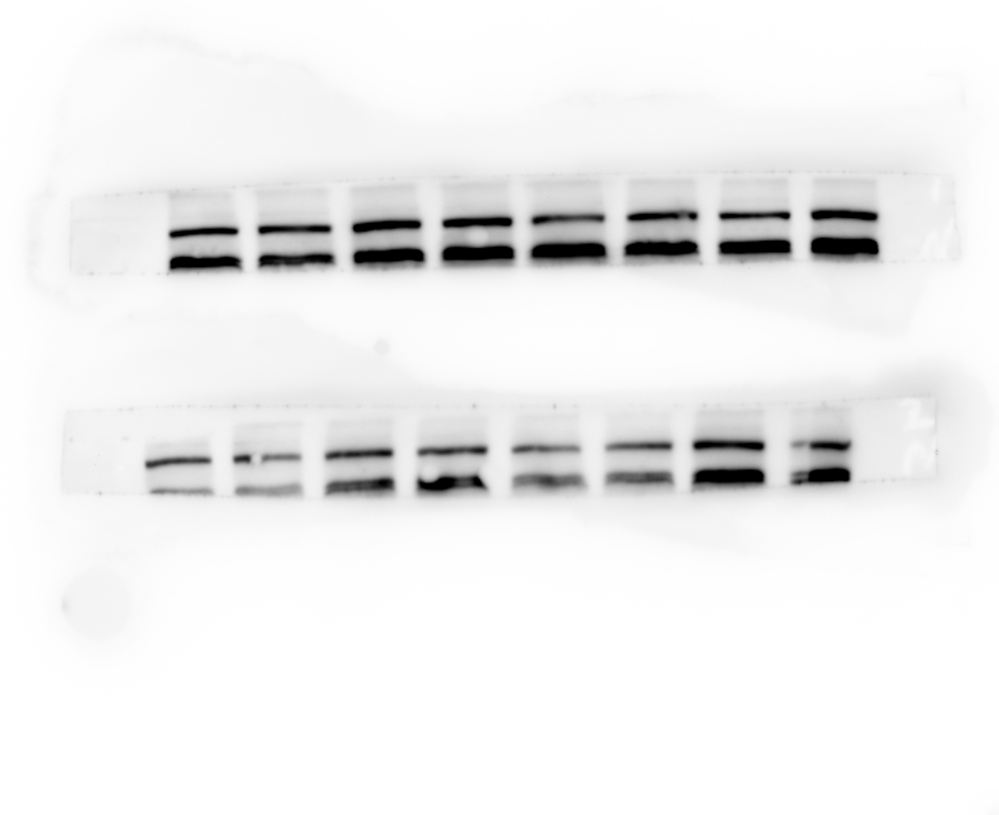
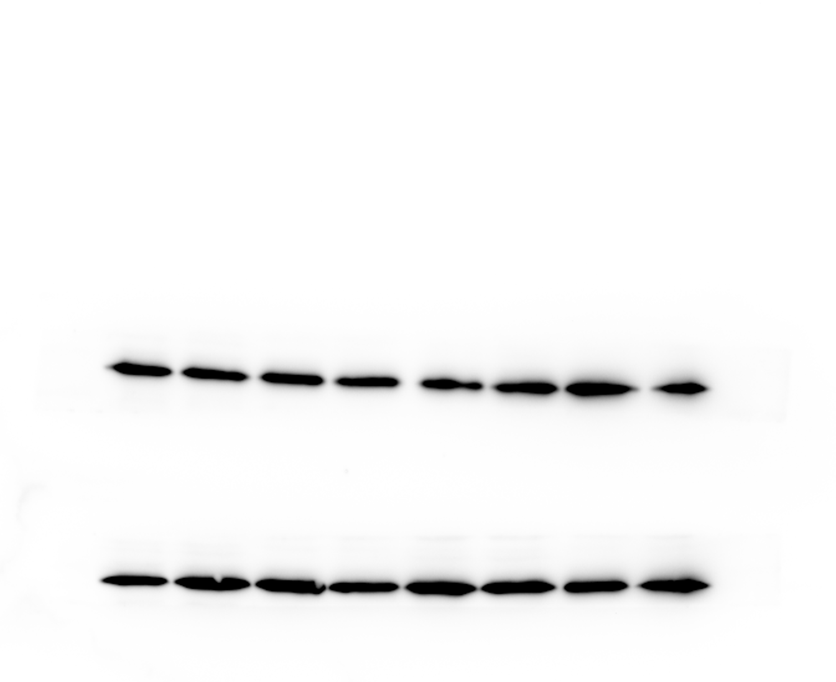
Full unedited gel for Figure 3A
CON
PA
CMS
CMS+PA
CON
PA
CMS
CMS+PA
NLRP3
CON
PA
CMS
CMS+PA
CON
PA
CMS
CMS+PA
NLRP3
CON
PA
CMS
CMS+PA
CON
PA
CMS
CMS+PA
β-actin
CON
PA
CMS
CMS+PA
CON
PA
CMS
CMS+PA
β-actin

Slide 4
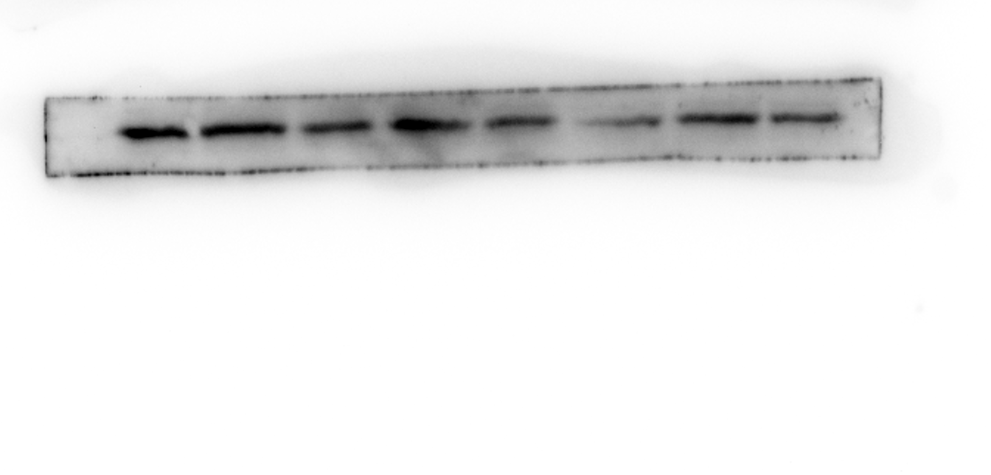
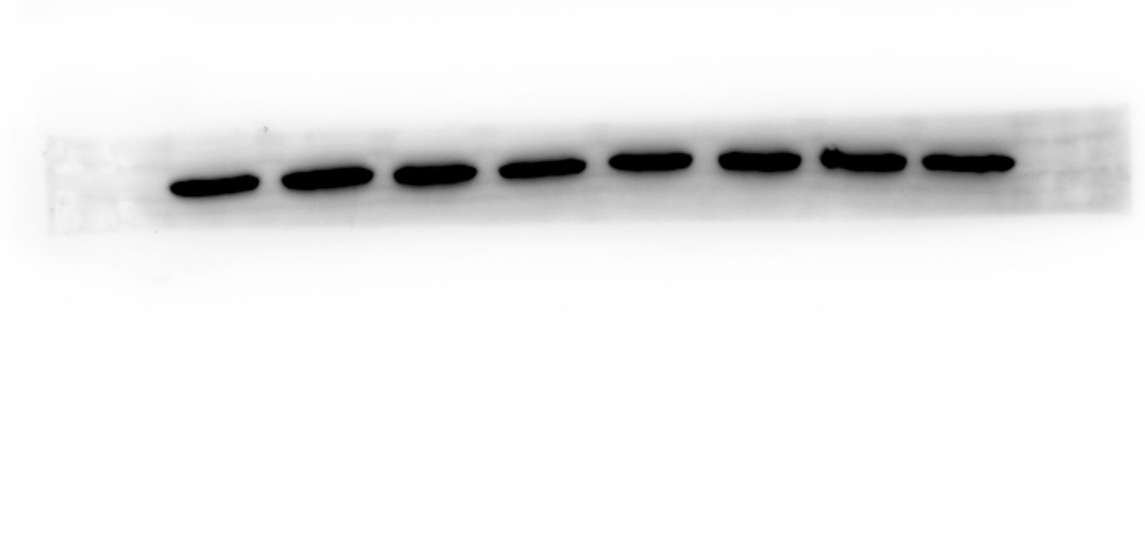
Full unedited gel for Figure 3B
CON
PA
CMS+PA
CON
PA
CMS
CMS+PA
CMS
ASC
CON
PA
CMS+PA
CON
PA
CMS+PA
CMS
CMS
β-actin

Slide 5
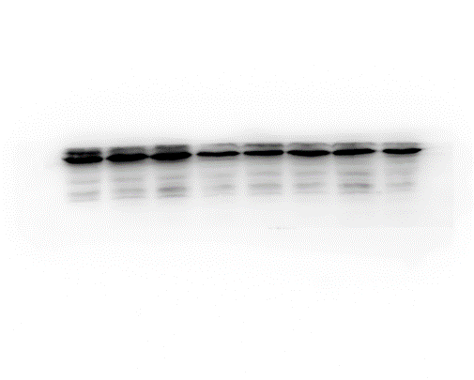
Full unedited gel for Figure 3C
CON
PA
CMS
CMS+PA
CON
PA
CMS
CMS+PA
Pro-casp1

Slide 6
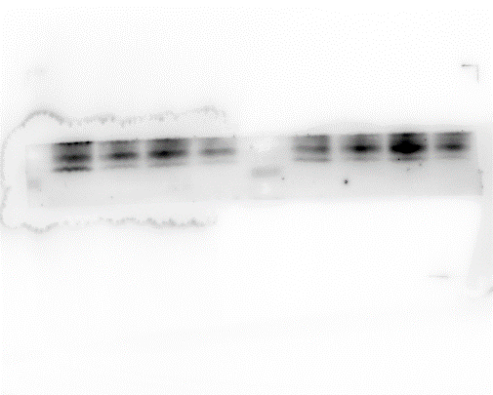
Full unedited gel for Figure 3C
CON
PA
CMS
CMS+PA
CON
PA
CMS
CMS+PA
Cleaved-casp1

Slide 7
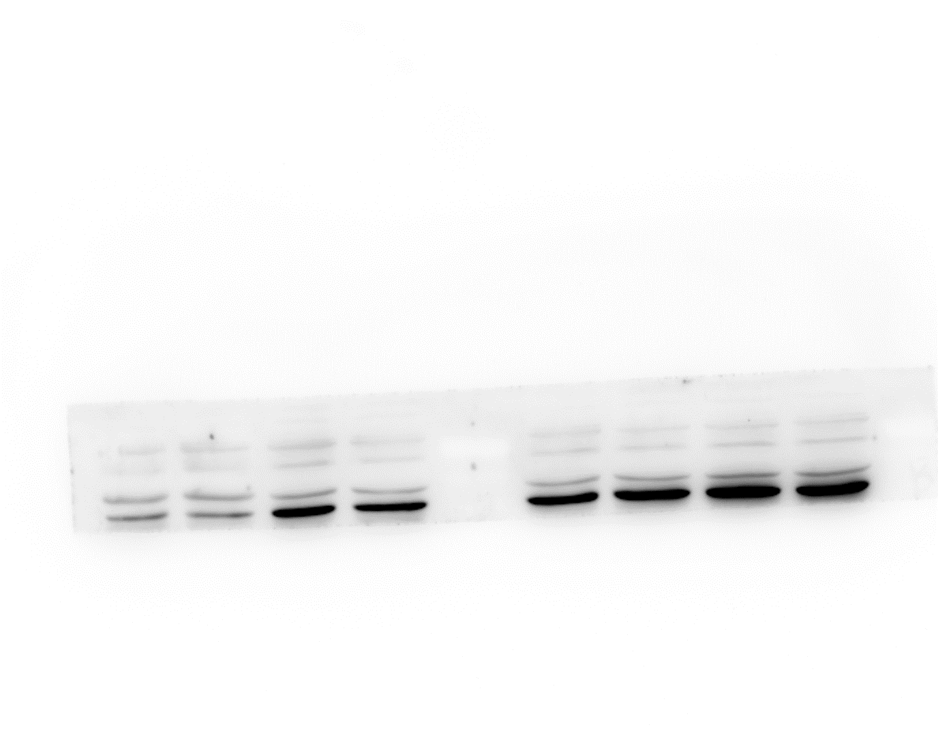
Full unedited gel for Figure 3C
CON
PA
CMS
CMS+PA
Pro-IL-1β

Slide 8
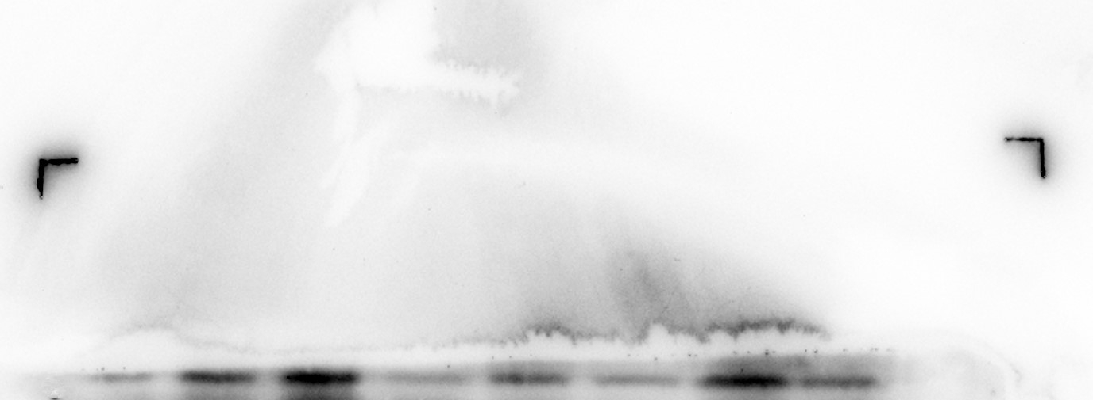
Full unedited gel for Figure 3C
CON
PA
CMS
CMS+PA
CON
PA
CMS
CMS+PA
Cleaved-IL-1β

Slide 9
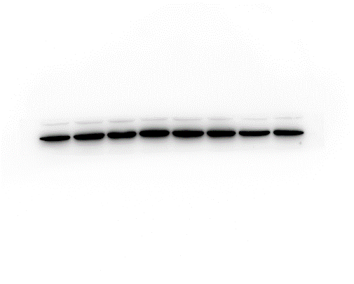
Full unedited gel for Figure 3C
CON
PA
CMS
CMS+PA
CON
PA
CMS
CMS+PA
GADPH

Slide 10
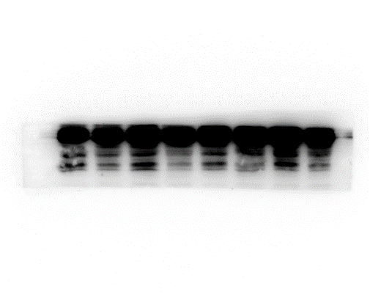
Full unedited gel for Figure 4F
LPS+ATP
LPS+ATP
PA
PBS+PA
PBS
PBS+PA
PBS
PBS
PBS
PA
Cleaved-casp1

Slide 11
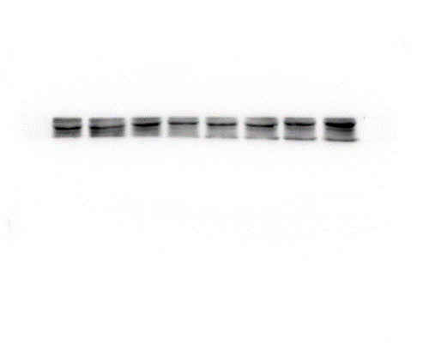
Full unedited gel for Figure 4F
LPS+ATP
LPS+ATP
PBS
PBS+PA
PBS
PA
PBS
PBS+PA
PBS
PA
Cleaved-IL-1β

Slide 12
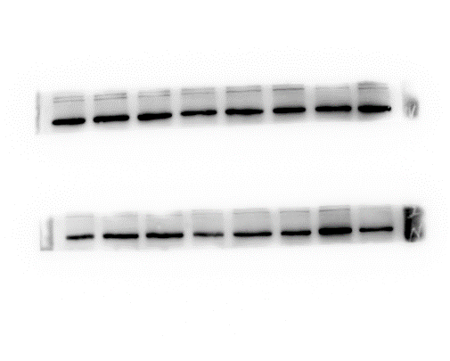
Full unedited gel for Figure 4F
LPS+ATP
LPS+ATP
PBS
PBS+PA
PBS
PA
PBS
PBS+PA
PBS
PA
NLRP3
LPS+ATP
LPS+ATP
PBS
PBS+PA
PBS
PA
PBS+PA
PBS
PBS
PA
NLRP3

Slide 13
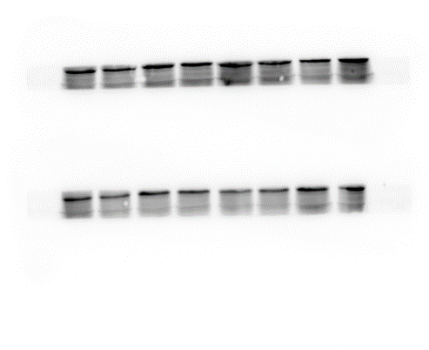
Full unedited gel for Figure 4F
LPS+ATP
LPS+ATP
PA
PBS
PBS+PA
PBS
PBS
PBS+PA
PBS
PA
ASC
LPS+ATP
LPS+ATP
PA
PBS
PBS+PA
PBS
PBS
PBS+PA
PBS
PA
ASC

Slide 14
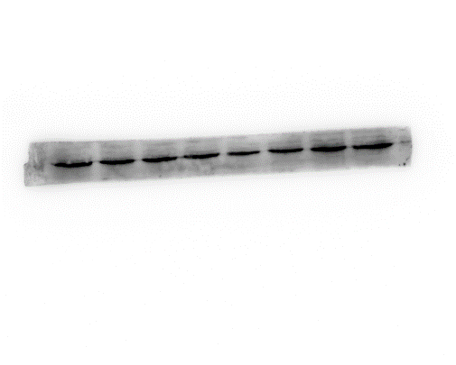
Full unedited gel for Figure 4F
LPS+ATP
LPS+ATP
PA
PBS+PA
PBS
PBS+PA
PBS
PBS
PBS
PA
Pro-casp1

Slide 15
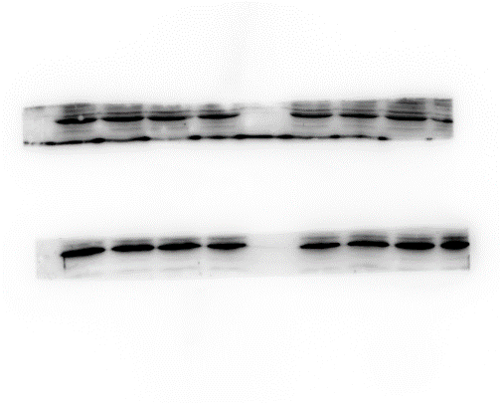
Full unedited gel for Figure 4F
LPS+ATP
LPS+ATP
PBS
PBS+PA
PBS
PA
PBS
PBS+PA
PBS
PA
Pro-IL-1β

Slide 16
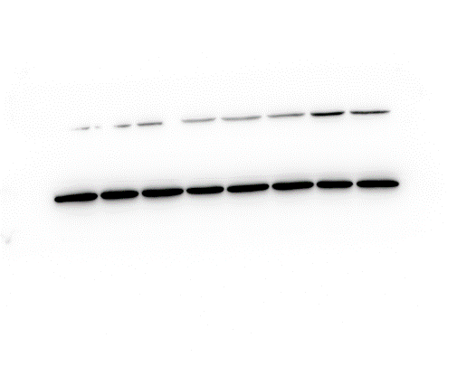
Full unedited gel for Figure 4F
LPS+ATP
LPS+ATP
PA
PBS+PA
PBS
PBS+PA
PBS
PBS
PBS
PA
β-actin

