Slide 1
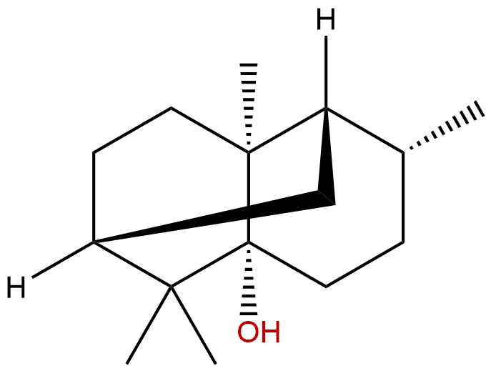
Patchouli alcohol (PA)

