Slide 1
Supplemental Information
Identification of serum prognostic biomarkers of severe COVID-19 by quantitative proteomic approach
Yayoi Kimura, Yusuke Nakai, Jihey Shin, Miyui Hara, Yuriko Takeda, Sousuke Kubo, Sundararaj S Jeremiah, Yoko Ino, Tomoko Akiyama, Kayano Moriyama, Kazuya Sakai, Ryo Saji, Mototsugu Nishii, Hideya Kitamura, Kota Murohashi, Kouji Yamamoto, Takeshi Kaneko, Ichiro Takeuchi, Eri Hagiwara, Takashi Ogura, Hideki Hasegawa, Tomohiko Tamura, Takeharu Yamanaka and Akihide Ryo

Slide 2
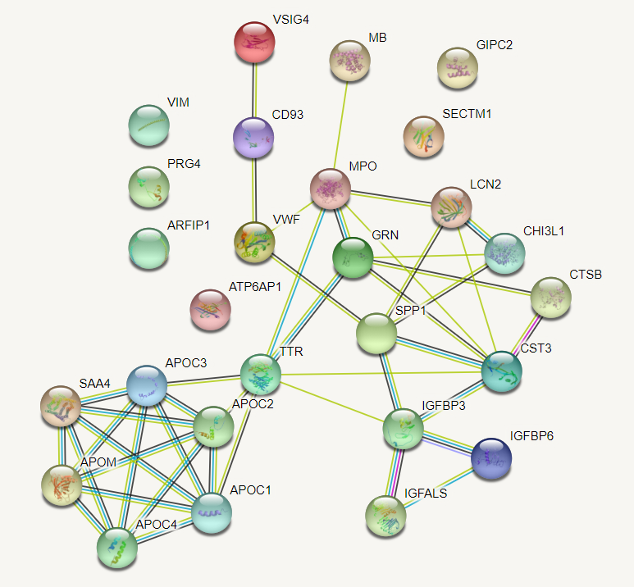
Figure S1 Protein-protein interaction network using the STRING database for 27 differentially expressed proteins in severe COVID-19 patients with different prognosis

Slide 3
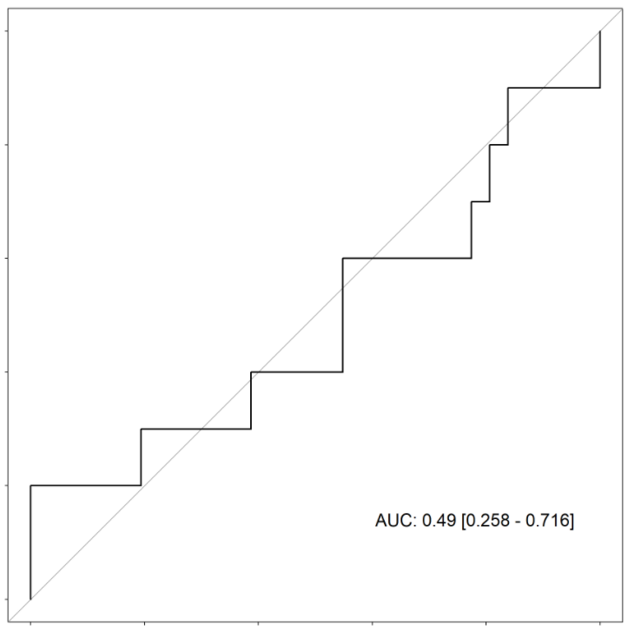
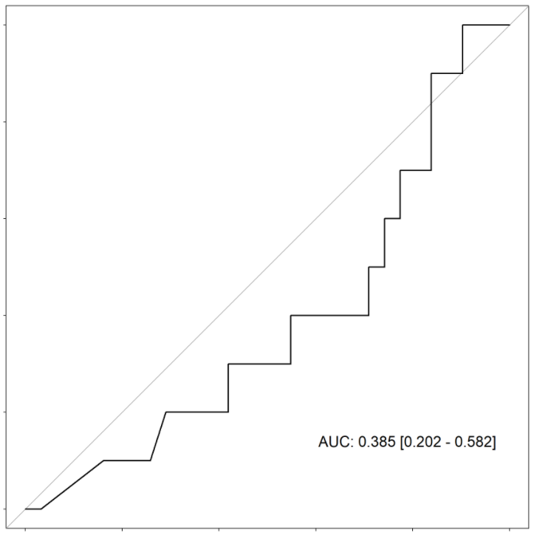
A
CRP
D-dimer
ns
ns
B
CRP
D-dimer
1.0
1.0
0.8
0.8
0.6
0.6
Sensitivity
Sensitivity
0.4
0.4
0.2
0.2
0.0
AUC: 0.49 [0.258 - 0.716]
0.0
AUC: 0.385 [0.202 - 0.582]
1.0
0.8
0.6
0.4
0.2
0.0
1.0
0.8
0.6
0.4
0.2
0.0
Specificity
Specificity
Figure S2 Serum levels and ROC curves of CRP and D-dimer
A, In 10 COVID-19 patients with adverse prognosis, the median serum levels [interquartile range, IQR] of CRP and D-dimer were 7.18 [3.72, 15.32] mg/dL and 2.63 [0.92, 4.89] ng/mL, respectively. In 31 COVID-19 patients with favorable prognosis, the median serum levels [IQR] of CRP and D-dimer were 8.66 [4.18, 14.41] mg/dL and 1.04 [0.63, 2.91] ng/mL, respectively. Differences of continuous values between two groups were compared by the Mann-Whitney U-test : ns; non-significant. B, ROC curve for prediction of clinical prognosis of severe COVID-19 patients. AUC indicates the area under the ROC curve [95% CI].

